Slide 1
CCNA 4 v3.0 Module 2
WAN Technologies

Slide 2
Objectives
WAN Technologies Overview
WAN Technologies
WAN Design

Slide 3
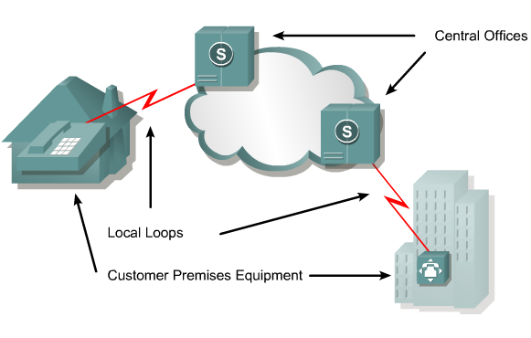
WAN Technology

Slide 4
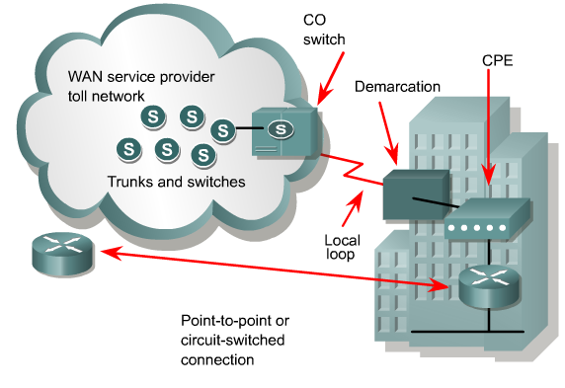
WAN Service Providers

Slide 5
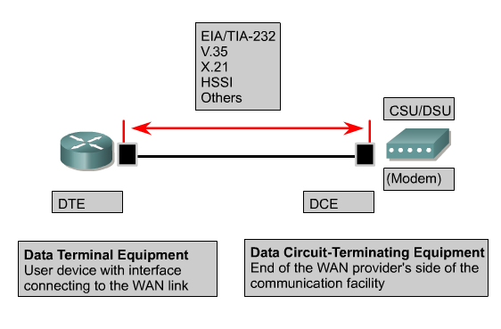
Physical Layer: WANs

Slide 6
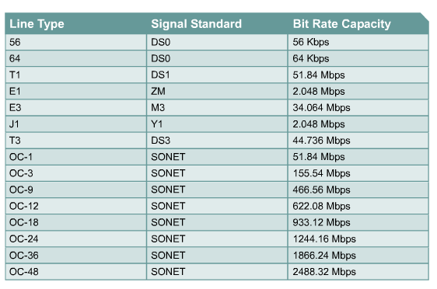
WAN Line Types and Bandwidth

Slide 7




WAN Devices
WAN
switch
Communication Server
Modem
CSU/DSU
Router
WAN are designed to:
Operate over large geographic area.
Allow access over serial inerfaces operating at lower speeds.
Provide full-time and part-time connectivity.

Slide 8
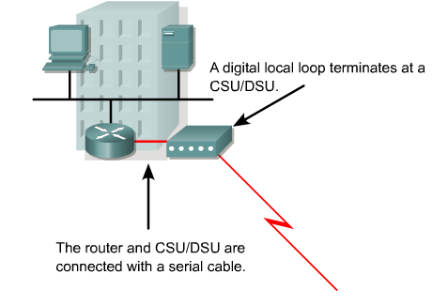
CSU/DSU

Slide 9
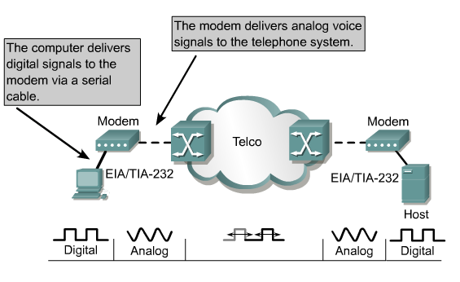
Modem Transmission

Slide 10
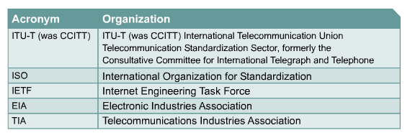
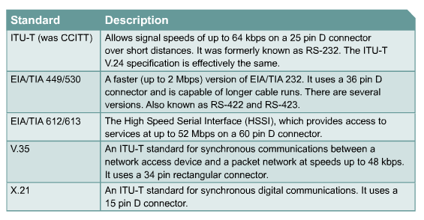
WAN Standards

Slide 11
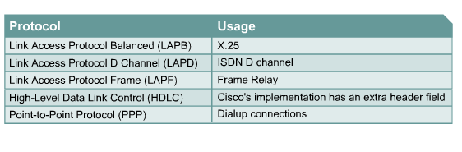
WAN Data-Link Protocols

Slide 12
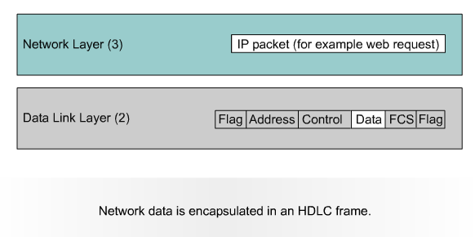
WAN Encapsulation

Slide 13
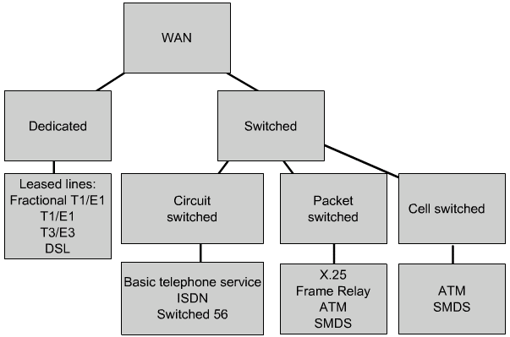
WAN Link Type

Slide 14
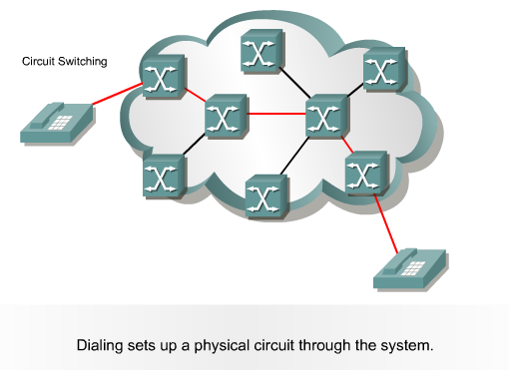
Circuit Switching
• Connection-oriented
• Monopolise
• Variability of delay (jitter) are low
• Expensive

Slide 15
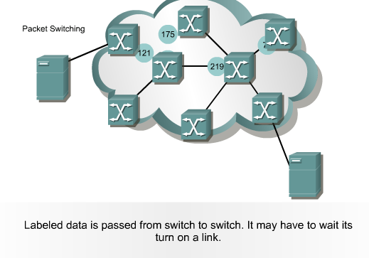
Packet Switching
• Connection-oriented or Connectionless
• Shared
• Variability of delay (jitter) are high
• Cheap

Slide 16

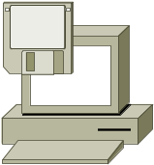
Typical WAN Encapsulation Protocols: Layer 2
HDLC, PPP, SLIP
Leased Line
X.25, Frame Relay, ATM
Packet-Switched
Service
Provider
PPP, SLIP, HDLC
Circuit-Switched
Telephone
Company
Notes:
Purpose: This figure introduces students to various encapsulation options to use over the various physical connections.
Emphasize: In order to exchange traffic over a WAN link, the packets must be encapsulated into a Layer 2 frame. There are a variety of Layer 2 encapsulation types available that can be used, depending on the WAN connection being used. Some of the types are listed the figure.
Encapsulation must be configured on the router when configuring the interface. Some of these encapsulation types will be seen again in the following chapters.
In an ISDN environment, the Point-to-Point Protocol (PPP) is the B channel’s Layer 2 encapsulation. Link Access Procedure on the D channel (LAPD) is the encapsulation for the D channel.
Either the proprietary Cisco or Internet Engineering Task Force (IETF) (defined in RFC 1490) encapsulations are the Layer 2 encapsulations for Frame Relay.
Note: Other encapsulations not shown include AppleTalk Remote Access Protocol (ARAP), Compressed Serial Link Internet Protocol (CSLIP), or Synchronous Data Link Control (SDLC).
Transition: We will first look at the HDLC encapsulation.

Slide 17
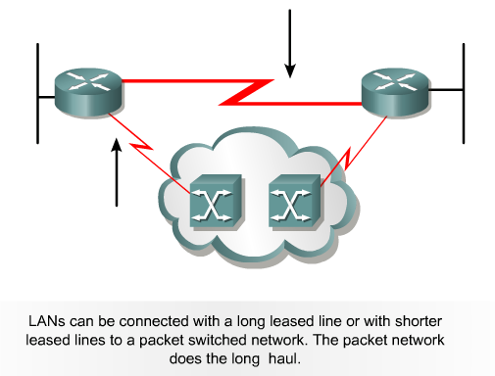
WAN Link Options

Slide 18
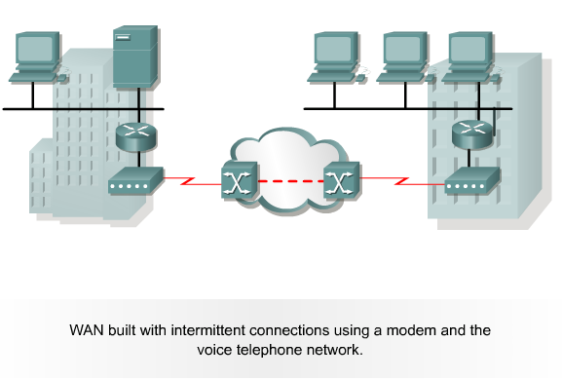
Analog Dialup

Slide 19
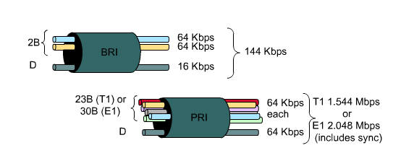
ISDN

Slide 20
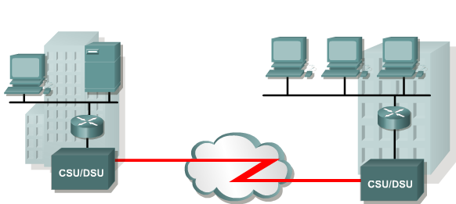
Leased Line
Leased lines are not only used to provide direct point-to-point connections between Enterprise LANS, they can also be used to connect individual branches to a packet switched network.

Slide 21
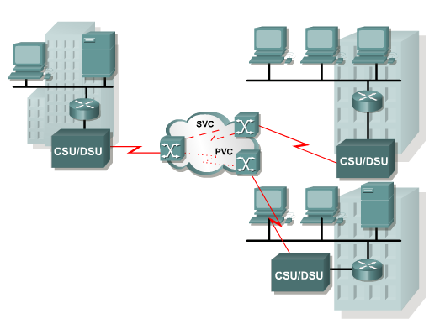
WAN with X.25
X.25 provides a low bit rate, shared-variable capacity that may either be switched or permanent

Slide 22
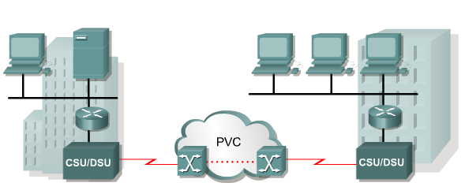
Frame Relay
Most Frame Relay connections are based on PVCs rather than SVCs. It implements no error or flow control. Frame Relay provides permanent shared medium bandwidth connectivity that carries both voice and data traffic.

Slide 23
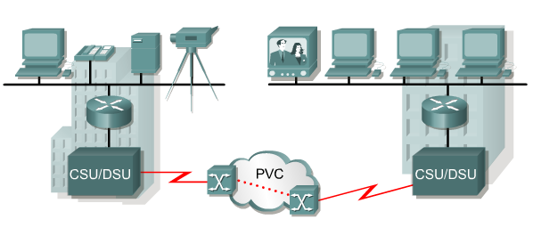
ATM
Asynchronous Transfer Mode (ATM) is a technology capable of transferring voice, video, and data through private and public networks. It is built on a cell based architecture rather than on a frame-based architecture.

Slide 24
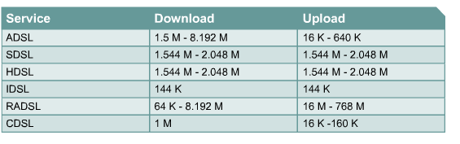
DSL

Slide 25
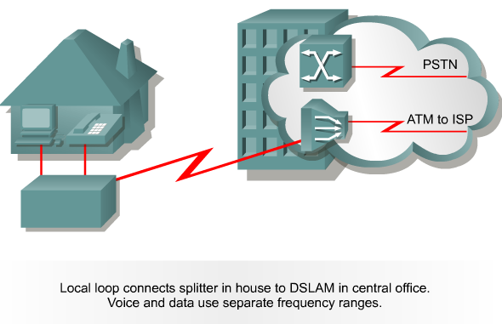
ADSL Technology

Slide 26
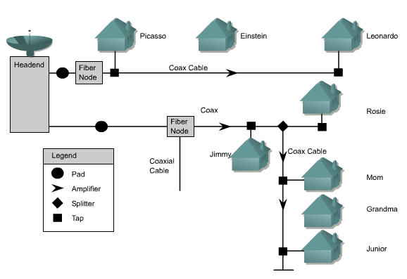
Cable Modem
Enhanced Cable Modems enable two-way. High speed data transmissions using the same coaxial lines that transmit cable television.

Slide 27
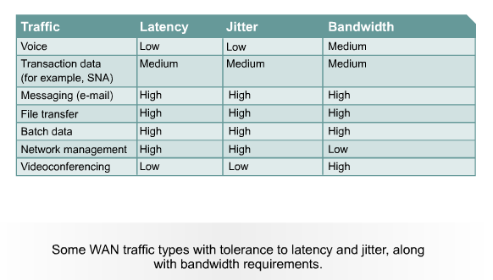
Comparing WAN Traffic Types

Slide 28
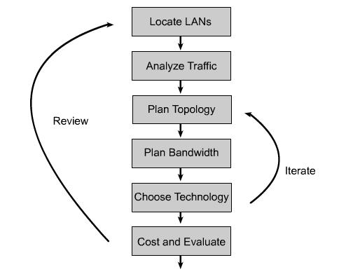
Steps In WAN Design

Slide 29
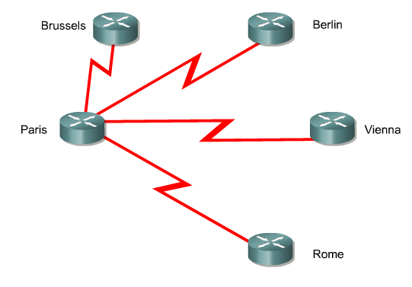
Star Topology

Slide 30
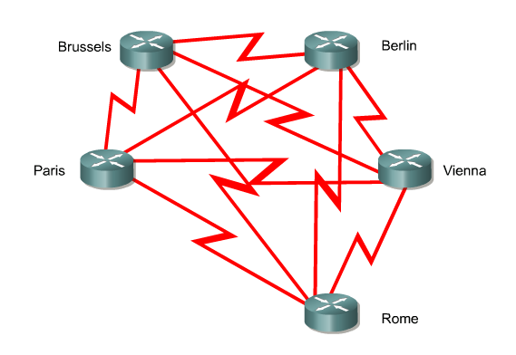
Full-Mesh Topology

Slide 31
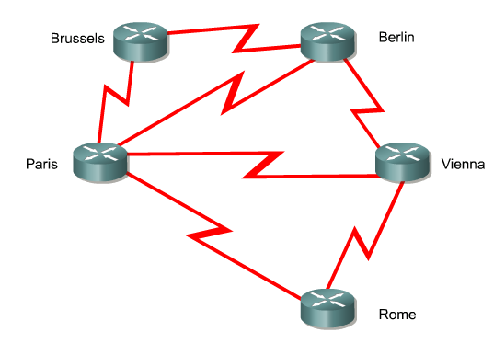
Partial-Mesh Topology

Slide 32
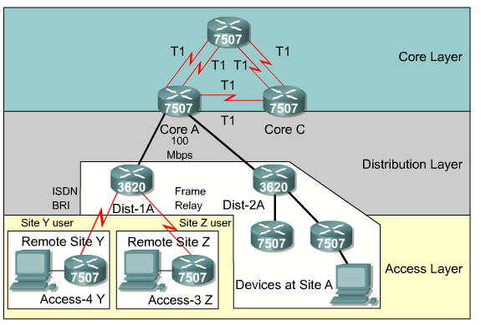
Three-Layer Design Model

Slide 33
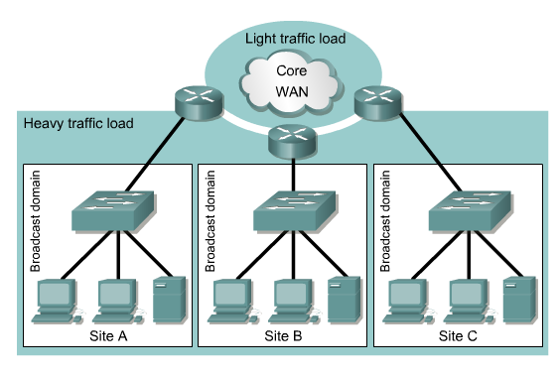
One-Layer Hierarchy

