Slide 1
CCNA 4 v3.0 Module 3
PPP

Slide 2
Objectives
Serial point-to-point links
PPP authentication
Configuring PPP

Slide 3
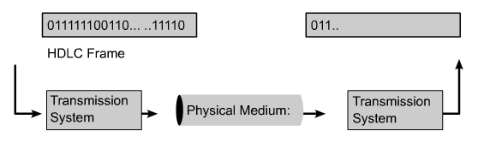
Introduction to Serial Communication
Some of the many serial communications standards include the following:
RS-232-E
V.35
High-Speed Serial Interface (HSSI)

Slide 4
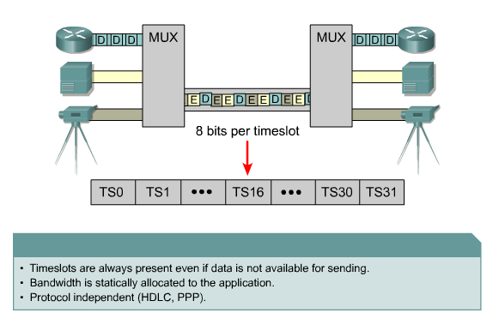
Time-Division Multiplexing

Slide 5
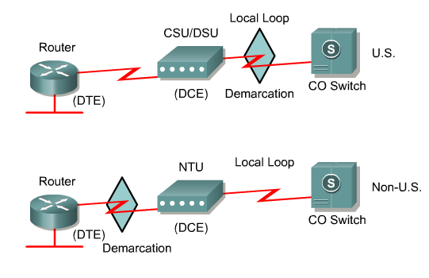
Demarcation Point
The point in the network where the responsibility of the service provider or "telco" ends.

Slide 6
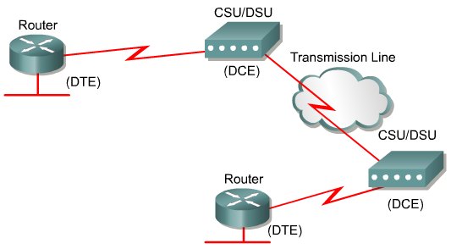
DTE-DCE

Slide 7
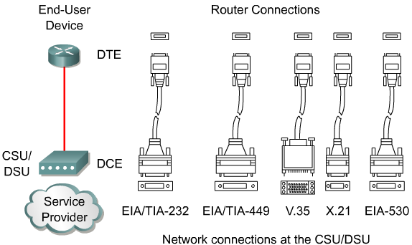
Serial Connection Options

Slide 8
HDLC Frame Format
Cisco HDLC
Flag
Address
Control
Proprietary
Data
FCS
Flag
Uses a proprietary data field to support
multiprotocol environments.
Standard HDLC
Flag
Address
Control
Data
FCS
Flag
Supports only single-protocol environments.
HDLC - High-level Data Link Control
Notes:
Purpose: This figure introduces students to HDLC encapsulation.
Emphasize: HDLC is the default Layer 2 protocol for Cisco router serial interfaces. Cisco’s proprietary enhancement to HDLC incorporates a protocol or type field to allow multiple protocols to be carried on a single link.
HDLC High-Level Data Link Control

Slide 9
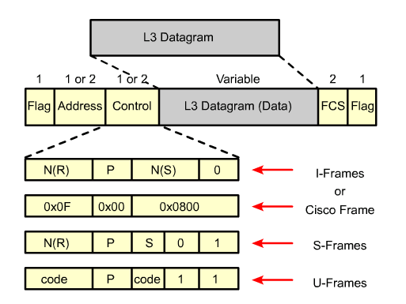
HDLC Encapsulation
Notes:
3.1.5 HDLC encapsulation

Slide 10
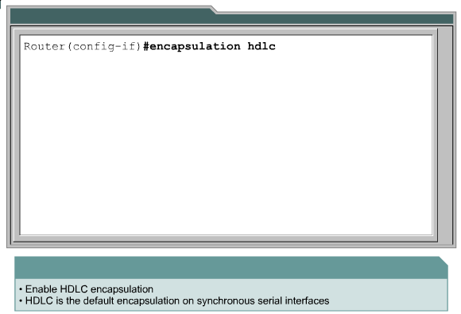
Configuring HDLC Encapsulation

Slide 11
Troubleshooting a Serial Interface
Five possible problem states can be identified in the interface status line of the show interface serial display:
  Serial x is down, line protocol is down.
  Serial x is up, line protocol is down.
  Serial x is up, line protocol is up (looped).
  Serial x is up, line protocol is down (disabled).
  Serial x is administratively down, line protocol is down.

Slide 12
PPP Frame Format
PPP
Flag
Address
Control
Protocol
Data
FCS
Flag
Uses a Protocol data field to support multiprotocol environments.
Cisco HDLC
Flag
Address
Control
Proprietary
Data
FCS
Flag
Uses a proprietary field to support multiprotocol environments.

Slide 13
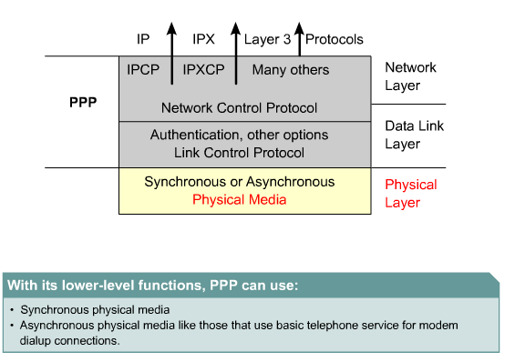
PPP Layered Architecture

Slide 14
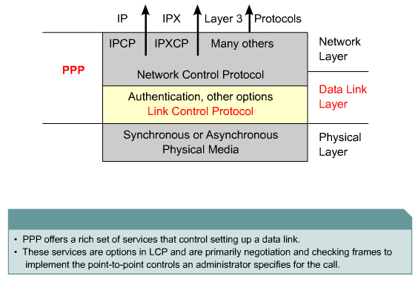
PPP and the Data Link Layer

Slide 15
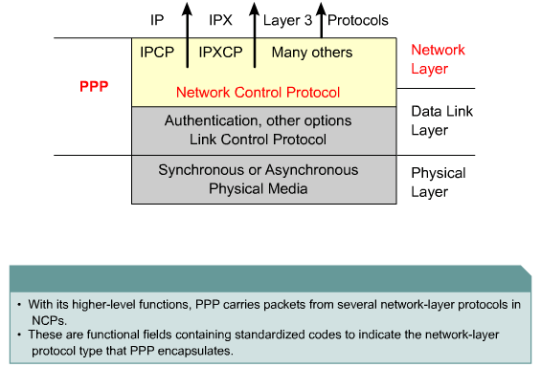
PPP and the Network Layer

Slide 16
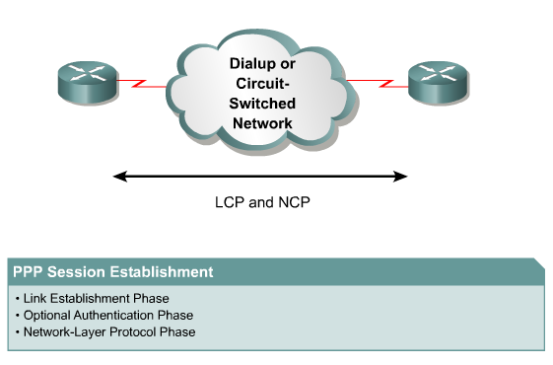
Establishing a PPP Session

Slide 17
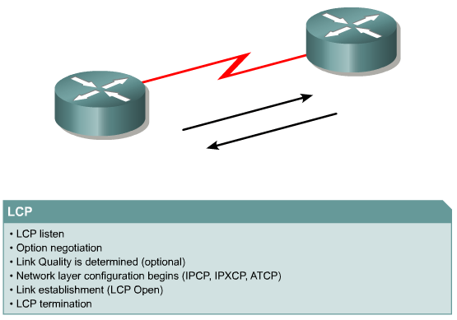
PPP Operation

Slide 18
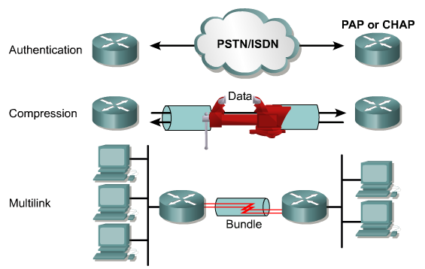
LCP Options

Slide 19
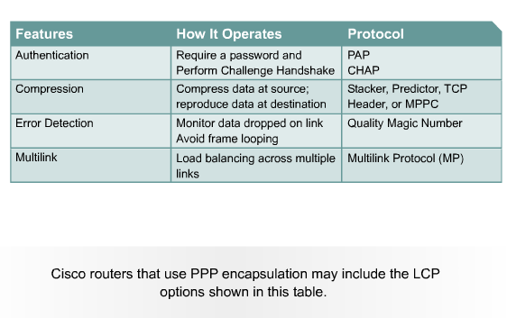
PPP Configuration Options

Slide 20
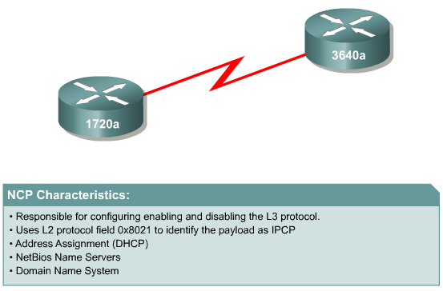
NCP

Slide 21
PPP Authentication Protocols
When configuring PPP authentication, the network administrator can select Password Authentication Protocol (PAP) or Challenge Handshake Authentication Protocol (CHAP).
In general, CHAP is the preferred protocol

Slide 22


PPP Authentication Overview
Point-to-Point
Network
PPP Session Establishment
1 Link Establishment Phase
2 Optional Authentication Phase
3 Network Layer Protocol Phase
Two PPP authentication protocols:
PAP and CHAP
Notes:
Purpose: This graphic presents the PPP authentication overview.
Emphasize: A PPP session establishment has three phases, as follows:
Link establishment phase—In this phase, each PPP device sends LCP packets to configure and test the data link.
Authentication phase (optional)—After the link has been established and the authentication protocol decided on, the peer may be authenticated.
PPP supports two authentication protocols: PAP and CHAP.
Both of these protocols are detailed in RFC 1334, PPP Authentication Protocols. However, RFC 1994, PPP Challenge Handshake Authentication Protocol, obsoletes RFC 1334.
Network-layer protocol phase—In this phase, the PPP devices send NCP packets to choose and configure one or more network-layer protocol.

Slide 23
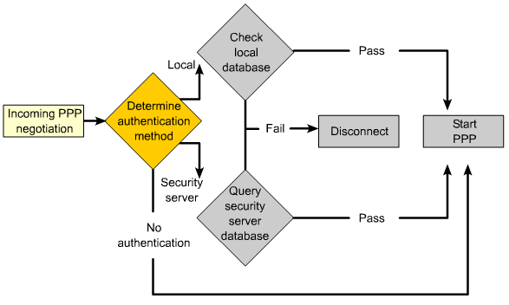
PPP Encapsulation and Authentication Process

Slide 24
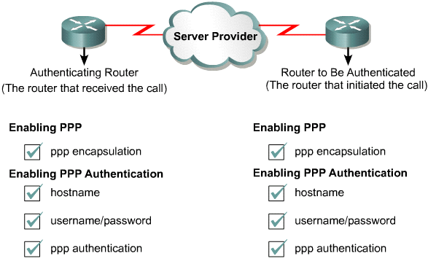
PPP Authentication role

Slide 25
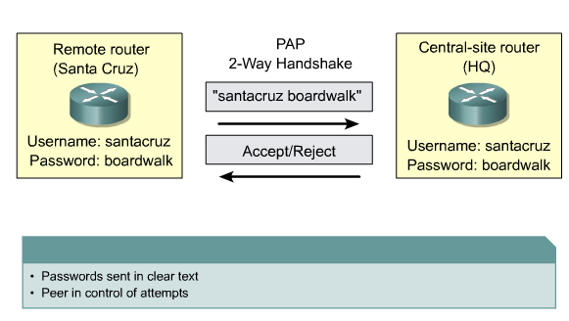
Password Authentication Protocol (PAP)

Slide 26
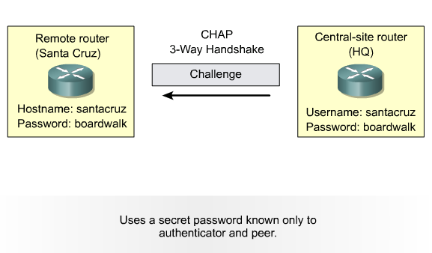
Challenge Handshake Authentication Protocol (CHAP)
CHAP provides protection against playback attack through the use of a variable challenge value that is unique and unpredictable.

Slide 27
CHAP Authentication
RS
HQ
Dialup or
Circuit-Switched
Network
Run PPP
Local User
Database
Local User
Database
Use CHAP
Name: RS
Password: urbiz
Request for Challenge
username RS
password urbiz
Challenge string
Response
Accept/Reject
Notes:
CHAP is used to periodically verify the identity of the remote node using a three-way handshake. This verification is done upon initial link establishment and can be repeated any time after the link has been established. The best authentication to use is CHAP, rather than PAP. The LCP layer of PPP takes care of the challenge information.
The three-way handshake sequence follows:
(1) The station sends a challenge message to the remote station
(2) The remote peer replies with a one-way hash value
(3) If it matches the station’s own calculation, authentication is acknowledged. Passwords are
not sent over the link. This method is a much more secure way of authentication.
CHAP provides protection against playback attack through the use of a variable challenge value that is unique and unpredictable. The use of repeated challenges every two minutes during any CHAP session limits the time of exposure to any single attack. The access server (or a third-party authentication server such as Terminal Access Controller Access Control System [TACACS]) is in control of the frequency and timing of the challenges. A major advantage of the constantly changing challenge string is that the line cannot be sniffed and played back later to gain unauthorized access to the network.

Slide 28

CHAP in Action—Call
User dials in
766_1
5200_1
Notes:
This slide and the following few slides show the series of events that occur during a CHAP authentication between two routers. The steps shown in this slide are:
1. The call comes in to 5200_1
2. The incoming interface is configured with the ppp authentication chapcommand.
3. LCP negotiates CHAP and MD5.
4. A CHAP challenge is required on this call.

Slide 29
CHAP in Action—Challenge
User dials in
766_1
5200_1
01
id
random
5200_1
Notes:
This slide illustrates the following steps in the CHAP authentication between the two routers:
1. A CHAP challenge packet is built with the following characteristics:
01 = challenge
id = sequential number which identifies the challenge
random = a reasonably random number
5200_1 = the authentication name of the challenger
2. The id and random values are kept on the access server. A list of outstanding challenges is maintained.
3. The challenge packet is sent to the caller.

Slide 30
CHAP in Action—Response
User dials in
766_1
5200_1
user pass
5200_1 pc1
01
id
random
5200_1
MD5
hash
Notes:
This slide illustrates the receipt and MD5 processing of the challenge packet from the server.
The calling router processes the CHAP challenge packet in the following manner:
The id is fed into the MD5 algorithm handler
The random value is fed into the MD5 algorithm handler
The name 5200_1 is used to look up the password
The password is fed into the MD5 algorithm handler
The result is the one-way MD5 hashed CHAP challenge that will be sent back in the CHAP response.

Slide 31
CHAP in Action—Response
User dials in
766_1
5200_1
user pass
5200_1 pc1
01
id
random
5200_1
02
id
hash
766_1
MD5
hash
Notes:
This slide illustrates the building of the CHAP response packet that will be sent to the access server.
The response packet is assembled from the following components:
02 = CHAP response packet type
id = copied from the challenge packet
hash = the output from the MD5 algorithm handler. (The hashed information from the challenge packet.)
766_1 is the authentication name of this caller
The packet is then sent to the challenger.

Slide 32
CHAP in Action—Verification
User dials in
766_1
5200_1
user pass
5200_1 pc1
01
id
random
5200_1
user pass
766_1 pc1
02
id
hash
766_1
MD5
MD5
hash
=?
hash
Notes:
This slide shows the process of processing the response packet that occurs on the challenger.
The CHAP response packet is processed in the following manner:
The id is used to find original challenge packet
The id is fed into the MD5 algorithm handler
The original challenge random is fed into the MD5 meat grinder
The name 766_1 is used to look up the password (this name can be used to identify this session) from one of the following sources:
local username and password database
TACACS server with Cisco IOS version 11.1 and before for the password or Cisco IOS version 11.2
and later to verify the hash
RADIUS server is asked for the password
The password is fed into the MD5 algorithm handler
The hash value received in the response packet is then compared to the MD5 hashed value calculated
CHAP authentication succeeds if they’re equal.

Slide 33
CHAP in Action—Result
User dials in
766_1
5200_1
user pass
5200_1 pc1
01
id
random
5200_1
user pass
766_1 pc1
02
id
hash
766_1
MD5
MD5
hash
hash
03
id
“Welcome in”
Notes:
The slide illustrates the success message being sent to the calling router.
If authentication was successful, a CHAP success packet is built as follows:
03 = CHAP success message type
id = copied from the response packet
“Welcome in” is simply a text message of some kind meant to be a user readable explanation
If authentication failed a CHAP failure packet is built:
04 = CHAP failuremessage type
id = copied from the response packet
“Authentication failure” or some such message meant to be a user readable explanation
The packet is then sent to the caller.

Slide 34

Configuring CHAP Example
Left
router
PSTN/ISDN
Right
router
hostname right
username left password 123
int serial 0
encapsulation ppp
ppp authentication CHAP
hostname left
username right password 123
int serial 0
encapsulation ppp
ppp authentication CHAP
*
*
*
*
Two-way CHAP
Notes:
Purpose: This figure shows an example of CHAP configuration between two routers.
Emphasize: When you configure the usernames and passwords for the local databases, the passwords on both systems must be identical. Usernames and passwords are case sensitive.
Transition: The next section introduces other PPP LCP options. The first option is PPP callback.

Slide 35
Configuring PAP Example
Left
router
Dialup or
Circuit-Switched
Network
Right
router
hostname left
interface serial 0
encapsulation ppp
ppp pap sent-username left
password abc
hostname right
username left password abc
interface serial 0
encapsulation ppp
ppp authentication PAP
One-way PAP
Notes:
Purpose: This figure shows an example of two-way PAP authentication configuration.
Emphasize: This is two-way PAP authentication.
The dialer-map command is introduced here. This command contains the name, the IP address, and phone number used to reach the other router.
Transition: Since PAP is an insecure authentication mechanism, let’s look at CHAP in the next figure.

Slide 36
Configuring PAP Example
Left
router
Dialup or
Circuit-Switched
Network
Right
router
hostname left
interface serial 0
encapsulation ppp
ppp pap sent-username left
password abc
hostname right
username left password abc
interface serial 0
encapsulation ppp
ppp authentication PAP
*
*
One-way PAP
Notes:
Purpose: This figure shows an example of two-way PAP authentication configuration.
Emphasize: This is two-way PAP authentication.
The dialer-map command is introduced here. This command contains the name, the IP address, and phone number used to reach the other router.
Transition: Since PAP is an insecure authentication mechanism, let’s look at CHAP in the next figure.

Slide 37
Configuring PAP Example
Left
router
Dialup or
Circuit-Switched
Network
Right
router
hostname left
username right password abc
interface serial 0
encapsulation ppp
ppp authentication PAP
ppp pap sent-username left
password abc
hostname right
username left password abc
interface serial 0
encapsulation ppp
ppp authentication PAP
ppp pap sent-username right
password abc
Two-way PAP
Notes:
Purpose: This figure shows an example of two-way PAP authentication configuration.
Emphasize: This is two-way PAP authentication.
The dialer-map command is introduced here. This command contains the name, the IP address, and phone number used to reach the other router.
Transition: Since PAP is an insecure authentication mechanism, let’s look at CHAP in the next figure.

Slide 38
Configuring PAP Example
Left
router
Dialup or
Circuit-Switched
Network
Right
router
hostname left
username right password abc
interface serial 0
encapsulation ppp
ppp authentication PAP
ppp pap sent-username left
password abc
hostname right
username left password abc
interface serial 0
encapsulation ppp
ppp authentication PAP
ppp pap sent-username right
password abc
*
*
*
*
Two-way PAP
Notes:
Purpose: This figure shows an example of two-way PAP authentication configuration.
Emphasize: This is two-way PAP authentication.
The dialer-map command is introduced here. This command contains the name, the IP address, and phone number used to reach the other router.
Transition: Since PAP is an insecure authentication mechanism, let’s look at CHAP in the next figure.

Slide 39
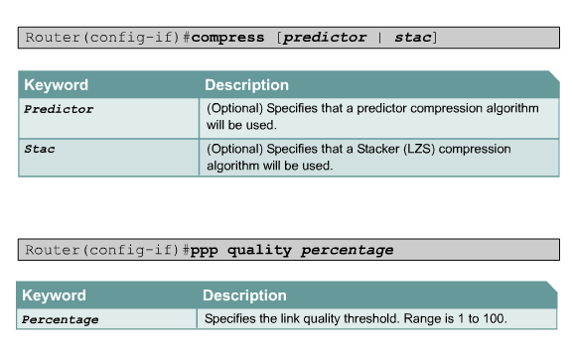
Configuring PPP

Slide 40
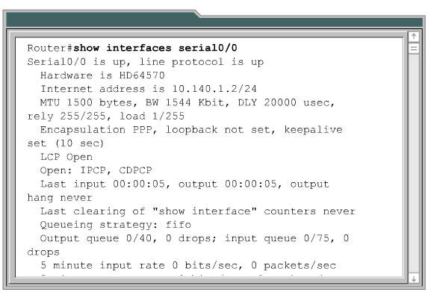
Verifying PPP

Slide 41
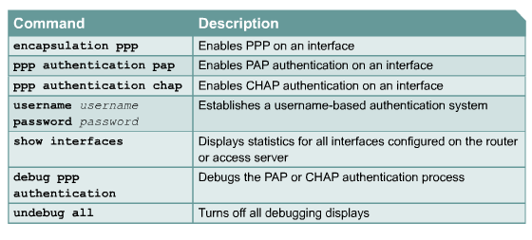
PPP Configuration Commands

Slide 42
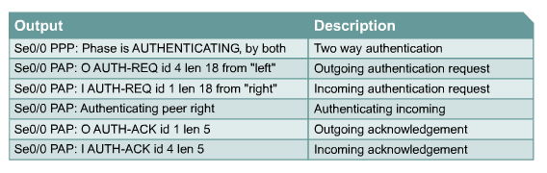
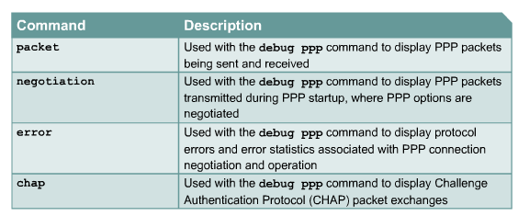
Debug PPP Authentication

Slide 43
Debug PPP Authentication
Se1 PPP: Treating connection as a dedicated line
Se1 PPP: Phase is AUTHENTICATING, by both
Se1 CHAP: Using alternate hostname RB
Se1 CHAP: O CHALLENGE id 19 len 23 from "RB"
Se1 CHAP: I CHALLENGE id 51 len 23 from "RA"
Se1 CHAP: Using alternate hostname RB
Se1 CHAP: O RESPONSE id 51 len 23 from "RB"
Se1 CHAP: I RESPONSE id 19 len 23 from "RA"
Se1 CHAP: O SUCCESS id 19 len 4
Se1 CHAP: I SUCCESS id 51 len 4

Slide 44


