Slide 1


Presentation_ID
© 2001, Cisco Systems, Inc. All rights reserved.

Slide 2
DHCP
Presenter:
Magang
magang@bupt.edu.cn

Slide 3
Introducing DHCP
Dynamic Host Configuration Protocol (DHCP) —— RFC 2131
Client/server mode
Who not need DHCP: router, switch, server
Cisco IOS feature set: Easy IP
DHCP uses UDP : c to s (67), s to c (68)

Slide 4

BOOTP and DHCP differences
DHCP, BOOTP shares UDP port
The four basic IP parameters:
  IP address
  Gateway address
  Subnet mask
  DNS server address

Slide 5
Major DHCP features
Automatic allocation – DHCP assigns a permanent IP address to a client.
Manual allocation – The IP address for the client is assigned by the administrator. DHCP conveys the address to the client.
Dynamic allocation – DHCP assigns, or leases, an IP address to the client for a limited period of time.

Slide 6
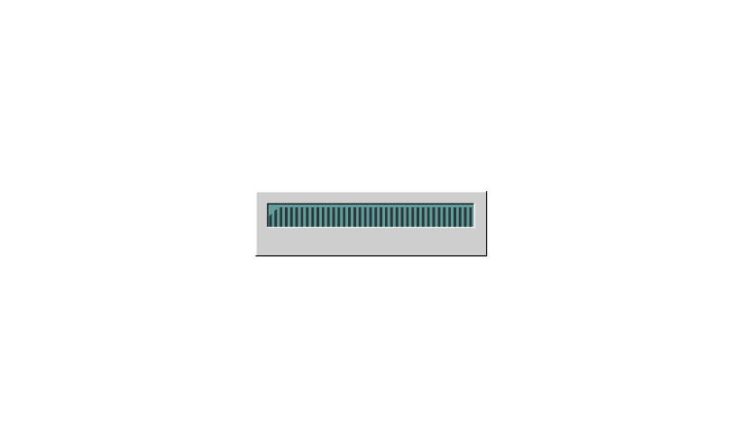
DHCP operation

Slide 7
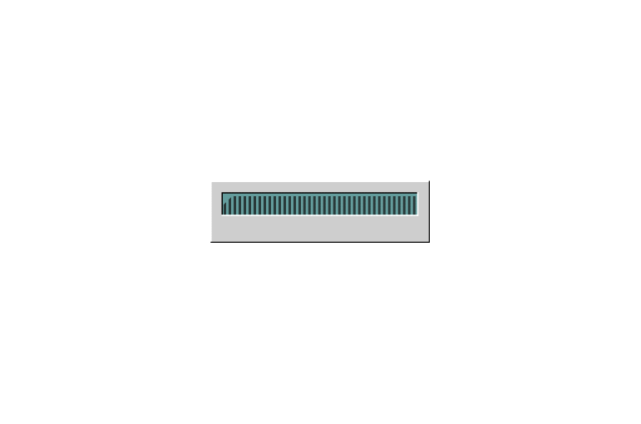
Configuring DHCP

Slide 8
Verifying DHCP operation
show ip dhcp binding
show ip dhcp server statistics
debug ip dhcp server events

Slide 9
DHCP relay
When happened: server and client are not on the same segment
Router: no forward the Broadcast
Use ip helper-address command
Open eight UDP services:
  Time BOOTP/DHCP Client
  TACACS TFTP
  DNS NetBIOS Name Service
  BOOTP/DHCP Server NetBIOS datagram Service

Slide 10


Presentation_ID
© 2001, Cisco Systems, Inc. All rights reserved.

