Slide 1
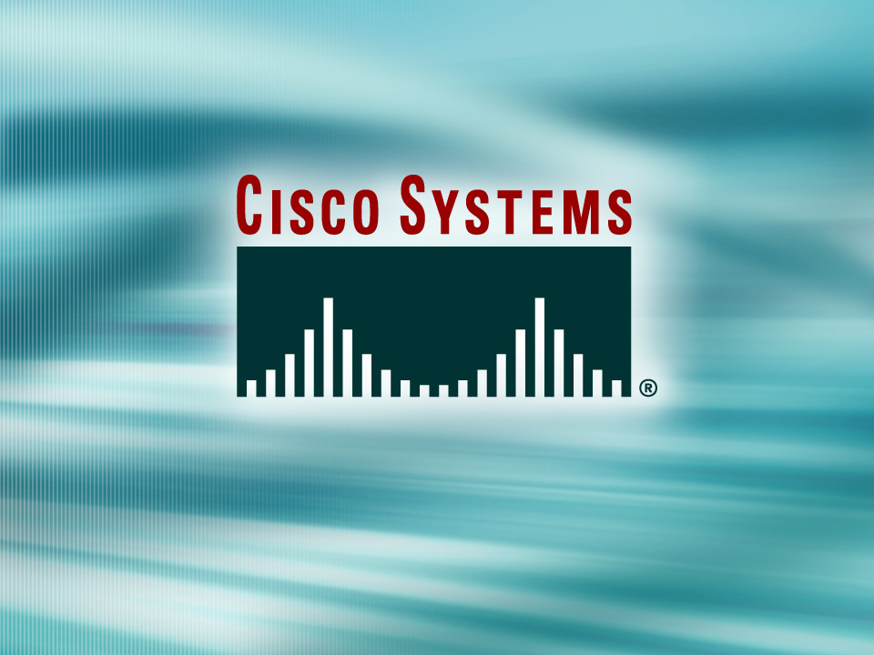

Presentation_ID
© 2001, Cisco Systems, Inc. All rights reserved.

Slide 2
Network Address Translation
Presenter:
Magang
magang@bupt.edu.cn

Slide 3
Agenda
Network Address Translation (NAT)
DHCP

Slide 4
Why use Private Addressing?

Slide 5
Solutions to IP address depletion.
Private IP Addresses:
  Class A --- 10.0.0.0 to 10.255.255.255 (= /8)
  Class B --- 172.16.0.0 to 172.31.255.255 (= /12)
  Class C --- 192.168.0.0 to 192.168.255.255 (= /16)
RFC 1631 - Network Address Translator (NAT)
Notes:
Because many private networks exist alongside public nets, grabbing "just any address" is strongly discouraged. RFC 1918 sets aside three blocks of IP addresses (i.e., a Class A, a Class B, and a Class C range) for private, internal use. Addresses in this range will not be routed on the Internet backbone . Internet routers immediately discard private addresses.
When using private addresses on a network that is connected to the Internet, you should filter packets and routing updates to avoid "leaking" any RFC 1918 addresses between autonomous systems. For example, if both you and your provider use addresses from the 192.168.0.0 /16 block, your routers could get confused if confronted with updates from both systems.
NAT is the process of swapping one address for another in the IP packet header. In practice, NAT is used to allow hosts that are privately addressed (using RFC 1918 addresses) to access the Internet.
When a host inside the private domain wants to transmit to a host on the outside world, it forwards the packet to the NAT-enabled device. The NAT process then looks inside the IP header and, if appropriate, replaces the inside IP address with a globally unique IP address. When an outside host sends a response, the NAT process receives it, checks the current table of network address translations, and replaces the destination address with the original inside source. NAT translations can occur dynamically or statically and can be used for a variety of purposes.
The most powerful feature of NAT routers is their capability to use port address translation (PAT), which allows multiple inside addresses to map to the same global address. This is sometimes called a "many-to-one" NAT. This procedure allows for many user inside of the private network to share one single external IP address. When using PAT the NAT router keeps track of the different conversations by mapping TCP and UDP port numbers.

Slide 6
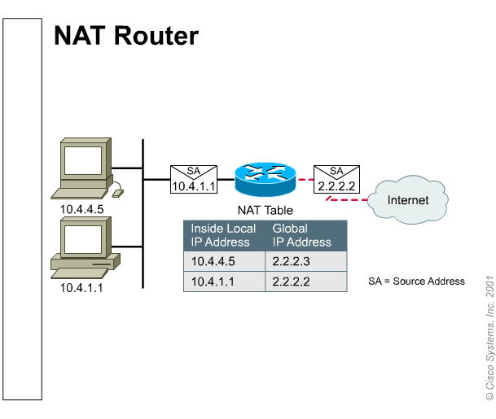
NAT a simple concept.

Slide 7
NAT Advantages
Conserves real (legal) addresses
Increases Flexibility when connecting to the Internet
Eliminates address renumbering (expansion of networks, merges)
Protects network security.
Notes:
Conserves real (legal) addresses : By translating real (few) to Private addresses (many)
Reduces Overlaps : NAT can be used to resolve addressing issues that arise when inside addresses overlap with addresses in the outside network. This can occur when two companies merge, both with duplicate addresses in the networks.
Increases Flexibility when connecting to the Internet
Eliminates address renumbering (expansion of networks, merges)

Slide 8
NAT types.
Static NAT:
Fixed mapping of an internal address to an external address (Lookup Table)
Dynamic NAT:
Mapping is done dynamically on a first come first served basis
PAT (Overload):
Port address translation is used to allow many internal users to share a single ‘inside global’ address

Slide 9



How does it work?
10.1.1.2
Port Translation Table
Static
Translation Table
10.1.1.2 = 203.10.10.2 10.1.1.3 = 203.10.10.3 10.1.1.4 = 203.10.10.4
Dynamic
Translation Table
10.1.1.4 = 203.10.10.2 10.1.1.2 = 203.10.10.3 10.1.1.3 = 203.10.10.4
Inside Local IP SRC Port DST Port Inside Global IP
10.1.1.4 1024 80 203.10.10.2
10.1.1.3
10.1.1.2 1122 80 203.10.10.2
10.1.1.3 1343 80 203.10.10.2
(config)# ip nat inside source static 10.1.1.2 203.10.10.2
(config)# ip nat pool NET-10 203.10.10.2 netmask 255.255.255.0
(config)# ip nat inside source list 2 pool NET-10 overload
(config)# ip nat pool NET-10 203.10.10.2 203.10.10.4 netmask 255.255.255.0
(config)# ip nat inside source list 2 pool NET-10
10.1.1.4

Slide 10
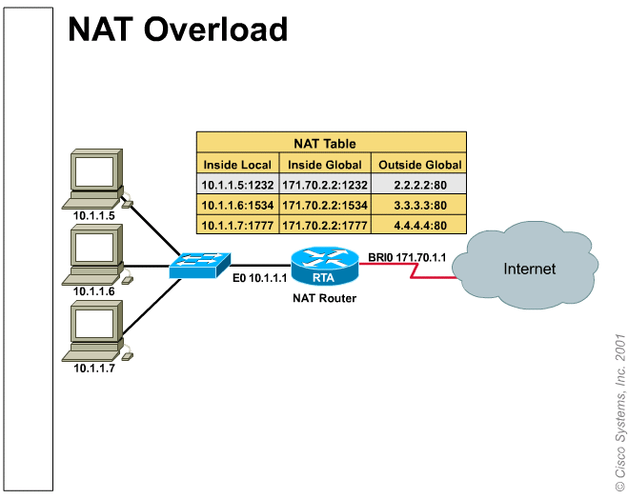
Most common situation for small Networks.
Notes:
Network 10.0.0.0 is the internal Private Addressing scheme
Network 171.70.2.2 is the real address assigned to this company
Network host:
2.2.2.2
3.3.3.3
4.4.4.4
Are real external addresses that the internal machines are trying to reach.
As we can see all the machines are using basically one real address

Slide 11
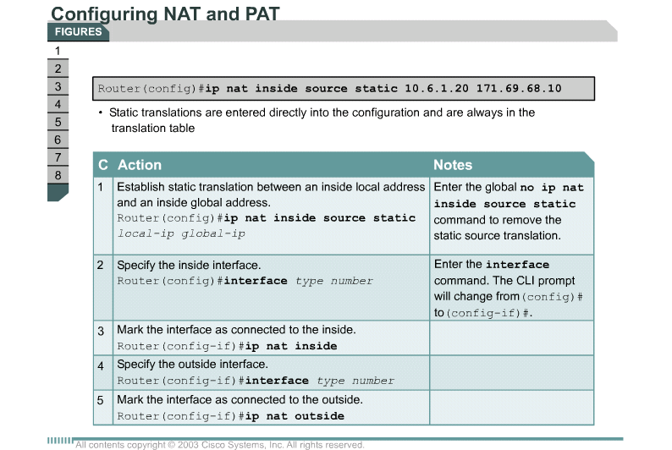
Configuring NAT and PAT

Slide 12
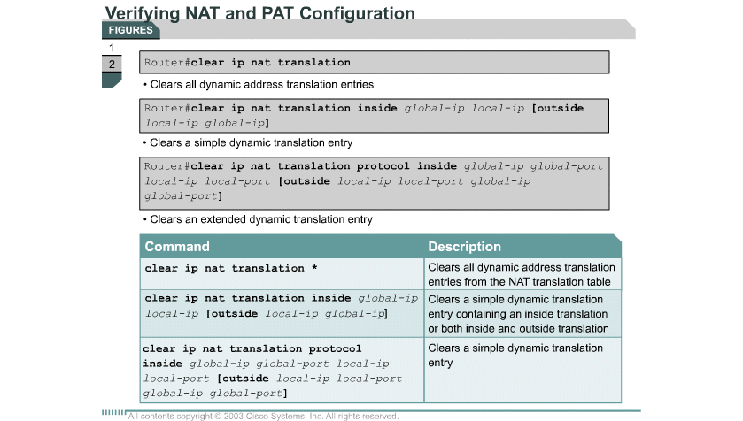
Verifying NAT and PAT configuration
Troubleshooting: debug ip nat
Notes:
Debug ip nat

Slide 13
DHCP

Slide 14
Introducing DHCP
Dynamic Host Configuration Protocol (DHCP) —— RFC 2131
Client/server mode
Who not need DHCP: router, switch, server
Cisco IOS feature set: Easy IP
DHCP uses UDP : c to s (67), s to c (68)

Slide 15

BOOTP and DHCP differences
DHCP, BOOTP shares UDP port
The four basic IP parameters:
  IP address
  Gateway address
  Subnet mask
  DNS server address

Slide 16
Major DHCP features
Automatic allocation – DHCP assigns a permanent IP address to a client.
Manual allocation – The IP address for the client is assigned by the administrator. DHCP conveys the address to the client.
Dynamic allocation – DHCP assigns, or leases, an IP address to the client for a limited period of time.

Slide 17
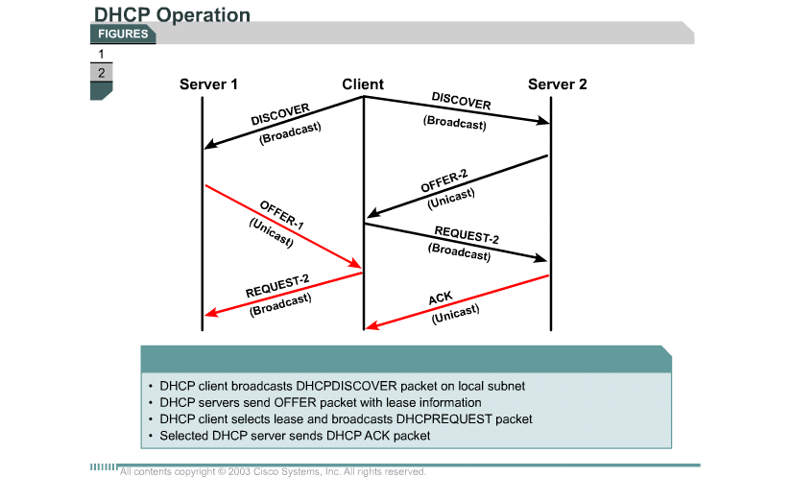
DHCP operation

Slide 18
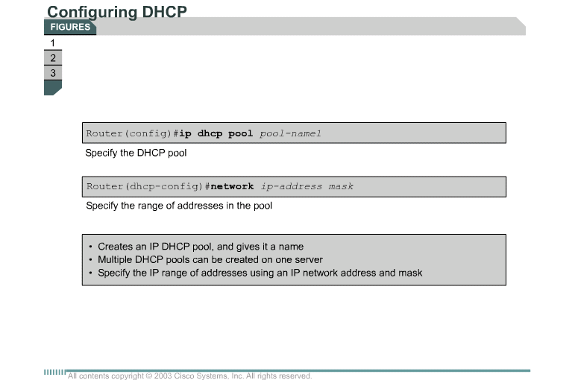
Configuring DHCP

Slide 19
Verifying DHCP operation
show ip dhcp binding
show ip dhcp server statistics
debug ip dhcp server events

Slide 20
DHCP relay
When happened: server and client are not on the same segment
Router: no forward the Broadcast
Use ip helper-address command
Open eight UDP services:
  Time BOOTP/DHCP Client
  TACACS TFTP
  DNS NetBIOS Name Service
  BOOTP/DHCP Server NetBIOS datagram Service

Slide 21


Presentation_ID
© 2001, Cisco Systems, Inc. All rights reserved.

