Slide 1


Slide 2

DHCP

Slide 3
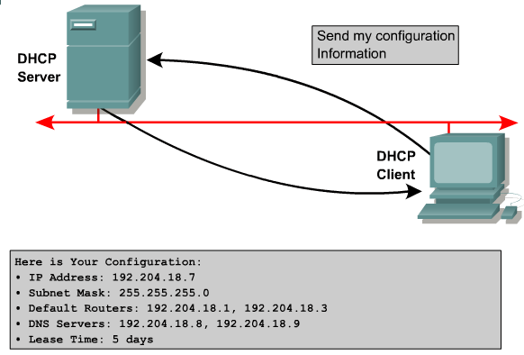
DHCP Features
Automatic Allocation
Manual Allocation
Dynamic Allocation
UDP DST PORT : 67 SRC PORT 68
Address pool :
192.204.18.2 ~ 192.204.18.50
UDP DST PORT : 68 SRC PORT 67

Slide 4
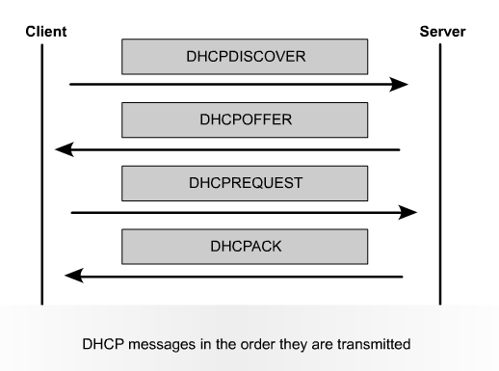
The Order of DHCP Messages Transmitting

Slide 5
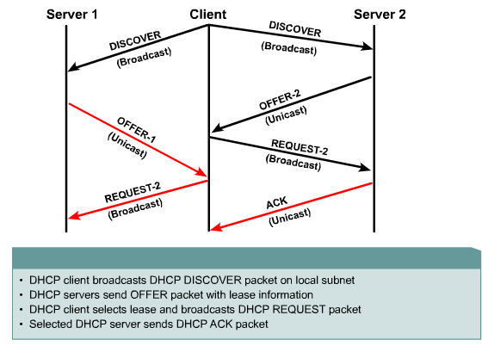
DHCP Operation

Slide 6
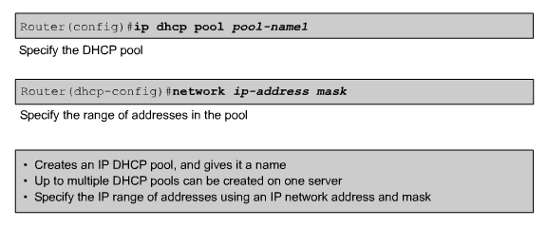
Configuring DHCP

Slide 7
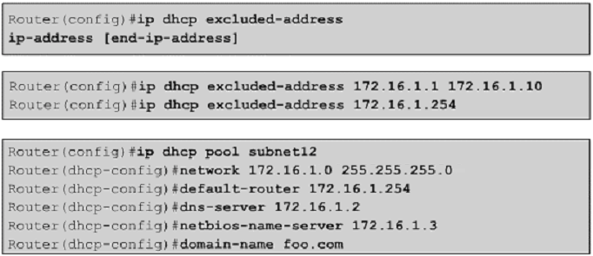
Configuring DHCP While Excluding IP

Slide 8
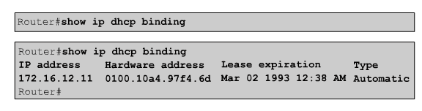
Verifying DHCP

Slide 9
Using Helper Addresses

Slide 10




Helper Addressing Overview
Diskless
Workstation
BOOTP
Server
  Routers do not forward broadcasts, by default
  Helper address provides selective connectivity

Slide 11
Why Use a Helper Address?
Diskless
Workstation
BOOTP
Server

Slide 12
Why Use a Helper Address?
Looking for
boot server.
Diskless
Workstation
BOOTP
Server
Broadcast
Unicast
Broadcast
  Sometimes clients do not know the server address
  Helpers change broadcast to unicast to reach server

Slide 13
IP Helper Address Commands
Router(config-if)#
ip helper-address address
Enables forwarding and specifies destination address for main UDP broadcast packets
Changes packet destination address from broadcast to unicast or directed broadcast address
Router(config)#
ip forward-protocol { udp [ port ] | nd | sdns }
  Specifies which protocols will be forwarded
Notes:
If a helper address is specified and UDP forwarding is enabled, broadcast packets destined to the following port numbers are forwarded by default:
Trivial File Transfer Protocol (TFTP) (port 69)
Domain Naming System (port 53)
Time service (port 37)
NetBIOS Name Server (port 137)
NetBIOS Datagram Server (port 138)
Boot Protocol (BOOTP) client and server datagrams (ports 67 and 68)
TACACS service (port 49)
IEN-116 Name Service (port 42)

Slide 14
Multiple Servers
Directed Broadcast and Unicast
TFTP server
172.16.3.2
DNS server
172.16.2.1
BOOTP server
172.16.2.2
E0
Broadcast
interface ethernet 0
ip address 172.16.1.100 255.255.255.0
ip helper-address 172.16.3.2
ip helper-address 172.16.2.255
!
ip forward-protocol udp 3000
no ip forward-protocol udp tftp
Notes:
教材2.8.3中关于直接广播的设置，接口上缺省关闭，因为安全问题。打开命令如下：
RTA(config-if)#ip directed-broadcast

Slide 15
Multiple Servers
Directed Broadcast and Unicast
TFTP server
172.16.3.2
DNS server
172.16.2.1
BOOTP server
172.16.2.2
Unicast
E0
Broadcast
Directed broadcast
to 172.16.2.255

Slide 16


