Slide 1
Network Address Translation

Slide 2
Agenda
Private Addressing
Network Address Translation (NAT)

Slide 3
Solutions to IP address depletion.
Private IP Addresses:
  Class A --- 10.0.0.0 to 10.255.255.255 (= /8)
  Class B --- 172.16.0.0 to 172.31.255.255 (= /12)
  Class C --- 192.168.0.0 to 192.168.255.255 (= /16)
RFC 1631 - Network Address Translator (NAT)
Notes:
Because many private networks exist alongside public nets, grabbing "just any address" is strongly discouraged. RFC 1918 sets aside three blocks of IP addresses (i.e., a Class A, a Class B, and a Class C range) for private, internal use. Addresses in this range will not be routed on the Internet backbone . Internet routers immediately discard private addresses.
When using private addresses on a network that is connected to the Internet, you should filter packets and routing updates to avoid "leaking" any RFC 1918 addresses between autonomous systems. For example, if both you and your provider use addresses from the 192.168.0.0 /16 block, your routers could get confused if confronted with updates from both systems.
NAT is the process of swapping one address for another in the IP packet header. In practice, NAT is used to allow hosts that are privately addressed (using RFC 1918 addresses) to access the Internet.
When a host inside the private domain wants to transmit to a host on the outside world, it forwards the packet to the NAT-enabled device. The NAT process then looks inside the IP header and, if appropriate, replaces the inside IP address with a globally unique IP address. When an outside host sends a response, the NAT process receives it, checks the current table of network address translations, and replaces the destination address with the original inside source. NAT translations can occur dynamically or statically and can be used for a variety of purposes.
The most powerful feature of NAT routers is their capability to use port address translation (PAT), which allows multiple inside addresses to map to the same global address. This is sometimes called a "many-to-one" NAT. This procedure allows for many user inside of the private network to share one single external IP address. When using PAT the NAT router keeps track of the different conversations by mapping TCP and UDP port numbers.

Slide 4
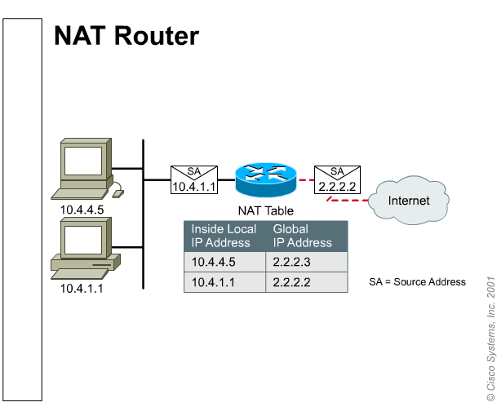
NAT a simple concept.

Slide 5
Why use Private Addressing?

Slide 6
NAT Advantages
Conserves real (legal) addresses
Increases Flexibility when connecting to the Internet
Eliminates address renumbering (expansion of networks, merges)
Notes:
Conserves real (legal) addresses : By translating real (few) to Private addresses (many)
Reduces Overlaps : NAT can be used to resolve addressing issues that arise when inside addresses overlap with addresses in the outside network. This can occur when two companies merge, both with duplicate addresses in the networks.
Increases Flexibility when connecting to the Internet
Eliminates address renumbering (expansion of networks, merges)

Slide 7
NAT types
Static NAT:
Fixed mapping of an internal address to an external address (Lookup Table)
Dynamic NAT:
Mapping is done dynamically on a first come first served basis
PAT (Overload):
Port address translation is used to allow many internal users to share a single ‘inside global’ address

Slide 8
Address types
Inside Local (内部本地地址 ):内网中的IP地址，可以是私用地址。
Inside Global (内部全局地址): 注册的IP地址(由NIC提供),对外部展示的内部地址。
Outside Local (外部本地地址):在内部网络看到的一个外部主机的IP地址。它不必是一个注册地址，只保证从内部可到达即可。
Outside Global (外部全局地址):由主机所有者分配的IP地址。通常是注册地址。

Slide 9



Static How does it work?
10.1.1.2
Static
Translation Table
10.1.1.2 = 203.10.10.2 10.1.1.3 = 203.10.10.3 10.1.1.4 = 203.10.10.4
10.1.1.3
(config)# ip nat inside source static 10.1.1.2 203.10.10.2
10.1.1.4

Slide 10
Dynamic How does it work?
10.1.1.2
Dynamic
Translation Table
10.1.1.4 = 203.10.10.2 10.1.1.2 = 203.10.10.3 10.1.1.3 = 203.10.10.4
10.1.1.3
(config)# ip nat pool NET-10 203.10.10.2 203.10.10.4 netmask 255.255.255.0
(config)# ip nat inside source list 2 pool NET-10
10.1.1.4
Notes:
access-list 2 permit 10.1.1.0 0.0.0.255

Slide 11
PAT How does it work?
10.1.1.2
Port Translation Table
Inside Local IP SRC Port DST Port Inside Global IP
10.1.1.4 1024 80 203.10.10.2
10.1.1.3
10.1.1.2 1122 80 203.10.10.2
10.1.1.3 1343 80 203.10.10.2
(config)# ip nat pool NET-10 203.10.10.2
netmask 255.255.255.0
(config)# ip nat inside source list 2 pool NET-10 overload
10.1.1.4
Notes:
access-list 2 permit 10.1.1.0 0.0.0.255
ip nat inside source list 101 interface dialer1 overload
access-list 101 permit ip 10.0.0.0 0.255.255.255 any

Slide 12
PAT How does it work?
10.1.1.2
Port Translation Table
Inside Local IP SRC Port DST Port Inside Global IP
10.1.1.4 1024 80 203.10.10.2
10.1.1.3
10.1.1.2 1122 80 203.10.10.2
10.1.1.3 1343 80 203.10.10.2
(config)# ip nat inside source list 2 interface s0/0 overload
10.1.1.4
Notes:
access-list 2 permit 10.1.1.0 0.0.0.255
ip nat inside source list 101 interface dialer1 overload
access-list 101 permit ip 10.0.0.0 0.255.255.255 any

Slide 13
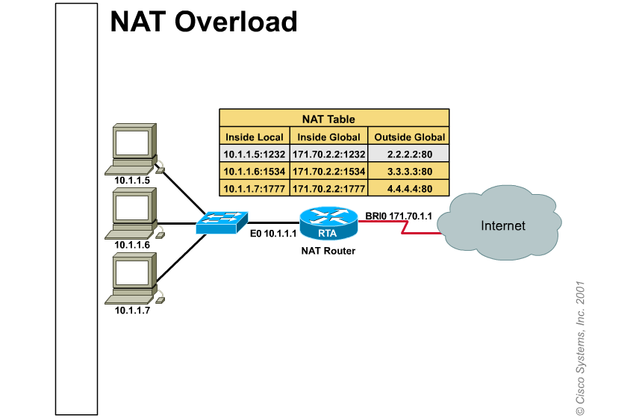
Most common situation for small Networks.
Notes:
Network 10.0.0.0 is the internal Private Addressing scheme
Network 171.70.2.2 is the real address assigned to this company
Network host:
2.2.2.2
3.3.3.3
4.4.4.4
Are real external addresses that the internal machines are trying to reach.
As we can see all the machines are using basically one real address

Slide 14
Static NAT Configuration Example
ip nat inside source static 10.1.1.1 192.168.2.2
!
interface Ethernet0
ip address 10.1.1.10 255.255.255.0
ip nat inside
!
interface Serial0
ip address 172.16.2.1 255.255.255.0
ip nat outside
!
This interface connected to the inside network.
This interface connected to the outside world.
Maps the inside local address to the inside global address.
Notes:
Purpose: This figure displays the static NAT configuration output.
Emphasize: Highlight the inside and outside interfaces on this configuration.
Note: This figure and the subsequent NAT configuration figures only display the configurations necessary to configure NAT translation. Other commands may be necessary for routing.

Slide 15
Dynamic NAT Configuration
ip nat pool dyn-nat 192.168.2.1 192.168.2.254
netmask 255.255.255.0
ip nat inside source list 1 pool dyn-nat
!
interface Ethernet0
ip address 10.1.1.10 255.255.255.0
ip nat inside
!
interface Serial0
ip address 172.16.2.1 255.255.255.0
ip nat outside
!
access-list 1 permit 10.1.1.0 0.0.0.255
!
This interface connected to the inside network.
This interface connected to the outside world.
Translate between inside hosts addressed from 10.1.1.0/24 to
the globally unique 192.168.2.0/24 network.
Notes:
Purpose: This figure displays the dynamic NAT configuration output.

Slide 16
Configuring Inside Global Address Overloading
ip nat pool ovrld-nat 192.168.2.1 192.168.2.2
netmask 255.255.255.0
ip nat inside source list 1 pool ovrld-nat overload
!
interface Ethernet0/0
ip address 10.1.1.10 255.255.255.0
ip nat inside
!
interface Serial0/0
ip address 172.16.2.1 255.255.255.0
ip nat outside
!
access-list 1 permit 10.1.1.0 0.0.0.255
Notes:
Purpose: This figure describes how to configure inside global address overloading.

Slide 17
Configuring Inside Global Address Overloading
ip nat inside source list 1 interface Serial0/0 overload
!
interface Ethernet0/0
ip address 10.1.1.10 255.255.255.0
ip nat inside
!
interface Serial0/0
ip address 172.16.2.1 255.255.255.0
ip nat outside
!
access-list 1 permit 10.1.1.0 0.0.0.255
Notes:
Purpose: This figure describes how to configure inside global address overloading.

Slide 18
NAT issues.
Increases delay –
  Switching path delays are introduced because of the translation of each IP address within the packet headers. .
DNS –
  Relies on a static IP address mapping to a host name. Use static translation.
Security –
  When using NAT there will be no encryption of the TCP header.
Difficult Debugging
Notes:
Bootp, dhcp & snmp use the payload of a packet to transfer IP information and therefore will not work in environments were NAT is used.
DNS (Domain Name Server) requires a fixed IP address for the translation of the “name” and if you are using NAT (other than static translation) the IP will not be fixed and therefore the DNS translation will be incorrect.
Certain TCP transmissions require (for security reasons) that the TCP header is encrypted. If a packet with the TCP header encrypted reaches the NAT engine the translation will destroy the encryption rendering the packet unusable.(因为NAT可能改变端口号)
Due to the fact that many point of the network may be translated it is very difficult to debug a system using NAT.

Slide 19
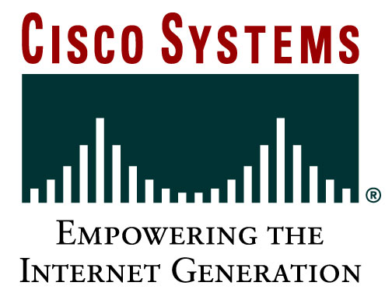
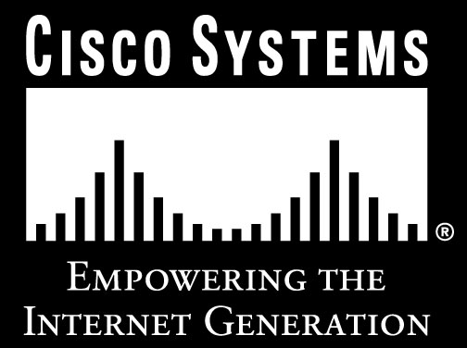
Presentation_ID
© 2001, Cisco Systems, Inc. All rights reserved.

