Slide 1

CSE 591 Midterm Review
Ross Maciejewski
rmacieje@asu.edu

Slide 2
What is Visualization?
“The use of computer-supported, interactive visual representations of data to amplify cognition.”¹
This is not simply the process of making a graphic or an image, the goal is to create insight, not pretty pictures
We want to help people form a mental image of something and internalize their own understanding
We want to promote discovery, decision making and explanations
1-Readings in Information Visualization: Using Vision to Think, SK Card, J Mackinlay and B.Shneiderman, 1999

Slide 3
The Information Seeking Mantra
Overview first,
then zoom and filter,
details on demand
1 - B. Shneiderman. The Eyes Have It: A Task by Data Type Taxonomy for Information Visualizations. In the Proceedings of the IEEE Symposium on Visual Languages, pp. 336-343, 1996.

Slide 4
Tasks for Visualization
Searching and browsing - find a specific piece of information, inspect data, seek information
Analyze – do comparisons, differences, look for outliers, extrema and patterns
Monitor – look for changes and trends

Slide 5
Data Types
Nominal
Data whose categories have no implied ordering
Examples include political affiliations of a population
Ordinal
Data that has a specified order, but no specified distance metric
Examples include beverage sizes at McDonalds (Small, medium, large)
Interval
Data that has measurable distances
Examples include periods of time (second, minute, etc.) – the zero point is arbitrary
Ratio
Same as interval, but include a zero point
Example include Celsius scale, height above sea level
1- SS Stevens, “On the Theory of Scales of Measurement,” Science, 103(2684):677-680, 1946.

Slide 6
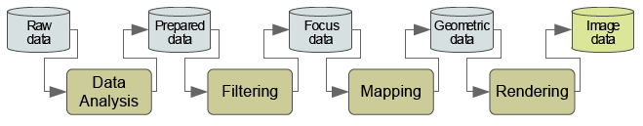
The Visualization Pipeline
We want to take these different data types and map them to an appropriate visual representation
Data Analysis – data are prepared for visualization (smooth, interpolate, transform)
Filtering – A subset of the data (usually user defined) is selected for visualization
Mapping – Data are mapped to geometric primitives and their attributes
Rendering – Geometric data are transformed to image data
Image taken from http://www.infovis-wiki.net/index.php/Visualization_Pipeline
Haber, R. & McNabb, D. A. (1990). Visualization idioms: A conceptual model for scientific visualization systems. In Visualization
in Scientific Computing.

Slide 7
Mapping Data
We need to know how to assign quantitative dimensions of our data to aesthetic attributes¹ of the data
Form | Surface | Motion | Sound | Text
Position Size Shape polygon glyph image Rotation Resolution | Color hue brightness saturation Texture pattern granularity orientation Blur Transparency | Direction Speed Acceleration | Tone Volume Rhythm Voice | Label
L Wilkinson (2005) The Grammar of Graphics

Slide 8
Aesthetic Attributes
An attribute must be capable of representing both continuous and categorical variables
When representing a continuous variable, an attribute must vary primarily on one psychophysical dimension
In order to use multidimensional attributes (such as color), we must scale them on a single dimension
An attribute does not imply a linear perceptual scale
Much of the skill in graphic design is knowing what combination of attributes should be avoided¹
1-SM Kosslyn (1994), The Elements of Graph Design

Slide 9
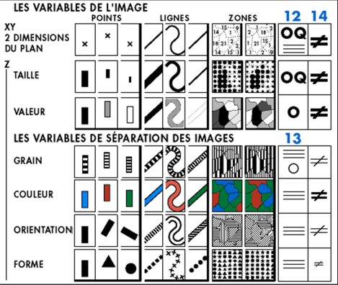
Bertin’s Visual Variables
Visualization is concerned primarily with a mapping to visual form
[x,y]
Position
[z]
Size (Taille)
Value (Valeur)
Color (Couleur)
Texture (Grain)
Orientation
Shape (Forme)
J Bertin (1967), The Semiology of Graphics

Slide 10
How Many Variables to Use?
The number of visual variables necessary for the representation is at least equal to the number of components in the information
With three components, the information can be perceived as a single image
Otherwise, we need several images (this is often termed small multiples and will be discussed in a future lecture)
The number of components is the best basis for a classification of graphic constructions
J Bertin (1967), The Semiology of Graphics

Slide 11
Bertin’s “Levels of Organization”
Components of information do not all involve the same intellectual approach
For example, we may choose to order qualitative (nominal) categories to compare ordered categories
A component can be classified as qualitative, ordered or quantitative
The visual variables which represent each component must permit parallel perceptual approaches
J Bertin (1967), The Semiology of Graphics

Slide 12
Bertin’s “Levels of Organization”
N – Nominal (Qualitative)
O – Ordered (Ordinal)
Q – Quantitative (Interval)
Position
N
O
Q
Size
N
O
Q
Value
N
O
Q
Texture
N
O
Color
N
Orientation
N
Shape
N
J Bertin (1967), The Semiology of Graphics

Slide 13
Combinatorics of Encodings
Challenge:
Pick the best encodings from the exponential number of possibilities (n+1)⁸
Principle of Consistency: The properties of the image should match the properties of the data
Principle of Importance Ordering: Encode the most important information in the most effective way
1 – This slide is borrowed from Pat Hanrahan’s “From Data to Image” lecture: http://graphics.stanford.edu/courses/cs448b-04-winter/lectures/encoding/

Slide 14
The Expressiveness & Effectiveness Criteria
Expressiveness: A set of facts is expressible in a visual language if the visualizations express all the facts in the set of data, and only the facts in the data
Effectiveness: A visualization is more effective than another visualization if the information conveyed by one visualization is more readily perceived than the information in the other visualization
1 – J. Mackinlay, Automating the Design of Graphical Presentations of Relational Information, ACM Transactions on Graphics, 5(2): 110-141, 1986.

Slide 15
Perception
A key goal of visualization is to produce images of data that support visual analysis¹
Human perception plays an important role in visualization
How we “see” details directly impacts the efficiency and effectiveness of an image (remember Mackinlay’s criteria from last lecture²)
By understanding perception, we can improve the quality and quantity of information being displayed³
1 - C. Healey and J. Enns, “Attention and Visual Memory in Visualization and Computer Graphics”, IEEE Transactions on Visualization and Computer Graphics, 2011 (Pre-print)
2 - J. Mackinlay, Automating the Design of Graphical Presentations of Relational Information, ACM Transactions on Graphics, 5(2): 110-141, 1986.
3 - Ware, C. Information Visualization: Perception for Design. Morgan Kaufmann Publishers, Inc., San Francisco, California, 2000.

Slide 16
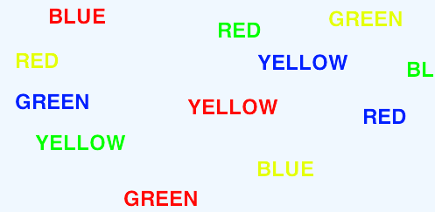
Selective Visual Attention
It is difficult to attend to more than one thing at the same time
When we attend to one task over the other, this is selective attention
Classic Stroop task – Read aloud the color of the word, not the word itself
Stroop, John Ridley (1935). "Studies of interference in serial verbal reactions". Journal of Experimental Psychology 18 (6): 643–66

Slide 17
Theoretical Interpretations of Selective Attention
Bottleneck/filter theories
A bottleneck is a mechanism that limits the amount of information to be attended to
Early selection¹ - select one message for further processing and all others are lost
Attenuation² – select one message for full processing, others are partially processed
Late selection³ – all messages get through but only one is selected for processing
1 – D. E. Broadbent, Perception and Communication. Oxford, United Kingdom: Oxford University Press, 1958
2 – A. Triesman, “Monitoring and storage of irrelevant messages in selective attention,” Psychological Review 87: 272-300
3 – J. A. Deutsch and D. Deutsch, "Attention: some theoretical considerations,“ Psychological Review 70: 80–90

Slide 18
Theoretical Interpretations of Divided Attention
Divided attention is the act of trying to attend to two stimuli at once and making multiple responses rather than making one response to multiple stimuli
Capacity Theories
A limited amount of resources are available to conduct tasks¹
Only one cognitive process can occur at a time²
1 – D. Kahneman (1973). Attention and effort. Englewood Cliffs, NJ: Prentice-Hall.
2 – H. Pashler, “Dual-Task Interference in Simple Tasks: Data and Theory,” Psychological Bulletin, 116(2): 220-244

Slide 19





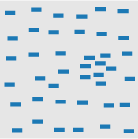

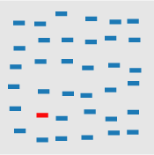
Partial List of Pre-Attentive Visual Features
Blob orientation length, width closure size
Curvature density, contrast number, estimation color(hue)
C. Healey and J. Enns, “Attention and Visual Memory in Visualization and Computer Graphics”, IEEE Transactions on Visualization and Computer Graphics, 2011 (Pre-print)

Slide 20
Color
Results from research on visual attention can be used to assign visual features to data values
One of the key components of visually representing data is choosing the appropriate color scale
There is no “best” color scale
Choice depends on^{1,2}
data type
problem domain
visual representation
Questions the analyst is asking of the data
While there is no “best” choice, there are design principles
1 - H. Levkowitz and G. T. Herman, "Color scales for image data," IEEE Computer Graphics and Applications, vol. 12, pp. 72-80, 1992
2 - P. Rheingans, "Task-based color scale design," Proceedings of Applied Image and Pattern Recognition, pp. 35-43, 1999.

Slide 21
Design Principles for Color Schemes
Order¹ – Given a univariate data type, the color scale that is chosen to map the data must represent a perceived ordering
Separation² – Important differences between ranges of the variable should be represented by colors that can be perceived as being different
Not only should they be perceived as different, but also equal
Aesthetics³ – color map should be aesthetically pleasing, contain a maximum perceptual resolution, and ordering should be intuitive
1 - B. E. Trumbo, “Theory for Coloring Bivariate Statistical Maps," The American Statistician, vol. 35, no. 4, pp. 220-226, 1981.
2 - H. Levkowitz and G. T. Herman, "Color scales for image data," IEEE Computer Graphics and Applications, vol. 12, pp. 72-80, 1992
3 - K. Moreland, “Diverging Color Maps for Scientific Visualization," Proceedings of the 5th International Symposium on Visual Computing, December 2009.

Slide 22


Univariate Color Schemes
Qualitative scheme
Rainbow color scale is one of the most commonly used, but it is a poor color map in a large variety of domain problems
Ordering of the hues is unintuitive
Nominal data types can use this scale as no ordering is implied
1 - D. Borland and R. M. Taylor, “Rainbow Color Map (Still) Considered Harmful,“ Computer Graphics & Applications, vol. 27, no. 2, pp. 14-17, 2007.
2 -P. Rheingans, “Task-based color scale design," Proceedings of Applied Image and Pattern Recognition, pp. 35-43, 1999.
3 - M. A. Harrower and C. A. Brewer, “ColorBrewer.org: An online tool for selecting color schemes for maps," The Catrtographic Journal, vol. 40, no. 1, pp. 27-37, 2003.

Slide 23

Univariate Color Schemes
Sequential color scheme
Simplest is the gray scale map where variable is mapped to brightness
Sequential maps represent ordered data
Dark colors typically represent high ranges, bright, low
Benefits are that the scale is intuitive
Weakness is that limited number of distinguishable colors can be represented
1 - D. Borland and R. M. Taylor, “Rainbow Color Map (Still) Considered Harmful,“ Computer Graphics & Applications, vol. 27, no. 2, pp. 14-17, 2007.
2 -P. Rheingans, “Task-based color scale design," Proceedings of Applied Image and Pattern Recognition, pp. 35-43, 1999.
3 - M. A. Harrower and C. A. Brewer, “ColorBrewer.org: An online tool for selecting color schemes for maps," The Catrtographic Journal, vol. 40, no. 1, pp. 27-37, 2003.

Slide 24
Histograms
Typical first look visualization method
Shows the shape of the data distribution
The choice of the histogram bin width greatly impacts the resultant visualization
There is no “best” number of bins, instead, different bin sizes can reveal different features of the data
Some methods work to determine an optimal number of bins, but these methods make assumptions on the underlying data distribution

Slide 25
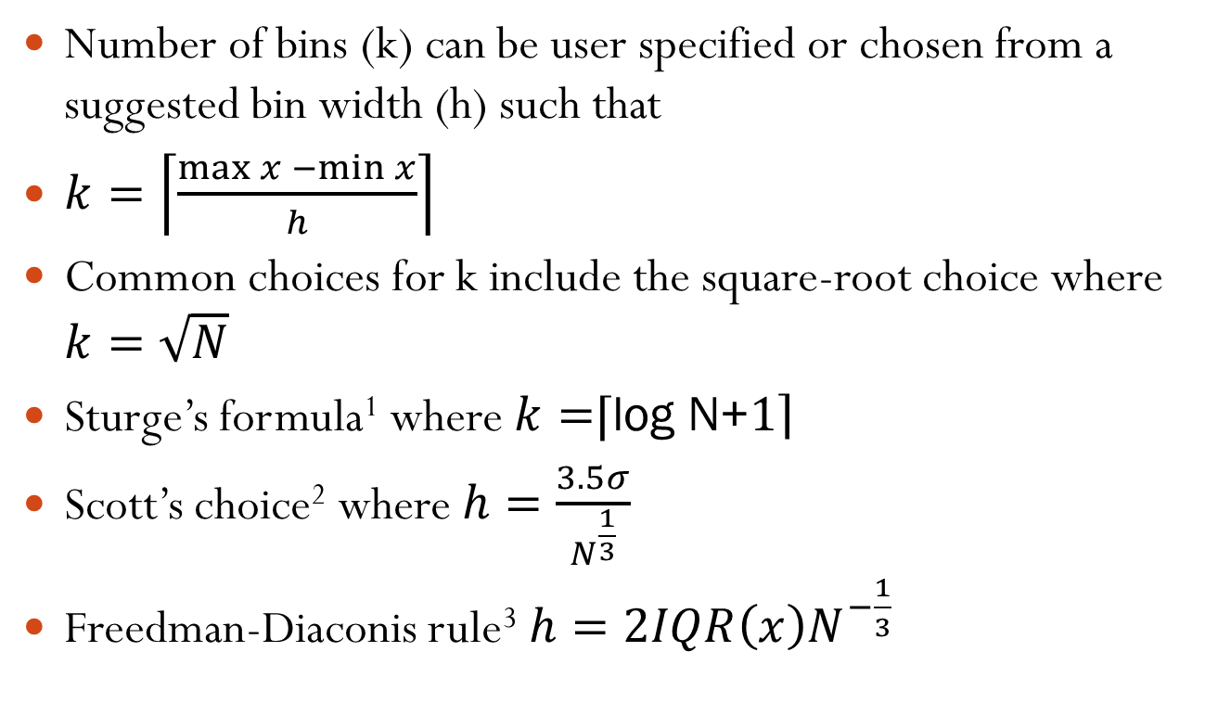
Histogram Binning
Number of bins (k) can be user specified or chosen from a suggested bin width (h) such that
$k=\left\lceil \left.\frac{\max{x −\min{x}}}{h}\right\rceil \right.$
Common choices for k include the square-root choice where $k=\sqrt{N}$
Sturge’s formula¹ where $k=$⌈log N+$\left.1\right\rceil$
Scott’s choice² where $h=\frac{3.5σ}{N^{\frac{1}{3}}}$
Freedman-Diaconis rule³ $h=2IQR\left(x\right)N^{−\frac{1}{3}}$
1 – H. A. Sturges. The choice of a class interval. Journal of the American Statistical Association, p. 65-66, 1926
2 - D. W. Scott. On optimal and data-based histograms. Biometrika, 66(3):605-610, 1979.
3 - Freedman, David; Diaconis, Persi, "On the histogram as a density estimator: L₂ theory". Probability Theory and Related Fields (Heidelberg: Springer Berlin) 57 (4): 453–476, 1981.
.

Slide 26
Quantiles
Quantiles – points taken at regular intervals from the cumulative distribution function of a random variable
Data is divided into q equal-sized data subset
The k^{th} q-quantile for a random variable is the value x such that the probability that the random variable will be less than x is at most k/q
The 2-quantile is the median
The 4-quantiles are called quartiles

Slide 27
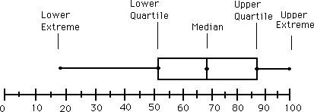
Box and Whisker Plots
Graphically depict groups of numerical data through their five-number summaries:
Smallest observation
Lower quartile
Median
Upper quartile
Sample maximum
Interquantile range (IQR) is the difference between the upper and lower quartile (Q₃-Q₁)

Slide 28
Q-Q Plots
Plot comparing the probability distribution by plotting their quantiles against each other
A point (x,y) on the plot corresponds to one of the quantiles of the second distribution
If the two distributions being compared are similar, the points in the Q-Q plot will approximately lie on the line y=x
If the distributions are linearly related they will lie approximately on a line, but not necessarily y=x
Q-Q plots can also be used as a graphical means of estimating parameters in a location-scale family of distributions
Wilk, M.B.; Gnanadesikan, R. (1968), "Probability plotting methods for the analysis of data", Biometrika (Biometrika Trust) 55 (1): 1–17.

Slide 29
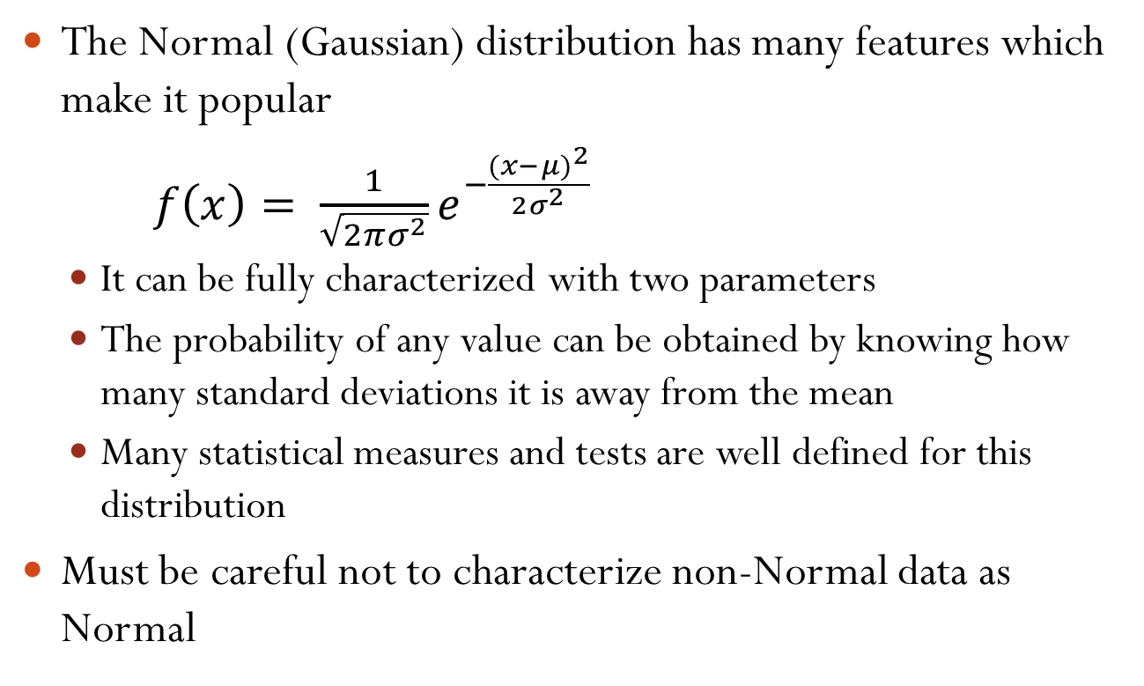
The Normal Distribution
The Normal (Gaussian) distribution has many features which make it popular
$f\left(x\right)= \frac{1}{\sqrt{2πσ^{2}}}e^{−\frac{(x−μ)^{2}}{2σ^{2}}}$
It can be fully characterized with two parameters
The probability of any value can be obtained by knowing how many standard deviations it is away from the mean
Many statistical measures and tests are well defined for this distribution
Must be careful not to characterize non-Normal data as Normal

Slide 30

Mean and Standard Deviation
For a sample population X = {x₁, … , x_{N}} the mean is defined as: $μ= \frac{1}{N}\sum_{i=0}^{N}{x_{i}}$
The standard deviation is defined as: $σ=\sqrt{\frac{1}{N}\sum_{i=0}^{N}{(x_{i}−μ)^{2}}}$

Slide 31
Skewness
Measure of the asymmetry of the probability distribution
Can be positive, negative or undefined
Negative skew indicates that the tail on the left side is longer than on the right
Positive skew indicates that the tail on the right side is longer than on the left
A zero value indicates the tails are relatively evenly distributed on both sides of the mean, but does not necessarily imply symmetry

Slide 32
The Power Transformation
We can transform data to a normal approximation by a power transformation¹
Such transformations reduce the effects of:
Skewness (transformations changes the range of data values and helps fit data onto the display)
Random noise (transformations can help show global trends)
Monotone spread
1 – J. W. Tukey. On the comparative anatomy of transformations. Annals of Mathematical Statistics, 28: 602-632, 1955.
Notes:
Show examples of skewness and random noise power transforms

Slide 33
Non-Data Components of Graphs
Axes and legends can often be as important as the data themselves
Poor axis choices and label choices can lead to confusing visualizations
Axis tick labels provide cognitive context for most basic plot types
They support estimation and contribute to the overall appearance of the graphic
Cleveland suggests choosing the scales so that the data rectangle fills up as much of the scale-line rectangle as possible
W. S. Cleveland. The Elements of Graphing Data. Wadsworth Publ. Co., Belmont, CA, USA, 1985.

Slide 34
Graph Aspect Ratios
Our ability to perceive trends and patterns in a given display is heavily influenced by the aspect ratio
Aspect ratio affects densities, relative distances and orientations
Several methods have been proposed for automatically selecting the aspect ratio
Aspect ratio: a = width/height

Slide 35
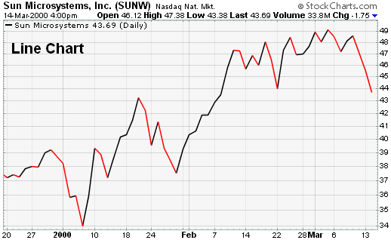
Univariate Case
In univariate representations, we think of data case as being shown along one dimension and value in another
4
3
Frequency count of batting average
2
1
.287
.292
.297
.302
.307
.312
.316
.321
.326
.331
.336
Batting average

Slide 36
Bivariate Case – Stacked Bar Graph
4
A. Ethier
A. Gonzalez
3
M. Byrd
J. Werth
R. Braun
A. Pujols
2
S. Castro
P. Polanco
M. Prado
R. Zimmerman
M. Holiday
J. Votto
1
O. Infante
J. Keppinger
A. Pagan
H. Ramirez
A. Huff
T. Tulowitzki
D. Uggla
C. Gonzalez
0
40
50
60
70
80
90
100
110
120
Runs Batted In
T. N. Dang, L. Wilkinson and A. Anand, “Stacking Graphic Elements to Avoid Over-Plotting," IEEE Transactions on Visualization and Computer Graphics, vol. 14, no. 6, pp. 1044-1052, 2010.

Slide 37
Bivariate Case - Scatterplot
Visualizes discrete data values along two axes
Used as a means of analyzing bivariate relationships
Quick means of assessing outliers, clusters and distributions
Putting a line through the data can help assess trends, but can also mislead viewer
Batting Average
Number of Runs

Slide 38
Multivariate Case - Mosaic Plot
Graphical display that allows you to examine the relationship among two or more categorical variables
Start as a square with length one
Divide first into horizontal bars whose widths are proportional to the probabilities associated with the first categorical variable
Next each bar is split vertically by the conditional probability of the second categorical variable

Slide 39
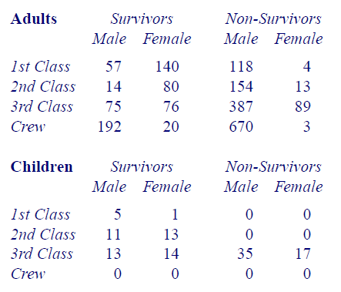
The Titanic Example

Slide 40
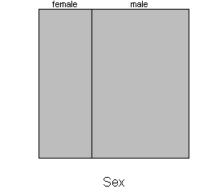
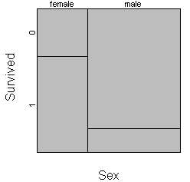
The Titanic Example
Mortality rates between men and women on the Titanic
http://www.childrensmercy.org/stats/definitions/mosaic.htm.

Slide 41
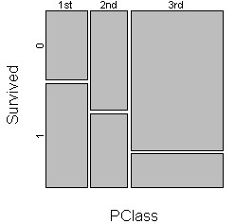
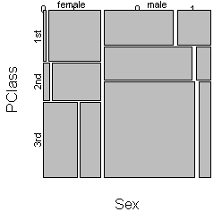
The Titanic Example

Slide 42
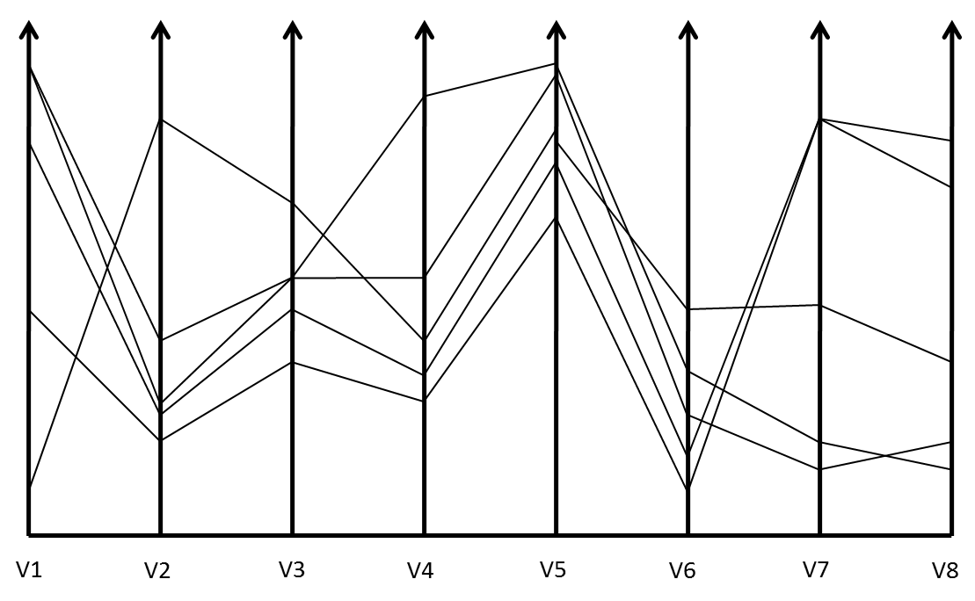
Parallel Coordinate Plots
1 - Inselberg A (1985) The Plane with Parallel Coordinates. The Visual Computer1(4):69-91
2 - Ankerst M, Berchtold B, Keim DA (1998) Similarity clustering of dimensions for an enhanced visualization of multidimensional data. IEEE Symposium on Information Visualization pp 52-62

Slide 43
Issues With Parallel Coordinate Plots
Different variables can take different values with very different ranges
Need to normalize data ranges (maybe do a power transformation and then a normalization?)
Order of the parallel coordinate plots has a major impact on the resultant visualization
The more variables we plot, the more lines we get and the more clutter that we get
1 -Yang, J., Peng, W., Ward, M.O., Rundensteiner, E.A., Interactive hierarchical dimension ordering, spacing and filtering for exploration of high dimensional datasets. In Proc. of IEEE Symposium on Information Visualization (2003), pp. 105–112.
2 – Zhou, H., Yuan, X., Qu, Huamin, Cui, W., Chen, B., “Visual Clustering in Parallel Coordinates,” Computer Graphics Forum 27(3) 1047-1054, 2008.

Slide 44
Star Plot
Lay out axes in a radial layout, length of a ray emanates from a central point
Rays are then joined together by a polyline drawn around the outside
At Bats
Runs
Batting Average
Infante
RBI
Gonzalez
Votto
S. E. Fienberg,”Graphical Methods in Statistics," The American Statistician, vol. 33 pp. 156-178, 1979.

Slide 45
K-Means
Given K, the K-means algorithm is implemented in four steps:
1. Choose K points at random as cluster centres (centroids)
2. Assign each instance to its closest cluster centre using certain distance measure (usually Euclidean or Manhattan)
3. Calculate the centroid of each cluster, use it as the new cluster centre (one measure of centroid is mean)
4. Go back to Step 2, stop when cluster centres do not change any more

Slide 46
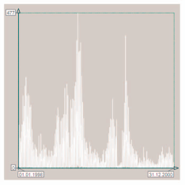
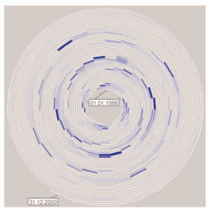
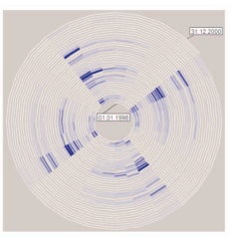
Linear vs. Cyclical Time
Linear time assumes a starting point and defines the time domain with data elements from the past and future
Natural processes may be cyclic (e.g., seasons)
The ordering of points in a cyclic time domain would be meaningless
Winter comes before summer, but also after summer
W. Aigner, S. Miksch, W. Muller, H. Schumann, C. Tominski, "Visual Methods for Analyzing Time-Oriented Data", IEEE Trans. On Visualization and Computer Graphics, Vol. 14, No. 1, Jan.-Feb. 2008, pp. 47-60.

Slide 47
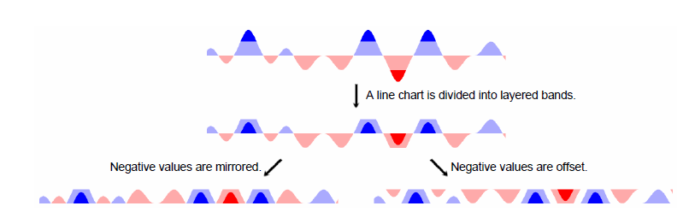
Sizing the Horizon
Jeffrey Heer, Nicholas Kong, and Maneesh Agrawala. 2009. Sizing the horizon: the effects of chart size and layering on the graphical perception of time series visualizations. In Proceedings of the 27th international conference on Human factors in computing systems (CHI '09). ACM, New York, NY, USA, 1303-1312.

Slide 48
Moving Average
A simple moving average is formed by computing the average price of a measure over a specific number of periods.
In this example we’ll look at stock market closing prices
A 5-day simple moving average is the five day sum of closing prices divided by five.
As its name implies, a moving average is an average that moves. Old data is dropped as new data comes available.
This causes the average to move along the time scale. Below is an example of a 5-day moving average evolving over three days.
Daily Closing Prices: 11,12,13,14,15,16,17
First day of 5-day SMA: (11 + 12 + 13 + 14 + 15) / 5 = 13 Second day of 5-day SMA: (12 + 13 + 14 + 15 + 16) / 5 = 14 Third day of 5-day SMA: (13 + 14 + 15 + 16 + 17) / 5 = 15

Slide 49
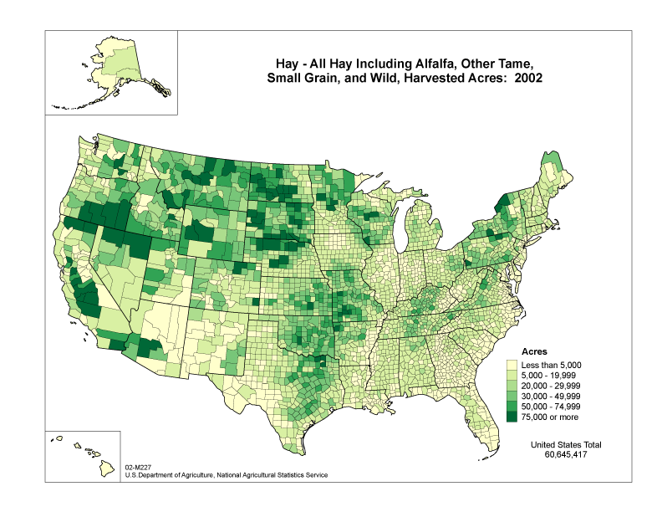
Choropleth Maps¹
Areas of the map are shaded in proportion to a measured variable
Coloring is based on a classification (histogram binning) of the distribution of the measured variable
http://www.nass.usda.gov
1 – J. K. Wright. Problems in Population Mapping. Notes on Statistical Mapping, with Reference to the Mapping of Population Phenomena. AGS and Population Association of America, p. 1-18, 1938.

Slide 50
Coloring Choropleth Maps¹
The number of colors depends on the number of classes (bins)
Too many classes can overwhelm the user and distract them from seeing trends
Too many classes can compromise legibility as colors become difficult to distinguish
Typical cartographic rule of thumb is 5-7 classes
Typical coloring schemes⁸ include sequential, divergent and qualitative
For more details on mapping as a visual representation, see ²
1 – C. A. Brewer. http://colorbrewer.org
2 – A. MacEachren. How Maps Work. Guilford Press, 1995.

Slide 51


Color Schemes¹
11 – C. A. Brewer. http://colorbrewer.org
Sequential Color Schemes
Suited for ordered data
Lightness steps dominate the look of the scheme
Light values are low data values, dark are high
Good for Ordinal, interval and ratio data types
Diverging Color Schemes
Puts an emphasis on critical midrange values
Color change represents deviation from a meaningful midrange critical value
Good for ratio data types where looking at data above and below a ‘zero’ point
Qualitative Color Schemes
Does not imply magnitude difference
Used to show differences between classes
Good for Nominal data types
1 – C. A. Brewer. http://colorbrewer.org

Slide 52
Class Interval Selection
The visual representation of the choropleth map is highly influenced by the class interval selection
This is similar to the concept of histogram binning
Popular choices for class interval selection include
Equal interval selection
Jenks’ Natural Breaks¹
Minimum boundary error²
Again, these choices for optimizing the class interval selection are highly dependent on the underlying data distribution
1– G. F. Jenks. The data model concept in statistical mapping. International Yearbook of Cartography, 26:186-190, 1967.
2 – E. K. Cromley and R. G. Cromley. An analysis of alternative classifications schemes for medical atlas mapping. European Journal of Cancer. Series B (Methodological), 26(2):211-252, 1964.

Slide 53
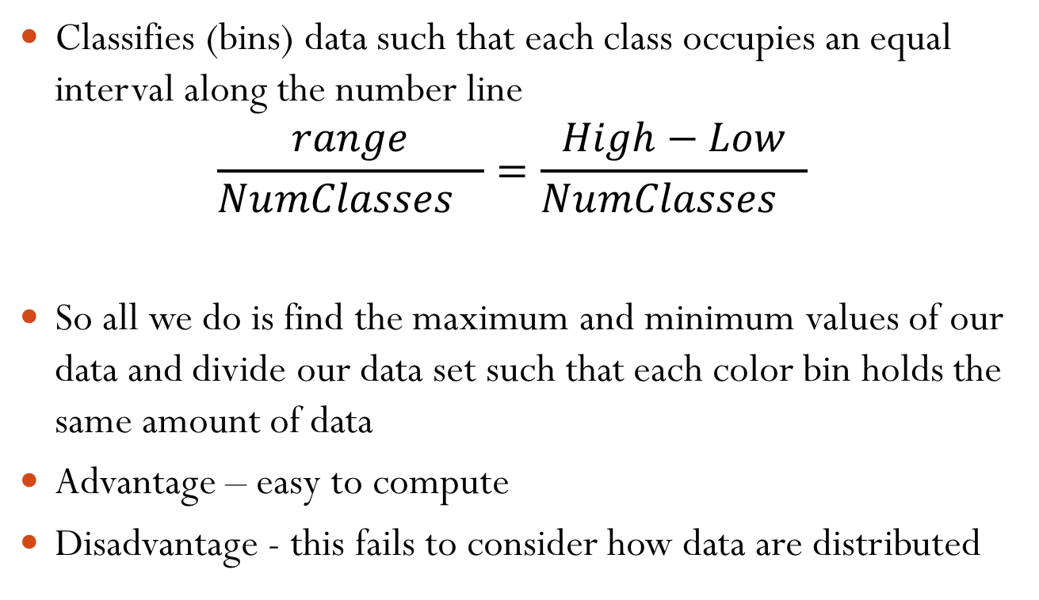
Equal Interval
Classifies (bins) data such that each class occupies an equal interval along the number line
$$\frac{range}{Nu{mClasses}_{}}=\frac{High−Low}{Nu{mClasses}_{}}$$
So all we do is find the maximum and minimum values of our data and divide our data set such that each color bin holds the same amount of data
Advantage – easy to compute
Disadvantage - this fails to consider how data are distributed
TA Slocum, RB McMaster, FC Kessler and HH Howard, “Thematic Cartography and Geovisualization,” Prentice Hall Series, 2009.

Slide 54
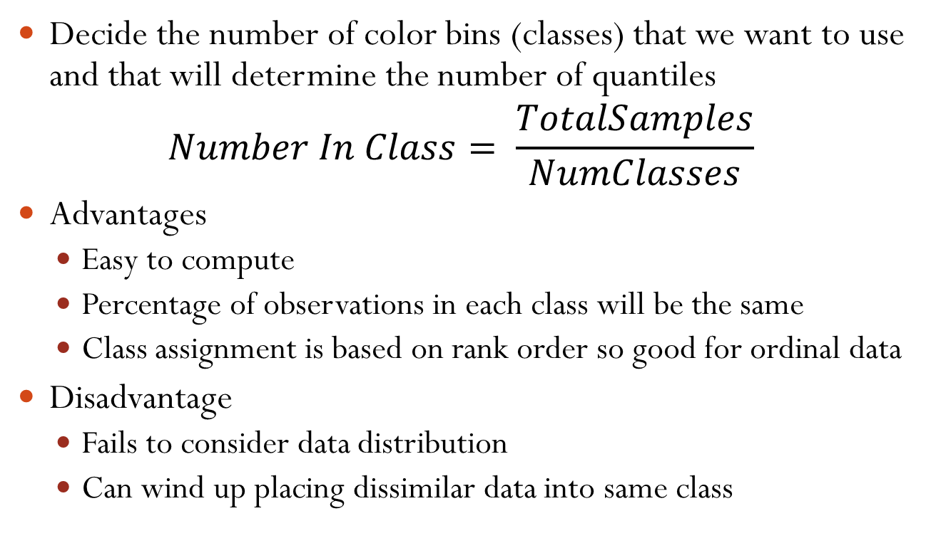
Quantiles
Decide the number of color bins (classes) that we want to use and that will determine the number of quantiles
$$Number In Class= \frac{TotalSamples}{NumClasses}$$
Advantages
Easy to compute
Percentage of observations in each class will be the same
Class assignment is based on rank order so good for ordinal data
Disadvantage
Fails to consider data distribution
Can wind up placing dissimilar data into same class
TA Slocum, RB McMaster, FC Kessler and HH Howard, “Thematic Cartography and Geovisualization,” Prentice Hall Series, 2009.

Slide 55
Quantiles
Decide the number of color bins (classes) that we want to use and that will determine the number of quantiles
$$Number In Class= \frac{TotalSamples}{NumClasses}$$
Advantages
Easy to compute
Percentage of observations in each class will be the same
Class assignment is based on rank order so good for ordinal data
Disadvantage
Fails to consider data distribution
Can wind up placing dissimilar data into same class
TA Slocum, RB McMaster, FC Kessler and HH Howard, “Thematic Cartography and Geovisualization,” Prentice Hall Series, 2009.

Slide 56
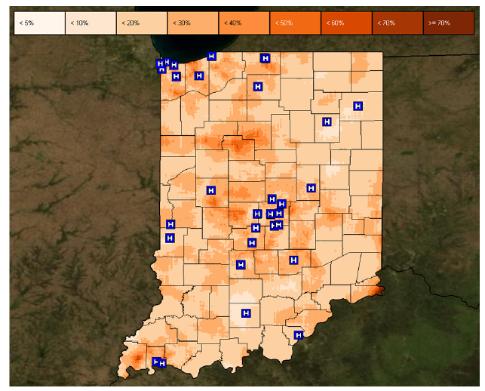
Isopleth Map
Isarithmic map or contour map is created by interpolating a set of isolines between sample points of known values
Created from collection of point data and then interpolating unknown values between them
Interpolation methods:
Kernel density estimation (see earlier lectures)
Inverse distance
Kriging
TA Slocum, RB McMaster, FC Kessler and HH Howard, “Thematic Cartography and Geovisualization,” Prentice Hall Series, 2009.

Slide 57
Proportional Symbol Mapping
Represent numerical data associated with point locations
Utilizes a symbol and scales the size to show data
Proportional symbols can be used for two forms of point data
True point data – actual measurements at point locations (number of calls made from a phone booth)
Conceptual point data – data collected over an area, but data is conceived as being located at points (for example the centroid)
TA Slocum, RB McMaster, FC Kessler and HH Howard, “Thematic Cartography and Geovisualization,” Prentice Hall Series, 2009.

Slide 58
Adjacency Matrix
y
 | 1 | 2 | 3 | 4 | 5 | 6 | 7 | 8 | 9 | 10
1 | 0 | 1 | 0 | 1 | 0 | 0 | 0 | 0 | 0 | 0
2 | 1 | 0 | 0 | 0 | 1 | 0 | 0 | 0 | 0 | 0
3 | 0 | 0 | 0 | 1 | 0 | 1 | 0 | 0 | 0 | 0
4 | 1 | 0 | 1 | 0 | 1 | 0 | 1 | 0 | 0 | 0
5 | 0 | 1 | 0 | 1 | 0 | 0 | 0 | 1 | 0 | 0
6 | 0 | 0 | 1 | 0 | 0 | 0 | 1 | 0 | 0 | 0
7 | 0 | 0 | 0 | 1 | 0 | 1 | 0 | 1 | 1 | 0
8 | 0 | 0 | 0 | 0 | 1 | 0 | 1 | 0 | 0 | 1
9 | 0 | 0 | 0 | 0 | 0 | 0 | 1 | 0 | 0 | 1
10 | 0 | 0 | 0 | 0 | 0 | 0 | 0 | 1 | 1 | 0
1
4.55
2
5.54
x
3
2.24
4
-5.15
5
9.02
6
3.1
7
-4.39
8
-2.09
9
.46
10
-3.06
MJ de Smith, MF Goodchild and PA Longley. Geospatial Analysis: A Comprehensive Guide to Principles, Techniques and Software Tools, 2007

Slide 59
Interaction Types
Highlighting and focus
Drill-down and hyperlinks
Overview and context
Changing parameters
Changing representations
Temporal fusion
A. Dix and G. Ellis. Starting Simple - adding value to static visualisation through simple interaction. Proceedings of Advanced Visual Interfaces , 1998

Slide 60
Interaction Types
Operator
Navigation, selection, manipulation, distortion, filtering
Space of Interaction
Screen, data value, data structure, attribute object, visualization structure
Parameters of the interaction operator
Focus, extents, transformation, blender
MO Ward, G Grinstein and D Keim. Interactive Data Visualization: Foundations, Techniques and Applications. A K Peters Ltd, 2010.

Slide 61
Interaction in Visualization
Broken down into 7 categories
Select
Explore
Reconfigure
Encode
Abstract/Elaborate
Filter
Connect
Ji Soo Yi; Youn ah Kang; Stasko, J.T.; Jacko, J.A.; , "Toward a Deeper Understanding of the Role of Interaction in Information Visualization," IEEE Transactions on Visualization and Computer Graphics, vol.13, no.6, pp.1224-1231, Nov.-Dec. 2007

Slide 62
Transitioning Between Data Views
Many interfaces schemes exist that allow users to move between focused and contextual views of a data set
Can categorize these schemes into four sorts of approaches
Overview+detail
Uses a spatial separation between focused and contextual views
Zooming
Uses a temporal separation
Focus+Context
Displays focus within the context
Cue-Based
Selectively highlight/supress
A. Cockburn, A. Karlson, and B. Bederson, "A Review of Overview+Detail, Zooming, and Focus+Context Interfaces", ACM Computing Surveys, Vol. 41, No. 1, Dec. 2008, pp. 2:1-2:31.

Slide 63
What is a Graph?
Vertices (nodes) connected by Edges (links)
We have several ways to represent a graph
Adjacency list
Adjacency matrix (this is analogous to the weights matrix in last lecture)
Adjacency List
1:3
2:3
3:1,2
2
1
3
 | 1 | 2 | 3
1 | 0 | 0 | 1
2 | 0 | 0 | 1
3 | 1 | 1 | 0

Slide 64
Graph Visualization Task Taxonomy
Topology-based tasks
Adjacency
Find the set of nodes adjacent to a node
Accessibility
Find the set of nodes accessible to a node
Common connection
Given nodes, find the set of nodes connected to all
Connectivity
Find shortest path
Identify clusters
Identify connected components
B. Lee, C. Plaisant, C. Sims Parr, J.-D. Fekete, N. Henry, "Task Taxonomy for Graph Visualization", Proc. of BELIV '06, April '06, pp. 1-5.
Some details from this slide borrowed from John Stasko’s Graph lecture: http://www.cc.gatech.edu/~stasko/7450/Notes/graph1.pdf

Slide 65
Graph Visualization Task Taxonomy
Attribute-based tasks
On the nodes
Find the nodes having a specific attribute value
On the edges
Given a node, find the nodes connected only by certain kinds of edges
Browsing tasks
Follow path
Revisit
Overview task
Compound exploratory task
Estimate size of a network
Find patterns
B. Lee, C. Plaisant, C. Sims Parr, J.-D. Fekete, N. Henry, "Task Taxonomy for Graph Visualization", Proc. of BELIV '06, April '06, pp. 1-5.
Some details from this slide borrowed from John Stasko’s Graph lecture: http://www.cc.gatech.edu/~stasko/7450/Notes/graph1.pdf

Slide 66
Clustering Coefficient
Measure of degree to which nodes in a graph tend to cluster together
Evidence suggests that in most real-world networks (particularly social networks), nodes tend to create tightly knit groups characterized by a high density of ties
This likelihood tends to be greater than the average probability of a tie randomly established between two nodes
There are two types of clustering coefficients
Global clustering coefficient
Local clustering coefficient

Slide 67
Global Clustering Coefficient
Based on triplets of nodes
Triplet – three nodes that are connected by either two or three undirected ties
Open triplet – two undirected ties
Closed triplet – three undirected ties
Clustering coefficient is the number of closed triplets over the total number of triplets
R. D. Luce and A. D. Perry (1949). "A method of matrix analysis of group structure". Psychometrika 14 (1): 95–116.

Slide 68
Local Clustering Coefficient
This is measured at the vertex level of a graph
Quantifies how close a vertex’s neighbors are to being a clique (a complete graph)
The neighborhood N_{i} for a vertex v_{i} is defined as its immediately connected neighbors
Let k_{i} be the number of vertices in the neighborhood
The local clustering coefficient for a vertex then is the proportion of links between the vertices within its neighborhood divided by the number of links that could possible exist between them
D. J. Watts and S. H. Strogatz, “Collective dynamics of `small-world' networks,” Nature, Vol. 393, No. 6684. (4 June 1998), pp. 440-442

Slide 69
Local Clustering Coefficient
For a directed graph, edge e_{ij} is distinct from edge e_{ji}
Thus, in a directed graph each neighborhood N_{i} has k_{i}(k_{i}-1) links that could exist among the vertices in the neighborhood
For a directed graph: $C_{i}=\frac{\left|\left\{e_{jk}\right\}\right|}{k_{i}(k_{i}−1)}$
For an undirected graph, e_{ij} and e_{ji} are identical, thus each neighborhood has k_{i}(k_{i}-1)/2 links that could exist
For an undirected graph: $C_{i}=\frac{2\left|\left\{e_{jk}\right\}\right|}{k_{i}(k_{i}−1)}$
Average clustering coefficient: $\overline{C}=\frac{1}{N}\sum_{i=1}^{N}{C_{i}}$

Slide 70
Graph Centrality
Another means of characterizing nodes is based on their relative importance in the graph
To do this, we utilize measures of centrality that were first developed in social network analysis
There are four measures of centrality that are widely used:
Degree centrality
Closeness
Betweenness
Eigenvector Centrality

Slide 71
Degree Centrality
Conceptually simplest, this is the number of links incident upon a node
The degree can be interpreted in terms of the immediate risk of a node for catching whatever is flowing through a network
Typically define both indegree and outdegree centality
May also want to find the centrality of a graph within a graph
Let v* be the node with the highest degree centrality in G
Let $X≡\left(Y,X\right)$be the Y node connected graph that maximizes H where y* is the node with the highest degree centrality in X
$H=\sum_{i=1}^{|Y|}{C_{D}(y^{∗})−C_{D}(y_{j})}$
Degree of centrality of the graph is:
$C_{D}\left(G\right)=\sum_{i=1}^{|V|}{\frac{C_{D}(V^{∗})−C_{D}\left(v_{i}\right)}{H}}$

Slide 72
Closeness Centrality
In graphs, there is a natural distance metric between nodes
This is the length of their shortest paths
Farness: Sum of the distances to all other nodes
Closeness: The inverse of farness
Can be regarded as a measure of how long it will take to spread information from a starting node to all other nodes
The more central a node is, the lower its total distance to all other nodes

Slide 73
Betweenness Centrality
Measure of a vertex within a graph
Introduced as a measure for quantifying the control of a human on the communication between other humans in a social network
Betweenness of a vertex in a graph is computed as follows:
For each pair of vertices (s,t) compute the shortest paths between them
For each pair of vertices (s,t) determine the fraction of shortest paths that pass through the vertex in question
Sum this fraction over all pairs of vertices
$C_{B}\left(v\right)= \sum{\frac{σ_{st}(v)}{σ_{st}}}$, where $σ_{st}$is the total number of shortest paths from node s to node t and $σ_{st}($v) is the number of those paths that pass through v

Slide 74
Treemap
Space filling representation developed by Johnson and Shneiderman
Children are drawn inside their parent
Alternate horizontal and vertical slicing at each successive level
Use area to encode other variable of data items
Johnson, B. and Shneiderman, B. Treemaps: A Space-Filling Approach to the Visualization of Hierarchical Information Structures. In Proceedings of the IEEE Information Visualization ’91, pages 275–282, IEEE, 1991.

Slide 75
Treemap Algorithm
Draw()
{
1) Change orientation from parent (horiz/vert)
2) Read all files and directories at this level
3) Make rectangles for each, scaled to size
4) Draw rectangles using appropriate size and color
5) For each directory
a) Make recursive call using its rectangle as focus
}
Parts of this slide borrowed from John Stasko’s Information Visualization Course Lecture: Hierarchies and Trees 2(Space Filling): http://www.cc.gatech.edu/~stasko/7450/Notes/tree2.pdf

Slide 76
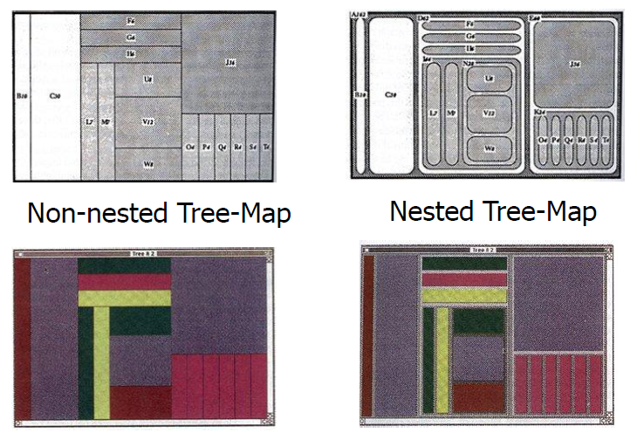
Nested vs. Non-Nested
Parts of this slide borrowed from John Stasko’s Information Visualization Course Lecture: Hierarchies and Trees 2(Space Filling): http://www.cc.gatech.edu/~stasko/7450/Notes/tree2.pdf

Slide 77
Hierarchical Clustering
Two main types of hierarchical clustering
Agglomerative:
Start with the points as individual clusters
At each step, merge the closest pair of clusters until only one cluster (or k clusters) left
Divisive:
Start with one, all-inclusive cluster
At each step, split a cluster until each cluster contains a point (or there are k clusters)
Traditional hierarchical algorithms use a similarity or distance matrix
Merge or split one cluster at a time

Slide 78
Agglomerative clustering algorithm
Most popular hierarchical clustering technique
Basic algorithm
Compute the distance matrix between the input data points
Let each data point be a cluster
Repeat
Merge the two closest clusters
Update the distance matrix
Until only a single cluster remains
Key operation is the computation of the distance between two clusters
Different definitions of the distance between clusters lead to different algorithms

Slide 79
Definition
Animation
Rapid successive display of many display frames where objects change position/appearance gradually so as to create the illusion of continuous movement
Where in InfoVis might animation be useful?
* - Material borrowed from John Stasko’s lecture on Animation: http://www.cc.gatech.edu/~stasko/7450/Notes/animation.pdf

Slide 80
Dynamic Information
Monitoring dynamic information can be cognitively strenuous
User must examine display and decided whether it has change
Often is preferable to explicitly alert user to a change by some sort of signal
Change empty mailbox icon to full
Adding motion to an icon

Slide 81
Perception
Animation is a very strong visual attention mechanism
It is difficult to focus on other items when animation is nearby
There have been a variety of user studies on perception
Some studies indicate that motion triggers a kind of orienting response attracting a user’s attention¹
Motion compares favorably to color and shape in terms of attracting attention
Research also found that motion cues seem independent of color and shape cues² (motion may provide an extra dimensionality to the display)
- Material borrowed from John Stasko’s lecture on Animation: http://www.cc.gatech.edu/~stasko/7450/Notes/animation.pdf
1 - Faraday, P., Sutcliffe, A., 1997. Designing effective multimedia presentations. In:Proceedin gs of ACM CHI ’97. ACM, New York, pp. 272–279.
2 - Bartram, L., Ware, C., 2002. Filtering and brushing with motion. Journal of Information Visualization 1, 66–79.

Slide 82
Storytelling with Data
Recently, news organizations have begun regularly incorporating dynamic graphics into their journalism
Visualization designers are “melding the skills of computer science, statistics, artistic design and storytelling”¹
Effective story-telling “requires skills like those familiar to movie directors, beyond a technical expert’s knowledge of computer engineering and science.”²
How can we design tools to support richer forms of storytelling?³
1 - K. Cukier. Show Me: New ways of visualising data. http://www..economist.com/node/15557455, 2010.
2 - K. Cukier. Show Me: New ways of visualising data. http://www..economist.com/node/15557455, 2010.
3 - E. Segel and J. Heer, "Narrative Visualization: Telling Stories with Data", IEEE Trans. on Visualization and Computer Graphics, Vol. 16, No. 6, Nov.-Dec. 2010, pp. 1139-1148.

Slide 83
Narrative Structure
We have a notion of a chain of causally related events
Stories often have a beginning middle and end
Much work has been done on developing typologies of narratives
Visualization brings with it text, images, video and interactivity, so what kind of typology can be developed in this setting?
E. Segel and J. Heer, "Narrative Visualization: Telling Stories with Data", IEEE Trans. on Visualization and Computer Graphics, Vol. 16, No. 6, Nov.-Dec. 2010, pp. 1139-1148.

Slide 84
Visual Narratives
Overview – utilize an establishing shot or overview to introduce the scene
Not all elements in a scene are of equal importance, so we can manipulate a scene to direct attention
Cultural bias in reading order bias where people look first
Where else in class have we talked about using such bias to direct attention?
Scene changes – try to establish some connection between scenes in order to maintain coherence
McCloud’s Understanding Comics presents a taxonomy of different transitions
E. Segel and J. Heer, "Narrative Visualization: Telling Stories with Data", IEEE Trans. on Visualization and Computer Graphics, Vol. 16, No. 6, Nov.-Dec. 2010, pp. 1139-1148.
S. McCloud. Understanding Comics. Kitchen Sink Press, 1993.

Slide 85
Design Space
Genre
Visual Narrative
Visual structuring
Highlight
Transition Guidance
Narrative Structure
Ordering
Interactivity
Messaging
E. Segel and J. Heer, "Narrative Visualization: Telling Stories with Data", IEEE Trans. on Visualization and Computer Graphics, Vol. 16, No. 6, Nov.-Dec. 2010, pp. 1139-1148.

Slide 86
Tag/Word Clouds
Currently very popular in the research community.
Have proven to be popular on the web.
Idea is to show word/concept importance visually.
Tags: User-specified metadata (descriptors) about other objects.
Sometimes generalized to just reflect word frequencies.

Slide 87
Word Tree
Shows context of a word or words
Follow word with all the phrases that follow it
Font size shows frequency of appearance
Continue branch until hitting unique phrase
Clicking on phrase makes it the focus
Ordered alphabetically, by frequency, or by first appearance
Wattenberg and Viégas, TVCG (InfoVis), 2008

Slide 88
Interaction

Slide 89
Vector Space Analysis
How does one compare the similarity of two documents
One model
Make a list of each unique word in a document
Throw out common words (a, an, the, etc.)
Make different forms the same (bake, bakes, baked)
Store count of how many times each word appeared
Alphabetize, make into a vector

Slide 90
Vector Space Analysis Cont.
Model
Want to see how closely two vectors go in same direction, inner product
Can get similarity of each document to every other one
Use a mass-spring layout algorithm to position representations of each document
Some similarities to how search engines work

Slide 91
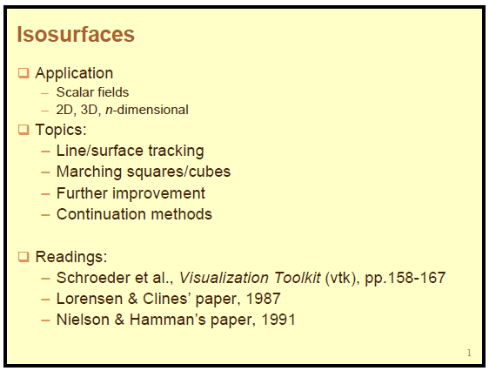

Slide 92
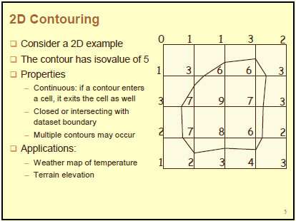

Slide 93
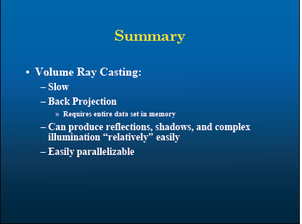

Slide 94
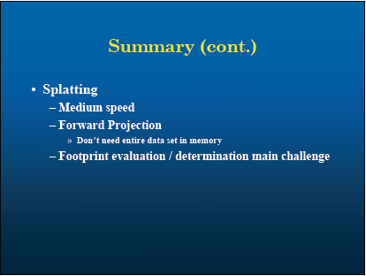

Slide 95
Announcements
Final is worth 20% of your grade
Midterm is 5/2/2017 – 9:50AM to 11:40AM

