Slide 1

CSE 591 Interaction
Ross Maciejewski
rmacieje@asu.edu

Slide 2
Enhancing our Visualizations
Past lectures, we’ve talked about multivariate data
Time series (line plots, cyclical, control chart, prediction)
Geographic (choropleth maps, spatial autocorrelation)
In these data, we’re seeing connections between events, locations and time
Last lecture, we discussed some interactive systems
So, what is interaction?

Slide 3
Interaction
Human Computer Interaction (HCI)
The communication between user and the system¹
Direct manipulation and instantaneous change
HCI research is far from having solid(and falsifiable) theories of interaction²
Interaction
Non-static images
Communication with an application through input
Analytic discourse
* - Material borrowed from John Stasko’s lecture on Interaction: http://www.cc.gatech.edu/~stasko/7450/Notes/interaction.pdf
1 - A. Dix and G. Ellis, "Starting Simple - adding value to static visualisation through simple interaction." Proc. of AVI '98, May 1998, pp. 124-134.
2 - Michel Beaudouin-Lafon: Designing interaction, not interfaces. AVI 2004: 15-22

Slide 4
Interaction
“The effectiveness of information visualization hinges on two things: its ability to clearly and accurately represent information and our ability to interact with it to figure out what the information means.” – Stephen Few, Now You See It
Up until now, we’ve discussed primarily representations for data visualization
Now we want to discuss potential interactions within data visualization
Remember, interaction is what distinguishes visualization from simply graphing data

Slide 5
What Is Interactive?
Computer Graphics considers about 20fps to be real-time rendering (so .05 seconds)
The minimum is about 10fps (.1 sec)
Animation, visual continuity, sliders
So, what happens at 1 second?
System response, conversation break
What about 10 seconds?
Cognitive response
* - Material borrowed from John Stasko’s lecture on Interaction: http://www.cc.gatech.edu/~stasko/7450/Notes/interaction.pdf

Slide 6
Simple Interactions
Earlier, we talked about stacked bar graphs and how they were difficult in seeing trends in certain bands
A stacked histogram allows three judgments
The trends on the total height of the columns
The proportion of each category in each column
The trends in the lowest category
By adding interaction, we can assess different trends
Examples
http://www.meandeviation.com/dancing-histograms/hist.html
http://www.digitalhistory.uh.edu/timeline/timelineN.cfm

Slide 7
Interaction Types
Highlighting and focus
Drill-down and hyperlinks
Overview and context
Changing parameters
Changing representations
Temporal fusion
A. Dix and G. Ellis. Starting Simple - adding value to static visualisation through simple interaction. Proceedings of Advanced Visual Interfaces , 1998

Slide 8
Interaction Types
Operator
Navigation, selection, manipulation, distortion, filtering
Space of Interaction
Screen, data value, data structure, attribute object, visualization structure
Parameters of the interaction operator
Focus, extents, transformation, blender
MO Ward, G Grinstein and D Keim. Interactive Data Visualization: Foundations, Techniques and Applications. A K Peters Ltd, 2010.

Slide 9
Interaction Types
How do we think of interacting with data?
Comparing and sorting
Provide a selection of data graphics to compare values and sort these values based on information
Adding/filtering variables
Highlighting
Aggregating/combining variables
Zoom and Pan
Rescale
Annotate
Bookmark
S. Few. Now You See It.

Slide 10
Interaction
Really, the key is user intent
Focusing on what a user wants to achieve through a specific interaction technique
Interaction is done by a person for a purpose
Seeking more information
Solving a problem
Exploratory analysis
Analytic discourse
* - Material borrowed from John Stasko’s lecture on Interaction: http://www.cc.gatech.edu/~stasko/7450/Notes/interaction.pdf

Slide 11
Interaction in Visualization
Broken down into 7 categories
Select
Explore
Reconfigure
Encode
Abstract/Elaborate
Filter
Connect
Ji Soo Yi; Youn ah Kang; Stasko, J.T.; Jacko, J.A.; , "Toward a Deeper Understanding of the Role of Interaction in Information Visualization," IEEE Transactions on Visualization and Computer Graphics, vol.13, no.6, pp.1224-1231, Nov.-Dec. 2007

Slide 12
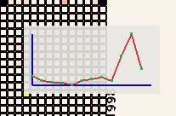
Select
Mark something as interesting
Mark items of interest to keep track of them
Often works as a preceding action to subsequent operation
Examples
Select or label a placemark in a map
Pop-up tooltip
Hovering mouse cursor brings up details
Ji Soo Yi; Youn ah Kang; Stasko, J.T.; Jacko, J.A.; , "Toward a Deeper Understanding of the Role of Interaction in Information Visualization," IEEE Transactions on Visualization and Computer Graphics, vol.13, no.6, pp.1224-1231, Nov.-Dec. 2007

Slide 13
Mouse Selection
Clicking on an item selects it and attributes of the data point are shown
Question is, where should we show the attributes?
Labeling is difficult as the dataset gets larger
We can wind up with a ball of string on the screen
Each label for a data point should
Be readable
Non-ambiguously relate to its graphical object
Not hide other pertinent information
Complete labeling may be desirable, but it is not always possible
* - Material borrowed from John Stasko’s lecture on Interaction: http://www.cc.gatech.edu/~stasko/7450/Notes/interaction.pdf

Slide 14
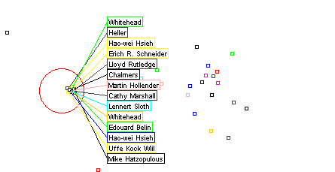
Excentric Labeling
Fekete, J.-D., Plaisant, C. Excentric Labeling: Dynamic Neighborhood Labeling for Data Visualization, Proceedings of the Conference on Human factors
in Computer Systems (CHI'99), ACM , New York, pp. 512-519.

Slide 15
Generalized Selection
When we click on an item in a visualization, what do we want to appear?
Can we generalize this selection criteria
Are we matching some attributes?
Which ones?
How should the program know?
Query Relaxation
As you dwell on your mouse pick, the selection criteria broaden
http://vimeo.com/19278343
Generalized Selection via Interactive Query Relaxation. Jeffrey Heer, Maneesh Agrawala, Wesley Willett. ACM Human Factors in Computing
Systems (CHI), 959–968, 2008

Slide 16
Explore
Show me something different
Enable users to examine a different subset of data
Overcome the limitation of display size
Examples
Panning an interactive map
Direct walk – following hyperlinks on web pages
http://www.visualthesaurus.com/app/view
Ji Soo Yi; Youn ah Kang; Stasko, J.T.; Jacko, J.A.; , "Toward a Deeper Understanding of the Role of Interaction in Information Visualization," IEEE Transactions on Visualization and Computer Graphics, vol.13, no.6, pp.1224-1231, Nov.-Dec. 2007

Slide 17
Reconfigure
Show me a different arrangement
Provide different perspectives by changing the spatial arrangement of representation
Example
Sorting columns in a spread sheet
Changing axes in a scatterplot
Ideally we want to keep the same fundamental representation of the data and what is being shown; however, we want to rearrange the elements
Ji Soo Yi; Youn ah Kang; Stasko, J.T.; Jacko, J.A.; , "Toward a Deeper Understanding of the Role of Interaction in Information Visualization," IEEE Transactions on Visualization and Computer Graphics, vol.13, no.6, pp.1224-1231, Nov.-Dec. 2007

Slide 18
Encode
Show me a different representation
Change the visual appearance
Again, we go back to our visual variables
Color, size, orientation, etc.
This let’s us look for a new perspective
Limited screen space real estate may force such changes
Ji Soo Yi; Youn ah Kang; Stasko, J.T.; Jacko, J.A.; , "Toward a Deeper Understanding of the Role of Interaction in Information Visualization," IEEE Transactions on Visualization and Computer Graphics, vol.13, no.6, pp.1224-1231, Nov.-Dec. 2007

Slide 19
Abstract/Elaborate
Show me more or less detail
Adjust the level of abstraction (overview and details)
Examples
Drill-down into the data
Tooltip of a mouse
Zoom in
Details-on-Demand
We talked about this in the information visualization mantra
We may not be able to show all the data due to the scale
Want to zoom into our data abstractions
Ji Soo Yi; Youn ah Kang; Stasko, J.T.; Jacko, J.A.; , "Toward a Deeper Understanding of the Role of Interaction in Information Visualization," IEEE Transactions on Visualization and Computer Graphics, vol.13, no.6, pp.1224-1231, Nov.-Dec. 2007

Slide 20
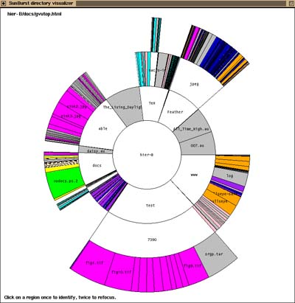
Sunburst Visualization
http://www.cc.gatech.edu/gvu/ii/sunburst/
Stasko, J.; Zhang, E.; , "Focus+context display and navigation techniques for enhancing radial, space-filling hierarchy visualizations,“ IEEE Syposium on Information Visualization, pp.57-65, 2000

Slide 21
Filter
Show me something conditionally
Change the set of data items being presented based on some specific conditions
This is a fundamental interactive operation in visualization
Goal is to focus our search through a narrowing or widening of the data
http://www.babynamewizard.com/voyager#ms=true&sw=m&exact=false
Ji Soo Yi; Youn ah Kang; Stasko, J.T.; Jacko, J.A.; , "Toward a Deeper Understanding of the Role of Interaction in Information Visualization," IEEE Transactions on Visualization and Computer Graphics, vol.13, no.6, pp.1224-1231, Nov.-Dec. 2007

Slide 22
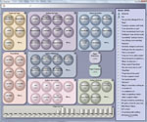
Facet Lens
http://research.microsoft.com/en-us/um/redmond/groups/cue/facetlens/
FacetLens: Exposing Trends and Relationships to Support Sensemaking within Faceted Datasets, Bongshin Lee, Greg Smith, George G Robertson, Mary Czerwinski, Desney S Tan, Proceedings of ACM CHI 2009, pp. 1293-1302

Slide 23
Typical Query Filter
This is what you’re doing in a sql database
SELECT x FROM y WHERE a<b
Benefits
Powerful and flexible
Cons
Must learn language
Only shows exact match
You won’t know the magnitude of the results
No context is shown
Reformulating to a new query can be slow
* - Material borrowed from John Stasko’s lecture on Interaction: http://www.cc.gatech.edu/~stasko/7450/Notes/interaction.pdf

Slide 24
Dynamic Query
Specifying a query brings immediate results
Interactive rates (return in <.1 seconds
Can let us fly through the data
Promotes exploration and gives us a truly interactive experience
We can couple this with visual representations of the world
Want rapid, incremental and reversible actions
Selection through pointing, not typing
However, there is not one perfect response to a query
We are trying to learn about a problem through exploration
www.myrateplan.com/cellphones
* - Material borrowed from John Stasko’s lecture on Interaction: http://www.cc.gatech.edu/~stasko/7450/Notes/interaction.pdf

Slide 25
Brushing
If we have multiple visual representations of the same data, we also want to be able to link these
Here if we select something in one view, we want to also see that selection in the other view
Typically done through highlighting

Slide 26
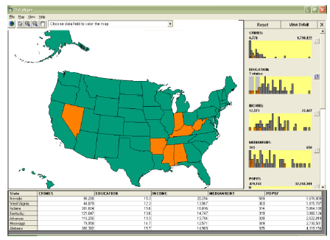
Brushing Histograms
Data values represented in histograms can be clicked on and selected
Items selection gives highlighting in a corresponding window
* - Material borrowed from John Stasko’s lecture on Interaction: http://www.cc.gatech.edu/~stasko/7450/Notes/interaction.pdf

Slide 27
Brushing Histograms vs. Dynamic Query
Brushing histograms were more highly rated by users
Allowed for more complex discovery tasks
Allowed for attribute correlation, comparison and trend evaluation
Dynamic queries were better for simple range specification
Select a single range
Multiple range
Functions more as an auxiliary control
Qing Li; North, C.; , "Empirical comparison of dynamic query sliders and brushing histograms," Information Visualization, 2003. IEEE Symposium on INFOVIS,
pp.147-153, 21-21 Oct. 2003

Slide 28
Connect
Show me related items
Highlight associations and relationship
Show hidden data items that are relevant to a specified item
View may wish to examine different attributes of a data case simultaneously
Alternatively, a user may wish to view data cases under different perspectives or representations
http://www.youtube.com/watch?v=q1xU_0vBJS0
Ji Soo Yi; Youn ah Kang; Stasko, J.T.; Jacko, J.A.; , "Toward a Deeper Understanding of the Role of Interaction in Information Visualization," IEEE Transactions on Visualization and Computer Graphics, vol.13, no.6, pp.1224-1231, Nov.-Dec. 2007

Slide 29
Readings and Homework
Required Reading:
Ji Soo Yi; Youn ah Kang; Stasko, J.T.; Jacko, J.A.; , "Toward a Deeper Understanding of the Role of Interaction in Information Visualization," IEEE Transactions on Visualization and Computer Graphics, vol.13, no.6, pp.1224-1231, Nov.-Dec. 2007
Chris Weaver: Conjunctive Visual Forms. IEEE Trans. Vis. Comput. Graph. 15(6): 929-936 (2009)
Homework
Homework #4 is in 1 week!
Milestone #2 is due in 1 week!
Midterm is in 2 weeks!

