Slide 2
A Statistical Analysis of Cricket-One Day Internationals
Aishwarya Pratap Singh
Ayushi Jain
Nikhil Lohia
Rahul Aakunuru

Slide 3
CRICKET
What is Cricket?
Countries where cricket is a popular sport
Aspects of the game
Who would be interested in the insights of the game?
A fan would like to see the trends of her favorite team.
A sports journalist would like to see a team’s performance over the years.
India | Australia | Pakistan | England
South Africa | Sri Lanka | New Zealand | West Indies
Batting | Bowling | Fielding
Notes:
Aishwarya Pratap Singh

Slide 4
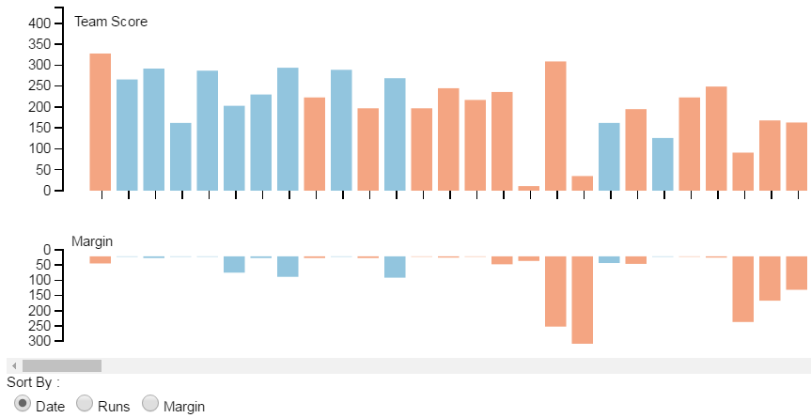
STRIKE
RATE
Runs scored Balls faced
Notes:
Rahul Aakunuru

Slide 5
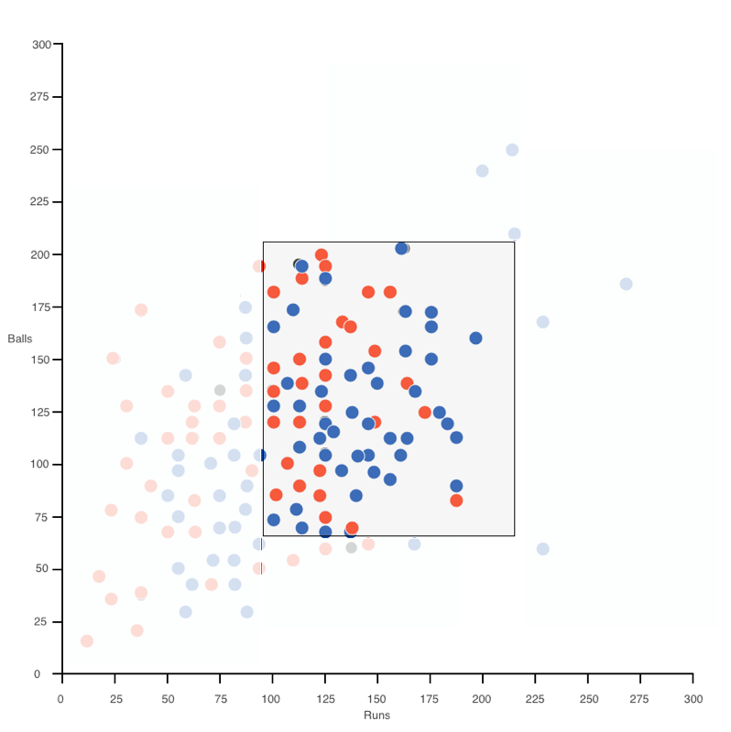
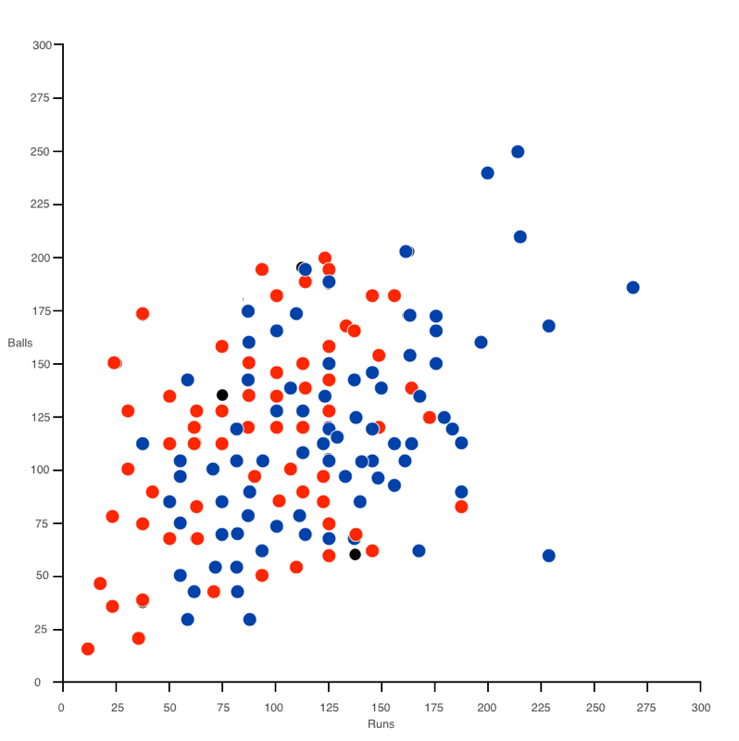
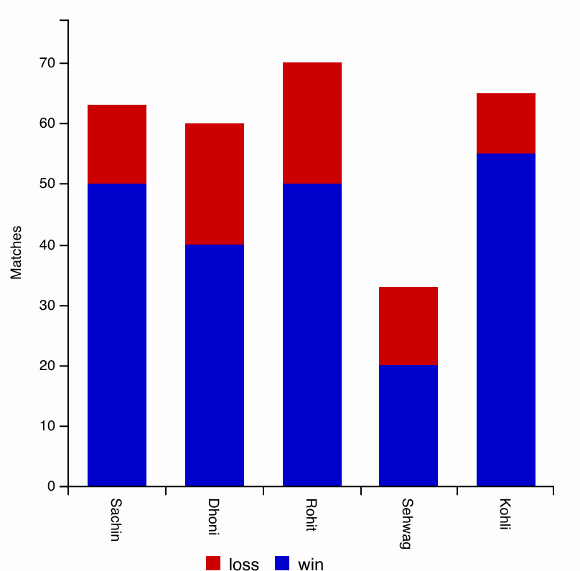
Runs Scored VS Balls Faced
Low
strike rate
???
Poor batsmen
High strike
rate
Notes:
Ayushi Jain
Performance of a team individually

Slide 6
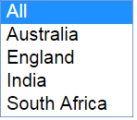
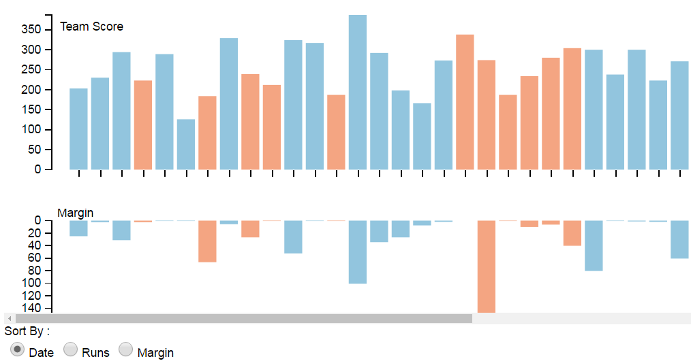
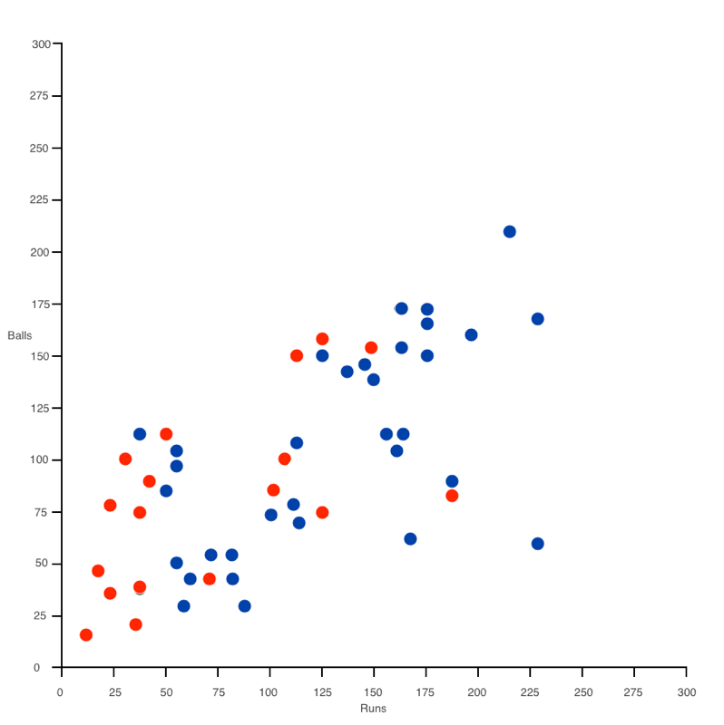
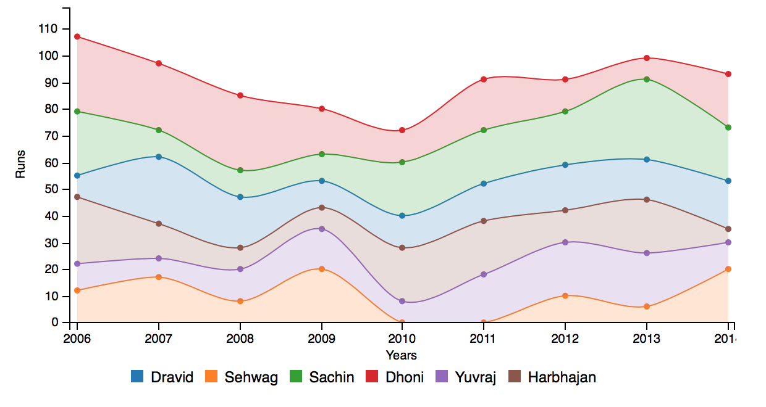
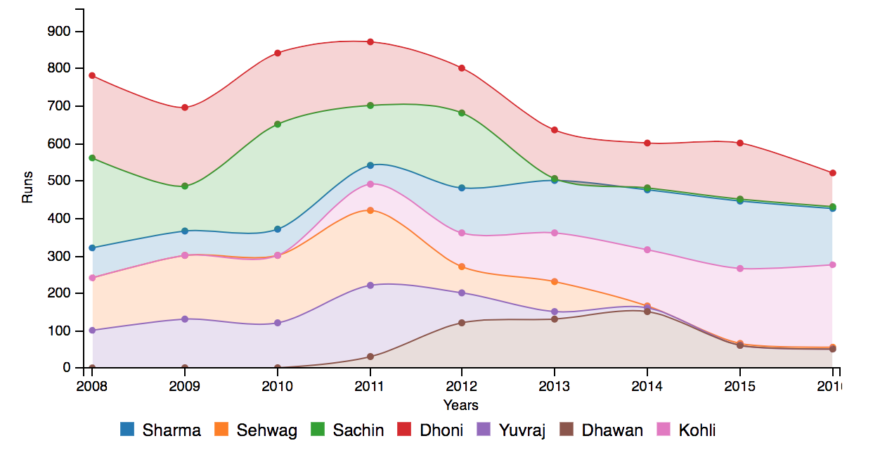
PERFORMANCE AGAINST TEAM
Notes:
Nikhil Lohia
Performance of a team against some other team

Slide 7
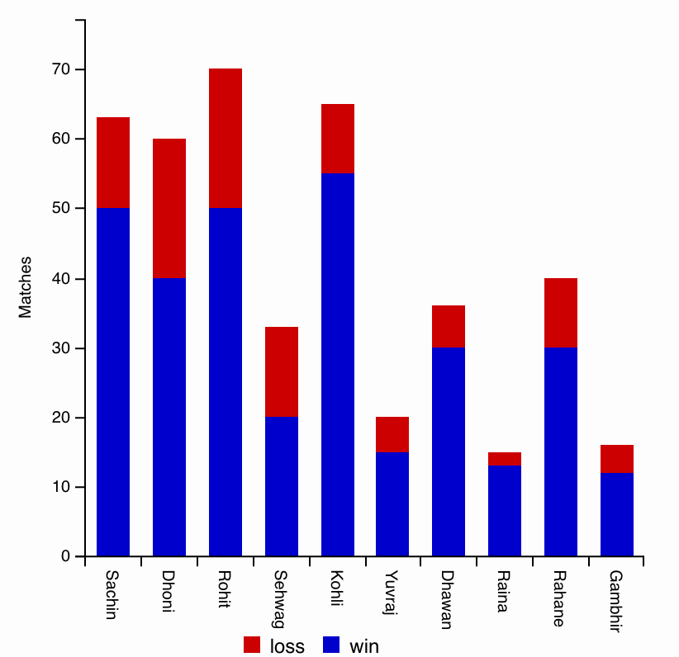
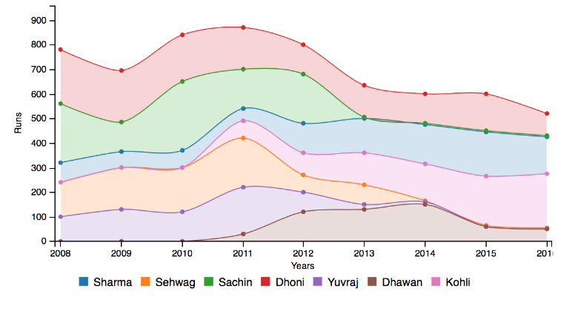
Notes:
Rahul Aakunuru

Slide 8
Relevant Insights
Analyze a player’s contribution to the team’s success.
Identify players in a certain bracket.
Team vs Team metrics
Compare the performance of players against different oppositions.
Notes:
Aishwarya Pratap Singh

Slide 9
நன்றி
ధన్యవాదాలు
धन्यवाद
Je vous remercie
THANK YOU
ಧನ್ಯವಾದ
谢谢
Hasta la vista
Dziękuję Ci
Gracias

