Slide 1
A Statistical Analysis of Cricket ODIs
Team Members:
Rahul Aakunuru Aishwarya Pratap Singh Ayushi Jain Nikhil Lohia

Slide 2
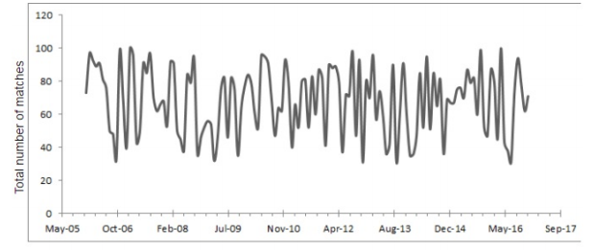
What is the popularity of cricket over the past 10 years?
We will visualize the total number of games played in each month from 2006 to 2017 by plotting them on a time series graph. We will point out the trends/patterns visible in the number of matches played.

Slide 3
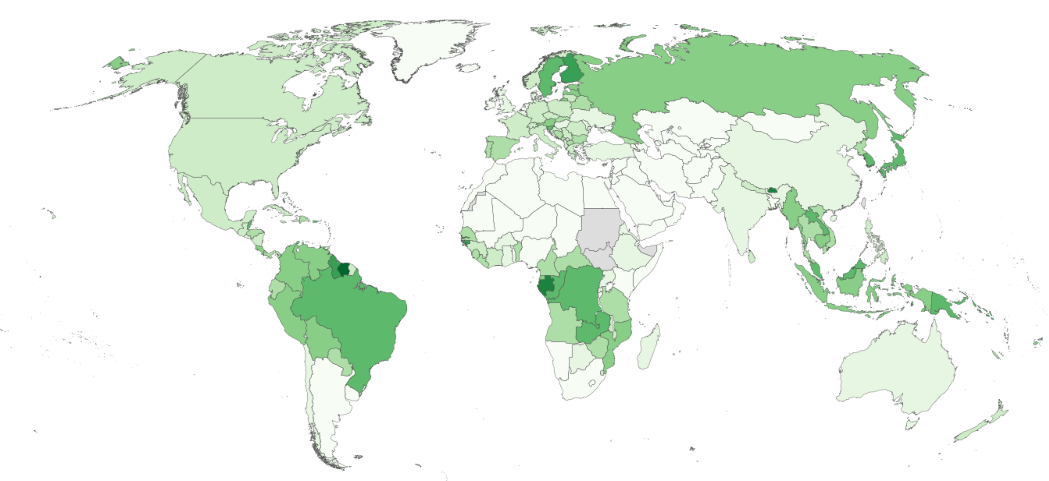
Which Venue Has the highest Score
A choropleth map of the world would help to visualize which venues are generally the high scoring pitch. The sequential color scheme gives a stark idea, the darker areas witness a higher score and it lightens with decreasing scores.

Slide 4
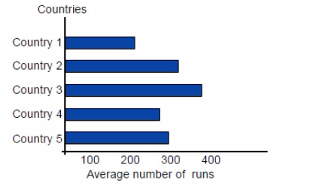
Which Country has the maximum number of average runs?
We will calculate the average number of runs of each team and plot these values on a bar graph. We will then identify patterns in the data and develop insights about the data. We will use a bar graph to visualize this data because we are comparing individual values; namely, we are comparing the average runs of the teams.

Slide 5
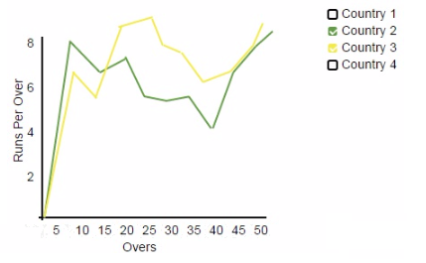
Analyze the performance of teams in different over intervals
We will plot teams’ average runs per over in a time series graphs and analyze which teams play well in which overs. We will also add checkboxes corresponding with different teams so users can select the teams of which they would like the view the performance.

Slide 6
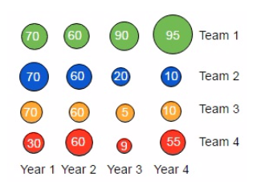

Percentage of runs scored in boundaries
We will use a bubble chart to visualize teams’ abilities to score runs by hitting boundaries. A bubble chart will be useful in visualizing this data because we are concerned with values rather than trends. As it is more fun to watch a game with more boundaries, we can answer questions such as “which is the most entertaining team?”
Percentage of matches won by
each team
We will use a bubble chart to visualize the percentage of matches won by teams from the year 2006 to 2016. This form of visualization will allow us to look at teams’ performances over the years.

Slide 7
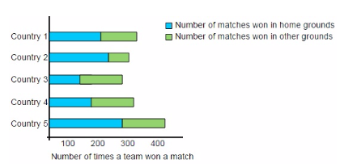
Is there a home advantage?
The analysis from the previous chart will give us a team’s winning percentage over the years. We would like to analyze the reason behind it. Therefore, we will visualize the home advantage (i.e. playing games on the home ground). We will visualize this data using a stacked bar graph by stacking the bars of the number of times a team has won at home and away.

Slide 8
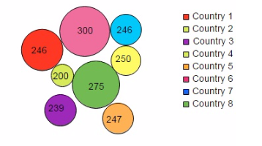
How many runs must a team score to win 90% of matches?
Using a bubble chart, we will visualize the number of runs a team has scored which has resulted in 90% of their winnings. The bubble chart will help us in comparing teams’ runs.

Slide 9
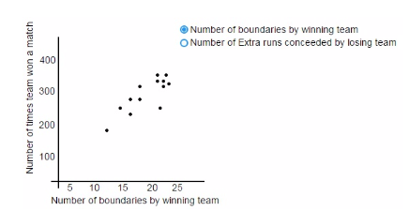
Number of matches a team has won vs number of boundaries hit
The following are two myths that exist in regards to Cricket:
The more boundaries a team scores, the better its chances are of winning.
If a team concedes more extra runs, its changes of winning will decrease.
We would like to test the accuracy of these myths with the help of a scatter plot. We will use the same scatter plot to analyze both myths. We will add a radio button so the user can choose which plot to view.

Slide 10
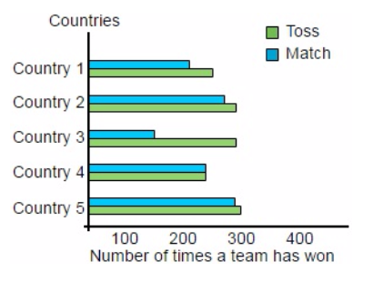
Number of times a team has won a toss and the match
There exists a myth regarding a team winning a coin toss and also winning the match. We will plot the number of times a team has won a toss and a match. With this, we can analyze if winning a toss is correlated with winning a game. We will use a double bar graph to compare the two values (coin toss wins and match wins) easily.

