Slide 1
Crime Analysis for Boston and San Francisco
Yiru Fei

Slide 2
Introduction
Differences and similarities of crime categories between these two cities
Boston: 694,583 residents
San Fansico: 883,305 residents

Slide 3
Data Description
Datetime | Category | Street | Latitude | Longitude
2019-10-13 | Auto Theft | LINCOLN ST | 42.25952 | -71.12156
2019-06-05 | Harassment | ZELLER ST | 42.29187 | -71.13635
2018-11-18 | Property Found | ZELLER ST | 42.29187 | -71.13635
2019/10/04 | Robbery | BALBOA ST | 37.77508 | -122.5113
2019/01/09 | Stolen Property | EDDY ST | 37.78289 | -122.4208
2018/01/01 | Motor Vehicle Theft | COLUMBUS AVE | 37.79786 | -122.4067
Crime data of Boston and San Fansico.

Slide 4
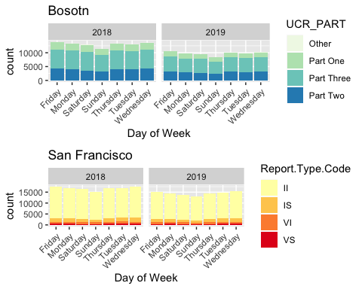
Bar Plot

Slide 5
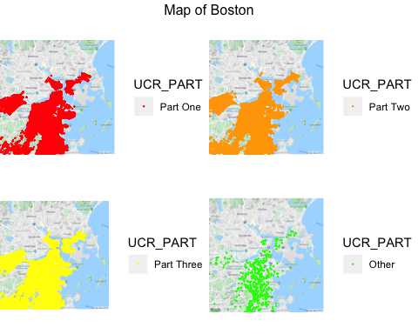
Maps of Different Crime Types

Slide 6
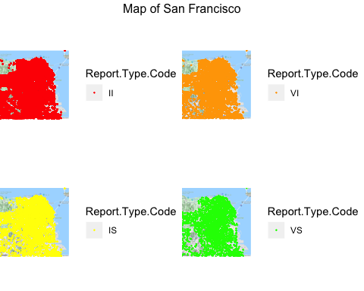
Maps of Different Crime Types

Slide 7
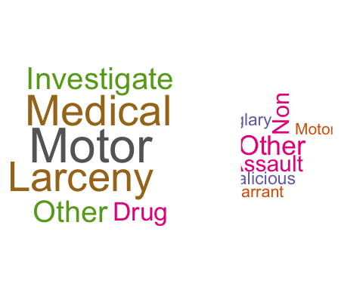
Word Cloud
The left side plot is crimes in Boston, the right side is crimes in San Francisco.

Slide 8
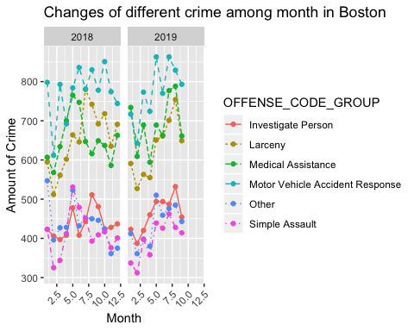
Line Plot

Slide 9
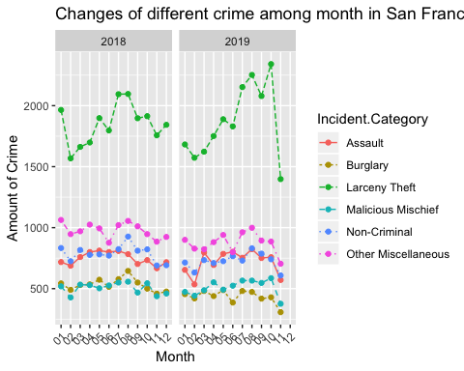
Line Plot

Slide 10
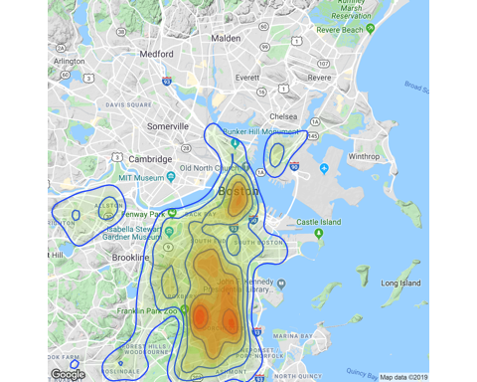
Map of Most Common Crime in Boston
Motor vehicle accident response always happened around Boston Common and South End

Slide 11
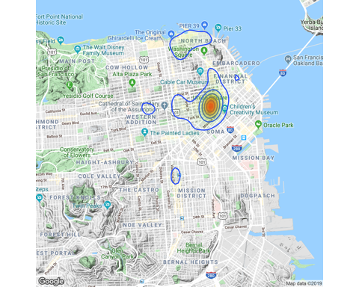
Map of Most Common Crime in San Francisco
Larceny theft always happened around downtown

Slide 12
Conclusion
Similarities: 1. Lower crime rates on Sunday and February 2. Crime rates will be higher in densely populated areas
Differences: 1. The crimes area in Boston is broader than in San Francisco 2. San Francisco has the most crime records is initial category

Slide 13
References
https://en.wikipedia.org/wiki/San_Francisco https://en.wikipedia.org/wiki/Boston https://data.boston.gov/dataset/crime-incident-reports-august-2015-to-date-source-new-system https://data.sfgov.org/Public-Safety/Police-Department-Incident-Reports-2018-to-Present/wg3w-h783

