Slide 1
Nonlinear Dimensionality Reduction by Locally Linear Embedding
Sam T. Roweis and Lawrence K. Saul
Presented by Yueng-tien , Lo
Reference:
"Nonlinear dimensionality reduction by locally linear embedding," Roweis & Saul, Science, 2000.
"Think Globally, Fit Locally: Unsupervised Learning of Low Dimensional Manifolds, "
Lawrence K. Saul, Sam T. Roweis, JMLR, 4(Jun):119-155, 2003.

Slide 2
In Memoriam
SAM ROWEIS 1972 - 2010

Slide 3
outline
Introduction
Algorithm
Examples
Conclusion

Slide 4
introduction
How do we judge similarity?
Our mental representations of the world are formed by processing large numbers of sensory inputs— including, for example, the pixel intensities of images, the power spectra of sounds, and the joint angles of articulated bodies.
While complex stimuli of this form can be represented by points in a high-dimensional vector space, they typically have a much more compact description.

Slide 5
the curse of dimensionality
Hughes effect
The problem caused by the exponential increase in volume associated with adding extra dimensions to a (mathematical) space.
From wiki

Slide 6
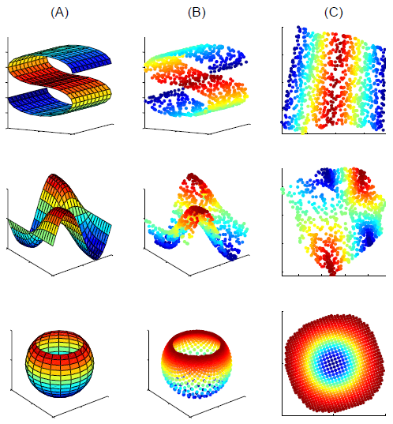
The problem of nonlinear dimensionality reduction
An unsupervised learning
algorithm must discover
the global internal coordi-
nates of the manifold
without external signals
that suggest how the data
should be embedded in
two dimensions.

Slide 7
manifold
In mathematics, more specifically in differential geometry and topology, a manifold is a mathematical space that on a small enough scale resembles the Euclidean space of a specific dimension, called the dimension of the manifold
The concept of manifolds is central to many parts of geometry and modern mathematical physics because it allows more complicated structures to be expressed and understood in terms of the relatively well-understood properties of simpler spaces.
From wiki

Slide 8
introduction
Coherent structure in the world leads to strong correlations between inputs (such as between neighboring pixels in images), generating observations that lie on or close to a smooth low-dimensional manifold.
To compare and classify such observations—in effect, to reason about the world—depends crucially on modeling the nonlinear geometry of these low-dimensional manifolds.

Slide 9
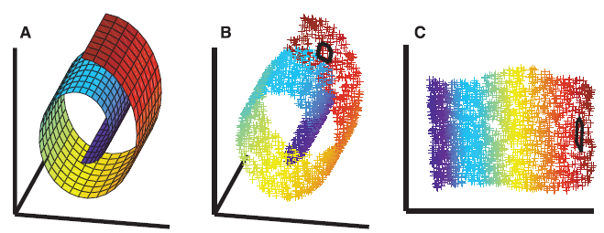
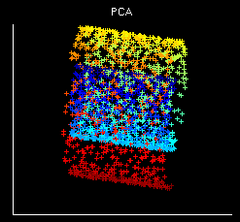
introduction
The color coding illustrates the neighborhood preserving mapping discovered by LLE
Unlike LLE, projections of the data by principal component analysis (PCA) or classical MDS map faraway data points to nearby points in the plane, failing to identify the underlying structure of the manifold

Slide 10
introduction
Previous approaches to this problem, based on multidimensional scaling (MDS) , have computed embeddings that attempt to preserve pairwise distances [or generalized disparities ] between data points.
Locally linear embedding (LLE) eliminates the need to estimate pairwise distances between widely separated data points.
Unlike previous methods, LLE recovers global nonlinear structure from locally linear fits.
The problem involves mapping high-dimensional inputs into a low dimensional “description” space with as many coordinates as observed modes of variability.

Slide 11
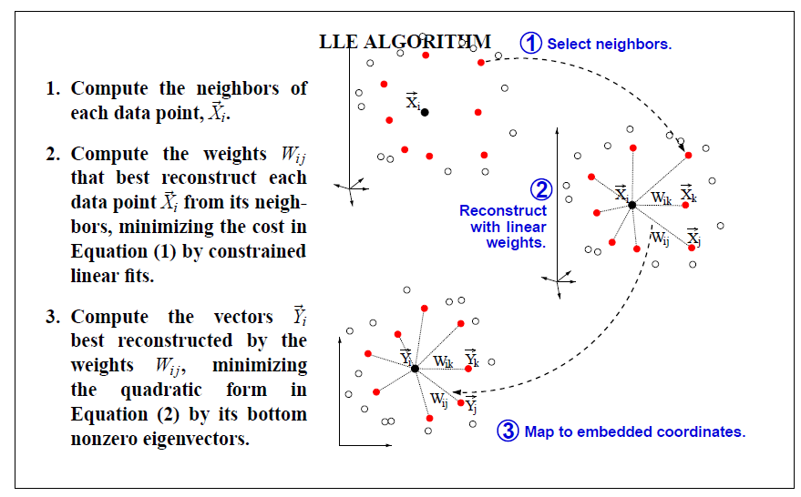
algorithm
ee

Slide 12
algorithm-step1
Suppose the data consist of N real-valued vectors each of dimensionality D, sampled from some underlying manifold.
we expect each data point and its neighbors to lie on or close to a locally linear patch of the manifold.

Slide 13
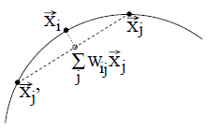
algorithm-step 2
Characterize the local geometry of these patches by linear coefficients that reconstruct each data point from its neighbors.
Reconstruction errors are measured by the cost function
which adds up the squared distances between all the data points and their reconstructions.

Slide 14
algorithm-step 2
Minimize the cost function subject to two constraints:
First, each data point is reconstructed only from its neighbors, enforcing does not belong to the set of neighbors of
Second, that the rows of the weight matrix sum to one: .

Slide 15
algorithm: a least-squares problem
The reconstruction is minimized:
we have introduced the “local” Gram matrix
By construction, this Gram matrix is symmetric and semipositive definite.
The reconstruction error can be minimized analytically using a Lagrange multiplier to enforce the constraint that

Slide 16
algorithm: a least-squares problem
Third, compute the reconstruction weights:
If the correlation matrix G is nearly singular, it can be conditioned (before inversion) by adding a small multiple of the identity matrix.
This amounts to penalizing large weights that exploit correlations beyond some level of precision in the data sampling process

Slide 17
algorithm
The constrained weights that minimize these reconstruction errors obey an important symmetry: for any particular data point, they are invariant to rotations, rescalings, and translations of that data point and its neighbors.
Suppose the data lie on or near a smooth nonlinear manifold of lower dimensionality

Slide 18
algorithm
By design, the reconstruction weights reflect intrinsic geometric properties of the data that are invariant to exactly such transformations.

Slide 19
algorithm-step3
Each high-dimensional observation is mapped to a low-dimensional vector representing global internal coordinates on the manifold.
This is done by choosing d-dimensional coordinate to minimize the embedding cost function
This cost function, like the previous one, is based on locally linear reconstruction errors, but here we fix the weights while optimizing the coordinates

Slide 20
algorithm-step3
Subject to constraints that make the problem well-posed, it can be minimized by solving a sparse eigenvalue problem, whose bottom nonzero eigenvectors provide an ordered set of orthogonal coordinates centered on the origin.

Slide 21
algorithm: a Eigenvalue problem
The embedding vectors are found by minimizing the cost function over with fixed weights
We remove this degree of freedom by requiring the coordinates to be centered on the origin
To avoid degenerate solutions, we constrain the embedding vectors to have unit covariance, with outer products that satisfy ,where :

Slide 22
algorithm: a Eigenvalue problem
Now the cost defines a quadratic form involving inner products of the embedding vectors and the symmetric matrix
where is 1 if and 0 otherwise.
The optimal embedding, up to a global rotation of the embedding space, is found by computing the bottom d+1 eigenvectors of this matrix

Slide 23
algorithm
For such implementations of LLE, the algorithm has only one free parameter: the number of neighbors, K.

Slide 24
algorithm
For such implementations of LLE, the algorithm has only one free parameter: the number of neighbors, K.

Slide 25
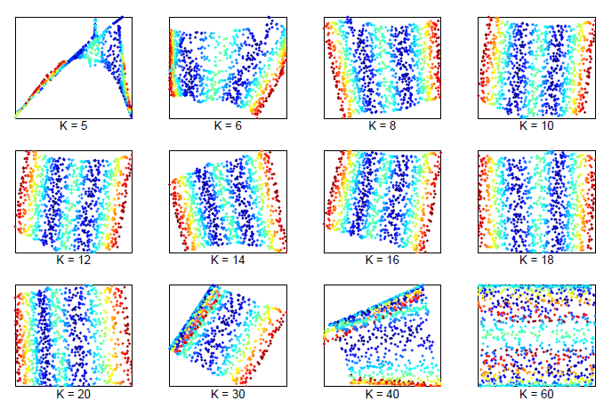
Effect of neighborhood size on LLE.

Slide 26
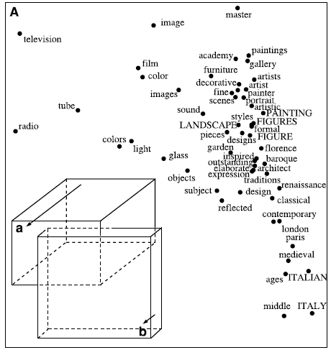
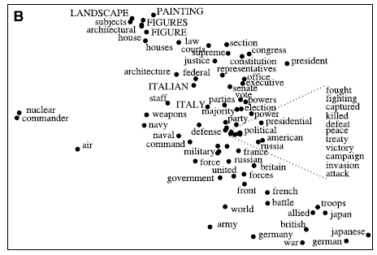
example
Coherent structure in th Note how LLE colocates
words with similar contexts
in this continuous semantic fd space.

Slide 27
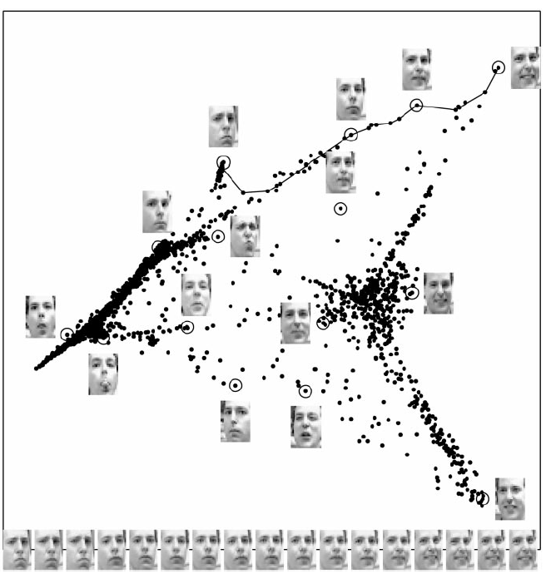
algorithm

Slide 28
Conclusion
LLE is likely to be even more useful in combination with other methods in data analysis and statistical learning.
Perhaps the greatest potential lies in applying LLE to diverse problems beyond those considered here.
Given the broad appeal of traditional methods, such as PCA and MDS, the algorithm should find widespread use in many areas of science.

Slide 29
Appendix

Slide 30
Appendix

