Slide 1
William Henry Perkin ——The man who invented synthetic dyes （合成染料）

Slide 2
1
Introduction
William Henry Perkin was born on March 12, 1838, in London, England. As a boy, Perkin’s curiosity prompted early interests in the arts, sciences, photography, and engineering.

Slide 3
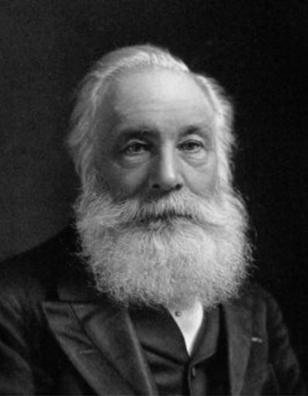
William Henry Perkin

Slide 4
2
Challenge
At the time, quinine（奎宁） was the only
viable medical treatment for malaria（疟疾）. and by 1856 demand for the drug was surpassing the available supply. Thus, when his teacher —— Hofmann made some passing comments about the desirability of a synthetic substitute for quinine, it was unsurprising that Perkin was moved to take up the challenge.

Slide 5
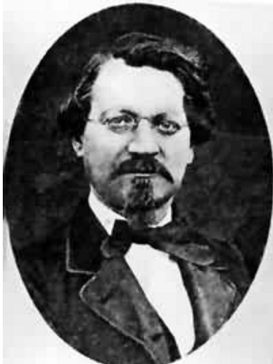
Hofmann，A.W.von

Slide 6
3
Accidental discovery
During his vacation in 1856, Perkin spent histime in the laboratory on the top floor of his family’s house. He was attempting to manufacture quinine from aniline, an inexpensive and readily available coal tar waste product. Despite his best efforts, however, he did not end up with quinine. Instead, he produced a mysterious dark sludge. Luckily, Perkin’s scientific training and nature prompted him to investigate the substance further.

Slide 7
4
unusually observant
Incorporating potassium dichromate and alcohol into the aniline at various stagesof the experimental process, he finally produced a deep purple solution. And, providing the truth of the famous scientist Louis Pasteur’s words ‘chance favors only the prepared mind’, Perkin saw the potential of his unexpected find.

Slide 8
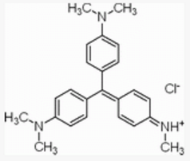
Chemical equation

Slide 9
5
Textile dyes
Historically, textile dyes were made from such natural sources as plants and animal excretions. Some of these, such as the glandular mucus of snails, were difficult to obtain and outrageously expensive. Indeed, the purple color extracted from a snail was once so costly that in society at the time only the rich could afford it. Further, natural dyes tended to me muddy in hue and fade quickly. It was against this backdrop that Perkin’s discovery was made.

Slide 10
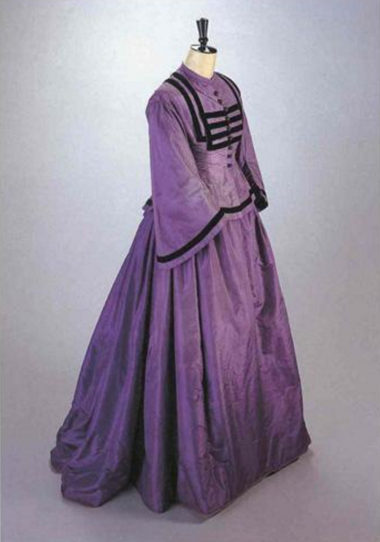
A silk skirt made from the most primitive aniline violet.

Slide 11
Ending
6
Perkin quickly grasped that his purple solution could be used to color fabric, thus making it the world’s first synthetic dye.

Slide 12
Thank you!

