Slide 1
Stock Prediction from Financial News Knowledge Graph
Fu Di, Kelvin Koa

Slide 2
Stock Prediction Problem
Efficient-market hypothesis (EMH):
Stock prices reflect all currently available information and any price changes that are not based on newly revealed information are inherently unpredictable.
Stock prediction using news sentiment is a popular topic since:
Financial news is a common source of new information on stock companies
There are proven technologies to extract sentiment from textual sources (e.g. NLP)

Slide 3
Stock Prediction Timeline
Introduction of sentiment analysis in financial prediction
These use simple NLP that captures named entities and term-level features
Deep learning models (e.g. CNN) that learns from structured events
E.g. Input = { Actor = Microsoft, Predicate = sues, Object = Barnes and Noble }
Use of knowledge graph techniques to learn from structured events

Slide 4
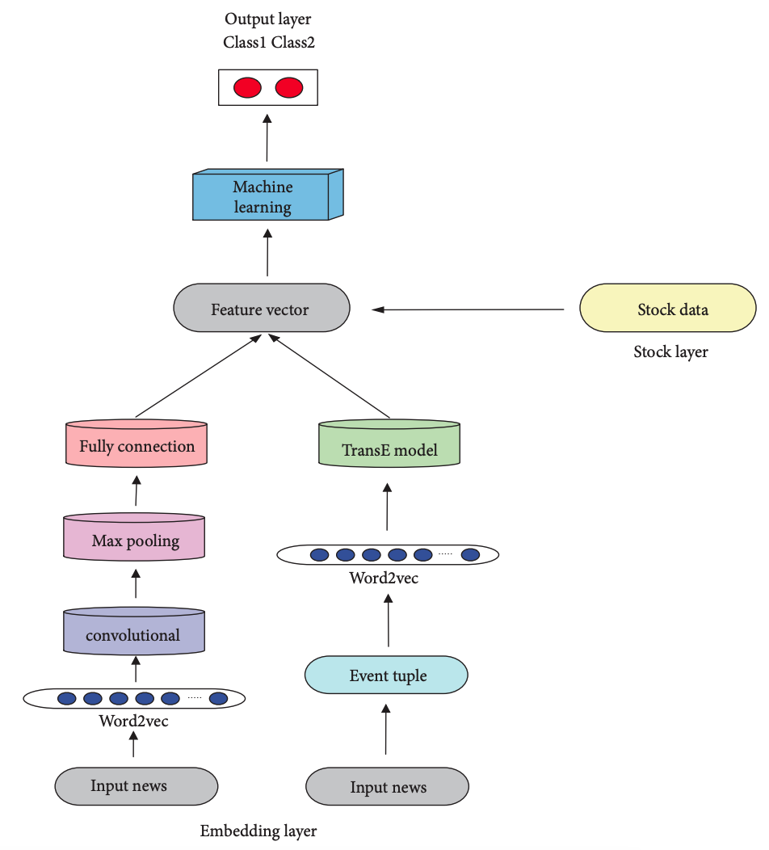
Background Work
Events were captured from financial news headlines, which were then used to build a knowledge graph of stock-event tuples, e.g. Chinese writers’ group, sues, Apple
Yang Liu, Qingguo Zeng, Joaqu´ın Ordieres Mer´e, and Huanrui Yang. Anticipating stock market of the renowned companies: A knowledge graph approach. Complexity, 2019.

Slide 5
Problem Statements
1
Many news headlines were filtered, resulting in smaller dataset
Only News Headline contains company name (e.g. Apple) are scalped
Large percentage of headlines are filtered due to poor performance of Reverb in tuple extraction
It is currently unknown how TransE embeddings influence prediction
Only results from the combined LSTM + TransE Model were shown
2

Slide 6
Main Contributions
1
We propose a different strategy to scalp news, looking for keywords related to the company stock from a keyword set
e.g. a proper keyword set for Apple Inc may be (apple, technology, smart phone, WWDC, tablet, Tim Cook)
Comparing with the reference work, in which only news with the title contains ’Apple’ was selected, our strategy can scalp more useful news related to the stock
2
We propose alternative embeddings Word2vec+TransR and Word2vec+TransD to improve event representation
Results across different combinations of techniques were compared to explore their impacts on the task

Slide 7
All Changes to Model
Change #2
Using LSTM of 5 days, to capture temporal information
Change #1
Using universal sentence encoder, to avoid costly manual labeling of news sentiment
Main Contributions (From Prev. Slide)
1. Different data scalping method to extract more news
2. Alternative KG embedding methods were explored

Slide 8
Proposed Architecture

Slide 9
word2vec
Fully Connected
Feature Vector
LSTM
Output
Layer
(Binary)
Event Tuple
TransE
….
Input News
…….
Universal Sentence Encoding
Stock Data
…….
Technical Indicators

Slide 10
Work Done
Steps | Description
Corpus Collection | Web crawler written to obtain financial news Stock data downloaded from Yahoo Finance
Data Pre-processing | Extract event tuples from news headlines Extract structural event embeddings from headlines Calculate technical indicators from stock data
Feature Selection | Combine event embeddings and tuples as feature vectors
Prediction Model | Write LSTM prediction model to do stock movement classification using news features and stock data from the past 5 days

Slide 11
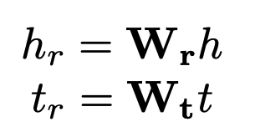
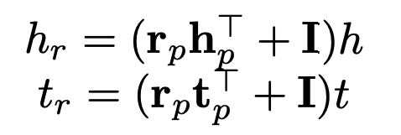
New proposed embeddings
Old:
Original relation space proposed in reference paper
Inspired by TransR
New:
Our proposed relation space, using dynamic mapping
Inspired by TransD

Slide 12

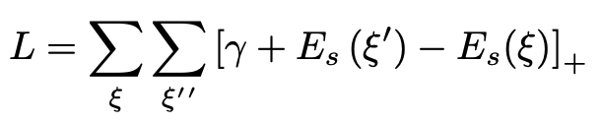
New proposed embeddings (2)
Embedding space is defined as:
where r_{p}, h_{p}, t_{p} are learnable parameters
The embedding loss of this structure model can be defined as:
For training, negative samples ξ ‘ are generated by randomly replacing head or tail entity in positive samples ξ

Slide 13
Experimental Settings
Results from the old (‘TransR’) and new (‘TransD’) embeddings were compared
3 main settings for each:
LSTM: Only stock data were used
KG_LSTM: Both stock data and KG embeddings were used
Hybrid_LSTM: Stock data, KG embeddings, Headline embeddings were used

Slide 14
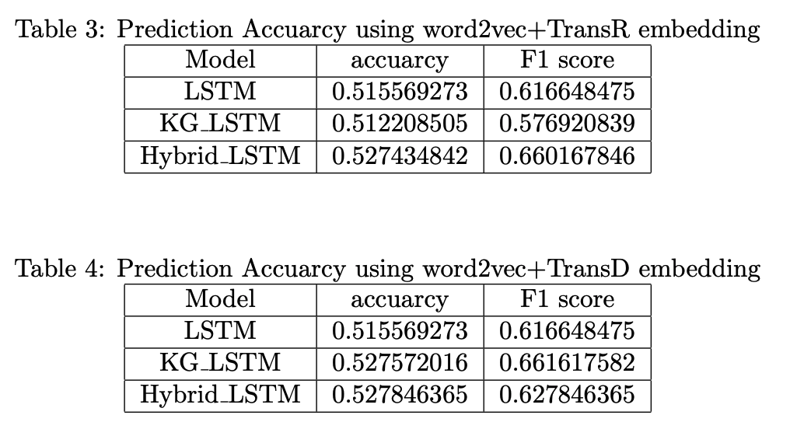
Results

Slide 15
Results (1)
Possible reason:
The reference paper manually tags a sentiment label for each news headline, which was not done in our work due to time constraints (see slide #7).
Hence, representations of positive and negative news could be mixed and not separated from each other
(see report for more details)
Adding KG embeddings / text embeddings did not significantly increase the performance of the LSTM model, which is contrary to results from reference paper

Slide 16
Results (2)
Possible reasons:
Extracted event triples are not clean enough since open information extraction models, such as OpenIE 5.1, often cannot deal with complex sentences
Unique relations are sparse
(see report for more details)
Event embeddings do not improve performance of stock prediction, which was not mentioned in the reference work as there is no related ablation study

Slide 17
Conclusion
In this project, we focused on the application of joint learning structural event embedding and sentence embedding for stock prediction
We found event embedding alone cannot improve the performance of the stock prediction model, likely due to the sparsity of relation and entities extracted from news embeddings
It would be beneficial if the extracted event knowledge graph can be linked to a large database such as freebase to address the sparsity issue and improve the embedding

Slide 18
Stock Prediction from Financial News Knowledge Graph
Fu Di, Kelvin Koa

