Slide 1
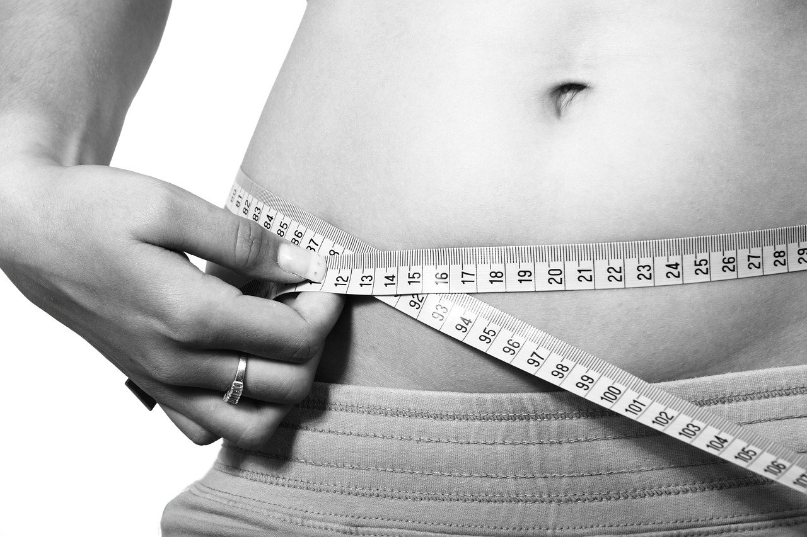
Body Fat Study
STAT679 Module 2
Group 1: Feiyun Yan, Ziang Zeng, Srivats Kumar Tharanilath

Slide 2
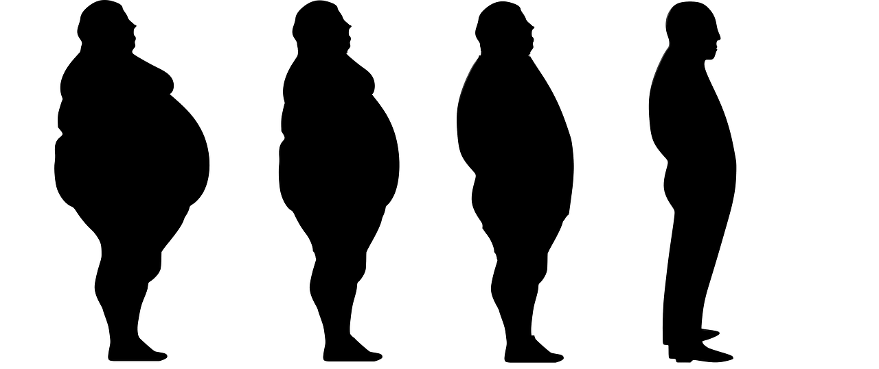
Data cleaning
Identifying the outlier by checking Siri formula and BMI formula
Recover the body fat through density and remove the near-zero and negative observation
Delete the observation with unreasonable body fat (No. 216)
Remove irrelevant variable: IDNO, redundant variable:’DENSITY’,’WEIGHT’,’HEIGHT’

Slide 3
Modeling
Predictors use to build our model.
BMI(Adiposity):
As a traditional indicator of body fat, we found that BMI continues to be one of the best predictor for us to use in our model to predict the Body Fat
Abdomen/Hip ratio:
In recent years, we found that clinics use Waist/Hip ratio to try and predict the body fat. This is because the body tends to store fat around the abdomen and the hip circumference is a good measure of the skeleton.

Slide 4
Modeling
We have decided to use a linear model to predict body fat. For the purposes of this model we will assume that the residuals are independent and normally distributed and do not depend on response variables. The final model we chose was :
Y = β0 + β1X1 + β2X2 + ϵ
Here β0 is the value of the intercept, β1 is the coefficient of Waist/Hip and β2 is the coefficient of Adiposity. We used a t test to check if the coefficients of our model our significant. However after testing we found that the p-value was less than 0.05 which means our our model is reasonable.

Slide 5
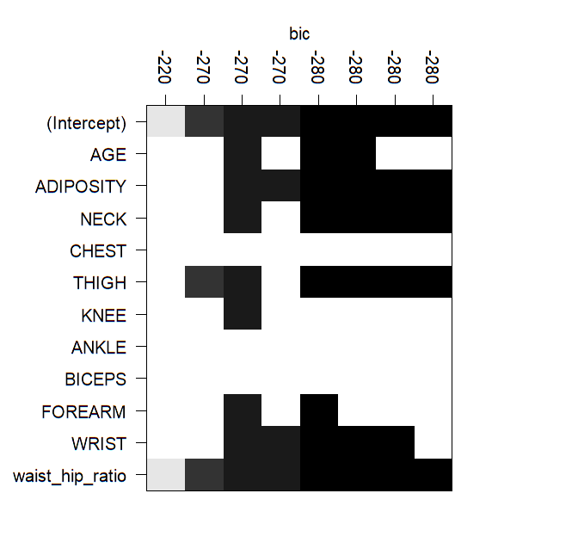
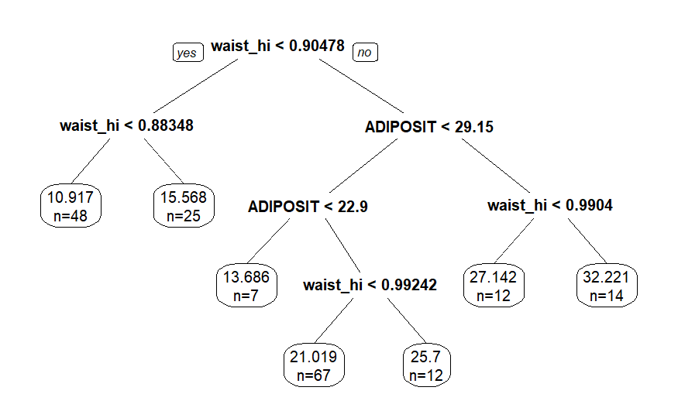
Modeling
This is the best regression tree we have found based on the cross validation error.

Slide 6
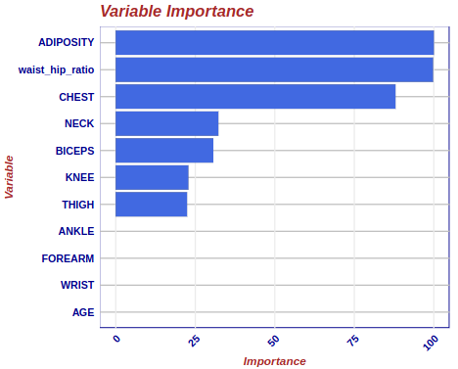
Modeling
Candidate Model 1: (Linear model with Thigh)
BODYFAT ~ Waist-to-hip-ratio* + THIGH
Candidate Model 2: (Linear model with Chest)
BODYFAT ~ Waist-to-hip-ratio* + CHEST
Candidate Model 3: (Linear model with Neck)
BODYFAT ~ Waist-to-hip-ratio* + NECK
Candidate Model 4: (Regression tree cp=0.021)
Candidate Model 5: (Linear model with Adiposity)
BODYFAT ~ ADIPOSITY + Waist-to-hip-ratio
*Note: Waist-to-hip-ratio = ABDOMEN / HIP

Slide 7
Results
Model | R Squared (Training) | MSE (Training) | R Squared (Testing) | MSE (Testing)
BODYFAT ~ Waist-to-hip-ratio + THIGH | 0.710 | 21.75 | 0.606 | 23.51
BODYFAT ~ Waist-to-hip-ratio + NECK | 0.627 | 16.89 | 0.598 | 23.20
BODYFAT ~ CHEST + Waist-to-hip-ratio | 0.667 | 19.42 | 0.593 | 23.80
BODYFAT ~ ADIPOSITY + Waist-to-hip-ratio | 0.691 | 18.03 | 0.655 | 20.21

Slide 8

Discussion of Results
The primary criterion by which we evaluated the model was the R-squared value. It is a reliable measure to assess how good the fitting of a model is. We found that while the R-squared value of the first model was generally better than our final model on the training data, we would find that it would have a much lower value on the testing data. This outcome indicates that this model tends to overfit the data. We can see that this shows our model is more robust that the one where we use THIGH.
We would also find that NECK underperforms generally. This would be the case with the Regression Tree approach as well given how it generally had bad results with an R-squared of 0.5 on the testing data.

Slide 9
Final Model
BODYFAT = -65.06 +70.47(Waist/Hip ratio) + 0.7456(Adiposity)
It follows the model design as stated earlier i.e Y = β0 + β1X1 + β2X2 + ϵ where β0 is the intercept, β1 is the coefficient of Waist/Hip ratio and β2 is the coefficient of adiposity. All of these have a p-value lower than 2e-16 which is less than 0.05.

Slide 10
Statistical Properties of Final Model
Some important statistical properties of of the final model:
An R-squared value of 0.691
An MSE value of 18.03
While evaluating the estimated values that the model predicts we find that a one unit change in the Waist/Hip Ratio can lead to a 70 unit change in the body fat and similarly a one unit change in the Adiposity can lead to a 0.75 change in the body fat.

Slide 11
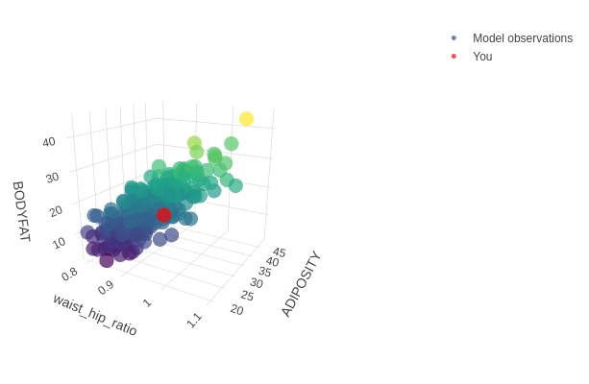
Visualization
We built a shiny app to predict the body fat as a 3d plot based on the model we have used. Here the red dot represents any input we may feed it in the Shiny App

Slide 12
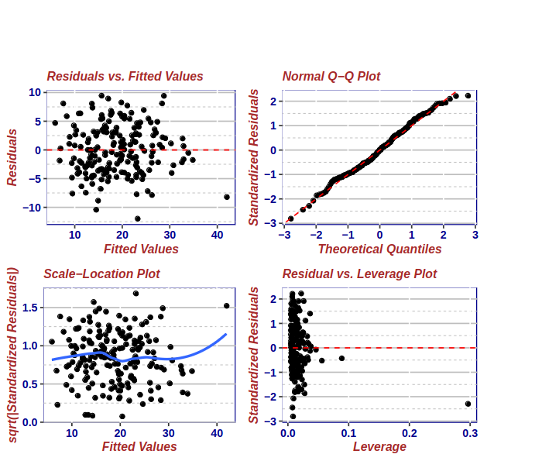
Model Diagnostics
We can see the that the first plot clearly shows that the residuals and fitted values as the Shapiro normality test gives us a p-value of 0.2937. This confirms our assumption that the residuals are independent and normally distributed. The Normal Q-Q plot is also an almost perfect line helps us confirm that the residuals are normally distributed.

Slide 13
Model Diagnostics
We however can observe some points that fall outside the Cook’s distance of the Residual vs Leverage plot. This means that the data either wasn’t cleaned fully as a result of which that point has leverage. Eliminating this point we found that the R-squared increased to 0.6977. We also tested for multicollinearity. We did so by calculating the VIF value which was found to be 1.778. This low enough for us to conclude that there is no multicollinearity in the given model

Slide 14

Strengths and Weaknesses
Strengths
Model is simple
Model is very robust since we did bootstrap for 100 times and we still have R-squared of 0.68
Weaknesses
R square value is high but still not enough
We use R-squared as our primary predictor, however this possibly will not work for any future models that are more complex and have more predictors

Slide 15
Thank you!

