Slide 1

2 0 1 6
The 15th
International
Semantic Web
Conference
Kobe, Japan

Slide 2
2 0 1 6
The 15th
International
Semantic Web
Conference
Kobe, Japan

Slide 4
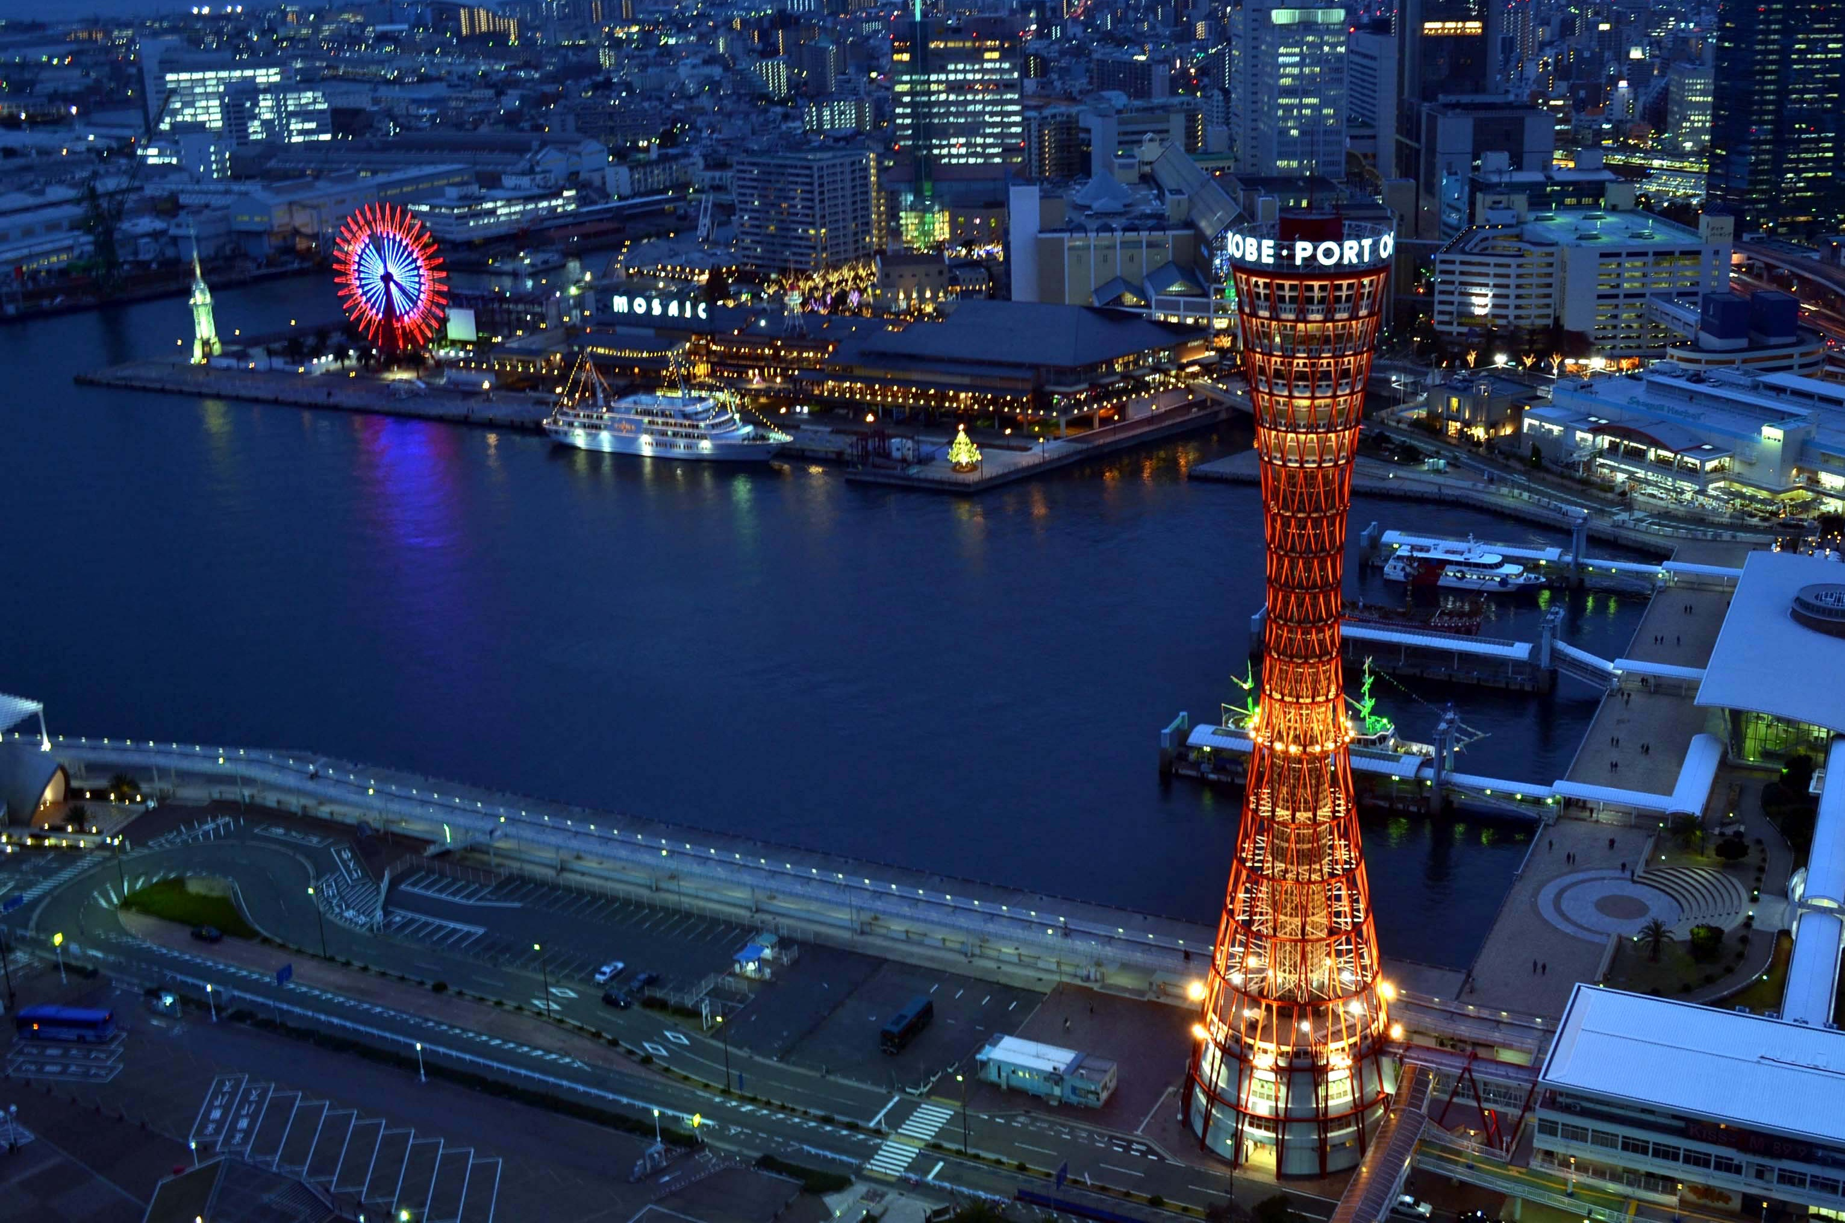

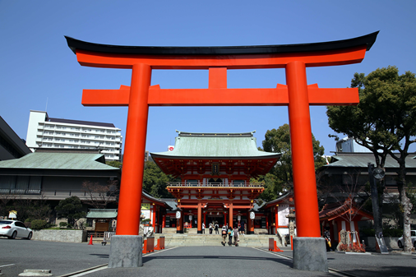
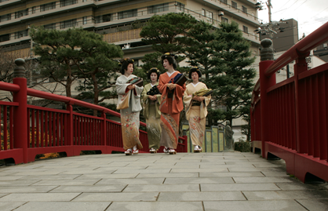
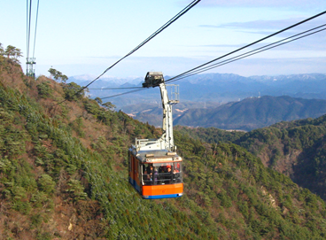
2 0 1 6
The 15th
International
Semantic Web
Conference
Kobe, Japan
October 17-21

Slide 5
2 0 1 6
The 15th
International
Semantic Web
Conference
Kobe, Japan
October 17-21

Slide 7


The 15th International
Semantic Web Conference
2 0 1 6
October 17-21
Kobe, Japan

Slide 8

2 0 1 6
The 15th
International
Semantic Web
Conference
October 17-21
Kobe, Japan
The 15th International Semantic Web Conference
October 17-21
2 0 1 6
Kobe, Japan

