Slide 1

Robo Advisor for Trading Equities
Project 2 - Group- 2

Slide 2

Motivation and Overview:
A smart robo advisor that provides customized insights to trading equities.
This project aims to:
- Assist user to be cautious about the risks in their equity investment
- Vision return on investment
- Improve return on investment via algorithm driven trading strategies

Slide 3
Project overview:
Mindmap
Technical
Input:
- The stocks the user would like to buy
- How long they would like to hold the stocks for
AWS LEX
AWS Lambda
Prophet
Technical analysis:
Price projection
Sharpe ratio
Sortino ratio.
Model evaluation:
statistical evaluation of the model (R2_score, mean_squared_error)
Via Machine Learning, the bot will tell user the price projection for the time holding the equities.
The bot will also provide technical analysis:
Sharpe ratio
Sortino ratio.
Confidence level on the analysis (confidence report, accuracy score etc)
Machine Learning
Moving Average Crossover strategy
Model:
Support Vector Machine (SVM)
Logistic Regression
Model evaluation:
Confusion matrix
Precision-Recall Curve
Recommendation
Trading strategy (e.g. buying and selling signals)

Slide 4
Model summary:
Prophet:
Effectively predict with data that has strong seasonality.
Designed to work with time-series data.
Ease of use and interpretation.
Machine learning
Used both the Logistic Regression Model
Logistic regression is easier to implement, interpret, and very efficient to train.
It not only provides a measure of how appropriate a predictor is, but also its direction of association (positive or negative).
and Support Vector Machine Model:
Popular ML for stock price predictions
SVM is relatively memory efficient

Slide 5
Data Clean up & Model Training - Prophet
Data source:
Stock data was sourced from Yahoo Finance API. Historical data and on-time data can be extracted from Yahoo Finance. It is simply to install, and it does not require an account.
Data preparation:
Prophet is design to produce a very short prediction period. Therefore, in this project, the maximum prediction period (holding period) is 3 months. 3 years of historical data was fitted to train the model with the expectation for an accurate prediction.
Raw data contains timezone component and also many unnecessary columns. These are removed to make the data cleaner.
Data for fitting is then formatted into “ds” and “y” format to fit into Prophet model.
Model training, seasonality and prediction limitation:
Historical data of 2019 - 2022 was used for model fitting. However, in 2020, COVID causes significant distortion on the seasonality of the data. Hence, the prediction accuracy was affected.
It was surprising that with an extended historical data for fitting (6 years), Prophet model did not provide a better performance.

Slide 6
Data Clean up & Model Training - SMA Strategy
Data cleaning, collection, preparing:
Chose 2 years worth of data in order to give a large enough sample to analyse monthly returns (1 month, 2 month and 3 month)
Established short (50) and long window (200) SMA’s to create signals - commonly used by traders
Created signals as per positive and negative daily returns
Training data began at index min and finished at index max - DateOffset(months= X) where x was the amount of months i wanted to analyse for test data
Used both logistic regression and svm model for the reasons stated earlier and also the precision-recall model of evaluation as our additional evaluation model

Slide 7
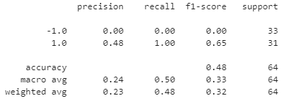
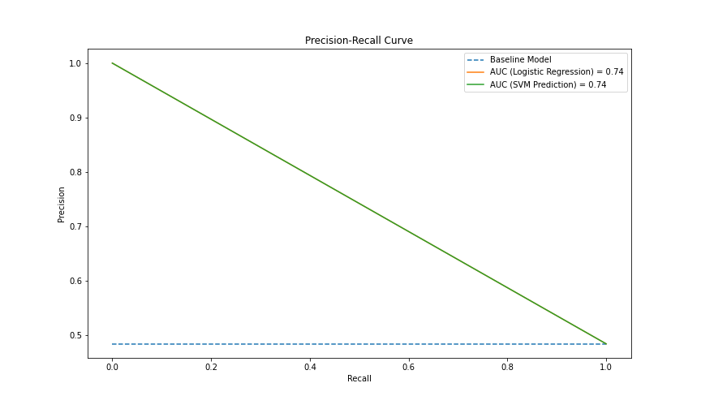
Model Evaluation
Prophet
Above metrics are from sklearn.metrics
Machine learning
SVM and
LR Testing Report:
Precision
-Recall Curve
 | 3 years historical data | 6 years historical data
Mean squared error | 21.29 | -8.99
R-squared score | -1.10 | 101.36
Mean absolute error | 4.02 | 9.77
Mean absolute percentage error | 9.5% | 24.5%

Slide 8

Discussion
Prophet:
In this project, Prophet predicting accuracy was not high enough to be considered a sufficient model for the predictive task. This can be explained that Prophet tends to work well with data that has strong seasonality. Tech-stocks with such high volatility as AAPL and GOOG, plus the distortion from COVID in 2020 affect considerably on the predicting accuracy of the model.
Although the model has a fair performance scores (ie. 9.95% of mean absolute percentage error) with 3 years of historical data, it performs poorly with 6 years of historical data (24.5% of mean absolute percentage error). This can be explained by the concept of “over fitting”.
A shorter period of prediction (1 month) would yield a better accuracy.

Slide 9
Postmortem - Lambda limitations
Layers required to support custom libraries (eg. pandas)
We learned to add layers through different mechanisms: ARN, Docker
Layers are limited to 250MB size, pandas & skicit-learn is more than 200 MB so size reduction was required
Given the limited time, we were not able to use Prophet with Lambda

Slide 10
Postmortem - ML models with LEX
Although technically it is possible, we learned that Lambda is not built for training ML models, it is designed for short interactions.
The ideal solution would be to save trained models for all the stocks and use then use Lambda just to trigger the predict function on the trained models
Because of the issues we had with the creation of a Prophet layer we took a shortcut, uploaded the model results to CSV file and LEX read the responses from the CSV file

Slide 11
Postmortem - Prophet model
If we have some more time, we would look for a method to remove the effect of a special event in the dataset but still keep the integrity.
Will try ARIMA model.

Slide 12
Discussion/Postmortem - SMA Models
Overall results provided a bit of inconsistency given the tight timeframe and volatile data set. This is also a result of using historicals as opposed to the forecasts data from prophet.
Firstly with more time we would of like to have connected forecasted results from prophet into this model as opposed to using historical data for our SMA trading strategy
Therefore trading strategy is based off historicals and should provide a disclaimer past performance is of course no indication of future performance
Also would perhaps consider using a larger data set in order to capture all types of markets both bear and bull with full cycles
Further to this would also consider larger test data sets in order to provide trading strategies over longer time frames
Lastly would like to research to see if anyway of optimising the SMA short and long windows for maximum return

Slide 13
Postmortem - Other learnings
Collaboration is hard when using a personal AWS account. We created dummy users and granted them access to one account
In order to run the model in a reasonable time we limited the Prophet forecasting to 3 months

Slide 14

AWS Lex Bot Demo

Slide 15

Q & A
Audience question

