Slide 1
Wireless LAN Technology

Slide 2
Wireless LAN Applications
LAN Extension
Cross-building interconnect
Nomadic Access
Ad hoc networking

Slide 3
LAN Extension
Wireless LAN linked into a wired LAN on same premises
  Wired LAN
    Backbone
    Support servers and stationary workstations
  Wireless LAN
    Stations in large open areas
    Manufacturing plants, stock exchange trading floors, and warehouses

Slide 4
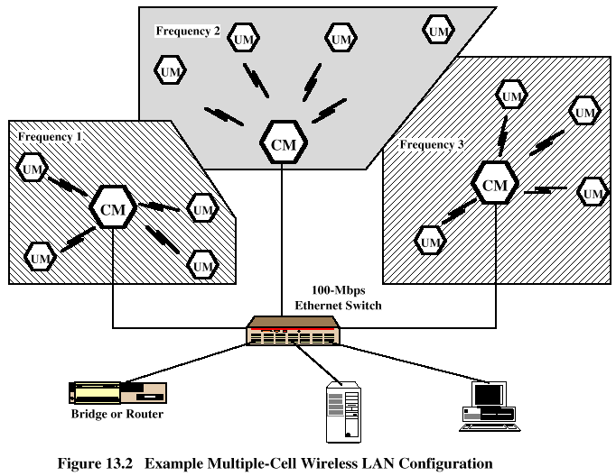
Multiple-cell Wireless LAN

Slide 5
Cross-Building Interconnect
Connect LANs in nearby buildings
  Wired or wireless LANs
Point-to-point wireless link is used
Devices connected are typically bridges or routers

Slide 6
Nomadic Access
Wireless link between LAN hub and mobile data terminal equipped with antenna
  Laptop computer or notepad computer
Uses:
  Transfer data from portable computer to office server
  Extended environment such as campus

Slide 7
Ad Hoc Networking
Temporary peer-to-peer network set up to meet immediate need
Example:
  Group of employees with laptops convene for a meeting; employees link computers in a temporary network for duration of meeting

Slide 8
Wireless LAN Requirements
Throughput
Number of nodes
Connection to backbone LAN
Service area
Battery power consumption
Transmission robustness and security
Collocated network operation
License-free operation
Handoff/roaming
Dynamic configuration

Slide 9
Wireless LAN Categories
Infrared (IR) LANs
Spread spectrum LANs
Narrowband microwave

Slide 10
Strengths of Infrared Over Microwave Radio
Spectrum for infrared virtually unlimited
  Possibility of high data rates
Infrared spectrum unregulated
Equipment inexpensive and simple
Reflected by light-colored objects
  Ceiling reflection for entire room coverage
Doesn’t penetrate walls
  More easily secured against eavesdropping
  Less interference between different rooms

Slide 11
Drawbacks of Infrared Medium
Indoor environments experience infrared background radiation
  Sunlight and indoor lighting
  Ambient radiation appears as noise in an infrared receiver
  Transmitters of higher power required
    Limited by concerns of eye safety and excessive power consumption
  Limits range

Slide 12
IR Data Transmission Techniques
Directed Beam Infrared
Ominidirectional
Diffused

Slide 13
Directed Beam Infrared
Used to create point-to-point links
Range depends on emitted power and degree of focusing
Focused IR data link can have range of kilometers
  Cross-building interconnect between bridges or routers

Slide 14
Ominidirectional
Single base station within line of sight of all other stations on LAN
Station typically mounted on ceiling
Base station acts as a multiport repeater
  Ceiling transmitter broadcasts signal received by IR transceivers
  IR transceivers transmit with directional beam aimed at ceiling base unit

Slide 15
Diffused
All IR transmitters focused and aimed at a point on diffusely reflecting ceiling
IR radiation strikes ceiling
  Reradiated omnidirectionally
  Picked up by all receivers

Slide 16
Spread Spectrum LAN Configuration
Multiple-cell arrangement (Figure 13.2)
Within a cell, either peer-to-peer or hub
Peer-to-peer topology
  No hub
  Access controlled with MAC algorithm
    CSMA
  Appropriate for ad hoc LANs

Slide 17
Spread Spectrum LAN Configuration
Hub topology
  Mounted on the ceiling and connected to backbone
  May control access
  May act as multiport repeater
  Automatic handoff of mobile stations
  Stations in cell either:
    Transmit to / receive from hub only
    Broadcast using omnidirectional antenna

Slide 18
Narrowband Microwave LANs
Use of a microwave radio frequency band for signal transmission
Relatively narrow bandwidth
Licensed
Unlicensed

Slide 19
Licensed Narrowband RF
Licensed within specific geographic areas to avoid potential interference
Motorola - 600 licenses in 18-GHz range
  Covers all metropolitan areas
  Can assure that independent LANs in nearby locations don’t interfere
  Encrypted transmissions prevent eavesdropping

Slide 20
Unlicensed Narrowband RF
RadioLAN introduced narrowband wireless LAN in 1995
  Uses unlicensed ISM spectrum
  Used at low power (0.5 watts or less)
  Operates at 10 Mbps in the 5.8-GHz band
  Range = 50 m to 100 m

