Slide 1
TIPE DATA DAN OPERATOR

Slide 2
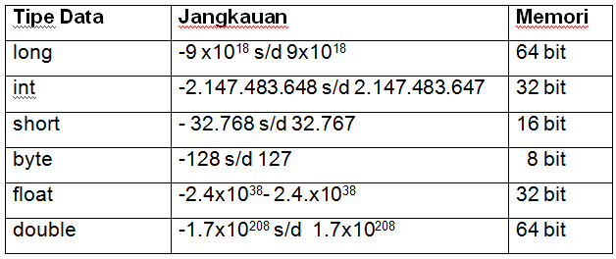
Tipe Data Numerik

Slide 3
Tipe Data Char
Ditandai dengan petik tunggal ('A') atau ('a')
contoh :
public char alphabet = ‘A’;
public char ascii = ‘\111’;
Type Data Boolean
Boolean benar =true
Boolean salah =false
contoh :
public boolean status = true;
public boolean check = 10 < 5 ;

Slide 4
import java.util.Scanner;
public class latih2 {
public static void main (String[] args) {
Scanner masukan = new Scanner(System.in);
float celcius, reamur;
System.out.print("Masukkan nilai suhu (celcius) : ");
celcius = masukan.nextFloat();
reamur = 0.8f * celcius;
System.out.println();
System.out.print("nilai suhu reamur dari input : ");
System.out.println(reamur);
}
}

Slide 5
Operator di Java
Operator Unary
Arti Operator | Operator | Contoh Pemakaian
Pre-Increment | ++operand | int i = 8 ; int j = ++i; i bernilai 9, j bernilai 9
Post-Increment | operand++ | int i = 8; int j = i++; i bernilai 9, j bernilai 8
Pre-Decrement | --operand | int i = 8 ; int j = --i; i bernilai 7 , j bernilai 7
Post-Increment | operand-- | int i=8; int j = i--; i bernilai 7, j bernilai 8

Slide 6
import java.util.Scanner;
public class latih2b {
public static void main (String[] args) {
Scanner input = new Scanner(System.in);
int A,x;
System.out.print("Masukkan Sebuah Bilangan(A) : ");
A = input.nextInt();
x=A;
System.out.println("Nilai Awal A = "+x);A++;
System.out.println(" A++ ->"+A);
A=x;++A;
System.out.println(" ++A ->"+A);
A=x;A--;
System.out.println(" A-- ->"+A);
A=x;--A;
System.out.println(" --A ->"+A);
}
}

Slide 7
Operator Aritmatika
Arti Operator | Operator | Contoh Pemakaian | Keterangan
Penjumlahan | + | sum=num1 + num2
Pengurangan | - | diff=num1 - num2
Perkalian | * | prod=num1 * num2
Pembagian | / | quot=num1 / num2 | jika num1 dan num2 adalah integer, pembagian akan menghasilkan nilai integer tanpa mengikutsertakan sisa, jika terdapat sisa.
Sisa (modulus) | % | mod=num1 % num2 | Hasil operasi modulus adalah sisa dari operasi num1 / num2. Hasil operasi modulus memiliki tanda ( +/- ) yang sama dengan operand pertama

Slide 8
Operator Relasi
Condition | Operator | Example
Is equal to (atau “is the same as”) | == | int i = 1; System.out.println(i==1); // (output : true)
Is not equal to (atau “is not the same as”) | != | int i = 1; System.out.println(i!=1); // (output : false)
Is less than | < | int i = 1; System.out.println(i<1); // (output : false)
Is less than or equal to | <= | int i = 1; System.out.println(i<=1); //(output : true)
Is greater than | > | int i = 1; System.out.println(i>1); //(output : false)
Is greater than or equal to | >= | int i = 1; System.out.println(i>=1); // (output : true)

Slide 9
Operator Logika
Nama Operator | Simbol | Example
AND | && | int i = 1; int j = 2; System.out.println((i<1)&&(j>0)); // (output : false)
OR | || | int i = 1; int j = 2; System.out.println((i<1)||(j>0)); // (output : true)
NOT | ! | int i = 1; System.out.println(!(i<3)); // (output : false)

Slide 10
import java.util.Scanner;
public class latih2c{
public static void main(String[] args) {
Scanner input = new Scanner(System.in);
int a,b;
System.out.print("Masukkan Bilangan Pertama : ");
a = input.nextInt();
System.out.print("Masukkan Bilangan Kedua : ");
b = input.nextInt();
System.out.println(a+" + "+b+" ="+(a+b));
System.out.println(a+" - "+b+" ="+(a-b));
System.out.println(a+" x "+b+" ="+(a*b));
System.out.println(a+" / "+b+" ="+(a/b));
System.out.println(a+" % "+b+" ="+(a%b));
System.out.println(a+" = "+b+" ="+(a==b));
System.out.println(a+" > "+b+" ="+(a>b));
System.out.println(a+" <= "+b+" ="+(a<=b));
System.out.println(a+" != "+b+" ="+(a!=b));
}
}

Slide 11
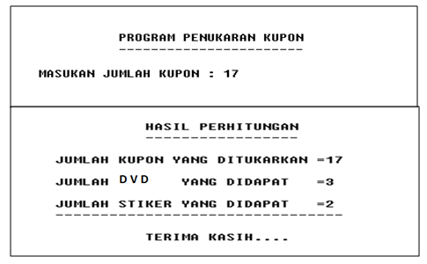
Soal latihan : Buatlah program untuk menghitung penukaran kupon yaitu : ⬄ Setiap 5 kupon akan mendapat 1 buah DVD ⬄Jika kupon kurang dari 5 maka 1 kupon dapat ditukar dengan 1 buah stiker.

