Slide 1
Cabled Array Hack Workshop
Welcome!
UW Oceanography
Applied Physics Lab
eScience Institute
UW IT

Slide 2
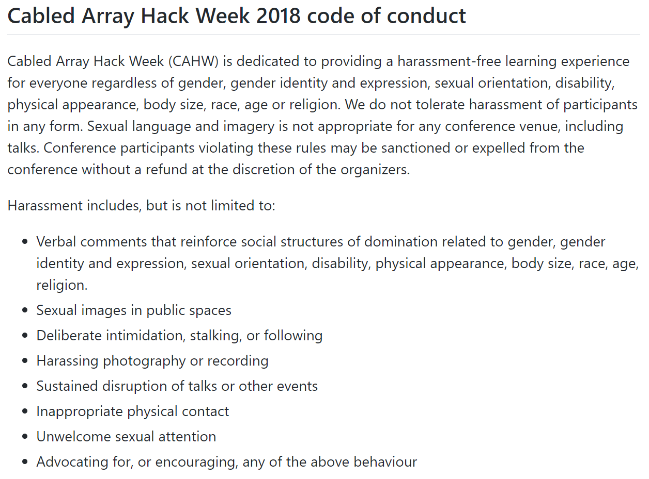

Slide 3
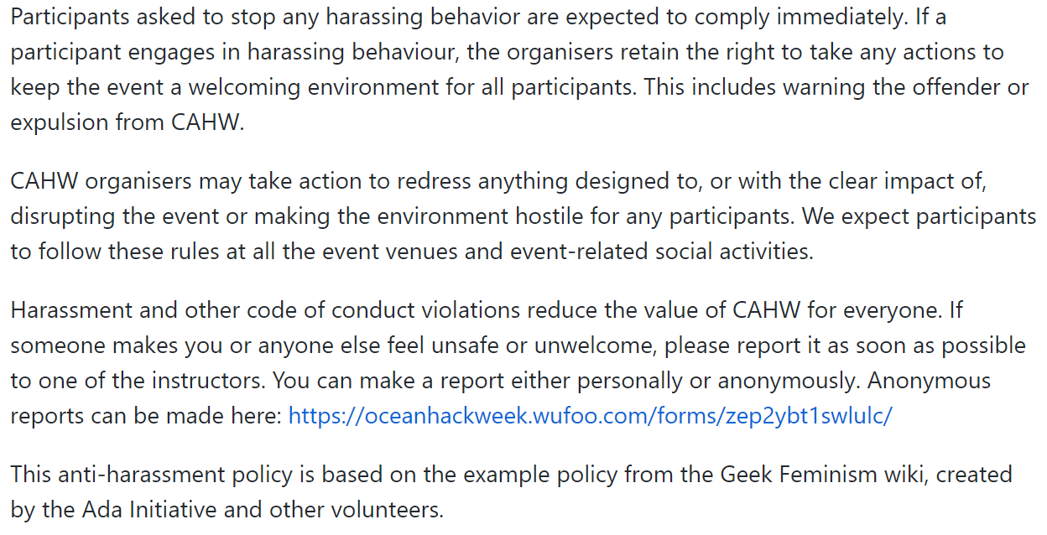

Slide 4
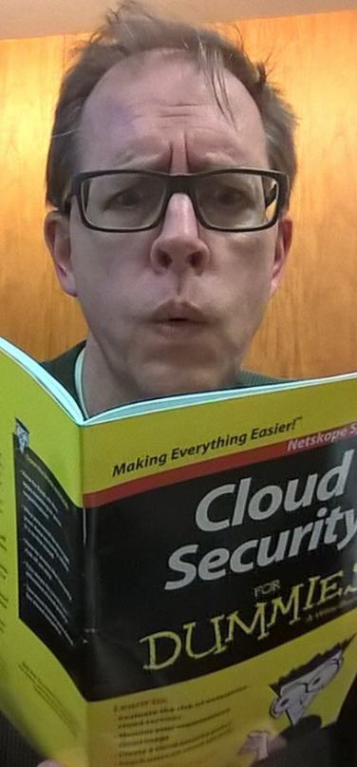
1 – Let’s establish the code of conduct right at the start. Brief overview, mechanisms for raising concerns in private, who you should talk to, and we are quite serious about any violations.
2 – You’re here and you belong here; it’s a good thing. Keeping up is hard work; this workshop is a little space to breathe and soak in some new things. And we have artifacts! (Beyond t-shirts)
3 – We will try to structure the forming of groups; we won’t just ‘turn you loose’ and expect magical hacking to occur.
Final remark: This is as much about a learning process.

Slide 5
demystify
!
KB
?
time

Slide 6
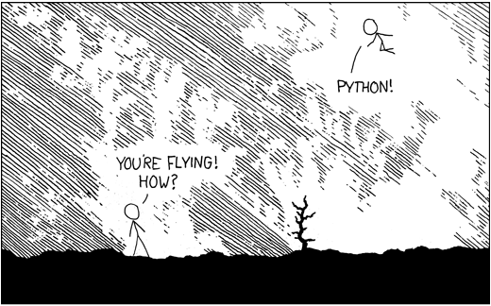
import antigravity

Slide 7
OMics
FTICR
MS
MODIS
OOI-CA

