Slide 1

SOLID
Principles which help to create good software architecture

Slide 2
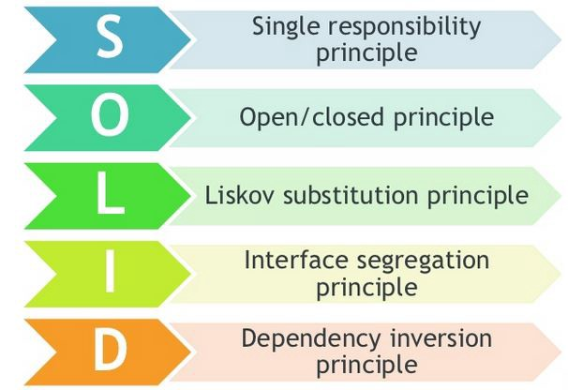
Single Responsibility Principle
Every module or class should have one, and only one responsibility in the software.
This responsibility should be fully encapsulated.
When you have more than one responsibility in a class, it will generate a coupled code in your application.
Use simple naming, long function names imply that there is something fishy.
Big is bad, small is good….
Make software more understandable, extendable, maintainable and testable.

Slide 3
Single Responsibility Principle - Benefits
Low coupling.
When it’s necessary to change a class, this will not impact any other classes.
Maintainable software.
If your class implements multiple responsibilities, they are no longer independent of each other. With this principle you avoid it.
Save time doing a refactor. if you have a coupled code and it’s necessary to do a big change, it will be necessary to test all the app again.
Classes that have only one responsibility are much easier to explain, understand and implement than the ones that provide a solution for everything.
Writing tests for code with single responsibility is easier.
What is the responsibility of your class/component/?

Slide 4
Single Responsibility Principle - Examples
Wrong Practice
Implement SRP
Class User {
Public Id;
Public Name;
Public Age;
Public Email;
ValidateEmail();
ValidateUser();
SaveUser();
}
IEmailValidator {
{
Validate (string email);
};
IUserValidator {
{
// Business Rules
Validate (User userInfo);
};
IUserCreateService {
{
// The strategy to save the user can be changed
Save (User userInfo);
};

