Slide 1
Predictive Analytics and Recommendation Systems in Banking
Goodwin Blesso I
mdt - 38

Slide 2
Loan Default Prediction (Supervised Learning Model)

Slide 3
Introduction
Problem Statement:
Banks need to minimize financial risk by predicting which customers are likely to default on loans.
Objective:
Develop a machine learning model to accurately predict loan default.
Benefits:
Improves loan approval processes and reduces the risks management strategies.

Slide 4
Overview
Dataset:
Synthetic Dataset: Created using Python’s Faker library.
Key Attributes: customer_id, age, income, credict_score, loan_amount, interest_rate, loan_term, repayment_status
Dataset Size: 100000 records.
Data Preprocessing:
Missing value treatment: Check for any missing values in the data frame.
Feature Scaling: Income, loan_amount, credict_score (feature)
Class Imbalance Handling: repayment_status (target)
EDA: It involves analyzing and visualizing data to understand its structure, detect patterns, and identify anomalies.
Model Development:
Algorithm Used: Logistic Regression (This algorithm was chosen for its simplicity, interpretability, and effectiveness in binary classification problems.)
Data split: Training: 70%, Testing: 30%.
Model Evaluation:
Metrics: Accuracy, Precision, Recall, F1-Score, ROC-AUC Score.
Result:
Accuracy: 97.61%
Classification report: 0.9956922869187407

Slide 5
Key Insights
Model Findings:
Low credit scores and income increase default risk.
Business Recommendations:
Prioritize customers with high credit scores for loans.
Conclusion
Summary:
Machine learning helps us to predict loan repayment status accurately.
Provides actionable insights for better profitability, reduces the risk management and financial losses for banks.

Slide 6
Customer Segmentation
(Unsupervised Learning Model)

Slide 7
Introduction
Problem Statement:
Banks face challenges in delivering personalized services due to diverse customer transaction behaviors.
Understanding customer segments can improve targeted marketing and operational efficiency.
Objective:
To analyze customer transaction behavior and segment customers to:
Deliver personalized banking services.
Optimize marketing campaigns.
Improve customer satisfaction and retention.
Benefits:
Better customer engagement satisfaction.
Increase in revenue.

Slide 8
Overview
Dataset:
Synthetic Dataset: Created using Python’s Faker library.
Key Attributes: customer_id, transcation_id, transcation_amount, transcation_type, tanscation_date
Dataset Size: 100000 records.
Data Preprocessing:
Missing value treatment: Check for any missing values in the data frame.
One-Hot Encoding: transcation_type (feature)
Feature Scaling: Applied MinMaxScaler to normalize numerical features (transcation_amount)
EDA: It involves analyzing and visualizing data to understand its structure, detect patterns, and identify anomalies.
Model Development:
Algorithm Used: K-Means Clustering.
Feature: transcation_amount, transcation_count, transcation_type (One-Hot Encoded)
Number of Clusters: 4 (Determined using Silhouette Score.)

Slide 9
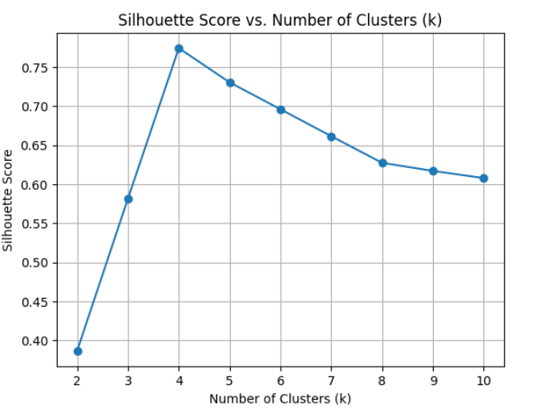
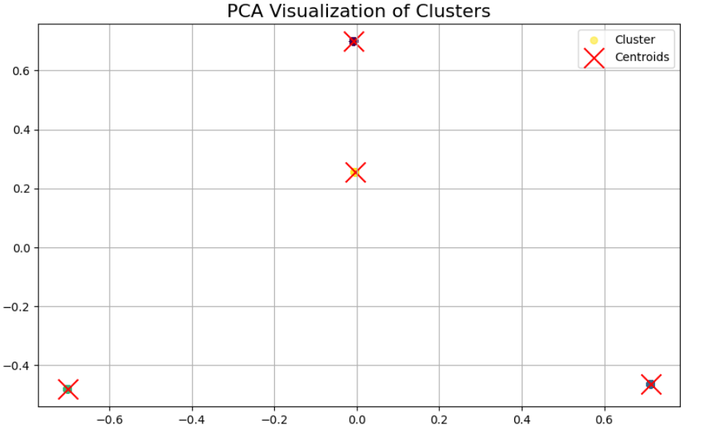
Model Evaluation:
Metrics: Silhouette Score, Davies-Bouldin Index
Results:
Silhouette Score: k=4 (Measures cluster separation)
Davies-Bouldin Index: 0.3543065134794949

Slide 10
Key Insights
Business Recommendations:
Cluster 0 (Bill Payment Dominant):
Introduce cashback offers and automated bill payment options.
Promote bundled services like mobile and utility payments.
Cluster 1 (Deposit Dominant):
Offer fixed deposit schemes and investment advisory services.
Cluster 2 (Withdrawal Dominant):
Launch personalized offers to encourage engagement.
Cluster 3 (Transfer Dominant):
Facilitate international transfers with low fees and added perks.
Conclusion
Summary:
Customer segmentation revealed distinct transaction patterns and preferences.
Clustering enables banks to better understand and serve their customers, driving satisfaction and revenue growth.

Slide 11
Product Recommendations
(Recommendation Engine)

Slide 12
Introduction
Problem Statement:
Recommending the right products to customers based on their past behavior can increase customer loyalty and boost cross-selling opportunities.
Objective:
Develop a recommendation system to suggest the most relevant products to customers.
Benefits:
Enhanced Customer Experience
Increased Sales and Revenue
Improved Customer Loyalty

Slide 13
Overview
Dataset:
Synthetic Dataset: Created using Python’s Faker library.
Key Attributes: customer_id, transcation_id, interaction_type, products
Dataset Size: 10000 records.
Data Preprocessing:
Missing value treatment: Check for any missing values in the data frame.
Label Encoding: interaction_type (feature)
EDA: It involves analyzing and visualizing data to understand its structure, detect patterns, and identify anomalies.
Model Development:
Algorithm Used: Cosine Similarity (Collaborative Filtering)
Used to measure the similarity between customers based on their interaction patterns.
User-Item Matrix: Rows = Customers, Columns = Products.

Slide 14
Model Evaluation:
Metrics: Precision, Recall, Mean Average Precision (MAP), Normalized Discounted Cumulative Gain (NDCG).
Results:
Average Precision at k=5: 0.64
Average Recall at k=5: 0.9833333333333334
Mean Average Precision (MAP): 1.2553333333333334
Average NDCG at k=5: 0.9374272283708148
Conclusion
The recommendation system effectively identifies relevant products for diverse customer segments.
Business Impact:
Enhanced cross-selling opportunities through personalized recommendations.
Improved customer satisfaction and loyalty.

Slide 15
Thank You

