Slide 1
Classifying Cybersecurity Incidents
Goodwin Blesso I
mdt - 38

Slide 2
Introduction
Problem Statement:
Microsoft want us to develop a machine learning model that improves the SOC efficiency and accurately classifies cybersecurity incidents based on past evidence and customer feedback.
Objective:
Build a classification model to categorize incidents as TP, BP, or FP.
Enhance SOC efficiency by reducing false positives.
Support automated threat intelligence for faster incident response.
Improve accuracy in cybersecurity incident classification.
Benefits:
Faster Response Times – Analysts focus on real threats.
Reduced Alert Fatigue – Eliminates unnecessary investigations.
Enhanced Security – Increases detection accuracy.
Cost & Resource Savings – Automates manual triage efforts.

Slide 3
Overview
Dataset:
Data Source: Historical records of cybersecurity incidents
Features: AlertTitle, EntityType, Category, EvidenceRole, SuspicionLevel, LastVerdict, OSFamily, OSVersion, CountryCode
Target: IncidentGrade
Dataset Size: 47,58,418 rows
Data Preprocessing:
Read the historical cybersecurity data in a variable df.
Missing Value Treatment: Checked for missing values in the df and treated it.
Columns with more than 80% of missing values has been dropped from df.
The missing values in the column are handled using Mode imputation approach.
Encoding: Used One-hot encoding and frequency encoding techniques for categorical columns.
Feature Selection: Used “DecisionTreeClassifier” to select the features based on the contributions.

Slide 4
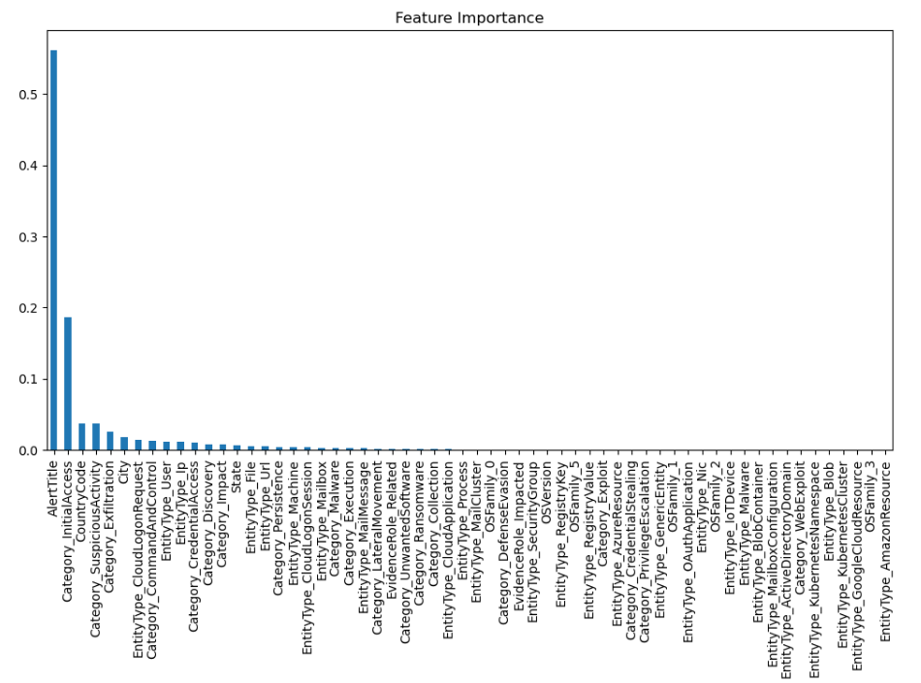

Slide 5
EDA:
It involves analyzing and visualizing data to understand its structure, detect patterns, and identify anomalies.
Insights:
Incident Grade Distribution: The majority of incidents fall under the "BenignPositive" category.
Incident Category: A significant number of incidents are reported under the "InitialAccess" category.
Alert Title Analysis: The alert title "0" has the highest occurrence, with around 6,500 reports.
Incident Timeframe: All reported incidents are from the months of May and June.
Day-wise Trend: Most incidents occur on weekdays (Monday - Friday).
Hourly Trend: Incident reports peak between 11 AM to 11 PM.
Model Development:
Data split: (Training: 80%, Validation: 20%)
Stratified sampling: Used to ensure that both the training and validation sets have similar class distributions.
Algorithm Used: Decision Tree Classifier model is chosen for its Interpretability (provide a clear and easy-to-understand structure) and Faster Training & Prediction (It trains quickly and make predictions in real-time).

Slide 6
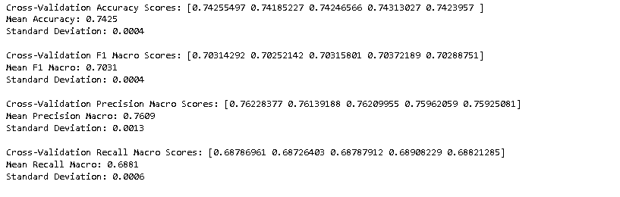
SMOTE (Synthetic Minority Over-sampling Technique): Balances class distribution by generating synthetic samples for minority classes to improve model accuracy.
Hyperparameter Tuning (RandomizedSearchCV): Optimizes model performance by efficiently searching for the best hyperparameter combinations.
K-Fold Cross-Validation: Ensures model performance is consistent by splitting the dataset into multiple training and validation sets.
Output:

Slide 7
Model Evaluation:
Performance Metrics: Macro-F1 score, Precision, Recall
Scores:
Training Data:
Model | Macro F1-Score | Macro Precision | Macro Recall
DecisionTreeClassifier | 0.7001 | 0.7042 | 0.7013
RandomForestClassifier | 0.7003 | 0.7044 | 0.7013
XGBoostClassifier | 0.6539 | 0.6664 | 0.6499
LightGBMClassifier | 0.6554 | 0.7497 | 0.6437
CatBoostClassifier | 0.6478 | 0.6630 | 0.6412
Test Data:
Model | Macro F1-Score | Macro Precision | Macro Recall
DecisionTreeClassifier | 0.6945 | 0.6956 | 0.6995
RandomForestClassifier | 0.6930 | 0.6956 | 0.68948

Slide 8
Recommendations:
Automate Incident Classification – Use machine learning to categorize incidents (TP, FP, BP) and reduce manual review time.
Reduce False Alarms – Minimize false positives to help SOC analysts focus on real threats and improve efficiency.
Enhance Threat Intelligence – Leverage historical data to detect attack patterns and strengthen security policies.
Continuous Model Improvement – Regularly update and retrain the model to adapt to evolving cyber threats.
Challenges:
Handling Large Dataset – The dataset size caused frequent crashes while applying SMOTE for oversampling the minority class.
Hyperparameter Tuning Limitations – GridSearchCV took excessive time and eventually crashed, making it difficult to fine-tune the model.
Conclusion:
The machine learning model successfully classifies cybersecurity incidents, helping SOC analysts prioritize real threats efficiently.
It reduces false positives and improving detection accuracy, also supports faster and more effective security incident response.

Slide 9
Thank You

