Slide 1
Illuminating Insights for Global Electronics
Goodwin Blesso I
mdt- 38

Slide 2
Exploratory Data Analysis for
Global Electronics

Slide 3
Introduction
Problem Statement:
Global Electronics is facing challenges in understanding customer behavior, optimizing store operations, and identifying high-performing products and regions.
Objective:
Uncover insights from customer, product, sales, and store data.
Provide actionable recommendations to improve operations and drive business growth.
Benefits:
Improved Customer Experience
Revenue Growth
Efficient Operations & Data-Driven Decisions

Slide 4
Overview
Dataset:
Customers: CustomerKey, Name, City, Gender, State Code, Zip Code, State, Country, Continent, Birthday
Product: ProductKey, Product Name, Brand, Color, UnitCost, UnitPrice, SubcategoryKey, Subcategory, Category, CategoryKey
Store: StoreKey, Country, State, Square Meters, Open Date
Sales: Order Number, Line Item, Order Date, Delivery Date, StoreKey, CustomerKey, ProductKey, Quantity, Currency Code
Exchange: Date, Currency, Exchange
Data Preprocessing:
Missing value treatment: Check for any missing values in the data frame.
EDA: It involves analyzing and visualizing data to understand its structure, detect patterns, and identify anomalies.
Tools Used:
Jupyter Notebook: Performed data preprocessing , cleaning and EDA using Python library’s.
MySQL Database: Imported preprocessed data into a relational database.
Power BI: Developed interactive dashboards and visualizations to present insights.

Slide 5
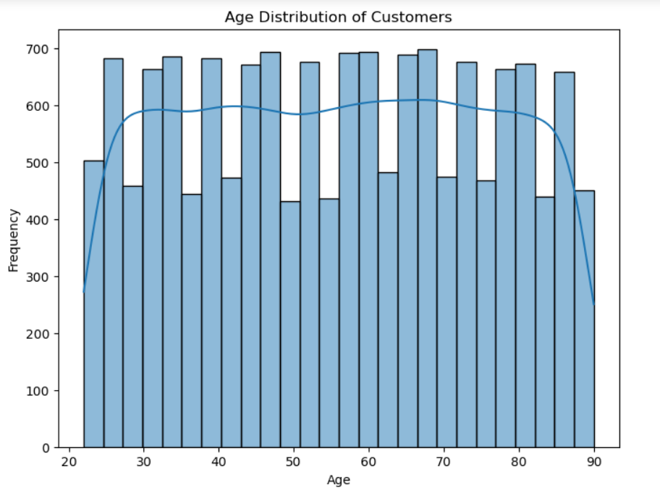
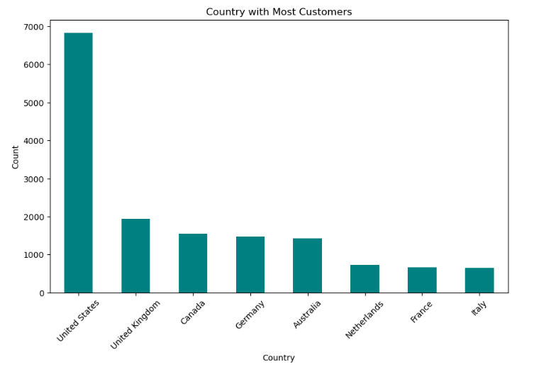
EDA Insights
Customer Analysis

Slide 6
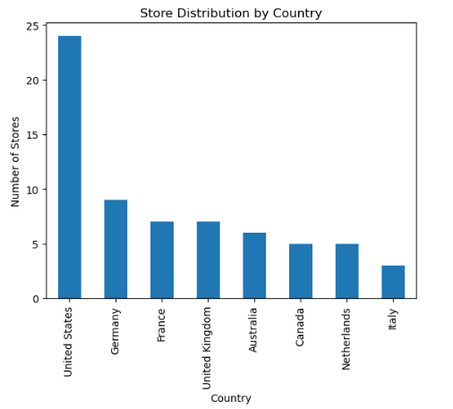
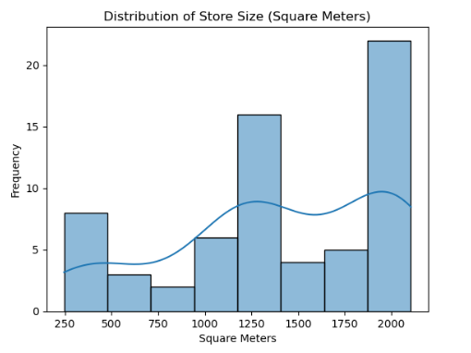
Store Analysis

Slide 7
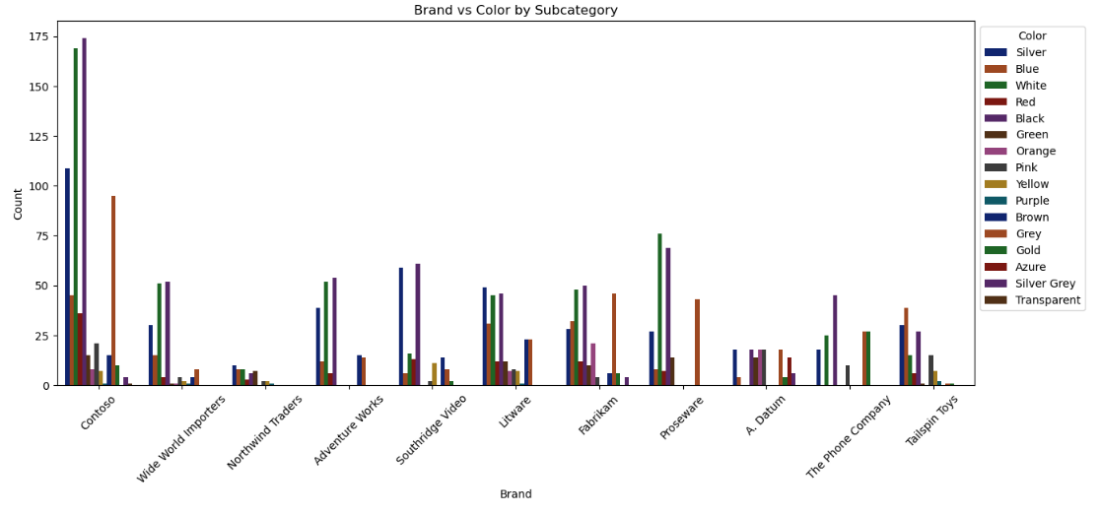
Product Analysis

Slide 8
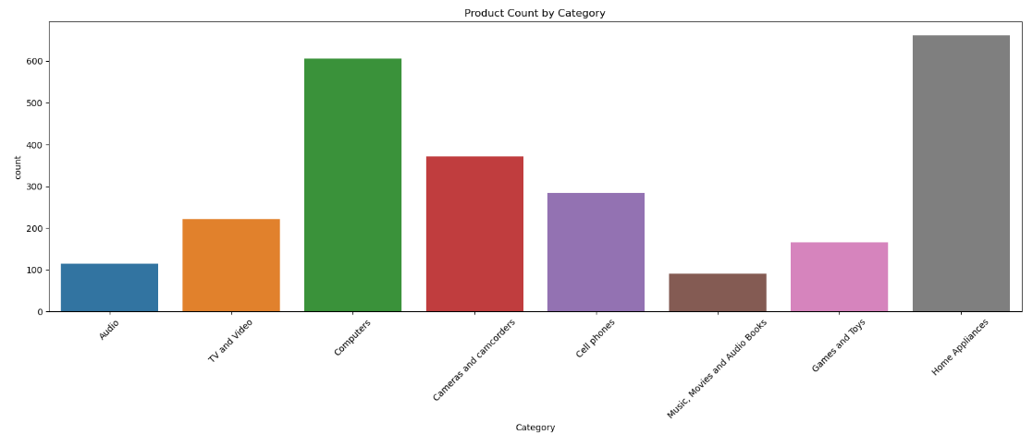

Slide 9
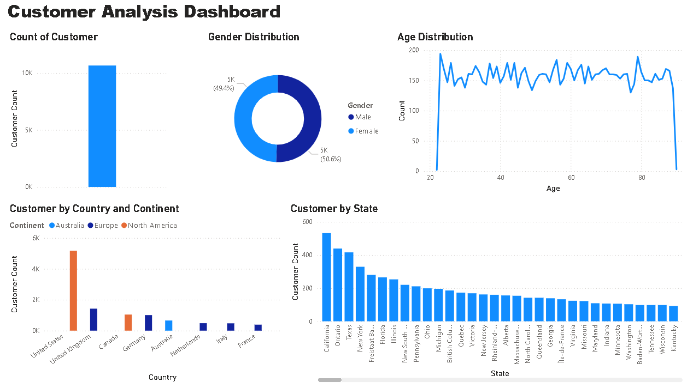
Power BI Visualization

Slide 10
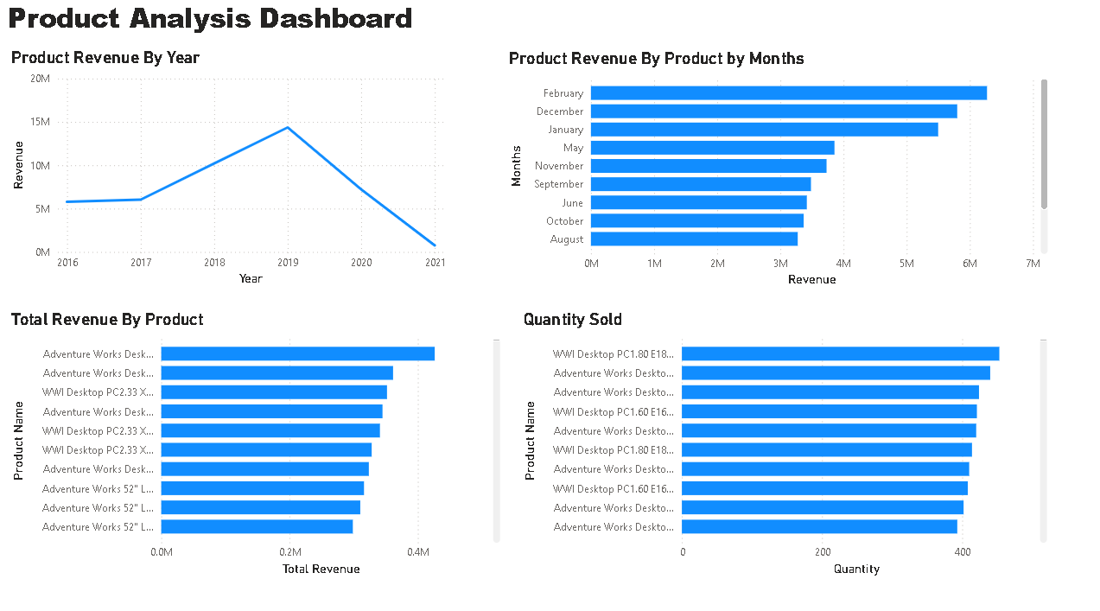

Slide 11
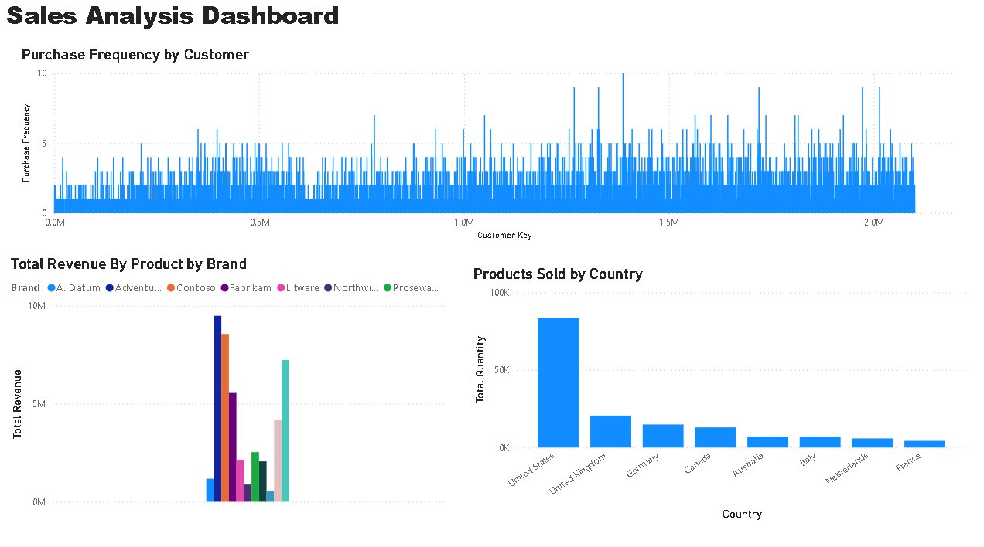

Slide 12
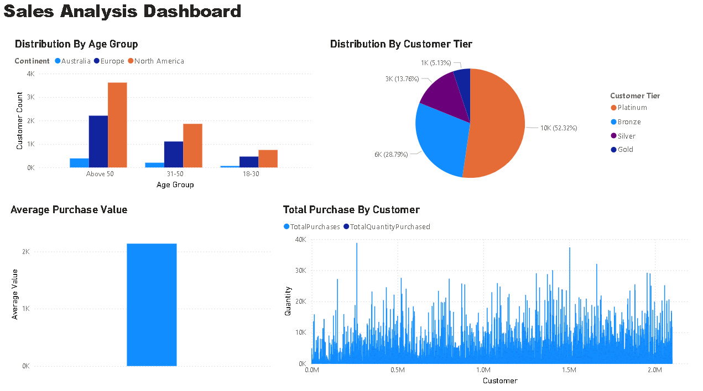

Slide 13
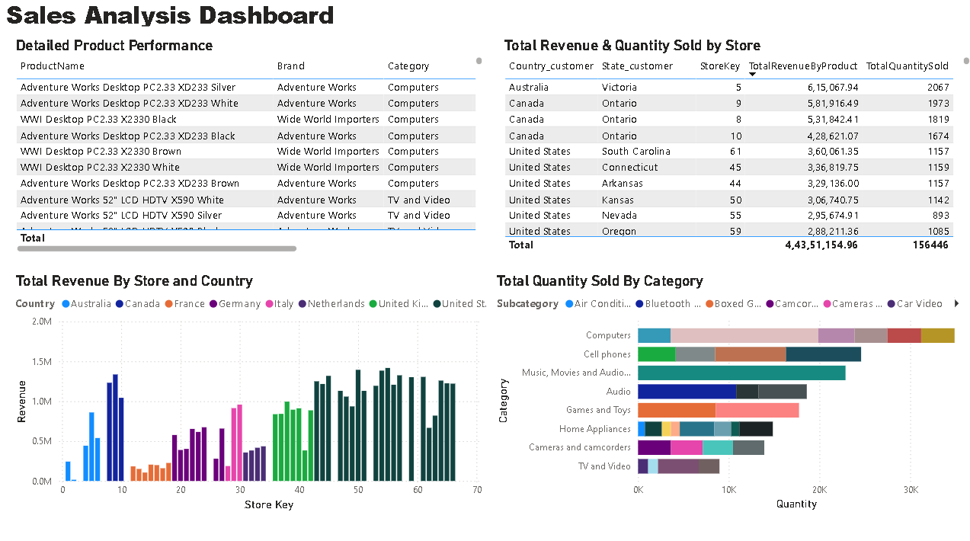

Slide 14
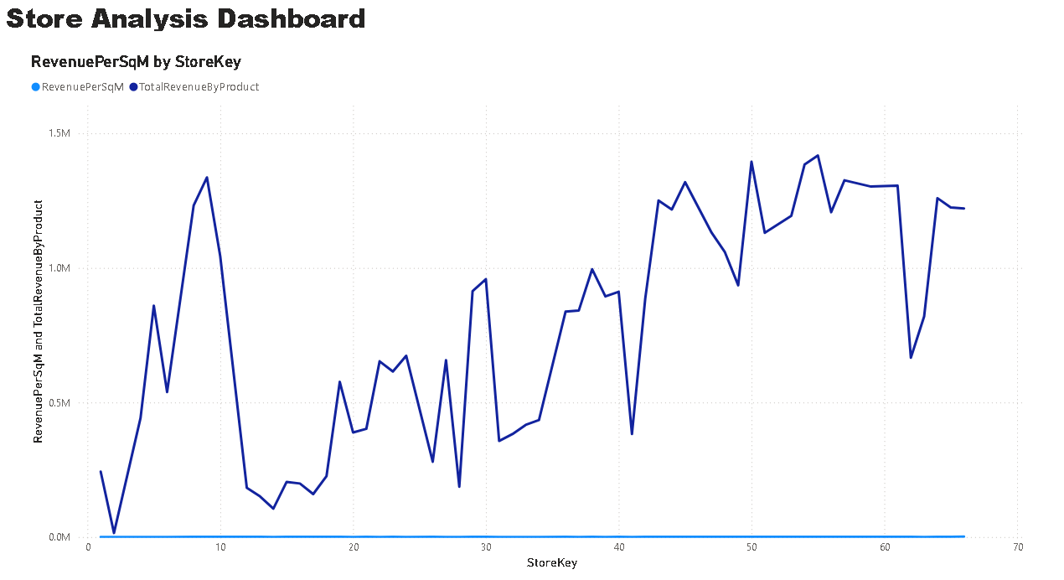

Slide 15
Key Insights
Customer Analysis:
Total Customer Base: The dataset contains 10,657 unique customers.
Gender Distribution: The customer base is nearly balanced, with Male (50.6%) and Female (49.4%).
Age Distribution: Customers' ages range from 22 to 90 years.
Geographical Insights:
North America, particularly the United States, has the highest concentration of customers.
California is the leading state in customer count.
Product Analysis:
Revenue Trends:
2019 recorded the highest revenue at $14 million, while 2021 had the lowest revenue.
February consistently generated the highest revenue across all years.
Top-Performing Products:
Most products got sold in the category of Computers.
The product "Adventure Works Desktop PC2.33.XD233" generated the highest revenue.
In terms of quantity sold, "WWI Desktop PC1.80 E1800 White" was the top-selling product, with 453 units sold.
Brand Performance:
The "Adventure Works" brand contributed the highest revenue among all brands.

Slide 16
Sales Analysis:
Demographics & Purchasing Behaviour:
Majority of purchases were made by customers aged 50 and above.
Customer Tier Distribution:
The "Platinum" tier has the highest number of customers, with purchases exceeding $10,000.
Purchase Value & Frequency:
Average purchase value per customer: $2,137.82.
Highest single customer purchase value: $38,818.88.
Purchase frequency varies between 1 and 10 transactions per customer.
Geographical Sales Performance:
The United States recorded the highest product sales.
Store Analysis:
Top-Performing Store:
Store Key: 5, located in Victoria, Australia, has generated the highest revenue.
Total Revenue: $615,067.94
Total Quantity Sold: 2,067 units
Operational Duration: 10 years
Stores with 2,000+ square meters generated more profit.

Slide 17
Recommendations
Customer Targeting & Retention
Most purchases are made by customers above 50. So, implement loyalty programs and targeted marketing campaigns for this age group of customers.
Platinum-tier customers (purchased >10,000) contribute significantly to revenue. So, provide exclusive discounts, premium memberships, and personalized recommendations.
United States & North America have the highest customer base. So, Increase store presence and optimize inventory in these regions.
Product Optimization
"Adventure Works Desktop PC2.33.XD233" generates the highest revenue. Increase stock availability, run promotions, and bundle offers with accessories.
"WWI Desktop PC1.80 E1800 White" has the highest quantity sold. Ensure efficient supply chain management to avoid stock shortages.
February records the highest revenue across years. Optimize marketing and inventory in Q1 to maximize seasonal sales.
Store Performance
Stores with 2,000+ square meters generate more profit. Prioritize store expansions and upgrades to larger spaces for better revenue.
Analyze stores with low revenue & assess inventory, location, or demand gaps. Relocate or repurpose low-performing stores to maximize efficiency.

Slide 18
4. Sales & Revenue Growth Strategies
Improve online shopping experience with seamless website navigation. Introduce Click & Collect options to integrate online and offline sales.
Offer time-limited discounts during slow sales periods to drive urgency
Analyze seasonal demand trends and adjust pricing accordingly.
Offer discounts on bulk purchases to encourage higher spending per order.
Replace underperforming SKUs with fast-moving items.
Utilize customer feedback & reviews to refine product offerings and services.
Conclusion
By implementing these strategies, Global Electronics can:
Improve customer loyalty & retention.
Optimize inventory & product performance.
Expand high-performing stores & optimize locations.
Increase sales volume & profitability across channels.

Slide 19
Thank You

