Slide 1
RedBus Data Scraping & Dynamic Filtering
Goodwin Blesso I
MDT - 38

Slide 2
Introduction
Problem Statement:
The current process of analyzing bus travel data is manual, time-consuming, and lacks centralized visibility.
Transportation companies and travel platforms struggle to efficiently gather real-time data on routes, pricing, schedules, and availability, limiting their ability to make data-driven decisions and offer competitive services.
Objective:
To develop an automated system that scrapes live RedBus data using Selenium.
To develop a dynamic and user-friendly Streamlit interface, for enabling efficient filtering and visualization.
Benefits:
Real-Time Insights: Instantly access live data on routes, schedules, pricing, and seat availability.
Strategic Decision Support: Enable businesses to analyze travel trends, pricing strategies, and customer preferences.
Improved Customer Experience: Support personalization by offering filtered, data-driven travel options.
Competitive Analysis: Benchmark offerings against market competitors for better pricing and service strategies.

Slide 3
Overview
Data Scraping:
Selenium: It automates the browser to extract real-time bus data from the RedBus website, including routes, timings, fares, ratings and seat availability.
Data : I have scraped transportation details from the following 12 states:
States: Kerala, Andhra Pradesh, Telangana, Assam, Kadamba, Bihar, Chandigarh, Himachal Pradesh, Punjab, Rajasthan, West Bengal, and Uttar Pradesh.
Data Preprocessing:
Data Collection: Scraped transportation data from 12 different states and consolidated it into a single DataFrame.
Missing value treatment: Identified and handled missing values to ensure data consistency and quality.
Data Analysis: Used SQL queries to retrieve and filter data based on user inputs.
Tools Used:
Jupyter Notebook: Used for data collection, cleaning, and application development with Python libraries.
MySQL Database: Preprocessed data was stored in a structured relational database for efficient access and management.

Slide 4
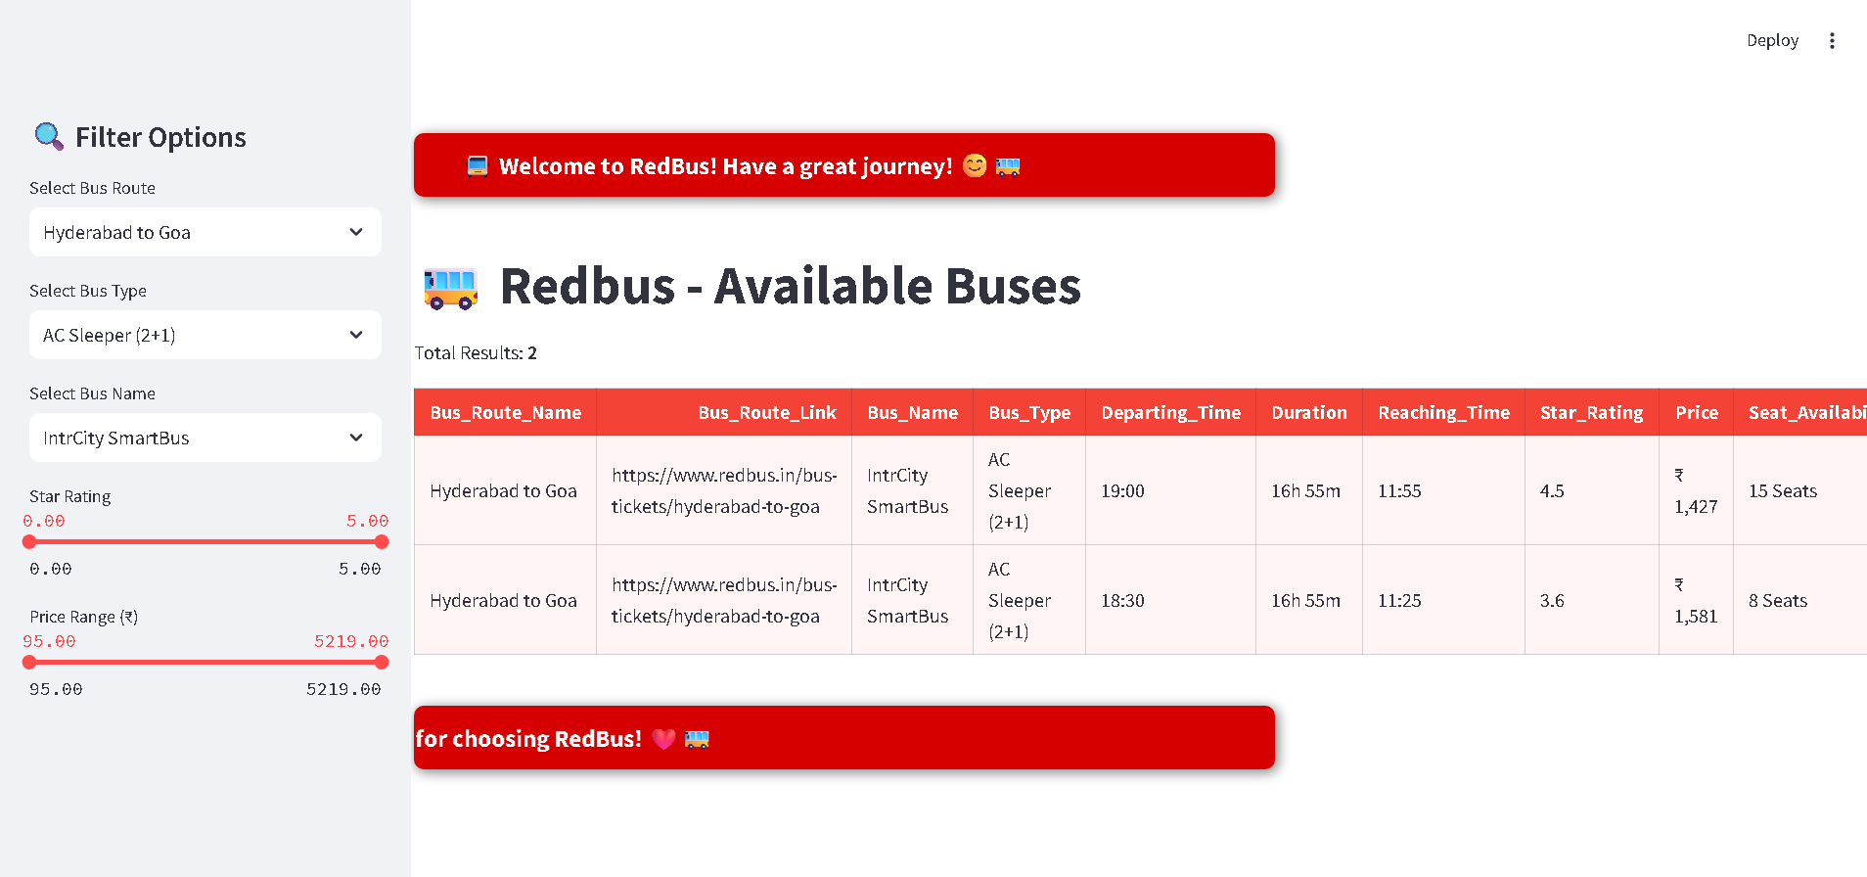
Deployment:
Streamlit Application: Developed an interactive web application using Streamlit to dynamically filter and visualize bus travel details in real time, the user interface looks as below:

Slide 5
Workflow:
Accessing the Application
Run the steamlit application using the command “streamlit run app.py”
It redirects to the web browser and navigate to the RedBus application.
Enter Filter Options
Select Bus Route: Use the dropdown to choose your desired route (e.g., Bettiah to Patna).
Select Bus Type: Pick your preferred bus type (e.g., A/C Seater (2+2)).
Select Bus Name: Enter the name of the travel operator you are interested in.
Star Rating: Use the slider to filter buses based on customer ratings.
Price: Adjust the price slider to set your desired fare range.
Output:
Filtered results based on the selected criteria will be displayed under the "RedBus - Available Buses" section.
Recommendations:
Travel Aggregators:
Using our Streamlit app, travel aggregators can dynamically display bus availability and schedules in real time, filtered by route, bus type, rating, price, and operator—enhancing the booking experience.

Slide 6
Market Analysis:
With the collected and pre-processed data stored in MySQL and visualized through Streamlit, companies can analyse travel patterns, pricing trends, and user preferences across states effectively.
Customer Service:
Our interactive filtering options in Streamlit allow customer service teams or portals to quickly provide personalized travel recommendations based on user-selected criteria like comfort, budget, and operator preferences.
Competitor Analysis
The solution enables organizations to compare services across multiple state transport systems, empowering them to benchmark price, availability, and ratings—all within a single app interface.
Conclusion:
This project effectively showcases how Selenium-based web scraping, combined with a user-friendly Streamlit application, enables users and travel agencies to gain valuable insights into bus transport data across multiple Indian states.

Slide 7
Thank You

