Slide 1

MASTER'S DEFENSE
A Deep Reinforcement Learning Framework for Autonomous Cybersecurity Defense in IoT Networks
Um Arcabouço de Aprendizado por Reforço Profundo para Defesa Cibernética Autônoma em Redes IoT
Felipe Augusto Oliveira dos Santos
Advisor: Prof. Dr. Denis Fantinato
Examination Committee: Prof. Dr. Denis Fantinato (UNICAMP) · Prof. Dr. Alexandre da Silva Simões (UNESP)
Prof. Dr. João Kleinschmidt (UFABC)
School of Electrical and Computer Engineering (FEEC) · Campinas — August 31, 2026
Notes:
Good morning. Welcome the committee: Prof. Denis Fantinato (advisor), Prof. Alexandre Simoes, Prof. Joao Kleinschmidt. State the title slowly. One-sentence framing: this dissertation asks WHEN a learning-based defender genuinely earns its place in IoT security, and answers it with a controlled, reproducible experiment.

Slide 2
PRESENTATION
About the Speaker
PHOTO
(replace in
Google Slides)
Felipe Augusto Oliveira dos Santos
M.Sc. candidate, Electrical Engineering (Computer Engineering area) — FEEC / UNICAMP
[TODO: B.Sc. degree, institution, year]
[TODO: current professional role / industry experience]
[TODO: research interests — e.g. reinforcement learning, cybersecurity, IoT]
Research line: adversarial reinforcement learning for autonomous IoT defense (advisor: Prof. Dr. Denis Fantinato)
Journal article condensing this dissertation submitted to Elsevier Internet of Things (2026)
Placeholders marked [TODO] — fill in before presenting.
FEEC · UNICAMP
2
Notes:
TODO before the defense: fill in the biography placeholders (education, professional role, interests) and paste your photo into the framed box. Keep it to 45 seconds — the committee knows you; this is for the public audience.

Slide 3
PRESENTATION
Agenda
1
Context — Why IoT defense outgrew static security — and the vocabulary we need (kill chain, RL, POMDP)
2
Research Question — When does learned sequential control beat per-flow classification?
3
Framework — Dataset projection, reactive attacker, partially observable environment, reward contracts
4
Results — The aliasing crossover · reward ablation · robustness · zero-day-like classes
5
Closing — Findings, limitations, future work
FEEC · UNICAMP
3
Notes:
Walk the agenda in ~40 seconds. Emphasize the shape of the talk: first I teach the background (kill chain + RL + partial observability), then I state the research question, then the framework we built, then the evidence, then what it means. Total ~35 minutes.

Slide 4
1 · CONTEXT
IoT Turned Every Network Into an Attack Surface
19.8B → 40.6B
USD 12.2T
33 attacks
IoT devices worldwide, 2025 → 2034 (forecast)
projected annual cybercrime damages by 2031
attack types executed device-to-device in CICIoT2023
Why traditional security fails here
Constrained devices
Extreme heterogeneity
Static defenses
No compute, memory, or energy budget for on-device security agents
Disparate protocols and OSes — uniform policy enforcement is impractical
Signature IDS misses zero-days; anomaly IDS floods operators with false positives
⇒ The gap: defenses that adapt, learn from data, and act autonomously — the promise of Deep RL.
FEEC · UNICAMP
4
Notes:
Teach: scale first. 19.8 billion devices in 2025, forecast to more than double to 40.6 billion by 2034 (Statista). Cybercrime damages projected at USD 12.2 trillion annually by 2031 (Cybersecurity Ventures / Morgan). Then the three structural reasons traditional IT security fails on IoT: (1) devices are resource-constrained — no room for antivirus/firewall agents; (2) extreme heterogeneity — no uniform policy enforcement; (3) signature IDS is reactive — zero-days have no signature, and anomaly IDS drowns in false positives on heterogeneous traffic. Land the conclusion: we need defense that is adaptive, data-driven, autonomous.

Slide 5
1 · CONTEXT
The Cyber Kill Chain: a Decision Frame for Defense
An intrusion is a campaign in stages — and each stage has a proportionate response.
BENIGN
RECON
ACCESS
MANEUVER
IMPACT
▸
▸
▸
▸
Routine traffic. Business as usual.
Scanning, fingerprinting, enumeration.
Foothold: brute force, injection, hijack.
Lateral movement, botnet staging.
DDoS, exfiltration, detonation.
Defender's five-action menu (recommended-action mapping):
OBSERVE
LOG
RESTRICT
BLOCK
ISOLATE
monitor only
record & watch
throttle traffic
drop flows
quarantine segment
cost of interruption grows monotonically → · over-forcing early = availability damage · under-forcing late = compromise
FEEC · UNICAMP
5
Notes:
This is the vocabulary slide — teach it well, everything later hangs on it. An intrusion is not one event; it is a campaign in stages. Walk the five stages with the story: attacker scans (RECON), gets a foothold (ACCESS), moves laterally / positions (MANEUVER), and detonates — DDoS, exfiltration (IMPACT). Two teaching points: (1) stopping an attack EARLY is cheap, stopping it LATE is expensive; (2) each stage has a proportionate response — the recommended-action mapping (IoTWarden). Over-reacting has a real availability cost: you cannot isolate the network on every port scan. This stage-to-action alignment is what our reward and our attacker dynamics are built on.

Slide 6
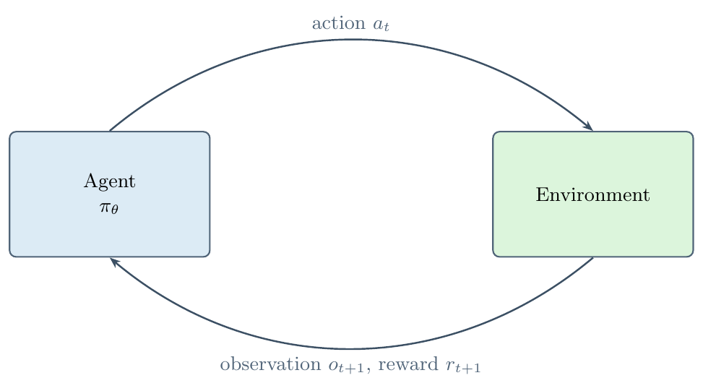
1 · CONTEXT
Reinforcement Learning in One Slide
DQN off-policy · value-based
Learns Q-values; replays past experience from a buffer. Sample-efficient — but bootstrap can wobble.
PPO on-policy · actor-critic
Learns from fresh rollouts with clipped, conservative policy updates. The de-facto stability standard.
A2C on-policy · actor-critic
Synchronous advantage actor-critic — simpler, faster updates from parallel workers.
Learn a policy π(a | s) that maximizes expected cumulative reward — by trial and error, not labels.
Same MLP policy network (2×64 units), same budget, same seeds — the comparison isolates the learning rule.
FEEC · UNICAMP
6
Notes:
Keep this brisk — the committee knows RL; this is calibration, not a lecture. Agent observes state, picks action, environment returns reward and next state; the agent learns a policy maximizing cumulative discounted reward. No labels — learning from interaction; credit assignment over time is the hard part. Three algorithms, spanning the two model-free families: DQN (off-policy, value-based, replay buffer), PPO and A2C (on-policy actor-critic; PPO adds clipped updates). Foreshadow: the on-policy/off-policy distinction becomes an empirical finding later — remember it.

Slide 7
1 · CONTEXT
The Perception Gap: From MDP to POMDP
Full observability (MDP)
Partial observability (POMDP) — this work
state sₜ is visible → react to what you see
stage sₜ is hidden → only feature rows oₜ ∼ Z(· | sₜ)
A memoryless rule per state can be optimal — classification is enough.
Adjacent stages emit overlapping observations — no single row identifies the stage.
The only way through: accumulate evidence over time
oₜ₋₄ … oₜ
belief bₜ(s)
π(a | history)
aₜ
window of recent
observations (w = 5)
implicit posterior over
hidden stages
policy conditioned
on the window
proportionate
defensive action
If one snapshot cannot diagnose, memory becomes the defense. This is where sequential control earns its keep.
FEEC · UNICAMP
7
Notes:
THE central concept of the thesis — spend time here. In an MDP the agent sees the true state. Our defender never does: the true kill-chain stage is latent. It sees only traffic features — and adjacent stages EMIT OVERLAPPING FEATURES. That is partial observability (POMDP): observations are drawn from an observation kernel Z, and the optimal policy must act on a BELIEF built from history, not on a single observation. Teaching metaphor: a doctor who never sees the disease, only symptoms — and adjacent diseases share symptoms; one snapshot cannot diagnose, a case history can. Our agent approximates belief with a sliding window of the last 5 observations. Foreshadow: we make ambiguity a CONTROLLED DIAL (aliasing rate alpha) and study defense as a function of it.

Slide 8
2 · RESEARCH QUESTION
When does a learned sequential policy
genuinely beat a memoryless
per-flow classifier?
The skeptic's objection this thesis answers: “If each flow reveals the attack stage, your RL agent is just an expensive classifier — a supervised model should match it.”
Answer strategy: make stage ambiguity a controlled dial (aliasing rate α), keep everything else fixed, and measure where classification stops being enough.
Notes:
Slow down; this is the thesis in one slide. The naive pitch — 'RL beats a classifier' — is not a scientific claim until you ask WHEN and WHY. If every flow reveals the attacker's intent, defense collapses to per-flow classification, and a well-tuned classifier is the right tool. RL earns its keep only when the problem is genuinely sequential AND partially observed. So the dissertation poses the skeptic's objection to itself: 'your agent is solving a disguised classification problem' — and designs experiments to answer it. Everything that follows is that answer.

Slide 9
2 · RESEARCH QUESTION
Five Contributions — the Map of This Talk
1
A genuinely partially observable kill-chain environment
Reactive escalation attacker + real CICIoT2023 features + controllable aliasing α
2
A controlled crossover: windowed RL vs per-flow control
Tie at α = 0 by design; disjoint CIs from α = 0.4 onward
3
A reward ablation that answers the privileged-reward objection
Best learned agent beats RF-Acting under both reward contracts
4
A held-out attack-class prevention advantage
Higher prevention on all 10 unseen classes — no dependence on detector recall
5
Algorithm reliability + reproducibility by construction
On-policy stability finding · hash-pinned manifests · 462 tests
FEEC · UNICAMP
9
Notes:
One breath per card; each returns later with evidence. 1: a genuinely partially observable kill-chain environment on real CICIoT2023 traffic with a reactive attacker — the instrument. 2: the controlled crossover — tie at alpha=0, separation as ambiguity grows. 3: reward ablation — the advantage survives removing the shaped reward (kills the privileged-reward objection). 4: on ten held-out attack classes the RL defender prevents more on every class, independent of detector recall. 5: honest algorithm-reliability reporting + a fully hash-pinned reproducible artifact chain (462 tests).

Slide 10
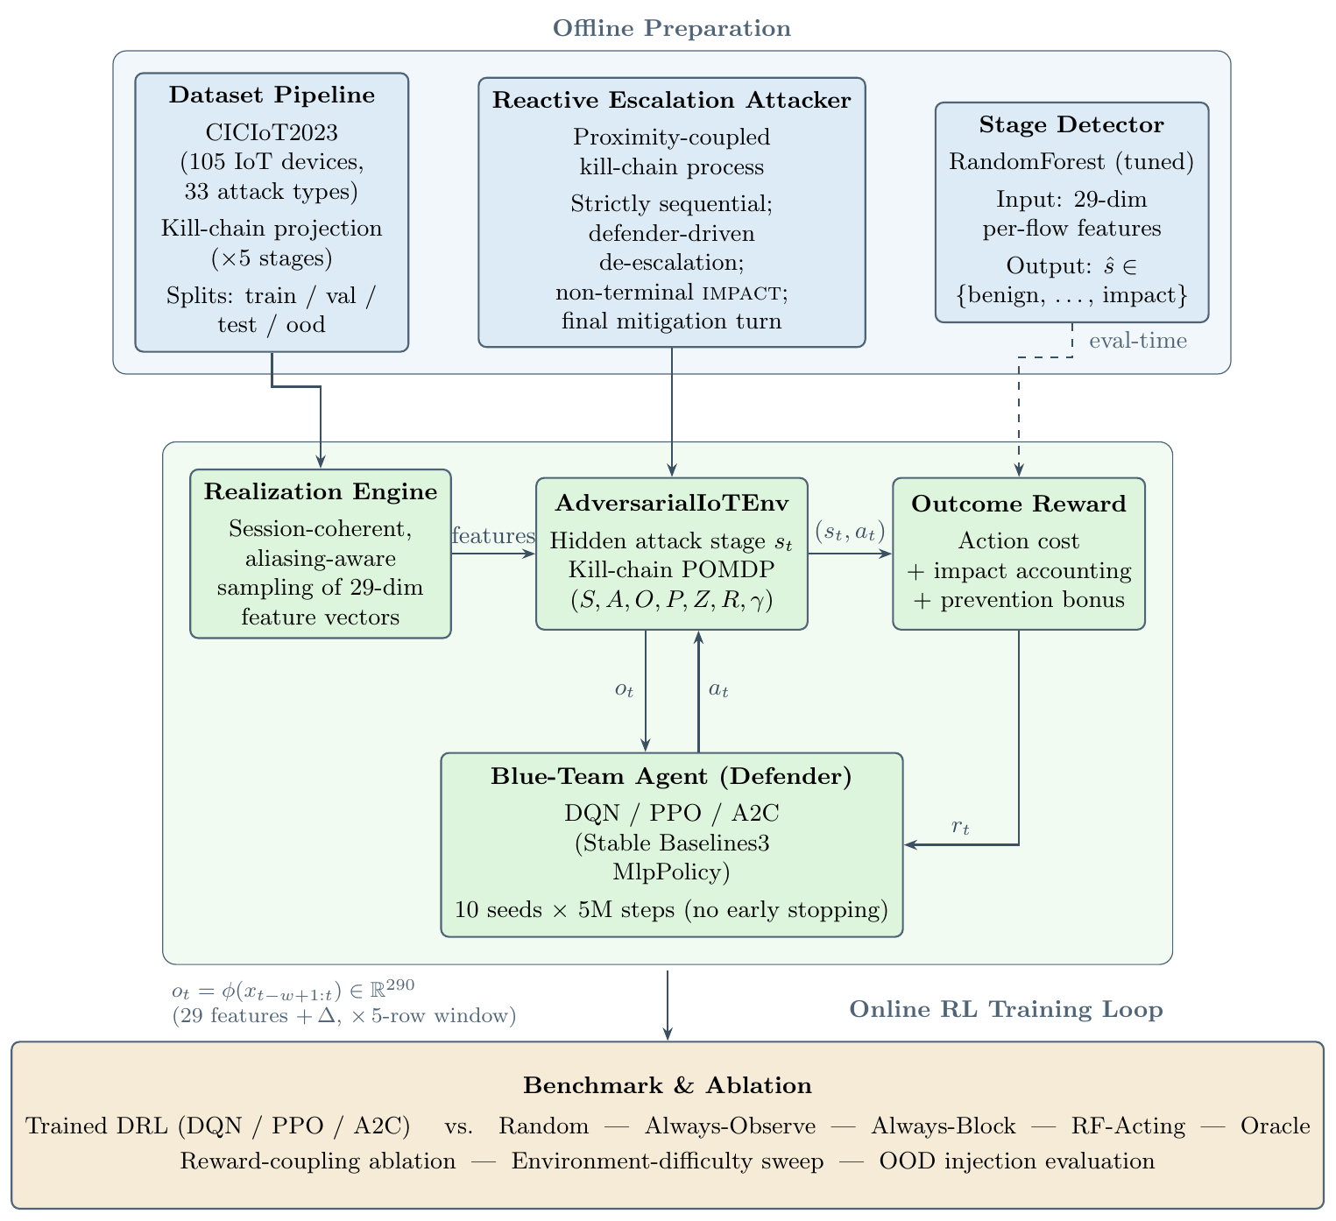
3 · FRAMEWORK
Framework at a Glance
Offline: kill-chain projection · closed-form attacker · supervised stage detector
Online: attacker → realization engine → windowed obs → defender → escalation kernel
Evaluation: held-out benchmark vs baselines + oracle, then ablations
Closed loop, not trace replay.
Every defender action changes the attacker's next move — evaluation included.
FEEC · UNICAMP
10
Notes:
Orient with the figure (thesis Fig. 3.1): three blocks. Offline preparation — project CICIoT2023 onto the 5-stage kill chain, specify the closed-form attacker, train the supervised stage detector (it powers the baseline, not our agent). Online loop — attacker emits a stage; realization engine samples a real feature row for that stage (session-coherent, aliased); Gymnasium env builds the windowed observation; blue-team agent acts; escalation kernel moves the attacker. Held-out evaluation — benchmark vs baselines + oracle, then ablations. Key sentence: the loop is genuinely CLOSED — the environment responds to the defender's action; it does not replay a fixed trace.

Slide 11
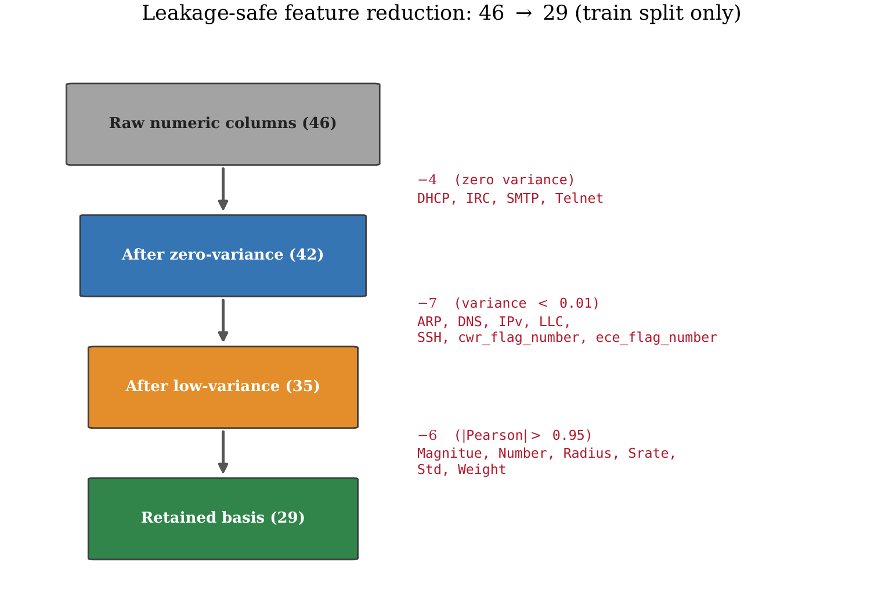
3 · FRAMEWORK
Real Traffic: the CICIoT2023 Dataset
105 devices
physical IoT testbed — cameras, sensors, speakers, hubs
33 attack types
7 categories: DDoS, DoS, Recon, Web, Brute force, Spoofing, Mirai
46 → 29 features
leakage-safe selection, fit on the training partition only
235,324 training rows after reserving held-out classes
FEEC · UNICAMP
11
Notes:
Why this dataset: contemporary, large, real. 105 physical IoT devices at the Canadian Institute for Cybersecurity; 33 attack types in 7 categories, attacks launched BY compromised IoT devices against others — realistic botnet behavior. Each row is a pre-aggregated flow record: 46 statistical features. We apply a leakage-safe funnel — fit on the training partition only — removing zero-variance, low-variance, and highly correlated columns: 29 features survive (timing/rate, header/size, TCP flags, protocol indicators, distribution moments). Training pool after reserving OOD classes: 235,324 rows. Point to the funnel figure.

Slide 12
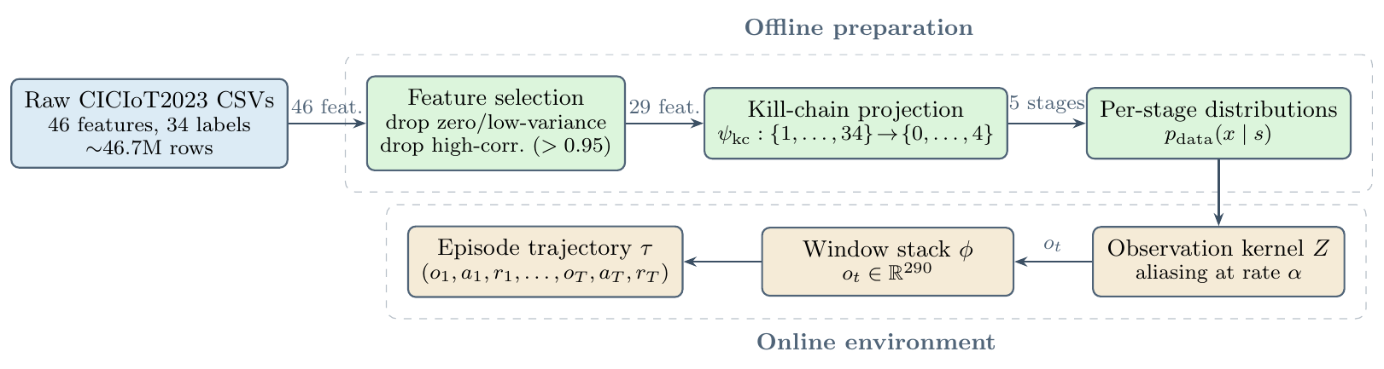
3 · FRAMEWORK
From 34 Labels to 5 Stages, 10 Held Out
Deterministic projection ψ
34 labels → 5 stages; each stage becomes an empirical feature distribution p(x | s) of real rows.
10 classes reserved, never trained on
≥ 2 per non-benign stage (e.g. VulnerabilityScan, SqlInjection, DNS_Spoofing, DoS-SYN_Flood) — the zero-day probe.
FEEC · UNICAMP
12
Notes:
Two moves. First, a deterministic map psi projects each of the 34 CICIoT2023 labels onto exactly one kill-chain stage: scanners to RECON, brute-force/injection to ACCESS, spoofing + Mirai staging to MANEUVER, DoS/DDoS floods to IMPACT. Each stage now has an empirical feature distribution — the environment samples real rows per stage. Second, the splits protocol: TEN attack classes (at least two per non-benign stage) are RESERVED — never seen in training by either the detector or the agents. They become our zero-day-like stress test later. Disjointness is asserted by automated tests.

Slide 13
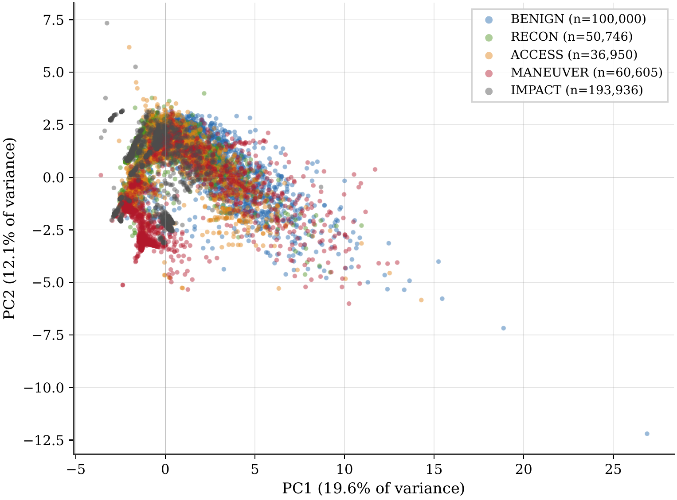
3 · FRAMEWORK
Adjacent Stages Genuinely Overlap in Feature Space
2-D PCA of the 29 features, colored by kill-chain stage
IMPACT floods separate; BENIGN · RECON · ACCESS interleave heavily
No single flow row reveals the stage — ambiguity is a property of the data
The aliasing rate α turns this real overlap into a controlled experimental dial
Session coherence is imposed at the environment layer (no session key in the dataset) — declared as a modeling abstraction.
FEEC · UNICAMP
13
Notes:
Anticipates the objection 'you fabricated the ambiguity'. PCA projection of the 29-dim feature space, colored by stage: IMPACT floods separate sharply (flag counts, rates), but BENIGN/RECON — and the middle of the chain — overlap substantially. Even with full feature information, neighboring stages are not linearly separable. So the aliasing dial alpha AMPLIFIES a real property of the data; it does not invent one. Mention session coherence honestly: CICIoT2023 has no session key, so within-stage draws are made contiguous at the environment layer — a modeling abstraction, declared as such (limitations).

Slide 14
3 · FRAMEWORK
A Reactive Attacker: the Escalation Tug-of-War
Proportionate d = 0
Under-force d ≤ −1
Over-force d ≥ +1
▼ push-back
▲ escalate
■ hold
Attacker pushed back one stage with p = 0.90 (ISOLATE: 0.98)
Attacker advances with p_up scaled by proximity to IMPACT
Attacker merely holds — and availability cost is still paid
d = chosen action − recommended action for the true stage (the defender never sees that stage — it must infer it)
Proximity-coupled escalation
escalation prob. scales with proximity λ = s/4 (floor 0.4) — the deeper the foothold, the harder it pushes. No fixed intrusion budget.
Prevention is the goal
Hold the attacker below IMPACT for all 100 steps → episode prevented (+50). One good block is not enough — sustained pressure is.
FEEC · UNICAMP
14
Notes:
The attacker is not a script — it reacts to the defender's force. Signed force gap d = action minus recommended action for the true stage. Three regimes: proportionate (d=0) pushes the attacker DOWN one stage with p=0.90 (0.98 for ISOLATE); under-force (d≤−1) lets it ADVANCE with p_up scaled by proximity — momentum compounds as it nears IMPACT (sigma_min=0.4); over-force (d≥+1) merely HOLDS — and the reward still charges the availability cost. Onset is autonomous from BENIGN (p=0.35 to RECON, 0.10 straight to ACCESS — stolen credential). PREVENTION = holding the attacker below IMPACT for the whole 100-step horizon. Closed form, no learned attacker: fully specified, reproducible threat model — a declared scope boundary.

Slide 15
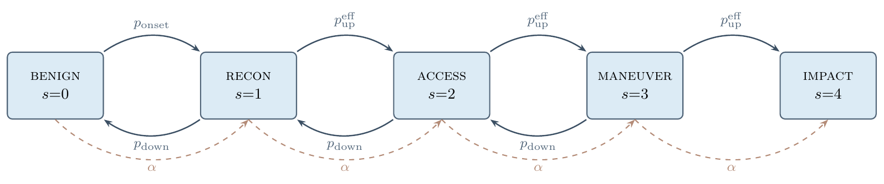
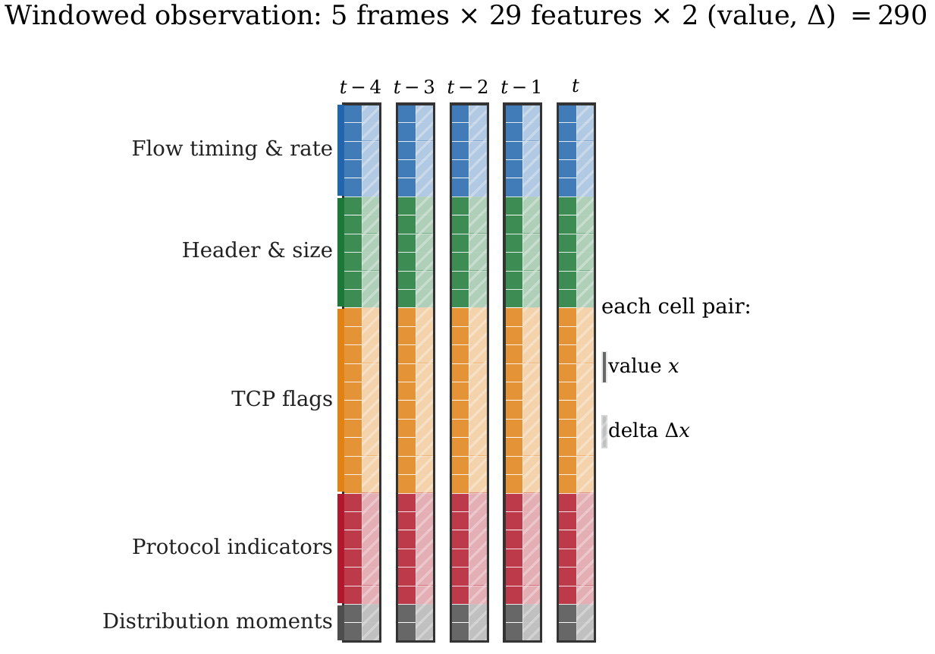
3 · FRAMEWORK
The α Dial: Aliasing and the Windowed Observer
Z = (1−α)·own-stage + α·adjacent-stage rows
α = 0: rows informative · α = 1: every row misleads
Observation = last w = 5 rows + temporal deltas → 290-dim
Identical aliased stream for every policy — no one is privileged
FEEC · UNICAMP
15
Notes:
How partial observability is instrumented. Top figure: the state machine — solid arrows are attacker transitions; dashed arrows are ALIASING: with probability alpha, the emitted feature row comes from an ADJACENT stage, not the true one. Z is a two-component mixture: (1−α) own-stage + α adjacent-stage. At α=0, single rows are informative; at α=1 every row misleads. Same aliased stream feeds every policy — nobody is privileged. Bottom: what the agent actually sees — the last 5 rows + their temporal deltas, stacked into 290 dims. The window is the agent's only belief machinery; the RF baseline reads one row.

Slide 16
3 · FRAMEWORK
Two Reward Contracts: Sparse Is Primary
OUTCOME · primary
COUPLED · ablation only
Sparse: action cost + terminal accounting only
Prevented episode → +50 · terminal defense → +250
Compromise → −200 (−150 more if passive at impact)
No per-step stage hints — measures defense, not imitation
Adds per-step shaping keyed to the true stage
+5 proportionality bonus · −5 disproportion penalty
Benign guardrails: overreact −50 · block-on-benign −100
Rewards exactly what a classifier predicts — a privileged signal
Design principle: if the reward hands the agent the stage label, a classifier wins by construction. Train under the sparse contract; keep the shaped one only to test that objection.
FEEC · UNICAMP
16
Notes:
Critical design decision. The COUPLED reward pays per step for choosing the stage-recommended action — but that rewards exactly what a supervised classifier predicts: training under it alone would conflate 'learned to defend' with 'imitated a lookup table'. So the PRIMARY contract is the sparse OUTCOME reward: action costs + terminal accounting + prevention bonus — no per-step stage hints. Much harder credit assignment (reward arrives ~100 steps late), but it measures defense, not imitation. The coupled variant is retained ONLY as the ablation that answers the privileged-reward objection. Benign guardrails and caps prevent degenerate block-everything policies; availability cost rises with action severity.

Slide 17
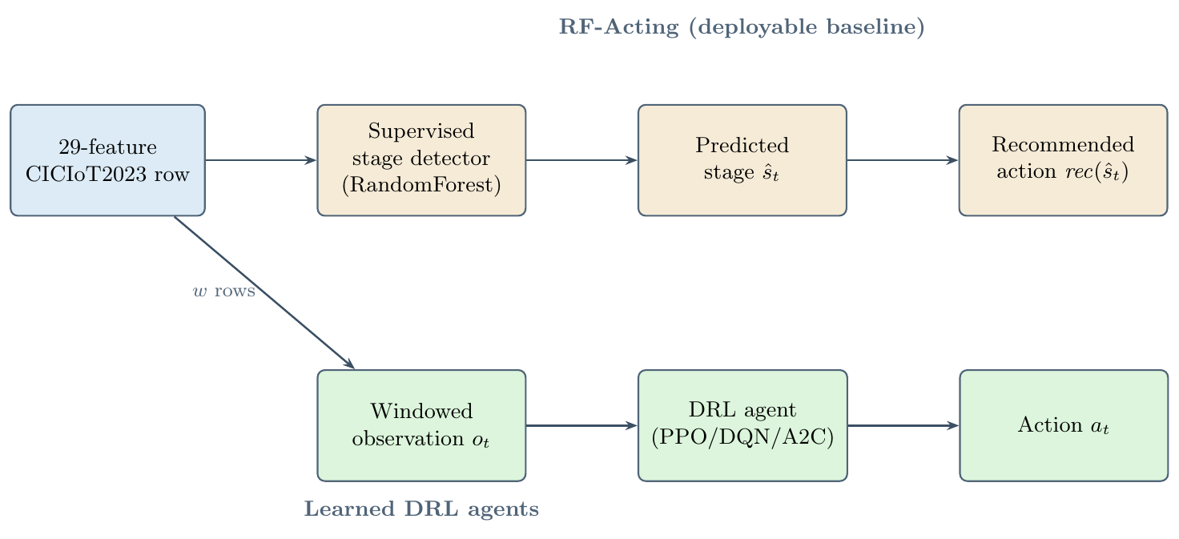
3 · FRAMEWORK
The Contenders
Windowed RL (ours) PPO · A2C · DQN read the 290-dim window; infer the stage implicitly
RF-Acting (deployable) Tuned RandomForest (macro-F1 0.924) + recommended-action rule — memoryless per-flow control
Trivials always-OBSERVE · always-BLOCK · random — bracket the reward scale
Oracle (instrument) Reads the true stage → prices perfect perception at +194.8 — a ceiling, not a competitor
FEEC · UNICAMP
17
Notes:
Who competes. Learned agents: PPO, A2C, DQN — windowed observation, never see the true stage, never consume the detector. Deployable baseline: RF-Acting — a hyperparameter-TUNED RandomForest stage detector (macro-F1 0.924; the strongest classifier a practitioner would ship, not a straw man) + the recommended-action rule; memoryless: one row, one action. Trivial baselines: always-observe, always-block, random — they bracket the reward scale. And the ORACLE: same action rule but reading the TRUE stage — not a competitor, a measuring instrument: it prices perfect perception (+194.8 ceiling). Figure: detector position — RF-Acting consumes the detector; our agents bypass it. That architectural contrast is the experiment.

Slide 18
3 · FRAMEWORK
Evaluation Protocol: Built to Be Believed
10 × 5M
n = 300
seeds × training steps per algorithm — no early stopping, best-on-validation checkpoint
held-out episodes per policy · 95% bootstrap CIs · separation = disjoint intervals
CPU-only
462 tests
commodity workstation — no GPU anywhere in the pipeline
hash-pinned manifests per figure · end-to-end re-verification on a fresh checkout
Same aliased observation stream, same splits, same reward for every contender — the only variable is the controller.
FEEC · UNICAMP
18
Notes:
Rigor slide — deliver with quiet confidence. 10 seeds per algorithm; FIXED 5M-step budget, NO early stopping (an early-stop rule tuned to one algorithm truncates another — and full budgets are what exposed DQN's instability). Best-on-validation checkpoint carried forward. Evaluation: n=300 episodes per policy on the held-out balanced-test split; 95% bootstrap CIs; separation = disjoint intervals — a conservative criterion. Everything CPU-only. Reproducibility: every figure ships a manifest pinning input hashes + git commit; 462 automated tests; the whole chain re-verifies on a fresh checkout. All numbers ahead carry these guarantees.

Slide 19
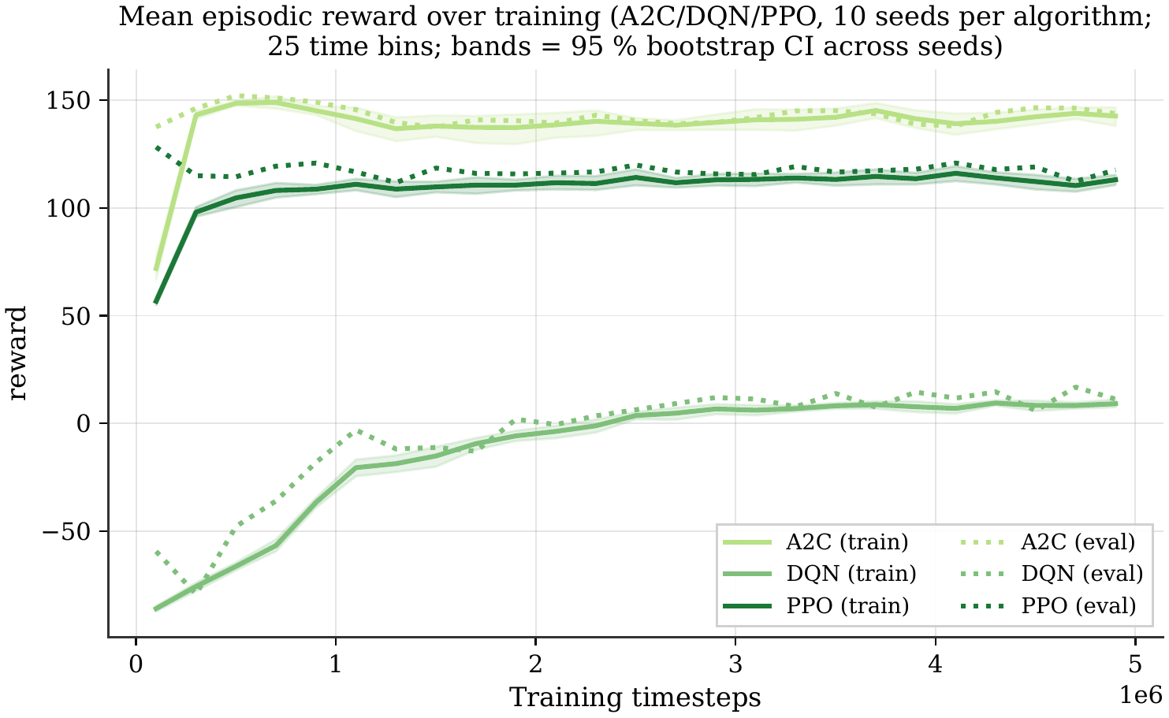
4 · RESULTS
Sparse-Reward Training: a Reliability Story
Best checkpoint at α = 0.4 (10 seeds)
A2C +138.7 sd ~9
tightest seeds — most reliable
PPO +121.3 sd ~15
stable plateau, close second
DQN +72.5 sd ~52
destabilizes without shaping
On-policy advantage = training-time stability, not peak return.
FEEC · UNICAMP
19
Notes:
First result. Learning curves over 5M steps, 10 seeds, sparse outcome reward, headline alpha 0.4. Dashed grey band = RF-Acting reference; dash-dot black = oracle ceiling. Read: both ON-POLICY algorithms climb out of the negative regime and plateau — best-checkpoint PPO +121.3 (sd ~15), A2C +138.7 (sd ~9, the tightest). OFF-POLICY DQN destabilizes without per-step shaping: best-checkpoint +72.5, across-seed sd ~52, seeds ranging roughly −15 to +132 — replay does not bootstrap credit across a 100-step sparse episode. Finding: the on-policy advantage is TRAINING RELIABILITY, not peak return. We report all three — including the unstable one.

Slide 20
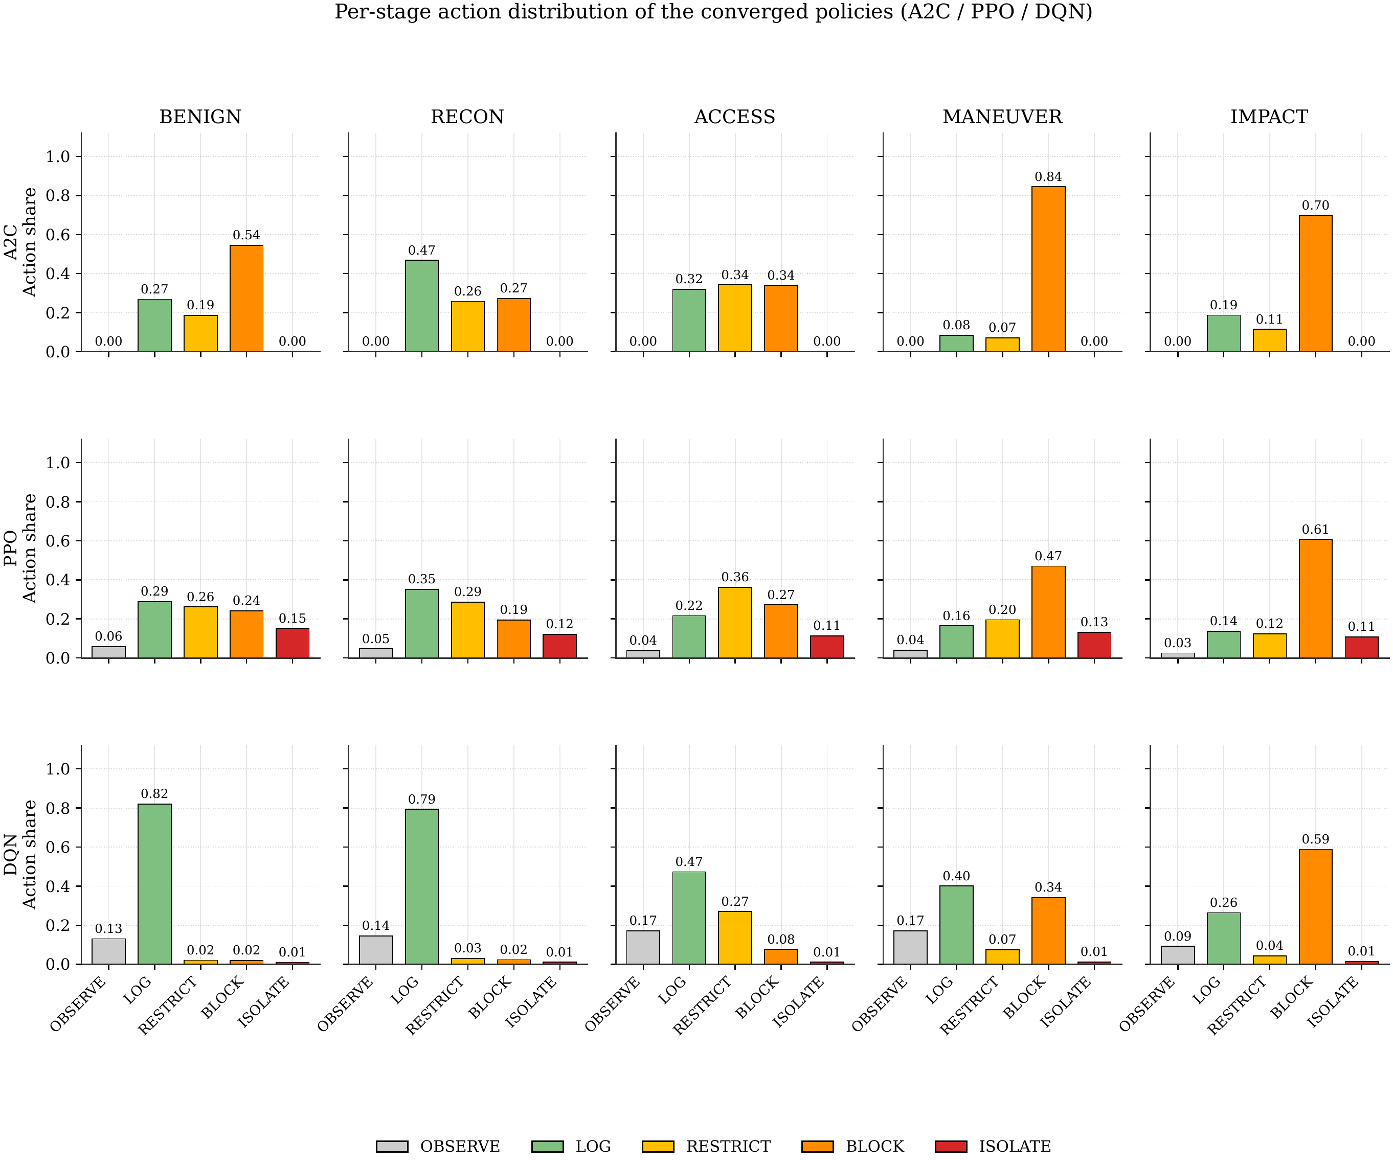
4 · RESULTS
Same Reward, Two Learned Doctrines
A2C — prevent at maneuver
Blocks 84.4% of MANEUVER steps; suppresses the advance before impact; never isolates.
PPO — contain at impact
Admits the late stage, then isolates at the boundary. Different doctrine, same reward.
Both keep aggressive action on benign traffic under 1%.
FEEC · UNICAMP
20
Notes:
My favorite teaching slide: the algorithms did not just score differently — they learned different DEFENSIVE PHILOSOPHIES. Per-stage action distributions (rows: A2C, PPO, DQN; columns: BENIGN→IMPACT). A2C: prevent-at-maneuver — blocks 84.4% of MANEUVER steps, suppresses the mid-chain advance, never isolates. PPO: contain-at-impact — tolerates deeper penetration, then acts at the final stage. Both benign-safe on the left column (aggressive action on <1% of benign flows). Neither doctrine was programmed — both emerged from the same sparse reward. This interpretability matters for a security operator: strategy, not black-box scores.

Slide 21
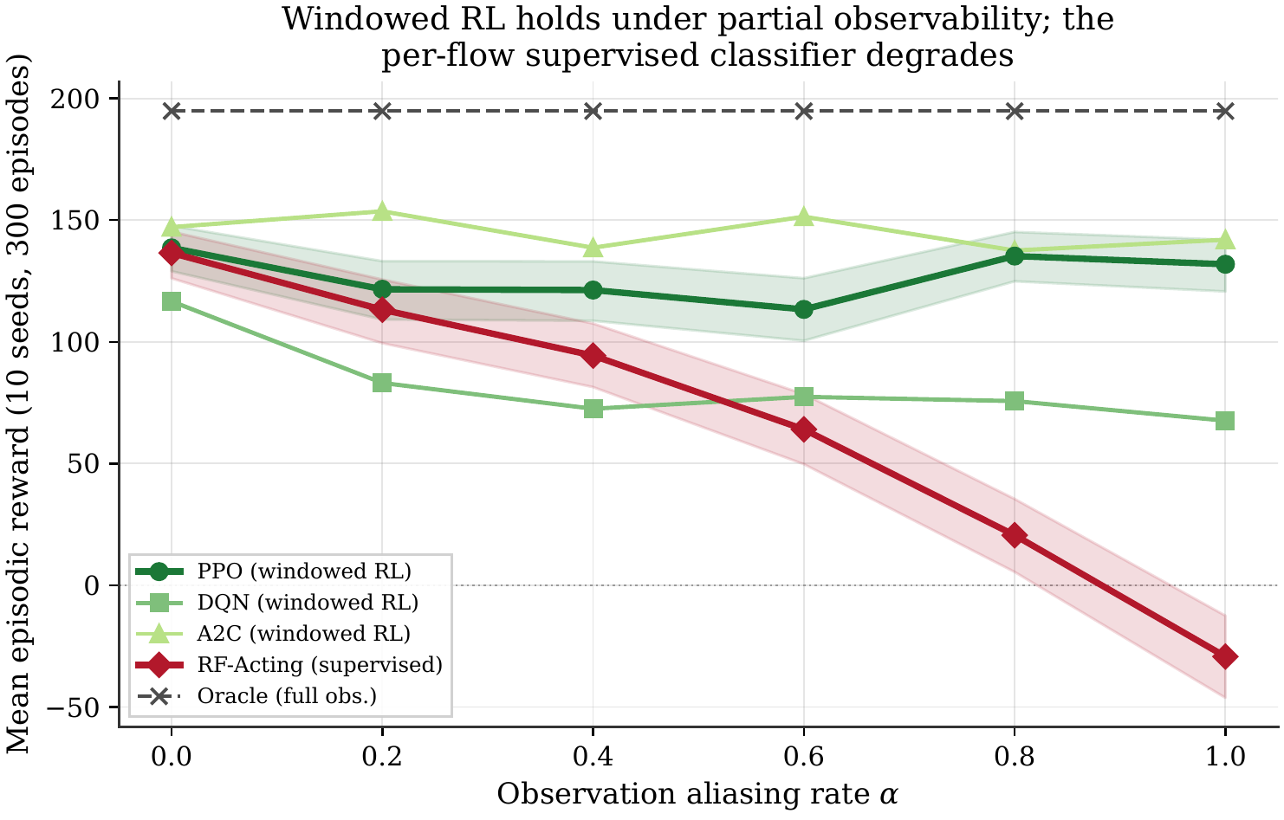
4 · RESULTS — HEADLINE
The Aliasing Crossover
Tie at α = 0
PPO +138.6 vs RF +136.5 — overlapping CIs. No built-in RL favoritism.
RF collapses
monotone fall to -29.3 at α = 1 — net-harmful under full ambiguity.
PPO stays flat
disjoint CIs from α = 0.4 on; gap +26.9 widening to +161.2.
Oracle ceiling +194.8 — the price of perfect perception.
FEEC · UNICAMP
21
Notes:
THE slide of the defense — take your time. X-axis: aliasing rate alpha (ambiguity dial). Y: mean episodic reward on the held-out split, 95% bootstrap CIs. Walk it in order. (1) At α=0, honesty anchor: PPO +138.6 vs RF +136.5 — STATISTICAL TIE, overlapping CIs: the environment does NOT favor RL by construction; where the task is per-flow classification, the classifier ties. (2) As α rises, RF-Acting degrades MONOTONICALLY: +113.2, +94.4, +64.0, +20.5 … −29.3 at α=1 — NET-HARMFUL, worse than doing nothing's baseline of always-block at ~0. (3) Windowed PPO stays FLAT — no monotonic trend; the window absorbs the ambiguity. (4) From α=0.4 (headline): DISJOINT CIs — gap +26.9, widening to +161.2 at α=1. Oracle flat at +194.8 prices perfect perception. One sentence: when observation gets ambiguous, memoryless classification collapses; windowed control does not.

Slide 22
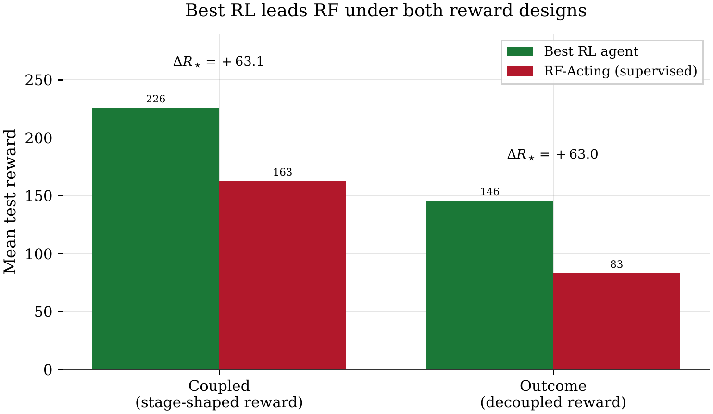
4 · RESULTS
The Advantage Survives Removing the Shaping
Coupled (shaped)
best RL: DQN +226.2
RF − best-RL = -63.1
Outcome (sparse)
best RL: A2C +146.1
RF − best-RL = -63.0
Shaping changes which algorithm wins — not whether learned control leads. (DQN: +226.2 coupled → -8.6 sparse.)
FEEC · UNICAMP
22
Notes:
Answering the privileged-reward objection head-on. Retrain EVERYTHING under both contracts; score RF under the same contract each time. Coupled: best learned agent is DQN +226.2 — thrives on dense shaping — RF-minus-best-RL = −63.1 (RL leads). Outcome: best learned agent is A2C +146.1 — gap −63.0, virtually identical. Two lessons: (1) the RL-vs-RF separation does NOT depend on the privileged shaping — objection closed; (2) the reward contract changes WHICH algorithm wins: DQN's coupled win evaporates under sparsity (−8.6 pooled mean, variance triples) — the same replay machinery that exploits dense signals fails sparse credit assignment. Off-policy value bootstrapping needs shaping; on-policy tolerates its absence.

Slide 23
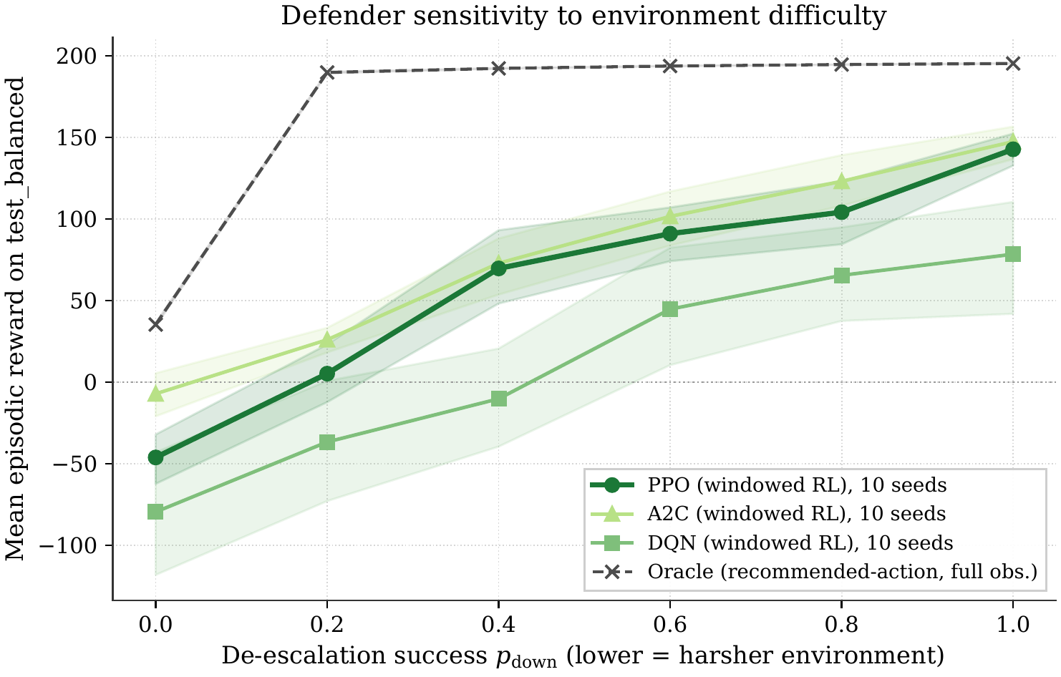
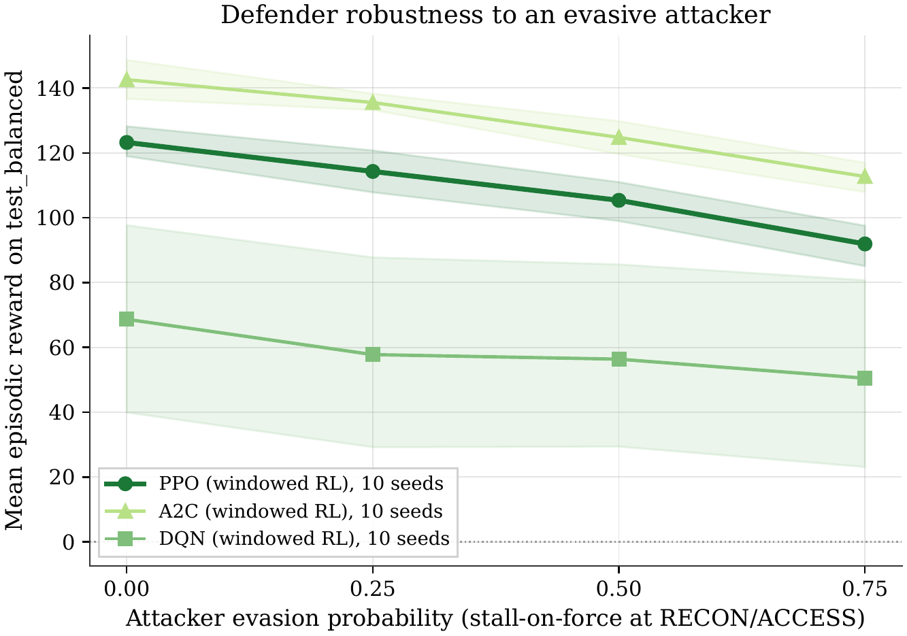
4 · RESULTS
Robustness: Harsher Environments, Evasive Attackers
Environment difficulty (de-escalation prob.)
Evasive persistence (post-detection hardening)
A2C leads at every difficulty; widest on-policy margin at the harshest setting.
A2C clears the pre-registered 25% criterion (+142.6 → +112.7); PPO narrowly misses.
FEEC · UNICAMP
23
Notes:
Two off-distribution stress tests on FIXED policies — trained once, never retrained per condition. Left (difficulty sweep): lower p_down = proportionate actions less likely to push the attacker back; monotone response, no rank inversions; A2C leads at EVERY difficulty (−7.2 at the harshest → +147.3 at the easiest); the prevent-at-maneuver doctrine loses the least ground exactly where it is harshest. DQN's fragility reappears as the widest bands. Right (evasion sweep): attacker hardens against eviction after sensing force (post-detection hardening, up to 0.75). Pre-registered criterion: lower CI bound must not fall more than 25% of evasion-free mean. A2C +142.6 → +112.7, compromise 0.23 → 0.41 — CLEARS it; PPO narrowly misses; DQN within band but from a low base. Graceful degradation, not collapse — and a real A2C-over-PPO separation.

Slide 24
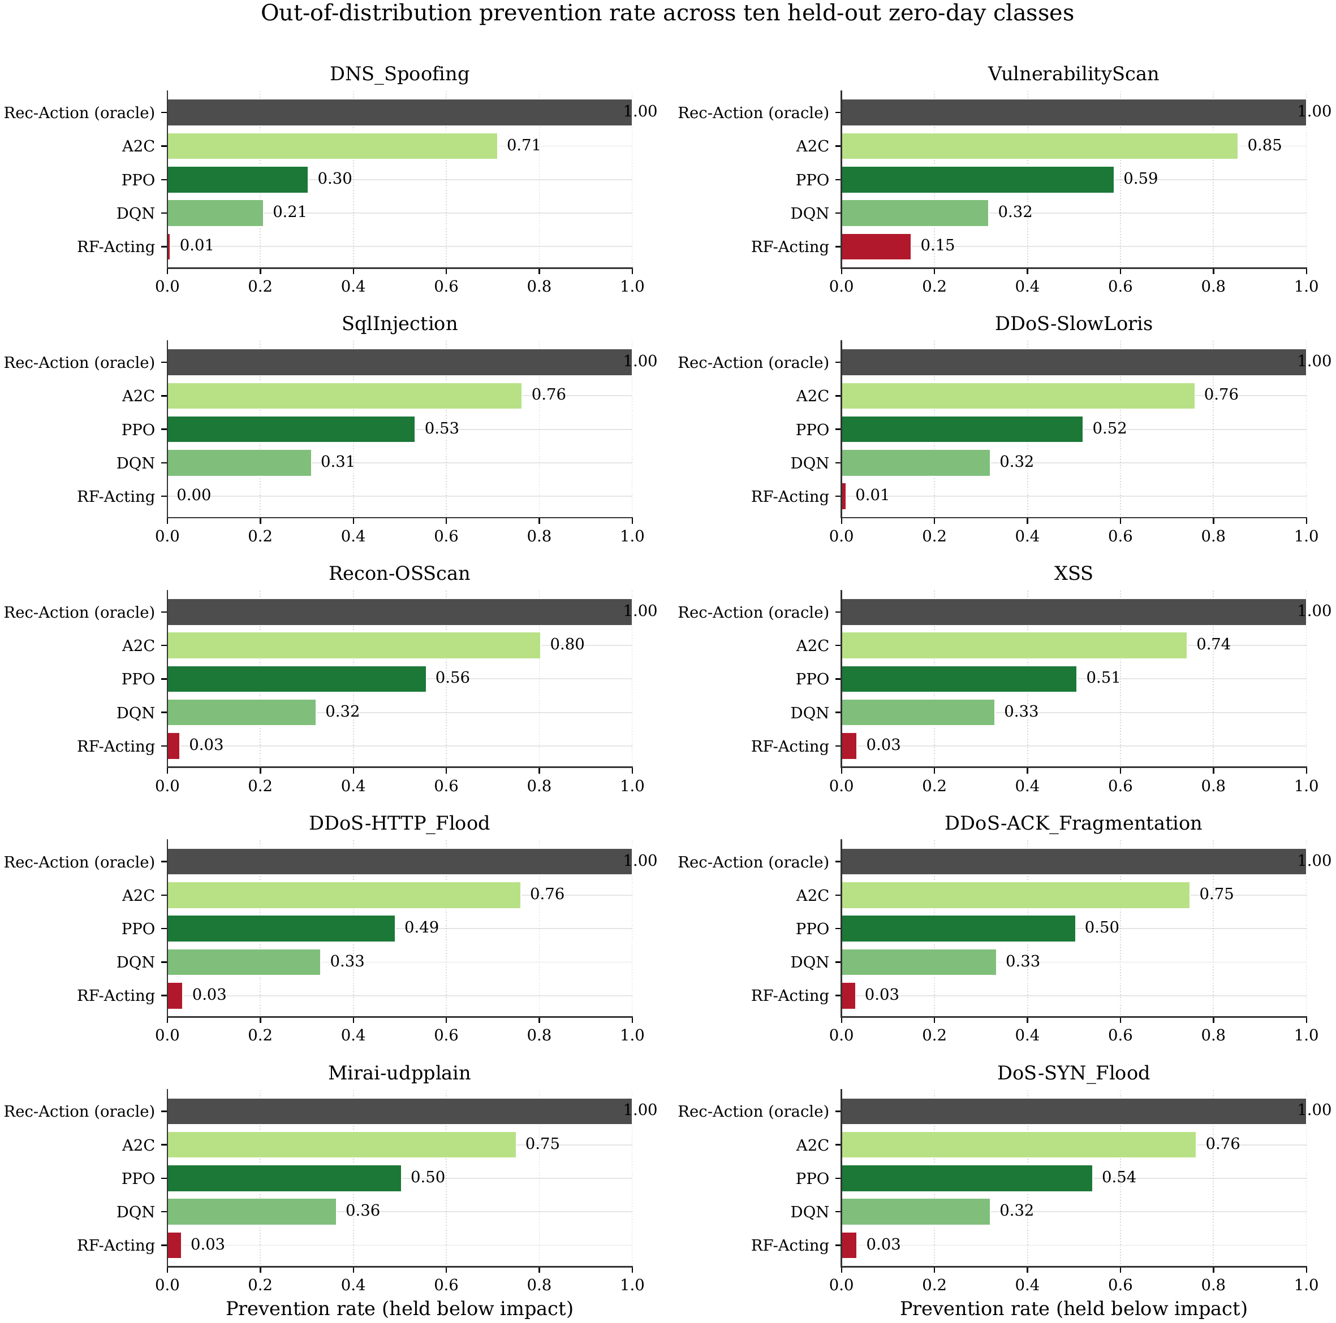
4 · RESULTS
Ten Attack Classes the System Never Saw
0.71 – 0.85
best windowed RL (A2C): prevention on every held-out class
0.00 – 0.15
RF-Acting: prevention on the same classes
+0.70 to +0.78
advantage on every single class — none negative
(always-BLOCK reaches 1.0 only by disrupting 100% of benign traffic — inadmissible; learned agents stay under 1%.)
FEEC · UNICAMP
24
Notes:
The zero-day-like probe. The 10 reserved classes are injected at their true stage into an otherwise in-distribution episode (single-stage feature injection) at headline alpha. Metric: PREVENTION RATE — attacker held below IMPACT for the whole episode. Grid: rows = policies, columns = classes. Best windowed RL (A2C) prevents 0.71–0.85 on EVERY class; RF-Acting 0.00–0.15. Advantage +0.70 to +0.78 per class. Note honestly: always-block 'prevents' 1.0 everywhere — by quarantining 100% of benign traffic; reward 0.0; operationally inadmissible. The meaningful frontier is prevention WHILE benign-safe (<1% FPR) — only the learned agents live there. Also honest: moderate absolute rates — the oracle ceiling is far above; the claim is the relative advantage, not near-perfect security.

Slide 25
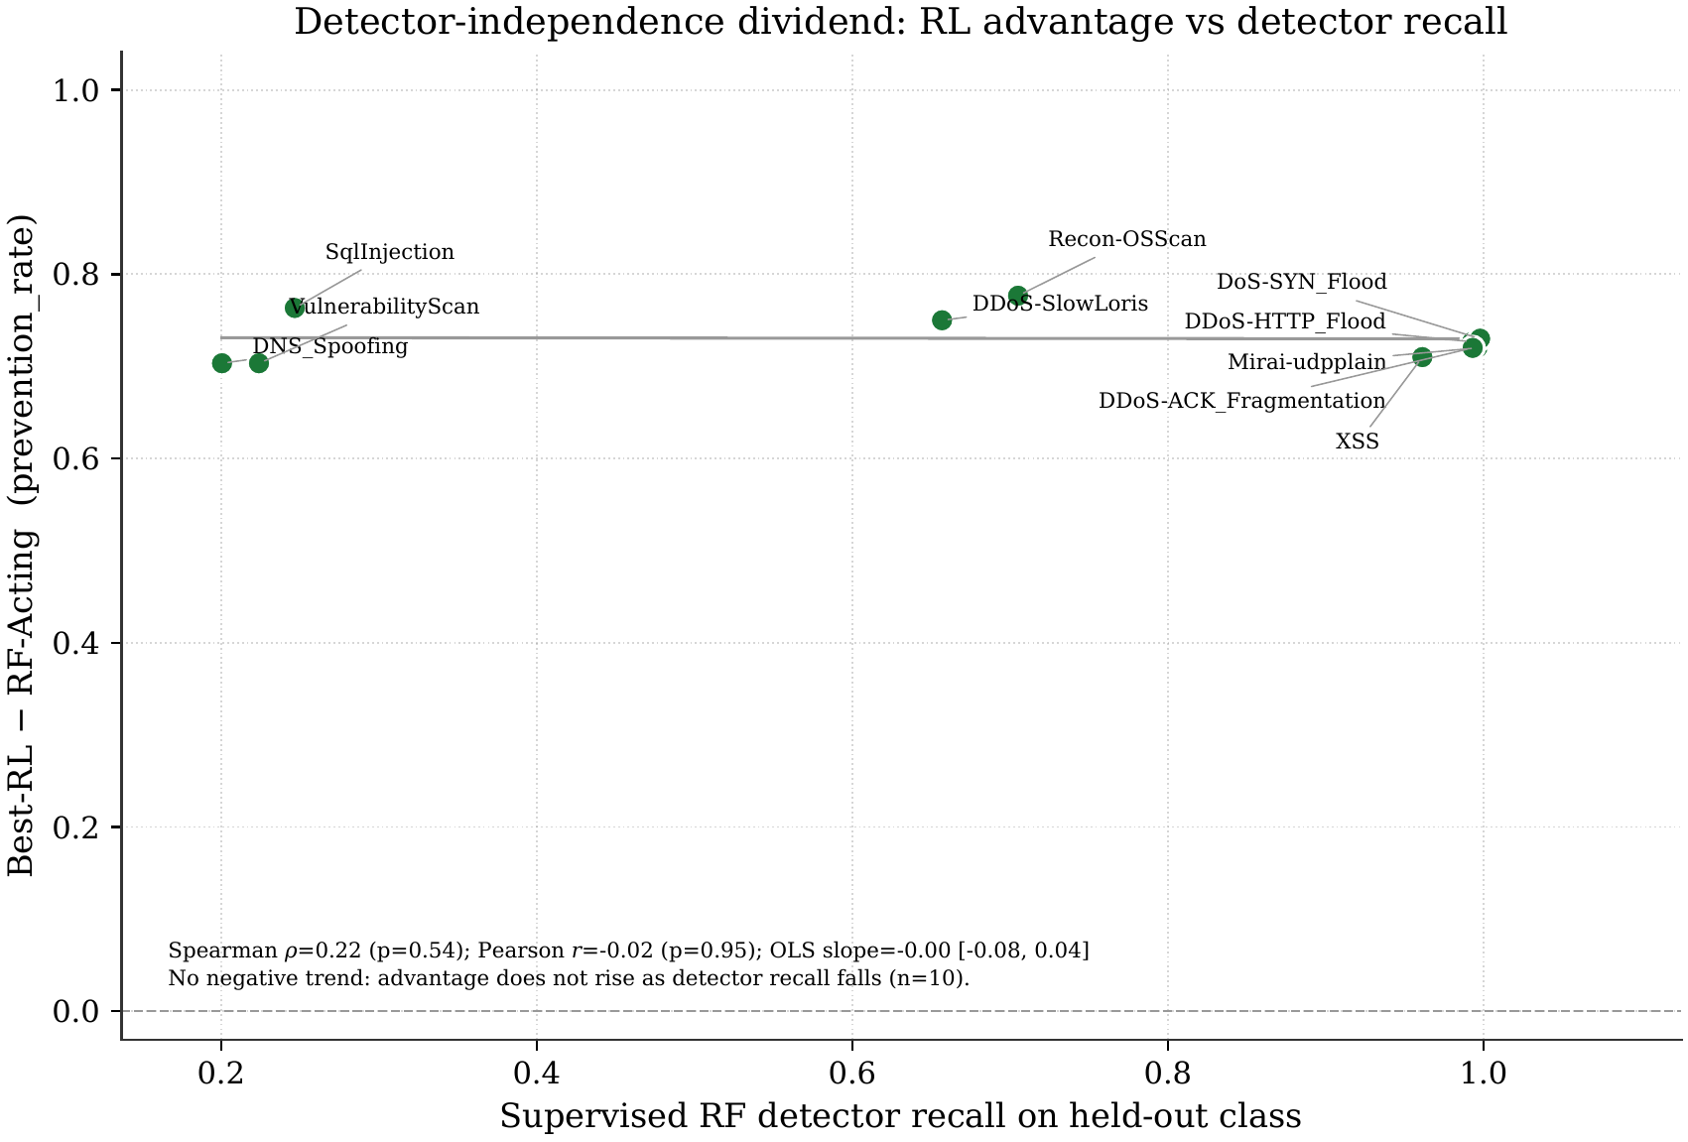
4 · RESULTS
No Dependence on Detector Recall
Spearman ρ = 0.22 (p = 0.54) · Pearson r = -0.02 (p = 0.95)
OLS slope 95% CI [-0.08, +0.04] — spans zero
Advantage as large where the detector sees almost perfectly as where it is nearly blind
Mechanism: RF acts passively on ~2/3 of steps → attacker reaches impact → late block = mitigated, not prevented
Caveat stated plainly: n = 10 classes — no detectable trend, not proof of independence.
FEEC · UNICAMP
25
Notes:
Why the OOD result matters scientifically — the last version of the skeptic's objection: 'RL only wins where the detector is blind.' If true, advantage should SHRINK as detector recall rises. Scatter: per-class RF recall (x) vs RL prevention advantage (y). The held-out classes span recall 0.20–0.998 by construction — near-blind to near-perfect. Result: NO detectable trend. Spearman rho 0.22 (p=0.54), Pearson r −0.02 (p=0.95), bootstrap OLS slope CI [−0.08, +0.04] spans zero. Honest caveat: n=10 — absence of a detectable trend, not proof of independence; but the trend the objection REQUIRES (negative) is absent. Mechanism (structural, not perceptual): prevention needs SUSTAINED proportionate pressure; RF — even when it classifies correctly — acts passively ~2/3 of steps, lets the attacker reach IMPACT, then blocks late: 'mitigated', never 'prevented'. A one-shot classifier structurally cannot express temporal control.

Slide 26
5 · CLOSING
Limitations — Stated, Not Hidden
Modeling abstractions
Conditional advantage
Session coherence + aliasing are environment-layer constructs; α is a knob, not a measured deployment property
At α = 0 the claim is a tie — the win emerges only as ambiguity grows
Designed attacker
Memoryless baseline
Reactive but not co-trained; crossover is conditional on this attacker class — self-play deferred
Isolates windowed vs per-flow control — a windowed supervised baseline is named follow-up work
Single dataset
OOD scope
CICIoT2023 only; replication on Bot-IoT required before claiming dataset independence
Feature-injection stress test at n = 10 classes — not deployed zero-day generalization
FEEC · UNICAMP
26
Notes:
Owning the boundaries pre-empts half the committee's questions. (1) Session coherence + aliasing are modeling abstractions — the dataset has no session key; alpha is a controlled knob, and the contribution is the SHAPE of the response, anchored by the alpha=0 tie. (2) The advantage is conditional on partial observability — at alpha=0 we claim a tie, nothing more. (3) The attacker is designed, reactive, NOT co-trained; the crossover is conditional on this attacker class; evasive-persistence is the closest tested relaxation; self-play is future work. (4) RF-Acting is memoryless by construction — the benchmark isolates windowed vs memoryless CONTROL; a windowed supervised baseline is the most direct strengthening and is named follow-up work. (5) Single dataset — replication on Bot-IoT is the natural next step. (6) OOD study is a controlled feature-injection stress test at n=10 — not deployed zero-day evidence.

Slide 27
5 · CLOSING
What This Dissertation Establishes
1
The crossover is real and controlled
Tie at α = 0 → disjoint CIs from α = 0.4 → RF net-harmful at α = 1 while windowed PPO holds flat
2
It is not a reward artifact
Best learned agent leads under both reward contracts (-63.1 coupled, -63.0 sparse)
3
It extends to unseen attack classes
Prevention advantage +0.70–+0.78 on all 10 held-out classes — independent of detector recall
Operationally deployable: benign disruption < 1% · policy footprint 90 KB / 23K params (vs 181 MB tuned RF) · fully reproducible (462 tests, hash-pinned figures)
FEEC · UNICAMP
27
Notes:
The three findings, one breath each. F1: windowed temporal control beats memoryless per-flow control PRECISELY under partial observability — tie at alpha=0, RF monotone collapse to net-harmful, PPO flat, disjoint CIs from alpha=0.4. F2: the advantage is not a reward artifact — best RL leads under both contracts (−63.1 / −63.0); shaping changes which algorithm wins. F3: on ten held-out classes, prevention advantage on every class, no detectable recall dependence — temporal control, not detector blind spots. Plus the operational bonus: benign-safe (<1% FPR) and a 90 KB / 23K-param policy vs 181 MB tuned RF — edge-deployable. Closing line: the contribution is not 'RL wins' — it is a controlled account of WHEN and WHY it wins, reproducible end-to-end.

Slide 28
5 · CLOSING
Where This Goes Next
Strengthen the claim
Harder adversaries
Toward deployment
Windowed supervised baseline (named follow-up)
Recurrent belief-state policies
Second dataset: Bot-IoT replication
Co-adaptive self-play attacker
Stage-skipping / non-monotonic chains
Multi-agent cooperative defense
Edge-hardware cost quantification
Federated multi-site training
Constrained-MDP FPR guarantees
Dissemination: condensed journal article submitted to Elsevier Internet of Things (2026) · code + hash-chain manifests public on GitHub (feli-santos/rl-iot-defense-system)
FEEC · UNICAMP
28
Notes:
Grouped future work. Nearest to the thesis: windowed supervised baseline (the most direct strengthening); recurrent belief-state policies — a preliminary recurrent trial did NOT beat the window under this budget, worth characterizing; second dataset (Bot-IoT). Threat model: co-adaptive self-play attacker; multi-agent defense (RESTRAIN-style coordination). Deployment: edge hardware quantification (the 90 KB policy invites it); federated multi-site training; constrained-MDP false-positive guarantees. Dissemination: a condensed journal article of this work is submitted to Elsevier Internet of Things (2026). Code, manifests, and the full artifact chain are public on GitHub.

Slide 29
Thank you.
Committee · colleagues · family — obrigado.
Felipe Augusto Oliveira dos Santos · FEEC / UNICAMP
Advisor: Prof. Dr. Denis Fantinato
Code & reproducibility: github.com/feli-santos/rl-iot-defense-system
Backup slides follow →
Notes:
Thank the committee by name; thank the audience. Then: 'I am at your disposal for questions.' Backup slides follow the thank-you slide: reward constants, hyperparameters, kill-chain mapping, detector performance, benign safety, reproducibility chain.

Slide 30
BACKUP
Supporting detail for questions — reward constants · hyperparameters · kill-chain mapping · detector performance · benign safety · reproducibility
Notes:
Divider — backup material for Q&A. Not part of the timed talk.

Slide 31
BACKUP B1
Reward Constants (Environment Design Defaults)
Constant | Value | Constant | Value
impact terminal penalty | −200 | de-escalation reward (capped 150) | +15
defense-success bonus (terminal) | +250 | proportionality bonus (capped 100) | +5
missed-impact penalty | −150 | disproportion penalty | −5
prevention bonus (truncation) | +50 | benign-passive bonus | +10
overreact-on-benign | −50 | block-on-benign / on-recon | −100 / −50
p_down (ISOLATE) | 0.90 (0.98) | p_up base / proximity floor | 0.90 / 0.4
onset recon / access | 0.35 / 0.10 | action costs (obs→iso) | 0, .1, .3, .5, .8
Sparse outcome contract strips the five stage-conditioned shaping components; action cost + terminal accounting + prevention remain.
FEEC · UNICAMP
31
Notes:
Full constant table from methodology Table 3.5. Calibration: terminal outcomes set the scale; per-step shaping an order of magnitude smaller; caps kill reward farming; guardrails make over-blocking on benign never profitable.

Slide 32
BACKUP B2
Training Hyperparameters (Grid-Searched per Algorithm)
Hyperparameter | PPO | A2C | DQN
Learning rate | 3 × 10⁻⁴ | 7 × 10⁻⁴ | 5 × 10⁻⁴
Discount γ | 0.99 | 0.99 | 0.99
Rollout n_steps | 2048 | 256 | —
GAE λ / entropy / value coef | 0.95 / 0.01 / 0.5 | 0.95 / 0.01 / 0.5 | —
Epochs × batch | 10 × 64 | — | batch 64
Replay buffer / learning starts | — | — | 200k / 5000
Target update / exploration | — | — | 5000 / 1.0→0.05 (20%)
Network (all) | MLP 2×64 ReLU | MLP 2×64 ReLU | MLP 2×64 ReLU
10 seeds × 5,000,000 steps, no early stopping; best-on-validation checkpoint carried to the benchmark.
FEEC · UNICAMP
32
Notes:
Appendix C. Notables: A2C n_steps=256 (vs default 5) — long rollouts for the sparse credit delay; DQN 200k replay buffer + slow target updates; same 2×64 MLP everywhere isolates the learning rule.

Slide 33
BACKUP B3
CICIoT2023 → Kill-Chain Mapping (34 Labels, 10 Held Out)
Stage | CICIoT2023 labels (★ = held out)
BENIGN | BenignTraffic
RECON | PortScan · OSScan★ · HostDiscovery · PingSweep · VulnerabilityScan★
ACCESS | BrowserHijacking · CommandInjection · SqlInjection★ · Backdoor_Malware · Uploading_Attack · XSS★ · DictionaryBruteForce
MANEUVER | MITM-ArpSpoofing · DNS_Spoofing★ · Mirai-greeth_flood · Mirai-greip_flood · Mirai-udpplain★
IMPACT | 4 DoS + 12 DDoS flood variants, incl. DoS-SYN_Flood★ · DDoS-ACK_Fragmentation★ · DDoS-SlowLoris★ · DDoS-HTTP_Flood★
Deterministic map ψ implemented in code; ≥ 2 held-out classes per non-benign stage enable the OOD probe across the whole chain.
FEEC · UNICAMP
33
Notes:
Appendix B. Stars = the 10 reserved OOD classes, at least two per non-benign stage. Unknown labels raise a hard error — no silent leakage.

Slide 34
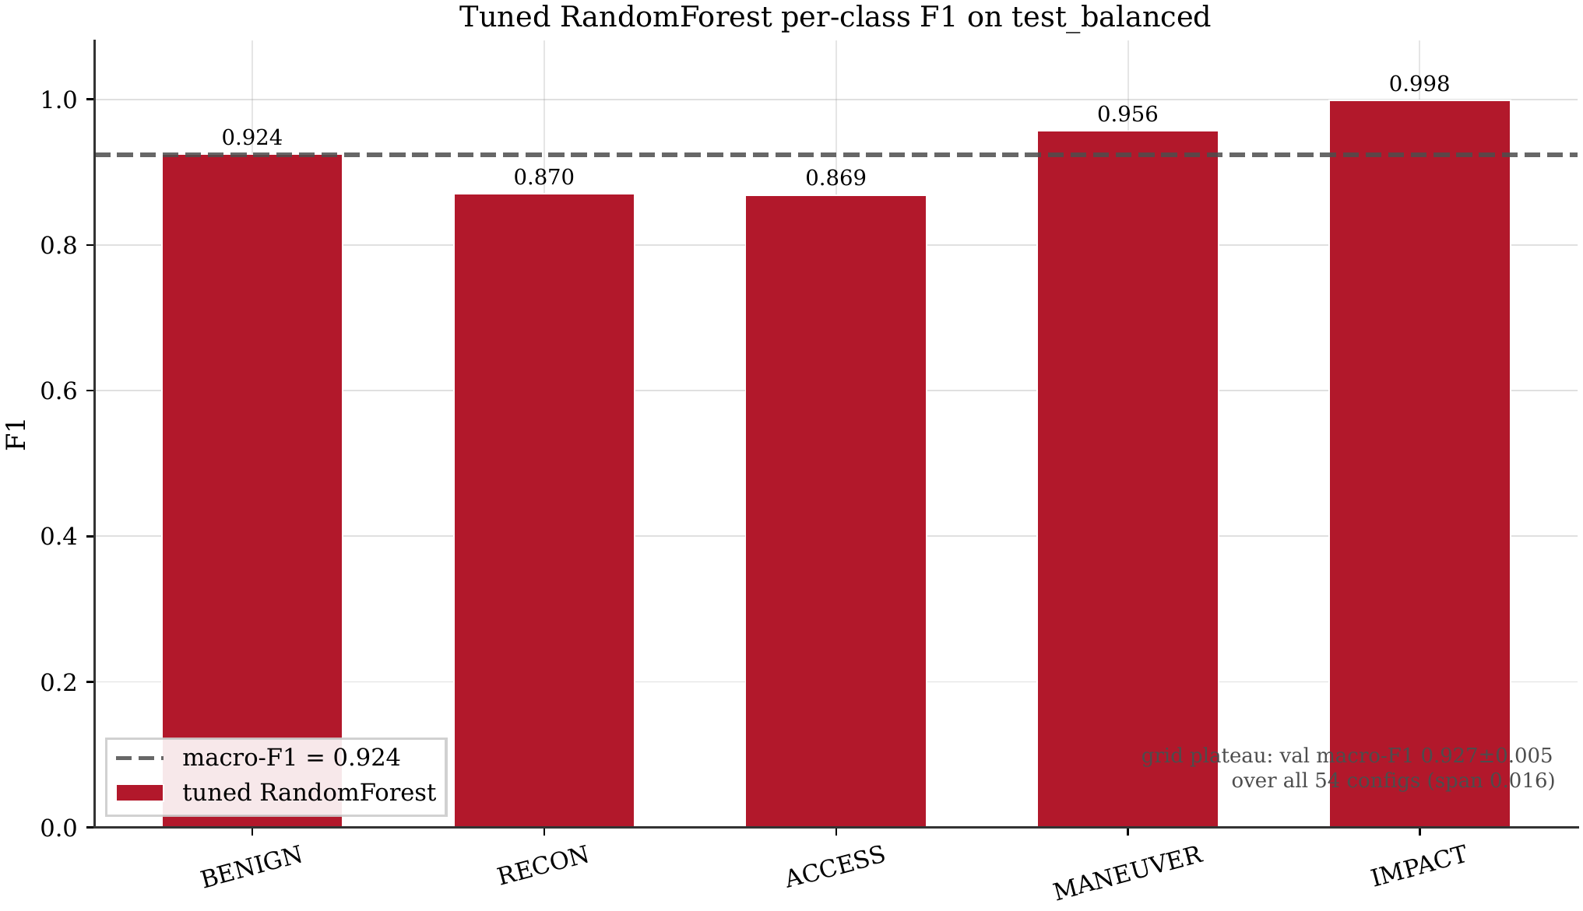
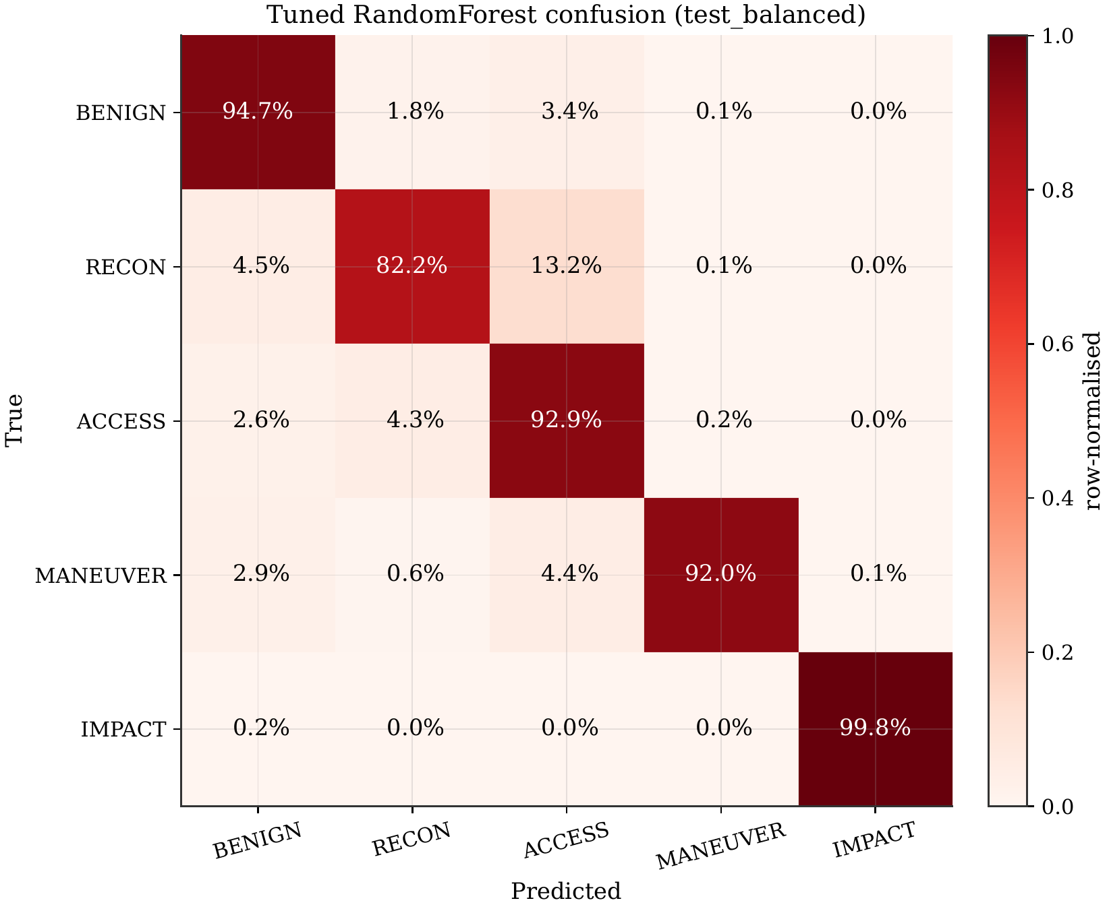
BACKUP B4
The Tuned RandomForest Detector Is Not a Straw Man
Macro-F1 0.924 (held-out balanced test) · worst class 0.87 on the ambiguous middle stages · grid-flat validation — the strongest classifier a practitioner would deploy.
FEEC · UNICAMP
34
Notes:
Fairness evidence: 54-cell grid search on validation macro-F1; interior optimum (200 trees, depth 20, balanced weights); validation F1 flat at 0.927±0.005 across tree count — not under-tuned. Balanced-test macro-F1 0.924; worst class 0.87 (recon/access ambiguity); impact 0.999. Only material confusion: RECON→ACCESS 13.2% — inherent overlap in the middle of the chain.

Slide 35
BACKUP B5
Benign Safety: Prevention Without Collateral Damage
1% operational threshold
always-OBSERVE
0%
never acts — every attack lands
DQN
0.46%
under threshold
A2C
0.66%
under threshold — strongest defender
PPO
0.89%
under threshold
Random
41.3%
disrupts 4 in 10 benign flows
always-BLOCK
100%
perfect prevention, inadmissible
Aggressive action (block / isolate) on true-benign flows · square-root scale for visibility · always-OBSERVE scores ≈ −350 reward.
FEEC · UNICAMP
35
Notes:
The availability axis. Benign FPR = fraction of true-benign flows hit with block/isolate. Learned agents: PPO 0.89%, A2C 0.66%, DQN 0.46% — all under the 1% operational threshold. Random 41.3%; always-block 100% (that is why its perfect prevention is inadmissible); always-observe 0% but loses every episode (~−350). Trivials bracket the trade-off; learned agents are the only policies strong AND safe.

Slide 36
BACKUP B6
Reproducibility: Every Number Has a Chain of Custody
1
2
3
4
experiment run
render layer
thesis build
verification
canonical summary JSON + manifest (input hashes + git SHA)
macros + tables generated from JSONs — no hand-typed numbers
LaTeX consumes generated macros; figures pinned by hash
harness re-walks every manifest on a fresh checkout → PASS
462
SHA-256
0 retrain
tests pass on a fresh checkout
hash chain, splits to figures
verification without retraining
FEEC · UNICAMP
36
Notes:
Every figure ships a manifest.json: SHA-256 of every input artifact + the producing git commit + the exact command. A harness re-walks the chain on a fresh checkout. Thesis numbers are macro-generated from canonical JSONs — never hand-typed. 462 tests. Clone → pytest → reproducibility_smoke → PASS, no retraining needed.

