Slide 1
MVC Structure in Web Applications
Presented by Felice Forgione

Slide 2
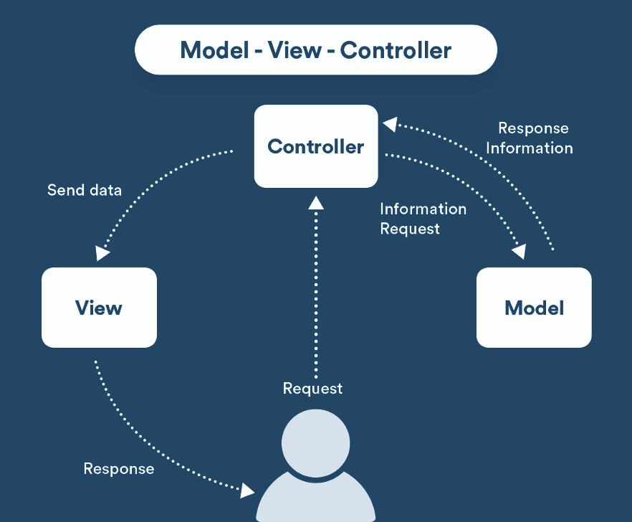
Model View Controller (MVC)
Architectural Blueprint for your Code
A design pattern to structure your application so the code is organized and processes information in a logical way
Incorporates the idea of “separation of concerns” by abstracting code into components
Code is separated into different sections that have their own purpose
MVC provides modularity, reusability, readability, and organization.
Notes:
It's NOT a framework but it is used my most frameworks.
Never repeat yourself. Code that will be used in multiple places will be stored in only one place.
Creates a solid structure for a web application. Everything has its place.
Very clean and organized

Slide 3
MVC Components
Controller request-response handler. controls flow of information
Model represents the structure and storage of data
View what the user will see and interact with

Slide 4
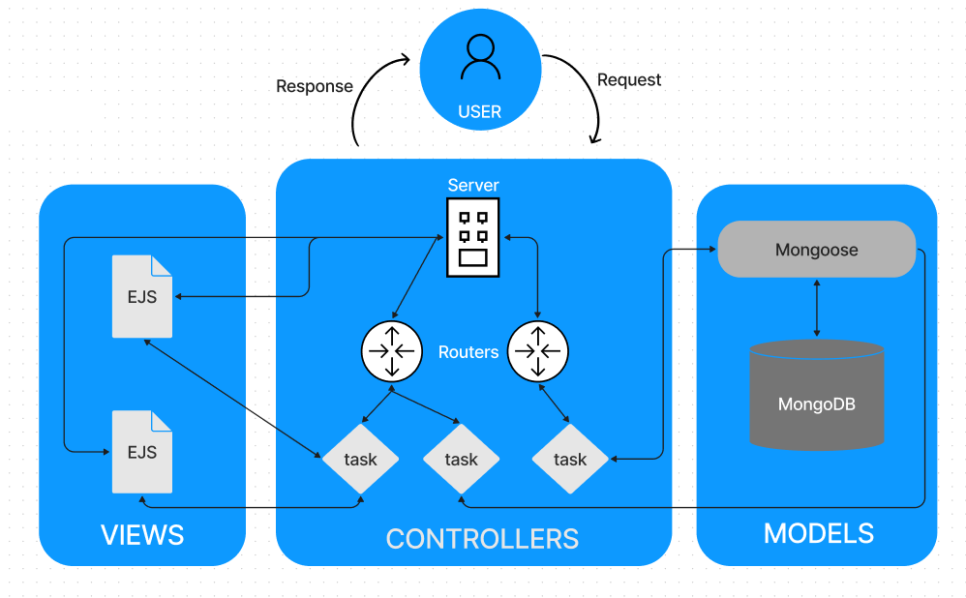
Simple Application Structure
Requests from the user are sent to the server via URL paths which are processed as Routes by the Routers
These routes are then handed over to specific controllers
Mongoose acts as a interpreter between the controller and the database
MongoDB is used as the data storage
EJS view files will be rendered to html and presented to the user as a response
Notes:
Each path may be routed multiple times to reach a specific function in a specific file

Slide 5
Model Component
A constructor that utilizes a database schema to create a equivalent record in the database from the object passed to it via the controller.
Never communicates with the user or views directly. Must go thru controller.
Use large scale data storage such as Oracle, MySql, MongoDB, PostgreSQL
Database Interactions, Adding and retrieving data, Processing data from or to the database
Database interfaces such as Mongoose are also part of the model since they directly interact with database
Even if you don’t store data, you might need a model for authentication

Slide 6
View Component
Frontend code that is sent to the client (browser) This is the only thing the user ever sees.
It consists of HTML, CSS, and JavaScript.
Never communicates with the user or model directly. Must go thru controller.
Views use templating languages such as EJS, Handlebars, Pug, etc
Using the data it receives from the controller, it will typically render out html to be eventually presented to the user.

Slide 7
Controller Component
Uses programming languages such as JavaScript to control how the app behaves
Handles the flow of data between the model and views and user
Processes all server-side logic. Can be seen as the brain of the application.
Acts like a middle man:
Takes info from user
Process info and talks to database models if needed
Receives info from database (via models)
Speaks to View to explain what presentation is needed for the user
Route Processing - chooses the appropriate controller
Process GET/POST/PUT/DELETE requests
Notes:
Main component consisting of multiple controllers

Slide 8

Analogy: Requesting Food at a Restaurant
An food order is placed by a customer (http request by user) at a restaurant (Web Server)
The waiter (CONTROLLER) receives the order and sends it to the kitchen to make the order
The kitchen uses a cookbook (MODEL) to determine what ingredients are needed and how to cook it.
The waiter than takes the cooked food and places it nicely on the table with appropriate tableware, napkins, and condiments. (VIEW)
User enjoys the meal they ordered (http response)

Slide 9
Technical Example of a Request Made to our Web Application
A user clicks on a food menu item to get more detailed information
User clicks on a food image (the rendered HTML from the VIEW) which sends a GET request. The URL will have a path with the specific product ID /products/[unique product ID]
The SERVER will receive the request and parse the URL and finds the appropriate router to use
The ROUTER then further parses the URL and finds the appropriate CONTROLLER to use based on the URL and request method
THe CONTROLLER will find the appropriate MODEL to make a request to the database and send it the unique product id
The DATABASE will retrieve the data and pass it back to the CONTROLLER
The CONTROLLER will then take this data and pass it to the VIEW
The VIEW will render the data into HTML and send it back to the CONTROLLER
THe rendered HTML is sent back to user as a response from the server

Slide 10
Object Data Modeling (ODM)
A data layer exists between the objects and the database that converts the object into the appropriate structure of the database.
Acts as a translator between JavaScript objects in code and the representation of those objects in MongoDB
Schemas are structured set of rules that validates incoming data and ensures that only the expected data is passed along. They also allow developers to view the key structures of the database without having direct access to the database.
Create a structure for CRUD operations to our database making getting data very easy. This improves readability, documentation and speed of development.
Mongoose is a popular ODM library for MongoDB

Slide 11
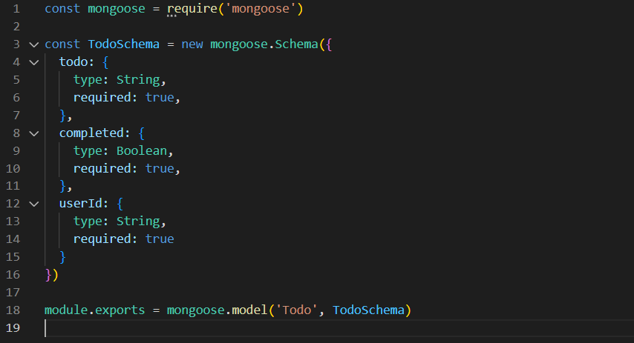
Example: Mongoose Schema
Notes:
Every document object will have its own Schema
Mongoose provides many options to further validate the incoming data

Slide 12
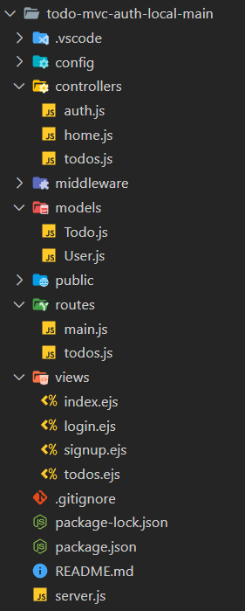
Code Structure Guidelines
Everything has its place. Creates a solid structure for a web application.
MVC components are grouped logically into separate folders. Folders for Models, Routes, Views
Multiple router files are used to organize code into specific parts of the web application Ex: login, checkout
Each database table/collection has its own model file
Can add additional organization by grouping middleware and configuration files into their own folders
In the end, the main server file is less cluttered and easier to read and maintain

Slide 13
“Clean code always looks like it was written by someone who cares.”
— Robert C. Martin

Slide 14
EXTRA RESOURCES
Model–view–controller Wiki | https://en.wikipedia.org/wiki/Model-view-controller
Mongoose ODM | https://mongoosejs.com/
EJS Templating | https://ejs.co/

