Slide 1


Hyperscript
By: Felicia Jayasaputra & Mico Monks

Slide 2
What is Hyperscript?
Hyperscript is a scripting language that does the front end of web development. It utilizes interactive HTML to handle events in a user-friendly way. You can also use it for asynchronous code, to enhance your existing code, or to even debug.

Slide 3
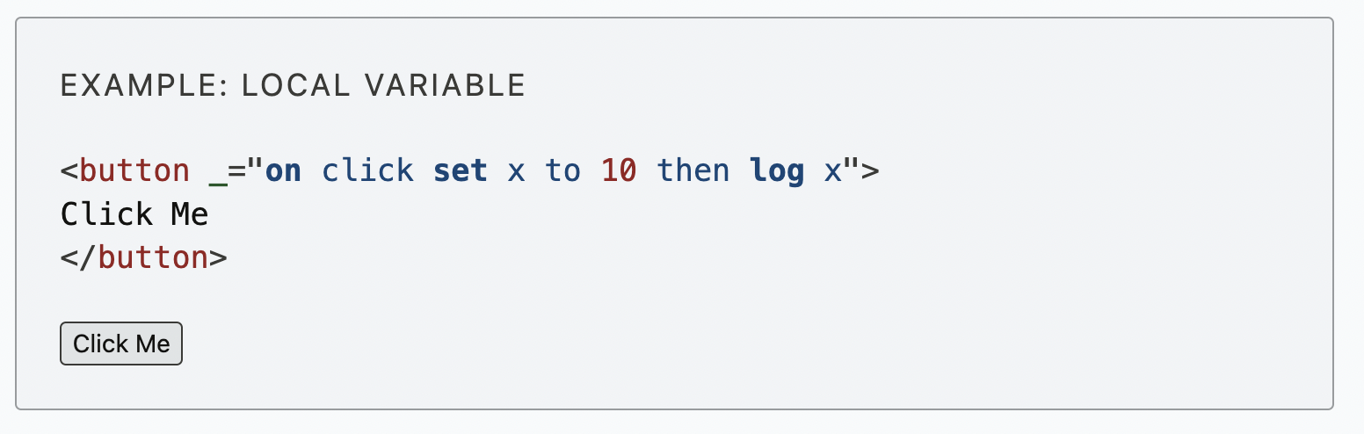
Manipulating Code in the DOM
In Hyperscript, we can directly manipulate code embedded directly on elements. This means we can add events directly into the HTML elements instead of using JavaScript or another file. Here are some fun examples of what you can do with Hyperscript.
https://csci331.cs.montana.edu/~t37k234/CSCI331Final/hsdemo.html

Slide 4
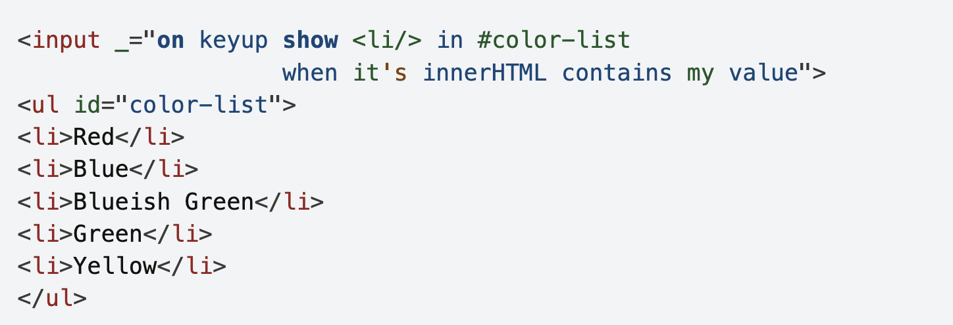
Filter Elements in Hyperscript
This is one of the filter elements that we can use in Hyperscript. We can use “show” and “when” to filter things that we want to look/search from the list. We can start by typing one letter in the search bar, and this will show the match things in the list. Below is the example of the code:
Link to the Hyperscript demo: https://csci331.cs.montana.edu/~t37k234/CSCI331Final/filter.html

Slide 5
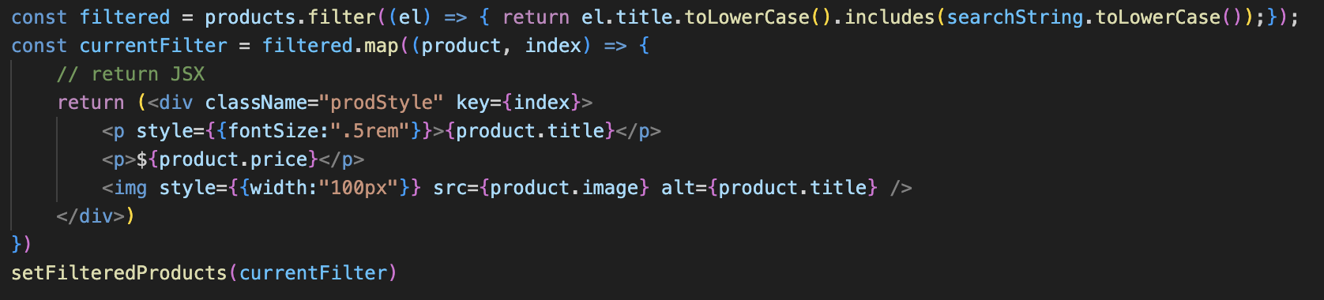
Filter Elements in React
We are now going to compare on the filter elements that we did in class.
As we can see, this Filter Elements that we did in class is more complicated and not as language friendly as Hyperscript. This contain more elements that we need to remember such as the methods and the list of parameters inside of it. Therefore, Hyperscript code is much easier to understand and to remember.

Slide 6
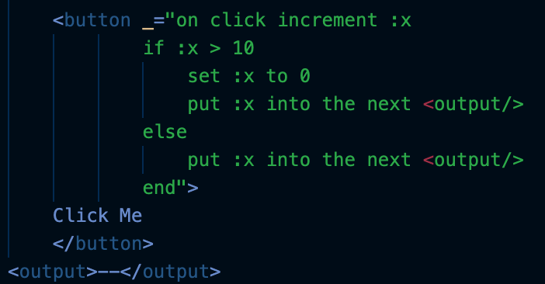
Increment Button in Hyperscript
Here is some code in Hyperscript to implement a count button similar to what we had to do in the next.js assignment. As you can see, it is far less code and can be written directly into the HTML!
Basically, Hyperscript allows us to add code directly to an element. The code for the button allows us to add if statements, and increment variables. In the example, we are incrementing x. Once x is greater than 10, we are setting it back to 0. In either case, we will display x in the output below with "put". As you can see, I didn't write this code super eloquently, but it is still far more simple than in next.js.
Link to Hyperscript demo: https://csci331.cs.montana.edu/~t37k234/CSCI331Final/increment.html

Slide 7
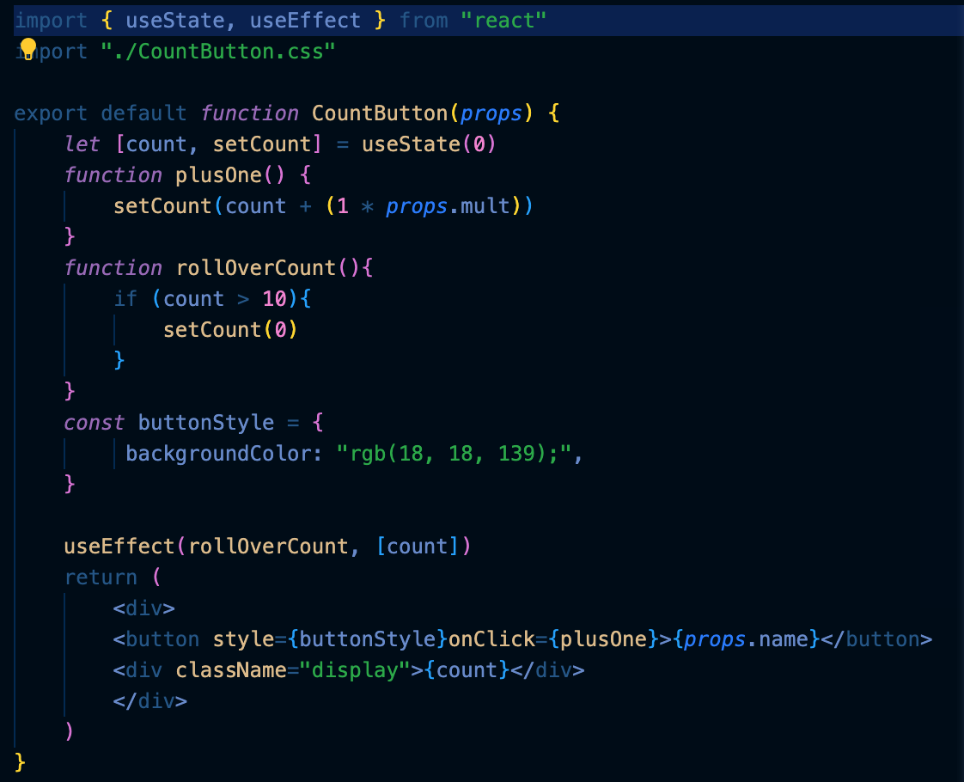
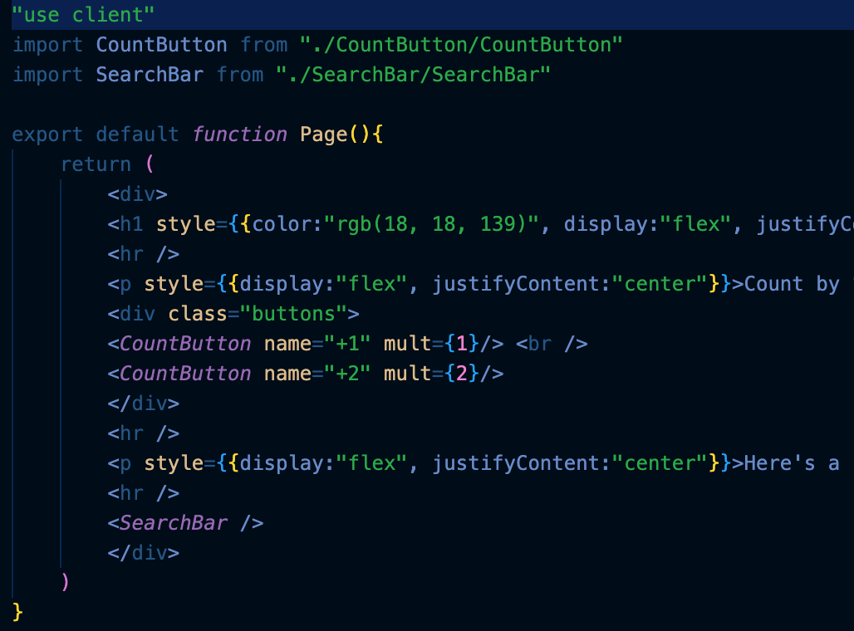
Increment Button in Next.js
As you can see, this is much more difficult in next.js. Not only do we have to add several functions that interact with useEffect, but we have to import that file onto our page. Even if you decide to use only one button for comparison, it takes far more lines of code and uses more files than necessary for Hyperscript.

Slide 8
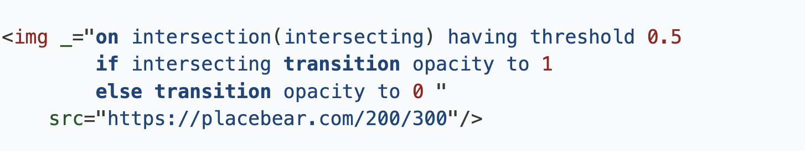
Intersection Events in Hyperscript
Another feature that we can use in Hyperscript is the intersection event. When at least half of the image comes into view, it will become visible. We can do this with the intersecting property. Since it has a threshold of 0.5, its opacity will transition to 1 (visible) when 50% of it is in view. If less than 50% of the image is in view, it does not meet the 0.5 threshold, and its opacity will be 0 (invisible). Below is the example of the code:
Link to the Hyperscript demo: https://csci331.cs.montana.edu/~t37k234/CSCI331Final/intersection.html

Slide 9

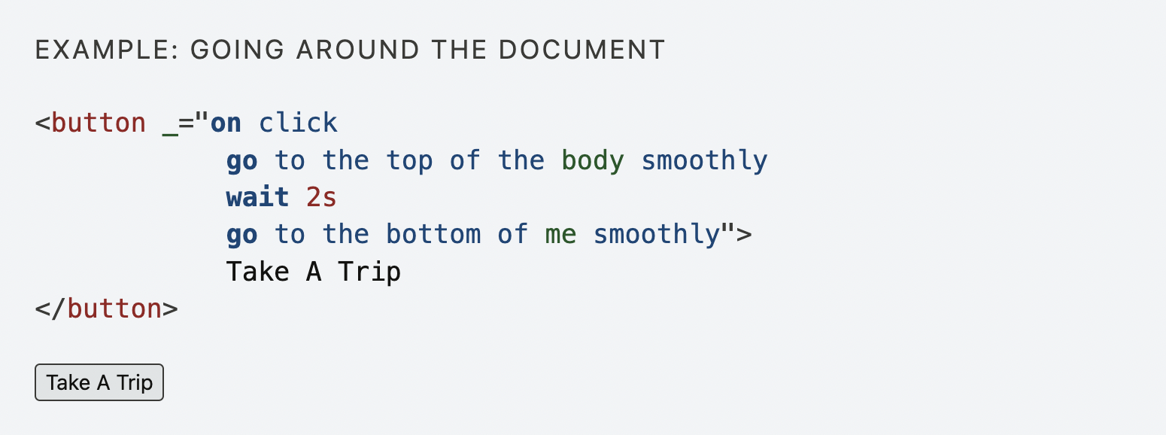
Go command in Hyperscript
Going Places
While using ajax is exciting, sometimes you simply wish to navigate the browser to a new location. To support this hyperscript has a go command that allows you to navigate locally or to new URLs, depending on how it is used:
Link: https://csci331.cs.montana.edu/~t37k234/CSCI331Final/updown.html

Slide 10
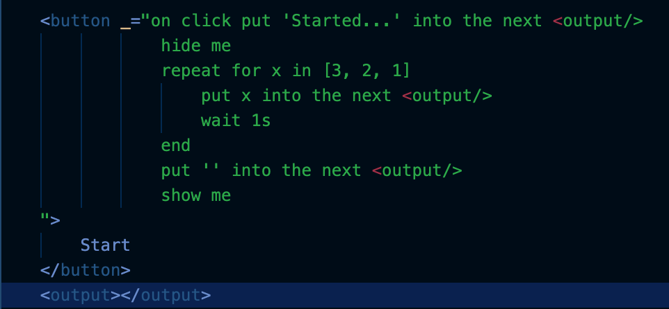
Countdown and Waiting
Another thing you can do in Hyperscript is waiting. This allows you to add time to events and control what happens when. Here is a simple countown demo I have made that utilizes waiting as well as some other Hyperscript functions:
Link to Hyperscript demo:
https://csci331.cs.montana.edu/~t37k234/CSCI331Final/updown.html

Slide 11
That's Hyperscript!
Learn more here: https://hyperscript.org/

