Slide 1
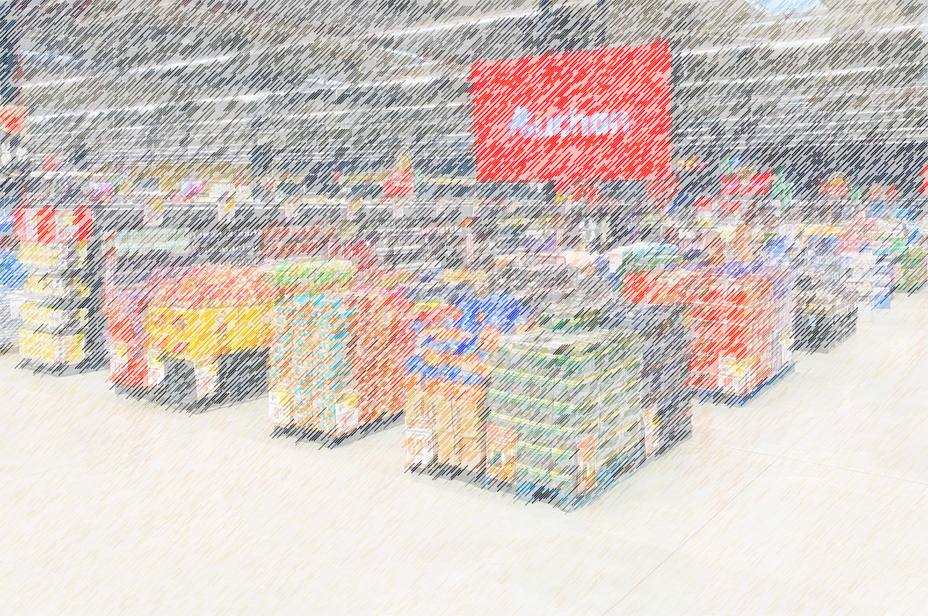

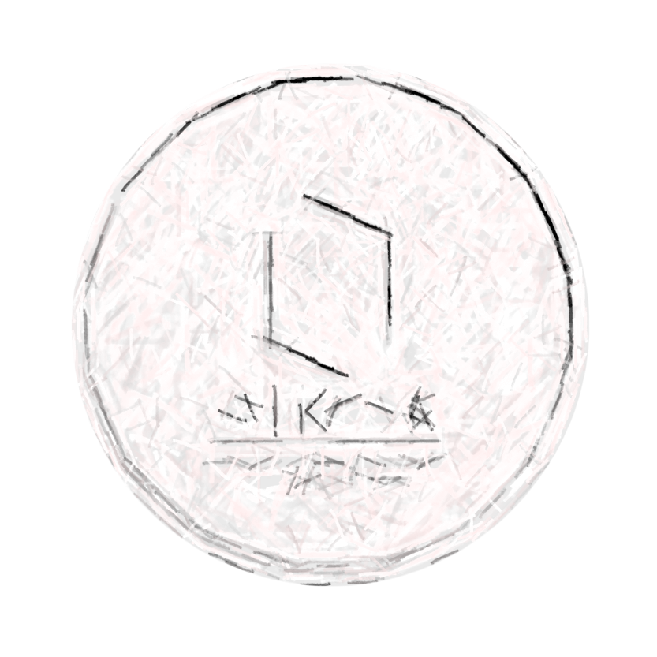
OIKOS8
OIKOS thinks out of any Box

Slide 2

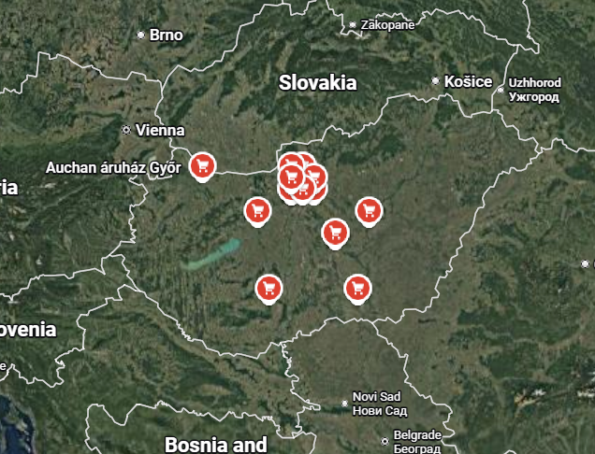
Overview
Store Network (Hungary)
19 hypermarkets
5 supermarkets
Nationwide retail coverage
Strong dominance of hypermarket format
Analysis
Strategy
Impact
Customer Loyalty
Loyalty program is key driver
55% of transactions via loyalty cards
1M+ registered members
49% regular shoppers (of loyal members)
90%+ visit at least once per year
Strategic Direction
Focus on modernizing hypermarket model
Not shifting to discount format
Improve customer experience & relevance
Especially targeting younger customers

Slide 3
Overview
Analysis
Company Overview
Auchan Retail is a French international grocery retailer
Operates large-format hypermarkets and supermarkets
Focus on wide assortment and destination shopping
Strategy
Impact
Revenue Drivers
High basket value per visit
Strong promotional campaigns & supplier activation
Cross-category purchases (food + non-food)
Business Model
Large-format retail (hypermarket-centered)
One-stop shopping experience
Combines food + non-food categories
Focus on planned shopping trips

Slide 4
Overview
Task 1 Design a scalable concept with innovative ideas for repurposing the 2,000–4,000 m² space to enhance customer experience
Analysis
Strategy
Impact
How can shopping in Auchan be turned into a culture for Hungarians, through scalable and non-institutional changes in the short term?
Task 2 Detail the implementation and impact of your project

Slide 5
Overview
Turn Auchan from a transactional hypermarket into a repeatable cultural-social destination through modular, low-cost, event-based activations.
Analysis
Strategy
Impact
Shift from “shopping place” → “social place”
Instead of:
people come → buy → leave
You want:
people come → stay → interact → return even without urgent shopping

Slide 6
How?
Why?
What?
Overview
Analysis
Strategy
Impact

Slide 7
Overview
Analysis
Strategy
International Benchmark Analysis
Impact
Site Analysis
Financial Analysis

Slide 8
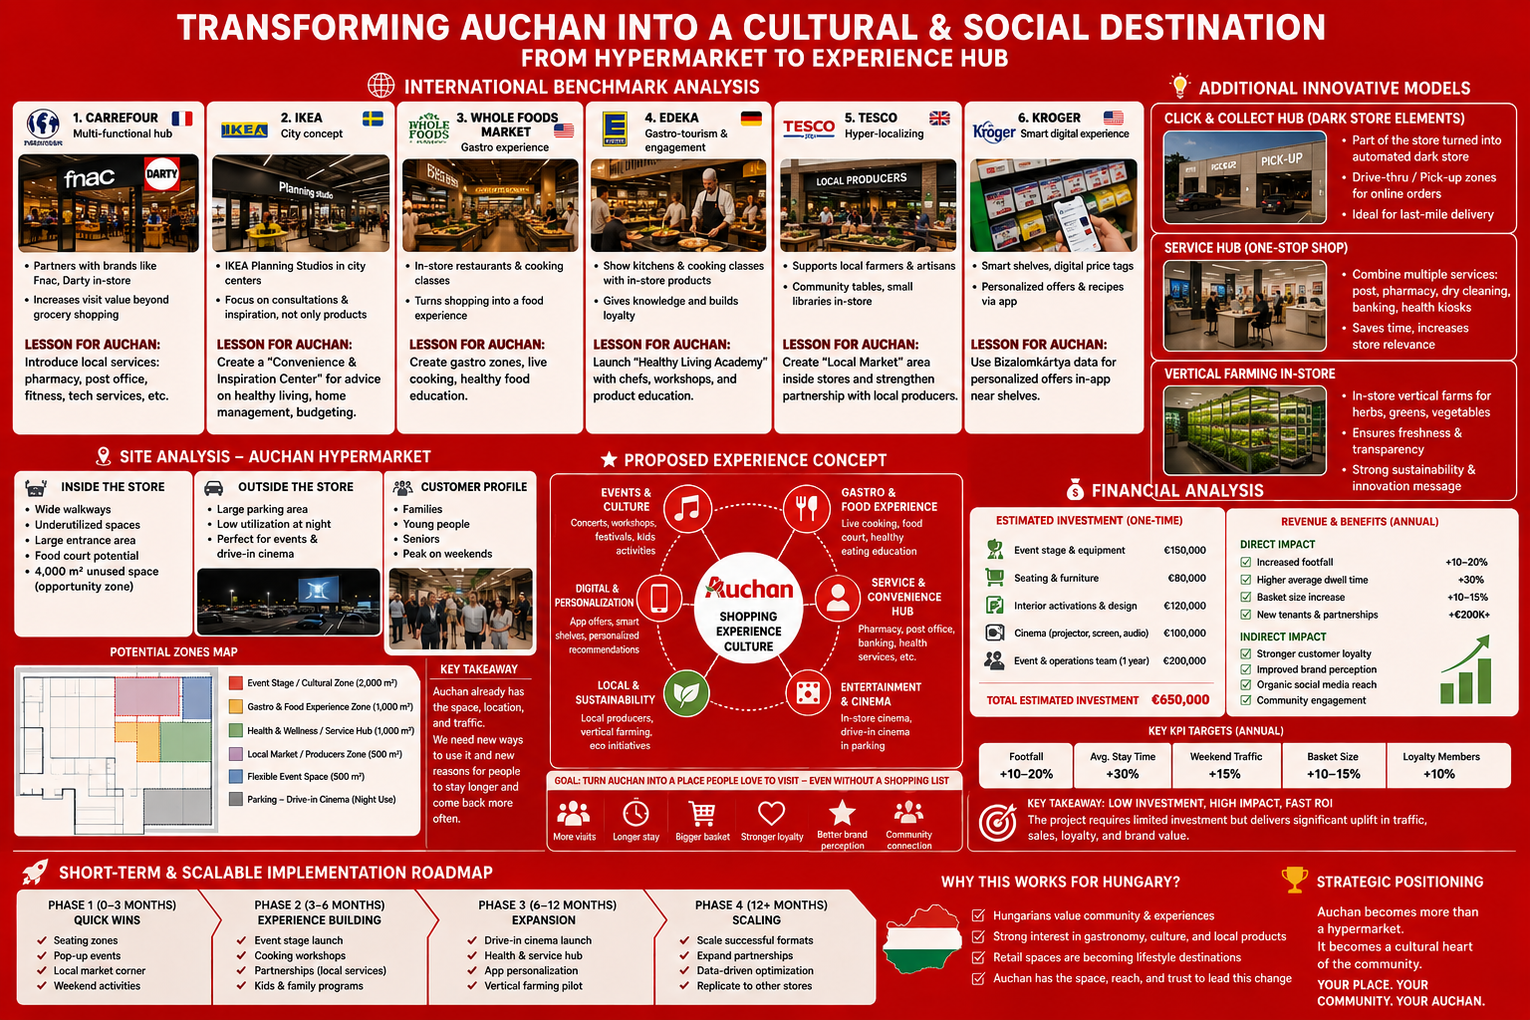
International Benchmark
Overview
Analysis
Strategy
Impact

Slide 9
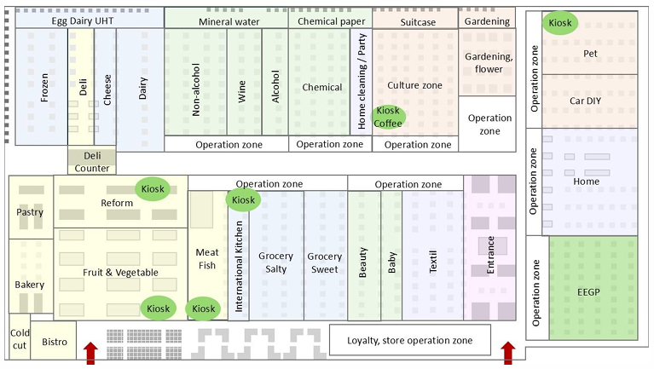
Site Analysis
Overview
Analysis
Strategy
Impact

Slide 10
Site Analysis
Overview
Analysis
Strategy
Impact
Example of typical route
Typical Daily Shopping Basket (Top 10 Items)
🍞 Bread
🥚 Eggs
🥛 Milk
🧀 Cheese
🍗 Chicken / Meat
🍎 Fruits
🥕 Vegetables
🧈 Butter
🧻 Toilet Paper
☕ Coffee

Slide 11
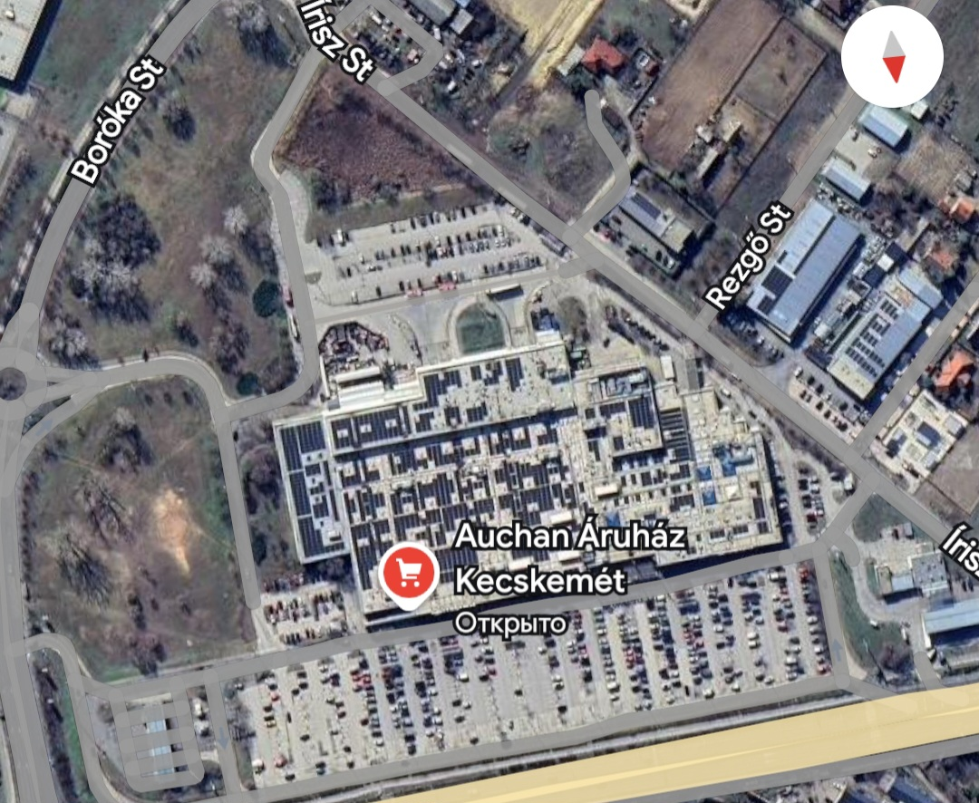
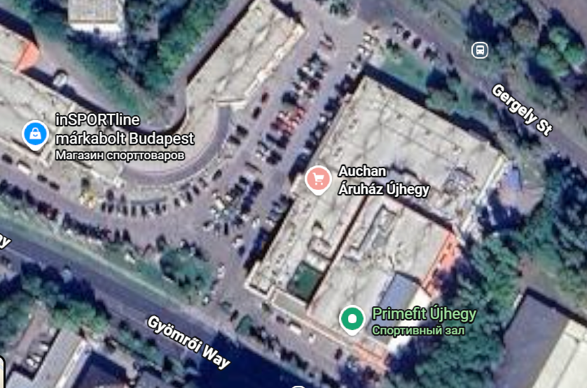
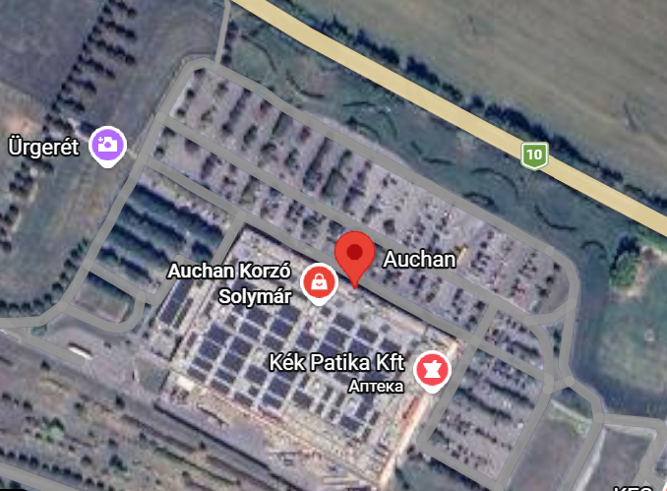
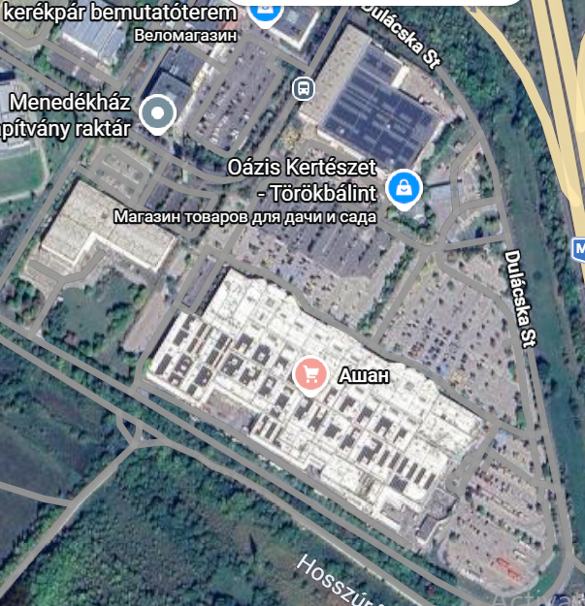
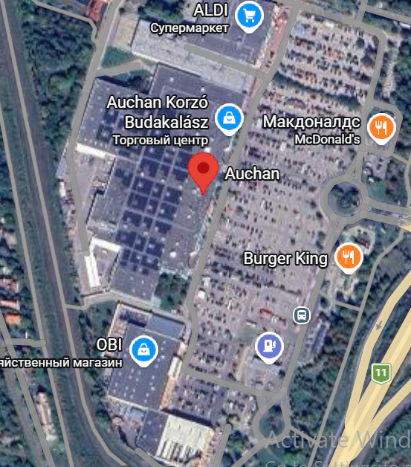
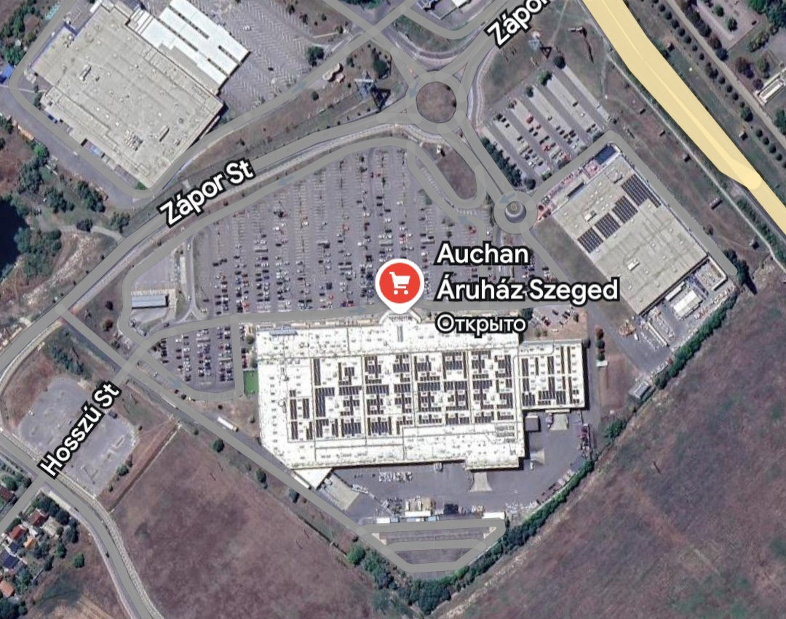
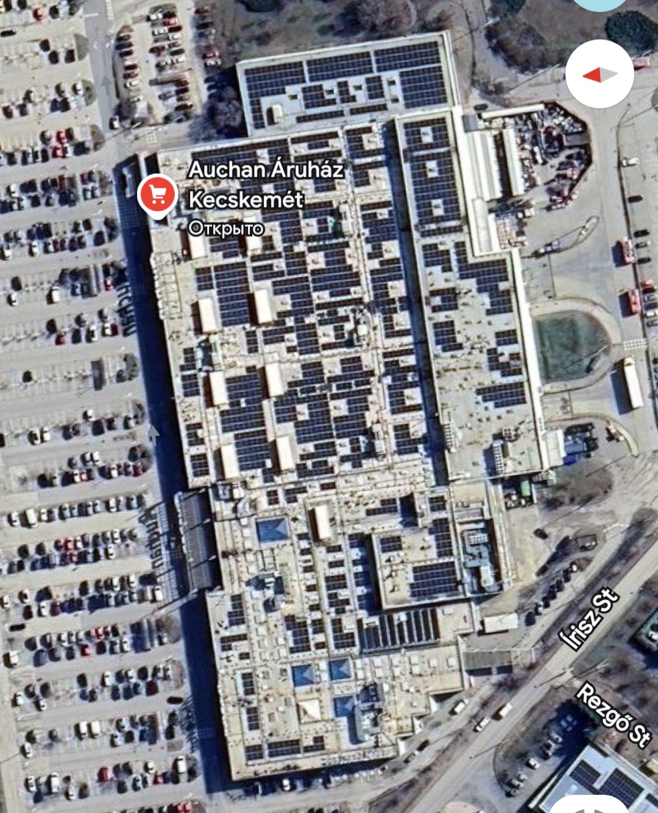
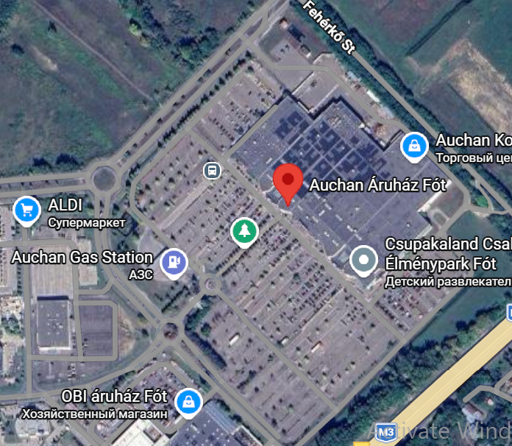
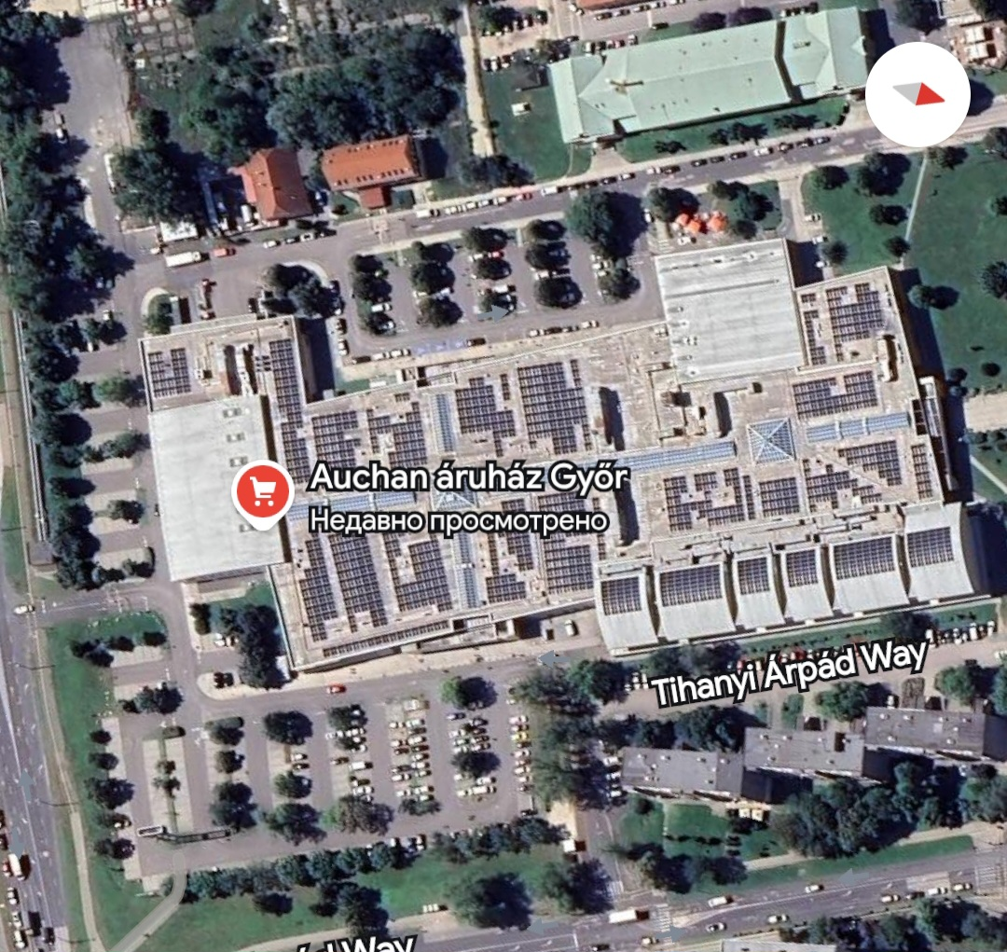
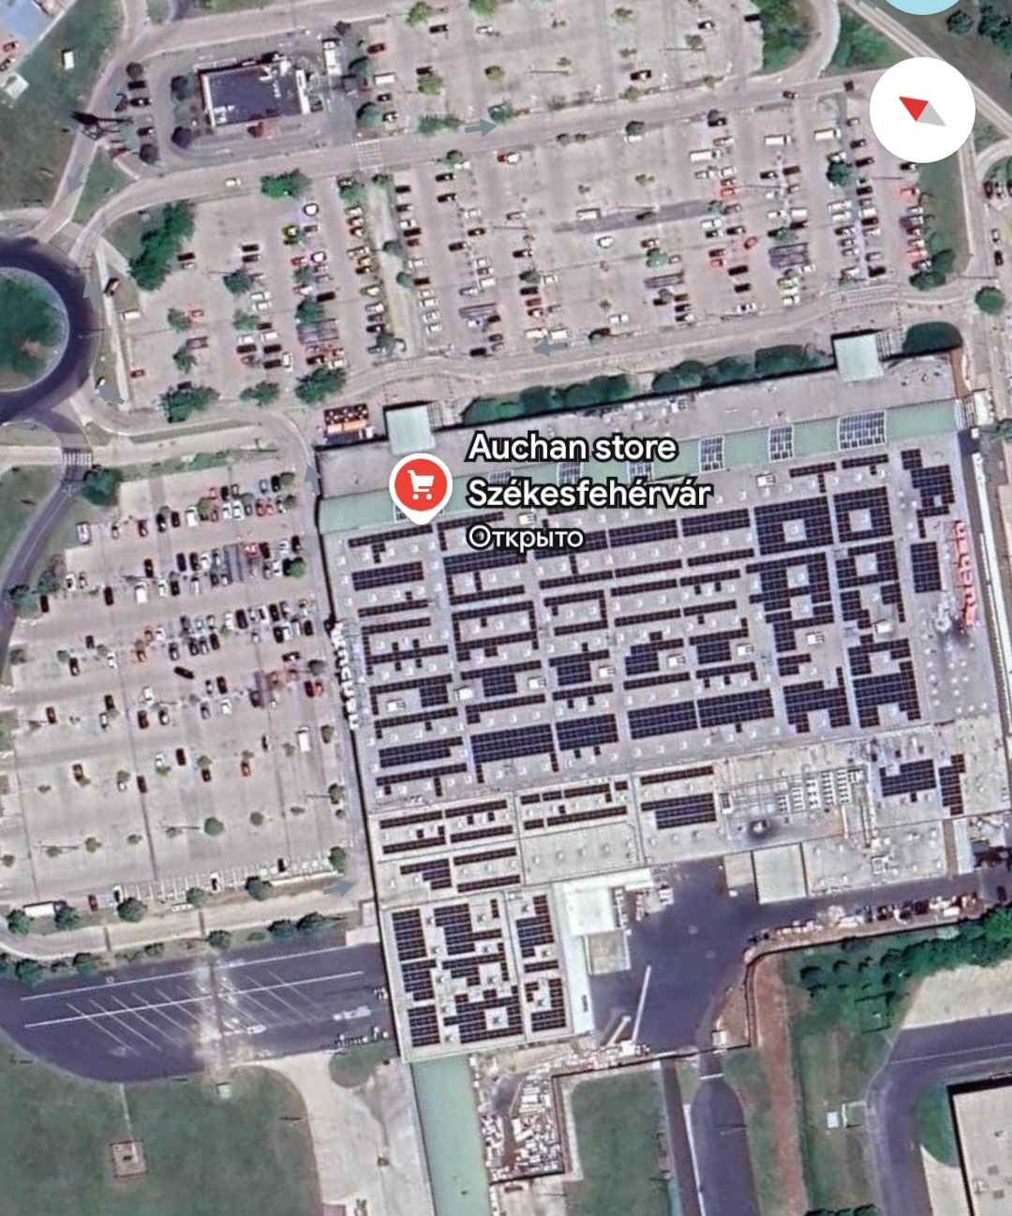
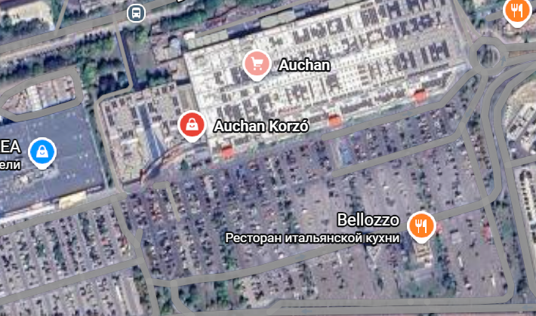
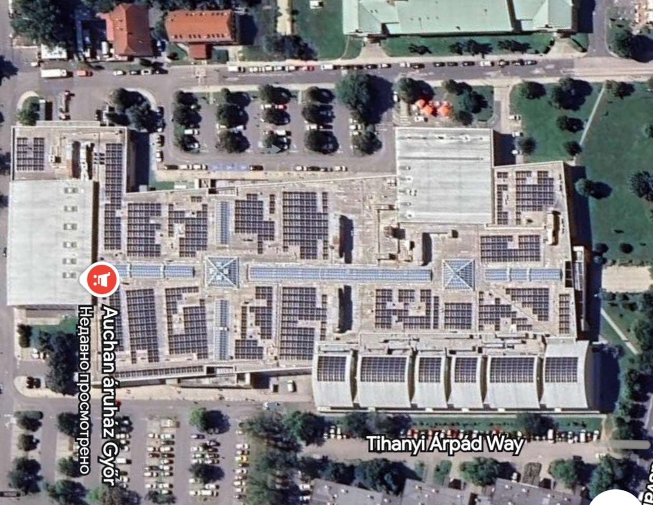
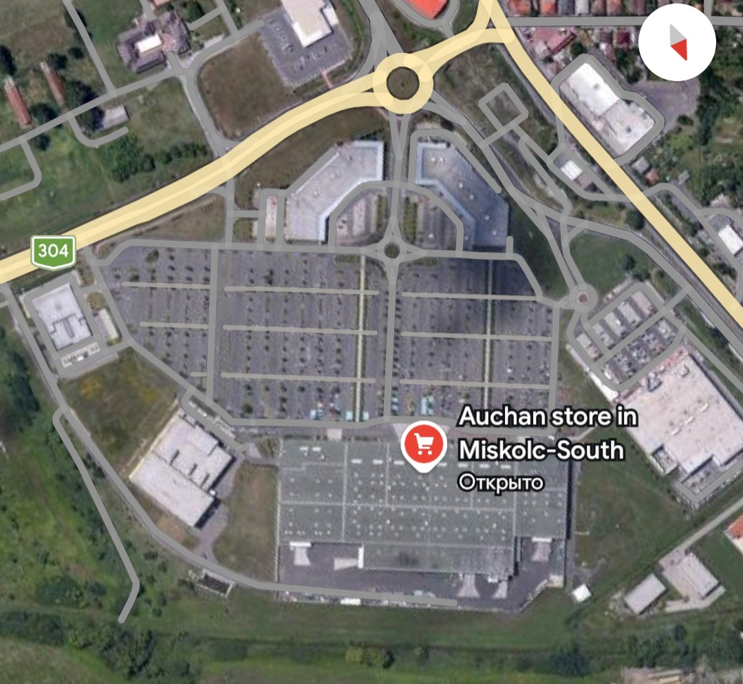
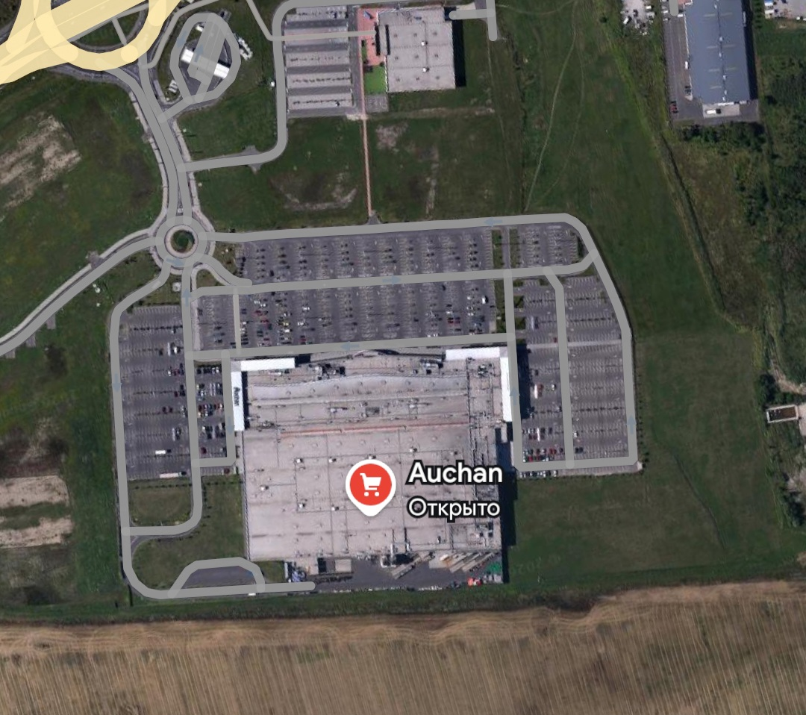
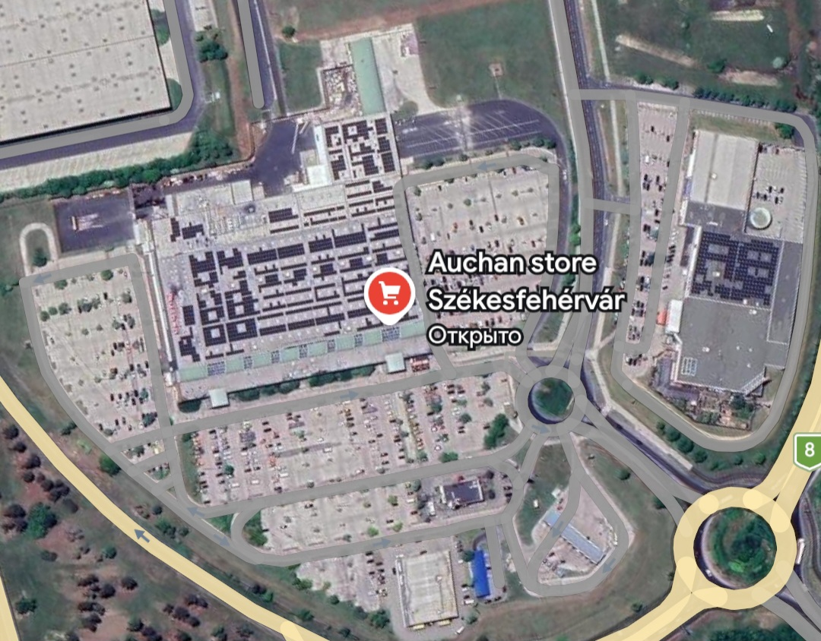
Site Analysis
Overview
Analysis
Strategy
Impact

Slide 12
Site Analysis
Overview
6000–12000m
Analysis
Strategy
Impact
The interval
8000–16000m
AND WE CAN USE IT TOO. . .
2000–4000m
+

Slide 13
Site Analysis
Overview
Analysis
Strategy
Impact
Food Products | Non-Food Products
AREA A
AREA B
AREA C

Slide 14
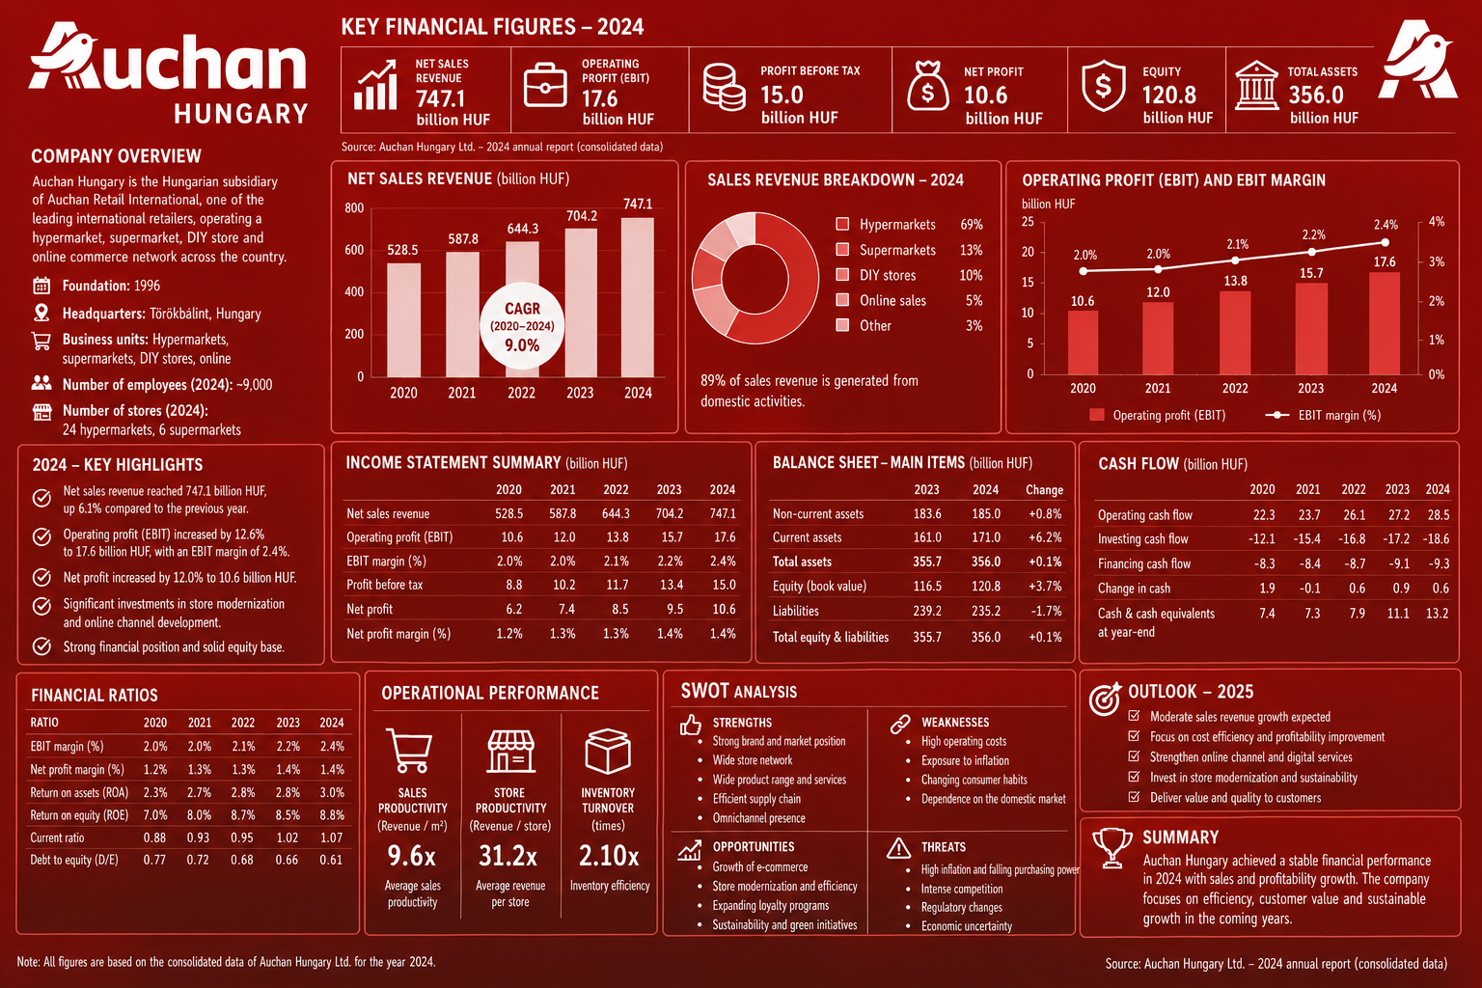
Financial Analysis
Overview
Analysis
Strategy
Impact
2024 fin. report is the most recent available data

Slide 15
Financial Analysis
Overview
Analysis
Strategy
Impact

Slide 16
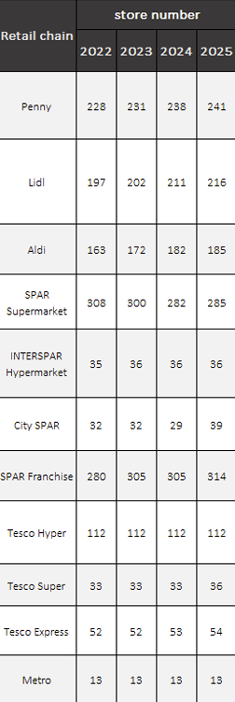
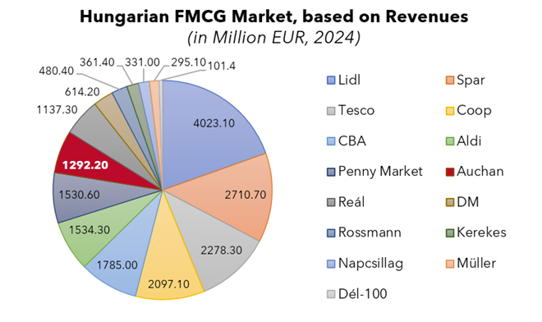
Market Analysis
Overview
Analysis
Strategy
Impact
“Auchan operates in a highly competitive retail market where growth is driven by expanding e-commerce, price-sensitive consumers, and increasing demand for efficient omnichannel shopping experiences”

Slide 17
Sooo. . .
It’s time for Strategy
Overview
Analysis
Strategy
Impact

Slide 18
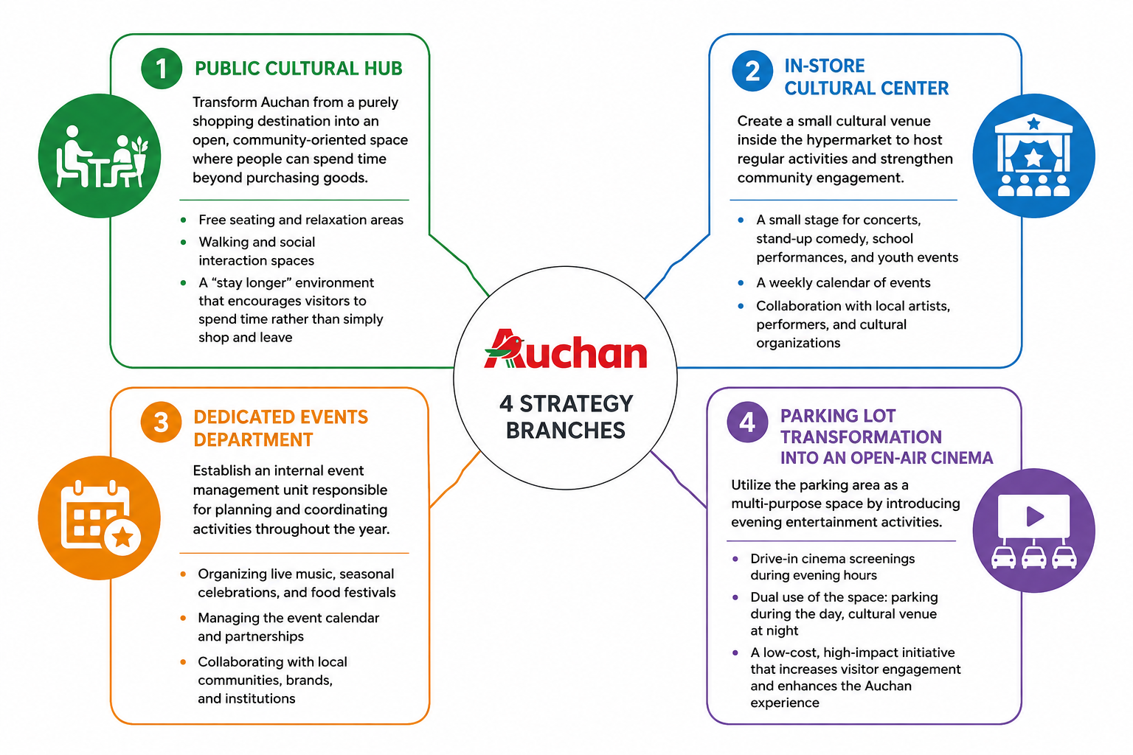
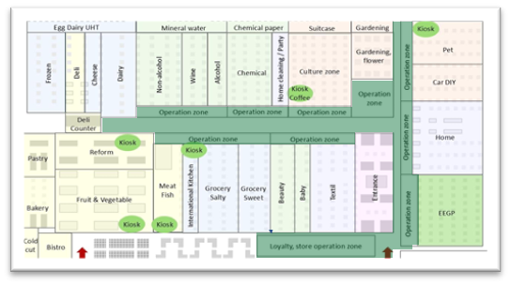
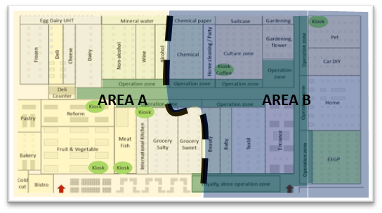
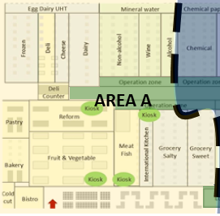
Overview
Analysis
Strategy
Impact
AREA C

Slide 19
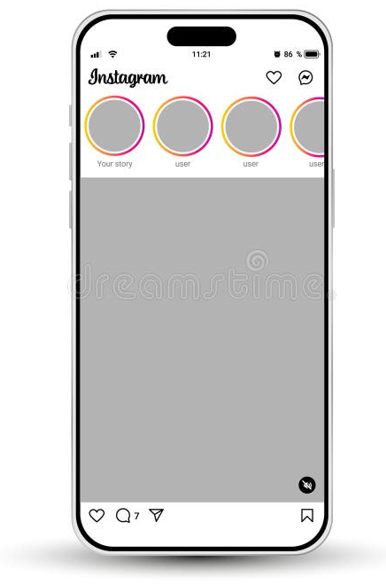

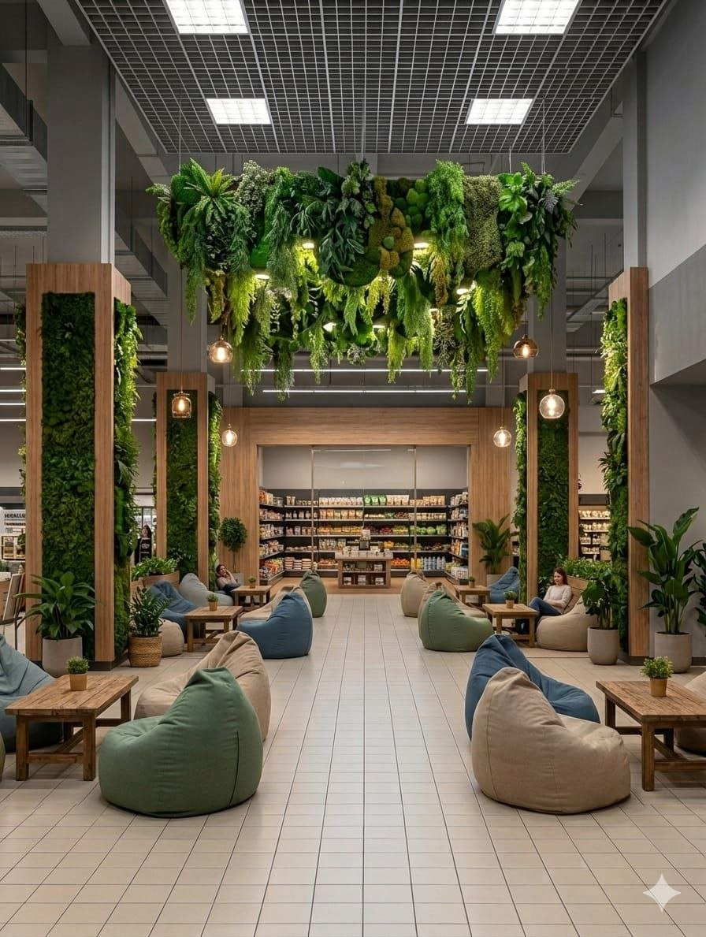
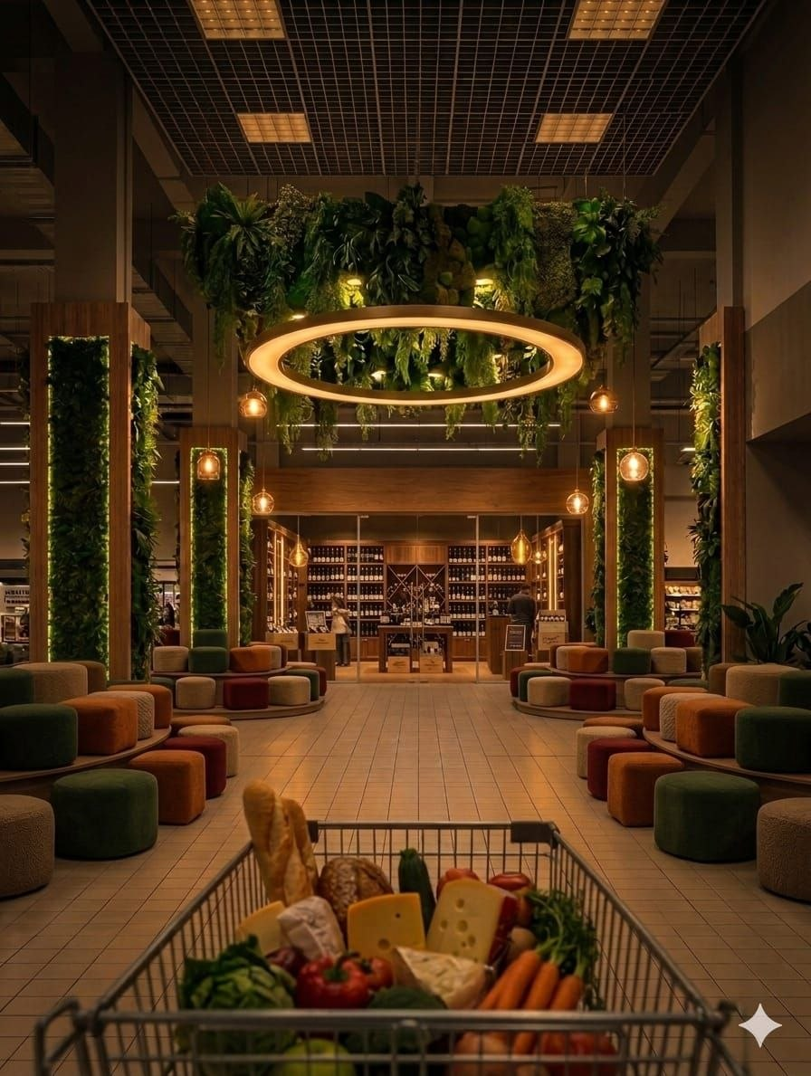

Overview
Analysis
Strategy
Impact
2
2
1
1
#All concepts generated by Gemini AI

Slide 20
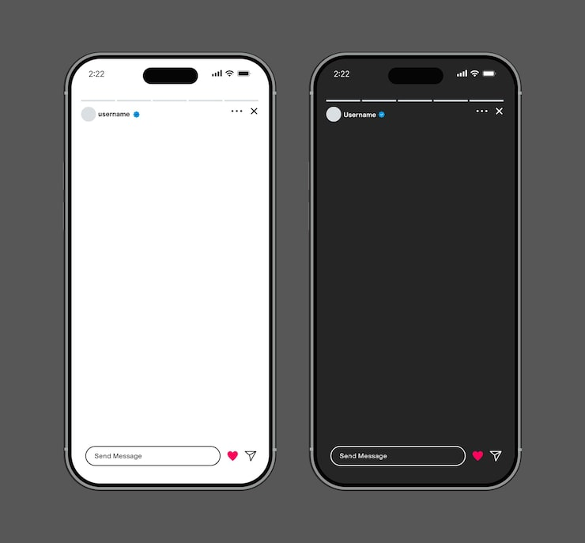

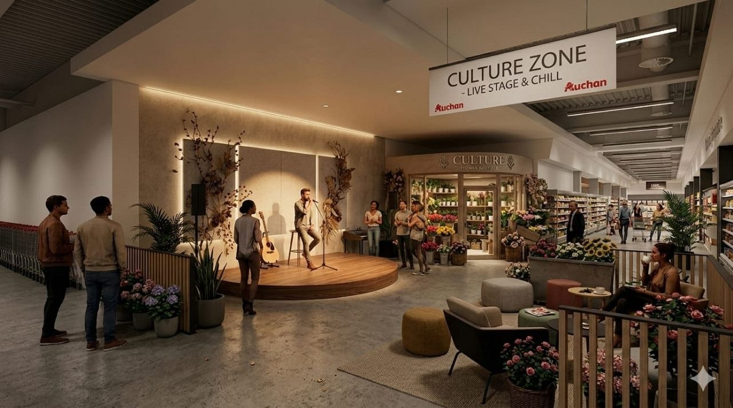
Overview
Analysis
Strategy
Impact
1
#All concepts generated by Gemini AI

Slide 21

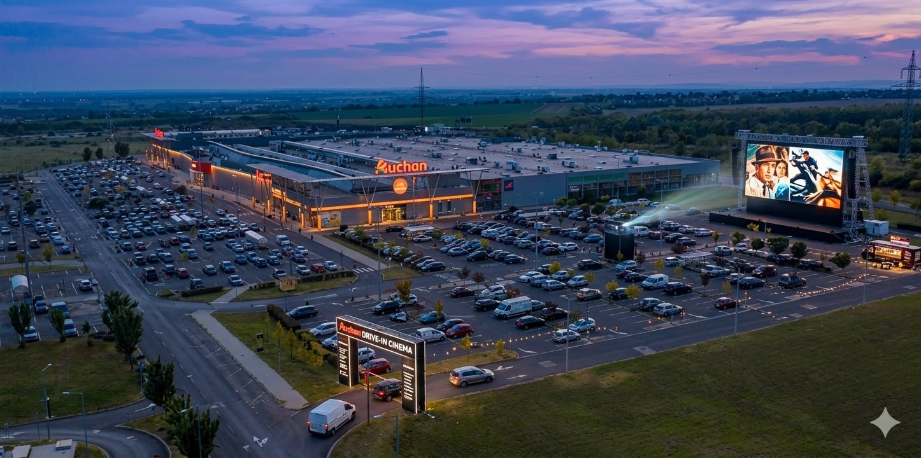


Overview
Analysis
Strategy
Impact
for 360 view
#All concepts generated by Gemini AI

Slide 22

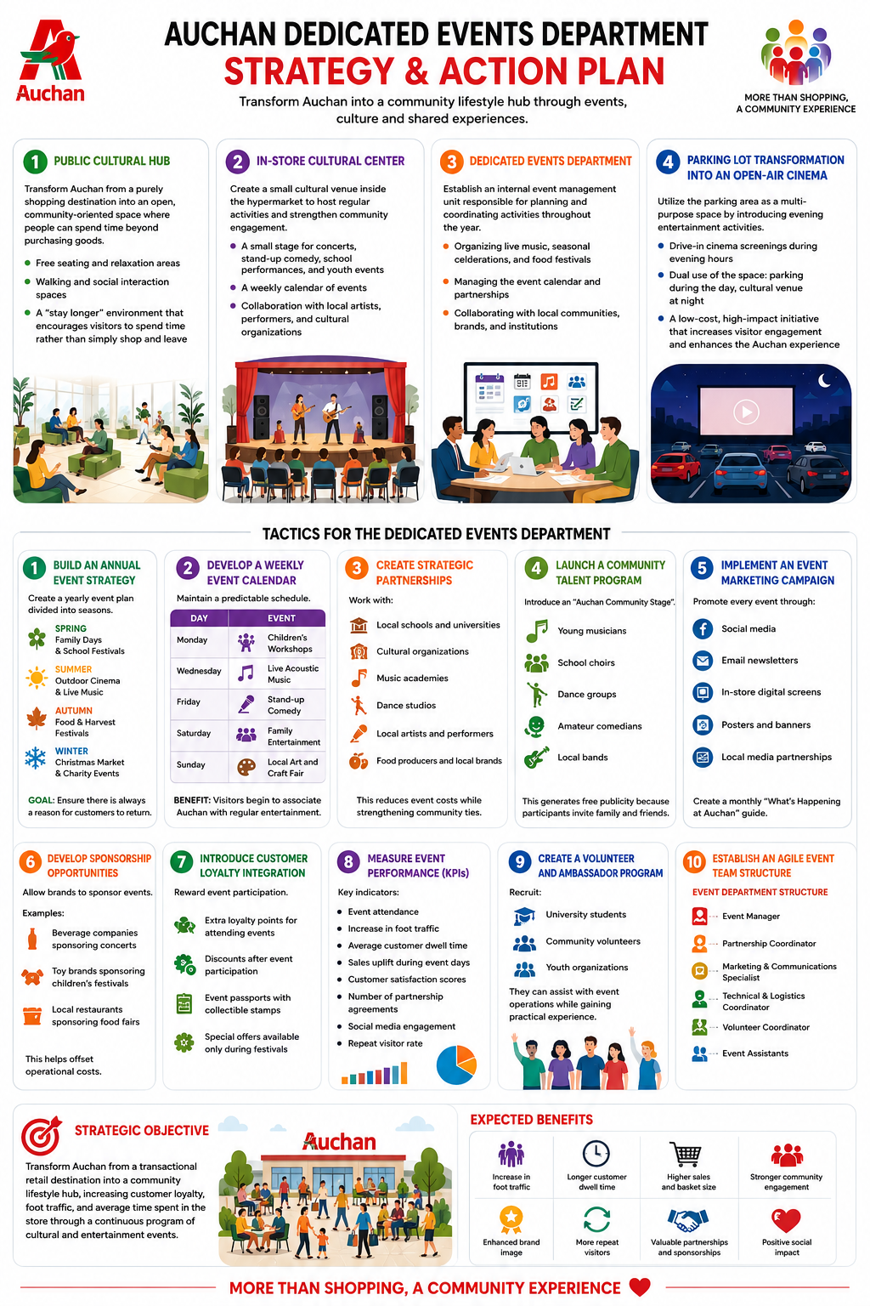
Overview
They organize this all. . .
Analysis
Strategy
Impact

Slide 23

Overview
Analysis
Strategy
Impact
Every week
OkAuchan is the official mobile application of the Hungarian Auchan network

Slide 24
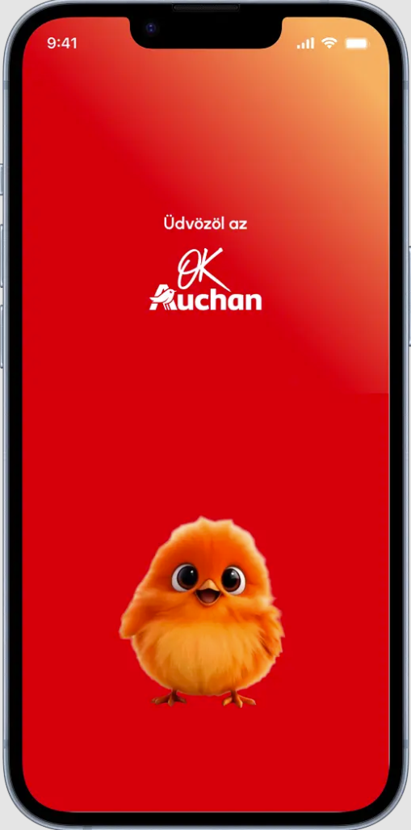
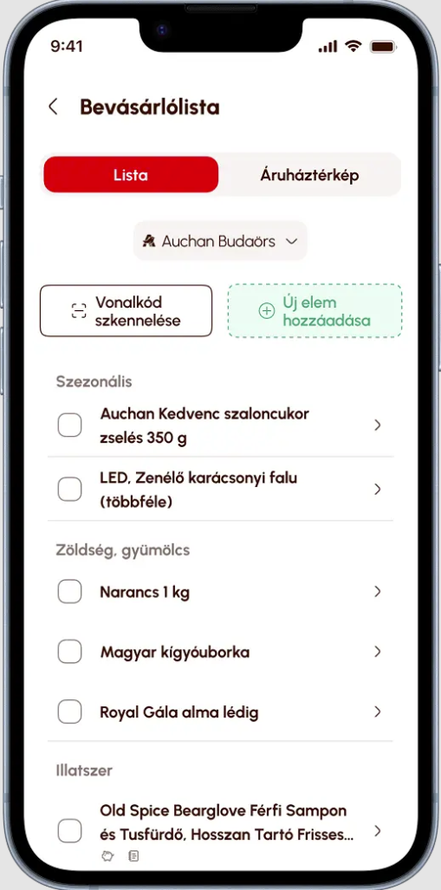
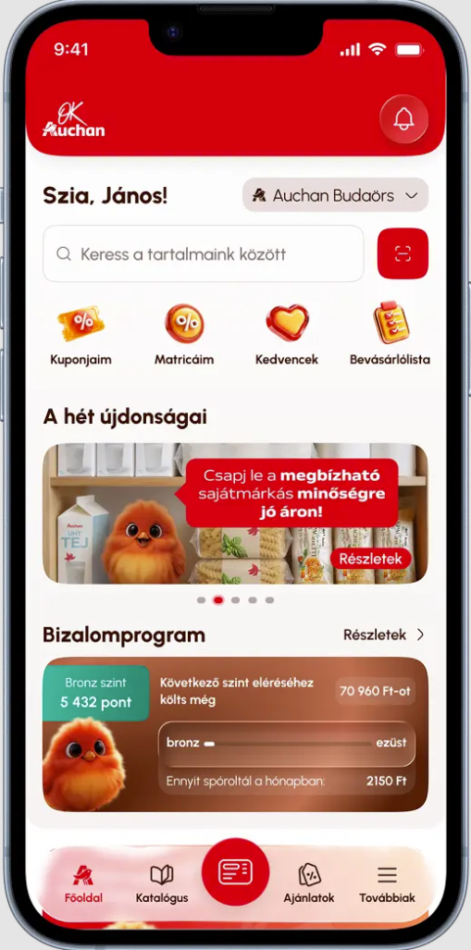
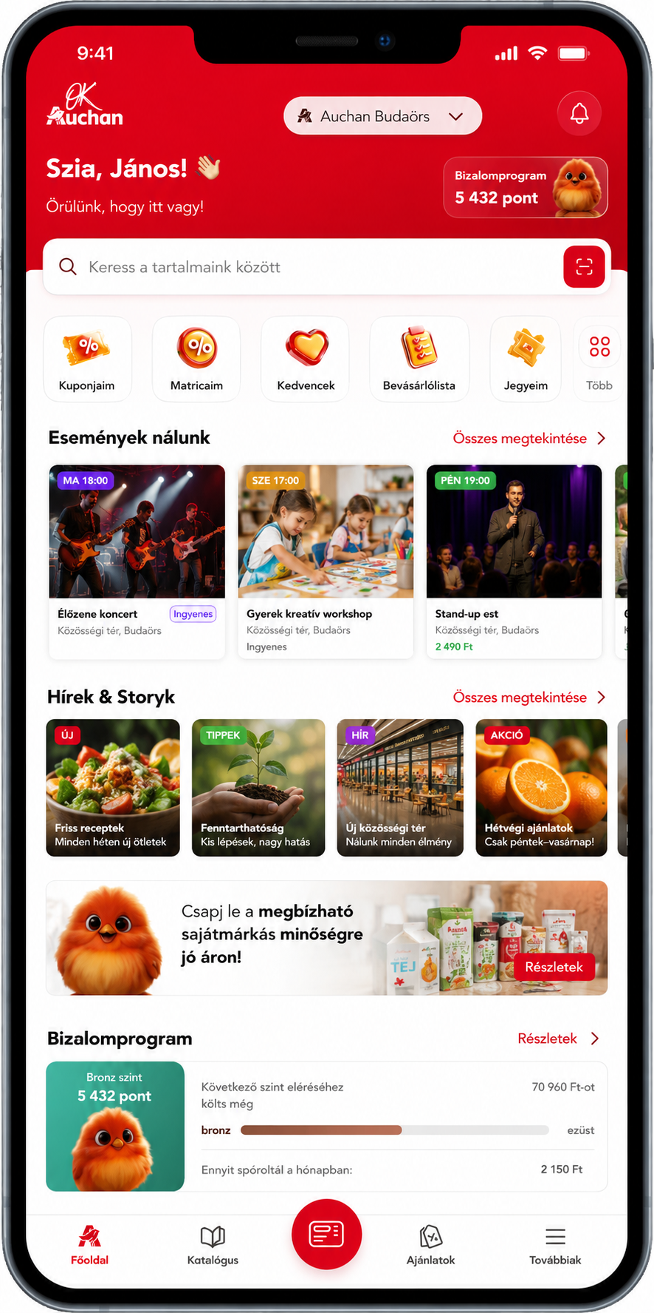
Overview
Analysis
Strategy
Impact

Slide 25
Overview
Analysis
Strategy
Impact
New “Events & Stories” Section Added on Home Screen
Event Cards with Visual Scheduling
“Hírek & Storyk” (News & Stories) Section Introduced
Stronger Content Hierarchy on Home Screen
More Engaging Visual Browsing Experience
Improved User Engagement Flow

Slide 26
Overview
Analysis
Strategy
Impact
Every week
OkAuchan is the official mobile application of the Hungarian Auchan network

Slide 27
Overview
Analysis
Strategy
Impact

Slide 28
Overview
Analysis
Strategy
And now.
IMPACT
Impact

Slide 29
Overview
Analysis
Strategy
Customer Personas | (%) |  | motivation | impact
Bargain-Hunter Ágota | 24% | Baby Boomers / Gen X | Consumers are highly sensitive to price changes and are strongly influenced by discounts and promotions. | Need to ensure low prices and provide attractive promotions and discounts.
Experience-Seeker Éva | 21% | Millennials / Gen X | People like to try new products; shoppers are attracted by variety and new offerings. | Hypermarket trend: development of large stores (around 2000–4000 m²) to meet consumer demand.
Local Helga (Տեղականը | 20% | Gen X / Baby Boomers | Consumers value socially responsible products, waste reduction, and ecological awareness. | Increase availability of local producers and introduce a Farmer’s Market concept.
Conscious Tibor/Tekla | 16% | Millennials / Gen Z | Focus on healthy lifestyle, Bio/Organic and sustainable products. | Hypermarket trend: creation of dedicated bio/organic and healthy food sections.
Get-it-Done Lóri (Արագ | 16% | Gen Z / Millennials | Shopping is seen as a leisure activity; people also shop at discount stores such as Lidl/Aldi. | Development of loyalty programs and self-service technologies (apps, kiosks, self-checkout).
Digital Borka | 2% | Gen Z | Consumers are tech-savvy, use apps, and compare prices through digital platforms and online tools. | Creation of a digital ecosystem and omnichannel integration (e.g., Auchan GO-type solutions).
Impact

Slide 30
Overview
Bargain-Hunter Ágota | 1 774 000 | 7,0 | 5,0 | 7,3 | 532 200
Experience-Seeker Éva | 1 537 000 | 4,0 | 50,0 | 6,0 | 3 074 000
Local Helga | 1 504 000 | 12,0 | 10,0 | 13,2 | 1 804 800
Conscious Tibor/Tekla | 1 209 000 | 6,0 | 30,0 | 7,8 | 2 176 200
Get-it-Done Lóri | 1 191 000 | 3,0 | 20,0 | 3,6 | 714 600
Digital Borka | 176 000 | 5,0 | 40,0 | 5,4 | 70 400
 | 7 391 000 |  |  |  | 8 372 200
Analysis
Strategy
Impact

Slide 31
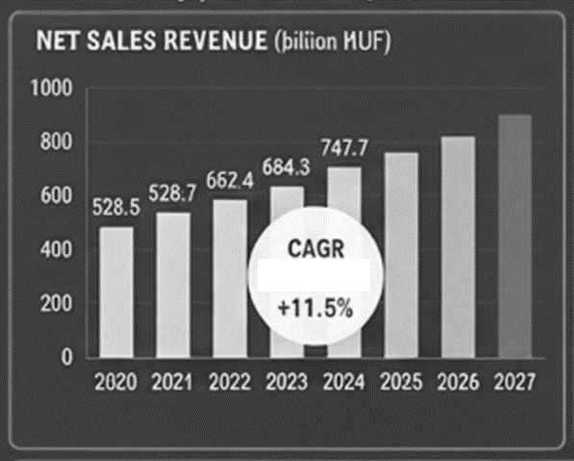
Overview
Analysis
Strategy
Impact
before/after
1078,8
Daily Transactions | € 4 500,00 | € 5 085,00
Base Daily Revenue (EUR) | €99 000 | € 111 870,00
Base Monthly Revenue (EUR) | €2 970 000 | € 3 356 100,00
Base Annual Revenue (EUR) | €36 135 000 | € 40 832 550,00
Base Annual EBITDA (EUR) | €1 152 336 | € 1 302 139,37
10-13%

Slide 32
Strategy
Overview
Analysis
Impact
AUCHAN REFORMS - FINANCIAL MODEL 2025
BLOCK 1: Elo Group Official (2025)
Group Annual Revenue (Milion EUR) | 32 142 | € 36 320,46
Group Annual EBITDA (M EUR) | 1 025 | € 1 158,25
Group EBITDA Margin | 3,19% | € 0,04
BLOCK 2:
Average Basket (EUR) | €22 | € 24,86
Daily Transactions | € 4 500,00 | € 5 085,00
Base Daily Revenue (EUR) | €99 000 | € 111 870,00
Base Monthly Revenue (EUR) | €2 970 000 | € 3 356 100,00
Base Annual Revenue (EUR) | €36 135 000 | € 40 832 550,00
Base Annual EBITDA (EUR) | €1 152 336 | € 1 302 139,37
BLOCK 3: Reform Impact & ROI
Incremental Monthly Transactions | 24975 | € 28 221,75
Incremental Monthly Revenue (EUR) | €549 450 | € 620 878,50
Incremental Annual Revenue (EUR) | €6 593 400 | € 7 450 542,00
Incremental Daily Revenue (EUR) | €18 064 | € 20 412,44
Incremental EBITDA Margin | 12,0% | € 0,14
Incremental Annual EBITDA (EUR) | €791 208 | € 894 065,04
Project CAPEX (Investment EUR) | €750 000 | € 847 500,00
Payback Period (Months) | 11,4 | € 12,85
Payback Period (Years) | 0,95 | € 1,07
Appendix
In € millions | 2023 | 2022 | Change at current exchange rates | Change at constant exchange rates
Revenue | 32902 | 33485 | -1,7% | +0,3%
Gross profit | 8082 | 7963 | +1,5% | +3,6%
Gross profit margin | 24,6% | 23,8% | 0.8pp | 0.8 pp
EBITDA | 1528 | 1697 | -10,0% | -7,3%
EBITDA margin | 4,6% | 5,1% | -0,4 pp | 0.4 pp
Operating profit | -14 | 366 | n.a. | n.a.
Net income | -378 | 42 | n.a. | n.a.
In € millions | 2025 | 2024 | Δ %
Revenue | 32 142 | 31 669 | +1,5%
Gross margin | 7 374 | 7 303 | +1,0%
% revenue | 22,9% | 23,1% | -0,0 pt
Payroll expenses | -4 323 | -4 294 | +0,7%
External expenses | -2 099 | -2 155 | -2,6%
% revenue | 20,0% | 20,4% | +0,0 pt
EBITDA | 1 025 | 883 | +16,1%
% revenue | 3,2% | 2,8% | +0,0 pt

Slide 33
Country | Hypermarkets | Supermarkets | Convenience stores | Digital
France | 145 | 273 | 7 | 203
Spain | 80 | 271 | 49
Portugal | 31 | 5 | 238 | 36
Luxembourg | 3 |  |  | 4
Poland | 70 | 30 | 6
Hungary | 19 | 5 | 2 | 5
Romania | 33 | 8 | 398
Ukraine | 17 | 4 | 15 | 1
Russia | 94 | 137
Senegal | 1 | 30 | 12 | 1
Ivory Coast |  | 8 | 5
TOTAL | 493 | 771 | 732 | 250
In millions of euros Excluding Auchan Hungary | 2024 | 2023 | Change at constant exchange rates
Revenues | 32290 | 31776 | +2,1 %
Gross profit | 7907 | 7818 | +2,0 %
Gross profit margin | 24,5% | 24,6% | 0,0 pt
EBITDA | 1224 | 1472 | -16,8 %
EBITDA margin | 3,8% | 4,6% | 0,0 pt
Other operating income/expenses | -868 | -382 | n.a.
Operating profit | -846 | -40 | n.a.
Net income/loss | -1223 | -378 | n.a.
Adjusted net income/loss³ | -92 | 44 | n.a.
Free cash flow | -224 | 13 | n.a.
Net financial debt at 31 December | 2921 | 2917
o/w Auchan Retail | 6 | -367 | n.a.
o/w New Immo Holding | 2905 | 3321

Slide 34
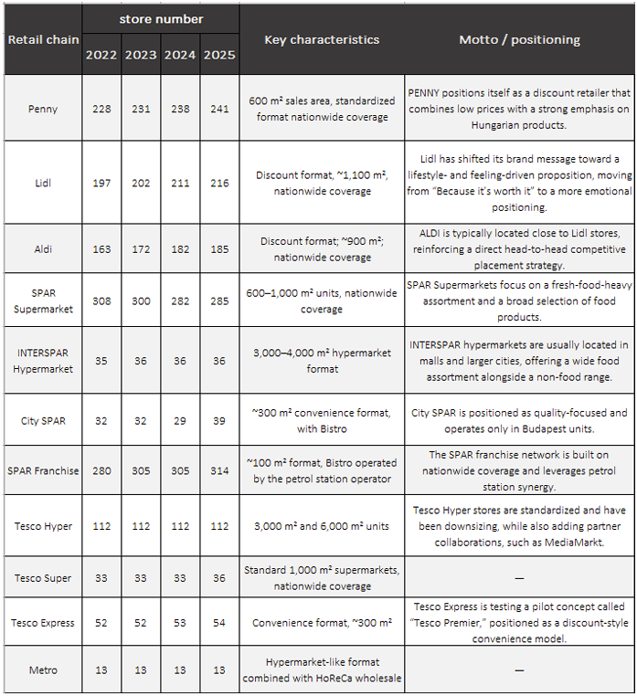
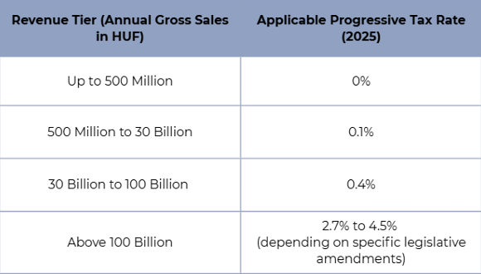
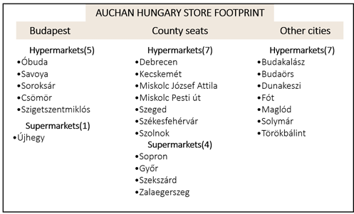

Slide 35
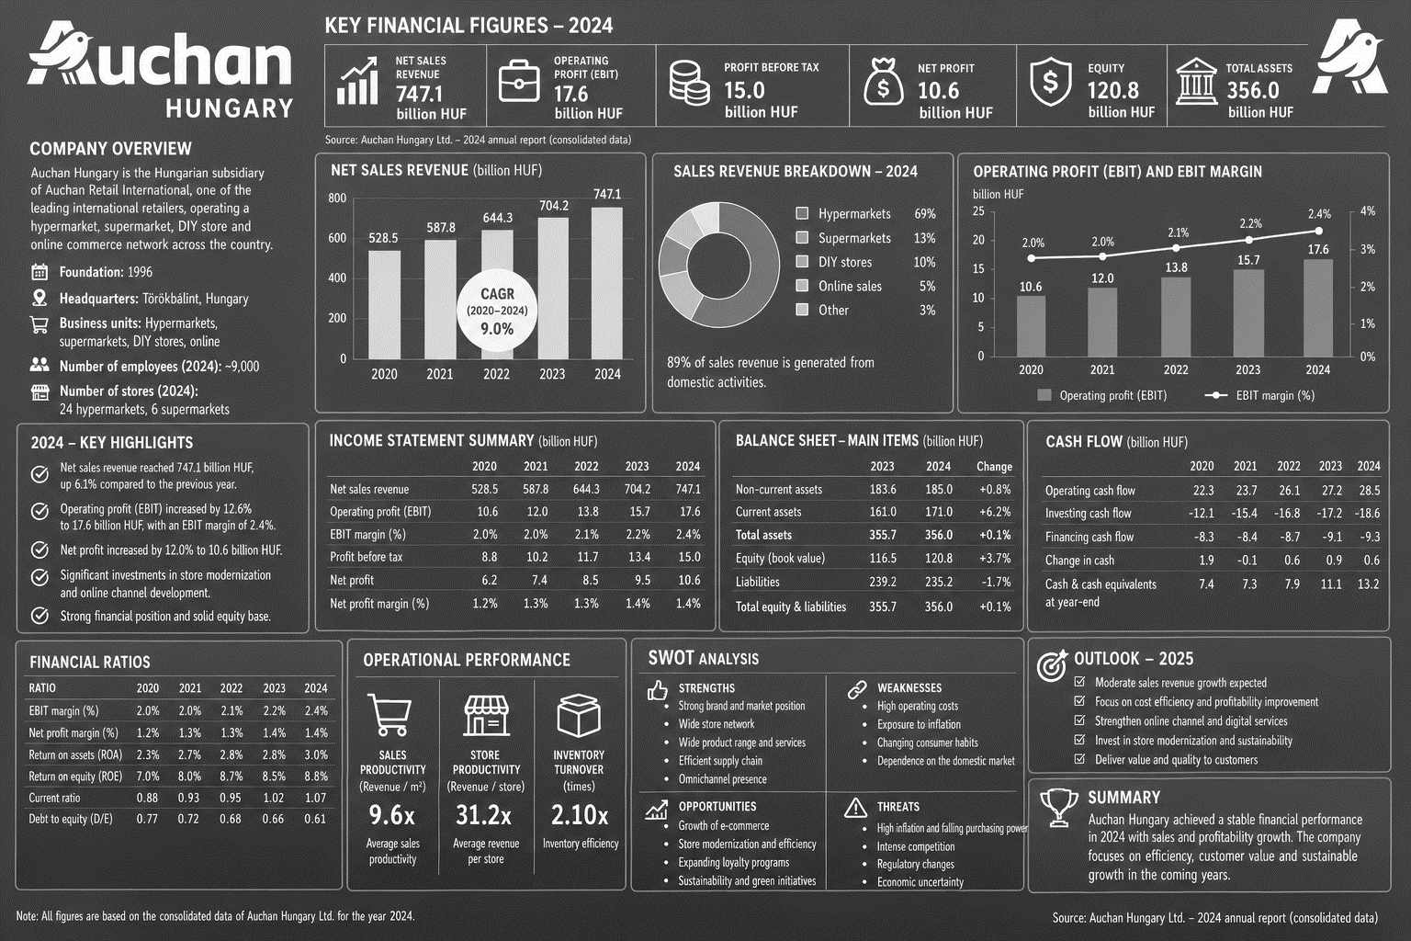
OIKOS-Fx-OIKOS-Fx-OIKOS-FxOIKOS-FxOIKOS-FxOIKOS-FxOIKOS-FxOIKOS-FxOIKOS-FxOIKOS-FxOIKOS-FxOIKOS-FxOIKOS-FxOIKOS-FxOIKOS-FxOIKOS-FxOIKOS-FxOIKOS-FxOIKOS-FxOIKOS-FxOIKOS-FxOIKOS-FxOIKOS-FxOIKOS-FxOIKOS-FxOIKOS-FxOIKOS-FxOIKOS-FxOIKOS-FxOIKOS-FxOIKOS-FxOIKOS-FxOIKOS-FxOIKOS-FxOIKOS-FxOIKOS-FxOIKOS-FxOIKOS-FxOIKOS-FxOIKOS-FxOIKOS-FxOIKOS-FxOIKOS-FxOIKOS-FxOIKOS-FxOIKOS-FxOIKOS-FxOIKOS-FxOIKOS-FxOIKOS-FxOIKOS-FxOIKOS-FxOIKOS-FxOIKOS-FxOIKOS-FxOIKOS-FxOIKOS-FxOIKOS-FxOIKOS-FxOIKOS-FxOIKOS-FxOIKOS-FxOIKOS-FxOIKOS-FxOIKOS-FxOIKOS-FxOIKOS-FxOIKOS-FxOIKOS-FxOIKOS-FxOIKOS-FxOIKOS-FxOIKOS-FxOIKOS-FxOIKOS-FxOIKOS-FxOIKOS-FxOIKOS-FxOIKOS-FxOIKOS-FxOIKOS-FxOIKOS-FxOIKOS-FxOIKOS-FxOIKOS-FxOIKOS-FxOIKOS-FxOIKOS-FxOIKOS-FxOIKOS-FxOIKOS-FxOIKOS-FxOIKOS-FxOIKOS-FxOIKOS-FxOIKOS-FxOIKOS-FxOIKOS-FxOIKOS-FxOIKOS-FxOIKOS-FxOIKOS-FxOIKOS-FxOIKOS-FxOIKOS-FxOIKOS-FxOIKOS-FxOIKOS-FxOIKOS-FxOIKOS-FxOIKOS-FxOIKOS-FxOIKOS-FxOIKOS-FxOIKOS-FxOIKOS-FxOIKOS-FxOIKOS-FxOIKOS-FxOIKOS-FxOIKOS-FxOIKOS-FxOIKOS-FxOIKOS-FxOIKOS-FxOIKOS-FxOIKOS-FxOIKOS-FxOIKOS-FxOIKOS-FxOIKOS-FxOIKOS-FxOIKOS-FxOIKOS-FxOIKOS-FxOIKOS-FxOIKOS-FxOIKOS-FxOIKOS-FxOIKOS-FxOIKOS-FxOIKOS-FxOIKOS-FxOIKOS-FxOIKOS-FxOIKOS-FxOIKOS-FxOIKOS-FxOIKOS-FxOIKOS-FxOIKOS-FxOIKOS-FxOIKOS-FxOIKOS-FxOIKOS-FxOIKOS-FxOIKOS-FxOIKOS-FxOIKOS-FxOIKOS-FxOIKOS-FxOIKOS-FxOIKOS-FxOIKOS-FxOIKOS-FxOIKOS-FxOIKOS-FxOIKOS-FxOIKOS-FxOIKOS-FxOIKOS-FxOIKOS-FxOIKOS-FxOIKOS-FxOIKOS-FxOIKOS-FxOIKOS-FxOIKOS-FxOIKOS-FxOIKOS-FxOIKOS-FxOIKOS-FxOIKOS-FxOIKOS-FxOIKOS-FxOIKOS-FxOIKOS-FxOIKOS-FxOIKOS-FxOIKOS-FxOIKOS-FxOIKOS-FxOIKOS-FxOIKOS-FxOIKOS-FxOIKOS-FxOIKOS-FxOIKOS-FxOIKOS-FxOIKOS-FxOIKOS-FxOIKOS-FxOIKOS-FxOIKOS-FxOIKOS-FxOIKOS-FxOIKOS-FxOIKOS-FxOIKOS-FxOIKOS-FxOIKOS-FxOIKOS-FxOIKOS-FxOIKOS-FxOIKOS-FxOIKOS-FxOIKOS-FxOIKOS-FxOIKOS-FxOIKOS-FxOIKOS-FxOIKOS-FxOIKOS-FxOIKOS-FxOIKOS-FxOIKOS-FxOIKOS-FxOIKOS-FxOIKOS-FxOIKOS-FxOIKOS-FxOIKOS-FxOIKOS-FxOIKOS-FxOIKOS-FxOIKOS-FxOIKOS-FxOIKOS-FxOIKOS-FxOIKOS-FxOIKOS-FxOIKOS-FxOIKOS-FxOIKOS-FxOIKOS-FxOIKOS-FxOIKOS-FxOIKOS-FxOIKOS-FxOIKOS-FxOIKOS-FxOIKOS-FxOIKOS-FxOIKOS-FxOIKOS-FxOIKOS-FxOIKOS-FxOIKOS-FxOIKOS-FxOIKOS-FxOIKOS-FxOIKOS-FxOIKOS-FxOIKOS-FxOIKOS-FxOIKOS-FxOIKOS-FxOIKOS-FxOIKOS-FxOIKOS-FxOIKOS-FxOIKOS-FxOIKOS-FxOIKOS-FxOIKOS-FxOIKOS-FxOIKOS-FxOIKOS-FxOIKOS-FxOIKOS-FxOIKOS-FxOIKOS-FxOIKOS-FxOIKOS-FxOIKOS-FxOIKOS-FxOIKOS-FxOIKOS-FxOIKOS-FxOIKOS-FxOIKOS-FxOIKOS-FxOIKOS-FxOIKOS-FxOIKOS-FxOIKOS-FxOIKOS-FxOIKOS-FxOIKOS-FxOIKOS-FxOIKOS-FxOIKOS-FxOIKOS-FxOIKOS-FxOIKOS-FxOIKOS-FxOIKOS-FxOIKOS-FxOIKOS-FxOIKOS-FxOIKOS-FxOIKOS-FxOIKOS-FxOIKOS-FxOIKOS-FxOIKOS-FxOIKOS-FxOIKOS-FxOIKOS-FxOIKOS-FxOIKOS-FxOIKOS-FxOIKOS-FxOIKOS-FxOIKOS-FxOIKOS-FxOIKOS-FxOIKOS-FxOIKOS-FxOIKOS-FxOIKOS-FxOIKOS-FxOIKOS-FxOIKOS-FxOIKOS-FxOIKOS-FxOIKOS-FxOIKOS-FxOIKOS-FxOIKOS-FxOIKOS-FxOIKOS-FxOIKOS-FxOIKOS-FxOIKOS-FxOIKOS-FxOIKOS-FxOIKOS-FxOIKOS-FxOIKOS-FxOIKOS-FxOIKOS-FxOIKOS-FxOIKOS-FxOIKOS-FxOIKOS-Fx
OIKOS-Fx-OIKOS-Fx-OIKOS-FxOIKOS-FxOIKOS-FxOIKOS-FxOIKOS-FxOIKOS-FxOIKOS-FxOIKOS-FxOIKOS-FxOIKOS-FxOIKOS-FxOIKOS-FxOIKOS-FxOIKOS-FxOIKOS-FxOIKOS-FxOIKOS-FxOIKOS-FxOIKOS-FxOIKOS-FxOIKOS-FxOIKOS-FxOIKOS-FxOIKOS-FxOIKOS-FxOIKOS-FxOIKOS-FxOIKOS-FxOIKOS-FxOIKOS-FxOIKOS-FxOIKOS-FxOIKOS-FxOIKOS-FxOIKOS-FxOIKOS-FxOIKOS-FxOIKOS-FxOIKOS-FxOIKOS-FxOIKOS-FxOIKOS-FxOIKOS-FxOIKOS-FxOIKOS-FxOIKOS-FxOIKOS-FxOIKOS-FxOIKOS-FxOIKOS-FxOIKOS-FxOIKOS-FxOIKOS-FxOIKOS-FxOIKOS-FxOIKOS-FxOIKOS-FxOIKOS-FxOIKOS-FxOIKOS-FxOIKOS-FxOIKOS-FxOIKOS-FxOIKOS-FxOIKOS-FxOIKOS-FxOIKOS-FxOIKOS-FxOIKOS-FxOIKOS-FxOIKOS-FxOIKOS-FxOIKOS-FxOIKOS-FxOIKOS-FxOIKOS-FxOIKOS-FxOIKOS-FxOIKOS-FxOIKOS-FxOIKOS-FxOIKOS-FxOIKOS-FxOIKOS-FxOIKOS-FxOIKOS-FxOIKOS-FxOIKOS-FxOIKOS-FxOIKOS-FxOIKOS-FxOIKOS-FxOIKOS-FxOIKOS-FxOIKOS-FxOIKOS-FxOIKOS-FxOIKOS-FxOIKOS-FxOIKOS-FxOIKOS-FxOIKOS-FxOIKOS-FxOIKOS-FxOIKOS-FxOIKOS-FxOIKOS-FxOIKOS-FxOIKOS-FxOIKOS-FxOIKOS-FxOIKOS-FxOIKOS-FxOIKOS-FxOIKOS-FxOIKOS-FxOIKOS-FxOIKOS-FxOIKOS-FxOIKOS-FxOIKOS-FxOIKOS-FxOIKOS-FxOIKOS-FxOIKOS-FxOIKOS-FxOIKOS-FxOIKOS-FxOIKOS-FxOIKOS-FxOIKOS-FxOIKOS-FxOIKOS-FxOIKOS-FxOIKOS-FxOIKOS-FxOIKOS-FxOIKOS-FxOIKOS-FxOIKOS-FxOIKOS-FxOIKOS-FxOIKOS-FxOIKOS-FxOIKOS-FxOIKOS-FxOIKOS-FxOIKOS-FxOIKOS-FxOIKOS-FxOIKOS-FxOIKOS-FxOIKOS-FxOIKOS-FxOIKOS-FxOIKOS-FxOIKOS-FxOIKOS-FxOIKOS-FxOIKOS-FxOIKOS-FxOIKOS-FxOIKOS-FxOIKOS-FxOIKOS-FxOIKOS-FxOIKOS-FxOIKOS-FxOIKOS-FxOIKOS-FxOIKOS-FxOIKOS-FxOIKOS-FxOIKOS-FxOIKOS-FxOIKOS-FxOIKOS-FxOIKOS-FxOIKOS-FxOIKOS-FxOIKOS-FxOIKOS-FxOIKOS-FxOIKOS-FxOIKOS-FxOIKOS-FxOIKOS-FxOIKOS-FxOIKOS-FxOIKOS-FxOIKOS-FxOIKOS-FxOIKOS-FxOIKOS-FxOIKOS-FxOIKOS-FxOIKOS-FxOIKOS-FxOIKOS-FxOIKOS-FxOIKOS-FxOIKOS-FxOIKOS-FxOIKOS-FxOIKOS-FxOIKOS-FxOIKOS-FxOIKOS-FxOIKOS-FxOIKOS-FxOIKOS-FxOIKOS-FxOIKOS-FxOIKOS-FxOIKOS-FxOIKOS-FxOIKOS-FxOIKOS-FxOIKOS-FxOIKOS-FxOIKOS-FxOIKOS-FxOIKOS-FxOIKOS-FxOIKOS-FxOIKOS-FxOIKOS-FxOIKOS-FxOIKOS-FxOIKOS-FxOIKOS-FxOIKOS-FxOIKOS-FxOIKOS-FxOIKOS-FxOIKOS-FxOIKOS-FxOIKOS-FxOIKOS-FxOIKOS-FxOIKOS-FxOIKOS-FxOIKOS-FxOIKOS-FxOIKOS-FxOIKOS-FxOIKOS-FxOIKOS-FxOIKOS-FxOIKOS-FxOIKOS-FxOIKOS-FxOIKOS-FxOIKOS-FxOIKOS-FxOIKOS-FxOIKOS-FxOIKOS-FxOIKOS-FxOIKOS-FxOIKOS-FxOIKOS-FxOIKOS-FxOIKOS-FxOIKOS-FxOIKOS-FxOIKOS-FxOIKOS-FxOIKOS-FxOIKOS-FxOIKOS-FxOIKOS-FxOIKOS-FxOIKOS-FxOIKOS-FxOIKOS-FxOIKOS-FxOIKOS-FxOIKOS-FxOIKOS-FxOIKOS-FxOIKOS-FxOIKOS-FxOIKOS-FxOIKOS-FxOIKOS-FxOIKOS-FxOIKOS-FxOIKOS-FxOIKOS-FxOIKOS-FxOIKOS-FxOIKOS-FxOIKOS-FxOIKOS-FxOIKOS-FxOIKOS-FxOIKOS-FxOIKOS-FxOIKOS-FxOIKOS-FxOIKOS-FxOIKOS-FxOIKOS-FxOIKOS-FxOIKOS-FxOIKOS-FxOIKOS-FxOIKOS-FxOIKOS-FxOIKOS-FxOIKOS-FxOIKOS-FxOIKOS-FxOIKOS-FxOIKOS-FxOIKOS-FxOIKOS-FxOIKOS-FxOIKOS-FxOIKOS-FxOIKOS-FxOIKOS-FxOIKOS-FxOIKOS-FxOIKOS-FxOIKOS-FxOIKOS-FxOIKOS-FxOIKOS-FxOIKOS-FxOIKOS-FxOIKOS-FxOIKOS-FxOIKOS-FxOIKOS-FxOIKOS-FxOIKOS-FxOIKOS-FxOIKOS-FxOIKOS-FxOIKOS-FxOIKOS-FxOIKOS-FxOIKOS-FxOIKOS-FxOIKOS-FxOIKOS-FxOIKOS-FxOIKOS-FxOIKOS-FxOIKOS-FxOIKOS-FxOIKOS-Fx
OIKOS8
OIKOS8
OIKOS8

Slide 36
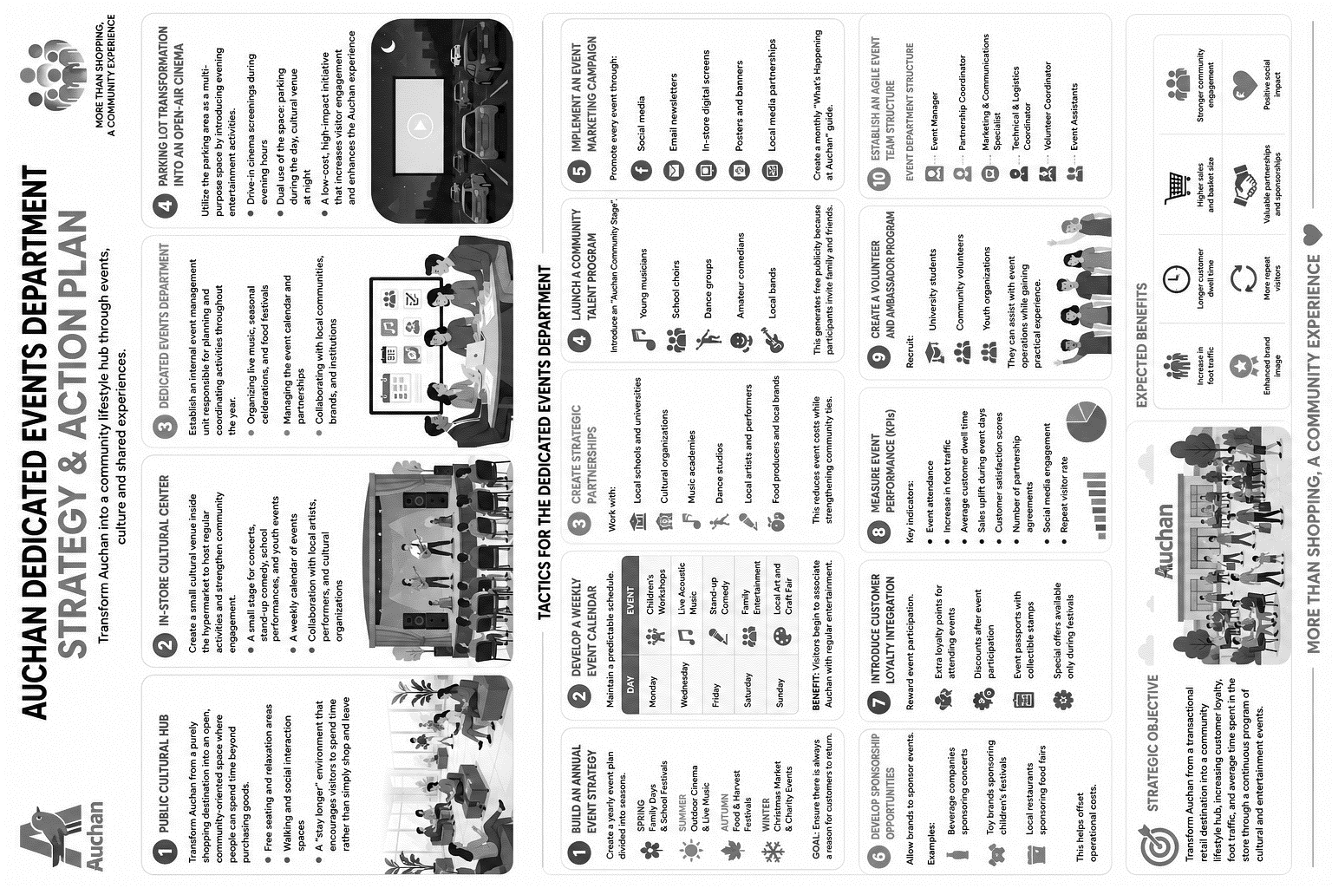
OIKOS-Fx-OIKOS-Fx-OIKOS-FxOIKOS-FxOIKOS-FxOIKOS-FxOIKOS-FxOIKOS-FxOIKOS-FxOIKOS-FxOIKOS-FxOIKOS-FxOIKOS-FxOIKOS-FxOIKOS-FxOIKOS-FxOIKOS-FxOIKOS-FxOIKOS-FxOIKOS-FxOIKOS-FxOIKOS-FxOIKOS-FxOIKOS-FxOIKOS-FxOIKOS-FxOIKOS-FxOIKOS-FxOIKOS-FxOIKOS-FxOIKOS-FxOIKOS-FxOIKOS-FxOIKOS-FxOIKOS-FxOIKOS-FxOIKOS-FxOIKOS-FxOIKOS-FxOIKOS-FxOIKOS-FxOIKOS-FxOIKOS-FxOIKOS-FxOIKOS-FxOIKOS-FxOIKOS-FxOIKOS-FxOIKOS-FxOIKOS-FxOIKOS-FxOIKOS-FxOIKOS-FxOIKOS-FxOIKOS-FxOIKOS-FxOIKOS-FxOIKOS-FxOIKOS-FxOIKOS-FxOIKOS-FxOIKOS-FxOIKOS-FxOIKOS-FxOIKOS-FxOIKOS-FxOIKOS-FxOIKOS-FxOIKOS-FxOIKOS-FxOIKOS-FxOIKOS-FxOIKOS-FxOIKOS-FxOIKOS-FxOIKOS-FxOIKOS-FxOIKOS-FxOIKOS-FxOIKOS-FxOIKOS-FxOIKOS-FxOIKOS-FxOIKOS-FxOIKOS-FxOIKOS-FxOIKOS-FxOIKOS-FxOIKOS-FxOIKOS-FxOIKOS-FxOIKOS-FxOIKOS-FxOIKOS-FxOIKOS-FxOIKOS-FxOIKOS-FxOIKOS-FxOIKOS-FxOIKOS-FxOIKOS-FxOIKOS-FxOIKOS-FxOIKOS-FxOIKOS-FxOIKOS-FxOIKOS-FxOIKOS-FxOIKOS-FxOIKOS-FxOIKOS-FxOIKOS-FxOIKOS-FxOIKOS-FxOIKOS-FxOIKOS-FxOIKOS-FxOIKOS-FxOIKOS-FxOIKOS-FxOIKOS-FxOIKOS-FxOIKOS-FxOIKOS-FxOIKOS-FxOIKOS-FxOIKOS-FxOIKOS-FxOIKOS-FxOIKOS-FxOIKOS-FxOIKOS-FxOIKOS-FxOIKOS-FxOIKOS-FxOIKOS-FxOIKOS-FxOIKOS-FxOIKOS-FxOIKOS-FxOIKOS-FxOIKOS-FxOIKOS-FxOIKOS-FxOIKOS-FxOIKOS-FxOIKOS-FxOIKOS-FxOIKOS-FxOIKOS-FxOIKOS-FxOIKOS-FxOIKOS-FxOIKOS-FxOIKOS-FxOIKOS-FxOIKOS-FxOIKOS-FxOIKOS-FxOIKOS-FxOIKOS-FxOIKOS-FxOIKOS-FxOIKOS-FxOIKOS-FxOIKOS-FxOIKOS-FxOIKOS-FxOIKOS-FxOIKOS-FxOIKOS-FxOIKOS-FxOIKOS-FxOIKOS-FxOIKOS-FxOIKOS-FxOIKOS-FxOIKOS-FxOIKOS-FxOIKOS-FxOIKOS-FxOIKOS-FxOIKOS-FxOIKOS-FxOIKOS-FxOIKOS-FxOIKOS-FxOIKOS-FxOIKOS-FxOIKOS-FxOIKOS-FxOIKOS-FxOIKOS-FxOIKOS-FxOIKOS-FxOIKOS-FxOIKOS-FxOIKOS-FxOIKOS-FxOIKOS-FxOIKOS-FxOIKOS-FxOIKOS-FxOIKOS-FxOIKOS-FxOIKOS-FxOIKOS-FxOIKOS-FxOIKOS-FxOIKOS-FxOIKOS-FxOIKOS-FxOIKOS-FxOIKOS-FxOIKOS-FxOIKOS-FxOIKOS-FxOIKOS-FxOIKOS-FxOIKOS-FxOIKOS-FxOIKOS-FxOIKOS-FxOIKOS-FxOIKOS-FxOIKOS-FxOIKOS-FxOIKOS-FxOIKOS-FxOIKOS-FxOIKOS-FxOIKOS-FxOIKOS-FxOIKOS-FxOIKOS-FxOIKOS-FxOIKOS-FxOIKOS-FxOIKOS-FxOIKOS-FxOIKOS-FxOIKOS-FxOIKOS-FxOIKOS-FxOIKOS-FxOIKOS-FxOIKOS-FxOIKOS-FxOIKOS-FxOIKOS-FxOIKOS-FxOIKOS-FxOIKOS-FxOIKOS-FxOIKOS-FxOIKOS-FxOIKOS-FxOIKOS-FxOIKOS-FxOIKOS-FxOIKOS-FxOIKOS-FxOIKOS-FxOIKOS-FxOIKOS-FxOIKOS-FxOIKOS-FxOIKOS-FxOIKOS-FxOIKOS-FxOIKOS-FxOIKOS-FxOIKOS-FxOIKOS-FxOIKOS-FxOIKOS-FxOIKOS-FxOIKOS-FxOIKOS-FxOIKOS-FxOIKOS-FxOIKOS-FxOIKOS-FxOIKOS-FxOIKOS-FxOIKOS-FxOIKOS-FxOIKOS-FxOIKOS-FxOIKOS-FxOIKOS-FxOIKOS-FxOIKOS-FxOIKOS-FxOIKOS-FxOIKOS-FxOIKOS-FxOIKOS-FxOIKOS-FxOIKOS-FxOIKOS-FxOIKOS-FxOIKOS-FxOIKOS-FxOIKOS-FxOIKOS-FxOIKOS-FxOIKOS-FxOIKOS-FxOIKOS-FxOIKOS-FxOIKOS-FxOIKOS-FxOIKOS-FxOIKOS-FxOIKOS-FxOIKOS-FxOIKOS-FxOIKOS-FxOIKOS-FxOIKOS-FxOIKOS-FxOIKOS-FxOIKOS-FxOIKOS-FxOIKOS-FxOIKOS-FxOIKOS-FxOIKOS-FxOIKOS-FxOIKOS-FxOIKOS-FxOIKOS-FxOIKOS-FxOIKOS-FxOIKOS-FxOIKOS-FxOIKOS-FxOIKOS-FxOIKOS-FxOIKOS-FxOIKOS-FxOIKOS-FxOIKOS-FxOIKOS-FxOIKOS-FxOIKOS-FxOIKOS-FxOIKOS-FxOIKOS-FxOIKOS-FxOIKOS-FxOIKOS-FxOIKOS-FxOIKOS-FxOIKOS-Fx
OIKOS-Fx-OIKOS-Fx-OIKOS-FxOIKOS-FxOIKOS-FxOIKOS-FxOIKOS-FxOIKOS-FxOIKOS-FxOIKOS-FxOIKOS-FxOIKOS-FxOIKOS-FxOIKOS-FxOIKOS-FxOIKOS-FxOIKOS-FxOIKOS-FxOIKOS-FxOIKOS-FxOIKOS-FxOIKOS-FxOIKOS-FxOIKOS-FxOIKOS-FxOIKOS-FxOIKOS-FxOIKOS-FxOIKOS-FxOIKOS-FxOIKOS-FxOIKOS-FxOIKOS-FxOIKOS-FxOIKOS-FxOIKOS-FxOIKOS-FxOIKOS-FxOIKOS-FxOIKOS-FxOIKOS-FxOIKOS-FxOIKOS-FxOIKOS-FxOIKOS-FxOIKOS-FxOIKOS-FxOIKOS-FxOIKOS-FxOIKOS-FxOIKOS-FxOIKOS-FxOIKOS-FxOIKOS-FxOIKOS-FxOIKOS-FxOIKOS-FxOIKOS-FxOIKOS-FxOIKOS-FxOIKOS-FxOIKOS-FxOIKOS-FxOIKOS-FxOIKOS-FxOIKOS-FxOIKOS-FxOIKOS-FxOIKOS-FxOIKOS-FxOIKOS-FxOIKOS-FxOIKOS-FxOIKOS-FxOIKOS-FxOIKOS-FxOIKOS-FxOIKOS-FxOIKOS-FxOIKOS-FxOIKOS-FxOIKOS-FxOIKOS-FxOIKOS-FxOIKOS-FxOIKOS-FxOIKOS-FxOIKOS-FxOIKOS-FxOIKOS-FxOIKOS-FxOIKOS-FxOIKOS-FxOIKOS-FxOIKOS-FxOIKOS-FxOIKOS-FxOIKOS-FxOIKOS-FxOIKOS-FxOIKOS-FxOIKOS-FxOIKOS-FxOIKOS-FxOIKOS-FxOIKOS-FxOIKOS-FxOIKOS-FxOIKOS-FxOIKOS-FxOIKOS-FxOIKOS-FxOIKOS-FxOIKOS-FxOIKOS-FxOIKOS-FxOIKOS-FxOIKOS-FxOIKOS-FxOIKOS-FxOIKOS-FxOIKOS-FxOIKOS-FxOIKOS-FxOIKOS-FxOIKOS-FxOIKOS-FxOIKOS-FxOIKOS-FxOIKOS-FxOIKOS-FxOIKOS-FxOIKOS-FxOIKOS-FxOIKOS-FxOIKOS-FxOIKOS-FxOIKOS-FxOIKOS-FxOIKOS-FxOIKOS-FxOIKOS-FxOIKOS-FxOIKOS-FxOIKOS-FxOIKOS-FxOIKOS-FxOIKOS-FxOIKOS-FxOIKOS-FxOIKOS-FxOIKOS-FxOIKOS-FxOIKOS-FxOIKOS-FxOIKOS-FxOIKOS-FxOIKOS-FxOIKOS-FxOIKOS-FxOIKOS-FxOIKOS-FxOIKOS-FxOIKOS-FxOIKOS-FxOIKOS-FxOIKOS-FxOIKOS-FxOIKOS-FxOIKOS-FxOIKOS-FxOIKOS-FxOIKOS-FxOIKOS-FxOIKOS-FxOIKOS-FxOIKOS-FxOIKOS-FxOIKOS-FxOIKOS-FxOIKOS-FxOIKOS-FxOIKOS-FxOIKOS-FxOIKOS-FxOIKOS-FxOIKOS-FxOIKOS-FxOIKOS-FxOIKOS-FxOIKOS-FxOIKOS-FxOIKOS-FxOIKOS-FxOIKOS-FxOIKOS-FxOIKOS-FxOIKOS-FxOIKOS-FxOIKOS-FxOIKOS-FxOIKOS-FxOIKOS-FxOIKOS-FxOIKOS-FxOIKOS-FxOIKOS-FxOIKOS-FxOIKOS-FxOIKOS-FxOIKOS-FxOIKOS-FxOIKOS-FxOIKOS-FxOIKOS-FxOIKOS-FxOIKOS-FxOIKOS-FxOIKOS-FxOIKOS-FxOIKOS-FxOIKOS-FxOIKOS-FxOIKOS-FxOIKOS-FxOIKOS-FxOIKOS-FxOIKOS-FxOIKOS-FxOIKOS-FxOIKOS-FxOIKOS-FxOIKOS-FxOIKOS-FxOIKOS-FxOIKOS-FxOIKOS-FxOIKOS-FxOIKOS-FxOIKOS-FxOIKOS-FxOIKOS-FxOIKOS-FxOIKOS-FxOIKOS-FxOIKOS-FxOIKOS-FxOIKOS-FxOIKOS-FxOIKOS-FxOIKOS-FxOIKOS-FxOIKOS-FxOIKOS-FxOIKOS-FxOIKOS-FxOIKOS-FxOIKOS-FxOIKOS-FxOIKOS-FxOIKOS-FxOIKOS-FxOIKOS-FxOIKOS-FxOIKOS-FxOIKOS-FxOIKOS-FxOIKOS-FxOIKOS-FxOIKOS-FxOIKOS-FxOIKOS-FxOIKOS-FxOIKOS-FxOIKOS-FxOIKOS-FxOIKOS-FxOIKOS-FxOIKOS-FxOIKOS-FxOIKOS-FxOIKOS-FxOIKOS-FxOIKOS-FxOIKOS-FxOIKOS-FxOIKOS-FxOIKOS-FxOIKOS-FxOIKOS-FxOIKOS-FxOIKOS-FxOIKOS-FxOIKOS-FxOIKOS-FxOIKOS-FxOIKOS-FxOIKOS-FxOIKOS-FxOIKOS-FxOIKOS-FxOIKOS-FxOIKOS-FxOIKOS-FxOIKOS-FxOIKOS-FxOIKOS-FxOIKOS-FxOIKOS-FxOIKOS-FxOIKOS-FxOIKOS-FxOIKOS-FxOIKOS-FxOIKOS-FxOIKOS-FxOIKOS-FxOIKOS-FxOIKOS-FxOIKOS-FxOIKOS-FxOIKOS-FxOIKOS-FxOIKOS-FxOIKOS-FxOIKOS-FxOIKOS-FxOIKOS-FxOIKOS-FxOIKOS-FxOIKOS-FxOIKOS-FxOIKOS-FxOIKOS-FxOIKOS-FxOIKOS-FxOIKOS-FxOIKOS-FxOIKOS-FxOIKOS-FxOIKOS-FxOIKOS-FxOIKOS-FxOIKOS-FxOIKOS-FxOIKOS-FxOIKOS-FxOIKOS-FxOIKOS-FxOIKOS-FxOIKOS-FxOIKOS-FxOIKOS-FxOIKOS-FxOIKOS-FxOIKOS-Fx
OIKOS8
OIKOS8
OIKOS8

Slide 37
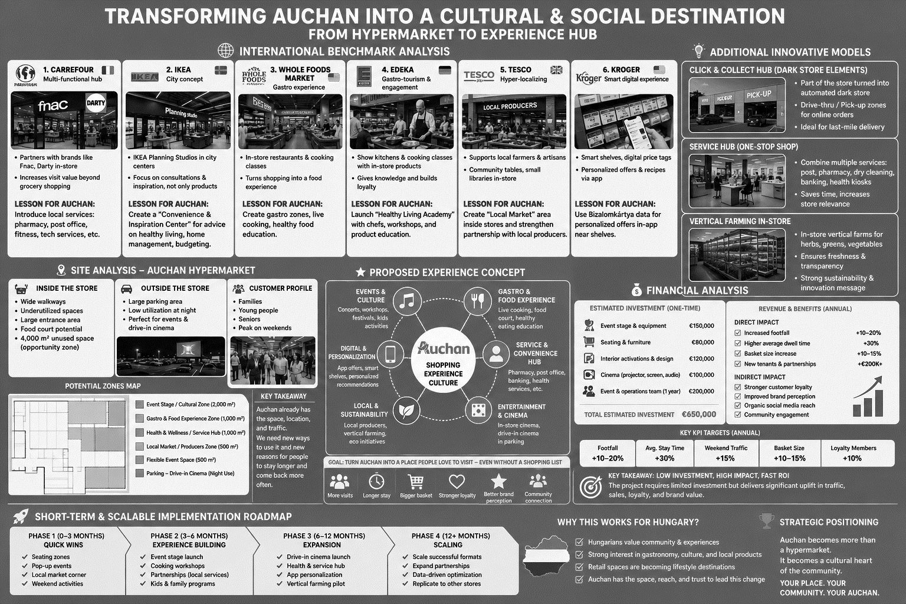
OIKOS8
OIKOS8
OIKOS8

