Slide 1

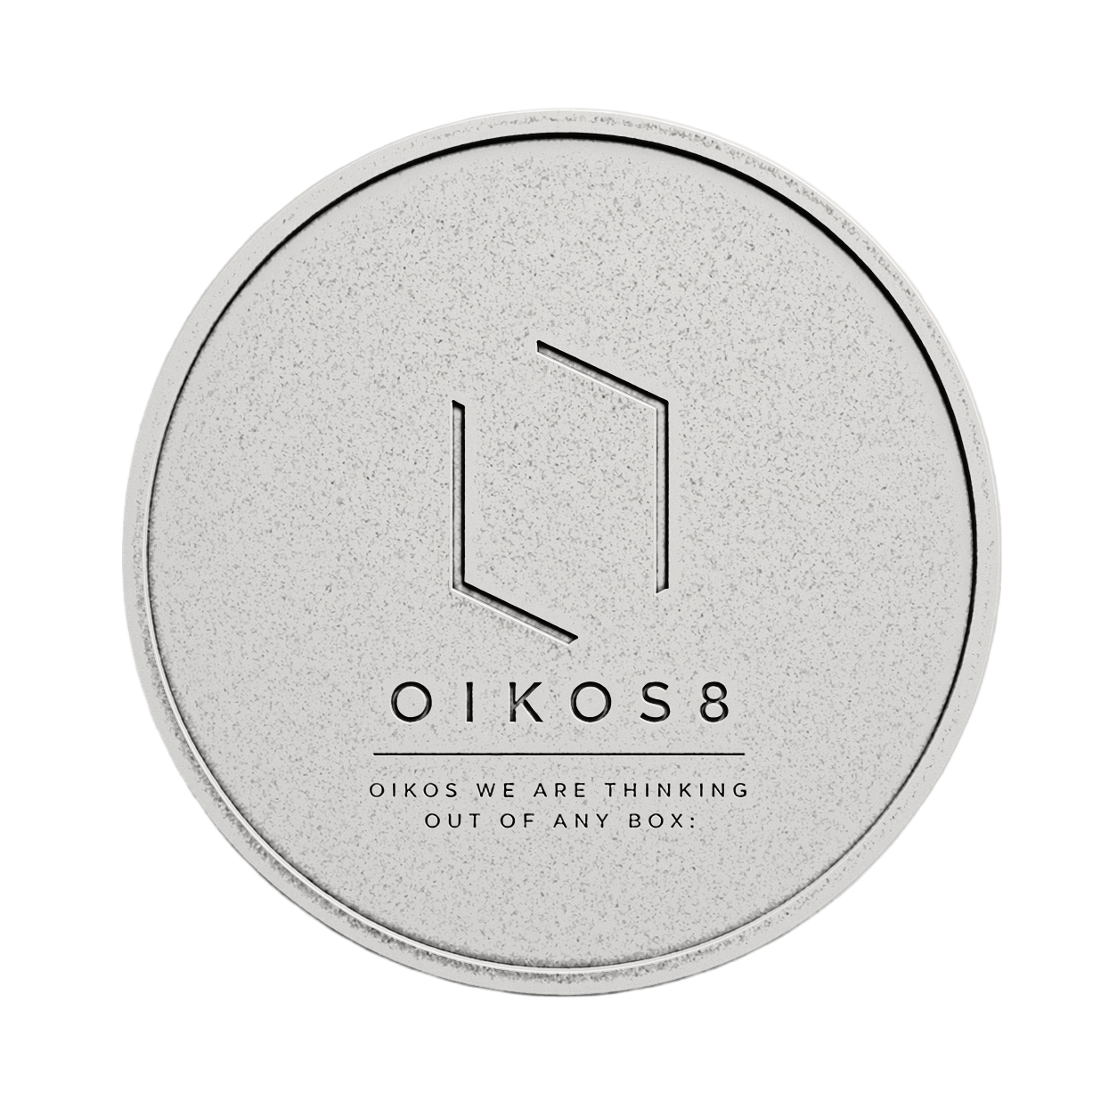
CASEKEY Demo Case 2: BABE Laboratorios
TEAM: OIKOS8

Slide 2



1 of 4 > OVERVIEW > The Challenge
Scaling Trust Without Losing Trust
BABÉ has built its business on trust, pharmacist relationships, and Culture of Care — with ~170% sales growth across ~50 countries and 85% of revenue internationally.
The central challenge: How can BABÉ scale trust without diluting it?

Slide 3


EXECUTIVE SUMMARY
BABÉ Care Network™ — Transform to Win
The Opportunity:
BABÉ has built unmatched trust with pharmacists and consumers across 50 countries. The market is shifting toward care-based, expert-guided skincare. No competitor has built a scalable ecosystem around trust.
The Challenge:
BABÉ's trust engine works, but it doesn't scale. Fragmentation across markets, inconsistent experiences, and lack of consumer data limit growth.
The Solution:
BABÉ Care Network™ — a care operating system connecting pharmacists, consumers, dermatologists, and data into one integrated ecosystem.
Four Pillars of Execution:
1
2
Pharmacist Enablement
Consumer Engagement
Training, certification, digital tools
Care Passport, digital touchpoints, journey tracking
3
4
Data & Intelligence
Ecosystem Integration
Care Index™, AI-driven optimization
Regional hubs, cross-country continuity, compliance
The Impact:
€50M+
+8-12%
3.5x
Revenue Target
Margin Increase
ROI by Year 3
From €20M (58% CAGR over 3 years)
Through ecosystem monetization
18-month payback period
Competitive Moat: Network effects, data advantage, trust lock-in, regulatory leadership
The Ask:
Approve €8-12M investment to transform BABÉ from a product company into a global care operating system.

Slide 4
2 of 4 > ANALYSIS
ANALYSIS
Understanding the market, competition, and BABÉ's position

Slide 5

BABÉ's Real Competitive Advantage Is Not Products — It Is Trust
Traditional Competitive Battlefield
BABÉ's Hidden Asset
Large competitors dominate on:
BABÉ competes in the trust business, not the skincare business.
Product innovation
Marketing budget
Distribution scale
Pharmacists, dermatologists & pediatricians
Relationship-based credibility
"Science with Emotion"
Professional advocacy network
BABÉ's advantage is its trust network.

Slide 6


The Question We Need to Solve
The strategic question is not "How can BABÉ sell more products?" It is: How can BABÉ create a globally consistent care experience while scaling through thousands of pharmacies, distributors, and healthcare professionals?
Tension 1: Trust vs. Scale
Tension 2: Consistency vs. Localization
Tension 3: Physical Trust vs. Digital Expectations
Personal relationships are hard to scale globally.
Local adaptation creates variation in experience and execution.
BABÉ needs digital enablement without digital dependency.
BABÉ Care Network™ solves these tensions through three pillars: Global Care Excellence, Digital Care Infrastructure, and Category-Led Expansion.

Slide 7





The Future Market Is Moving Toward BABÉ
The next three years are a strategic window: market trends are converging with BABÉ's strengths in trust, expertise, prevention, personalization, and professional guidance.
Skin Health Shift
Prevention Over Treatment
Expert Guidance Demand
Skincare is increasingly viewed as healthcare.
Preventive skincare is growing fast.
Consumers want dermatologists and pharmacists to help them decide.
Dermo-Cosmetics Growth
Trust Economy
The category still offers substantial growth potential.
Trust in experts remains stronger than trust in advertising.
Strategic Insight: BABÉ already has trust. It now needs scale.

Slide 8
The Market Is Crowded — But the Most Valuable Space Is Empty
Competitors optimize around products, brands, and distribution. No major player has built a scalable ecosystem around trust, care, and pharmacist enablement. BABÉ can own this white space.
Dimension
Large Competitors
BABÉ
Scale
High
Medium
Marketing Budget
High
Low
Distribution Reach
High
Medium
Professional Trust
Medium
High
Pharmacist Engagement
Medium
Very High
Care Philosophy
Low
Very High
Community Infrastructure
Low
None Yet
Competitive Positioning Map
The White Space
The key gap is High Scale + High Relationship Depth. Large competitors lead on scale; independent pharmacies lead on relationship depth. The top-right quadrant is empty.
The winner may be the brand that owns the strongest care ecosystem. Products become part of the system. Trust becomes the moat.

Slide 9
BABÉ Already Owns the Assets Required to Win
BABÉ already has the strategic assets it needs. The opportunity is to organize and scale them.
Trust Capital
Global Pharmacy Network
Culture of Care
30+ years of credibility with pharmacists, dermatologists, and consumers.
Operating in ~50 countries through pharmacy-focused channels.
"Science with Emotion" aligns the organization globally.
Professional Advocacy
Growth Engine
Healthcare professionals drive trust and adoption.
170% growth over five years and €20M revenue.
Networks scale exponentially.

Slide 10
The Problem Is Not Growth — The Problem Is Fragmentation
BABÉ has a trust engine, but not yet a trust operating system. Growth is constrained by execution variability, not demand: no shared care infrastructure.
1
Inconsistent Customer Experience
2
Distributor Dependency
Experience varies by pharmacist, threatening brand equity at scale.
Local distributors reduce visibility and control at the last mile.
3
Limited Consumer Data
4
Knowledge Does Not Scale
BABÉ lacks consumer-level insight into purchase and journey.
Critical expertise remains trapped in people instead of systems.
BABÉ Care Network™ can serve as the operating system for care.

Slide 11
3 of 4 > STRATEGY
The BABÉ Care Network™ Solution
And implementation roadmap.

Slide 12




Four Pillars of Implementation
The BABÉ Care Network™ requires coordinated execution across four critical tactical areas:
Pharmacist Enablement
Consumer Engagement
Data & Intelligence
Training, certification, and digital tools
Care Passport, digital touchpoints, journey tracking
Care Index™, outcome measurement, AI optimization
Ecosystem Integration
Distributor coordination, regional hubs, cross-country continuity
Each pillar must be built sequentially but executed in parallel across markets.

Slide 13
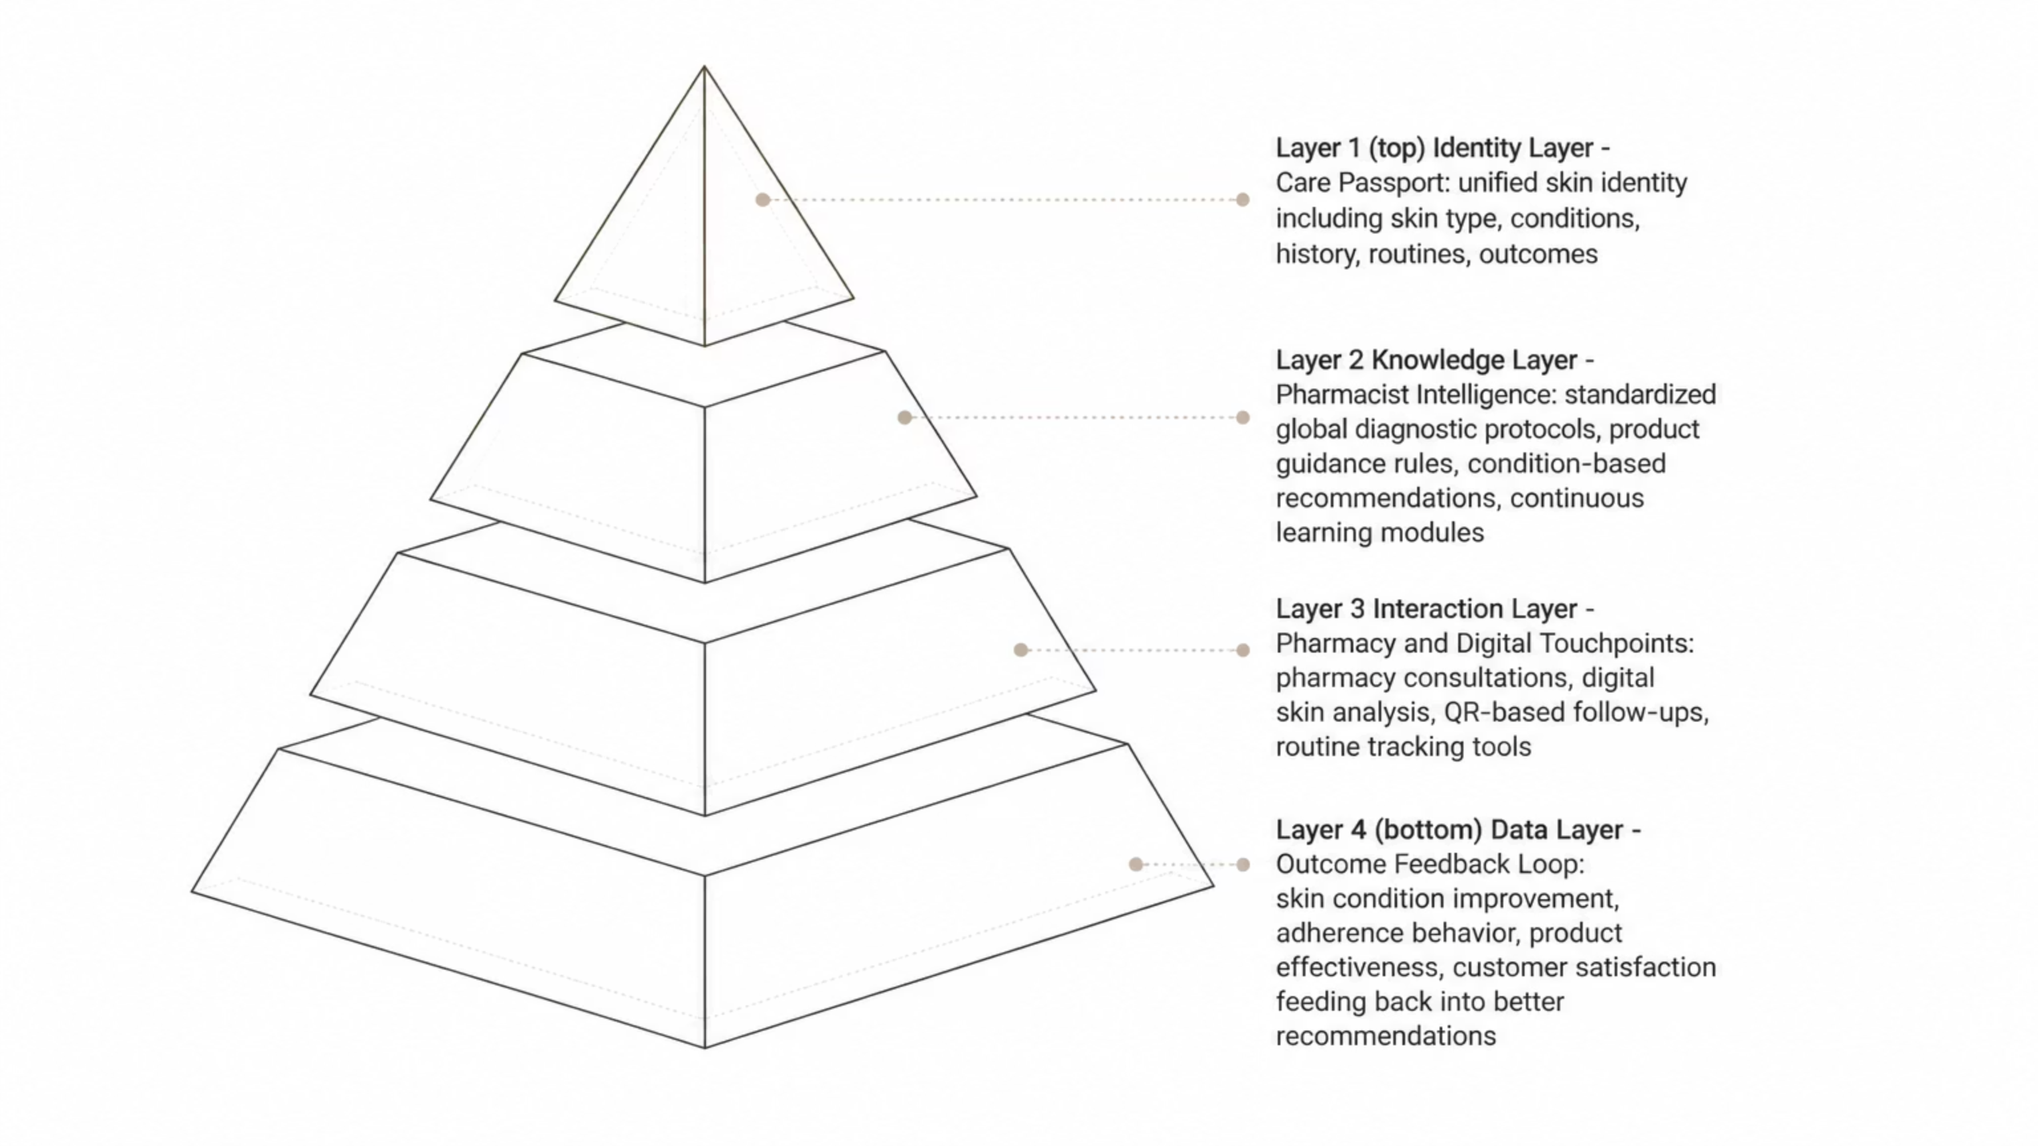
BABÉ Care Network™ = The Operating System for Global Skin Health
BABÉ Care Network™ is a care operating system that connects pharmacists, consumers, dermatologists, pediatricians, distributors, and BABÉ internal teams. If trust is BABÉ's asset, then systems — not products — scale trust.
The system turns BABÉ into a global care operating system with embedded products. Key advantages: Network Effects, Data Advantage, and Trust Standardization.
#The image generated via AI from my concept

Slide 14
Ecosystem Integration — Scaling Across Markets
The Care Network™ must work seamlessly across 50+ countries with different distributors, regulations, and market dynamics.
01
02
03
Distributor Enablement
Regional Care Hubs
Cross-Country Continuity
Training and incentives for local partners to support the ecosystem
Local teams managing pharmacist relationships, training, and market adaptation
Unified Care Passport allowing consumers to continue care across borders
04
05
Localization Framework
Compliance & Governance
Standardized protocols with flexibility for regional needs
Centralized oversight ensuring consistent quality and regulatory adherence
Success Metric: Full ecosystem deployment in 15+ countries by Year 3; <5% variance in care quality across markets

Slide 15






Data & Intelligence — The Competitive Moat
Data transforms BABÉ from a product company into a care intelligence platform. Outcome data drives better recommendations and innovation.
Care Index™
Outcome Measurement
AI-Driven Optimization
Feedback Loop
Proprietary metric measuring skin health improvement across conditions
Systematic tracking of skin condition improvement, adherence, and satisfaction
Machine learning to improve recommendations and predict outcomes
Consumer and pharmacist data feeds product innovation and market expansion
Privacy-First Architecture
GDPR-compliant data governance ensuring consumer trust
Success Metric: 1M+ outcome data points collected by Year 3; AI model accuracy >85%

Slide 16




Consumer Engagement — Building the Care Journey
Consumers need a unified way to track their skin health, receive personalized guidance, and stay engaged with BABÉ across touchpoints.
Key Tactics:
Care Passport
Digital identity capturing skin type, conditions, routines, and outcomes
Pharmacy Consultations
QR-based check-ins and follow-ups at point of purchase
Digital Skin Analysis
Mobile app for self-assessment and routine tracking
Care Journey Tracking
Personalized recommendations based on skin improvement data
Community Building
Peer support, expert content, and condition-specific guidance
Success Metric: 500K+ active Care Passport users by end of Year 2

Slide 17




Pharmacist Enablement — The Foundation of Trust
Pharmacists are BABÉ's primary distribution channel and trust multiplier. Enablement means giving them the tools, knowledge, and incentives to become care advisors.
BABÉ Care Academy
Diagnostic Protocols
Digital Tools
Standardized certification program covering skin conditions, product guidance, and care protocols
Unified global frameworks for skin assessment and recommendation
Mobile app for consultations, product recommendations, and patient follow-up
Incentive Alignment
Regional Support
Commission structures tied to care outcomes, not just product sales
Dedicated care coaches in each market to drive adoption and quality
Success Metric: 80%+ pharmacist certification rate in priority markets by Year 2

Slide 18
3-Year Path to Becoming a Global Care Operating System
BABÉ's transformation follows a sequenced build: product company → care platform → global care operating system.
Year 1 — Foundation
Year 3 — Platformization
Build & Pilot Care Network™
Global Ecosystem & AI Care Intelligence
Launch Care Passport
Build BABÉ Care Academy
Define Care Index™ framework
Select 2–3 model markets
Full global deployment of Care Network™
AI-driven Care Index™ optimization
Cross-country journey continuity
Data feedback loop for innovation
1
2
3
Year 2 — Expansion
Multi-Country Rollout
Roll out Care Passport to top countries
Expand pharmacist certification
Activate regional Care Hubs
Introduce Care Journey tracking
Key Principle: Standardize → Validate → Scale → Dominate.

Slide 19
4 of 4 > IMPACT
IMPACT
The strategic choice and business case

Slide 20





Strategic Risks & Mitigation
Transformation at this scale carries execution risks. BABÉ must address them proactively.
Pharmacist Adoption
Consumer Data Privacy
Market Fragmentation
Risk: Pharmacists resist change or lack time for training
Mitigation: Outcome-based incentives, simplified tools, regional support teams
Risk: Data breaches or regulatory violations damage trust
Mitigation: GDPR-first architecture, third-party security audits, transparent governance
Risk: Regional variations undermine global consistency
Mitigation: Standardized protocols with localization flexibility, centralized governance
Competitive Response
Technology Execution
Risk: Large competitors launch similar ecosystems
Mitigation: Speed to market, pharmacist lock-in, data advantage, brand trust
Risk: Platform delays or poor user experience
Mitigation: Agile development, MVP approach, continuous user testing

Slide 21





Competitive Moat — Why BABÉ Wins
The BABÉ Care Network™ creates defensible advantages that competitors cannot easily replicate.
Network Effects
Each new pharmacist strengthens the ecosystem for consumers
Each consumer data point improves recommendations for all users
Ecosystem becomes more valuable as it scales
Data Advantage
1M+ outcome data points by Year 3 create proprietary insights
AI models trained on real-world skin health outcomes
Competitors lack access to this outcome-driven data
Trust Lock-in
Pharmacists invested in BABÉ training and certification
Consumers with Care Passport history stay engaged
Switching costs increase with ecosystem depth
Regulatory Moat
First-mover advantage in care ecosystem standards
Potential to set industry benchmarks for outcome measurement
Regulatory relationships with health authorities

Slide 22
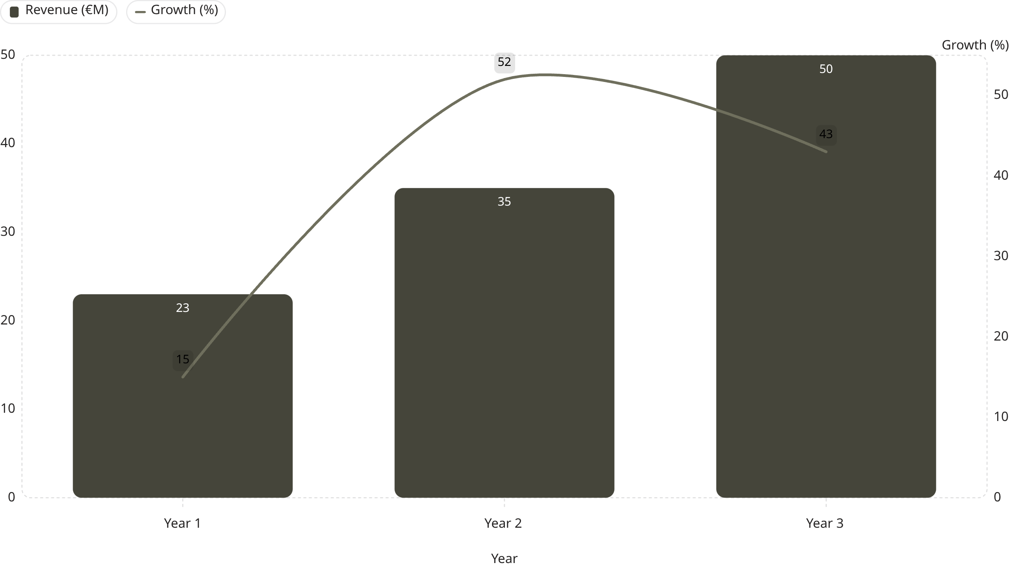


Financial Impact — The Business Case
The BABÉ Care Network™ transformation unlocks significant revenue and margin expansion through ecosystem monetization and operational efficiency.
Revenue Growth:
The projected 3-Year CAGR is 58%, significantly higher than the historical 34%, demonstrating accelerated growth with the Care Network™.
Margin Expansion:
The shift from a product-centric to an ecosystem-centric model improves gross margins by 8-12%. Reduced distributor dependency increases direct margin capture, and data-driven recommendations reduce product waste and returns.
Investment Required
ROI
€8-12M over 3 years (technology, training, regional hubs)
3.5x by Year 3; payback period 18 months
#The Chart is imported from Canva

Slide 23

This Is Not a Growth Decision. It Is a Category-Defining Decision.
BABÉ is at a strategic inflection point: become a global care operating system, or remain a conventional dermocosmetics brand.
Traditional Brand Path
BABÉ Care Network™ Path
Products & marketing
Price-driven competition
Linear growth
Care system & trust infrastructure
Pharmacists + consumers + data
Scalable ecosystem
€20M
170%
Current Revenue
5-Year Growth
Base for transformation
Proven demand
~50
2–2.5x
Countries
Revenue Potential
Existing network
Within 3–5 years
Final Recommendation: Approve the BABÉ Care Network™ Transformation Program.

Slide 24

CLOSING RECOMMENDATION
The Time to Act Is Now
BABÉ stands at a strategic inflection point. The company has already achieved what most brands never reach — strong pharmacy trust, international presence, and proven growth. But the next phase requires a fundamental shift in how BABÉ operates.
Why Now?
Market trends are converging with BABÉ's strengths
Competitors haven't yet built care ecosystems
BABÉ's trust capital is at peak value
Technology and data capabilities are now mature
What's at Stake?
If BABÉ acts:
If BABÉ waits:
Become the global leader in care-based dermocosmetics
Unlock 2-2.5x revenue growth
Build defensible competitive advantages
Risk commoditization
Lose first-mover advantage
Watch competitors build similar ecosystems
The Path Forward:
Year 1 focuses on foundation-building in 2-3 model markets. Year 2 expands to top markets. Year 3 achieves global scale with AI-driven optimization.
Final Recommendation:
Approve the BABÉ Care Network™ Transformation Program.
This is not a growth initiative. It is a category-defining decision that will determine BABÉ's future as a company.

Slide 25
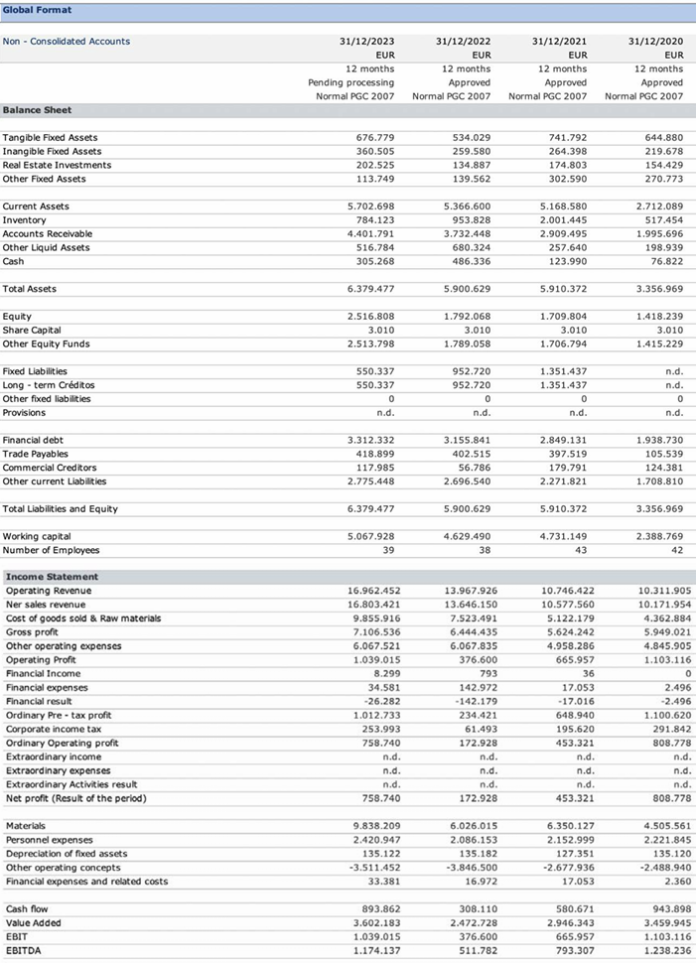

Slide 26
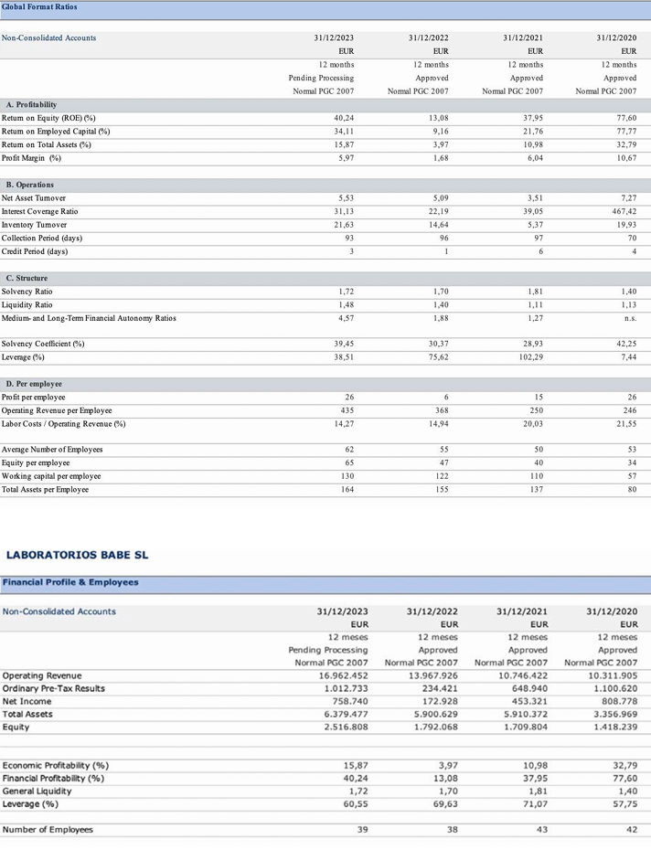

Slide 27
EBIDTA |  | t | QS/avCpQ | Oprev/avPwi | operRev | avPwith inf | t | inflation | High-End Serums: $49.00 (e.g., Eyelash, Brow, and Hair serums)
1 174 137,00 |  | 2023 | 110 747,88 | 506 671,57 | 16 962 452,00 | 33,48 | 2023 | 6,28 | Mid-Range Treatments: $22.00 – $39.00 (e.g., Eyelash Conditioners, Face Serums, and Shampoos)
511 782,00 |  | 2022 | 88 766,15 | 406 105,16 | 13 967 926,00 | 34,39 | 2022 | 9,19 | Budget Cosmetics: $15.00 (e.g., Mascaras, Brow Fillers, and Lip Masks)
793 307,00 |  | 2021 | 72 468,10 | 331 541,55 | 10 746 422,00 | 32,41 | 2021 | 2,9
1 238 236,00 |  | 2020 | 71 028,94 | 324 957,38 | 10 311 905,00 | 31,73 | 2020 | 0,74 | avP | 31,5
 | Er<0,1(10%) |  | avQofCustomers | the Qof sell's In Y (QS)
 |  |  |  |  |  |  |  |  | In the e-commerce, beauty, and cosmetics industry, the average customer purchases from a brand between 2.5 and 2.8 times per year. If the customer joins a brand's loyalty program, that frequency typically jumps to 5 to 8 times per year
 | t | QS/avCpQ | b | operRev | Oprev/avPwi | QS/avCpQ | b
 | 48,5701861 | -705289,1712 | 1422506397 | -0,991404532 | 36,62913801 | -555478,6631 |  |  | avCustomerpurchQ(avCpQ) | 4,575
 | 26,69271025 | 382574,6111 | 771211675,2 | 0,332219076 | 12,18966688 | 670279,3316
 | 0,775511376 | 279584,2995 | #N/A | 0,900312871 | 186309,5664 | #N/A
 | 1,727284358 | 1 | #N/A | 4,515692639 | 1 | #N/A
 | 2,70035E+11 | 78167380505 | #N/A | 3,13491E+11 | 34711254550 | #N/A
kimprtnt | 0 | 48,5701861
 |  | more than 1
 | prediction
2026 | 2882944,663 | 191319,1831 | 1,22 | 150,7379765 | 50,7379765
2025 | 1912553,645 | 156819,0025 | 1,2 | 141,8399945 | 41,83999451
2024 | 1348388,126 | 130682,5021 | 1,18 | 124,2239798 | 24,22397981 | origine | delta | delta^2
2023 | 1085449,145 | 110747,8831 | Temp of Customers(chain) |  |  | 1 174 137,00 | 88 687,86 | 7 865 535 657,55
2022 | 723081,6795 | 88766,15479 |  |  |  | 511 782,00 | - 211 299,68 | 44 647 554 549,46
2021 | 636771,2066 | 72468,09815 |  |  |  | 793 307,00 | 156 535,79 | 24 503 454 617,46
2020 | 1272159,969 | 71028,93528 |  |  |  | 1 238 236,00 | - 33 923,97 | 1 150 835 680,18
 |  |  |  |  |  |  | err^2 | 139 792,15

Slide 28
t | Y^EBIDTA | X^QS/avCpQ | X changing rate |  | Delta %
2028 | 6698416,764 | 298917,0917 | 1,26 | 151,9661933 | 51,96619333
2027 | 4407833,49 | 237235,787 | 1,24 | 152,8934477 | 52,89344768
2026 | 2882944,663 | 191319,1831 | 1,22 | 150,7379765 | 50,7379765
2025 | 1912553,645 | 156819,0025 | 1,2 | 141,8399945 | 41,83999451
2024 | 1348388,126 | 130682,5021 | 1,18 | 124,2239798 | 24,22397981
2023 | 1085449,145 | 110747,8831 | Temp of Customers(chain)
2022 | 723081,6795 | 88766,15479
2021 | 636771,2066 | 72468,09815 |  |  | Delta % (5y interval)
2020 | 1272159,969 | 71028,93528 |  | the boost+% in 5 y | 169,9077248

