Slide 1

G2M Case Study
Virtual Internship
Felipe I. Crespo
14-Jan-2023

Slide 2
Agenda
Executive Summary
Problem Statement
Approach
EDA
EDA Summary
Recommendations

Slide 3

Background –G2M(cab industry) case study
XYZ is a private equity firm in US. Due to remarkable growth in the Cab Industry in last few years and multiple key players in the market, it is planning for an investment in Cab industry.
Objective : Provide actionable insights to help XYZ firm in identifying the right company for making investment.
The analysis has been divided into four parts:
Data Understanding
Forecasting profit and number of rides for each cab type
Finding the most profitable Cab company
Recommendations for investment

Slide 4
Data Exploration
18 Features( including 4 derived features)
Timeframe of the data: 2016-01-31 to 2018-12-31
Total data points :359,392
Hypothesis:
1. Is there any seasonability in the demand?
2. Which cities are the most profitable?
3. Are the profits increasing over the years?
4. Which company has maximum cab users?
5. Which company has the lowest cost per km?
Cab_Data.csv
Customer_ID.csv
Transaction_ID.csv
City.csv
df_main

Slide 5
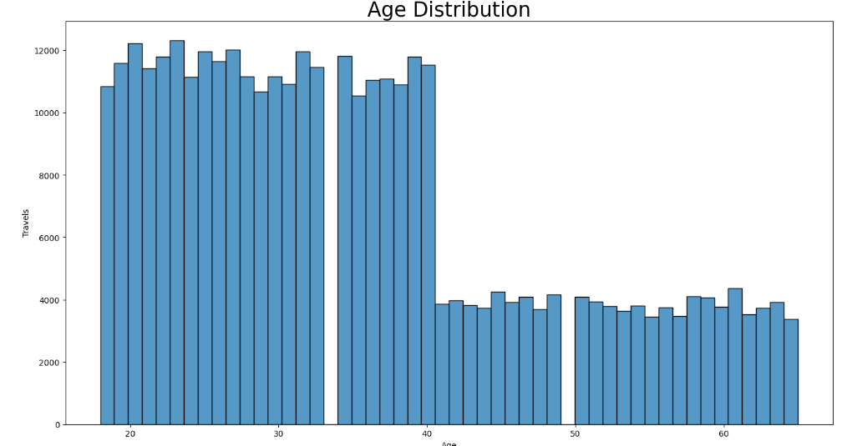
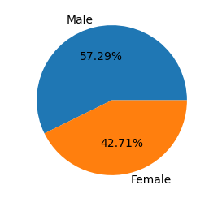
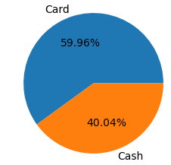
Profit Analysis
Getting familiar whit the data
There is a big drop after 40 years old

Slide 6
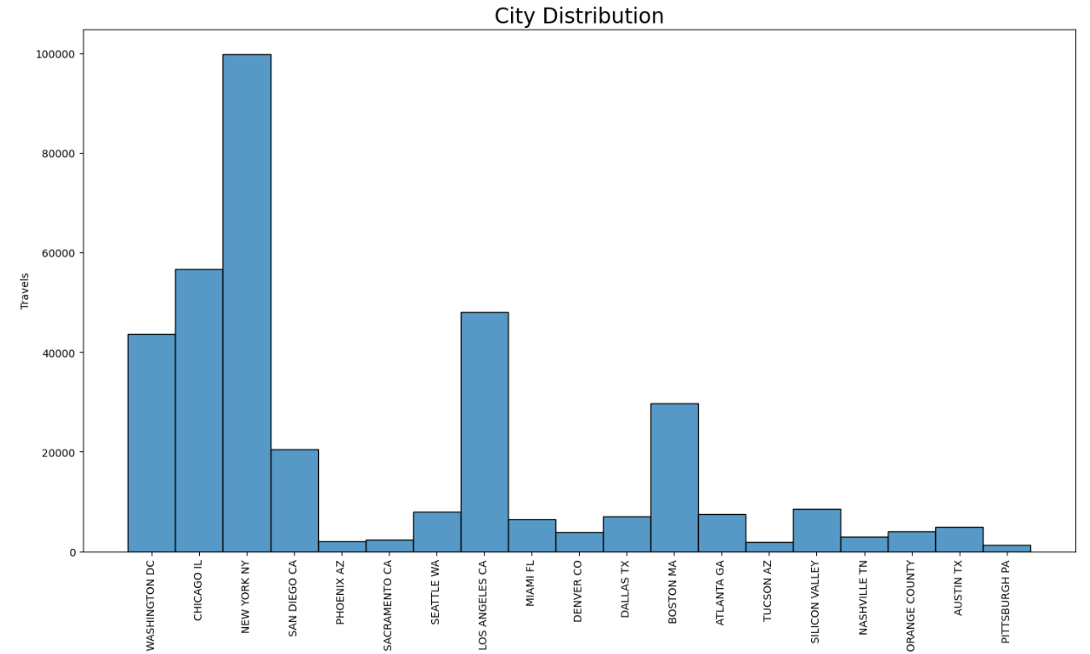
Getting familiar whit the data
The five cities with the most trips are New York, Chicago, Los Angeles, Washington D.C. and Boston

Slide 7
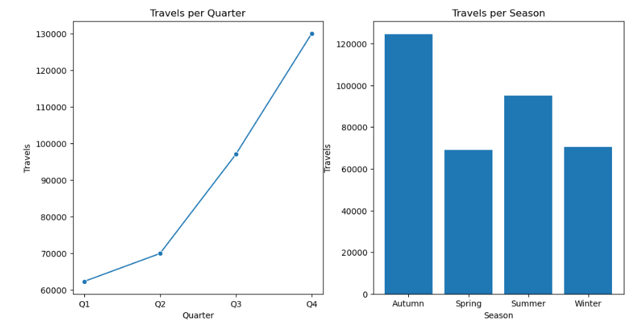
Season
* The information is accumulated in the 3 years

Slide 8
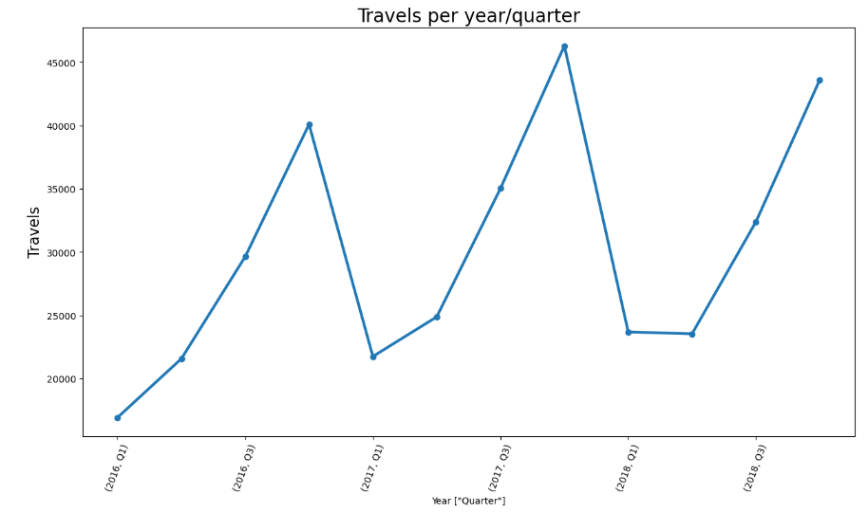
Quarters
We can see as always the last quarter is the one with the highest demand

Slide 9
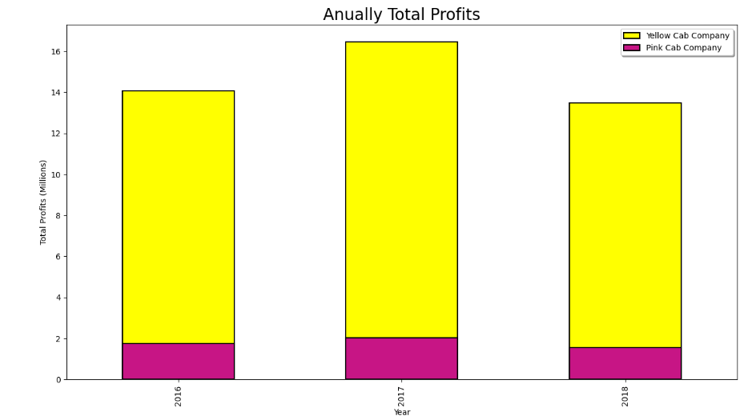
Annual Profit by Company

Slide 10
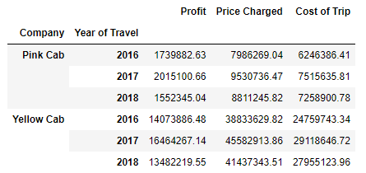
Cost, Price and Profit

Slide 11
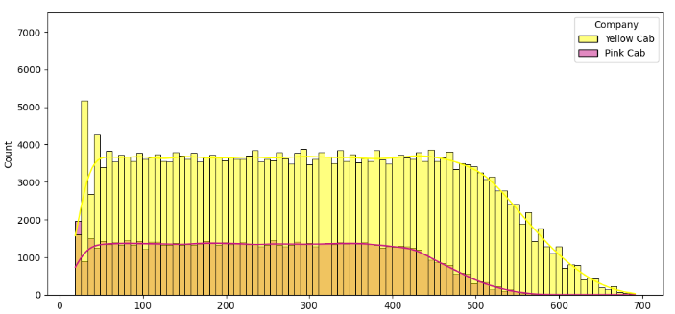
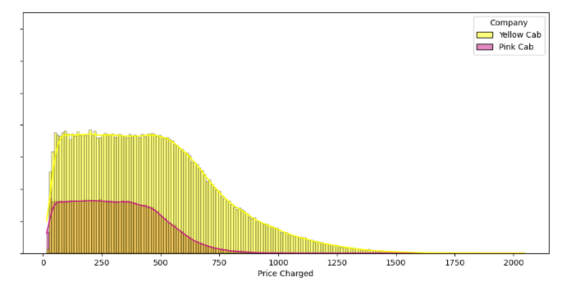
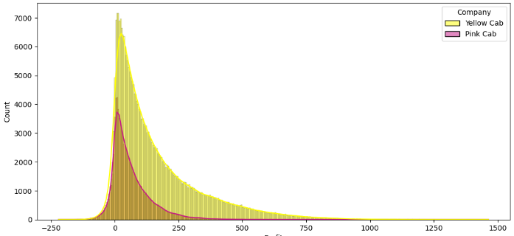
Cost, Price and Profit
Cost
Price
Profit

Slide 12
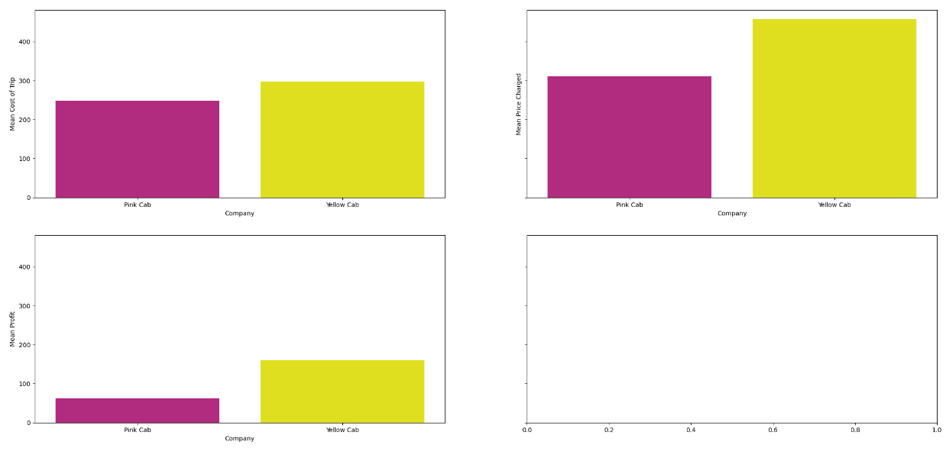
Cost, Price and Profit
We see that the average costs in the case of Pink Cab are lower.
But the Price and profit in Yellow Cab is higher

Slide 13
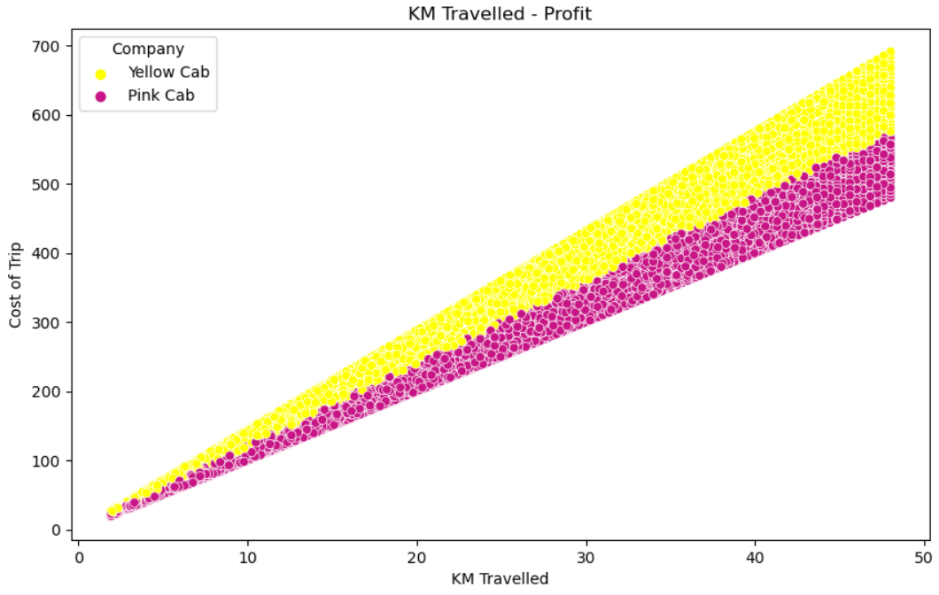
Km Travelled – Cost of Trip
Here we can see that the costs per km are lower in Pink Cab

Slide 14
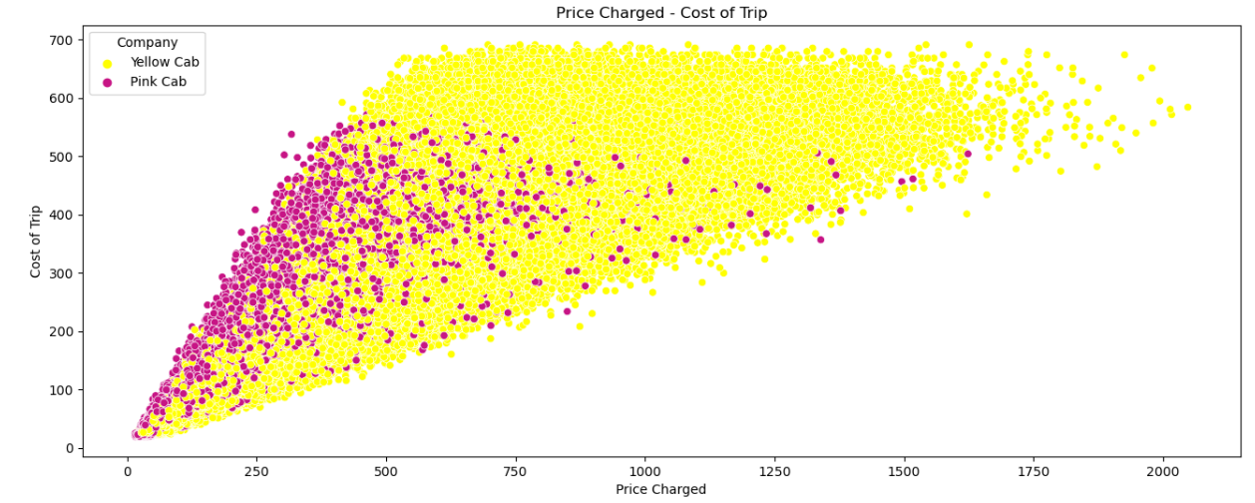
Price vs Cost

Slide 15
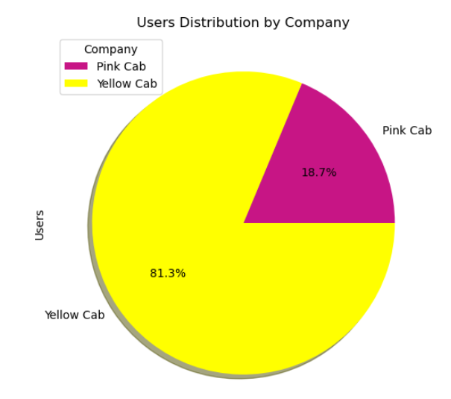
Users
It is seen that Yellow Cab has more number of users

Slide 16
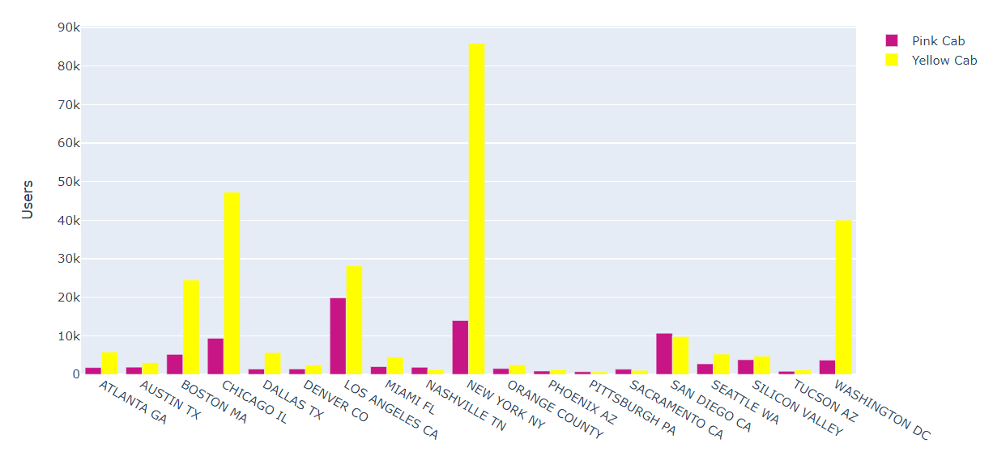
Users
Yellow Cab has the 5 largest cities

Slide 17
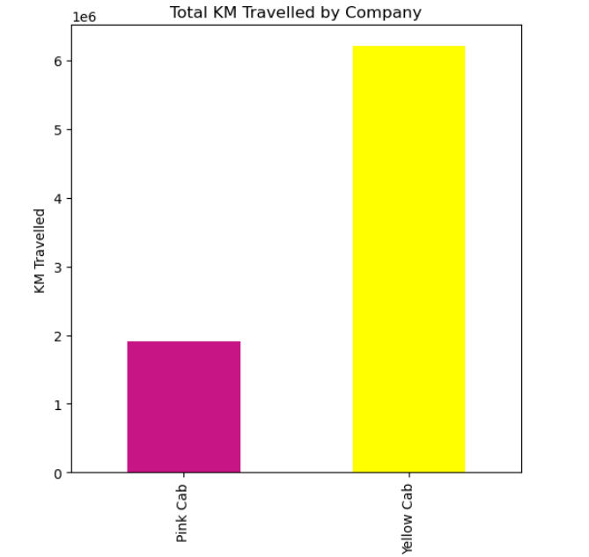
Km Travelled
Values ​​are expressed in millions

Slide 18
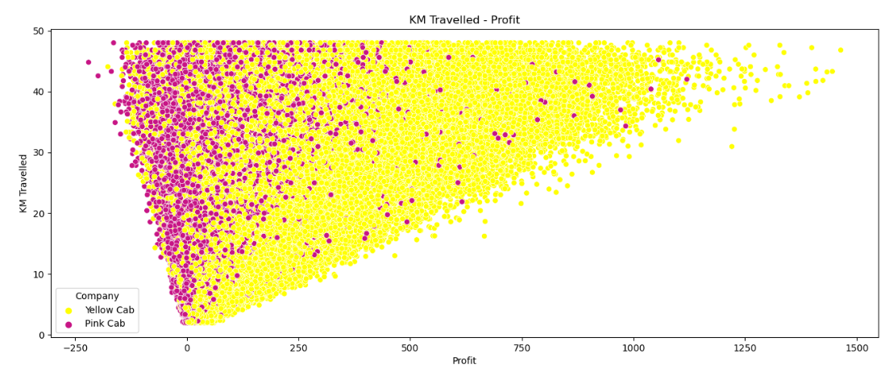
Km Travelled vs Profit

Slide 19
Pink Cab
Pros and Cons
Poor cost benefit calculation management
Possibility of drowning by bigger competitors
Minor costs
Competitive prices
Market growth opportunity

Slide 20
Yellow Cab
Pros and Cons
Higher costs
Slower business growth
Consolidated in the market
Cost improvement opportunity
Customers continue to consume it even with higher prices than the competition

Slide 21
Recommendations
Having deep knowledge of the cab market, advertising and agreeing to risky investments. I would recommend Pink Cab.
Since it has greater growth potential.
From wanting to make a safer investment with a longer-term investment.
I would recommend Yellow Cab since it is consolidated as a company and greater cost management could increase profits in the short term.

Slide 22
Thank You

