Slide 1

CPU Emulator Tutorial
This program is part of the software suite
that accompanies the book
The Elements of Computing Systems
by Noam Nisan and Shimon Schocken
MIT Press
www.idc.ac.il/tecs
This software was developed by students at the
Efi Arazi School of Computer Science at IDC
Chief Software Architect: Yaron Ukrainitz

Slide 2

Background
The Elements of Computing Systems evolves around the construction of a complete computer system, done in the framework of a 1- or 2-semester course.
In the first part of the book/course, we build the hardware platform of a simple yet powerful computer, called Hack. In the second part, we build the computer’s software hierarchy, consisting of an assembler, a virtual machine, a simple Java-like language called Jack, a compiler for it, and a mini operating system, written in Jack.
The book/course is completely self-contained, requiring only programming as a pre-requisite.
The book’s web site includes some 200 test programs, test scripts, and all the software
tools necessary for doing all the projects.

Slide 3

The book’s software suite
(All the supplied tools are dual-platform: Xxx.bat starts
Xxx in Windows, and Xxx.sh starts it in Unix)
Simulators
(HardwareSimulator, CPUEmulator, VMEmulator):
Used to build hardware platforms and
execute programs;
Supplied by us.
This tutorial is about the
CPU emulator.
Translators (Assembler, JackCompiler):
Used to translate from high-level to low-level;
Developed by the students, using the book’s specs; Executable solutions supplied by us.
Other
Bin: simulators and translators software;
builtIn: executable versions of all the logic gates and chips mentioned in the book;
OS: executable version of the Jack OS;
TextComparer: a text comparison utility.

Slide 4

Tutorial Objective
Learn how to use the CPU Emulator
for simulating the execution of machine language programs on the Hack computer

Slide 5
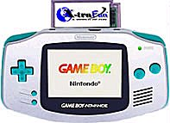

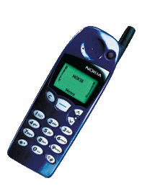
The Hack computer
This CPU emulator simulates the operations of the Hack computer, built in chapters 1-5 of the book.
Hack -- a 16-bit computer equipped with a screen and a keyboard -- resembles hand-held computers like game machines, PDA’s, and cellular telephones.
Before such devices are actually built in hardware, they are planned and simulated in software.
The CPU emulator is one of
the software tools used for
this purpose.

Slide 6
CPU Emulator Tutorial
I. Basic Platform
II. I/O devices
III. Interactive simulation
IV. Script-based simulation
V. Debugging
Relevant reading (from “The Elements of Computing Systems”):
Chapter 4: Machine Language
Chapter 5: Computer Architecture
Appendix B: Test Scripting Language

Slide 7
CPU Emulator Tutorial
Part I:
Basic Platform

Slide 8
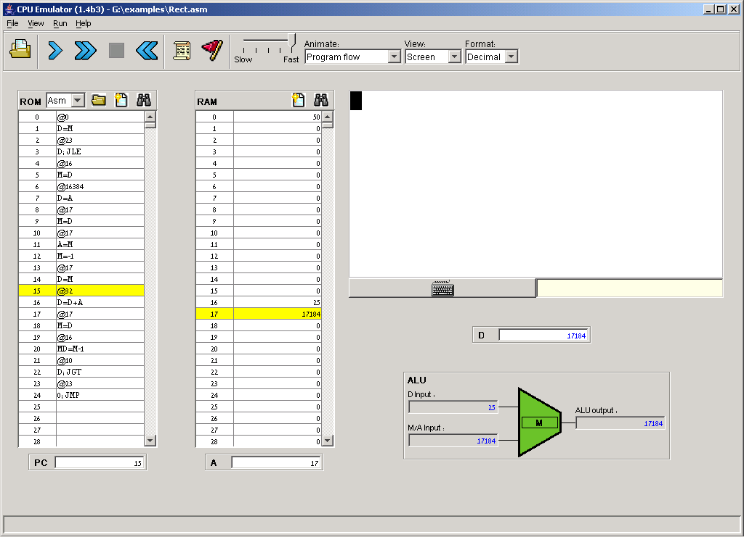
The Hack Computer Platform (simulated)
Travel Advice:
This tutorial includes some examples of programs written in the Hack machine language (chapter 4).
There is no need however to understand either the language or the programs in order to learn how to use the CPU emulator.
Rather, it is only important to grasp the general logic of these programs,
as explained (when relevant)
in the tutorial.

Slide 9
The Hack Computer Platform
screen
data
memory
keyboard enabler
instruction memory
ALU
registers

Slide 10
Instruction memory
The loaded code can be viewed
either in binary, or in symbolic notation (present view)
Instruction memory (32K): Holds a machine language program
Next instruction
is highlighted
Program counter (PC) (16-bit):
Selects the next instruction.

Slide 11
Data memory (RAM)
Data memory (32K RAM), used for:
General-purpose data storage
(variables, arrays, objects, etc.)
Screen memory map
Keyboard memory map
Address (A) register, used to:
Select the current RAM location
OR
Set the Program Counter (PC) for jumps (relevant only if the current instruction includes a jump directive).

Slide 12
Registers
Registers (all 16-bit):
D: Data register
A: Address register
M: Stands for the memory register
whose address is the current
value of the Address register
M (=RAM[A])
D
A

Slide 13
Arithmetic/Logic Unit
Arithmetic logic unit (ALU)
The ALU can compute various arithmetic and logical functions (let’s call them f) on subsets of the three registers {M,A,D}
All ALU instructions are of the form
{M,A,D} = f ({M,A,D})
(e.g. M=M-1, MD=D+A , A=0, etc.)
The ALU operation (LHS destination, function, RHS operands) is specified by the current instruction.
Current instruction
M (=RAM[A])
D
A

Slide 14
CPU Emulator Tutorial
Part II:
I/O Devices

Slide 15
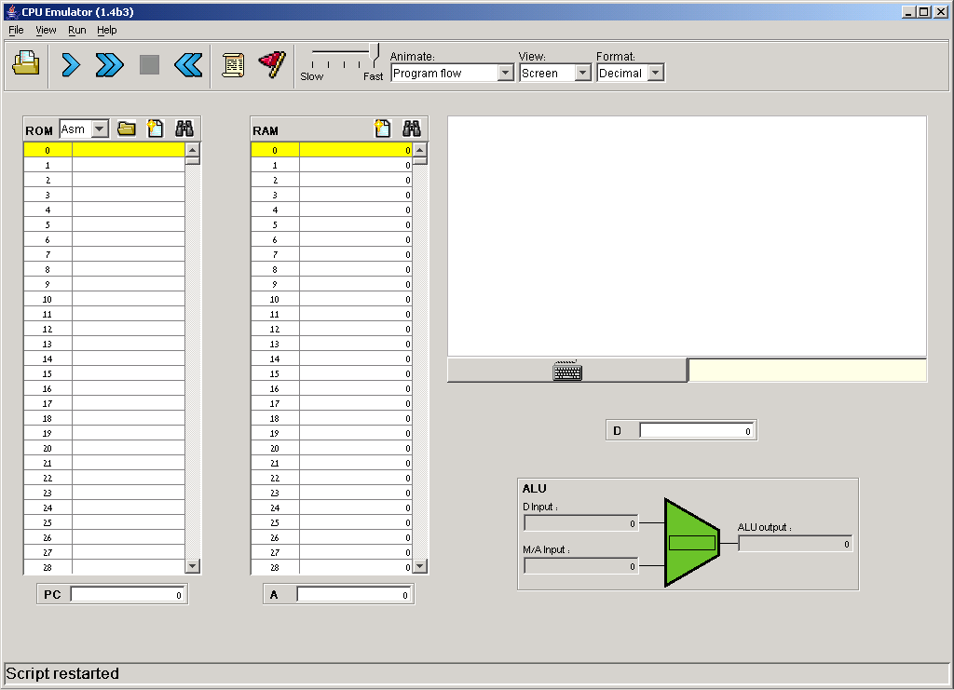
I/O devices: screen and keyboard
Simulated screen: 256 columns by 512 rows, black & white memory-mapped device. The pixels are continuously refreshed from respective bits in an 8K memory-map, located at RAM[16384] - RAM[24575].
Simulated keyboard:
One click on this button causes the CPU emulator to intercept all the keys subsequently pressed on the real computer’s keyboard; another click disengages the real keyboard from the emulator.

Slide 16
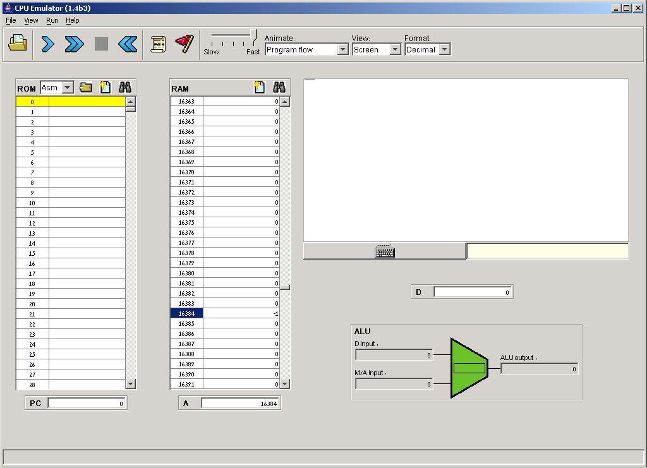
Screen action demo
Perspective: That’s how computer programs put images (text, pictures, video) on the screen: they write bits into some display-oriented memory device.
This is rather hard to do in machine language programming, but quite easy in high-level languages that write to the screen indirectly, using OS routines like printString or drawCircle, as we will see in chapters 9 and 12.
Since all high level programs and OS routines are eventually translated into machine language, they all end up doing something like this example.
3. Built-in Refresh action:
The emulator draws the corresponding pixels on the screen. In this case, 16 black pixels, one for each binary 1.
Select a word in the RAM region that serves as the screen memory map, e.g. address 16384 (the first word in the screen memory map).
Enter a value, say –1 (1111111111111111 in binary)

Slide 17
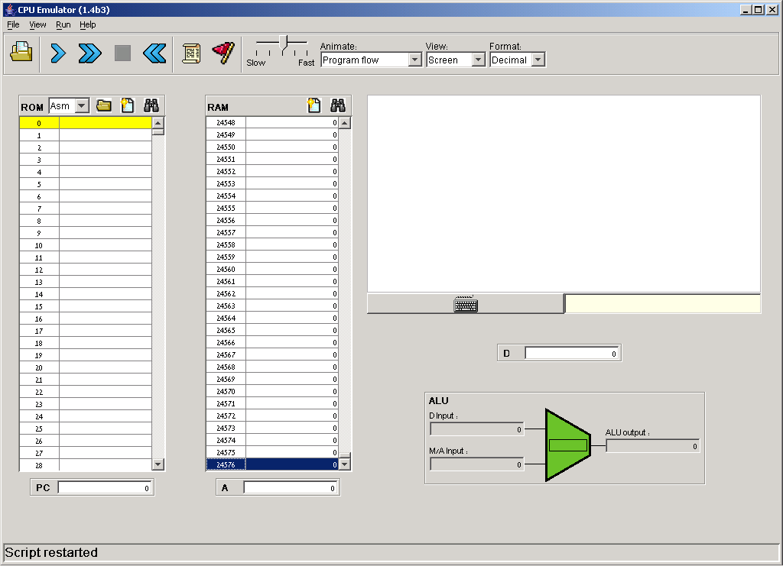
Keyboard action demo
Click the keyboard enabler
Press some key on the real keyboard, say “S”
3. Watch here:
Keyboard memory map
(a single 16-bit memory location)

Slide 18
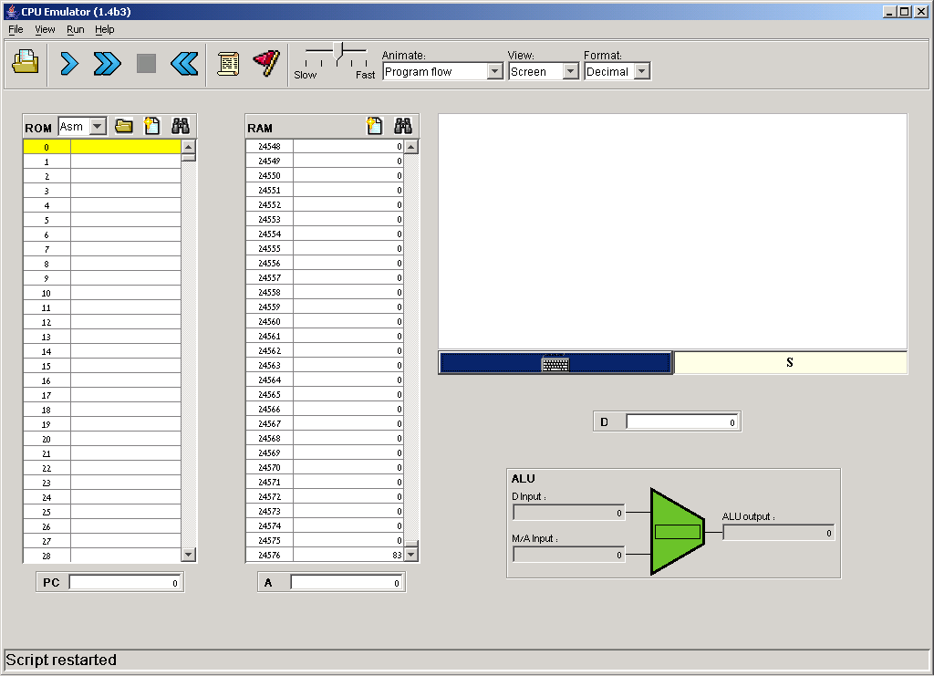
Keyboard action demo
Perspective: That’s how computer programs read from the keyboard: they peek some keyboard-oriented memory device, one character at a time.
This is rather tedious in machine language programming, but quite easy in high-level languages that handle the keyboard indirectly, using OS routines like readLine or readInt, as we will see in Chapters 9 and 12.
Since all high level programs and OS routines are eventually translated into machine language, they all end up doing something like this example.
Visual echo (convenient GUI effect, not part of the hardware platform)
As long a key is pressed,
The emulator displays Its character code in the keyboard memory map
Keyboard memory map
(a single 16-bit memory location)

Slide 19
CPU Emulator Tutorial
Part III:
Interactive
Simulation

Slide 20
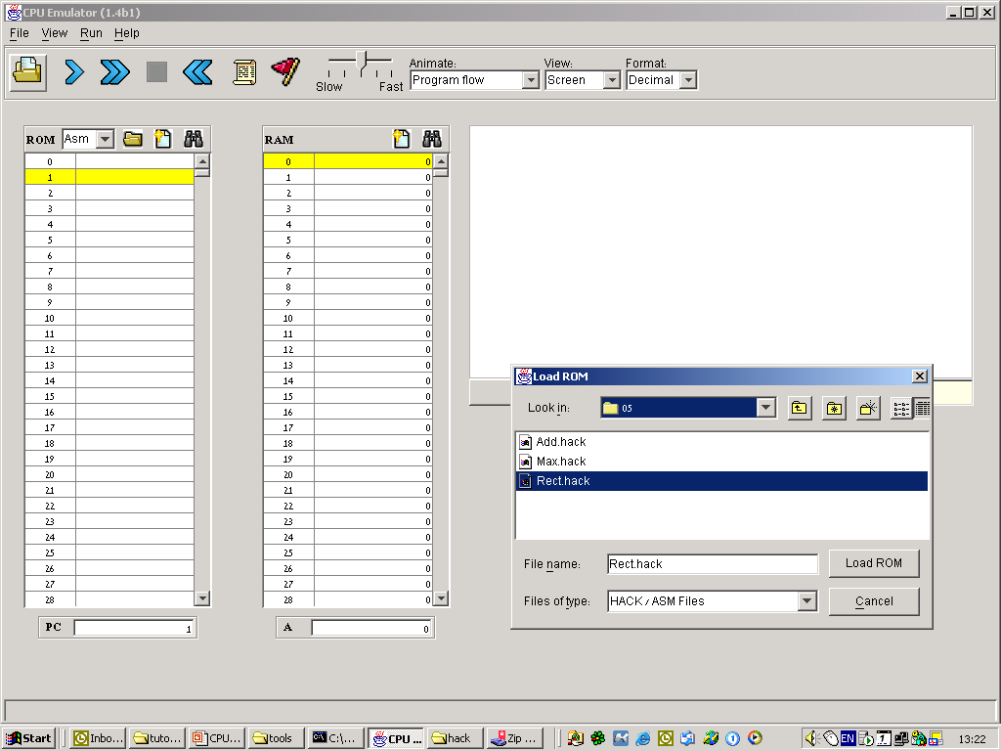
Loading a program
Navigate to a directory and select a .hack or .asm file.

Slide 21
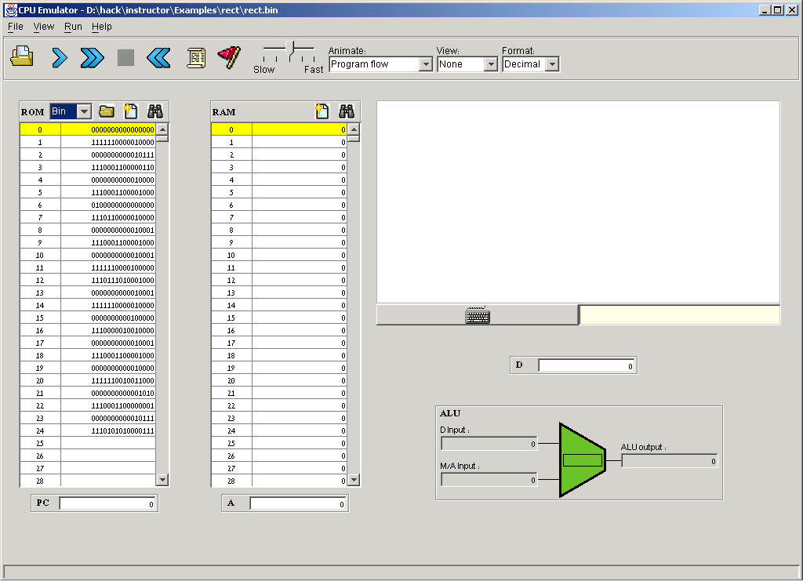
Loading a program
Can switch from binary to symbolic representation

Slide 22
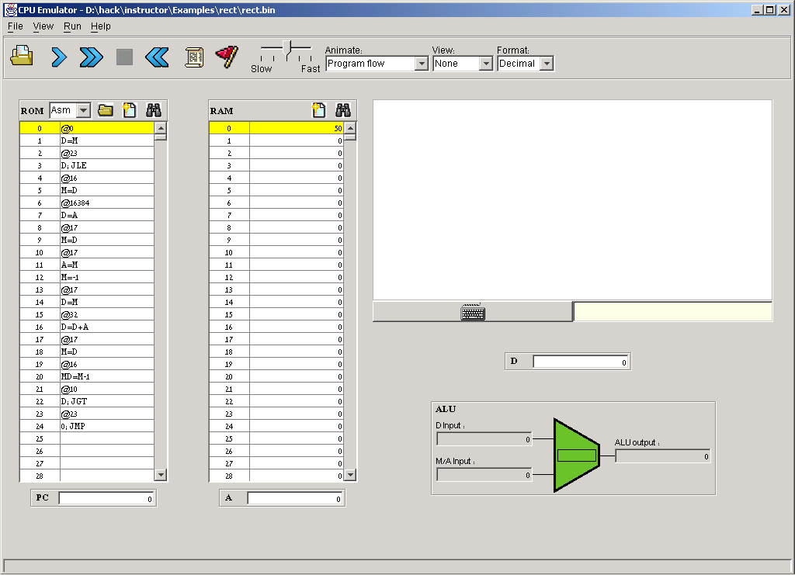
Running a program
4. Watch here
2. Click the “run” button.
1. Enter a number,
say 50.
3. To speed up execution,
use the speed control slider
Program’s description: Draws a rectangle at the top left corner of the screen. The rectangle’s width is 16 pixels, and its length is determined by the current contents of RAM[0].
Note: There is no need to understand the program’s code in order to understand what’s going on.

Slide 23
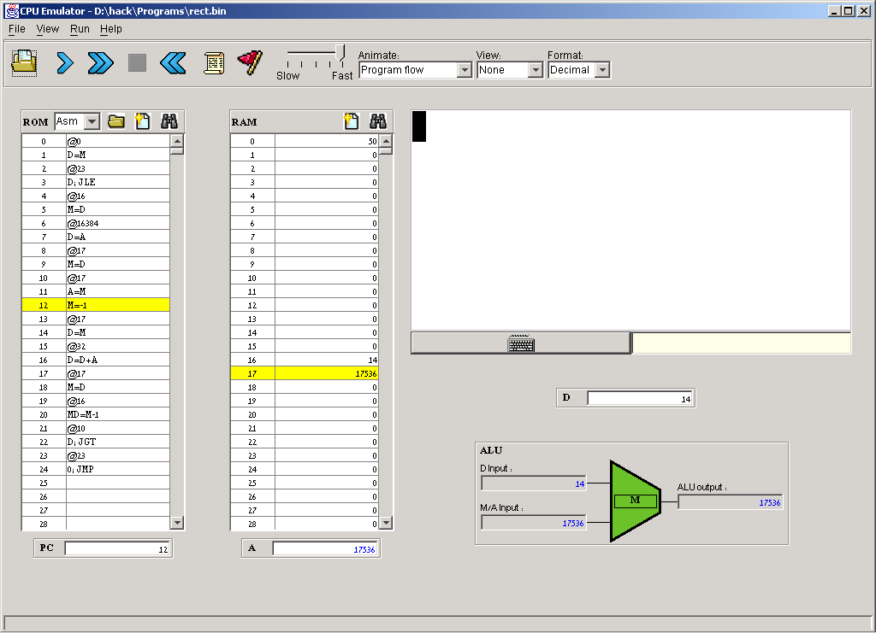
Running a program
4. Watch here
2. Click the “run” button.
1. Enter a number,
say 50.
3. To speed up execution,
use the speed control slider
Program’s description: Draws a rectangle at the top left corner of the screen. The rectangle’s width is 16 pixels, and its length is determined by the current contents of RAM[0].
Note: There is no need to understand the program’s code in order to understand what’s going on.

Slide 24
Hack programming at a glance (optional)
Next instruction is M=-1.
Since presently A=17536, the next ALU instruction will effect RAM[17536] = 1111111111111111. The 17536 address, which falls in the screen memory map, corresponds to the row just below the rectangle’s current bottom. In the next screen refresh, a new row of 16 black pixels will be drawn there.
Program action:
Since RAM[0] happens to be 50, the program draws a 16X50 rectangle. In this example the user paused execution when there are 14 more rows to draw.
Program’s description: Draws a rectangle at the top left corner of the screen. The rectangle’s width is 16 pixels, and its length is determined by the current contents of RAM[0].
Note: There is no need to understand the program’s code in order to understand what’s going on.

Slide 25
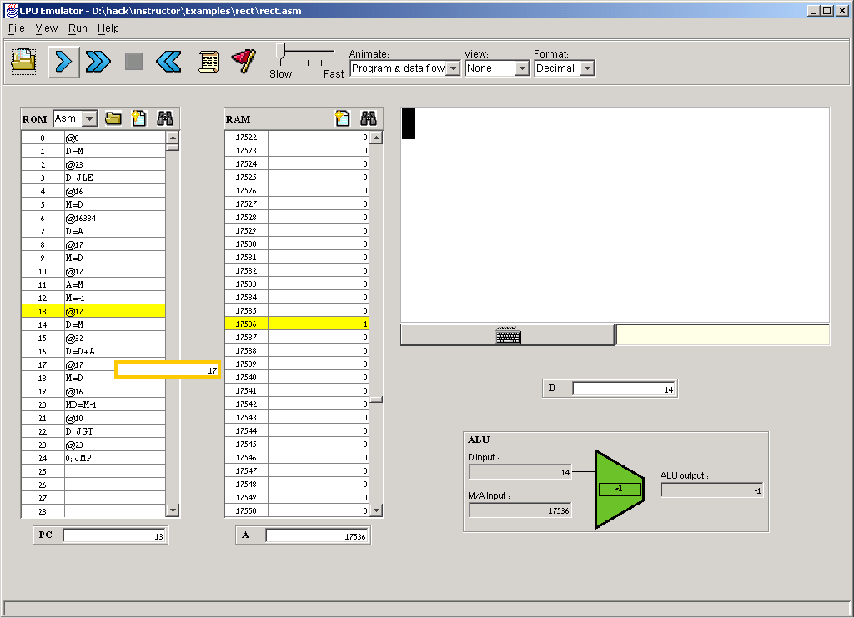
Animation options
Controls execution (and animation) speed.
Animation control:
Program flow (default): highlights the current instruction in the instruction memory and the currently selected RAM location
Program & data flow: animates all program and data flow in the computer
No animation: disables all animation
Usage tip: To execute any non-trivial program quickly, select no animation.
The simulator can animate both program flow and data flow

Slide 26
CPU Emulator Tutorial
Part IV:
Script-Based
Simulation

Slide 27
Interactive VS Script-Based Simulation
A program can be executed and debugged:
Interactively, by ad-hoc playing with the emulator’s GUI
(as we have done so far in this tutorial)
Batch-ly, by running a pre-planned set of tests, specified in a script.
Script-based simulation enables planning and using tests that are:
Pro-active
Documented
Replicable
Complete (as much as possible)
Test scripts:
Are written in a Test Description Language (described in Appendix B)
Can cause the emulator to do anything that can be done interactively, and quite a few things that cannot be done interactively.

Slide 28
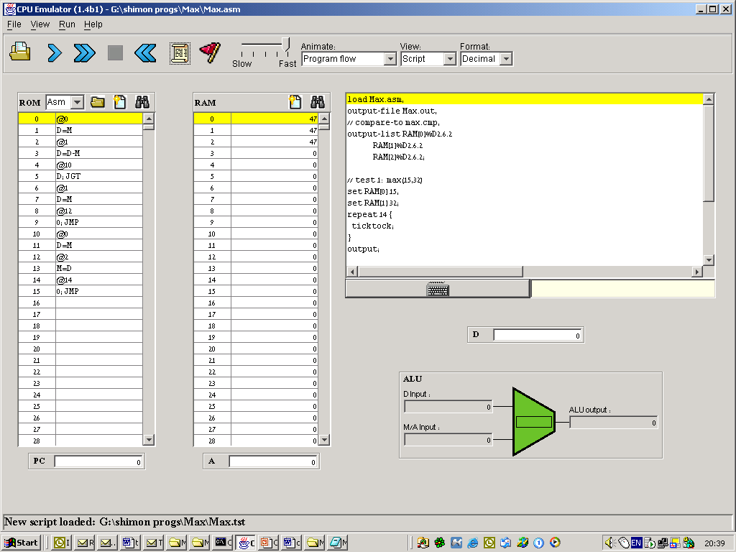
The basic setting
test script
tested program

Slide 29
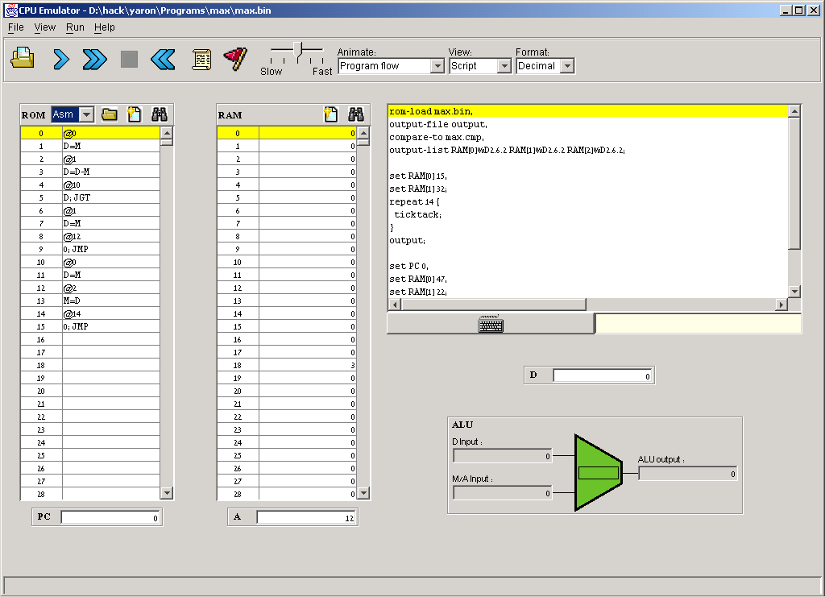
Example: Max.asm
Note: For now, it is not necessary to understand either the Hack machine language or the Max program. It is only important to grasp the program’s logic. But if you’re interested, we give a language overview on the right.
Hack language at a glance:
(label) // defines a label
@xxx // sets the A register
// to xxx’s value
The other commands are self-explanatory; Jump directives like JGT and JMP mean “Jump to the address currently stored in the A register”
Before any command involving a RAM location (M), the A register must be set to the desired RAM address (@address)
Before any command involving a jump, the A register must be set to the desired ROM address (@label).
// Computes M[2]=max(M[0],M[1]) where M stands for RAM
@0
D=M // D = M[0]
@1
D=D-M // D = D - M[1]
@FIRST_IS_GREATER
D;JGT // If D>0 goto FIRST_IS_GREATER
@1
D=M // D = M[1]
@SECOND_IS_GREATER
0;JMP // Goto SECOND_IS_GREATER
(FIRST_IS_GREATER)
@0
D=M // D=first number
(SECOND_IS_GREATER)
@2
M=D // M[2]=D (greater number)
(INFINITE_LOOP)
@INFINITE_LOOP // Infinite loop (our standard
0;JMP // way to terminate programs).

Slide 30
Sample test script: Max.tst
// Load the program and set up:
load Max.asm,
output-file Max.out,
compare-to Max.cmp,
output-list RAM[0]%D2.6.2
RAM[1]%D2.6.2
RAM[2]%D2.6.2;
// Test 1: max(15,32)
set RAM[0] 15,
set RAM[1] 32;
repeat 14 {
ticktock;
}
output; // to the Max.out file
// Test 2: max(47,22)
set PC 0, // Reset prog. counter
set RAM[0] 47,
set RAM[1] 22;
repeat 14 {
ticktock;
}
output;
// test 3: max(12,12)
// Etc.
The scripting language
has commands for:
Loading programs
Setting up output and compare files
Writing values into RAM locations
Writing values into registers
Executing the next command (“ticktack”)
Looping (“repeat”)
And more (see Appendix B).
Notes:
As it turns out, the Max program requires 14 cycles to complete its execution
All relevant files (.asm,.tst,.cmp) must
be present in the same directory.
Output
| RAM[0] | RAM[1] | RAM[2] |
| 15 | 32 | 32 |
| 47 | 22 | 47 |

Slide 31
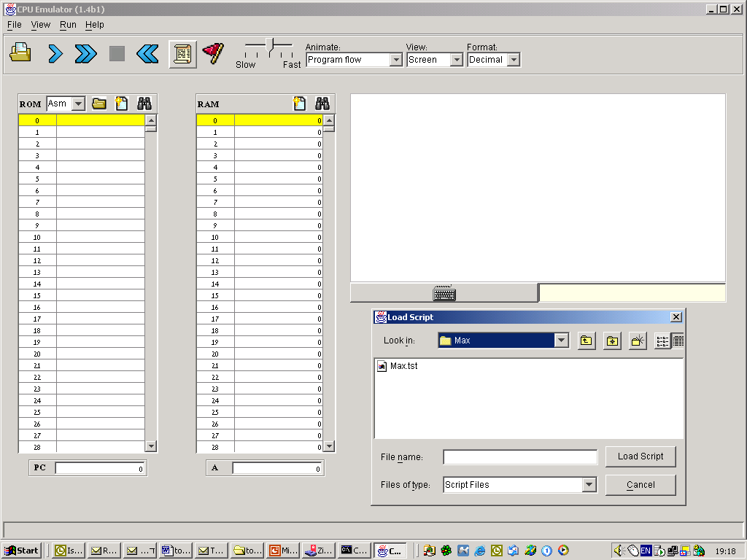
Using test scripts
Load a script
Interactive loading of the tested program itself (.asm or .hack file) is typically not necessary, since test scripts typically begin with a “load program” command.

Slide 32
Using test scripts
Speed control
Load a script
Script = a series of simulation steps, each ending with a semicolon;
Reset
the script
Important point: Whenever an assembly program (.asm file) is loaded into the emulator, the program is assembled on the fly into machine language code, and this is the code that actually gets loaded. In the process, all comments and white space are removed from the code, and all symbols resolve to the numbers that they stand for.
Pause the simulation
Execute step after step repeatedly
Execute the next simulation step

Slide 33
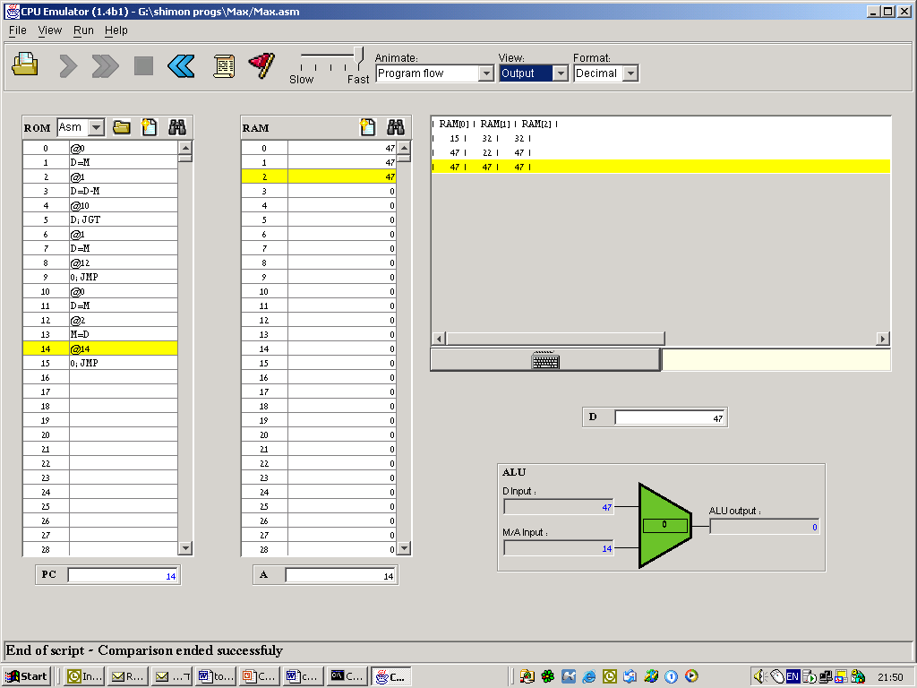
Using test scripts
View options:
Script: Shows the current script;
Output: Shows the generated output file;
Compare: Shows the given comparison file;
Screen: Shows the simulated screen.
When the script terminates, the comparison of the script output and the compare file is reported.

Slide 34
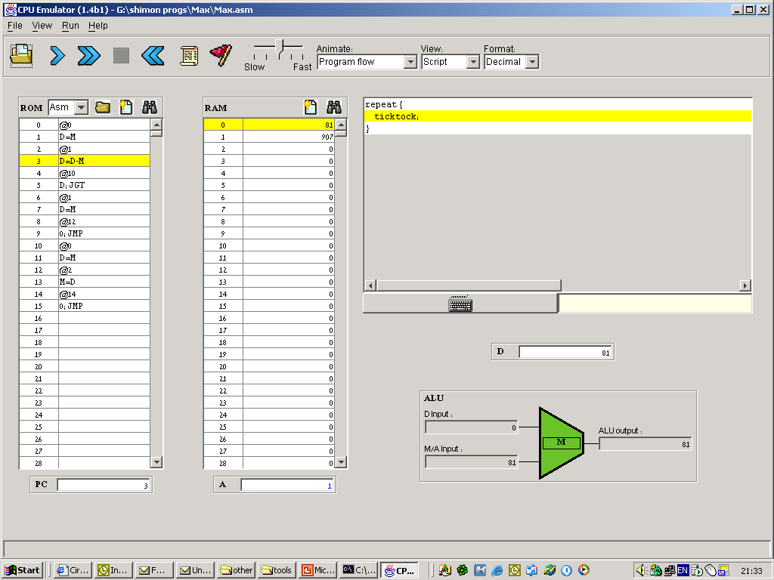
The default script (and a deeper understanding of the CPU emulator logic)
If you load a program file without first loading a script file, the emulator loads a default script (always). The default script consists of a loop that runs the computer clock infinitely.
Note that these run/stop buttons don’t control the program. They control the script, which controls the computer’s clock, which causes the computer hardware to fetch and execute the program’s instructions, one instruction per clock cycle.

Slide 35
CPU Emulator Tutorial
Part V:
Debugging

Slide 36
Breakpoints: a powerful debugging tool
The CPU emulator continuously keeps track of:
A: value of the A register
D: value of the D register
PC: value of the Program Counter
RAM[i]: value of any RAM location
time: number of elapsed machine cycles
Breakpoints:
A breakpoint is a pair <variable, value> where variable is one of
{A, D, PC, RAM[i], time} and i is between 0 and 32K.
Breakpoints can be declared either interactively, or via script commands.
For each declared breakpoint, when the variable reaches the value, the
emulator pauses the program’s execution with a proper message.

Slide 37
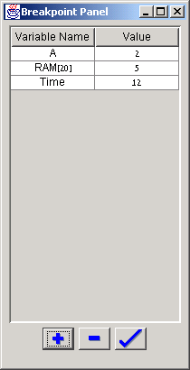
Breakpoints declaration
2. Previously-declared breakpoints
1. Open the breakpoints panel
3. Add, delete, or update breakpoints

Slide 38
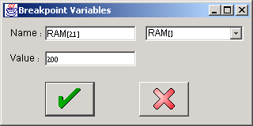
Breakpoints declaration
1. Select the system variable on which you want to break
2. Enter the value at which the break should occur

Slide 39
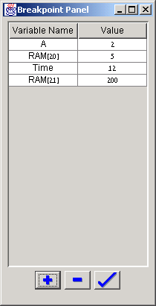
Breakpoints usage
1. New breakpoint
2. Run the program
3. When the A register will be 2, or RAM[20] will be 5, or 12 time units (cycles) will elapse, or RAM[21] will be 200, the emulator will pause the program’s execution with an appropriate message.
A powerful debugging tool!

Slide 40

Postscript: Maurice Wilkes (computer pioneer) discovers debugging:
As soon as we started programming, we found to our surprise that it wasn't as easy to get programs right as we had thought. Debugging had to be discovered. I can remember the exact instant when I realized that a large part of my life from then on was going to be spent in finding mistakes in my own programs.
(Maurice Wilkes, 1949).

