Slide 1
2022-2023 Ideas

Slide 2
Technical debt on PINNs (PDE solvers and beyond)
1) Stochastic dynamic batching (new idea)
2) Neural net optimization
Baseline cases (float32)
Fluid dynamics as use case:
Increasing Re along the training (CFD: warm start)
Increasing the number of collocation points along the training (CFD: multigrid)
Euler initialization (CFD: hybrid initialization)
Versus data-driven methods:
Random
Constant values
Glorot
Collocation points | 1M
Time steps | 1,000
DOE size | 1 | 50
Data size | 12 GB | 600 GB
https://proceedings.neurips.cc/paper/2021/file/df438e5206f31600e6ae4af72f2725f1-Paper.pdf

Slide 3
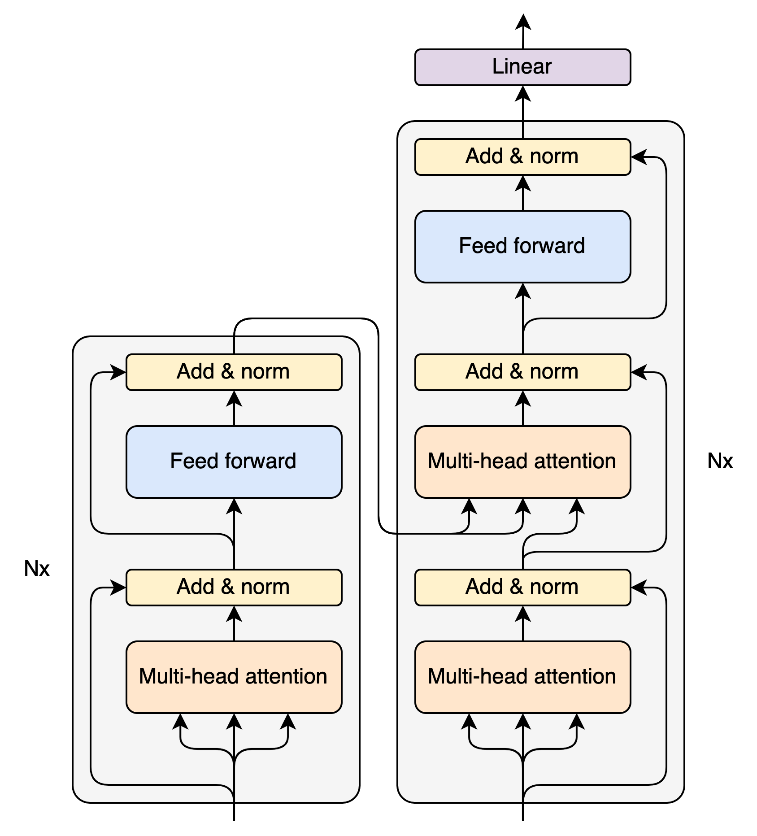

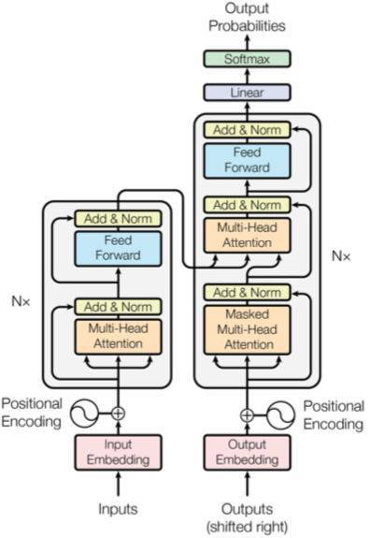
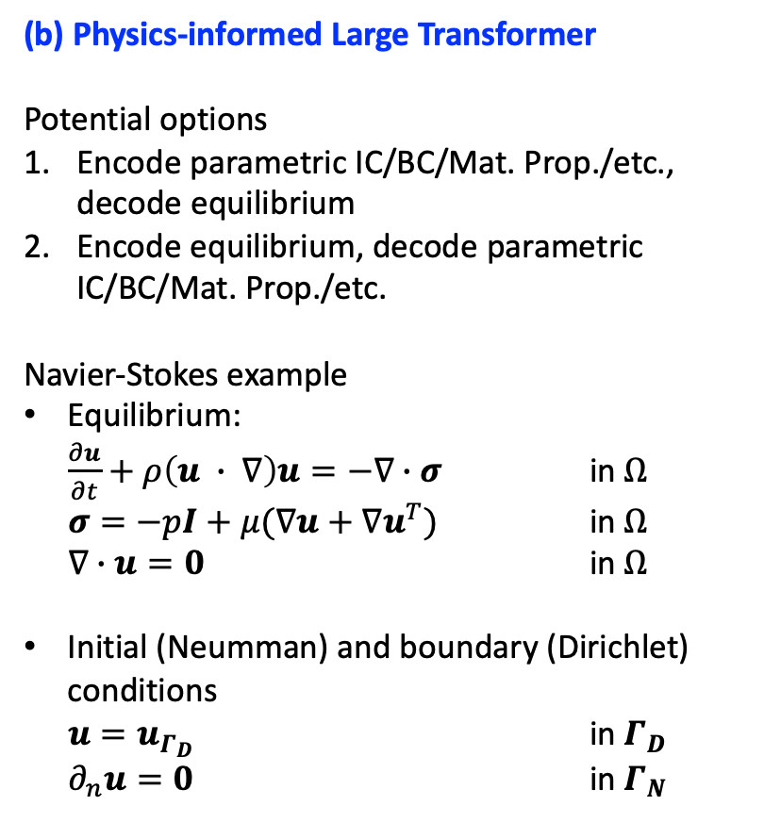
Parametric PINNs (neural operators) and large transformers
(a) Base transformer architecture
(b) Physics-informed Large Transformer
Potential options
Encode parametric IC/BC/Mat. Prop./etc., decode equilibrium
Encode equilibrium, decode parametric IC/BC/Mat. Prop./etc.
Navier-Stokes example
Equilibrium:
$\frac{∂u}{∂t}+ρ\left(u ∙ ∇\right)u=−∇∙σ$ in $Ω$
$σ=−pI+μ(∇u+∇u^{T})$ in $Ω$
$∇∙u=0$ in $Ω$
Initial (Neumman) and boundary (Dirichlet) conditions
$u=u_{Γ_{D}}$ in $Γ_{D}$
$∂_{n}u=0$ in $Γ_{N}$
Encode
Decode

Slide 4
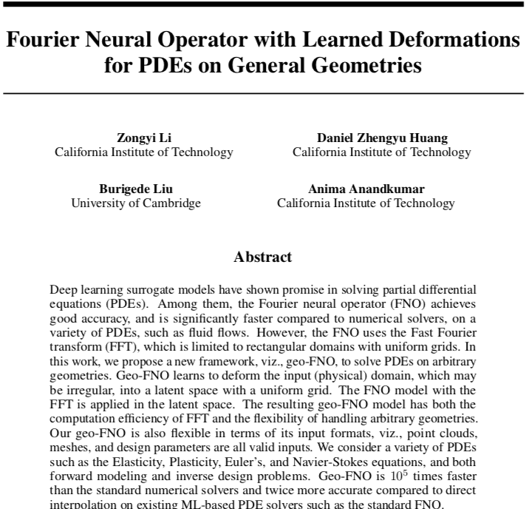
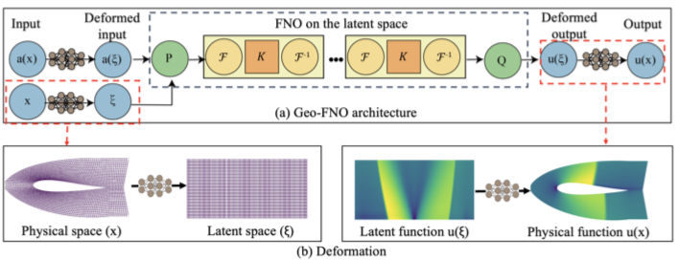
Fourier Neural Operators
Observations for both neural operators and transformer-like architectures thus far:
Use case: parametric PDEs (changing model parameters, boundary conditions, and even geometry)
Often small transformers (limitation of hardware used in research? Or something else?)
Mostly academic applications

Slide 5


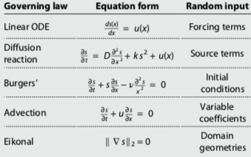
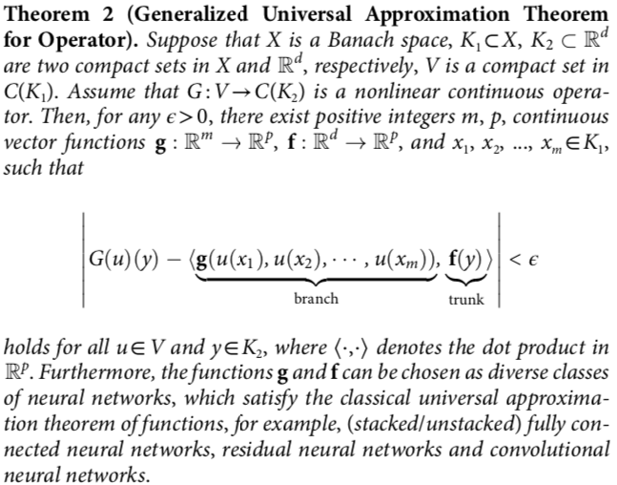
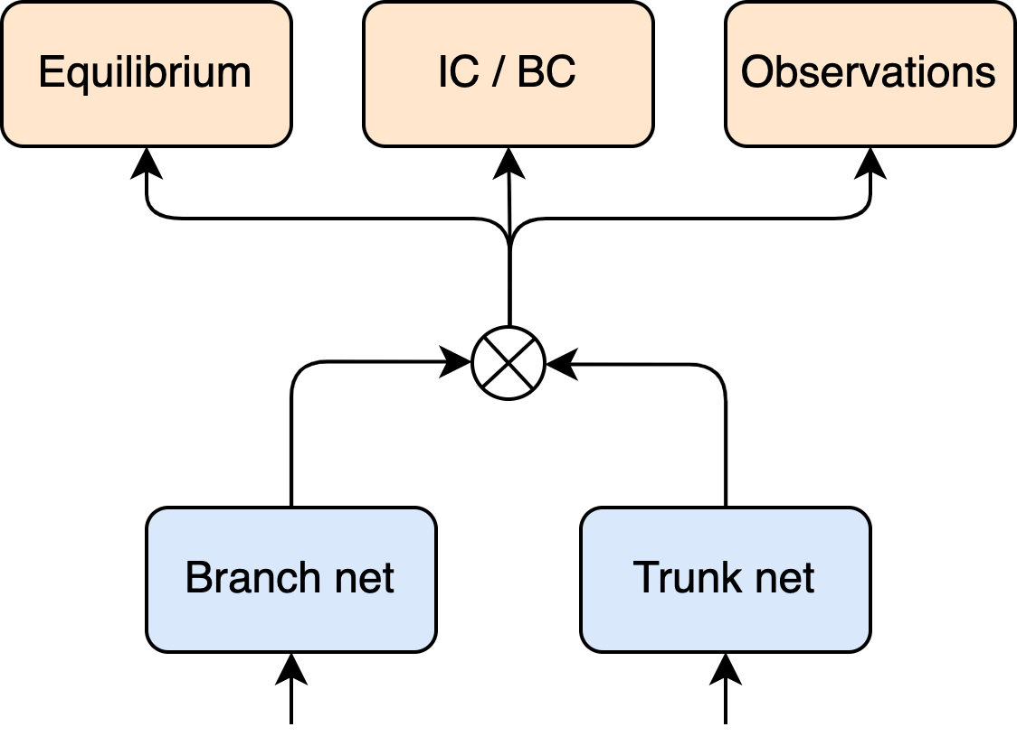
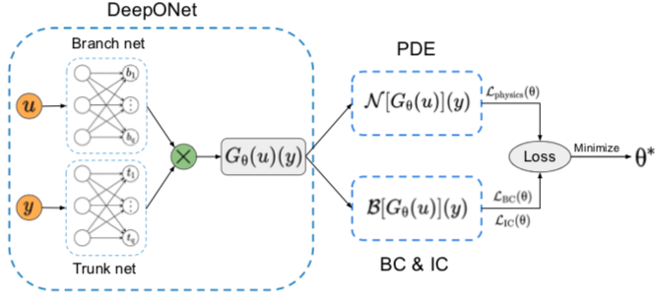
Small transformers-like neural operator: DeepONet
Parametric portion
Non-parametric portion

Slide 6
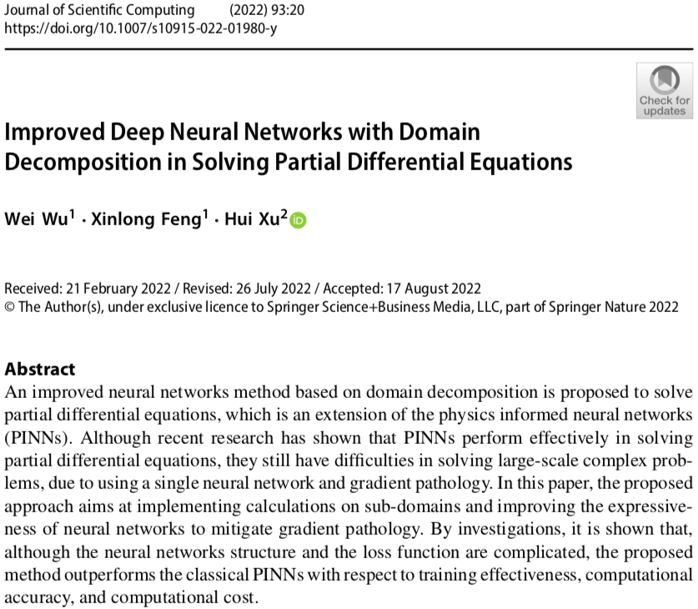
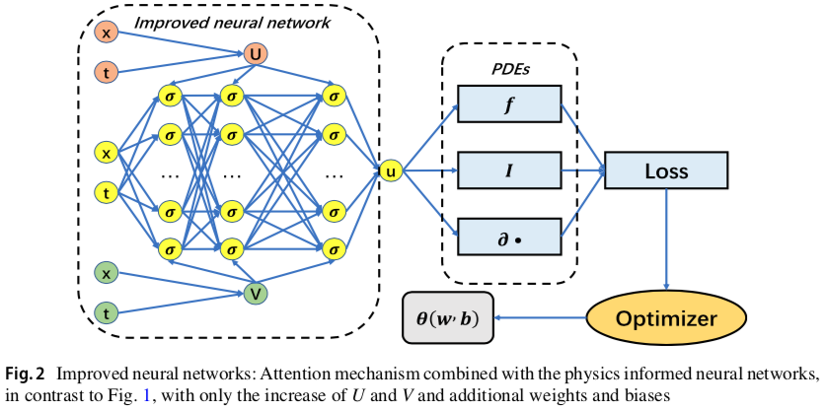
Attention mechanism

Slide 7
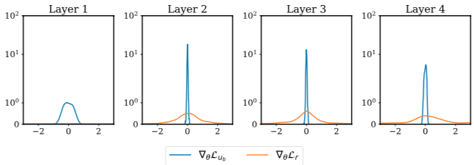
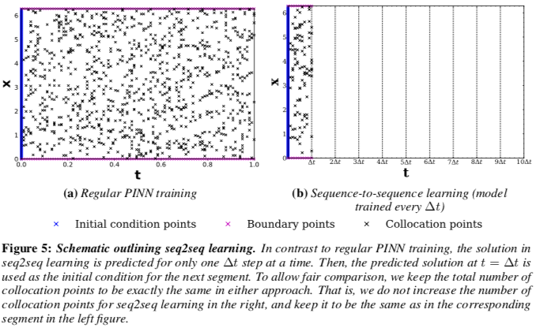
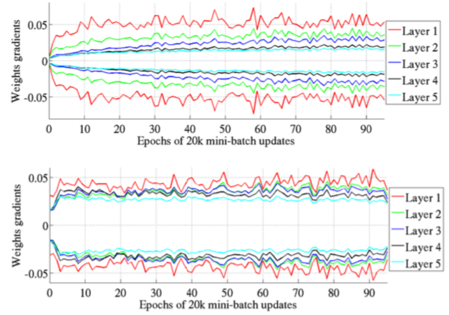
PINN work that we might need to consider
1) Conditioning gradients throughout training
2) Marching through time
https://epubs.siam.org/doi/pdf/10.1137/20M1318043
http://proceedings.mlr.press/v9/glorot10a/glorot10a.pdf
https://proceedings.neurips.cc/paper/2021/file/df438e5206f31600e6ae4af72f2725f1-Paper.pdf

Slide 8
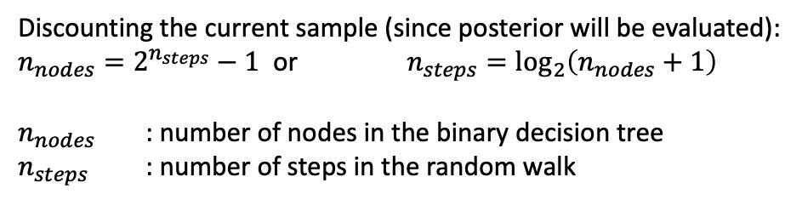
Binary decision tree: 6 steps
Current sample
Accepted sample
Posterior evaluation request
New sample (one step
of random walk)
Rejected sample
Assuming acceptance rate of 23%
Steps
1
1.00
2
0.23
0.77
3
0.053
0.177
0.177
0.593
4
0.012
0.041
0.041
0.136
0.041
0.136
0.136
0.457
5
0.003
0.009
0.009
0.031
0.009
0.031
0.031
0.105
0.009
0.031
0.031
0.105
0.031
0.105
0.105
0.352
6
0.0007
0.002
0.002
0.007
0.002
0.007
0.007
0.024
0.002
0.007
0.007
0.024
0.007
0.024
0.024
0.081
0.002
0.007
0.007
0.024
0.007
0.024
0.024
0.081
0.007
0.024
0.024
0.081
0.024
0.081
0.081
0.271
Discounting the current sample (since posterior will be evaluated):
$n_{nodes}=2^{n_{steps}}−1$ or $n_{steps}=\log_{2}\left(n_{nodes}+1\right)$
$n_{nodes}$ : number of nodes in the binary decision tree
$n_{steps}$ : number of steps in the random walk

Slide 9


Allocation of compute resources
Current sample
Accepted sample
Posterior evaluation request
New sample (one step
of random walk)
Rejected sample
Assuming 7 compute nodes are available
1.00
0.23
0.77
0.053
0.177
0.177
0.593
0.012
0.041
0.041
0.136
0.041
0.136
0.136
0.457
0.003
0.009
0.009
0.031
0.009
0.031
0.031
0.105
0.009
0.031
0.031
0.105
0.031
0.105
0.105
0.352
0.0007
0.002
0.002
0.007
0.002
0.007
0.007
0.024
0.002
0.007
0.007
0.024
0.007
0.024
0.024
0.081
0.002
0.007
0.007
0.024
0.007
0.024
0.024
0.081
0.007
0.024
0.024
0.081
0.024
0.081
0.081
0.271
Compute node allocated based on probabilities
Compute node allocated based on depth of the tree

Slide 10
Allocation of compute resources
Current sample
Accepted sample
Posterior evaluation request
New sample (one step
of random walk)
Rejected sample
Allocated compute node
With 16 compute nodes, we can run 6 steps
1.00
0.23
0.77
0.053
0.177
0.177
0.593
0.012
0.041
0.041
0.136
0.041
0.136
0.136
0.457
0.003
0.009
0.009
0.031
0.009
0.031
0.031
0.105
0.009
0.031
0.031
0.105
0.031
0.105
0.105
0.352
0.0007
0.002
0.002
0.007
0.002
0.007
0.007
0.024
0.002
0.007
0.007
0.024
0.007
0.024
0.024
0.081
0.002
0.007
0.007
0.024
0.007
0.024
0.024
0.081
0.007
0.024
0.024
0.081
0.024
0.081
0.081
0.271
Compute node allocated based on probabilities
Compute node allocated based on depth of the tree

Slide 11
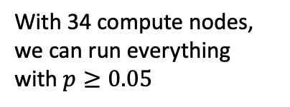
Allocation of compute resources
Current sample
Accepted sample
Posterior evaluation request
New sample (one step
of random walk)
Rejected sample
Allocated compute node
With 34 compute nodes, we can run everything with $p≥0.05$
1.00
0.23
0.77
0.053
0.177
0.177
0.593
0.012
0.041
0.041
0.136
0.041
0.136
0.136
0.457
0.209
0.031
0.105
0.031
0.105
0.031
0.105
0.105
0.352
0.048
0.161
0.037
0.124
0.024
0.081
0.024
0.081
0.024
0.081
0.024
0.081
0.081
0.271
0.029
0.095
0.022
0.073
0.062
0.062
0.062
0.062
0.062
0.062
0.019
0.019
0.017
0.056

Slide 12
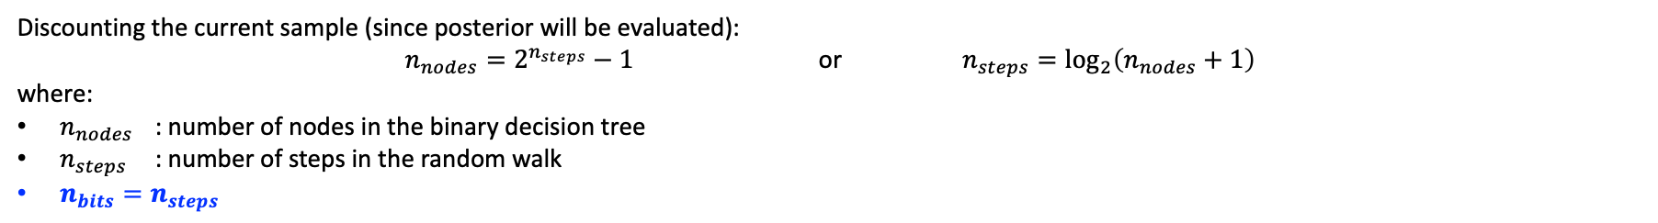
Encoding nodes using binary numbers
Current sample
Accepted sample
Posterior evaluation request
New sample (one step
of random walk)
Rejected sample
0 0 0 0 0
0
Steps
0 0 0 0 1
1
1
0 0 0 0 1
1.00
0 0 0 0 0
0 0 0 1 1
3
0 0 0 1 0
2
2
0.23
0.77
0 0 0 1 1
0 0 0 0 1
0 0 0 1 0
0 0 0 0 0
0 0 1 1 1
7
0 0 1 0 1
5
0 0 1 1 0
6
0 0 1 0 0
4
3
0.053
0.177
0.177
0.593
0 0 1 1 1
0 0 0 1 1
0 0 1 0 1
0 0 0 0 1
0 0 1 1 0
0 0 0 1 0
0 0 1 0 0
0 0 0 0 0
0 1 1 1 1
15
0 1 0 1 1
11
0 1 1 0 1
13
0 1 0 0 1
9
0 1 1 1 0
14
0 1 0 1 0
10
0 1 1 0 0
12
0 1 0 0 0
8
4
0.012
0.041
0.041
0.136
0.041
0.136
0.136
0.457
0 1 1 1 1
0 0 1 1 1
0 1 0 1 1
0 0 0 1 1
0 1 1 0 1
0 0 1 0 1
0 1 0 0 1
0 0 0 0 1
0 1 1 1 0
0 0 1 1 0
0 1 0 1 0
0 0 0 1 0
0 1 1 0 0
0 0 1 0 0
0 1 0 0 0
0 0 0 0 0
1 1 1 1 1
31
23
27
19
21
25
17
30
22
26
18
28
20
24
16
1 0 1 1 1
1 1 0 1 1
1 0 0 1 1
1 1 1 0 1
1 0 1 0 1
1 1 0 0 1
1 0 0 0 1
1 1 1 1 0
1 0 1 1 0
1 1 0 1 0
1 0 0 1 0
1 1 1 0 0
1 0 1 0 0
1 1 0 0 0
1 0 0 0 0
29
5
0.003
0.009
0.009
0.031
0.009
0.031
0.031
0.105
0.009
0.031
0.031
0.105
0.031
0.105
0.105
0.352
Discounting the current sample (since posterior will be evaluated):
$n_{nodes}=2^{n_{steps}}−1$ or $n_{steps}=\log_{2}\left(n_{nodes}+1\right)$
where:
$n_{nodes}$ : number of nodes in the binary decision tree
$n_{steps}$ : number of steps in the random walk
$n_{bits}=n_{steps}$

Slide 13
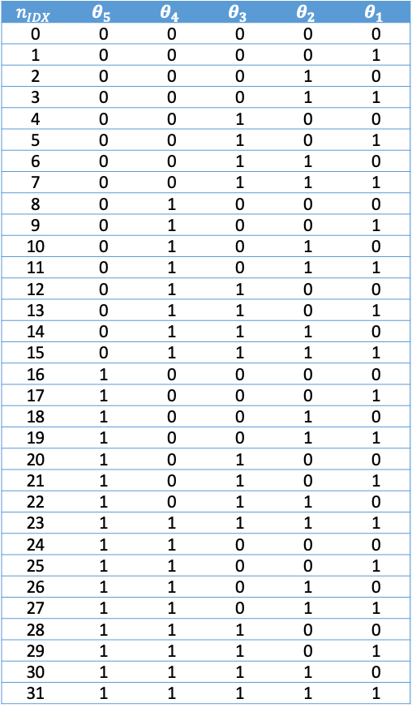
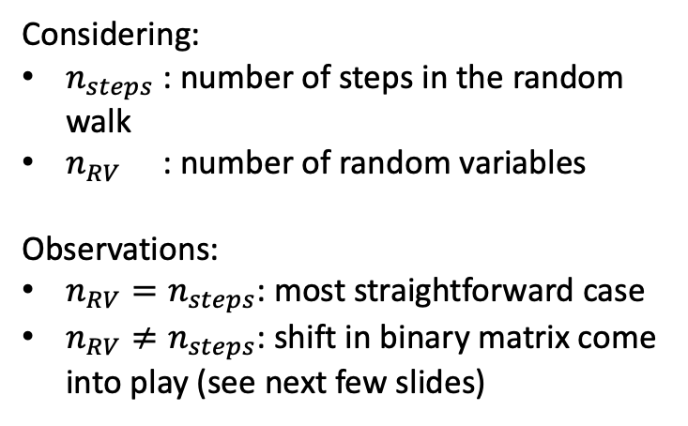
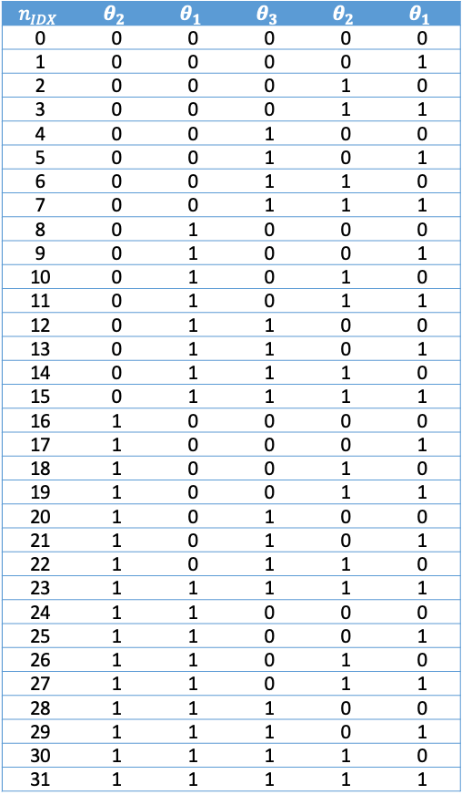
Tying the number of steps and random variables
(a) Number random variables and steps are the same
(b) Number of random variables is smaller than number of steps
$$n_{IDX}$$ | $$θ_{5}$$ | $$θ_{4}$$ | $$θ_{3}$$ | $$θ_{2}$$ | $$θ_{1}$$
0 | 0 | 0 | 0 | 0 | 0
1 | 0 | 0 | 0 | 0 | 1
2 | 0 | 0 | 0 | 1 | 0
3 | 0 | 0 | 0 | 1 | 1
4 | 0 | 0 | 1 | 0 | 0
5 | 0 | 0 | 1 | 0 | 1
6 | 0 | 0 | 1 | 1 | 0
7 | 0 | 0 | 1 | 1 | 1
8 | 0 | 1 | 0 | 0 | 0
9 | 0 | 1 | 0 | 0 | 1
10 | 0 | 1 | 0 | 1 | 0
11 | 0 | 1 | 0 | 1 | 1
12 | 0 | 1 | 1 | 0 | 0
13 | 0 | 1 | 1 | 0 | 1
14 | 0 | 1 | 1 | 1 | 0
15 | 0 | 1 | 1 | 1 | 1
16 | 1 | 0 | 0 | 0 | 0
17 | 1 | 0 | 0 | 0 | 1
18 | 1 | 0 | 0 | 1 | 0
19 | 1 | 0 | 0 | 1 | 1
20 | 1 | 0 | 1 | 0 | 0
21 | 1 | 0 | 1 | 0 | 1
22 | 1 | 0 | 1 | 1 | 0
23 | 1 | 1 | 1 | 1 | 1
24 | 1 | 1 | 0 | 0 | 0
25 | 1 | 1 | 0 | 0 | 1
26 | 1 | 1 | 0 | 1 | 0
27 | 1 | 1 | 0 | 1 | 1
28 | 1 | 1 | 1 | 0 | 0
29 | 1 | 1 | 1 | 0 | 1
30 | 1 | 1 | 1 | 1 | 0
31 | 1 | 1 | 1 | 1 | 1
$$n_{IDX}$$ | $$θ_{2}$$ | $$θ_{1}$$ | $$θ_{3}$$ | $$θ_{2}$$ | $$θ_{1}$$
0 | 0 | 0 | 0 | 0 | 0
1 | 0 | 0 | 0 | 0 | 1
2 | 0 | 0 | 0 | 1 | 0
3 | 0 | 0 | 0 | 1 | 1
4 | 0 | 0 | 1 | 0 | 0
5 | 0 | 0 | 1 | 0 | 1
6 | 0 | 0 | 1 | 1 | 0
7 | 0 | 0 | 1 | 1 | 1
8 | 0 | 1 | 0 | 0 | 0
9 | 0 | 1 | 0 | 0 | 1
10 | 0 | 1 | 0 | 1 | 0
11 | 0 | 1 | 0 | 1 | 1
12 | 0 | 1 | 1 | 0 | 0
13 | 0 | 1 | 1 | 0 | 1
14 | 0 | 1 | 1 | 1 | 0
15 | 0 | 1 | 1 | 1 | 1
16 | 1 | 0 | 0 | 0 | 0
17 | 1 | 0 | 0 | 0 | 1
18 | 1 | 0 | 0 | 1 | 0
19 | 1 | 0 | 0 | 1 | 1
20 | 1 | 0 | 1 | 0 | 0
21 | 1 | 0 | 1 | 0 | 1
22 | 1 | 0 | 1 | 1 | 0
23 | 1 | 1 | 1 | 1 | 1
24 | 1 | 1 | 0 | 0 | 0
25 | 1 | 1 | 0 | 0 | 1
26 | 1 | 1 | 0 | 1 | 0
27 | 1 | 1 | 0 | 1 | 1
28 | 1 | 1 | 1 | 0 | 0
29 | 1 | 1 | 1 | 0 | 1
30 | 1 | 1 | 1 | 1 | 0
31 | 1 | 1 | 1 | 1 | 1
Considering:
$n_{steps}$ : number of steps in the random walk
$n_{RV}$ : number of random variables
Observations:
$n_{RV}=n_{steps}$: most straightforward case
$n_{RV}≠n_{steps}$: shift in binary matrix come into play (see next few slides)

Slide 14
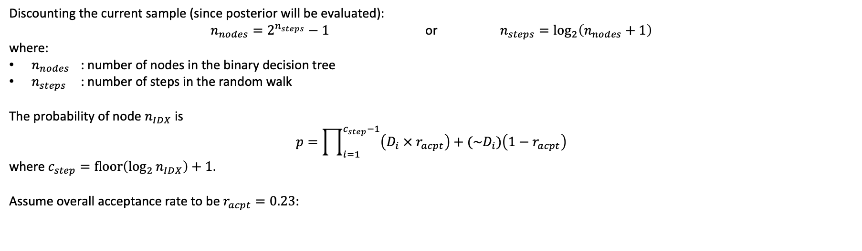
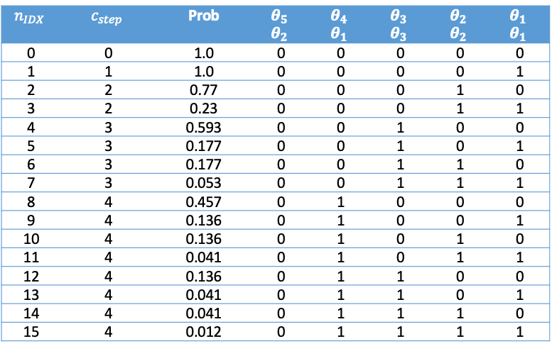
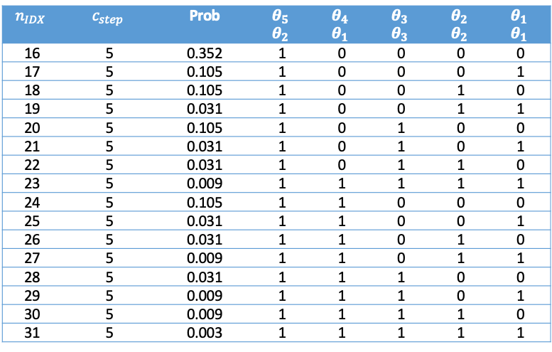
From binary encoding to probabilities
Discounting the current sample (since posterior will be evaluated):
$n_{nodes}=2^{n_{steps}}−1$ or $n_{steps}=\log_{2}\left(n_{nodes}+1\right)$
where:
$n_{nodes}$ : number of nodes in the binary decision tree
$n_{steps}$ : number of steps in the random walk
The probability of node $n_{IDX}$ is
$$p=\prod_{i=1}^{c_{step}−1}{\left(D_{i} × r_{acpt}\right)+(\sim D_{i})\left(1−r_{acpt}\right)}$$
where $c_{step}=\operatorname{floor}\left({\log_{2}{n}}_{IDX}\right)+1$.
Assume overall acceptance rate to be $r_{acpt}=0.23$:
$$n_{IDX}$$ | $$c_{step}$$ | Prob | $$θ_{5}$$ $$θ_{2}$$ | $$θ_{4}$$ $$θ_{1}$$ | $$θ_{3}$$ $$θ_{3}$$ | $$θ_{2}$$ $$θ_{2}$$ | $$θ_{1}$$ $$θ_{1}$$
0 | 0 | 1.0 | 0 | 0 | 0 | 0 | 0
1 | 1 | 1.0 | 0 | 0 | 0 | 0 | 1
2 | 2 | 0.77 | 0 | 0 | 0 | 1 | 0
3 | 2 | 0.23 | 0 | 0 | 0 | 1 | 1
4 | 3 | 0.593 | 0 | 0 | 1 | 0 | 0
5 | 3 | 0.177 | 0 | 0 | 1 | 0 | 1
6 | 3 | 0.177 | 0 | 0 | 1 | 1 | 0
7 | 3 | 0.053 | 0 | 0 | 1 | 1 | 1
8 | 4 | 0.457 | 0 | 1 | 0 | 0 | 0
9 | 4 | 0.136 | 0 | 1 | 0 | 0 | 1
10 | 4 | 0.136 | 0 | 1 | 0 | 1 | 0
11 | 4 | 0.041 | 0 | 1 | 0 | 1 | 1
12 | 4 | 0.136 | 0 | 1 | 1 | 0 | 0
13 | 4 | 0.041 | 0 | 1 | 1 | 0 | 1
14 | 4 | 0.041 | 0 | 1 | 1 | 1 | 0
15 | 4 | 0.012 | 0 | 1 | 1 | 1 | 1
$$n_{IDX}$$ | $$c_{step}$$ | Prob | $$θ_{5}$$ $$θ_{2}$$ | $$θ_{4}$$ $$θ_{1}$$ | $$θ_{3}$$ $$θ_{3}$$ | $$θ_{2}$$ $$θ_{2}$$ | $$θ_{1}$$ $$θ_{1}$$
16 | 5 | 0.352 | 1 | 0 | 0 | 0 | 0
17 | 5 | 0.105 | 1 | 0 | 0 | 0 | 1
18 | 5 | 0.105 | 1 | 0 | 0 | 1 | 0
19 | 5 | 0.031 | 1 | 0 | 0 | 1 | 1
20 | 5 | 0.105 | 1 | 0 | 1 | 0 | 0
21 | 5 | 0.031 | 1 | 0 | 1 | 0 | 1
22 | 5 | 0.031 | 1 | 0 | 1 | 1 | 0
23 | 5 | 0.009 | 1 | 1 | 1 | 1 | 1
24 | 5 | 0.105 | 1 | 1 | 0 | 0 | 0
25 | 5 | 0.031 | 1 | 1 | 0 | 0 | 1
26 | 5 | 0.031 | 1 | 1 | 0 | 1 | 0
27 | 5 | 0.009 | 1 | 1 | 0 | 1 | 1
28 | 5 | 0.031 | 1 | 1 | 1 | 0 | 0
29 | 5 | 0.009 | 1 | 1 | 1 | 0 | 1
30 | 5 | 0.009 | 1 | 1 | 1 | 1 | 0
31 | 5 | 0.003 | 1 | 1 | 1 | 1 | 1

Slide 15
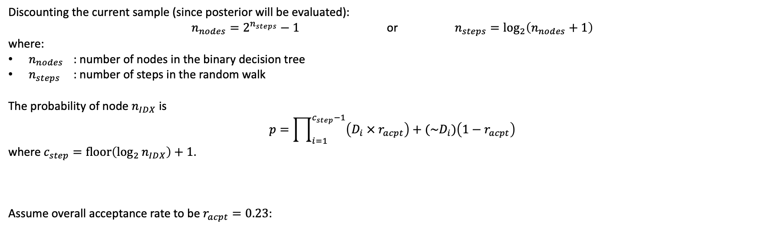
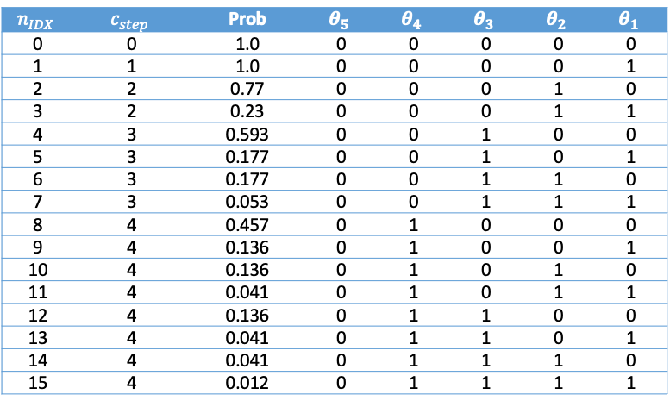
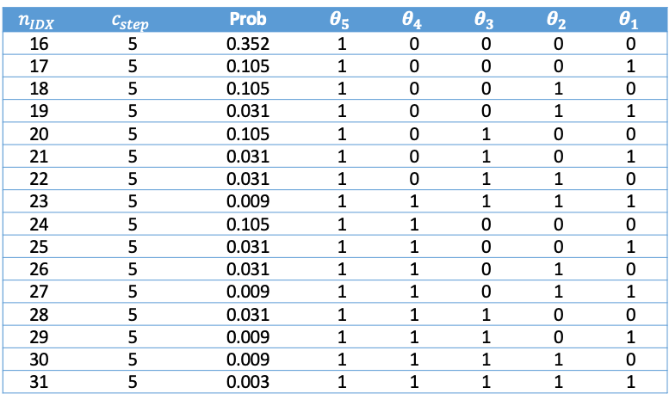
From binary encoding to probabilities
Discounting the current sample (since posterior will be evaluated):
$n_{nodes}=2^{n_{steps}}−1$ or $n_{steps}=\log_{2}\left(n_{nodes}+1\right)$
where:
$n_{nodes}$ : number of nodes in the binary decision tree
$n_{steps}$ : number of steps in the random walk
The probability of node $n_{IDX}$ is
$$p=\prod_{i=1}^{c_{step}−1}{\left(D_{i} × r_{acpt}\right)+(\sim D_{i})\left(1−r_{acpt}\right)}$$
where $c_{step}=\operatorname{floor}\left({\log_{2}{n}}_{IDX}\right)+1$.
Assume overall acceptance rate to be $r_{acpt}=0.23$:
$$n_{IDX}$$ | $$c_{step}$$ | Prob | $$θ_{5}$$ | $$θ_{4}$$ | $$θ_{3}$$ | $$θ_{2}$$ | $$θ_{1}$$
0 | 0 | 1.0 | 0 | 0 | 0 | 0 | 0
1 | 1 | 1.0 | 0 | 0 | 0 | 0 | 1
2 | 2 | 0.77 | 0 | 0 | 0 | 1 | 0
3 | 2 | 0.23 | 0 | 0 | 0 | 1 | 1
4 | 3 | 0.593 | 0 | 0 | 1 | 0 | 0
5 | 3 | 0.177 | 0 | 0 | 1 | 0 | 1
6 | 3 | 0.177 | 0 | 0 | 1 | 1 | 0
7 | 3 | 0.053 | 0 | 0 | 1 | 1 | 1
8 | 4 | 0.457 | 0 | 1 | 0 | 0 | 0
9 | 4 | 0.136 | 0 | 1 | 0 | 0 | 1
10 | 4 | 0.136 | 0 | 1 | 0 | 1 | 0
11 | 4 | 0.041 | 0 | 1 | 0 | 1 | 1
12 | 4 | 0.136 | 0 | 1 | 1 | 0 | 0
13 | 4 | 0.041 | 0 | 1 | 1 | 0 | 1
14 | 4 | 0.041 | 0 | 1 | 1 | 1 | 0
15 | 4 | 0.012 | 0 | 1 | 1 | 1 | 1
$$n_{IDX}$$ | $$c_{step}$$ | Prob | $$θ_{5}$$ | $$θ_{4}$$ | $$θ_{3}$$ | $$θ_{2}$$ | $$θ_{1}$$
16 | 5 | 0.352 | 1 | 0 | 0 | 0 | 0
17 | 5 | 0.105 | 1 | 0 | 0 | 0 | 1
18 | 5 | 0.105 | 1 | 0 | 0 | 1 | 0
19 | 5 | 0.031 | 1 | 0 | 0 | 1 | 1
20 | 5 | 0.105 | 1 | 0 | 1 | 0 | 0
21 | 5 | 0.031 | 1 | 0 | 1 | 0 | 1
22 | 5 | 0.031 | 1 | 0 | 1 | 1 | 0
23 | 5 | 0.009 | 1 | 1 | 1 | 1 | 1
24 | 5 | 0.105 | 1 | 1 | 0 | 0 | 0
25 | 5 | 0.031 | 1 | 1 | 0 | 0 | 1
26 | 5 | 0.031 | 1 | 1 | 0 | 1 | 0
27 | 5 | 0.009 | 1 | 1 | 0 | 1 | 1
28 | 5 | 0.031 | 1 | 1 | 1 | 0 | 0
29 | 5 | 0.009 | 1 | 1 | 1 | 0 | 1
30 | 5 | 0.009 | 1 | 1 | 1 | 1 | 0
31 | 5 | 0.003 | 1 | 1 | 1 | 1 | 1

Slide 16
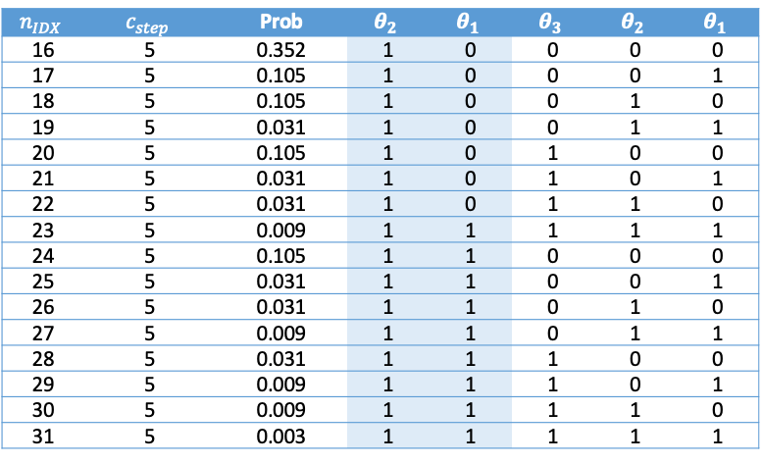

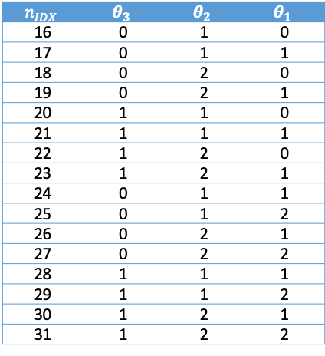
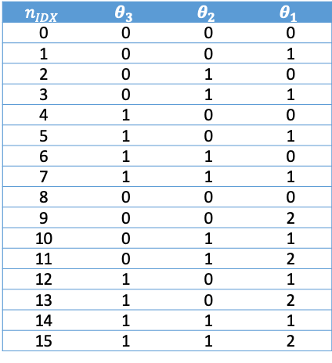
From binary encoding to probabilities
$$n_{IDX}$$ | $$c_{step}$$ | Prob | $$θ_{2}$$ | $$θ_{1}$$ | $$θ_{3}$$ | $$θ_{2}$$ | $$θ_{1}$$
0 | 0 | 1.0 | 0 | 0 | 0 | 0 | 0
1 | 1 | 1.0 | 0 | 0 | 0 | 0 | 1
2 | 2 | 0.77 | 0 | 0 | 0 | 1 | 0
3 | 2 | 0.23 | 0 | 0 | 0 | 1 | 1
4 | 3 | 0.593 | 0 | 0 | 1 | 0 | 0
5 | 3 | 0.177 | 0 | 0 | 1 | 0 | 1
6 | 3 | 0.177 | 0 | 0 | 1 | 1 | 0
7 | 3 | 0.053 | 0 | 0 | 1 | 1 | 1
8 | 4 | 0.457 | 0 | 1 | 0 | 0 | 0
9 | 4 | 0.136 | 0 | 1 | 0 | 0 | 1
10 | 4 | 0.136 | 0 | 1 | 0 | 1 | 0
11 | 4 | 0.041 | 0 | 1 | 0 | 1 | 1
12 | 4 | 0.136 | 0 | 1 | 1 | 0 | 0
13 | 4 | 0.041 | 0 | 1 | 1 | 0 | 1
14 | 4 | 0.041 | 0 | 1 | 1 | 1 | 0
15 | 4 | 0.012 | 0 | 1 | 1 | 1 | 1
$$n_{IDX}$$ | $$θ_{3}$$ | $$θ_{2}$$ | $$θ_{1}$$
0 | 0 | 0 | 0
1 | 0 | 0 | 1
2 | 0 | 1 | 0
3 | 0 | 1 | 1
4 | 1 | 0 | 0
5 | 1 | 0 | 1
6 | 1 | 1 | 0
7 | 1 | 1 | 1
8 | 0 | 0 | 0
9 | 0 | 0 | 2
10 | 0 | 1 | 1
11 | 0 | 1 | 2
12 | 1 | 0 | 1
13 | 1 | 0 | 2
14 | 1 | 1 | 1
15 | 1 | 1 | 2
$$n_{IDX}$$ | $$c_{step}$$ | Prob | $$θ_{2}$$ | $$θ_{1}$$ | $$θ_{3}$$ | $$θ_{2}$$ | $$θ_{1}$$
16 | 5 | 0.352 | 1 | 0 | 0 | 0 | 0
17 | 5 | 0.105 | 1 | 0 | 0 | 0 | 1
18 | 5 | 0.105 | 1 | 0 | 0 | 1 | 0
19 | 5 | 0.031 | 1 | 0 | 0 | 1 | 1
20 | 5 | 0.105 | 1 | 0 | 1 | 0 | 0
21 | 5 | 0.031 | 1 | 0 | 1 | 0 | 1
22 | 5 | 0.031 | 1 | 0 | 1 | 1 | 0
23 | 5 | 0.009 | 1 | 1 | 1 | 1 | 1
24 | 5 | 0.105 | 1 | 1 | 0 | 0 | 0
25 | 5 | 0.031 | 1 | 1 | 0 | 0 | 1
26 | 5 | 0.031 | 1 | 1 | 0 | 1 | 0
27 | 5 | 0.009 | 1 | 1 | 0 | 1 | 1
28 | 5 | 0.031 | 1 | 1 | 1 | 0 | 0
29 | 5 | 0.009 | 1 | 1 | 1 | 0 | 1
30 | 5 | 0.009 | 1 | 1 | 1 | 1 | 0
31 | 5 | 0.003 | 1 | 1 | 1 | 1 | 1
$$n_{IDX}$$ | $$θ_{3}$$ | $$θ_{2}$$ | $$θ_{1}$$
16 | 0 | 1 | 0
17 | 0 | 1 | 1
18 | 0 | 2 | 0
19 | 0 | 2 | 1
20 | 1 | 1 | 0
21 | 1 | 1 | 1
22 | 1 | 2 | 0
23 | 1 | 2 | 1
24 | 0 | 1 | 1
25 | 0 | 1 | 2
26 | 0 | 2 | 1
27 | 0 | 2 | 2
28 | 1 | 1 | 1
29 | 1 | 1 | 2
30 | 1 | 2 | 1
31 | 1 | 2 | 2

Slide 18
Allocation of compute resources
Current sample
Accepted sample
Posterior evaluation request
New sample (one step
of random walk)
Rejected sample
0 0 0 0 0
0 0 0 0 1
0 0 0 0 1
1.00
0 0 0 0 0
0 0 0 1 1
0 0 0 1 0
0.23
0.77
0 0 0 1 1
0 0 0 0 1
0 0 0 1 0
0 0 0 0 0
0 0 1 1 1
0 0 1 0 1
0 0 1 1 0
0 0 1 0 0
0.053
0.177
0.177
0.593
0 0 1 1 1
0 0 0 1 1
0 0 1 0 1
0 0 0 0 1
0 0 1 1 0
0 0 0 1 0
0 0 1 0 0
0 0 0 0 0
0 1 1 1 1
0 1 0 1 1
0 1 1 0 1
0 1 0 0 1
0 1 1 1 0
0 1 0 1 0
0 1 1 0 0
0 1 0 0 0
0.012
0.041
0.041
0.136
0.041
0.136
0.136
0.457
0 1 1 1 1
0 0 1 1 1
0 1 0 1 1
0 0 0 1 1
0 1 1 0 1
0 0 1 0 1
0 1 0 0 1
0 0 0 0 1
0 1 1 1 0
0 0 1 1 0
0 1 0 1 0
0 0 0 1 0
0 1 1 0 0
0 0 1 0 0
0 1 0 0 0
0 0 0 0 0
1 1 1 1 1
1 0 1 1 1
1 1 0 1 1
1 0 0 1 1
1 1 1 0 1
1 0 1 0 1
1 1 0 0 1
1 0 0 0 1
1 1 1 1 0
1 0 1 1 0
1 1 0 1 0
1 0 0 1 0
1 1 1 0 0
1 0 1 0 0
1 1 0 0 0
1 0 0 0 0
0.003
0.009
0.009
0.031
0.009
0.031
0.031
0.105
0.009
0.031
0.031
0.105
0.031
0.105
0.105
0.352
0.0007
0.002
0.002
0.007
0.002
0.007
0.007
0.024
0.002
0.007
0.007
0.024
0.007
0.024
0.024
0.081
0.002
0.007
0.007
0.024
0.007
0.024
0.024
0.081
0.007
0.024
0.024
0.081
0.024
0.081
0.081
0.271

Slide 19
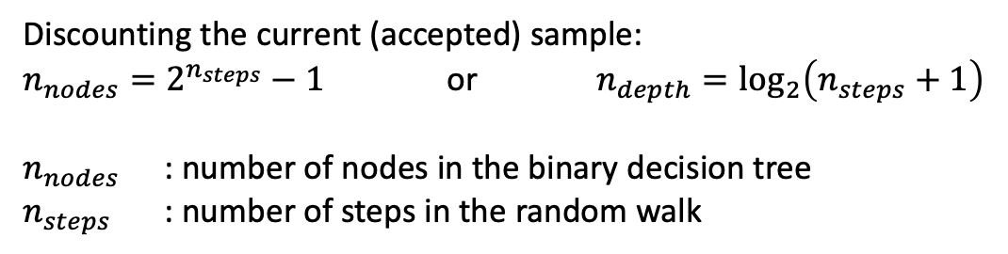
MCMC (cont’d)
Current sample
Accepted sample
Posterior evaluation request
New sample (one step
of random walk)
Rejected sample
Allocated compute resource
0 0 0 0 0
0 0 0 0 1
0 0 0 0 1
1.00
0 0 0 0 0
0 0 0 1 1
0 0 0 1 0
0.23
0.77
0 0 0 1 1
0 0 0 0 1
0 0 0 1 0
0 0 0 0 0
0 0 1 1 1
0 0 1 0 1
0 0 1 1 0
0 0 1 0 0
0.053
0.177
0.177
0.593
0 0 1 1 1
0 0 0 1 1
0 0 1 0 1
0 0 0 0 1
0 0 1 1 0
0 0 0 1 0
0 0 1 0 0
0 0 0 0 0
0 1 1 1 1
0 1 0 1 1
0 1 1 0 1
0 1 0 0 1
0 1 1 1 0
0 1 0 1 0
0 1 1 0 0
0 1 0 0 0
0.012
0.041
0.041
0.136
0.041
0.136
0.136
0.457
0 1 1 1 1
0 0 1 1 1
0 1 0 1 1
0 0 0 1 1
0 1 1 0 1
0 0 1 0 1
0 1 0 0 1
0 0 0 0 1
0 1 1 1 0
0 0 1 1 0
0 1 0 1 0
0 0 0 1 0
0 1 1 0 0
0 0 1 0 0
0 1 0 0 0
0 0 0 0 0
1 1 1 1 1
1 0 1 1 1
1 1 0 1 1
1 0 0 1 1
1 1 1 0 1
1 0 1 0 1
1 1 0 0 1
1 0 0 0 1
1 1 1 1 0
1 0 1 1 0
1 1 0 1 0
1 0 0 1 0
1 1 1 0 0
1 0 1 0 0
1 1 0 0 0
1 0 0 0 0
0.003
0.009
0.009
0.031
0.009
0.031
0.031
0.105
0.009
0.031
0.031
0.105
0.031
0.105
0.105
0.352
0.0007
0.002
0.002
0.007
0.002
0.007
0.007
0.024
0.002
0.007
0.007
0.024
0.007
0.024
0.024
0.081
0.002
0.007
0.007
0.024
0.007
0.024
0.024
0.081
0.007
0.024
0.024
0.081
0.024
0.081
0.081
0.271
Setup:
5 calibration params
8 processors
Probabilities coming from acceptance ratio of 0.23
Discounting the current (accepted) sample:
$n_{nodes}=2^{n_{steps}}−1$ or $n_{depth}=\log_{2}\left(n_{steps}+1\right)$
$n_{nodes}$ : number of nodes in the binary decision tree
$n_{steps}$ : number of steps in the random walk
Accept sample
Busy processor round 1
Reject sample
Busy processor round 2
Loglik. eval. request

Slide 20









MCMC
Backburner: this can be optimized even further with gradient information
$$θ_{1}$$
$$θ_{2}$$
$$θ_{3}$$
$$θ_{4}$$
$$θ_{5}$$
$$θ_{1}$$
Setup:
5 calibration params
10 processors
Accept sample
Busy processor round 1
Reject sample
Busy processor round 2
$$θ_{2}$$
Lik. eval. request
Busy processor round 3
Busy processor round 4
$$θ_{3}$$
4 horizons to start evaluating likelihood in the second iteration
$$θ_{4}$$
$$θ_{5}$$

Slide 21








MCMC (cont’d)
1.00
$$θ_{1}$$
0.23
0.77
$$θ_{2}$$
0.053
0.177
0.177
0.593
$$θ_{3}$$
0.041
0.041
0.136
0.041
0.136
0.136
0.457
0.012
$$θ_{4}$$
0.352
0.003
0.009
0.105
$$θ_{5}$$
0.009
0.031
0.009
0.031
0.0314
0.105
0.009
0.031
0.031
0.031
0.105
0.105
0.081
0.271
$$θ_{1}$$
Setup:
5 calibration params
10 processors
Probabilities coming from acceptance ratio of 0.23
Accept sample
Busy processor round 1
Busy processor round 2
0.048
0.201
Reject sample
$$θ_{2}$$
Loglik. eval. request
0.047
0.161
$$θ_{3}$$
Preference to higher probabilities
0.037
0.124

Slide 22
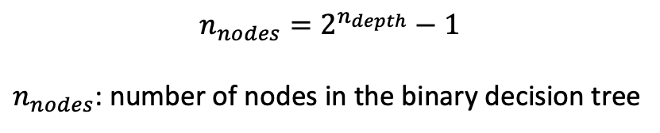
$$n_{nodes}=2^{n_{depth}}−1$$
$n_{nodes}$: number of nodes in the binary decision tree

Slide 23
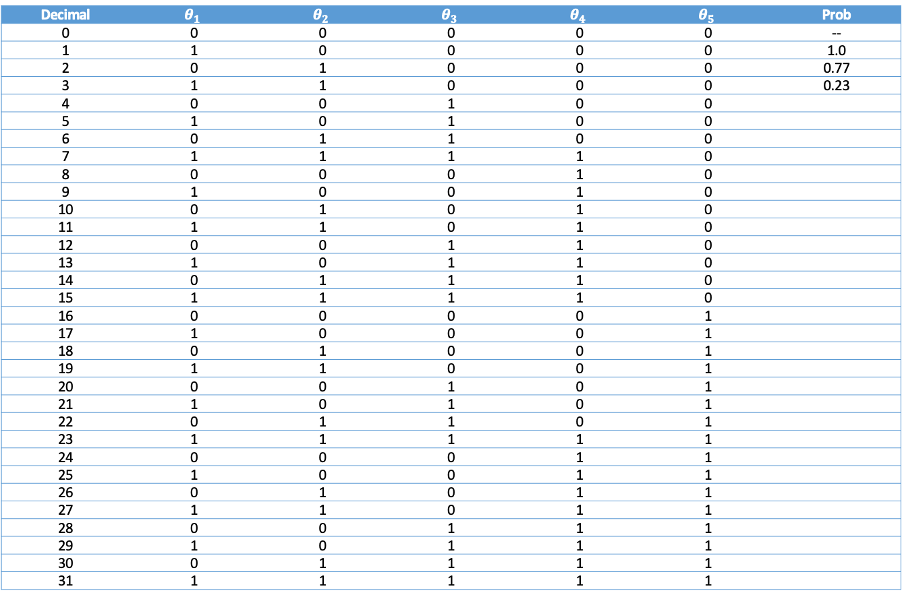
Estimated acceptance rate
Assume overall acceptance rate to be 0.23
Decimal | $$θ_{1}$$ | $$θ_{2}$$ | $$θ_{3}$$ | $$θ_{4}$$ | $$θ_{5}$$ | Prob
0 | 0 | 0 | 0 | 0 | 0 | --
1 | 1 | 0 | 0 | 0 | 0 | 1.0
2 | 0 | 1 | 0 | 0 | 0 | 0.77
3 | 1 | 1 | 0 | 0 | 0 | 0.23
4 | 0 | 0 | 1 | 0 | 0
5 | 1 | 0 | 1 | 0 | 0
6 | 0 | 1 | 1 | 0 | 0
7 | 1 | 1 | 1 | 1 | 0
8 | 0 | 0 | 0 | 1 | 0
9 | 1 | 0 | 0 | 1 | 0
10 | 0 | 1 | 0 | 1 | 0
11 | 1 | 1 | 0 | 1 | 0
12 | 0 | 0 | 1 | 1 | 0
13 | 1 | 0 | 1 | 1 | 0
14 | 0 | 1 | 1 | 1 | 0
15 | 1 | 1 | 1 | 1 | 0
16 | 0 | 0 | 0 | 0 | 1
17 | 1 | 0 | 0 | 0 | 1
18 | 0 | 1 | 0 | 0 | 1
19 | 1 | 1 | 0 | 0 | 1
20 | 0 | 0 | 1 | 0 | 1
21 | 1 | 0 | 1 | 0 | 1
22 | 0 | 1 | 1 | 0 | 1
23 | 1 | 1 | 1 | 1 | 1
24 | 0 | 0 | 0 | 1 | 1
25 | 1 | 0 | 0 | 1 | 1
26 | 0 | 1 | 0 | 1 | 1
27 | 1 | 1 | 0 | 1 | 1
28 | 0 | 0 | 1 | 1 | 1
29 | 1 | 0 | 1 | 1 | 1
30 | 0 | 1 | 1 | 1 | 1
31 | 1 | 1 | 1 | 1 | 1

Slide 24
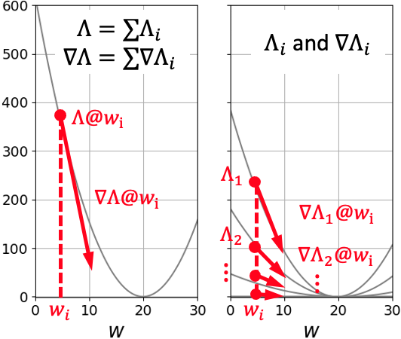
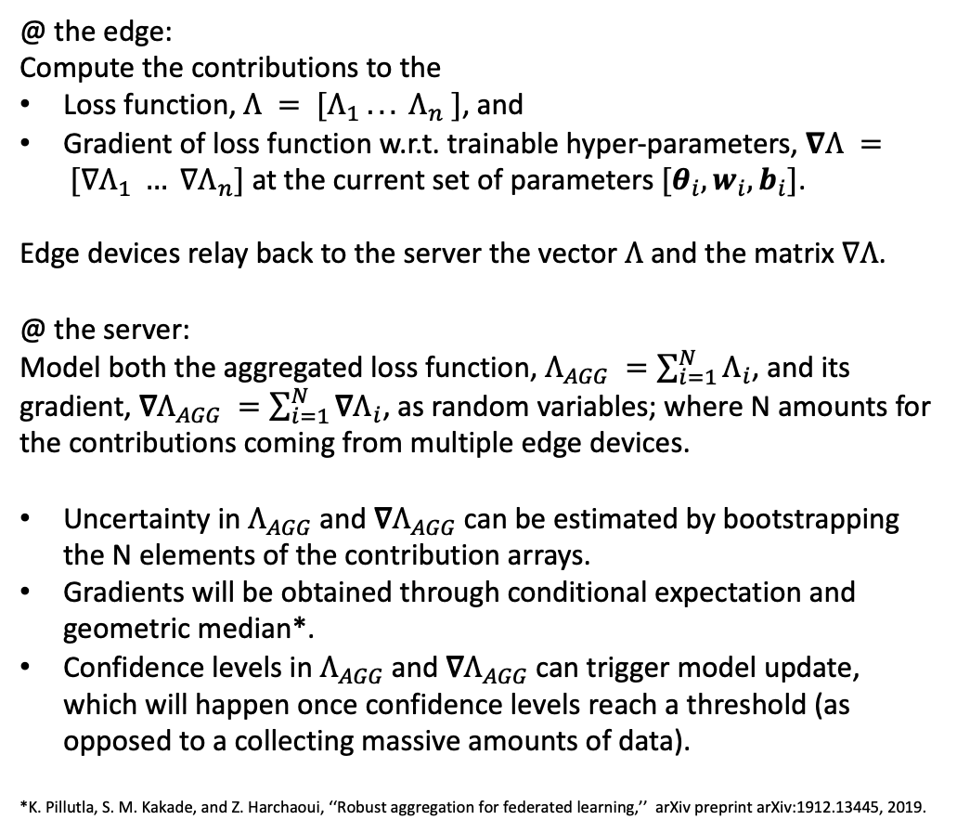
Federated (elastically distributed?) learning
@ the edge:
Compute the contributions to the
Loss function, $Λ = [Λ_{1} .. . Λ_{n} ]$, and
Gradient of loss function w.r.t. trainable hyper-parameters, $∇Λ = [∇Λ_{1} … ∇Λ_{n}]$ at the current set of parameters $[θ_{i}, w_{i}, b_{i}]$.
Edge devices relay back to the server the vector $Λ$ and the matrix $∇Λ$.
@ the server:
Model both the aggregated loss function, $Λ_{AGG} =\sum_{i=1}^{N}{Λ_{i}}$, and its gradient, $\text{∇}Λ_{AGG} =\sum_{i=1}^{N}{\text{∇}Λ_{i}}$, as random variables; where N amounts for the contributions coming from multiple edge devices.
Uncertainty in $Λ_{AGG}$and $\text{∇}Λ_{AGG}$can be estimated by bootstrapping the N elements of the contribution arrays.
Gradients will be obtained through conditional expectation and geometric median*.
Confidence levels in $Λ_{AGG}$and $\text{∇}Λ_{AGG}$can trigger model update, which will happen once confidence levels reach a threshold (as opposed to a collecting massive amounts of data).
*K. Pillutla, S. M. Kakade, and Z. Harchaoui, ‘‘Robust aggregation for federated learning,’’ arXiv preprint arXiv:1912.13445, 2019.

Slide 26
Encoding the steps in “binary” numbers
Current sample
Accepted sample
Posterior evaluation request
New sample (one step
of random walk)
Rejected sample
0 0 0
0
Steps
0 0 1
1
1
0 0 1
1.00
0 0 0
0 1 1
3
0 1 0
2
2
0.23
0.77
0 1 1
0 0 1
0 1 0
0 0 0
1 1 1
7
1 0 1
5
1 1 0
6
1 0 0
4
3
0.053
0.177
0.177
0.593
1 1 1
0 1 1
1 0 1
0 0 1
1 1 0
0 1 0
1 0 0
0 0 0
1 1 2
15
0 1 2
11
1 0 2
13
0 0 2
9
1 1 1
14
0 1 1
10
1 0 1
12
0 0 1
8
4
0.012
0.041
0.041
0.136
0.041
0.136
0.136
0.457
1 1 2
1 1 1
0 1 2
0 1 1
1 0 2
1 0 1
0 0 2
0 0 1
1 1 1
1 1 0
0 1 1
0 1 0
1 0 1
1 0 0
0 0 1
0 0 0
1 2 2
31
23
27
19
21
25
17
30
22
26
18
28
20
24
16
1 2 1
0 2 2
0 2 1
1 1 2
1 1 1
0 1 2
0 1 1
1 2 1
1 2 0
0 2 1
0 2 0
1 1 1
1 1 0
0 1 1
0 1 0
29
5
0.003
0.009
0.009
0.031
0.009
0.031
0.031
0.105
0.009
0.031
0.031
0.105
0.031
0.105
0.105
0.352
Observations:
3 bits are needed to encode 3 random variables.
Multiple steps can be encoded by simple increments

