Slide 1
2022-2023 Ideas

Slide 2
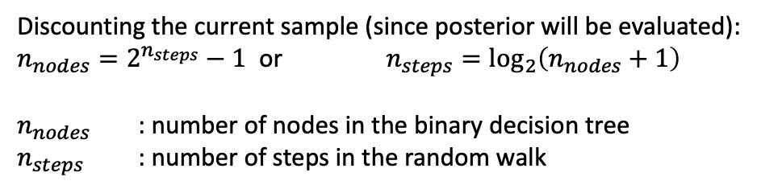
Binary decision tree: 6 steps
Current sample
Accepted sample
Posterior evaluation request
New sample (one step
of random walk)
Rejected sample
Assuming acceptance rate of 23%
Steps
1
1.00
2
0.23
0.77
3
0.053
0.177
0.177
0.593
4
0.012
0.041
0.041
0.136
0.041
0.136
0.136
0.457
5
0.003
0.009
0.009
0.031
0.009
0.031
0.031
0.105
0.009
0.031
0.031
0.105
0.031
0.105
0.105
0.352
6
0.0007
0.002
0.002
0.007
0.002
0.007
0.007
0.024
0.002
0.007
0.007
0.024
0.007
0.024
0.024
0.081
0.002
0.007
0.007
0.024
0.007
0.024
0.024
0.081
0.007
0.024
0.024
0.081
0.024
0.081
0.081
0.271
Discounting the current sample (since posterior will be evaluated):
$n_{nodes}=2^{n_{steps}}−1$ or $n_{steps}=\log_{2}\left(n_{nodes}+1\right)$
$n_{nodes}$ : number of nodes in the binary decision tree
$n_{steps}$ : number of steps in the random walk

Slide 3
Allocation of compute resources
Current sample
Accepted sample
Posterior evaluation request
New sample (one step
of random walk)
Rejected sample
Assuming 7 compute nodes are available
Steps
1
1.00
2
0.23
0.77
3
0.053
0.177
0.177
0.593
4
0.012
0.041
0.041
0.136
0.041
0.136
0.136
0.457
5
0.003
0.009
0.009
0.031
0.009
0.031
0.031
0.105
0.009
0.031
0.031
0.105
0.031
0.105
0.105
0.352
6
0.0007
0.002
0.002
0.007
0.002
0.007
0.007
0.024
0.002
0.007
0.007
0.024
0.007
0.024
0.024
0.081
0.002
0.007
0.007
0.024
0.007
0.024
0.024
0.081
0.007
0.024
0.024
0.081
0.024
0.081
0.081
0.271
Compute node allocated based on probabilities
Compute node allocated based on depth of the tree

Slide 4
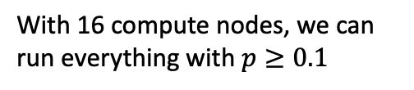
Allocation of compute resources
Current sample
Accepted sample
Posterior evaluation request
New sample (one step
of random walk)
Rejected sample
With 16 compute nodes, we can run everything with $p≥0.1$
1.00
0.23
0.77
0.053
0.177
0.177
0.593
0.012
0.041
0.041
0.136
0.041
0.136
0.136
0.457
0.003
0.009
0.009
0.031
0.009
0.031
0.031
0.105
0.009
0.031
0.031
0.105
0.031
0.105
0.105
0.352
0.0007
0.002
0.002
0.007
0.002
0.007
0.007
0.024
0.002
0.007
0.007
0.024
0.007
0.024
0.024
0.081
0.002
0.007
0.007
0.024
0.007
0.024
0.024
0.081
0.007
0.024
0.024
0.081
0.024
0.081
0.081
0.271
Compute node allocated based on probabilities
Compute node allocated based on depth of the tree

Slide 5
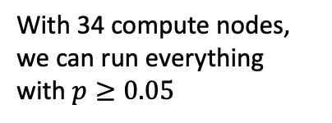
Allocation of compute resources
Current sample
Accepted sample
Posterior evaluation request
New sample (one step
of random walk)
Rejected sample
Allocated compute node
With 34 compute nodes, we can run everything with $p≥0.05$
1.00
0.23
0.77
0.053
0.177
0.177
0.593
0.012
0.041
0.041
0.136
0.041
0.136
0.136
0.457
0.209
0.031
0.105
0.031
0.105
0.031
0.105
0.105
0.352
0.048
0.161
0.037
0.124
0.024
0.081
0.024
0.081
0.024
0.081
0.024
0.081
0.081
0.271
0.029
0.095
0.022
0.073
0.062
0.062
0.062
0.062
0.062
0.062
0.019
0.019
0.017
0.056

Slide 6
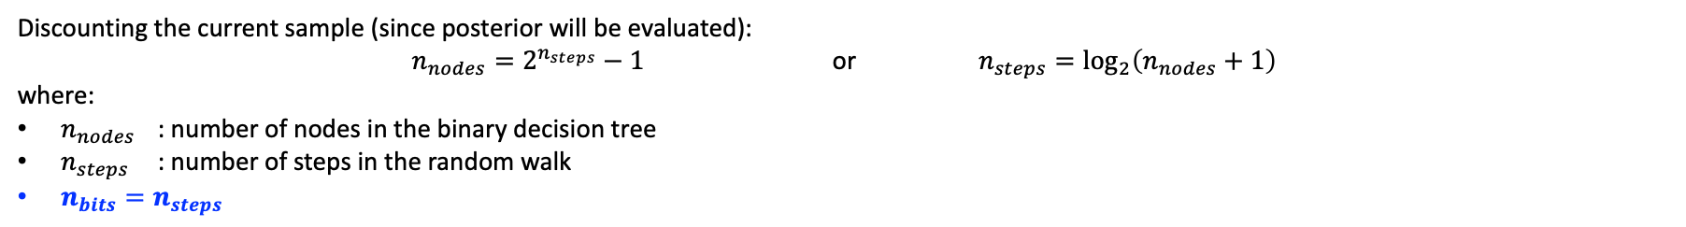
Encoding nodes using binary numbers
Current sample
Accepted sample
Posterior evaluation request
New sample (one step
of random walk)
Rejected sample
0 0 0 0 0
0
Steps
0 0 0 0 1
1
1
0 0 0 0 1
1.00
0 0 0 0 0
0 0 0 1 1
3
0 0 0 1 0
2
2
0.23
0.77
0 0 0 1 1
0 0 0 0 1
0 0 0 1 0
0 0 0 0 0
0 0 1 1 1
7
0 0 1 0 1
5
0 0 1 1 0
6
0 0 1 0 0
4
3
0.053
0.177
0.177
0.593
0 0 1 1 1
0 0 0 1 1
0 0 1 0 1
0 0 0 0 1
0 0 1 1 0
0 0 0 1 0
0 0 1 0 0
0 0 0 0 0
0 1 1 1 1
15
0 1 0 1 1
11
0 1 1 0 1
13
0 1 0 0 1
9
0 1 1 1 0
14
0 1 0 1 0
10
0 1 1 0 0
12
0 1 0 0 0
8
4
0.012
0.041
0.041
0.136
0.041
0.136
0.136
0.457
0 1 1 1 1
0 0 1 1 1
0 1 0 1 1
0 0 0 1 1
0 1 1 0 1
0 0 1 0 1
0 1 0 0 1
0 0 0 0 1
0 1 1 1 0
0 0 1 1 0
0 1 0 1 0
0 0 0 1 0
0 1 1 0 0
0 0 1 0 0
0 1 0 0 0
0 0 0 0 0
1 1 1 1 1
31
23
27
19
21
25
17
30
22
26
18
28
20
24
16
1 0 1 1 1
1 1 0 1 1
1 0 0 1 1
1 1 1 0 1
1 0 1 0 1
1 1 0 0 1
1 0 0 0 1
1 1 1 1 0
1 0 1 1 0
1 1 0 1 0
1 0 0 1 0
1 1 1 0 0
1 0 1 0 0
1 1 0 0 0
1 0 0 0 0
29
5
0.003
0.009
0.009
0.031
0.009
0.031
0.031
0.105
0.009
0.031
0.031
0.105
0.031
0.105
0.105
0.352
Discounting the current sample (since posterior will be evaluated):
$n_{nodes}=2^{n_{steps}}−1$ or $n_{steps}=\log_{2}\left(n_{nodes}+1\right)$
where:
$n_{nodes}$ : number of nodes in the binary decision tree
$n_{steps}$ : number of steps in the random walk
$n_{bits}=n_{steps}$

Slide 7
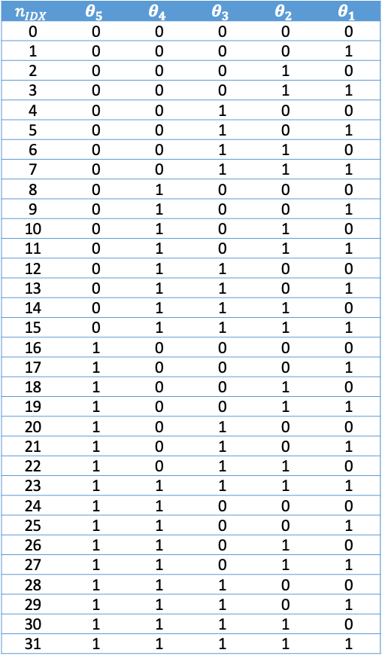
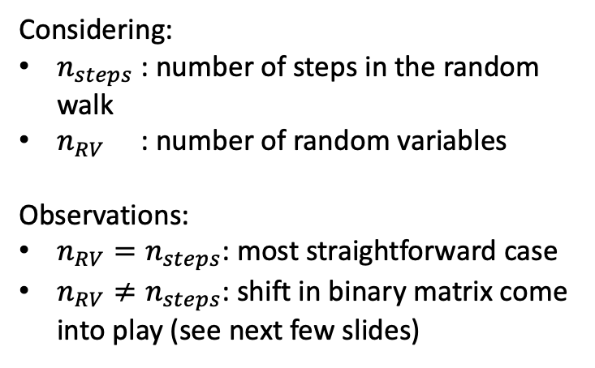
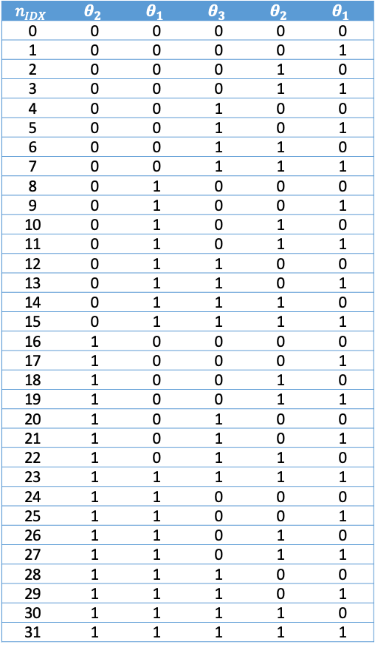
Tying the number of steps and random variables
(a) Number random variables and steps are the same
(b) Number of random variables is different than number of steps
$$n_{IDX}$$ | $$θ_{5}$$ | $$θ_{4}$$ | $$θ_{3}$$ | $$θ_{2}$$ | $$θ_{1}$$
0 | 0 | 0 | 0 | 0 | 0
1 | 0 | 0 | 0 | 0 | 1
2 | 0 | 0 | 0 | 1 | 0
3 | 0 | 0 | 0 | 1 | 1
4 | 0 | 0 | 1 | 0 | 0
5 | 0 | 0 | 1 | 0 | 1
6 | 0 | 0 | 1 | 1 | 0
7 | 0 | 0 | 1 | 1 | 1
8 | 0 | 1 | 0 | 0 | 0
9 | 0 | 1 | 0 | 0 | 1
10 | 0 | 1 | 0 | 1 | 0
11 | 0 | 1 | 0 | 1 | 1
12 | 0 | 1 | 1 | 0 | 0
13 | 0 | 1 | 1 | 0 | 1
14 | 0 | 1 | 1 | 1 | 0
15 | 0 | 1 | 1 | 1 | 1
16 | 1 | 0 | 0 | 0 | 0
17 | 1 | 0 | 0 | 0 | 1
18 | 1 | 0 | 0 | 1 | 0
19 | 1 | 0 | 0 | 1 | 1
20 | 1 | 0 | 1 | 0 | 0
21 | 1 | 0 | 1 | 0 | 1
22 | 1 | 0 | 1 | 1 | 0
23 | 1 | 1 | 1 | 1 | 1
24 | 1 | 1 | 0 | 0 | 0
25 | 1 | 1 | 0 | 0 | 1
26 | 1 | 1 | 0 | 1 | 0
27 | 1 | 1 | 0 | 1 | 1
28 | 1 | 1 | 1 | 0 | 0
29 | 1 | 1 | 1 | 0 | 1
30 | 1 | 1 | 1 | 1 | 0
31 | 1 | 1 | 1 | 1 | 1
$$n_{IDX}$$ | $$θ_{2}$$ | $$θ_{1}$$ | $$θ_{3}$$ | $$θ_{2}$$ | $$θ_{1}$$
0 | 0 | 0 | 0 | 0 | 0
1 | 0 | 0 | 0 | 0 | 1
2 | 0 | 0 | 0 | 1 | 0
3 | 0 | 0 | 0 | 1 | 1
4 | 0 | 0 | 1 | 0 | 0
5 | 0 | 0 | 1 | 0 | 1
6 | 0 | 0 | 1 | 1 | 0
7 | 0 | 0 | 1 | 1 | 1
8 | 0 | 1 | 0 | 0 | 0
9 | 0 | 1 | 0 | 0 | 1
10 | 0 | 1 | 0 | 1 | 0
11 | 0 | 1 | 0 | 1 | 1
12 | 0 | 1 | 1 | 0 | 0
13 | 0 | 1 | 1 | 0 | 1
14 | 0 | 1 | 1 | 1 | 0
15 | 0 | 1 | 1 | 1 | 1
16 | 1 | 0 | 0 | 0 | 0
17 | 1 | 0 | 0 | 0 | 1
18 | 1 | 0 | 0 | 1 | 0
19 | 1 | 0 | 0 | 1 | 1
20 | 1 | 0 | 1 | 0 | 0
21 | 1 | 0 | 1 | 0 | 1
22 | 1 | 0 | 1 | 1 | 0
23 | 1 | 1 | 1 | 1 | 1
24 | 1 | 1 | 0 | 0 | 0
25 | 1 | 1 | 0 | 0 | 1
26 | 1 | 1 | 0 | 1 | 0
27 | 1 | 1 | 0 | 1 | 1
28 | 1 | 1 | 1 | 0 | 0
29 | 1 | 1 | 1 | 0 | 1
30 | 1 | 1 | 1 | 1 | 0
31 | 1 | 1 | 1 | 1 | 1
Considering:
$n_{steps}$ : number of steps in the random walk
$n_{RV}$ : number of random variables
Observations:
$n_{RV}=n_{steps}$: most straightforward case
$n_{RV}≠n_{steps}$: shift in binary matrix come into play (see next few slides)

Slide 8
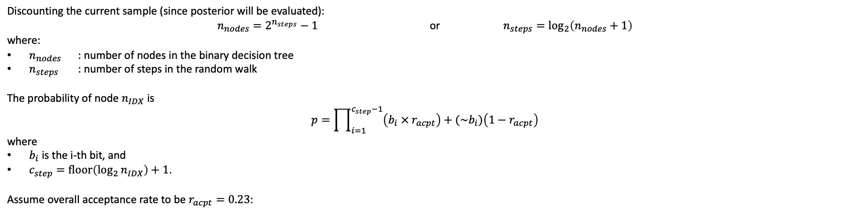
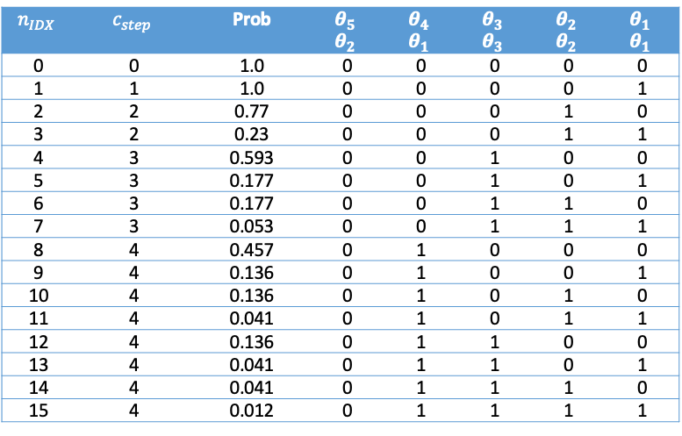
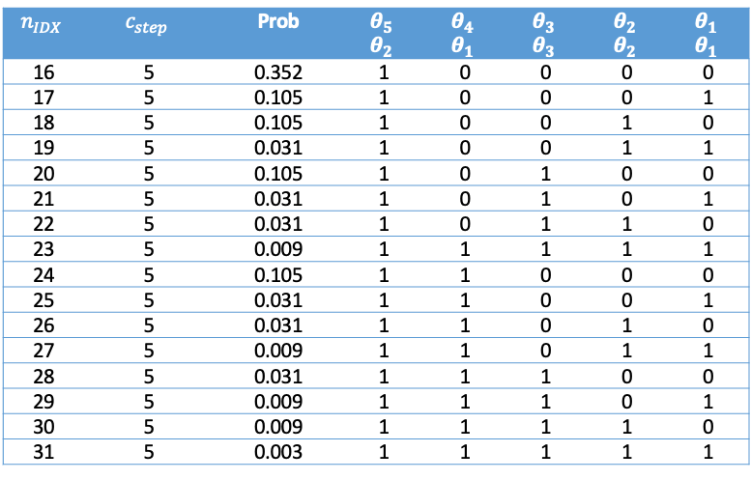
From binary encoding to probabilities
Discounting the current sample (since posterior will be evaluated):
$n_{nodes}=2^{n_{steps}}−1$ or $n_{steps}=\log_{2}\left(n_{nodes}+1\right)$
where:
$n_{nodes}$ : number of nodes in the binary decision tree
$n_{steps}$ : number of steps in the random walk
The probability of node $n_{IDX}$ is
$$p=\prod_{i=1}^{c_{step}−1}{\left(b_{i} × r_{acpt}\right)+(\sim b_{i})\left(1−r_{acpt}\right)}$$
where
$b_{i}$ is the i-th bit, and
$c_{step}=\operatorname{floor}\left({\log_{2}{n}}_{IDX}\right)+1$.
Assume overall acceptance rate to be $r_{acpt}=0.23$:
$$n_{IDX}$$ | $$c_{step}$$ | Prob | $$θ_{5}$$ $$θ_{2}$$ | $$θ_{4}$$ $$θ_{1}$$ | $$θ_{3}$$ $$θ_{3}$$ | $$θ_{2}$$ $$θ_{2}$$ | $$θ_{1}$$ $$θ_{1}$$
0 | 0 | 1.0 | 0 | 0 | 0 | 0 | 0
1 | 1 | 1.0 | 0 | 0 | 0 | 0 | 1
2 | 2 | 0.77 | 0 | 0 | 0 | 1 | 0
3 | 2 | 0.23 | 0 | 0 | 0 | 1 | 1
4 | 3 | 0.593 | 0 | 0 | 1 | 0 | 0
5 | 3 | 0.177 | 0 | 0 | 1 | 0 | 1
6 | 3 | 0.177 | 0 | 0 | 1 | 1 | 0
7 | 3 | 0.053 | 0 | 0 | 1 | 1 | 1
8 | 4 | 0.457 | 0 | 1 | 0 | 0 | 0
9 | 4 | 0.136 | 0 | 1 | 0 | 0 | 1
10 | 4 | 0.136 | 0 | 1 | 0 | 1 | 0
11 | 4 | 0.041 | 0 | 1 | 0 | 1 | 1
12 | 4 | 0.136 | 0 | 1 | 1 | 0 | 0
13 | 4 | 0.041 | 0 | 1 | 1 | 0 | 1
14 | 4 | 0.041 | 0 | 1 | 1 | 1 | 0
15 | 4 | 0.012 | 0 | 1 | 1 | 1 | 1
$$n_{IDX}$$ | $$c_{step}$$ | Prob | $$θ_{5}$$ $$θ_{2}$$ | $$θ_{4}$$ $$θ_{1}$$ | $$θ_{3}$$ $$θ_{3}$$ | $$θ_{2}$$ $$θ_{2}$$ | $$θ_{1}$$ $$θ_{1}$$
16 | 5 | 0.352 | 1 | 0 | 0 | 0 | 0
17 | 5 | 0.105 | 1 | 0 | 0 | 0 | 1
18 | 5 | 0.105 | 1 | 0 | 0 | 1 | 0
19 | 5 | 0.031 | 1 | 0 | 0 | 1 | 1
20 | 5 | 0.105 | 1 | 0 | 1 | 0 | 0
21 | 5 | 0.031 | 1 | 0 | 1 | 0 | 1
22 | 5 | 0.031 | 1 | 0 | 1 | 1 | 0
23 | 5 | 0.009 | 1 | 1 | 1 | 1 | 1
24 | 5 | 0.105 | 1 | 1 | 0 | 0 | 0
25 | 5 | 0.031 | 1 | 1 | 0 | 0 | 1
26 | 5 | 0.031 | 1 | 1 | 0 | 1 | 0
27 | 5 | 0.009 | 1 | 1 | 0 | 1 | 1
28 | 5 | 0.031 | 1 | 1 | 1 | 0 | 0
29 | 5 | 0.009 | 1 | 1 | 1 | 0 | 1
30 | 5 | 0.009 | 1 | 1 | 1 | 1 | 0
31 | 5 | 0.003 | 1 | 1 | 1 | 1 | 1

Slide 9
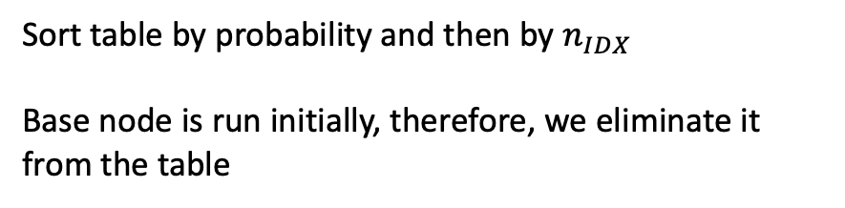
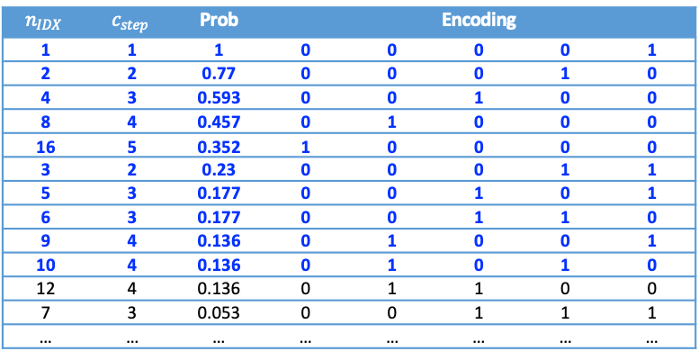
Selecting nodes to run
Current sample
Accepted sample
Posterior evaluation request
New sample (one step
of random walk)
Rejected sample
Allocated compute node
With 10 compute nodes available
0 0 0 0 0
0
Steps
0 0 0 0 1
1
1
0 0 0 0 1
1.00
0 0 0 0 0
0 0 0 1 1
3
0 0 0 1 0
2
2
0.23
0.77
0 0 0 1 1
0 0 0 0 1
0 0 0 1 0
0 0 0 0 0
0 0 1 1 1
7
0 0 1 0 1
5
0 0 1 1 0
6
0 0 1 0 0
4
3
0.053
0.177
0.177
0.593
0 0 1 1 1
0 0 0 1 1
0 0 1 0 1
0 0 0 0 1
0 0 1 1 0
0 0 0 1 0
0 0 1 0 0
0 0 0 0 0
0 1 1 1 1
15
0 1 0 1 1
11
0 1 1 0 1
13
0 1 0 0 1
9
0 1 1 1 0
14
0 1 0 1 0
10
0 1 1 0 0
12
0 1 0 0 0
8
4
0.012
0.041
0.041
0.136
0.041
0.136
0.136
0.457
0 1 1 1 1
0 0 1 1 1
0 1 0 1 1
0 0 0 1 1
0 1 1 0 1
0 0 1 0 1
0 1 0 0 1
0 0 0 0 1
0 1 1 1 0
0 0 1 1 0
0 1 0 1 0
0 0 0 1 0
0 1 1 0 0
0 0 1 0 0
0 1 0 0 0
0 0 0 0 0
1 1 1 1 1
31
23
27
19
21
25
17
30
22
26
18
28
20
24
16
1 0 1 1 1
1 1 0 1 1
1 0 0 1 1
1 1 1 0 1
1 0 1 0 1
1 1 0 0 1
1 0 0 0 1
1 1 1 1 0
1 0 1 1 0
1 1 0 1 0
1 0 0 1 0
1 1 1 0 0
1 0 1 0 0
1 1 0 0 0
1 0 0 0 0
29
5
0.003
0.009
0.009
0.031
0.009
0.031
0.031
0.105
0.009
0.031
0.031
0.105
0.031
0.105
0.105
0.352
$$n_{IDX}$$ | $$c_{step}$$ | Prob | Encoding
1 | 1 | 1 | 0 | 0 | 0 | 0 | 1
2 | 2 | 0.77 | 0 | 0 | 0 | 1 | 0
4 | 3 | 0.593 | 0 | 0 | 1 | 0 | 0
8 | 4 | 0.457 | 0 | 1 | 0 | 0 | 0
16 | 5 | 0.352 | 1 | 0 | 0 | 0 | 0
3 | 2 | 0.23 | 0 | 0 | 0 | 1 | 1
5 | 3 | 0.177 | 0 | 0 | 1 | 0 | 1
6 | 3 | 0.177 | 0 | 0 | 1 | 1 | 0
9 | 4 | 0.136 | 0 | 1 | 0 | 0 | 1
10 | 4 | 0.136 | 0 | 1 | 0 | 1 | 0
12 | 4 | 0.136 | 0 | 1 | 1 | 0 | 0
7 | 3 | 0.053 | 0 | 0 | 1 | 1 | 1
… | … | … | … | … | … | … | …
Sort table by probability and then by $n_{IDX}$
Base node is run initially, therefore, we eliminate it from the table

Slide 10
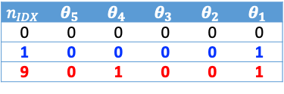
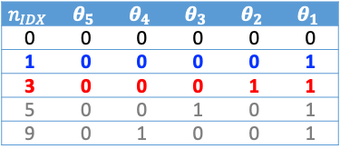
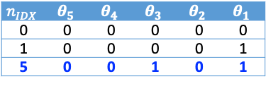
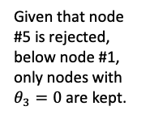
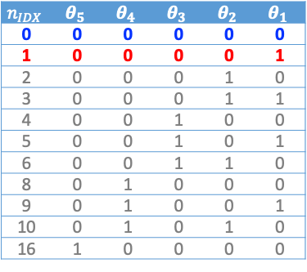



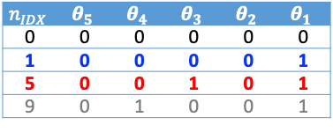


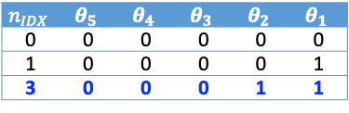

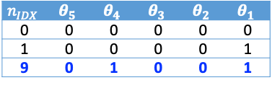
Running through the pruned decision tree
#3 gets accepted
Ready for next iteration
#1 vs #0
$$n_{IDX}$$ | $$θ_{5}$$ | $$θ_{4}$$ | $$θ_{3}$$ | $$θ_{2}$$ | $$θ_{1}$$
0 | 0 | 0 | 0 | 0 | 0
1 | 0 | 0 | 0 | 0 | 1
3 | 0 | 0 | 0 | 1 | 1
Given that node #3 is accepted, below node #3, only nodes with $θ_{2}=1$ are kept.
#3 vs #1
#3 gets rejected
#5 vs #1
#5 vs #1
$$n_{IDX}$$ | $$θ_{5}$$ | $$θ_{4}$$ | $$θ_{3}$$ | $$θ_{2}$$ | $$θ_{1}$$
0 | 0 | 0 | 0 | 0 | 0
1 | 0 | 0 | 0 | 0 | 1
5 | 0 | 0 | 1 | 0 | 1
9 | 0 | 1 | 0 | 0 | 1
Given that node #3 is rejected, below node #1, only nodes with $θ_{2}=0$ are kept.
#9 vs #1
#5 gets accepted
#5 gets rejected
Ready for next iteration
#9 vs #1
$$n_{IDX}$$ | $$θ_{5}$$ | $$θ_{4}$$ | $$θ_{3}$$ | $$θ_{2}$$ | $$θ_{1}$$
0 | 0 | 0 | 0 | 0 | 0
1 | 0 | 0 | 0 | 0 | 1
5 | 0 | 0 | 1 | 0 | 1
$$n_{IDX}$$ | $$θ_{5}$$ | $$θ_{4}$$ | $$θ_{3}$$ | $$θ_{2}$$ | $$θ_{1}$$
0 | 0 | 0 | 0 | 0 | 0
1 | 0 | 0 | 0 | 0 | 1
9 | 0 | 1 | 0 | 0 | 1
Given that node #5 is rejected, below node #1, only nodes with $θ_{3}=0$ are kept.
#1 vs #0
#1 gets accepted
#3 vs #1
$$n_{IDX}$$ | $$θ_{5}$$ | $$θ_{4}$$ | $$θ_{3}$$ | $$θ_{2}$$ | $$θ_{1}$$
0 | 0 | 0 | 0 | 0 | 0
1 | 0 | 0 | 0 | 0 | 1
2 | 0 | 0 | 0 | 1 | 0
3 | 0 | 0 | 0 | 1 | 1
4 | 0 | 0 | 1 | 0 | 0
5 | 0 | 0 | 1 | 0 | 1
6 | 0 | 0 | 1 | 1 | 0
8 | 0 | 1 | 0 | 0 | 0
9 | 0 | 1 | 0 | 0 | 1
10 | 0 | 1 | 0 | 1 | 0
16 | 1 | 0 | 0 | 0 | 0
$$n_{IDX}$$ | $$θ_{5}$$ | $$θ_{4}$$ | $$θ_{3}$$ | $$θ_{2}$$ | $$θ_{1}$$
0 | 0 | 0 | 0 | 0 | 0
1 | 0 | 0 | 0 | 0 | 1
3 | 0 | 0 | 0 | 1 | 1
5 | 0 | 0 | 1 | 0 | 1
9 | 0 | 1 | 0 | 0 | 1
Given that node #5 is accepted, below node #5, only nodes with $θ_{3}=1$ are kept.
#9 gets accepted
#9 gets rejected
Ready for next iteration
Ready for next iteration
Given that node #1 is accepted, below node#1, only nodes with $θ_{1}=1$ are kept.
$$n_{IDX}$$ | $$θ_{5}$$ | $$θ_{4}$$ | $$θ_{3}$$ | $$θ_{2}$$ | $$θ_{1}$$
0 | 0 | 0 | 0 | 0 | 0
1 | 0 | 0 | 0 | 0 | 1
9 | 0 | 1 | 0 | 0 | 1
$$n_{IDX}$$ | $$θ_{5}$$ | $$θ_{4}$$ | $$θ_{3}$$ | $$θ_{2}$$ | $$θ_{1}$$
0 | 0 | 0 | 0 | 0 | 0
1 | 0 | 0 | 0 | 0 | 1
Given that node #9 is rejected, below node #1, only nodes with $θ_{4}=0$ are kept.
Color-coding for tables:
Blue: current sample that is already accepted (part of the chain)
Red: current sample that is being checked and can be either accepted or rejected
Black: samples that have been already accepted and are part of the chain
Gray: samples that remain to be checked

Slide 11
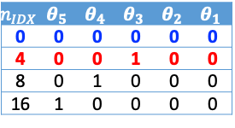

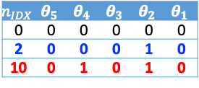
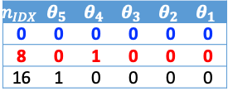
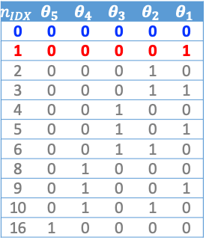

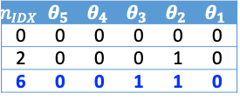

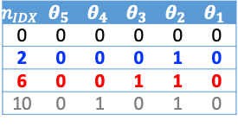

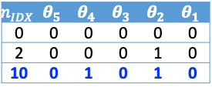
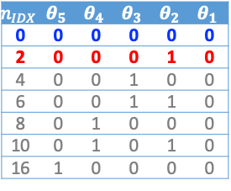


Running through the pruned decision tree (cont’d)
#2 gets accepted
#6 vs #2
#10 vs #6
#1 vs #0
#6 gets rejected
$$n_{IDX}$$ | $$θ_{5}$$ | $$θ_{4}$$ | $$θ_{3}$$ | $$θ_{2}$$ | $$θ_{1}$$
0 | 0 | 0 | 0 | 0 | 0
2 | 0 | 0 | 0 | 1 | 0
6 | 0 | 0 | 1 | 1 | 0
10 | 0 | 1 | 0 | 1 | 0
$$n_{IDX}$$ | $$θ_{5}$$ | $$θ_{4}$$ | $$θ_{3}$$ | $$θ_{2}$$ | $$θ_{1}$$
0 | 0 | 0 | 0 | 0 | 0
2 | 0 | 0 | 0 | 1 | 0
10 | 0 | 1 | 0 | 1 | 0
#2 vs #0
#6 gets accepted
#10 gets accepted
#10 gets rejected
#4 vs #0
Ready for next iteration
Ready for next iteration
#6 vs #2
Ready for next iteration
$$n_{IDX}$$ | $$θ_{5}$$ | $$θ_{4}$$ | $$θ_{3}$$ | $$θ_{2}$$ | $$θ_{1}$$
0 | 0 | 0 | 0 | 0 | 0
2 | 0 | 0 | 0 | 1 | 0
6 | 0 | 0 | 1 | 1 | 0
$$n_{IDX}$$ | $$θ_{5}$$ | $$θ_{4}$$ | $$θ_{3}$$ | $$θ_{2}$$ | $$θ_{1}$$
0 | 0 | 0 | 0 | 0 | 0
2 | 0 | 0 | 0 | 1 | 0
10 | 0 | 1 | 0 | 1 | 0
$$n_{IDX}$$ | $$θ_{5}$$ | $$θ_{4}$$ | $$θ_{3}$$ | $$θ_{2}$$ | $$θ_{1}$$
0 | 0 | 0 | 0 | 0 | 0
2 | 0 | 0 | 0 | 1 | 0
#10 vs #2
#8 vs #0
#16 vs #0
#2 gets rejected
#4 vs #0
#4 gets rejected
#8 vs #0
#16 vs #0
$$n_{IDX}$$ | $$θ_{5}$$ | $$θ_{4}$$ | $$θ_{3}$$ | $$θ_{2}$$ | $$θ_{1}$$
0 | 0 | 0 | 0 | 0 | 0
4 | 0 | 0 | 1 | 0 | 0
8 | 0 | 1 | 0 | 0 | 0
16 | 1 | 0 | 0 | 0 | 0
$$n_{IDX}$$ | $$θ_{5}$$ | $$θ_{4}$$ | $$θ_{3}$$ | $$θ_{2}$$ | $$θ_{1}$$
0 | 0 | 0 | 0 | 0 | 0
8 | 0 | 1 | 0 | 0 | 0
16 | 1 | 0 | 0 | 0 | 0
$$n_{IDX}$$ | $$θ_{5}$$ | $$θ_{4}$$ | $$θ_{3}$$ | $$θ_{2}$$ | $$θ_{1}$$
0 | 0 | 0 | 0 | 0 | 0
16 | 1 | 0 | 0 | 0 | 0
#1 vs #0
#1 gets rejected
#2 vs #0
$$n_{IDX}$$ | $$θ_{5}$$ | $$θ_{4}$$ | $$θ_{3}$$ | $$θ_{2}$$ | $$θ_{1}$$
0 | 0 | 0 | 0 | 0 | 0
1 | 0 | 0 | 0 | 0 | 1
2 | 0 | 0 | 0 | 1 | 0
3 | 0 | 0 | 0 | 1 | 1
4 | 0 | 0 | 1 | 0 | 0
5 | 0 | 0 | 1 | 0 | 1
6 | 0 | 0 | 1 | 1 | 0
8 | 0 | 1 | 0 | 0 | 0
9 | 0 | 1 | 0 | 0 | 1
10 | 0 | 1 | 0 | 1 | 0
16 | 1 | 0 | 0 | 0 | 0
$$n_{IDX}$$ | $$θ_{5}$$ | $$θ_{4}$$ | $$θ_{3}$$ | $$θ_{2}$$ | $$θ_{1}$$
0 | 0 | 0 | 0 | 0 | 0
2 | 0 | 0 | 0 | 1 | 0
4 | 0 | 0 | 1 | 0 | 0
6 | 0 | 0 | 1 | 1 | 0
8 | 0 | 1 | 0 | 0 | 0
10 | 0 | 1 | 0 | 1 | 0
16 | 1 | 0 | 0 | 0 | 0
#8 gets accepted
#16 gets accepted
#16 gets rejected
Ready for next iteration
Ready for next iteration
Ready for next iteration
#4 gets accepted
$$n_{IDX}$$ | $$θ_{5}$$ | $$θ_{4}$$ | $$θ_{3}$$ | $$θ_{2}$$ | $$θ_{1}$$
0 | 0 | 0 | 0 | 0 | 0
4 | 0 | 0 | 1 | 0 | 0
$$n_{IDX}$$ | $$θ_{5}$$ | $$θ_{4}$$ | $$θ_{3}$$ | $$θ_{2}$$ | $$θ_{1}$$
0 | 0 | 0 | 0 | 0 | 0
8 | 0 | 1 | 0 | 0 | 0
$$n_{IDX}$$ | $$θ_{5}$$ | $$θ_{4}$$ | $$θ_{3}$$ | $$θ_{2}$$ | $$θ_{1}$$
0 | 0 | 0 | 0 | 0 | 0
Ready for next iteration
$$n_{IDX}$$ | $$θ_{5}$$ | $$θ_{4}$$ | $$θ_{3}$$ | $$θ_{2}$$ | $$θ_{1}$$
0 | 0 | 0 | 0 | 0 | 0
16 | 1 | 0 | 0 | 0 | 0

Slide 12
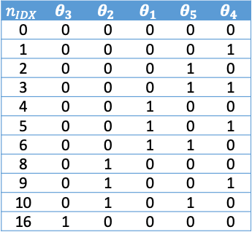
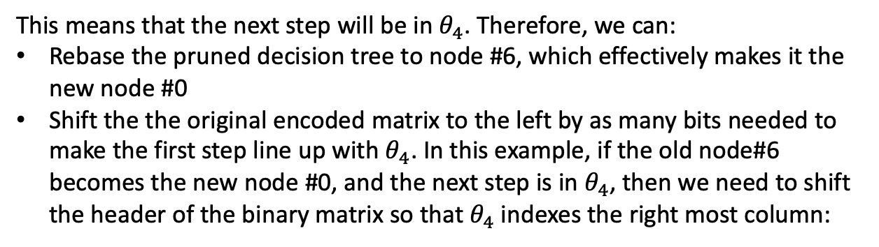
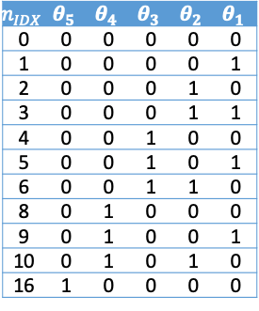


Moving from one iteration to the next
As we run through the decision tree, the end node can be any one in pruned tree. For example, node#6
$$n_{IDX}$$ | $$θ_{5}$$ | $$θ_{4}$$ | $$θ_{3}$$ | $$θ_{2}$$ | $$θ_{1}$$
6 | 0 | 0 | 1 | 1 | 0
This means that the next step will be in $θ_{4}$. Therefore, we can:
Rebase the pruned decision tree to node #6, which effectively makes it the new node #0
Shift the the original encoded matrix to the left by as many bits needed to make the first step line up with $θ_{4}$. In this example, if the old node#6 becomes the new node #0, and the next step is in $θ_{4}$, then we need to shift the header of the binary matrix so that $θ_{4}$indexes the right most column:
$$n_{IDX}$$ | $$θ_{5}$$ | $$θ_{4}$$ | $$θ_{3}$$ | $$θ_{2}$$ | $$θ_{1}$$
6 | 0 | 0 | 1 | 1 | 0
$$n_{IDX}$$ | $$θ_{3}$$ | $$θ_{2}$$ | $$θ_{1}$$ | $$θ_{5}$$ | $$θ_{4}$$
0 | 0 | 0 | 0 | 0 | 0
1 | 0 | 0 | 0 | 0 | 1
2 | 0 | 0 | 0 | 1 | 0
3 | 0 | 0 | 0 | 1 | 1
4 | 0 | 0 | 1 | 0 | 0
5 | 0 | 0 | 1 | 0 | 1
6 | 0 | 0 | 1 | 1 | 0
8 | 0 | 1 | 0 | 0 | 0
9 | 0 | 1 | 0 | 0 | 1
10 | 0 | 1 | 0 | 1 | 0
16 | 1 | 0 | 0 | 0 | 0
$$n_{IDX}$$ | $$θ_{5}$$ | $$θ_{4}$$ | $$θ_{3}$$ | $$θ_{2}$$ | $$θ_{1}$$
0 | 0 | 0 | 0 | 0 | 0
1 | 0 | 0 | 0 | 0 | 1
2 | 0 | 0 | 0 | 1 | 0
3 | 0 | 0 | 0 | 1 | 1
4 | 0 | 0 | 1 | 0 | 0
5 | 0 | 0 | 1 | 0 | 1
6 | 0 | 0 | 1 | 1 | 0
8 | 0 | 1 | 0 | 0 | 0
9 | 0 | 1 | 0 | 0 | 1
10 | 0 | 1 | 0 | 1 | 0
16 | 1 | 0 | 0 | 0 | 0

Slide 13
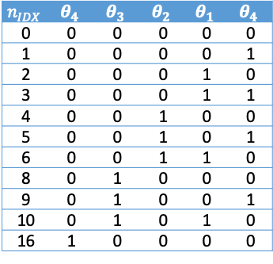
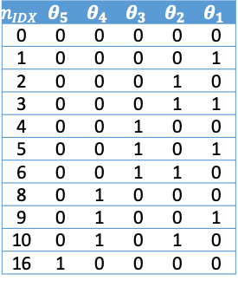
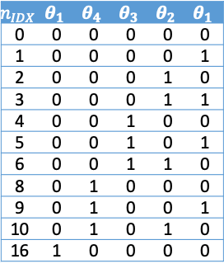
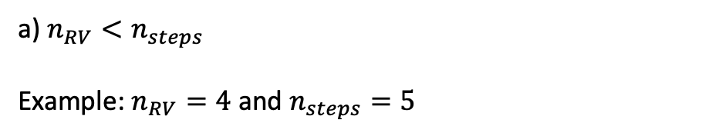
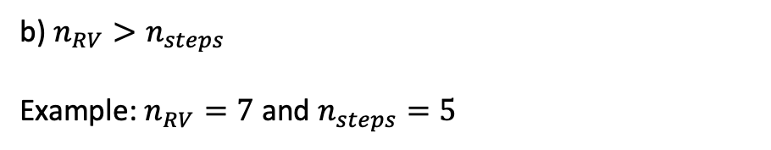

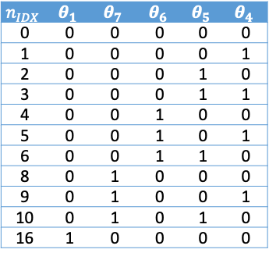

When number of steps is different than number of random variables
Building the decision tree, the probabilities and down-selecting the binary matrix representation is still the same. The difference is the shifting of the binary matrix header after running through the pruned decision tree.
a) $n_{RV}<n_{steps}$
Example: $n_{RV}=4$ and $n_{steps}=5$
b) $n_{RV}>n_{steps}$
Example: $n_{RV}=7$ and $n_{steps}=5$
$$n_{IDX}$$ | $$θ_{1}$$ | $$θ_{4}$$ | $$θ_{3}$$ | $$θ_{2}$$ | $$θ_{1}$$
6 | 0 | 0 | 1 | 1 | 0
$$n_{IDX}$$ | $$θ_{5}$$ | $$θ_{4}$$ | $$θ_{3}$$ | $$θ_{2}$$ | $$θ_{1}$$
6 | 0 | 0 | 1 | 1 | 0
$$n_{IDX}$$ | $$θ_{4}$$ | $$θ_{3}$$ | $$θ_{2}$$ | $$θ_{1}$$ | $$θ_{4}$$
0 | 0 | 0 | 0 | 0 | 0
1 | 0 | 0 | 0 | 0 | 1
2 | 0 | 0 | 0 | 1 | 0
3 | 0 | 0 | 0 | 1 | 1
4 | 0 | 0 | 1 | 0 | 0
5 | 0 | 0 | 1 | 0 | 1
6 | 0 | 0 | 1 | 1 | 0
8 | 0 | 1 | 0 | 0 | 0
9 | 0 | 1 | 0 | 0 | 1
10 | 0 | 1 | 0 | 1 | 0
16 | 1 | 0 | 0 | 0 | 0
$$n_{IDX}$$ | $$θ_{1}$$ | $$θ_{7}$$ | $$θ_{6}$$ | $$θ_{5}$$ | $$θ_{4}$$
0 | 0 | 0 | 0 | 0 | 0
1 | 0 | 0 | 0 | 0 | 1
2 | 0 | 0 | 0 | 1 | 0
3 | 0 | 0 | 0 | 1 | 1
4 | 0 | 0 | 1 | 0 | 0
5 | 0 | 0 | 1 | 0 | 1
6 | 0 | 0 | 1 | 1 | 0
8 | 0 | 1 | 0 | 0 | 0
9 | 0 | 1 | 0 | 0 | 1
10 | 0 | 1 | 0 | 1 | 0
16 | 1 | 0 | 0 | 0 | 0
$$n_{IDX}$$ | $$θ_{1}$$ | $$θ_{4}$$ | $$θ_{3}$$ | $$θ_{2}$$ | $$θ_{1}$$
0 | 0 | 0 | 0 | 0 | 0
1 | 0 | 0 | 0 | 0 | 1
2 | 0 | 0 | 0 | 1 | 0
3 | 0 | 0 | 0 | 1 | 1
4 | 0 | 0 | 1 | 0 | 0
5 | 0 | 0 | 1 | 0 | 1
6 | 0 | 0 | 1 | 1 | 0
8 | 0 | 1 | 0 | 0 | 0
9 | 0 | 1 | 0 | 0 | 1
10 | 0 | 1 | 0 | 1 | 0
16 | 1 | 0 | 0 | 0 | 0
$$n_{IDX}$$ | $$θ_{5}$$ | $$θ_{4}$$ | $$θ_{3}$$ | $$θ_{2}$$ | $$θ_{1}$$
0 | 0 | 0 | 0 | 0 | 0
1 | 0 | 0 | 0 | 0 | 1
2 | 0 | 0 | 0 | 1 | 0
3 | 0 | 0 | 0 | 1 | 1
4 | 0 | 0 | 1 | 0 | 0
5 | 0 | 0 | 1 | 0 | 1
6 | 0 | 0 | 1 | 1 | 0
8 | 0 | 1 | 0 | 0 | 0
9 | 0 | 1 | 0 | 0 | 1
10 | 0 | 1 | 0 | 1 | 0
16 | 1 | 0 | 0 | 0 | 0
Header row gets shifted by the number of random variables

Slide 15
0 0 0 0 0
0
0 0 0 0 1
1
0 0 0 0 1
0 0 0 0 0
0 0 0 1 1
3
0 0 0 1 0
2
0 0 0 0 1
0 0 0 1 0
0 0 0 0 0
0 0 1 0 1
5
0 0 1 1 0
6
0 0 1 0 0
4
0 0 0 0 1
0 0 0 1 0
0 0 0 0 0
0 1 0 0 1
9
0 1 0 1 0
10
0 1 0 0 0
8
0 0 0 0 0
1 0 0 0 0
16

Slide 17
0
0 0 0 0 0
0
1
0 0 0 0 1
1
1.00
0 0 0 0 1
0 0 0 0 0
3
2
0 0 0 1 1
3
0 0 0 1 0
2
0.23
0.77
5
6
4
0 0 0 0 1
0 0 0 1 0
0 0 0 0 0
0 0 1 0 1
5
0 0 1 1 0
6
0 0 1 0 0
4
0.177
0.177
0.593
9
10
8
0 0 0 0 1
0 0 0 1 0
0 0 0 0 0
0.136
0.136
0.457
0 1 0 0 1
9
0 1 0 1 0
10
0 1 0 0 0
8
16
0.352
0 0 0 0 0
1 0 0 0 0
16

Slide 18
Allocation of compute resources
Current sample
Accepted sample
Posterior evaluation request
New sample (one step
of random walk)
Rejected sample
0 0 0 0 0
0 0 0 0 1
0 0 0 0 1
1.00
0 0 0 0 0
0 0 0 1 1
0 0 0 1 0
0.23
0.77
0 0 0 1 1
0 0 0 0 1
0 0 0 1 0
0 0 0 0 0
0 0 1 1 1
0 0 1 0 1
0 0 1 1 0
0 0 1 0 0
0.053
0.177
0.177
0.593
0 0 1 1 1
0 0 0 1 1
0 0 1 0 1
0 0 0 0 1
0 0 1 1 0
0 0 0 1 0
0 0 1 0 0
0 0 0 0 0
0 1 1 1 1
0 1 0 1 1
0 1 1 0 1
0 1 0 0 1
0 1 1 1 0
0 1 0 1 0
0 1 1 0 0
0 1 0 0 0
0.012
0.041
0.041
0.136
0.041
0.136
0.136
0.457
0 1 1 1 1
0 0 1 1 1
0 1 0 1 1
0 0 0 1 1
0 1 1 0 1
0 0 1 0 1
0 1 0 0 1
0 0 0 0 1
0 1 1 1 0
0 0 1 1 0
0 1 0 1 0
0 0 0 1 0
0 1 1 0 0
0 0 1 0 0
0 1 0 0 0
0 0 0 0 0
1 1 1 1 1
1 0 1 1 1
1 1 0 1 1
1 0 0 1 1
1 1 1 0 1
1 0 1 0 1
1 1 0 0 1
1 0 0 0 1
1 1 1 1 0
1 0 1 1 0
1 1 0 1 0
1 0 0 1 0
1 1 1 0 0
1 0 1 0 0
1 1 0 0 0
1 0 0 0 0
0.003
0.009
0.009
0.031
0.009
0.031
0.031
0.105
0.009
0.031
0.031
0.105
0.031
0.105
0.105
0.352
0.0007
0.002
0.002
0.007
0.002
0.007
0.007
0.024
0.002
0.007
0.007
0.024
0.007
0.024
0.024
0.081
0.002
0.007
0.007
0.024
0.007
0.024
0.024
0.081
0.007
0.024
0.024
0.081
0.024
0.081
0.081
0.271

Slide 19
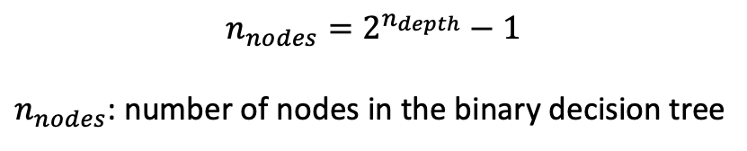
Backburner: this can be optimized even further with gradient information
$$n_{nodes}=2^{n_{depth}}−1$$
$n_{nodes}$: number of nodes in the binary decision tree

Slide 20
Encoding the steps in “binary” numbers
Current sample
Accepted sample
Posterior evaluation request
New sample (one step
of random walk)
Rejected sample
0 0 0
0
Steps
0 0 1
1
1
0 0 1
1.00
0 0 0
0 1 1
3
0 1 0
2
2
0.23
0.77
0 1 1
0 0 1
0 1 0
0 0 0
1 1 1
7
1 0 1
5
1 1 0
6
1 0 0
4
3
0.053
0.177
0.177
0.593
1 1 1
0 1 1
1 0 1
0 0 1
1 1 0
0 1 0
1 0 0
0 0 0
1 1 2
15
0 1 2
11
1 0 2
13
0 0 2
9
1 1 1
14
0 1 1
10
1 0 1
12
0 0 1
8
4
0.012
0.041
0.041
0.136
0.041
0.136
0.136
0.457
1 1 2
1 1 1
0 1 2
0 1 1
1 0 2
1 0 1
0 0 2
0 0 1
1 1 1
1 1 0
0 1 1
0 1 0
1 0 1
1 0 0
0 0 1
0 0 0
1 2 2
31
23
27
19
21
25
17
30
22
26
18
28
20
24
16
1 2 1
0 2 2
0 2 1
1 1 2
1 1 1
0 1 2
0 1 1
1 2 1
1 2 0
0 2 1
0 2 0
1 1 1
1 1 0
0 1 1
0 1 0
29
5
0.003
0.009
0.009
0.031
0.009
0.031
0.031
0.105
0.009
0.031
0.031
0.105
0.031
0.105
0.105
0.352
Observations:
3 bits are needed to encode 3 random variables.
Multiple steps can be encoded by simple increments

