Slide 1
GSERM: Text Mining & NLP Sentiment Analysis
Ted Kwartler

Slide 2
Machine Learning Supervised Learning
Goal: Predict a single “target” or “outcome” variable
Training data, where target value is known
Score to data where value is not known
Methods: Classification and Prediction

Slide 3
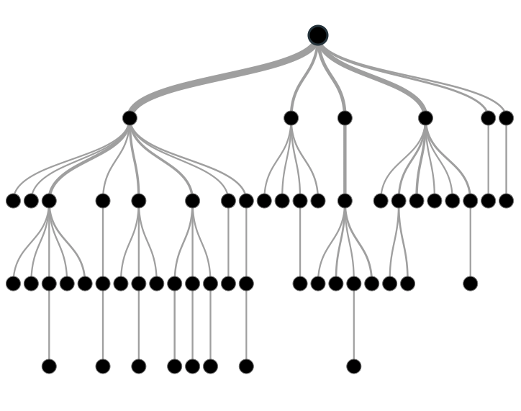

Supervised Learning
Inferring a function from labeled data.
“Learn from telling”, “Look at my data and I will tell you what to predict”
Data Setup
Method
Business Examples
Application
Marketing-Will a customer buy yes or no? How much will a customer spend?
Operations- Will an applicant default? When will a machine break?
Flat “Excel” file. Each row is a record or observation. Each column is an attribute of the record.
One column is the outcome, y or target attribute.
Modeling e.g. K-NN, linear regression, decision tree, random forest etc.
Make predictions for the target on the new data.

Slide 4
Supervised Learning in NLP
Is this email SPAM Vs non-Spam?
Is this document making fraudulent claims or not?
Using tweet mentions or financial documents predict a company’s revenue?

Slide 5
Machine Learning: Unsupervised Learning
Goal: Segment data into meaningful segments; detect patterns
There is no target (outcome) variable to predict or classify
Methods: Association rules, clustering, data reduction & exploration, visualization

Slide 6
Unsupervised Learning
Trying to find hidden structure in unlabelled data.
“Learn from observing”, “Look at my data and tell me about it”
Data Setup
Method
Business Examples
Application
Marketing-Find customer segments for specific marketing campaigns.
Operations-Identify locations for cell towers based on population density and area characteristics.
Text Analysis- Topic modeling of articles
Flat “Excel” file. Each row is a record or observation. Each column is an attribute of the record.
Clustering e.g. K-Means, Hierarchical Clustering etc
For new data assign to similar cluster

Slide 7
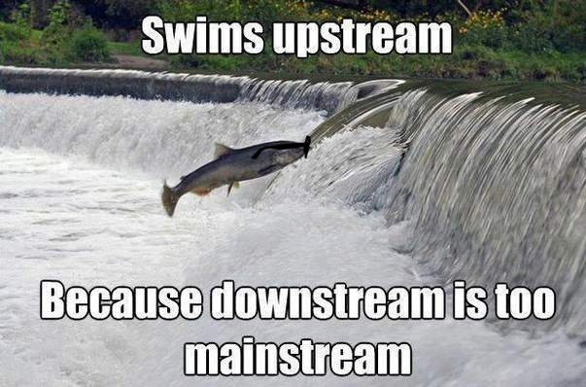
Your turn…
Methods
Scenario
Supervised or
Unsupervised
How many fish did each vessel catch?

Slide 8
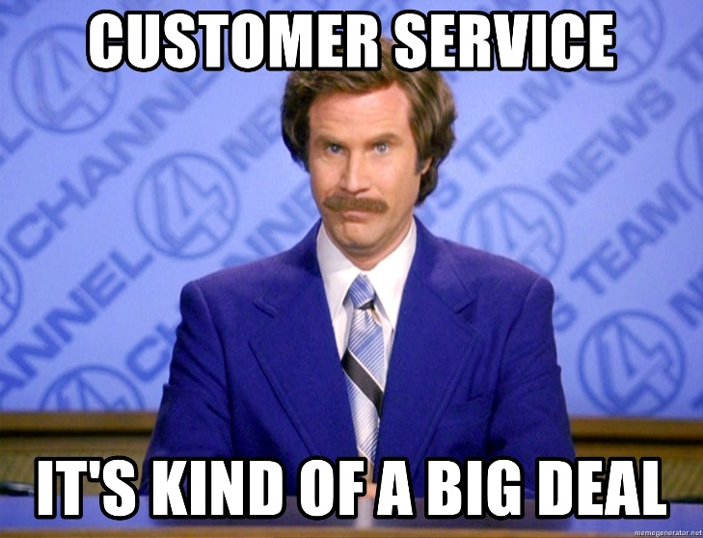
Your turn…
Methods
Scenario
Supervised or
Unsupervised
What observed customer personas exist in our customer data?

Slide 9

Your turn…
Methods
Scenario
Supervised or
Unsupervised
How many patients should we expect in the urgent care tomorrow?

Slide 10
Unsupervised Learning: Latent Dirichlet Allocation
Observe term frequency within documents
Identify “k” topics or clusters with similar frequency
A document may be more than one topic and is assigned to a cluster topic by probability
If K= 4, each document would get 4 probabilities

Slide 11

Unsupervised: Latent Dirichlet Allocation (LDA)
Latent – identify concealed topics e.g. not explicitly declared
Dirichlet – used in stats to represent multi-variate (multi-word) distributions
Instead of actual values it’s a “beta” distribution of probabilities 0-1
No “tails” values include 0 and 1
Beta distributions do not have to be symmetrical
Dirichlet will give k probabilities from beta distributions that generalize and sum to 1
Don’t worry about it!

Slide 12
K = 3: Three vectors & Three corresponding probabilities
{1,0,0 }
{0,0,1 }
{0,1,0 }

Slide 13
K = 3: vectors & 3 corresponding probabilities
{0.33, 0.33, 0.33}
{0.50,0.50,0 }

Slide 14
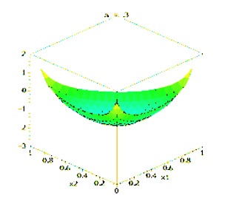
Dirichlet Function…
{0.33,0.33,0.33} each of the 3 vectors have equal likelihood among K represented as highest points
K can be more than 3 but can’t be visualized

Slide 15
Dirichlet Function…
Alpha is a parameter adjusts the probability distribution, adjusted through observed frequencies

Slide 16
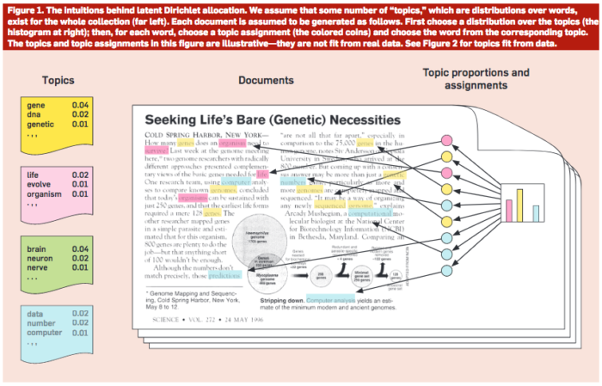
Common Sense Explanation
http://www.cs.columbia.edu/~blei/papers/Blei2012.pdf

Slide 17
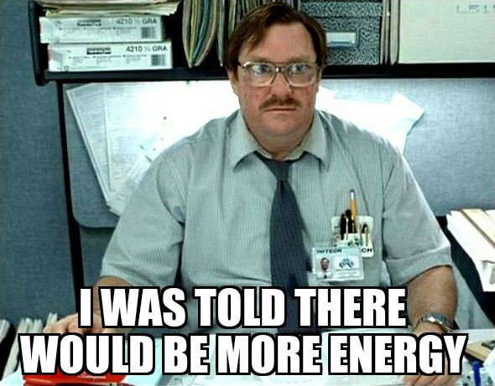
Open C_topicModeling.R

Slide 18
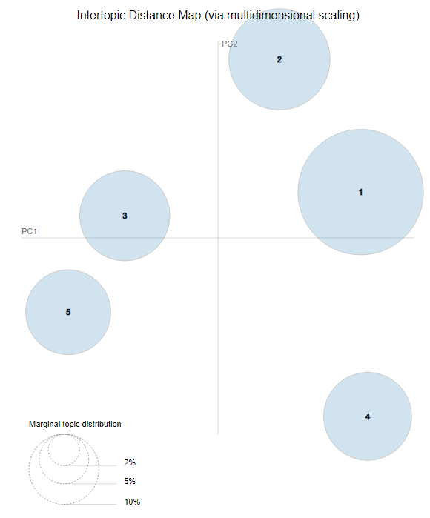
LDAvis: PCA of topics need to be interpreted
England-ness?
Non-Cricket
Cricket
Pakistan-ness?

Slide 19
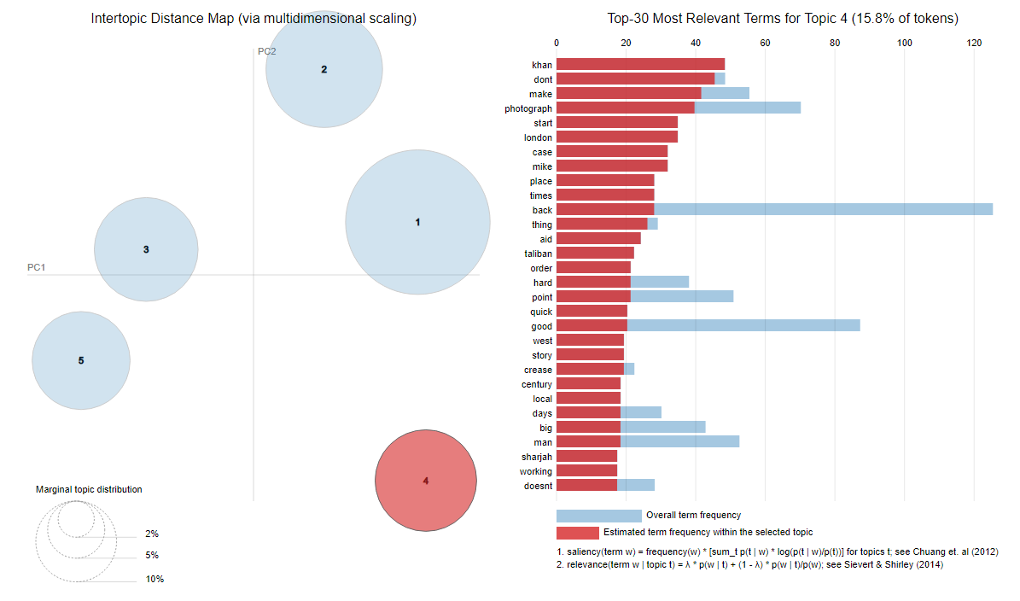
LDAvis: Interactive to show term distribution

Slide 20
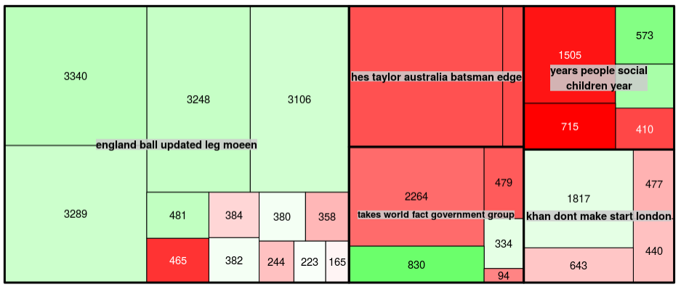
Interpreting a TreeMap: Multi-dimensional
Thick black lines: LDA defined Topic; named by 5 most typical words
Color: Polarity
Area: individual doc area is proportional to number of words
This shows the Guardian write positive and longer articles about Pakistan related to cricket than other topics.

