Slide 1
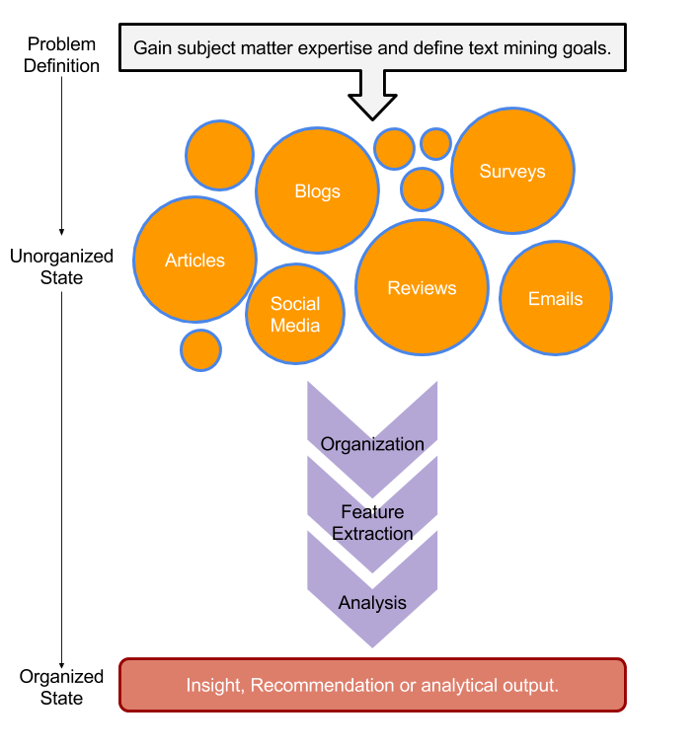
Remember This?

Slide 2


R for Cleaning Steps
Tomorrow I’m going to have a nice glass of Chardonnay and wind down with a good book in the corner of the county :-)
Remove Punctuation
Remove extra white space
Remove Numbers
Make Lower Case
Remove “stop” words
blogs
reviews
articles
tomorrow going nice glass chardonnay wind down good book corner county

Slide 3

Bag of Words “Lebron James hit a tough shot.
Bag of Words
Information is extracted based on frequency or weighting. Steps are taken to aid aggregation.
Example Text Changes:
Capitalization
Coffee = coffee
Punctuation
shot. = shot
Numbers
One = 1 or removed
Stopwords
Remove non-informative terms ie “and” “the”
Lebron
a
James
hit
tough
shot

Slide 4

Library TM Functions
VCorpus creates a corpus held in memory.
VCorpus(source)
Document
Corpus
Corpora
Corpus- A collection of documents that analysis will be based on.
6/7/20
Kwartler CSCI -96
4

Slide 5
Corpora Examples
Hamlet
All Shakespearn Works
Shakespeare, Chaucer,
Alcott & Dickens
Intra-document
Analysis
Intra-subject
Comparative Analysis
Inter-subject/author
Comparative Analysis
6/7/20
Kwartler CSCI -96
5

Slide 6
Library TM Functions
VCorpus creates a corpus held in memory.
VCorpus(source)
tm_map applies the transformations for the cleaning
tm_map(corpus, function)
getTransformations() will list all standard tm corpus transformations.
6/7/20
Kwartler CSCI -96
6

Slide 7
Library TM Functions
VCorpus creates a corpus held in memory.
VCorpus(source)
tm_map applies the transformations for the cleaning
tm_map(corpus, function)
Corpus
tm_map(corpus, removePunctuation)
tm_map(corpus, stripWhitespace)
tm_map(corpus, removeNumbers)
tm_map(corpus, content_transformer(tolower))
tm_map(corpus, removeWords)
content_transformer(Function) is needed to modify a corpus for non-tm package functions
6/7/20
Kwartler CSCI -96
7

Slide 8
Library qdap Functions
mgsub(“search pattern”, “replacement pattern”, text object)
replace_abbreviation()
replace_contraction()
replace_number() #1 to one
replace_ordinal() #1st to first
replace_symbol()
tm_map(corpus, content_transformer(replace_contractions))
tm_map(corpus, content_transformer(replace_abbreviation))
6/7/20
Kwartler CSCI -96
8

Slide 9
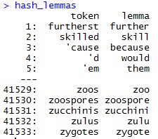
Poor Man’s Lemmatization (more to come later)
library(lexicon)
Qdap’s mgsub function can help you lemmatize words.
Bring in a lemmatization lexicon.
Supply a vector of patterns to search for
Supply a vector of patters to replace or change into.
Specify the vector the lexicon and substitutions should be applied to.
Better w UD PIPE covered on Friday
# Poor Man's Lemmatization
library(lexicon)
library(qdap)
data(hash_lemmas)
text$text <- mgsub(hash_lemmas$token,hash_lemmas$lemma,text$text)
Warning,: Not done in class because it takes a long time.

Slide 10
Custom Functions in this class
“tryTolower” is poached to account for errors when making lowercase.
tryTolower <- function(x){
# return NA when there is an error
y = NA
# tryCatch error
try_error = tryCatch(tolower(x), error = function(e) e)
# if not an error
if (!inherits(try_error, 'error'))
y = tolower(x)
return(y)}
Base: tolower (basic) – fails if not utf-8
Stringr: str_to_lower (wrapper) – fails if not utf-8
Custom: tryTolower (handles errors) – fault tolerant!

Slide 11
Custom Functions in this class
“cleanCorpus” is a convenience wrapper for basic cleaning operations
cleanCorpus<-function(corpus, customStopwords){
corpus <- tm_map(corpus, content_transformer(qdapRegex::rm_url))
corpus <- tm_map(corpus, removePunctuation)
corpus <- tm_map(corpus, stripWhitespace)
corpus <- tm_map(corpus, removeNumbers)
corpus <- tm_map(corpus, content_transformer(tryTolower))
corpus <- tm_map(corpus, removeWords, customStopwords)
return(corpus)
}

Slide 12
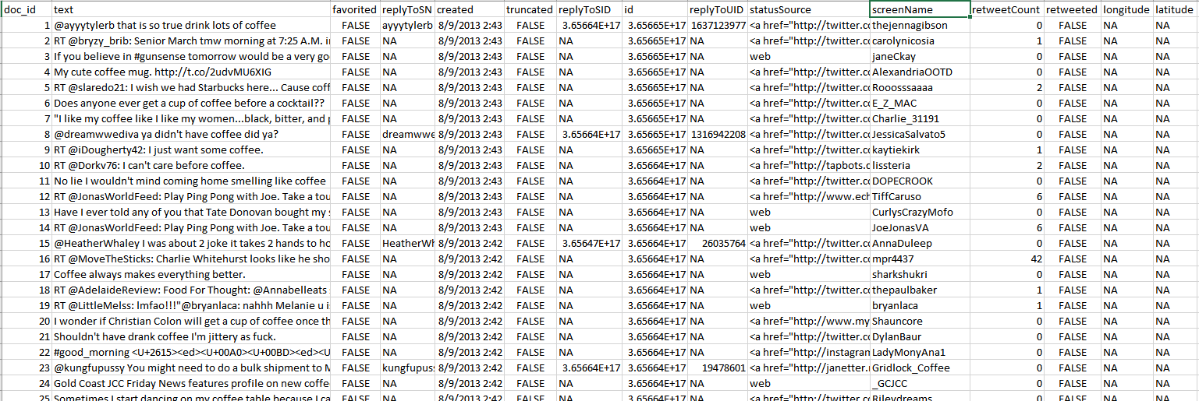
Meta Example
'$doc_id'
'$text'
META: $favorited, $created …
ID is for organization
Text is the information we want to examine
Meta adds context to our observations.

Slide 13
Nuances & Inputs for Setting Up a TM Project
“customStopwords” combines vectors of words to remove from the corpus
#Create custom stop words
customStopwords <- c(stopwords('english'), 'lol', 'smh')
Add channel specific stop words such as “lol” and “smh” for social media

Slide 14
Nuances & Inputs for Setting Up a TM Project
Retaining meta data information
# Data
text<-read.csv('coffee.csv', header=TRUE)
# As of tm version 0.7-3 tabular was deprecated
names(text)[1]<-'doc_id' #first 2 columns must be 'doc_id' & 'text'
txtCorpus <- VCorpus(DataframeSource(text))
txtCorpus <- cleanCorpus(txtCorpus)
The result is a list so brackets matter for accessing text vs meta-data.

Slide 15

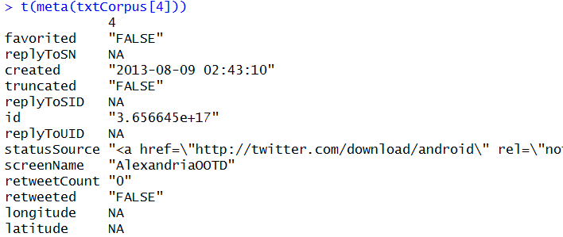

How do you retain meta information?
What is Meta?
What is content?
Meta information is data associated with the data you are analyzing. These can add context and allow you to partition data in insightful ways.
Timestamp (pre 9/11 Vs post 9/11)
Language (American Vs King’s English)
Author (Trump Vs Clinton)
Channel (Twitter Vs Legal Documents)
Content is simply the text (strings) you are analyzing. These data points represent the information of interest you are looking to gain insights from.
Retaining/Extracting Meta
Examining Content
SINGLE BRACKET
DOUBLE BRACKET
During an analysis it may be helpful to examine both meta & content information.

Slide 16
Bag of Words: TERM DOCUMENT MATRIX
The matrices are sparse (many 0’s) so additional steps may be needed to extract information.
Term Document Matrix
 | Tweet1 | Tweet2 | Tweet3 | Tweet4 | … | Tweet_n
Term1 | 0 | 0 | 0 | 0 | 0 | 0
Term2 | 1 | 1 | 0 | 0 | 0 | 0
Term3 | 1 | 0 | 0 | 2 | 0 | 0
… | 0 | 0 | 3 | 0 | 1 | 1
Term_n | 0 | 0 | 0 | 1 | 1 | 0
txtDtm <- TermDocumentMatrix(txtCorpus)
txtDtmM <- as.matrix(txtDtm)

Slide 17
Bag of Words: DOCUMENT TERM MATRIX
The matrices are sparse (many 0’s) so additional steps may be needed to extract information.
Document Term Matrix
 | Term1 | Term2 | Term3 | … | Term_n
Tweet1 | 0 | 1 | 1 | 0 | 0
Tweet2 | 0 | 1 | 0 | 0 | 0
Tweet3 | 0 | 0 | 0 | 3 | 0
… | 0 | 0 | 0 | 1 | 1
Tweet_n | 0 | 0 | 0 | 1 | 0
txtTdm <- DocumentTermMatrix(txtCorpus)
txtTdmM <- as.matrix(txtTdm)

Slide 18
Once cleaned, let’s get word frequencies.
beerFreq<-rowSums(beerTDMm)
beerFreq<-data.frame(word=names(beerFreq),frequency=beerFreq)
Term Document Matrix
Word Frequency Matrix
 | Tweet1 | Tweet2 | Tweet3 | Tweet4 | … | Tweet_n
Term1 | 0 | 0 | 0 | 0 | 0 | 0
Term2 | 1 | 1 | 0 | 0 | 0 | 0
Term3 | 1 | 0 | 0 | 2 | 0 | 0
… | 0 | 0 | 3 | 0 | 1 | 1
Term_n | 0 | 0 | 0 | 1 | 1 | 0
word | freq
Term1 | 0
Term2 | 2
Term3 | 3
… | 5
Term_n | 2

Slide 19
What about a DTM?
beerFreq<-???????(beerDTMm)
beerFreq<-data.frame(word=names(beerFreq),frequency=beerFreq)
Document Term Matrix
Word Frequency Matrix
 | Term1 | Term2 | Term3 | … | Term_n
Tweet1 | 0 | 1 | 1 | 0 | 0
Tweet2 | 0 | 1 | 0 | 0 | 0
Tweet3 | 0 | 0 | 0 | 3 | 0
… | 0 | 0 | 0 | 1 | 1
Tweet_n | 0 | 0 | 0 | 1 | 0
word | freq
Term1 | 0
Term2 | 2
Term3 | 3
… | 5
Term_n | 2
Can anyone think of how you could get a DTM to be a WFM?

Slide 20
Let’s practice! Open ﻿G_text_organization.R
Code to Create the DTM/ and change to a matrix
txtDTM <- DocumentTermMatrix(txtCorpus)
txtTDM <- TermDocumentMatrix(txtCorpus)

Slide 21
Live Discussion Point
Why are these matrices sparse? What do they represent?
In a Document Term Matrix what is each row?
In a Term Document Matrix what is each row?
Code to Create the DTM/ and change to a matrix
txtDTM <- DocumentTermMatrix(txtCorpus)
txtTDM <- TermDocumentMatrix(txtCorpus)

Slide 22
Lab/Homework
Due WEDS Before Class!
﻿Complete: Day1_HW_Student.R
Added another day because I underestimated the time it takes to upload large video files so the videos were delayed by a few hours!

