Slide 1
Intro to R
Why? This ensures a basic fluency before the course really starts.
Learning Objectives
What is R?
What is R Studio?
Scripting Structure in this course

Slide 2

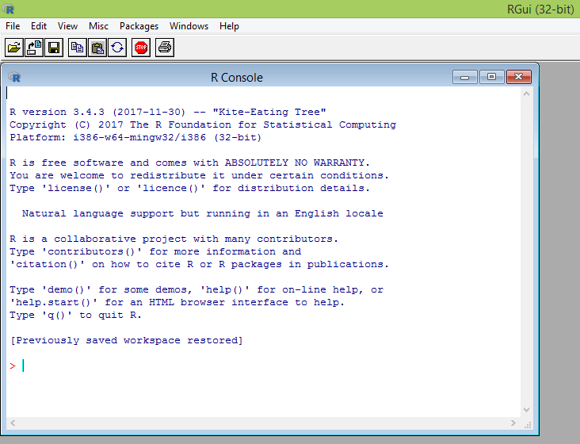
What is R?
R is a language & environment for statistical computing and graphics. It is the most popular statistical software in circulation today and is used by more than 2 million data scientists & statisticians worldwide.
How Companies Use R to Compete in a Data-Driven World, Data-informed.com
Flexible
Open source
Academic & growing in industry
Language agnostic, SQL, Weka, C, Fortran, Java etc

Slide 3

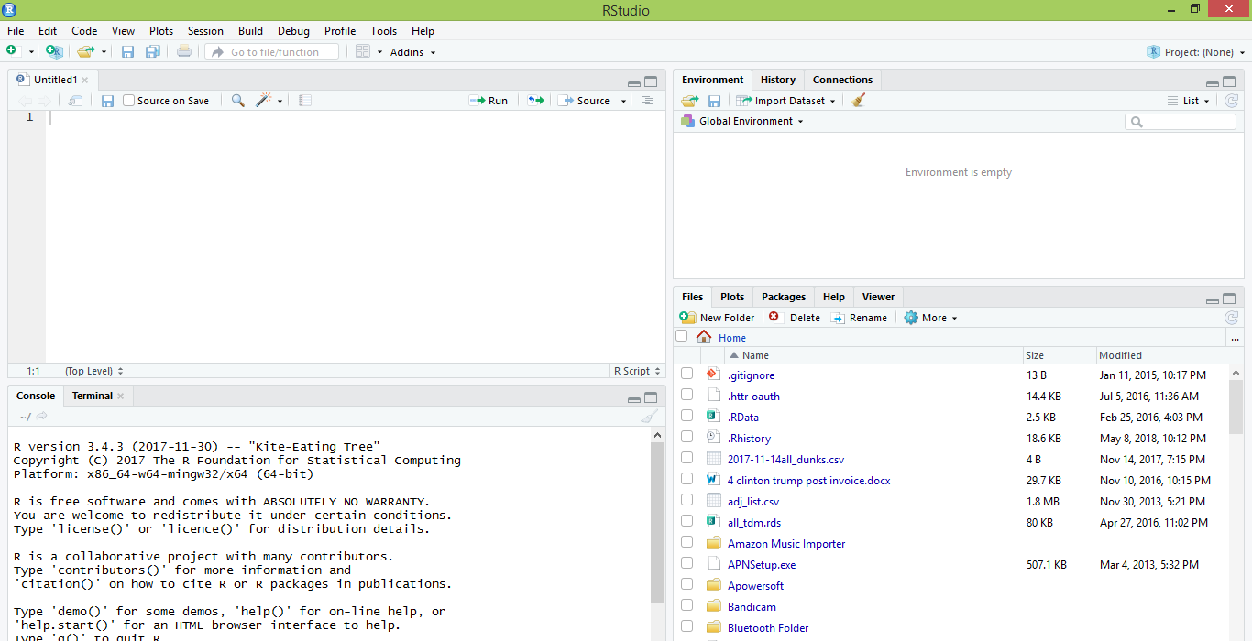
What is R Studio? The most popular IDE for R
IDE – Integrated Development Environment
Adds additional functionality e.g. git, shiny projects, markdown templates

Slide 4
What is the relationship between R & R studio?
Nice interface & additional functionality for faster programming, analysis & production.
Statistical & graphing software
R Studio sits atop of the installed R version. Without base R, R studio cannot function. By programmatically accessing base R, R Studio improves the interface and functionality.

Slide 5
R Studio has four main panes
Scripting
Environment
Commands are written & adjusted here then executed in the console. Then saved for future quick execution.
List of objects & values
e.g. loaded “excel” files
Files, Plots, Packages, Help
Console
Find files, load packages, see visualizations and quickly find help
Execution of scripts and commands, data exploration and code results
R Studio works on Linux, Windows and iOS.

Slide 6
R: Where is it being used?
Media
Google
Facebook
Twitter
Foursquare
Kickstarter
New York Times
Economist
Services
Zillow
Trulia
eHarmony
DataSong
PredictWise
Nationwide
Finance
Lloyd’s Bank
Credit Suisse
American Century
Australia and New Zealand Banking Group
Technology
SAS
Oracle
IBM
Teradata
Coursera
SAP
DataCamp
Alteryx
TIBCO
OneTick
Amazon
Google
Microsoft
U.S Government
Food & Drug
Administration
National Weather
Service
National Institute
of Standards
in Technology
R is ubiquitous in various industries used for analysis, prototyping and visualization. However, more often python is used in production environments.

Slide 7
Ok, it’s awesome
Pros
VERY extensible
10K+ packages
Built by stats, made for stats
Free, open source
Cutting edge
Diverse applications
Outstanding graphical capabilities
Large community-based help

Slide 8
Ok, it’s awesome but…
Cons
Tough to do “big data”
In memory data constraints w/o extra effort
Official documentation is terse
Not as polished as a commercial application
Slow compared to lower level languages
Production worthy apps can be difficult to create
Large community-based help

Slide 9
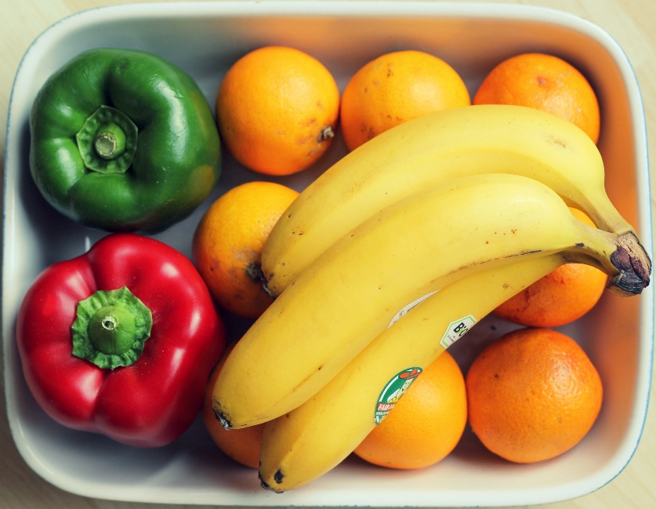
A basic R workflow
Let’s eat a banana for breakfast. Where is the fruit?
setwd(‘ted/fruit/basket’)
The item of interest needs to be in the “working directory”

Slide 10
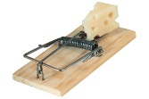
R Trap!
WINDOWS (local laptop):
In setwd() the slashes have to be switched (or “escaped”)!
setwd("~/desktop")
> setwd("~\desktop")
Error: '\d' is an unrecognized escape in character string starting ""~\d"

Slide 11

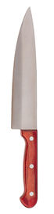
R uses functions, libraries & objects
Found the fruit basket! What tools do I need?
setwd(“ted/fruit/basket”)
library(knife)
library(peel)
Change R into a breakfast preparing machine with specialized libraries.

Slide 12

Another trap!
Before loading a library use
install.packages(“name of package”).
You only need to do this once per environment
But, will need to repeat it w/each new environment!

Slide 13

R uses functions, libraries & objects
Now R is a cutting & peeling machine, let’s pick our fruit.
setwd(“ted/fruit/basket”)
library(knife)
library(peel)
banana <- read.fruit(“Banana.csv”)
Must
Be In the working directory or full path declared
Be inside quotes
Have correct capitalization, spacing & spelling matter.
R now has the object called banana in memory ie “opening a spreadsheet”

Slide 14

What if my file is Excel or ???
R can open many files types with different functions
CSV
Excel
SaS
SPSS
Rds, rda, fst etc
Connections
Databases (SQL, mongoDB)
S3 Buckets
APIs
Recommendation: to get started stick with CSV. Most software can export CSV.

Slide 15
R uses functions, libraries & objects
R uses predefined functions to accomplish things.
Function
Input
Output

Slide 16
R uses functions, libraries & objects
Our Function accepts any number and is a “plus 2 and multiply by 3” Machine.

Slide 17
R uses functions, libraries & objects
plusTwoTimesThree
Input
X = 2

Slide 18
R uses functions, libraries & objects
plusTwoTimesThree
X = 2
2+X = 4
4 * 3 = 12
Return (12)
Input
X = 2

Slide 19
R uses functions, libraries & objects
plusTwoTimesThree
X = 2
2+X = 4
4 * 3 = 12
Return (12)
Input
X = 2
Output
12

Slide 20
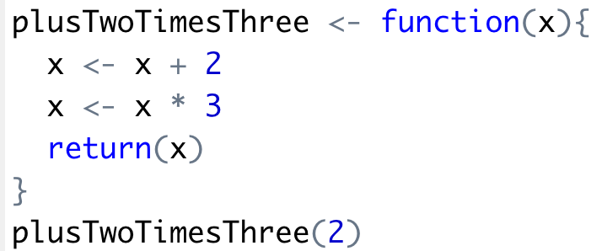
R uses functions, libraries & objects
Input
X = 2
Output
12

Slide 21

R uses functions, libraries & objects
Input
X = 2

Slide 22
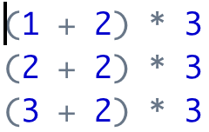


Why are functions better?
Write it 30 times
Write it once
etc.
Apply it in one line to 30 values
Get all the answers
Get all the answers
etc.
etc.
Saves time, more concise and less error prone.

Slide 23

R uses functions, libraries & objects
halfBanana <- cutinhalf(banana )
Output
Function
(
Input
)
“ <- ” is the assignment operator

Slide 24


R uses functions, libraries & objects
setwd(“ted/fruit/basket”)
library(knife)
library(peel)
banana <- read.fruit(“Banana.csv”)
halfBanana <- cutinhalf(banana )
halfBanana <- peel ( halfBanana)
Output
Function
(
Input
)
Results of an object can be used in the next function.

Slide 25
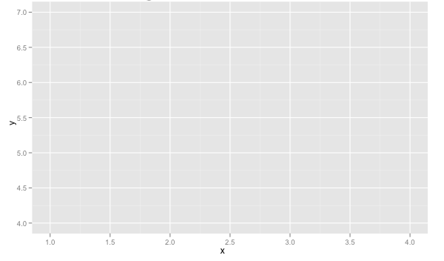
R uses functions, libraries & objects
setwd(“ted/fruit/basket”)
library(knife)
library(peel)
banana <- read.fruit(“Banana.csv”)
halfBanana <- cutinhalf(banana)
halfBanana <- peel(halfBanana)
plot(halfBanana)
Function
(
Input
)
You don’t always have to declare an output object & you can also save items to disk.

Slide 26






Workflow review
1
Use setwd() to point to your files & where to save outputs.
2
Load some customized libraries with library() for your specific analysis and methodology. Sometimes we will also create customized functions not in a library to aid our analysis.
3
Read in the file so the object is “in-memory” with read.csv() or similar.
4
Apply a function(s) from a library to adjust or create new objects in memory. The pseudo code for this is:
object<-function(applied to object)
5
Consume the results by saving, plotting etc.

Slide 27
On to more interesting stuff!

