Slide 1
Latent Semantic Analysis…cousin of PCA
In statistics PCA – Principal Component Analysis
High dimensional data can be approximated by “singular value decomposition” (SVD)

Slide 2
Latent Semantic Analysis
In text LSA – Latent Semantic Analysis
High dimensional data (text values) can be approximated by “singular value decomposition” (SVD)
 | Doc1 | Doc2
TermA | 10 | 6
TermB | 11 | 4
TermC | 8 | 5
TermD | 3 | 3
TermE | 2 | 2.8
TermF | 1 | 1
Doc1 Avg: 5.8
Doc2 Avg: 3.6

Slide 3
Plot the data in 2D space. In reality, text has higher dimensions.
Doc2
Doc1

Slide 4
Shift the origin to the average

Slide 5
Shifting the origin changes value but not relative position.

Slide 6
PCA “fits” a line going through the origin

Slide 7
The points are projected onto the fit line and squared distances from the origin are summed up.
Find the line that minimizes the data point to the projected point on the line.

Slide 8
A user defines the number of PCA dimensions.
Remember this happens in hyperspace among thousands of documents.
PCA1 is a line that “mixes”
the value of Doc1 & Doc2

Slide 9

Intuitive Example of PCA Where is the Musee Jacquemart-Andre in Paris?
Exact Answer has 2 data points.
LAT: 48.874911
LON:2.310612
Quick Answer has 1 data point.
Its about 1.5k from Arc de Triumph

Slide 10
Intuitive Example of PCA Where is the Musee Jacquemart-Andre in Paris?
Exact Answer has 2 data points.
LAT: 48.874911
LON:2.310612
Quick Answer has 1 data point.
Its about 1.5k from Arc de Triumph

Slide 11
Intuitive Example of PCA Where is the Musee Jacquemart-Andre in Paris?
Exact Answer has 2 data points.
LAT: 48.874911
LON:2.310612
Quick Answer has 1 data point.
Its about 1.5k from Arc de Triumph
2 Values, Highly Specific
1 Values, Less Specific, generally correct
LAT: 48.874911
LON:2.310612
Its about 1.5k from Arc de Triumph

Slide 12
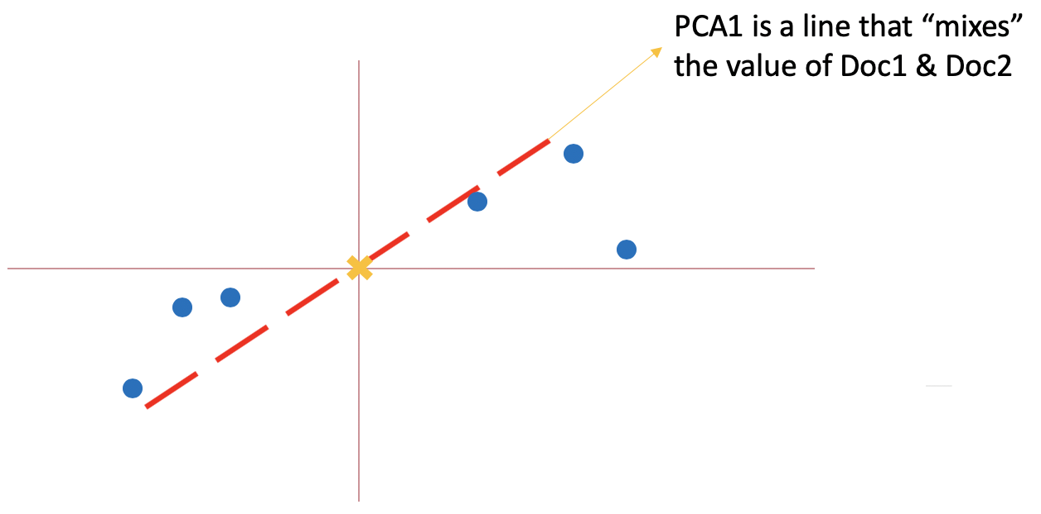
In our case, we have thousands of term vectors.
Term Vectors are paired to reduce dimensions

Slide 13
In our case, we have thousands of term vectors.
The reduced vectors are subject to more single value decompositions

Slide 14
In our case, we have thousands of term vectors.
Iteratively, these decompositions are reduced to the number of vectors you declare.
So 12 vectors were ultimately reduced to 2.

Slide 15
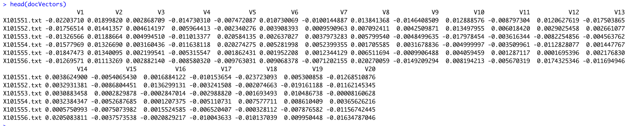
These vectors are dense, perfect for modeling.
Declared 20 vectors for all 2000 docs.

Slide 16
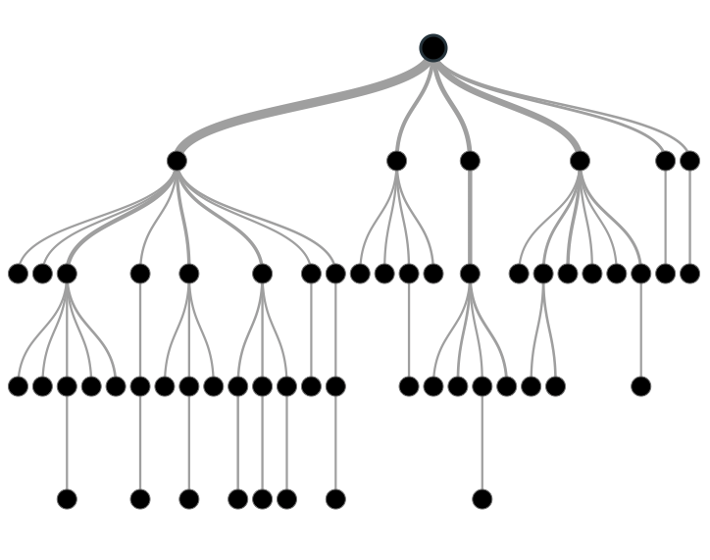

Supervised Learning
Inferring a function from labeled data.
“Learn from telling”, “Look at my data and I will tell you what to predict”
Data Setup
Method
Business Examples
Application
Marketing-Will a customer buy yes or no? How much will a customer spend?
Operations- Will an applicant default? When will a machine break?
Flat “Excel” file. Each row is a record or observation. Each column is an attribute of the record.
One column is the outcome, y or target attribute.
Modeling e.g. K-NN, linear regression, decision tree, random forest etc.
Make predictions for the target on the new data.

Slide 17
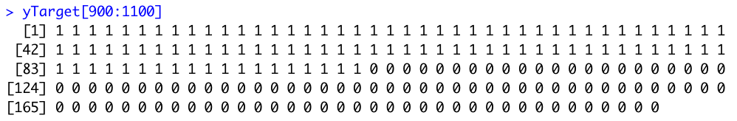
Supervised Learning
Output from LSA are “x-variables”
Data Setup
The label is ”y-variable”
Flat “Excel” file. Each row is a record or observation. Each column is an attribute of the record.
One column is the outcome, y or target attribute.

Slide 18
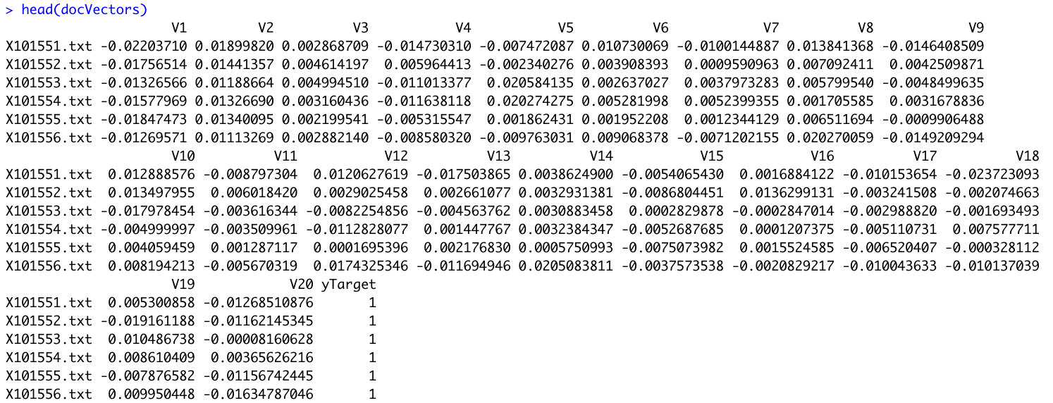
The modeling function usually needs a matrix with both.

Slide 19
Let’s open live_A_lsa_for modeling.R

