Slide 1
Get started with Machine Learning with Python
Felipe Lopes

Slide 2
Felipe Lopes
Computer Science at PUCRS
8+ years of development experience
CTO at Encore

Slide 3
What is Machine Learning
“… gives computer ability to learn without explicit programming”

Slide 4
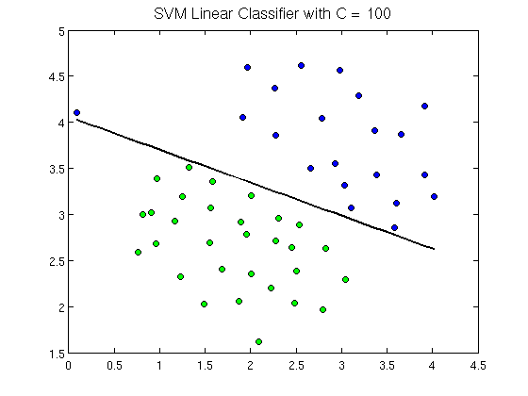
Model

Slide 5
Examples
Sentiment Analysis
Handwritten recognition
Fraud detection
Credit risk

Slide 6
Trending Topics
AI - Bring intelligence to computers
Data Science - Get knowledge from data and create products
Big Data – Beyond ability of trivial tech to compute and analyse

Slide 7
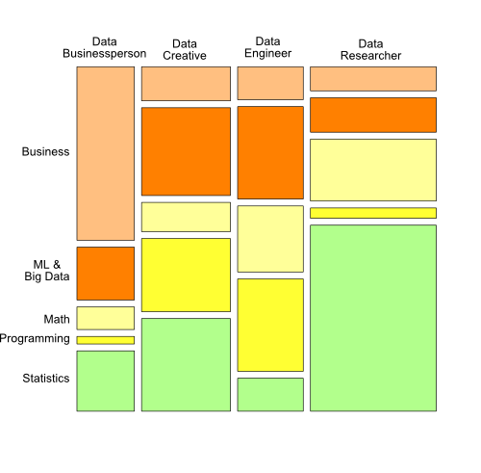
Roles at Data Science

Slide 8
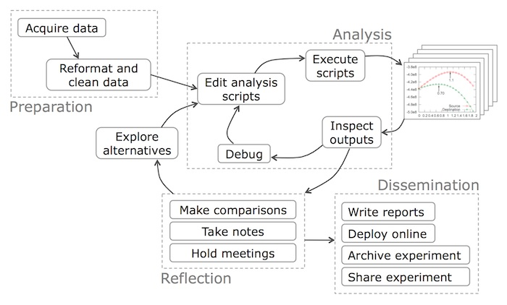
Data Science Project Workflow

Slide 9
Python Toolbox
Ipython Notebook
Numpy
Pandas
Scipy

