Slide 1

Neural Networks applied to Structure Health Monitoring using autoregressive models as feature extractors
Felipe da Costa Pereira – mat. 2212376 - ELE2389

Slide 2
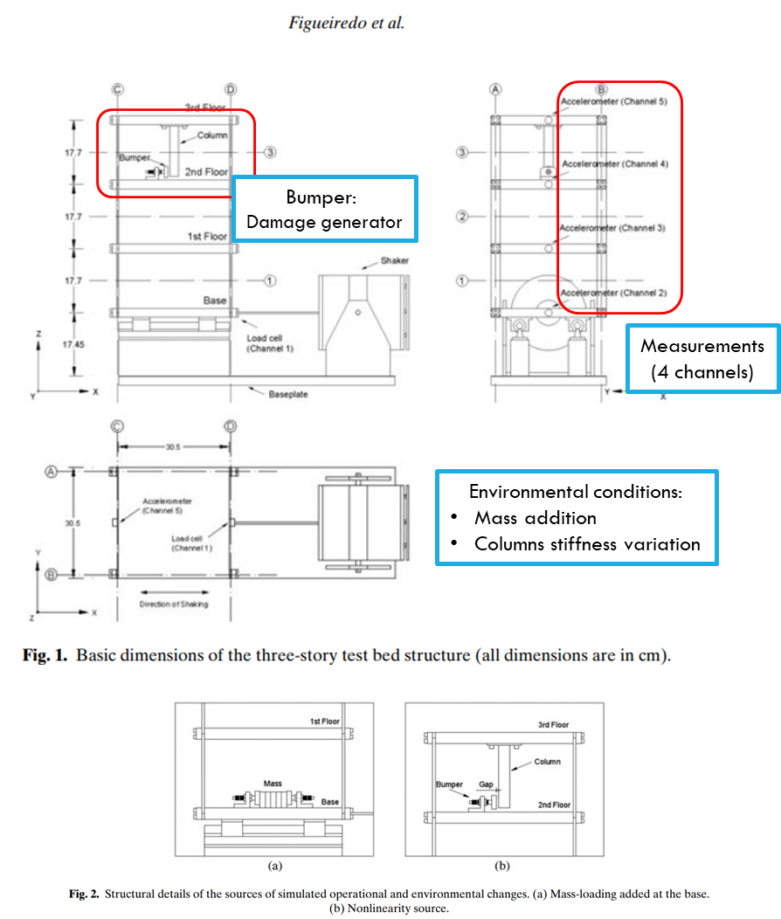
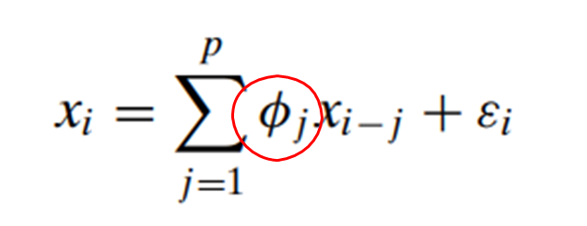
Problem description
Structure Health Monitoring (SHM): detect damage on a given physical system
Data: measures of accelerometers on laboratory assembly^{(*1)}
Different damage and environmental conditions ^{(*1)}
Autoregressive (AR) Models as feature extractors from timeseries measures^{(*2)}
Objectives:
train a MLP Neural Network as a classifier to predict the classes of damage (state conditions);
compare its results with other popular algorithms for classification;
train a self-organizing map to explore the feature space and the relations between state conditions;
(*1) [Figueiredo et al., Structural health monitoring using standard data sets - report, 2009]
(*2) [Figueiredo et al., Computer-Aided Civil and Infrastructure Engineering, 26(3):225–238., 2011]

Slide 3
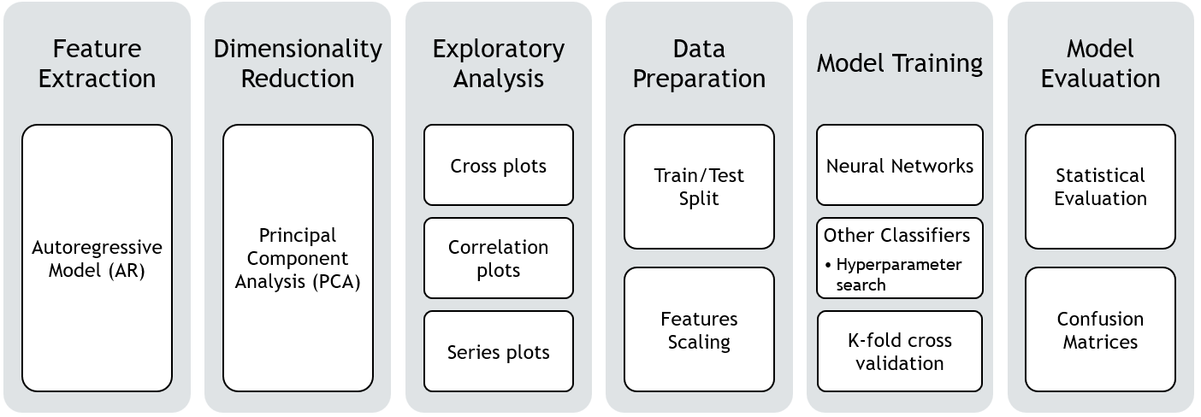
Data processing pipeline

Slide 4
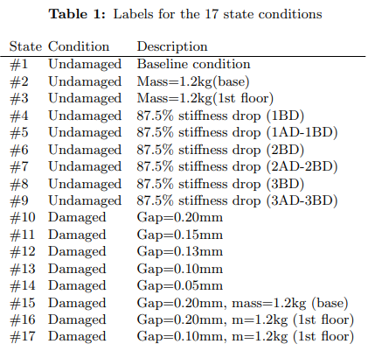
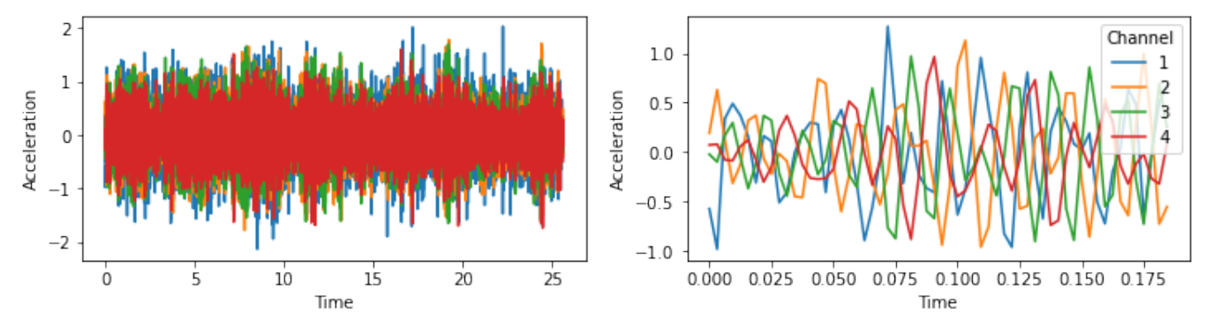

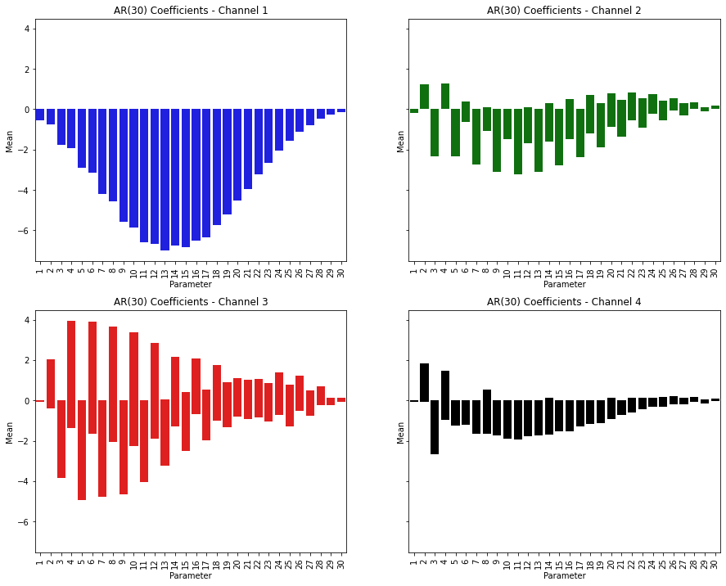
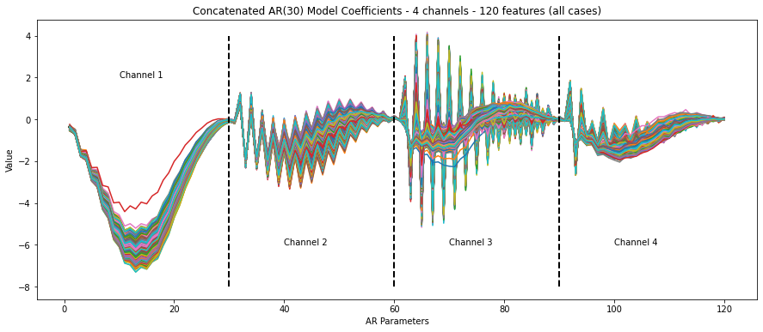
Dataset and feature extraction
4 sensors timeseries
case #790, label#16
Group 1
(Baseline)
Group 2
(Environmental
Change only)
Original Dataset:
Cases: 850 (17 conditions x 50)
Features: 4 timeseries x 8192 datapoints
Group 3
(Damage only)
1
AR model (p=30)
Group 4
(Damage +
Envoronmental change)
After AR Model:
Cases: 850 (17 conditions x 50)
Features: 4 channels x 30 AR coefficients
Ch1
Ch2
3
After concatenation:
Cases: 850
Features: 120 AR coefficients
2
Concatenation
Ch3
Ch4

Slide 5
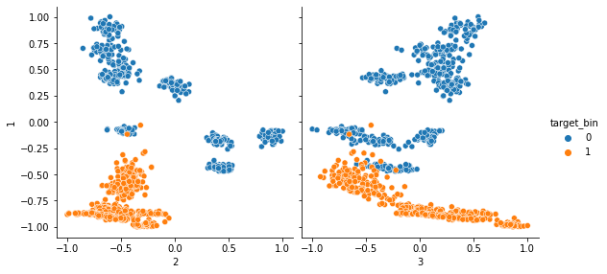
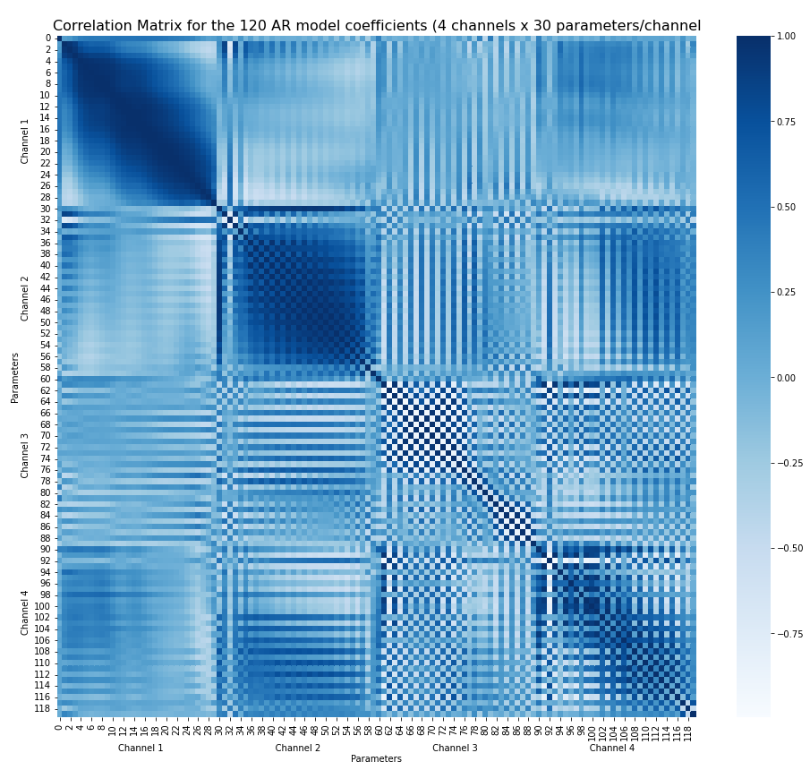
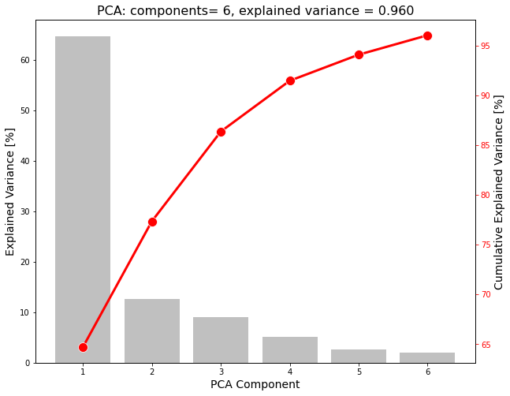
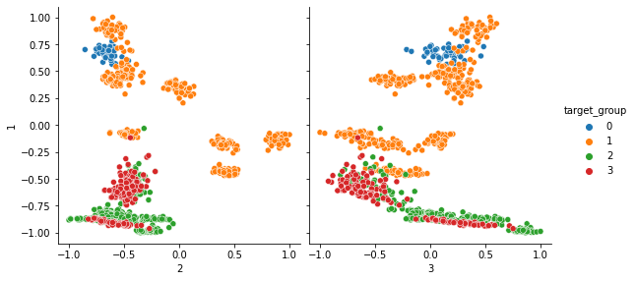
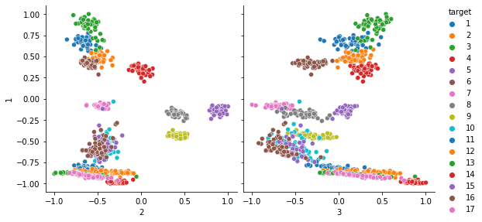
Exploratory analysis
binary
PCA 1
Correlation Matrix (AR Model)
PCA transform explained variances
4 groups
PCA 1
17 states
PCA 1
High correlation specially channels 1 and 2
PCA compression: 6 components representing 96% variance
PCA 2
PCA 3

Slide 6
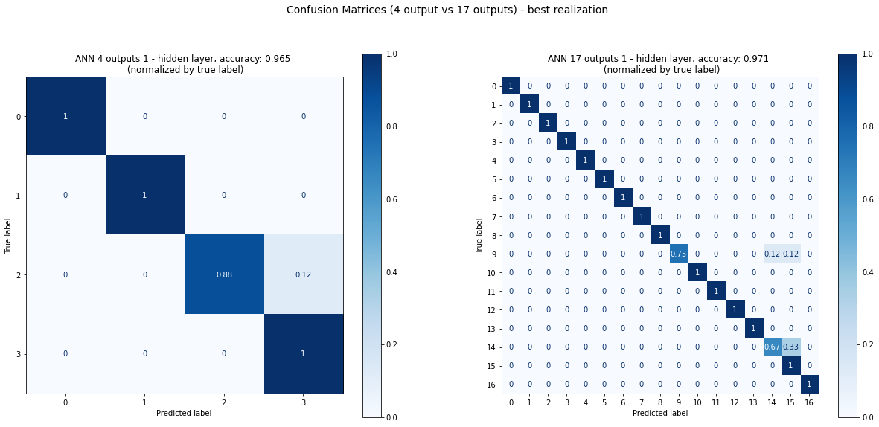
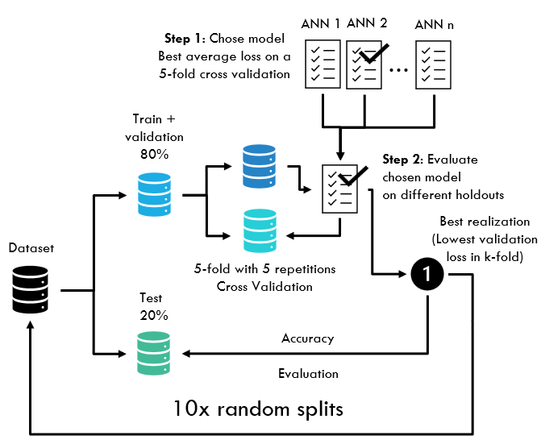
Neural network (MLP)
Confusion Matrices (normalized by true label)
4 groups vs 17 state conditions prediction
Model validation protocol
best accuracy = .965
Average = .956
best accuracy = .971
Average = .925
Chosen model: 6 input, 13 hidden neurons (1 hidden layer)
Relu activation (hidden layer) and softmax activation (output)
Similar performance in predicting either 4 group of 17 state conditions

Slide 7
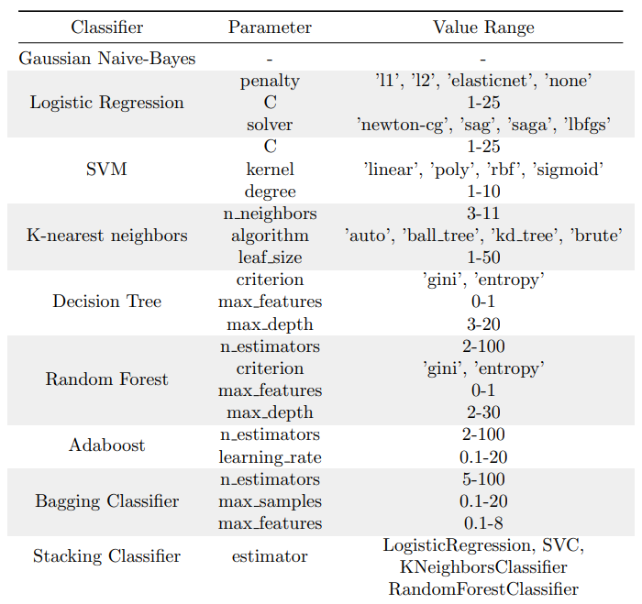
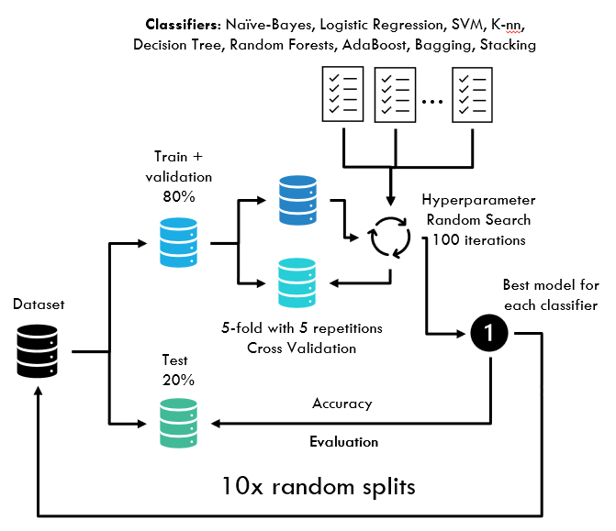
Soft models

Slide 8
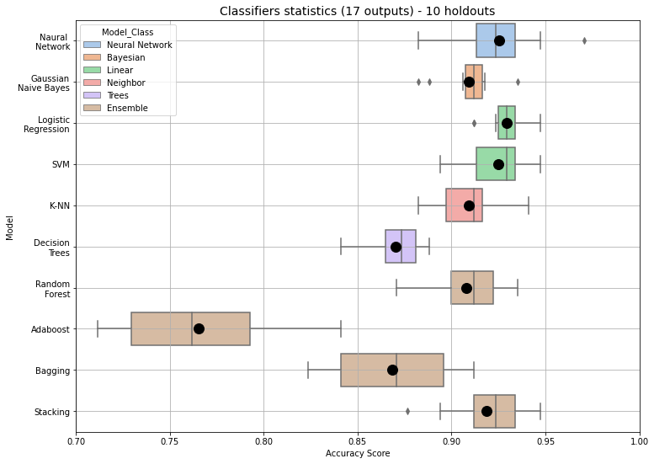
Classifiers Results
Neural Network, linear models (SVM and Logistic Regression - Softmax) showed a better performance;
Some classifiers performed worse than the Naïve Bayes Classifier
Poor performance for the AdaBoost, Bagging and Decision Trees algorithms
Stacking classifier was the best among ensemble methods;

Slide 9
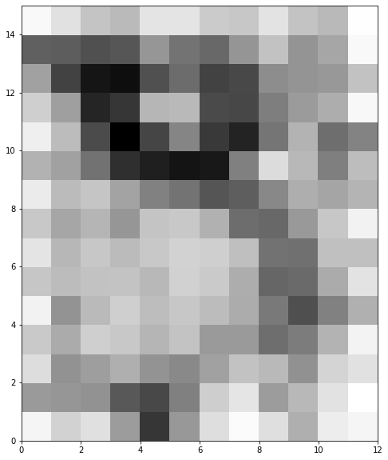
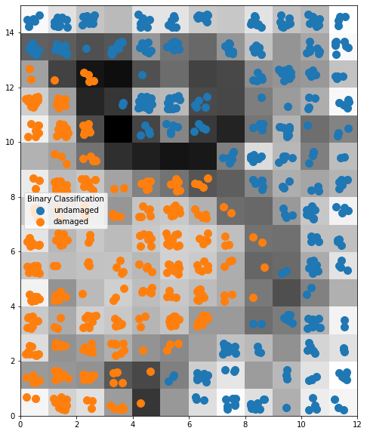
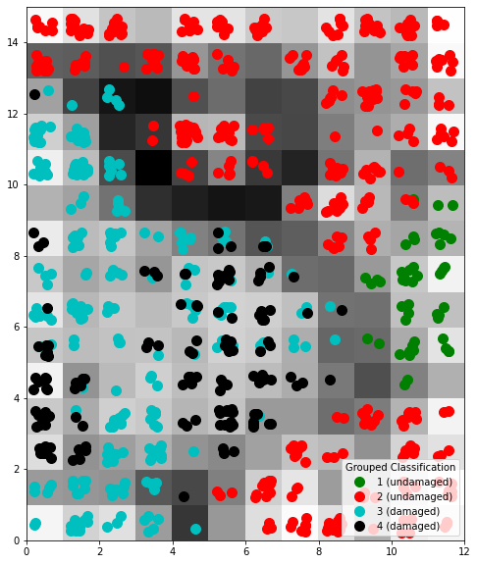
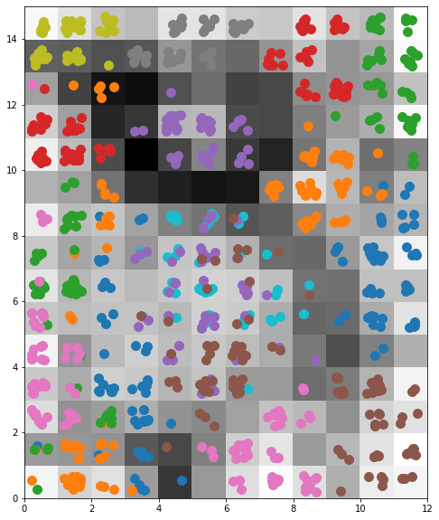
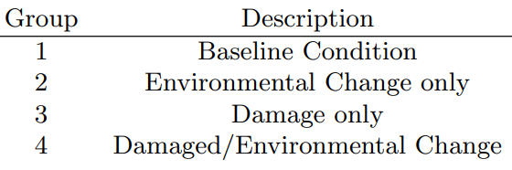
Self organizing map Results
12x15 som
Binary class labels
4 groups labels
17 state conditions labels
The self organizing map trained in this example (12x15) was not complex enough to map the features in 4 or 17 groups

Slide 10
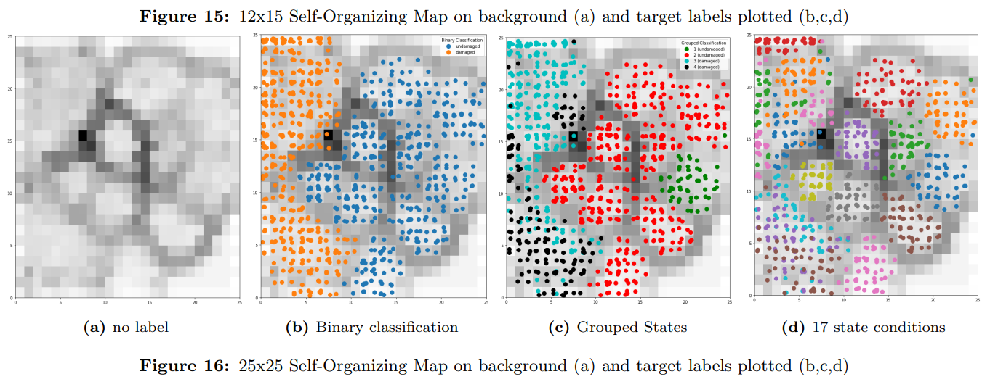
Self organizing map Results
The self organizing map trained in this example (25x25) can capture the four gourps and some of the 17 state conditions

Slide 11
Concluding remarks
AR models, when using an appropriate order, are indeed useful as a feature extractor and its coefficients can be used as features in the new input space. [Figueiredo et al., 2011]
For the proposed problem, the PCA technique was responsible for achieving a high compression transforming a 120-dimension input space into a 6-component with only a few loss of information.
The neural network model as well as the other classifiers (specially the linear models) performed well in detecting damage in the studied laboratory structure, considering the pre-processing procedures implemented (feature extraction and dimensionality reduction).
It’s reasonable to think that the same neural network or any of the soft classifiers, if applied directly to the initial feature space would lead to a poor performance as classifiers, due to the huge number of features, what shows the importance of the preliminary steps in a data processing pipeline.
Self-Organizing Map trained in this study was capable of capturing the groups at a high level (binary classification: damaged vs undamaged), but showed a weak performance when getting in more detailed classification

