Slide 1

Neural networks Applied to structure Health monitoring
Felipe da Costa Pereira

Slide 2

paper
Structural Health Monitoring (SHM);
Autoregressive Models as features extraction technique for damage detection:
Optimal Model order estimation
Datasets are measurements from a Laboratory test structure under different environments and failure conditions;
https://doi.org/10.1111/j.1467-8667.2010.00685.x

Slide 3
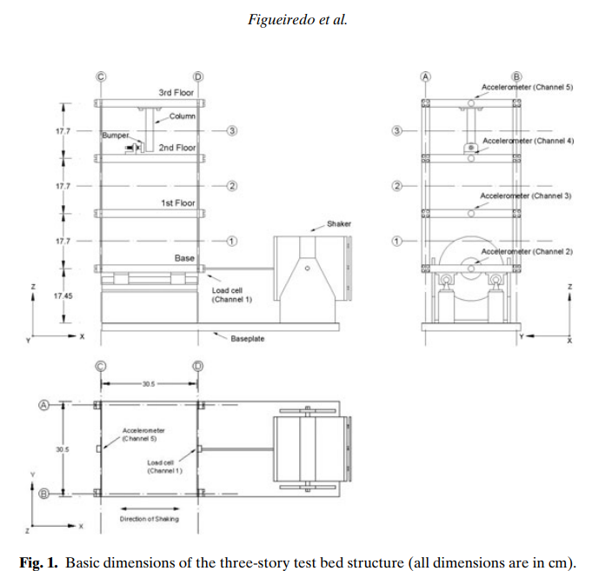
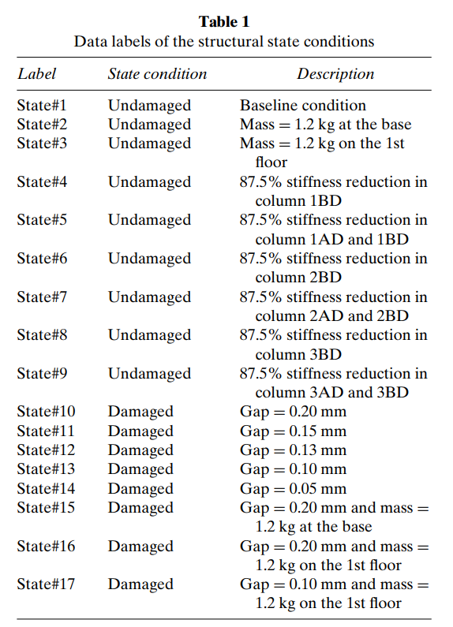
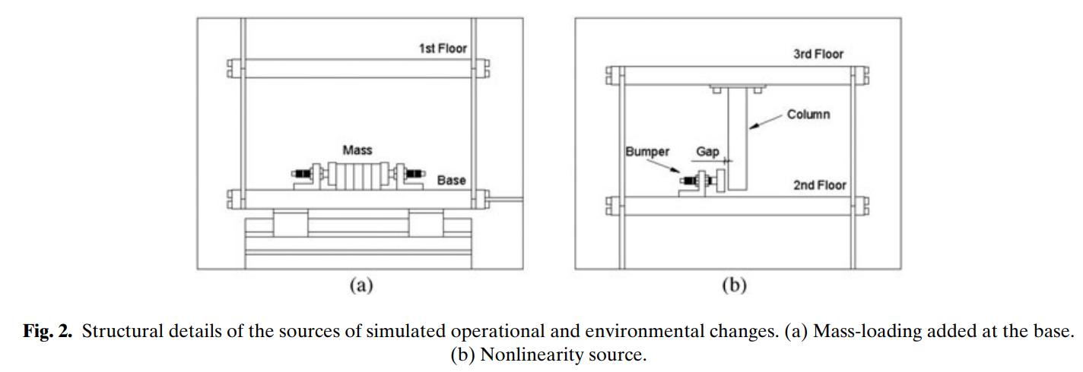
experiment
Bumper:
Damage generator
Group 1
Measurements
(4 channels)
Group 2
Environmental conditions:
Mass addition
Columns stiffness variation
Group 3
Group 4

Slide 4
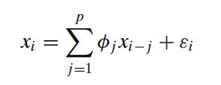
Feature extraction the autoregressive model
“Time-series analysis takes into account the fact that data points sampled over time may have an internal structure, such as autocorrelations, trends or seasonal variations…
The second SHM approach consists of fitting an AR model to signals from the undamaged and damaged structural conditions. In this approach, the AR parameters are used directly as damage sensitive features, and some form of a multivariate classifier can be used to distinguish between the damage classes.
The appropriate AR model order is initially unknown. A higher order model may better fit the data but may not generalize well to other data sets.
On the other hand, a low-order model will not necessarily capture the underlying physical system dynamics.”

Slide 5
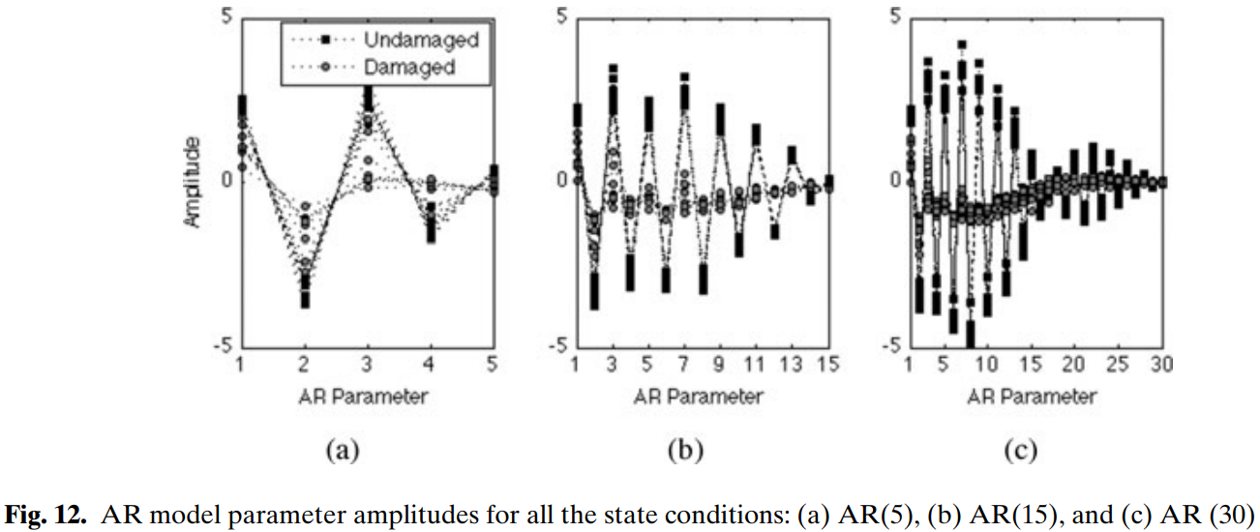
Feature extraction the autoregressive model
Conclusions based on statistical approach:
- 15<p<30: capable of discriminating the undamaged and damaged state conditions, even in the presence of simulated operational and environmental variability.
- If p<15: no guarantee to distinguish all the undamaged and damaged state conditions when the operational and environmental variability was included in the experiments.
- AR modeling can be an effective feature extraction technique when the damage introduces non linearities and the operational and environmental variations manifest themselves as linear system changes.

Slide 6





Dataset
Exploratory analysis
Histograms
Dimensionality Reduction
Supervised Model
Feature selection
Unsupervised (secondary objective)
Neural Network for classification
Series plot
Cross plots
Self Organized Map
Apply AR(p) model
PCA
Data Scaling
Feature Extraction
Validation
Train/Test split
K-fold cross validation
Test different architectures
Group similar damage types
4 x 8192 features
850
Experiments
(cases)
{ }
X =
time series
workflow
(4 x p) features = 120
{ }
XAR =
850
Ø
label
{}
Y =
850
(17 classes)

Slide 7
Dataset
Feature Extraction
Autoregressive Model (AR)
Model Training
Model Evaluation
Hyperparameter search
Statistical Evaluation
Train/Test Split
Features Scaling
Confusion Matrices
Data Preparation
Exploratory Analysis
Principal Component Analysis (PCA)
Dimensionality Reduction
Cross plots
Correlation plots
Series plots
Neural Networks
Other Classifiers

Slide 8
Dataset
Feature Extraction
Autoregressive Model (AR)
Model Training
Model Evaluation
Hyperparameter search
Statistical Evaluation
Train/Test Split
Features Scaling
Confusion Matrices
Data Preparation
Exploratory Analysis
Principal Component Analysis (PCA)
Dimensionality Reduction
Cross plots
Correlation plots
Series plots
Neural Networks
Other Classifiers
K-fold cross validation

Slide 10









Classifiers: Naïve-Bayes, Logistic Regression, SVM, K-nn, Decision Tree, Random Forests, AdaBoost, Bagging, Stacking
ANN 1
ANN 2
ANN n
Step 1: Chose model Best average loss on a 5-fold cross validation
…
…
Train +
validation
80%
Train +
validation
80%
Step 2: Evaluate chosen model
on different holdouts
Hyperparameter Random Search
100 iterations
Best realization
(Lowest validation loss in k-fold)
Best model for each classifier
Dataset
Dataset
5-fold with 5 repetitions
Cross Validation
5-fold with 5 repetitions
Cross Validation
Test
20%
Test
20%
Accuracy
Accuracy
Evaluation
Evaluation
Evaluation
10x random splits
10x random splits

Slide 11
Classifiers:
Logistic Regression, SVM, K-nn, Decision Trees, Random Forests, AdaBoost, Bagging, Stack
Train
80%
Train +
validation
80%
Hyperparameter Random Search
100 iterations
Best model for each classifier
5-fold with 5 repetitions
Cross Validation (20%)
Test
20%
Evaluation
10x
Process repeated for 10 randomly generated train/test sets

Slide 12
Objectives
Main Objectives:
Train an artificial neural network as a classifier to predict the class of damage
“Test” ANN different architectures to improve its performance
Secondary Objectives:
Compare ANN vs :
Soft-classifiers (SVM, k-nn, Softmax, Naïve Bayes, Decision Trees, etc)
Ensemble methods (Random Forests, Boosting, Bagging, etc)
Train a Self Organizing Map to explore relation between observations

Slide 13
Sugestão
Treinar uma rede para prever falha ou não

