Slide 1

IBM Applied Data Science Capstone.
By Felipe Demenech Vasconcelos.
24 FEB 2021.
THE BATTLE OF NEIGHBORHOODS – MUNICH. Find the best place to stay in Munich – Germany.

Slide 2
BUSINNES PROBLEM.
Find a good Airbnb accommodation in a large city like Munich is not always a easy task. In order to help us find the best Airbnb place to stay we've used python tools and Machine Learning algorithms, accordingly with the following criterias:
- Low cost - maximum price €50 per night.
- Places of interest - Near from beer gardens and German restaurants.
- Public transport - Near from U-Bahn (subway) stations.
IBM Applied Data Science Capstone – Felipe Demenech Vasconcelos.

Slide 3
DATA SOURCES.
- Lists with names of Munich boroughs and U-Bahn (subway) stations collected from Wikpedia pages.
- Downloaded a CSV file with the Munich Airbnb data from "inside airbnb" website.
- Obtained a list of venues in for each Munich borough using Gthe Foursquare API.
- Obtained all needed coordinates using the Geopy python library.
IBM Applied Data Science Capstone – Felipe Demenech Vasconcelos.

Slide 4
METODOLOGY.
- Get all needed data using python tools from related websites.
- Get all locations coordinates using Geocoder.
- Get all venues from each borough using the Foursquare API.
- Clean the data in order to eliminate missing data and filter the data accordingly to the need.
- Compile the obtained data into pandas dataframes and use then to get insights.
- Perform an exploratory data analysis and group the data according to their similarities and dissimilarities.
IBM Applied Data Science Capstone – Felipe Demenech Vasconcelos.

Slide 5
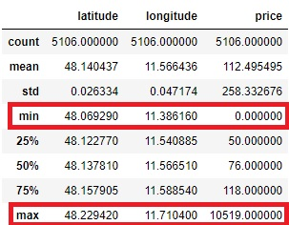
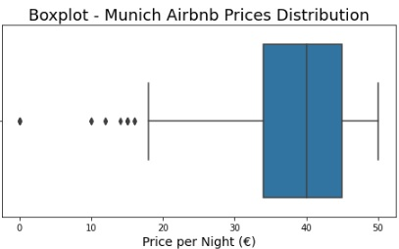
FIRST INSIGHTS FROM THE DATA ANALYSIS.
The Airbnb data had to filtered accordingly with the project criteria, so it was selected only the Airbnb hosts wirth price per night lower than €50.
Before the data filtering, the prices ware between €0 per night and €10519 per night.
Prices distribution after the places with prices bigger than €50 ware excluded from the dataset.
IBM Applied Data Science Capstone – Felipe Demenech Vasconcelos.

Slide 6
AIRBNB PRICES DISTRIBUTION BY BOROUGH.
IBM Applied Data Science Capstone – Felipe Demenech Vasconcelos.

Slide 7
TOP 10 VENUES IN MUNICH.
Accordingly with the data, cafés and plazas are the most common venues in Munich together with parks.
Focusing on our points of interest, Munich has a total of 64 beer gardens and 78 German restaurants.
IBM Applied Data Science Capstone – Felipe Demenech Vasconcelos.

Slide 8
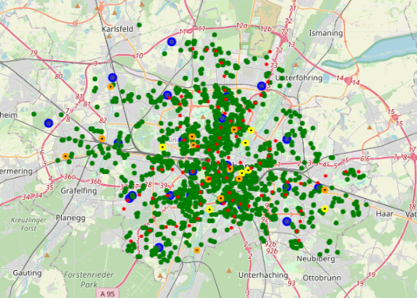
MUNICH FINAL MAP.
After all the data acquisition and cleaning, we ware abble to plot a map from Munich with all the interest points.
- Blue markers: center of the boroughs.
- Green markers: Airbnb options.
- Red markers: U-Bahn stations.
- Orange markers: German restaurants.
- Yellow markers: Beer gardens.
IBM Applied Data Science Capstone – Felipe Demenech Vasconcelos.

Slide 9
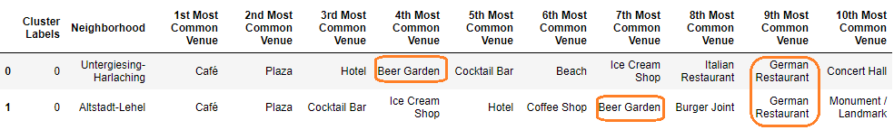
DATAFRAME OF MUNICH WITH CLUSTERED BOGOUGHS.
After used K-means algorithm in order to cluster the boroughs of Munich accordingly with the similarities and dissimilarities, we have obtained 5 clusters divisions.
Analysing the boroughs divisions and filtering accordingly with the project criterias we have selected 2 main central boroughs to concentrate our search for the best Airbnb accomodation.
IBM Applied Data Science Capstone – Felipe Demenech Vasconcelos.

Slide 10
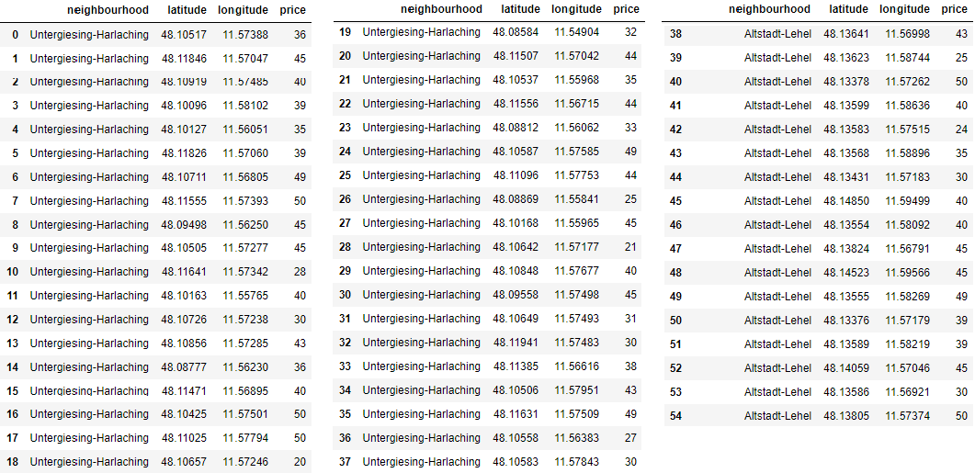
BEST AIRBNB ACCOMMODATIONS IN MUNICH ACCORDINGLY WITH THE PROJECT CRITERIA.
These dataframe is a list with all 55 accommodations inside the two filtered boroughs.
IBM Applied Data Science Capstone – Felipe Demenech Vasconcelos.

Slide 11
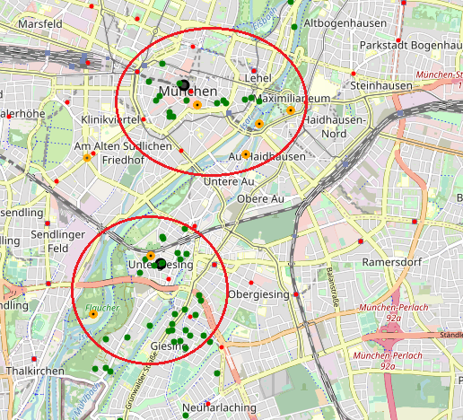
BEST AIRBNB ACCOMMODATIONS IN MUNICH ACCORDINGLY WITH THE PROJECT CRITERIA.
These final map shows us the position from all 55 best filtered possibilities for accommodation.
IBM Applied Data Science Capstone – Felipe Demenech Vasconcelos.

Slide 12
CONCLUSION.
The use of python tools and Machine Learning algorithms in order to help a tourist to find a good place to stay in a large city proved to be efficient.
Exploratory data analysis summed with ML algorithms helped us to filter the data sets and reduce the possibilities of choices, providing us agility and time gain.
IBM Applied Data Science Capstone – Felipe Demenech Vasconcelos.

