Slide 1
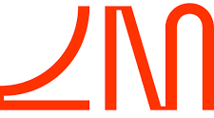
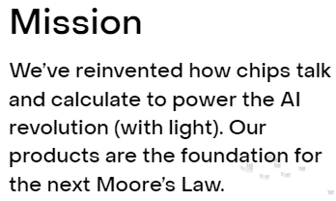

Start-up deep-dive: Lightmatter.
Founded in 2017
Headquartered in California, USA
Valued at $1.2billion
Developer of a light-powered chip designed to speed up artificial intelligence-driven computations by orders of magnitude
Key investors include Google Ventures, SIP Global Partners, Aliya Capital Partners, Hewlett Packard, and Fidelity
1

