Slide 1
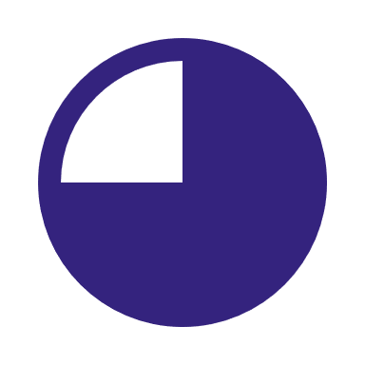



4 priority trends were identified based on impact on the industry and on KPMG’s business lines.
Trend | Impact on semiconductor industry | Impact on KPMG’s business lines
Geographic diversification of supply chain
Industry recovery and normalization
Increased cyberthreats
Automotive/semiconductor partnerships
Talent shortage
Innovations in manufacturing & design (incl. application of AI)
Advanced node technologies
Demand growth from automotive sector (AV/EV)
Demand growth from edge computing
Demand growth from 5G / 6G
Demand growth from generative AI
ESG and sustainability improvements
Metaverse growth
Prioritized for further analysis
Impact on semiconductor industry and relevance for KPMG’s business lines are based on qualitative analyses. Impact on semiconductor industry considers likelihood and impact of each trend
High
Medium
Low
1

