Slide 1
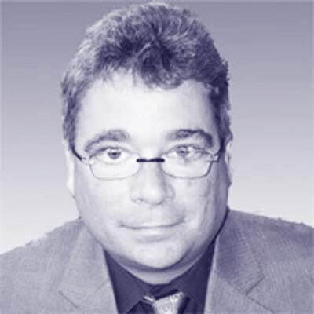
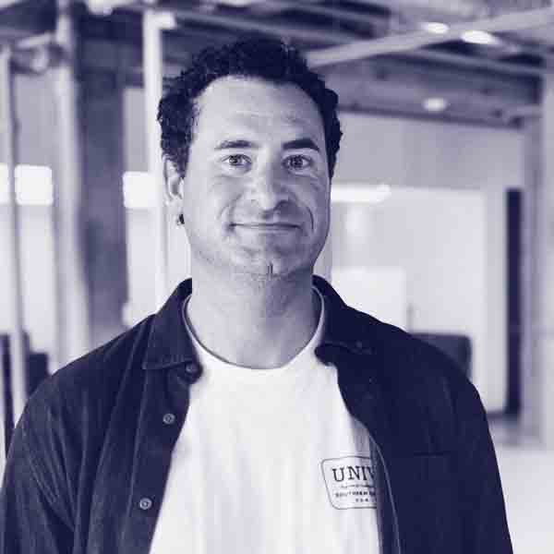
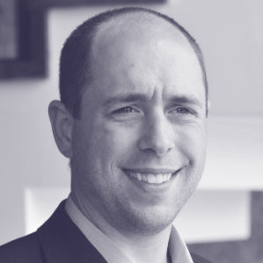
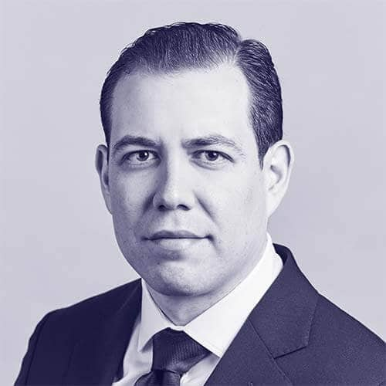
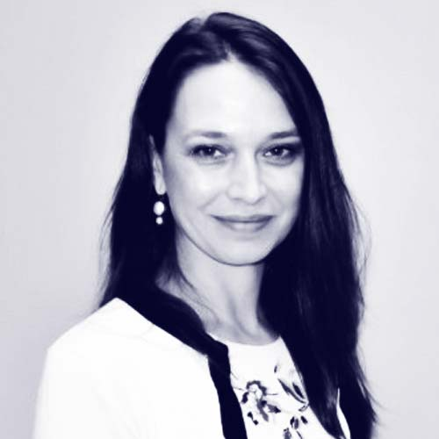
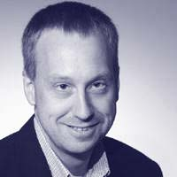
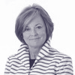
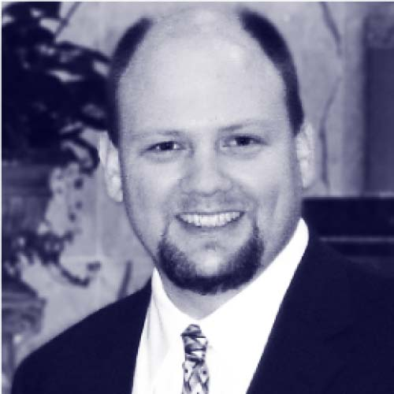
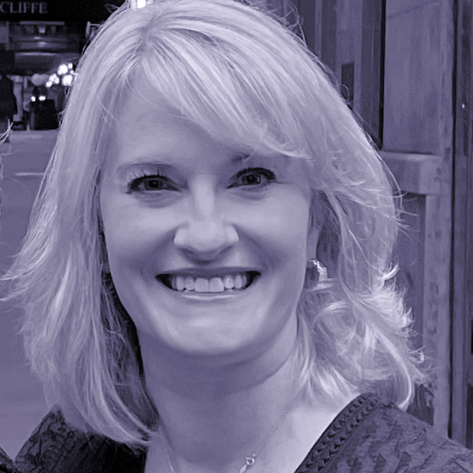
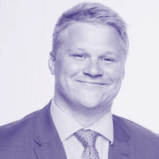

Actual slide
For context: User command = “Add John Sviokla”
Introductions.
Oliver Halter Partner
Jordan Katz Partner
Erich Klotz Senior Director
Carlo Sanchez Director
Daniela Terrizzi, PhD, RN Manager
30 years experience in enterprise tech
Leader of Manifold’s HealthCare practice
16 years experience in healthcare tech architecture & strategy
Experienced healthcare consultant
Ex-BCG, UofC MBA
Asst Prof UIC, 25 years healthcare experience
Fulbright Scholar
Tom Weakland Senior Advisor
Mary Van De Kamp Senior Advisor
Al Klein Senior Advisor
Kelly Pollard Senior Associate
James Zuercher Senior Associate
Led PwC’s Healthcare Advisory Practice
Former Chief Clinical Officer, Kindred HealthCare
30+ years experience in healthcare technology
RN and healthcare consultant MBA NYU Stern
Experienced healthcare consultant
UofC MBA

Slide 2
Slide representation in knowledge base
For context: User command = “Add John Sviokla”
<design element>
<title>.
<Oliver Halter picture>
<Jordan Katz picture>
<Erich Klotz picture>
<Carlo Sanchez picture>
<Daniela Terrizzi picture>
<Oliver Halter name and title>
<Jordan Katz name and title>
<Erich Klotz name and title>
<Carlo Sanchez name and title>
<Daniela Terrizzi name and title>
<Oliver Halter description>
<Jordan Katz description>
<Erich Klotz description>
<Carlo Sanchez description>
<Daniela Terrizzi description>
<Tom Weakland picture>
<Mary Van de Kamp picture>
<Al Klein picture>
<Kelly Pollard picture>
<James Zuercher picture>
<Tom Weakland name and title>
<Mary Van de Kamp name and title>
<Al Klein name and title>
<Kelly Pollard name and title>
<James Zuercher name and title>
<Tom Weakland description>
<Mary Van de Kamp description>
<Al Klein description>
<Kelly Pollard description>
<James Zuercher description>
<page number>
<Manifold logo>

