Slide 1

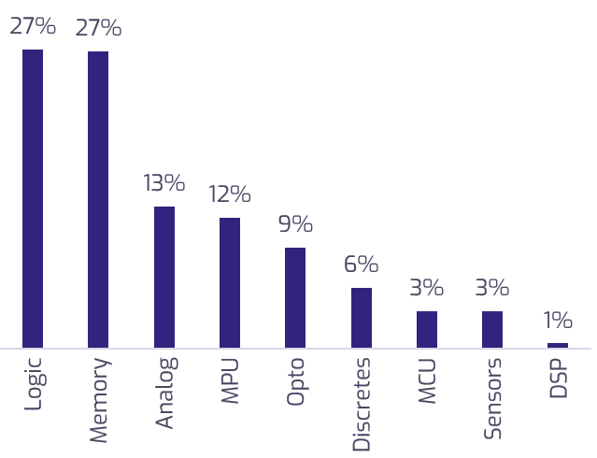

Segmentation by product type
Original slide
Logic and memory chips make up >50% of the market.
Semiconductor market share, by product type¹
% of semiconductor sales, 2020
Product type description
Logic: Main building blocks of digital circuits. They perform basic logical operations like AND, OR, NOT, and XOR
Memory: Store data. Includes volatile memory (like RAM) and non-volatile memory (like flash memory and ROM)
Analog: Process analog signals. Used in audio amplification, radio transmission, and signal processing.
Microprocessor Units (MPU): Umbrella term that includes central processing units (CPUs), graphics processing units (GPUs), and others
Opto: Source, detect, and control light. Used in fiber-optic communications, display technology, and lighting
Discretes: Individual semiconductor devices like diodes and thyristors. Used in power management, switching, and amplification
Microcontroller Units (MCU): Similar to MPUs, but don’t need external support chips to create a complete embedded system
Sensors: Convert environmental variables such as temperature, pressure, into electrical signals
Digital Signal Processors (DSP): Specialized microprocessors designed to process digital signals. Used in audio and video processing, telecommunications, and control systems
Source: SIA, 2020.
1

Slide 2
Semiconductor icon
header – segmentation by product type
Semantic representation – level 1
Design element
title
Semiconductor market shares by product type
Product type description
page number
Footnote
Manifold logo

Slide 3
Semiconductor icon
header – segmentation by product type
Semantic representation – level 2. Level 1 objects are grayed out, level 2 objects have black text and outline
Design element
title
Semiconductor market shares by product type
Product type description
Header
Header
Chart – market share by product type
Textbox – description of product types
page number
Footnote
Manifold logo

Slide 4
Semiconductor icon
header – segmentation by product type
Semantic representation – level 3. Level 1 and 2 objects are grayed out, level 3 objects have black text and outline
Design element
title
Semiconductor market shares by product type
Product type description
Header
Header
Chart – market share by product type
Textbox – description of product types
TBD how the chart can be broken down
Logic
Memory
Analog
Microprocessor Units (MPU)
Opto
Discretes
Microcontroller Units (MCU)
Sensors
Digital Signal Processors (DSP)
Note: Breakdown of textbox into bullets is based on the char index within text (as opposed to shape IDs. For example: Logic bullet goes from char 1 to char 113, memory bullet goes from char 114 to char 221)
page number
Footnote
Manifold logo

