Slide 1
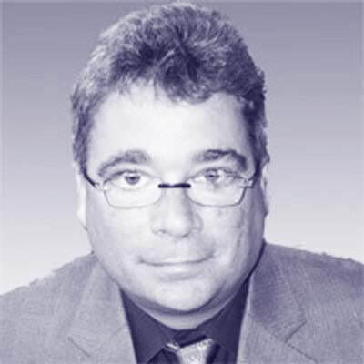
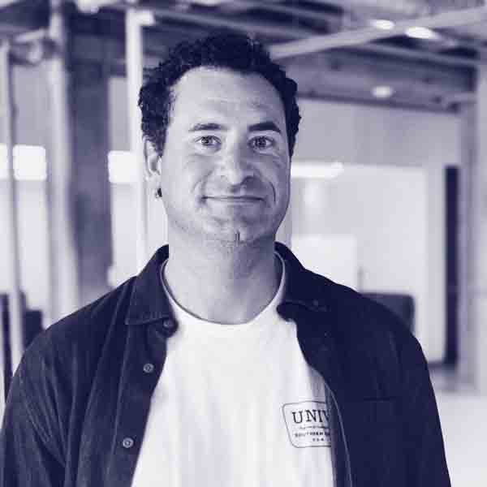
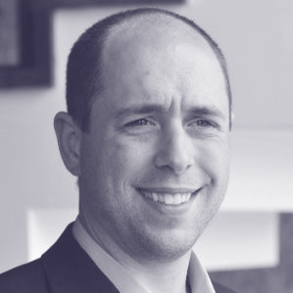
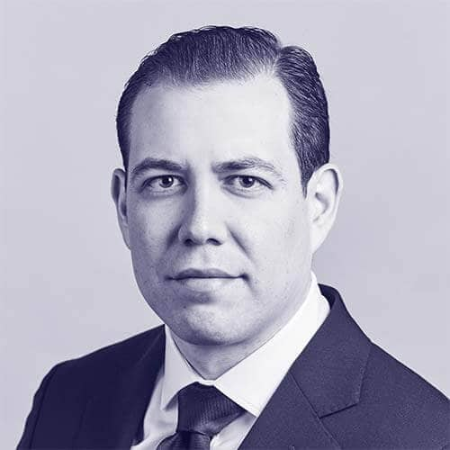
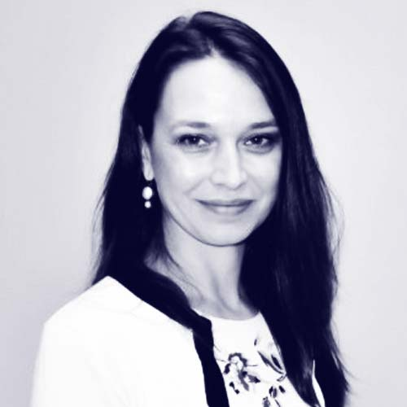
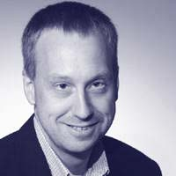
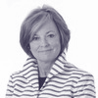
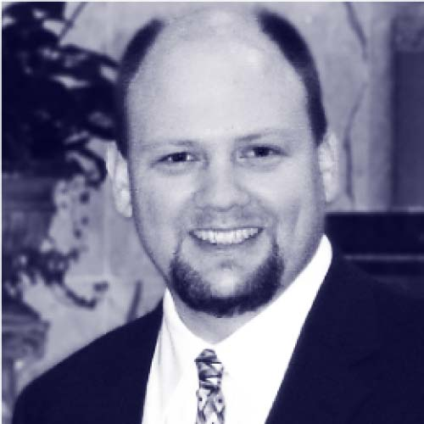
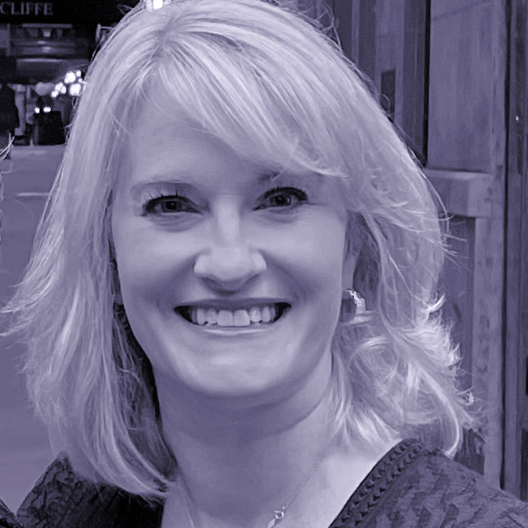
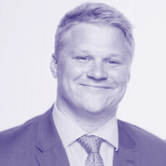

Introductions.
Oliver Halter Partner
Jordan Katz Partner
Erich Klotz Senior Director
Carlo Sanchez Director
Daniela Terrizzi, PhD, RN Manager
30 years experience in enterprise tech
Leader of Manifold’s HealthCare practice
16 years experience in healthcare tech architecture & strategy
Experienced healthcare consultant
Ex-BCG, UofC MBA
Asst Prof UIC, 25 years healthcare experience
Fulbright Scholar
Tom Weakland Senior Advisor
Mary Van De Kamp Senior Advisor
Al Klein Senior Advisor
Kelly Pollard Senior Associate
James Zuercher Senior Associate
Led PwC’s Healthcare Advisory Practice
Former Chief Clinical Officer, Kindred HealthCare
30+ years experience in healthcare technology
RN and healthcare consultant MBA NYU Stern
Experienced healthcare consultant
UofC MBA

