Slide 1


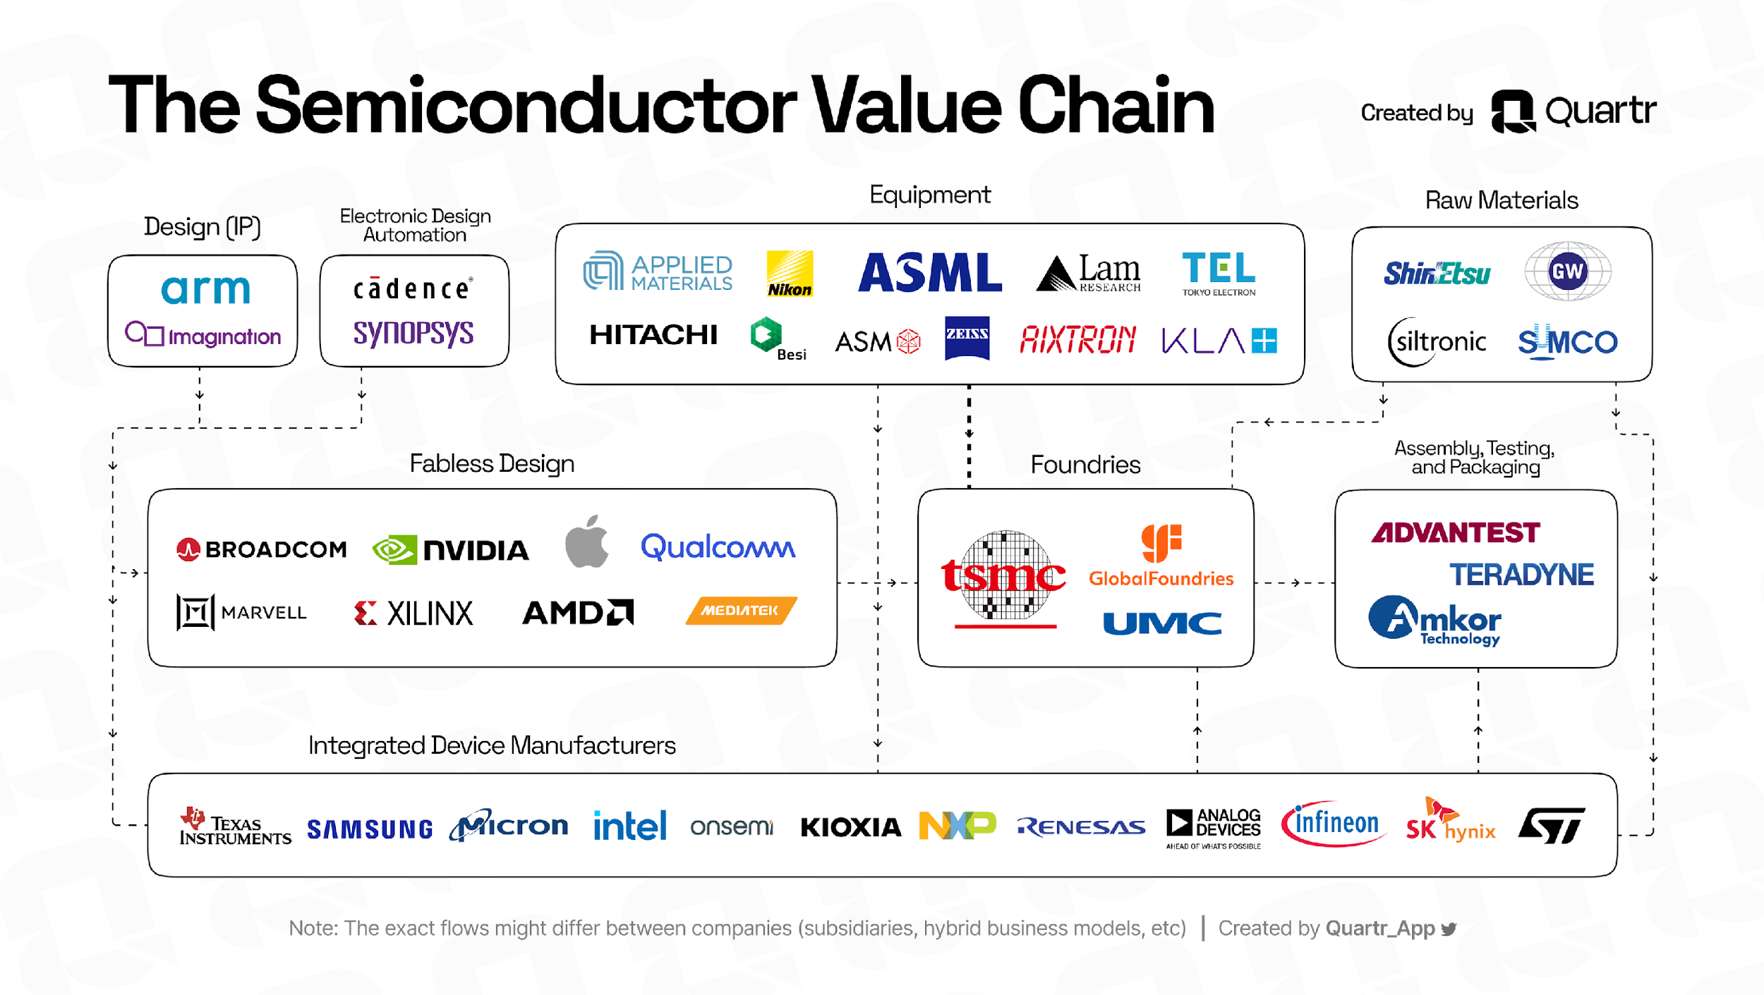







Actual slide
For context: User command = “Add the distribution firms”
Main industry players (not exhaustive).
Core players
Suppliers
Design
Manufacturing
ATP¹
Design
Manufacturing
Fabless design firms
Foundries
OSAT² firms
Core IP
EDA³
Raw materials
Equipment
Integrated device manufacturers (IDMs)
1
1. ATP: Assembly, testing, and packaging 2. OSAT: Outsourced semiconductor assembly and test 3. Electronic design automation

Slide 2
<design element>
<title>
Slide representation in knowledge base – level 1
For context: User command = “Add the distribution firms”
<semiconductor value chain – core players>
<semiconductor value chain – suppliers>
<divider>
<page number>
<footnote>
<Manifold logo>

Slide 3
Slide representation in knowledge base – level 2
For context: User command = “Add the distribution firms” Note: Grayed out text / shape outlines represents level 1
<design element>
<title>
<semiconductor value chain – core players>
<semiconductor value chain – suppliers>
<header – semiconductor core players>
<header – semiconductor suppliers>
<headers – value chain>
<headers – value chain>
<Fabless design firms – logos>
<Manufacturing firm– logos>
<ATP firms – logos>
<Design firms – logos>
<Manufacturing firms – logos>
<divider>
<Integrated device manufacturers (IDMs) – logos>
<page number>
<footnote>
<Manifold logo>

Slide 4
Slide representation in knowledge base – level 3
For context: User command = “Add the distribution firms” Note: Grayed out text / shape outlines represents levels 1 and 2
<design element>
<title>
<semiconductor value chain – core players>
<semiconductor value chain – suppliers>
<header – semiconductor core players>
<header – semiconductor suppliers>
<arrow>
<arrow>
<headers – value chain>
<headers – value chain>
<design - box>
<manuf. - box>
<atp - box>
<design - box>
<manuf. - box>
<Fabless design firms – logos>
<Manufacturing firm– logos>
<ATP firms – logos>
<Design firms – logos>
<Manufacturing firms – logos>
<header – fabless design firms>
<header – foundries>
<header – OSAT firms>
<core IP firms>
<EDA firms>
<raw materials firms>
<equipment firms>
<AMD logo>
<tsmc logo>
<amkor logo>
<umclogo>
<divider>
<NVIDIA logo>
<Teradyne logo>
<etc.>
<global foundries logo>
<etc.>
<Integrated device manufacturers (IDMs) – logos>
<page number>
<footnote>
<Manifold logo>

Slide 5
Slide representation in knowledge base – level 4
For context: User command = “Add the distribution firms” Note: Grayed out text / shape outlines represents levels 1, 2, 3
<design element>
<title>
<semiconductor value chain – core players>
<semiconductor value chain – suppliers>
<header – semiconductor core players>
<header – semiconductor suppliers>
<arrow>
<arrow>
<headers – value chain>
<headers – value chain>
<design - box>
<manuf. - box>
<atp - box>
<design - box>
<manuf. - box>
<Fabless design firms – logos>
<Manufacturing firm– logos>
<ATP firms – logos>
<Design firms – logos>
<Manufacturing firms – logos>
<header – fabless design firms>
<header – foundries>
<header – OSAT firms>
<core IP firms>
<EDA firms>
<raw materials firms>
<equipment firms>
<header – core IP>
<header – EDA>
<header – raw materials>
<header – equipment>
<AMD logo>
<tsmc logo>
<amkor logo>
<divider>
<arm logo>
<cadence logo>
<shin etsu logo>
<AMAT logo>
<NVIDIA logo>
<umclogo>
<Teradyne logo>
<imagination logo>
<synopsys logo>
<etc.>
<etc>
<etc.>
<global foundries logo>
<etc.>
<Integrated device manufacturers (IDMs) – logos>
<page number>
<footnote>
<Manifold logo>

