Slide 1
Logging, Scaling and High Availability
Production features
PCF Internal Architecture

Slide 2
Agenda
Cloud Native Apps
Elastic Runtime Architecture
High Availability

Slide 3
Fundamental Changes
Cloud Native applications operate in a different environment
Notes:
These three themes will be echoed throughout all of the presentations. We can can go back to them time and time again.

Slide 4
Distributed System
Distributed systems are hard to build, test, manage, and scale
Notes:
The move to distributed systems is undeniable if you want to modernize your application architecture.
The problem is that distributed systems are incredibly hard to build and manage.
Consider what must be be done when provisioning a systems like this (machines, app servers, databases, monitoring, routing, etc). Then handling Day 2 problems such as security patches or even just upgrading your own application while meeting business SLA (Service Level Agreements) such as no downtime.
We will see how PCF helps mitigate many of these issues so you can focus on offering true business value by creating compelling application experiences.

Slide 5
“Ephemeral” (Temporary) Infrastructure
Virtual machines and containers are temporary
Notes:
Distributed systems are built on cloud infrastructure such as Amazon and OpenStack. They leverage advanced in technology such as IaaS and containers.
With regard to the applications tier (not databases) resources such as containers are ephemeral to allow for quick startup times. There is no persistent disk.
It is also expected that VM instances the application tier will come and go. This will have downstream effects on application design that we will discuss later (stateless apps, backing services).
***Don’t allow students to get confused here*** Persistent datastores are available as services.

Slide 6
Immutable Infrastructure
Updates to systems and applications are not done in-place
New, updated instances are created instead
Notes:
Why practice Immutable Infrastructure:
Ephemeral resources, we need to be able to rebuild from scratch
Confidence that we can rebuild the system – [good time to insert a story about not being able to rebuild a system]
Avoid configuration drift
Security repaving – see https://medium.com/built-to-adapt/the-three-r-s-of-enterprise-security-rotate-repave-and-repair-f64f6d6ba29d#.85mkrrdco

Slide 7
Changes in App Design
Architecting for the Cloud

Slide 8
The 12 Factor App
Methodology for building web apps suitable for running on cloud platforms
  Most are best practices for any development
  Some specific to a Cloud deployment
http://12factor.net/
Notes:
12 factor app design provides guidance on how to build applications for the cloud. These apps are commonly known as cloud native applications.
There are 12 factors, but relax we won’t be going through all twelve at once but rather introducing the concepts to you in the appropriate context.

Slide 9
The 12 Factor Design Patterns
Codebase
Dependencies
Config
Backing
Services
Build, release, run
Processes
Port binding
Concurrency
Disposability
Dev/prod parity
Logs
Admin Processes
Notes:
For this module we will discuss the following 12 factors.

Slide 10
Processes
Execute the app as one or more stateless processes
http://12factor.net/processes
Notes:
12 factor apps are stateless and share nothing.
Any data that needs to be persisted must be stored in a stateful backing service.
The memory space or local file system may be used brief, single transaction cache such as creating a file download and then saving that file somewhere else like a database or S3.
It important to remember that the 12 factor app never assumes that cached in memory or disk will be available for future requests.
What implication does this have on sticky-sessions/session affinity?

Slide 11
Concurrency
Scale out via the
process model
worker 4
worker 3
Scale (running instances)
web 2
worker 2
web 1
worker 1
other 1
http://12factor.net/concurrency
Workload diversity (process types)
Notes:
Scale out in a horizontal fashion. Less emphasis on scaling up. Scaling up has it’s limits.
Also scale out in terms of process type – web processing, workers consuming from a queue, scheduled jobs

Slide 12
Disposability
Maximize robustness with fast startup and graceful shutdown
http://12factor.net/disposability
Notes:
12 factor apps can be started or stopped at moments notice, therefore they should start quickly and provide graceful shutdown.
Fast startup times help with elastic scale. Graceful shutdown means to properly shutdown the application in a way that doesn’t affect the end user experience and cleans up resources correctly.
Such as no longer accepting web requests after receiving a SIGTERM and letting in-process request complete.
Additionally, applications should be robust in the face of sudden death. For instance with a messaging design using idempotent design and acknowledgements to protect against the same message being incorrectly processed more than once.

Slide 13
Logs
Treat logs as event streams
http://12factor.net/logs
Notes:
Logs are invaluable when it comes to diagnosing system or application issues.
A 12 factor app does not concern itself with the storage of its log output. Why? Ephemeral resources, simplified config when managing 100s of applications and the single responsibility principle.
Instead a 12 factor app writes to stdout and stderr. This log output is captured by the execution environment with other logs to provide a time ordered series of events happening within the system.
The event stream can then be captured several ways: terminal, log management tools or in big data solutions such as Hadoop for further analysis.

Slide 14
Agenda
Cloud Native Apps
Elastic Runtime Architecture
High Availability

Slide 15
Elastic Runtime
What is the Elastic Runtime?
The Elastic Runtime is Cloud Foundry

Slide 16
Pivotal Cloud Foundry Simplified
Pivotal Cloud Foundry
Elastic Runtime
=
Cloud Foundry OSS
~ 30 VMs
MySQL
~ 10 VMs
Redis
~ 7 VMs
Metrics
~ 10 VMs
Notes:
Make sure to describe PCF as many distributed systems. It is the ER plus services.
Not pictured is the Ops Manager or Ops Manager Director

Slide 17
Pivotal Cloud Foundry – Elastic Runtime
Pivotal Cloud Foundry
Elastic Runtime
=
Cloud Foundry OSS
~ 30 VMs
MySQL
~ 10 VMs
Redis
~ 7 VMs
Metrics
~ 10 VMs
Notes:
This section will describe the main components of the ER. We will examine what’s inside the box.

Slide 18
Elastic Runtime Architecture
Elastic Runtime Subsystems
  Diego
  Loggregator
  Cloud Controller API
  Routing
Key Sequence Flows through
the ER
Elastic Runtime
=
Cloud Foundry OSS
~ 30 VMs
Notes:
The Elastic Runtime is a large and complex system made up of several components.
Luckily, the ER is made up of several subsystems that make it easier to divide up and understand.
We will also look at some key sequences that bring everything together to solidify understanding.

Slide 19
Diego
Cloud Foundry’s internal architecture
https://docs.pivotal.io/pivotalcf/concepts/diego/diego-architecture.html

Slide 20
Diego
Schedules Tasks and Long-Running Processes (LRPs)
TASK
  Is guaranteed to run at most once.
  Example: staging an application
LRP
  Typically represented as a web app
  LRPs can have multiple instances
  PCF will attempt to keep them running forever
Notes:
Some history. The original implementation of CF was mostly written in Ruby. The intention, perhaps, was that the processes could run on multiple operating systems. In practice, until very recently, only Ubuntu Linux was supported and Ruby is not a good choice for systems programming. (The Ops Manager is written in Ruby – a prefect example of a Ruby application). So the decision was made to rewrite the application management layer in Go. The original name for the VMs running Droplets was Droplet Execution Agent or DEA. Hence the rewrite was “DEA in Go” giving DIEGO. As it turned out, DIEGO encompassed a lot more than rewriting the DEAs so the name is not really accurate. Much of what used ot be done by the Cloud Controller got refactored as [part of DIEGO. Since one goal of the work was to support other containers (such as Docker), not just Droplets, DEA was no longer a suitable name. Hence they are now called Cells.
CF has always had Tasks – it’s how the Buildpacks run. However since V1.10, tasks are available to run your own jobs/scripts/whatever.
Applications are LRPs

Slide 21
Diego: Container
An application instance is run within an immutable container
Container
App Instance
Notes:
In recent years containers have become wildly popular.
The Cloud Foundry project has been using containers to run applications for several years. We don’t use Docker because it didn’t exist when new started.
The container provides isolation in terms of disk, network, memory and CPU.
The container is immutable meaning that once it is created it cannot (should not) be modified.

Slide 22
Diego: Cell
Containers are run within a Cell (Virtual Machine)
Cell
Container
Container
Container
App Instance
App Instance
App Instance
Notes:
Containers are run within a Cell VM and many containers can run on one cell. There is a kind of prison/jail metaphor going on. The applications are secure in the Cell – each in its own container.
Running applications in containers allow better resource utilization and application density on your infrastructure..

Slide 23
Diego: Garden
Containers are managed by Garden
}
Cell
Garden is an interface.
Garden-Linux is a backend implementation.
Garden
Garden-Linux
Notes:
Why is Garden an interface? So that it can have multiple back-ends like Linux, Windows and RunC.
Garden is an odd name. Originally, using the Prison metaphor, they were Warden containers as they secured the application. As part of the DIEGO rewrite, it was refactored into an interface and the replacement implementation for the old Warden containers was written in Go – hence Garden. Sadly “Guarden” hence Guardian would have been a perfect name, but they blew it! Two other implementations exist – one using RunC for running Docker containers and one supporting Windows containers.

Slide 24
Diego: Rep
Represents the Cell in the BBS/auctions
Cell
Garden
Garden-Linux
Rep
Notes:
The rest of DIEGO needs to talk to the Cell to find out information about it. The “Rep” component provides for this and “represents” the Cell in auctions and bids on work (to run tasks and LRPs).

Slide 25
Diego: Auction
An auction is held to bid on executing a task or an LRP
Why?
  To ensure load spread evenly across Cells
  Make best use of available resources
Notes:
We will see the auctioneer soon. Essentially it tries to find the best available Cell to run each container.

Slide 26
Diego: Executor
Manages container allocations on the cell
Cell
Garden
Garden-Linux
}
Also streams stdout and stderr to Metron
Rep
Executor
Notes:
The Executor manages container allocations against the cell such as memory and disk. And interfaces with Garden to creates the containers.

Slide 27
Diego: Metron
Forwards logs to the Loggregator subsystem
Cell
Garden
Rep
Executor
Loggregator
Metron
Notes:
Metron is part of the Loggregrator system. It forwards logs to to the Logregator sub system. The Log Aggregator sub-system (coming up soon) uses a Weather metaphor – hence Metron and Doppler.

Slide 28
Diego: BBS
BBS (Bulletin Board System) is the API to access the Diego database for tasks and LRPs
}
BBS
etcd
Data is persisted to etcd.
Notes:
The BBS is the API to access the Diego database for tasks and LRP’s. Think of the BBS as a whiteboard with Post-It notes on. Anything that needs to happen is placed on the BBS as an Action (Post-It note) to be carried out. Different components look for the Actions that concern them and make them happen. In this way all communication is asynchronous via the central BBS. It has a database so that messages are not lost, but it is not long-term persistence. Actions should be consumed and deleted very quickly or there is something wrong with the system.

Slide 29
Diego: Brain
The Brain is composed of two components
Brain
{
}
Auctioneer
Converger
Reconciles Desired LRPs vs Actual LRPs through auctions.
Hold auctions for tasks and LRPs.
Notes:
The Converger compares the actual state of the system (derived from the monitoring components) with the desired state (derived from the CC DB). They may be different because 1) an application is scaling up, 2) scaling down, 3) an application instance has failed. If there are too many instances (scaling down) the Converger picks a victim and sends it the SIGTERM to make ti shutdown. If there are too few, it asks the Auctioneer to determine where to run the containers for the new instances.
The Auctioneer tries to be smart about where to run the new instances. The Reps in each Cell bid according to available capacity and the Auctioneer makes an informed decision.

Slide 30
Loggregator
Logging subsystem
https://docs.pivotal.io/pivotalcf/loggregator/architecture.html

Slide 31
Loggregator: Metron
Forwards logs to the Loggregator subsystem
Cell
Garden
Rep
Executor
Loggregator
Metron

Slide 32
Loggregator: Doppler
Gathers logs from Metron
Loggregator
Cell
Doppler
Metron
App Syslog Drains
Splunk
Papertrail
Notes:
Typically multiple Doppler instances for throughput and redundancy. Can pull application logs from Doppler into third-party logging tools like Splunk, ELK, Papertrail via the Syslog Drain – we cover this with a lab later.

Slide 33
Loggregator: Traffic Controller
Handles client requests for logs
Loggregator
Also exposes a web socket endpoint called the firehose.
}
Cell
Traffic Controller
Doppler
Metron
App Syslog Drains
Splunk
Papertrail
cf logs APP_NAME
Notes:
The traffic controller allows the same logs to be sent to the App Manager or via cf logs.

Slide 34
Loggregator: Firehose
A websocket endpoint that exposes app logs, container metrics and ER component metrics
Does not include ER component logs
Notes:
??? ER Component logs are only available via BOSH – the JMX Bridge does provide these, but Loggregator does not. We only cover the JMX Bridge in the PCF Admin class.

Slide 35
Loggregator: Nozzles
Consume the firehose output
Loggregator
Cell
Traffic Controller
Doppler
Metron
Datadog
Nozzle
App Syslog Drains
Splunk
Papertrail
cf logs APP_NAME
Notes:
Nozzles essentially convert our logging output to the format required bya third-party logger, like Datadog

Slide 36
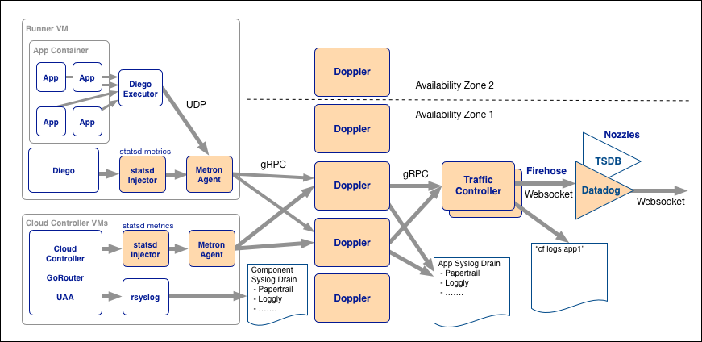
Full System Diagram
Notes:
Here is the complete system. It shows that there are TWO syslog outputs. The leftmost one is setup by Administrators to get internal CF logging . The second is the one we have seen on the other slides and it outputs per application logs.

Slide 37
Cloud Controller API
Your interface to Cloud Foundry
https://docs.pivotal.io/pivotalcf/concepts/architecture/cloud-controller.html

Slide 38

CCAPI: Cloud Controller
Cloud Controller exposes an API
  For using and managing the Elastic Runtime
Cloud Controller
cf push /
Apps Manager
Cloud Controller
API
Notes:
When you use the cf CLI or the App Manager (or your IDE plugin) it talks to this API. It is a REST API over HTTP.

Slide 39
CCAPI: Cloud Controller Database
The Cloud Controller persists Org/Space/App data in the Cloud Controller Database.
Cloud Controller
CC_DB
Notes:
Contains all the meta-data about the system.
This is now a clustered MySQL database – clustered for resilience in the event of server failure. In PCF 1.5 and older PostgresSQL was used. Anyone who has PCF installed from that time will still be using Postgres. It is to be discontinued in V1.12 and V1.11 will have migration support.

Slide 40
CCAPI: Blob Store
The Cloud Controller persists app packages and droplets to the blob store.
Cloud Controller
Blob Store
Notes:
We need to keep the applications you upload using cf push and the droplets we create. Rather than storing them as BLOBs in the CCDB, we chose to use a network mounted file system - the blobstore. The location of its contents are held in the CCDB. You can use Amazon S3 instead if running PCF on AWS.

Slide 41
CCAPI: CC-Bridge
CC-Bridge translates app specific messages into the generic language of tasks and LRPs
Cloud Controller
CC-Bridge
BBS
Notes:
Rather than rewrite the whole Cloud Controller a bridge was created. The CC still behaves as if t was controlling everything, but actually it uses the Bridge to put actions on the BBS for Diego to make happen.

Slide 42
Routing
Allowing the outside to talk to the inside
https://docs.pivotal.io/pivotalcf/concepts/architecture/router.html

Slide 43

Router
The router directs traffic to appropriate component.
Cloud Controller
cf push
Cell
Cell
Cell
http://…
Notes:
There are several “special” URLs defined by CF – the API URL for the CC, one for the UAA and so on. These are all on the System Domain. Everything else is routed to the corresponding application.

Slide 44
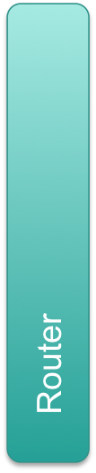
Router
The router routes requests to all app instances.
http://myapp.cfapps.io
Cell
Cell
Cell
http://yourapp.cfapps.io

Slide 45
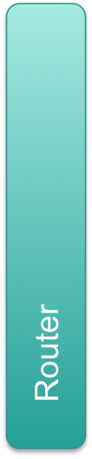
Router
The router round-robins between application instances
  Typically on different Cells
Cell
Cell
http://yourapp.cfapps.io
Cell
Cell
Notes:
For resilience, different instances of the same application are spread across different Cells – we will see more on this soon.

Slide 46

Elastic Runtime Simplified Architecture
CC_DB
Cloud Controller
cf push
Blob Store
Cell
Cell
Cell
http://…
Notes:
That’s all there is to it! Actually not – see next slide.

Slide 47
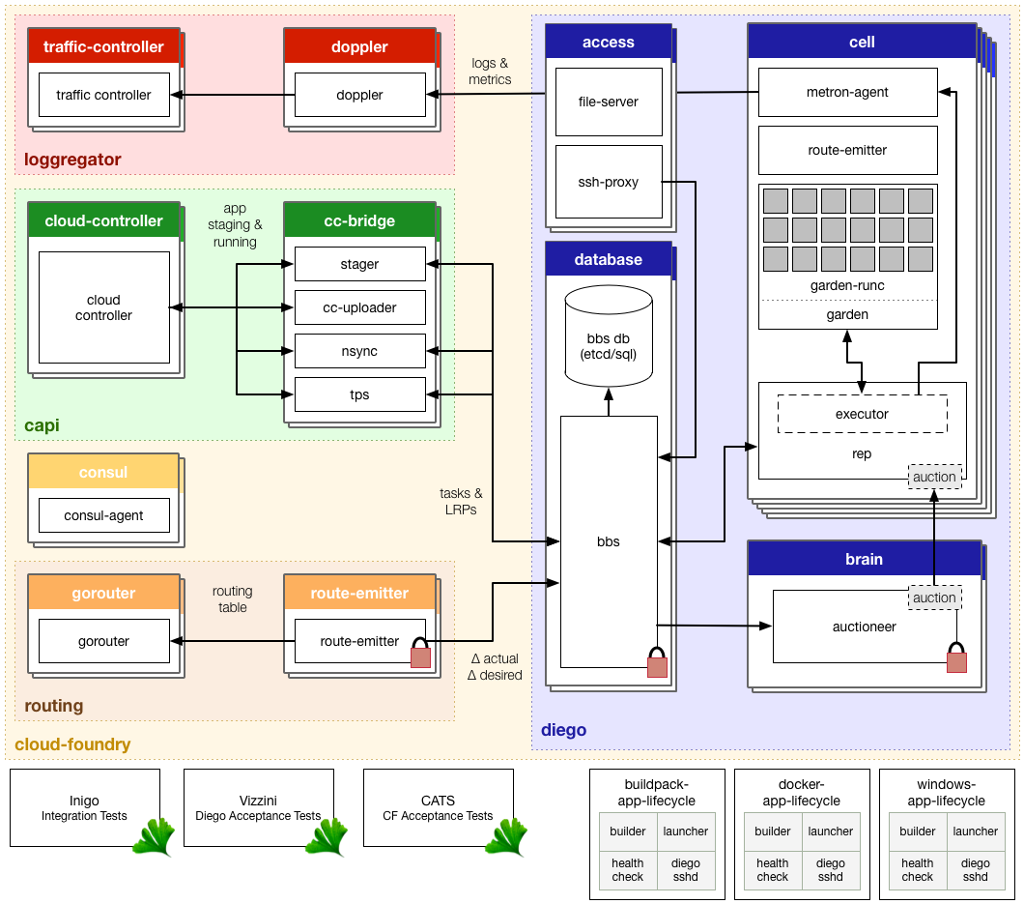
Notes:
This is the full system. There is no need to talk to this other than to make two points:
What we have seen is a simplification, just to explain the basics
In reality, recall the Haiku, you don’t need to worry about most of this, unless something goes wrong. You don’t really need to know how CF works to push an app any more than you need to know how a car works to drive one (let a alone fix it)

Slide 48
Key Flows
How things happen
https://docs.pivotal.io/pivotalcf/concepts/diego/diego-architecture.html
https://docs.pivotal.io/pivotalcf/concepts/how-applications-are-staged.html

Slide 49
Stage and Run Request Flow
Cloud Controller passes requests to run and stage applications to the CC-Bridge
Cloud Controller
CC-Bridge
Notes:
These flows simply show how all the components we have seen work together to deploy an application (LRP).

Slide 50
Stage and Run Request Flow
CC-Bridge translates stage and run requests into tasks and LRPs
Cloud Controller
CC-Bridge
BBS

Slide 51
Stage and Run Request Flow
BBS submits tasks and LRPs to the Auctioneer (Brain)
Cloud Controller
CC-Bridge
BBS
Brain
Auctioneer

Slide 52
Stage and Run Request Flow
Auctioneer distributes tasks and LRPs through an auction
Cell
Rep
Cloud Controller
CC-Bridge
BBS
Brain
Auctioneer
Cell
Rep

Slide 53
Stage and Run Request Flow
Auctioneer assigns the task or LRP to a cell
Executor creates a Garden container in the cell
Task or LRP runs in the container
Cell
Cloud Controller
CC-Bridge
BBS
Brain
Rep
Auctioneer
Executor

Slide 54
Stage and Run Request Flow
App Specific Domain
Cell
Cloud Controller
CC-Bridge
BBS
Brain
Rep
Auctioneer
Executor
Generic Domain Tasks and LRPS
Notes:
On the left the CC talks applications, as you move right (from BBS onwards) that gets translated into the internal “language” of Tasks and LRPs.

Slide 55
Review Pushing An App
CLI
Cloud Controller
Blob Store
CC
DB
Cell
(staging)
Cell
(running)
(1) cf push

Slide 56
Review Pushing An App
CLI
Cloud Controller
Blob Store
CC
DB
Cell
(staging)
Cell
(running)
(1) cf push
(2) Create App

Slide 57
Review Pushing An App
CLI
Cloud Controller
Blob Store
CC
DB
Cell
(staging)
Cell
(running)
(1) cf push
(2) Create App
(3) Store App Metadata

Slide 58
Review Pushing An App
CLI
Cloud Controller
Blob Store
CC
DB
Cell
(staging)
Cell
(running)
(1) cf push
(2) Create App
(3) Store App Metadata
(4) Upload App Files

Slide 59
Review Pushing An App
CLI
Cloud Controller
Blob Store
CC
DB
Cell
(staging)
Cell
(running)
(1) cf push
(2) Create App
(3) Store App Metadata
(4) Upload App Files
(5) Store App Files

Slide 60
Review Pushing An App
CLI
Cloud Controller
Blob Store
CC
DB
Cell
(staging)
Cell
(running)
(1) cf push
(2) Create App
(3) Store App Metadata
(4) Upload App Files
(5) Store App Files
(6) App Start

Slide 61
Review Pushing An App
CLI
Cloud Controller
Blob Store
CC
DB
Cell
(staging)
Cell
(running)
(1) cf push
(2) Create App
(3) Store App Metadata
(4) Upload App Files
(5) Store App Files
(6) App Start
(7) Stage App

Slide 62
Review Pushing An App
CLI
Cloud Controller
Blob Store
CC
DB
Cell
(staging)
Cell
(running)
(1) cf push
(2) Create App
(3) Store App Metadata
(4) Upload App Files
(5) Store App Files
(6) App Start
(7) Stage App
(8) Stream Staging Output

Slide 63
Review Pushing An App
CLI
Cloud Controller
Blob Store
CC
DB
Cell
(staging)
Cell
(running)
(1) cf push
(2) Create App
(3) Store App Metadata
(4) Upload App Files
(5) Store App Files
(6) App Start
(7) Stage App
(8) Stream Staging Output
(9) Store droplet

Slide 64
Review Pushing An App
CLI
Cloud Controller
Blob Store
CC
DB
Cell
(staging)
Cell
(running)
(1) cf push
(2) Create App
(3) Store App Metadata
(4) Upload App Files
(5) Store App Files
(6) App Start
(7) Stage App
(8) Stream Staging Output
(9) Store droplet
(10) Report Staging Complete

Slide 65
Review Pushing An App
CLI
Cloud Controller
Blob Store
CC
DB
Cell
(staging)
Cell
(running)
(1) cf push
(2) Create App
(3) Store App Metadata
(4) Upload App Files
(5) Store App Files
(6) App Start
(7) Stage App
(8) Stream Staging Output
(9) Store droplet
(10) Report Staging Complete
(11) Start Staged App

Slide 66
Review Pushing An App
CLI
Cloud Controller
Blob Store
CC
DB
Cell
(staging)
Cell
(running)
(1) cf push
(2) Create App
(3) Store App Metadata
(4) Upload App Files
(5) Store App Files
(6) App Start
(7) Stage App
(8) Stream Staging Output
(9) Store droplet
(10) Report Staging Complete
(11) Start Staged App
(12) Report App Status

Slide 67
Buildpack
Buildpacks provide framework and runtime support for your applications
  Enable multi-language support
  They build immutable droplets (stages your application)
  Cloud Foundry deploys one or more instances of your droplet

Slide 68
Agenda
Cloud Native Apps
Elastic Runtime Architecture
High Availability
Notes:
PCF has “4 levels” of HA – 4 mechanisms to support HA

Slide 69
Availability Zones
Application instances are evenly distributed across availability zones.
Zone 1
Zone 2
Cell
Cell
Cell
Cell
Notes:
1. Availability Zones

Slide 70
Availability Zones
Application stays up despite losing an AZ
Zone 1
Zone 2
Cell
Cell
Cell
Cell

Slide 71
Availability Zones and the Elastic Runtime
Internal components also spread across AZs
  ER components like Cells, Routers
  Loggregator components (Doppler, Traffic Controller)
  Database servers
    CCDB: Clustered MySQL servers
    BBS: Usesmutliple etcd servers
PCF Administrators determine the number of instances of these components to setup
Notes:
A question that often comes up is – what about all the internal processes? The same priniciple applies. If the PCF Ops team have setup at least 2 of each process (such as two routers) they will be paced in different AZs if possible.
Similarly for the internal database servers behind the CCDB and BBS.

Slide 72
BOSH Managed Processes
Elastic runtime processes are monitored and automatically restarted
Cloud Controller VM
Cloud Controller Process
Monit
Bosh Agent
Notes:
2. BOSH restarts failed processes (using monit – an open-source tool)

Slide 73
BOSH Managed Processes
Elastic runtime processes are monitored and automatically restarted
}
Cloud Controller VM
Cloud Controller VM
Cloud Controller Process
Cloud Controller Process
Cloud Controller process has failed.
Monit
Bosh Agent
Monit
Bosh Agent

Slide 74
BOSH Managed Processes
Restart event is reported back to the Health Monitor for further investigation
Cloud Controller VM
BOSH / Ops Manager Director
Cloud Controller Process
Health Monitor
Plugins
Pager, email, Resurrector
Message Bus
Monit
Bosh Agent
Notes:
Health Monitor is a bit like the converger in CF, keeping track of the state of the system. But it requires plugins to make it do things. For example the pager and email plugins allow notification of failures (as shown here) to be sent to an operator.

Slide 75
Failed VMs
Failed VMs will be recreated automatically.
Cloud Controller VM
BOSH / Ops Manager Director
Process
BOSH Director
{
Monit
Bosh Agent
Bosh Agent continuously reports health of the VM/job
Router VM
Process
Health Monitor
Resurrector
Message Bus
Monit
Bosh Agent
Notes:
This only happens if the Resurrector plugin is being used. Normally this is enabled when PCF is installed. Or there is a bosh command to turn it on or off. Your Ops team may prefer to let the underlying IaaS monitor and restart VMs, so the Resurrector is optional.

Slide 76
Failed VMs
Failed VMs will be recreated automatically.
Cloud Controller VM
BOSH / Ops Manager Director
Process
BOSH Director
{
Monit
Bosh Agent
Router VM
VM is destroyed /deleted
Process
Health Monitor
Resurrector
Message Bus
Monit
Bosh Agent

Slide 77
Failed VMs
Failed VMs will be recreated automatically
Cloud Controller VM
BOSH / Ops Manager Director
2) Director recreates VM/Job
Process
BOSH Director
Monit
Bosh Agent
Router VM
1) Resurrector
determines there is a missing VM
Process
Health Monitor
Resurrector
Message Bus
Monit
Bosh Agent
Notes:
The director actually starts and stops VMs keeping that logic all in a single place. The Resurrector just tells it to do so.

Slide 78
Self Healing Application Instances
Once running, failed application instances will be recreated
}
BBS
Brain
Desired State
=
Actual State
Auctioneer
Cell
Cell
Converger
Rep
Rep
Executor
Executor
Everything OK
Notes:
Cloud Foundry itself only looks after instances – restarting them if they fail. The difference between a Task and an LRT is that the Task is not expected to live for ever so it is allowed to terminate without forcing a restart.

Slide 79
Self Healing Application Instances
Once running, failed application instances will be recreated
}
}
BBS
Brain
Auctioneer
Desired State
!=
Actual State
Cell
Cell
Converger
Rep
Rep
Executor
Executor
Instance Failed

Slide 80
Self Healing Application Instances
Once running, failed application instances will be recreated
}
BBS
Brain
Desired State
=
Actual State
Auctioneer
Cell
Cell
Converger
Rep
Rep
Executor
Executor
Recovered
Notes:
The beauty of how the Converger works is that restarting a failed instance is no different to scaling up – desired < actual in both cases. Previously (the old DEA architecture restart was a special case).

Slide 81
Four Levels of High Availability
BOSH detects and recreates failed VMs
BOSH also detects and restarts failed processes
Application instances are automatically spread
  Across different Cells
  Across Cells in different Availability Zones
Cloud Foundry Converger detects if an application instance has failed and restarts it

Slide 82
Lab
Logging and scaling an application

