Slide 1
Introduction to Microservices
Monolith vs Microservices
Enabling Microservices with PCF_x0010_

Slide 2
Agenda
The Monolith
Microservices
Microservices and Pivotal Cloud Foundry

Slide 3
Monolith
A three tiered monolith.
Monolithic Application
Database
HTML
JS
MVC
Service
Service
Data Access
Browser

Slide 4
Monolith challenges

Slide 5
Monolith Design Patterns
Traditional monolithic design patterns are not appropriate for the cloud
  Session state in application tier (traditional cluster).
  Writing to the file system as if it were a persistent file system
  Relying on application server or the OS to provide dependencies for your application to run
  Long startup times
Notes:
Session state in application tier (traditional cluster).
Writing to the file system as if it were a persistent file system
Relying on application server or the OS to provide dependencies for your application to run
Long startup times

Slide 6
Monolith Change Cycle
Monoliths couple change cycles together
  Upgrade everything at same time
Monolithic Application
HTML
JS
This service has bug fixes and enhancements completed but must wait for changes in the rest of the app.
MVC
Service
Service
Data Access

Slide 7
Monolith Scaling
Monoliths services can’t be scaled independently
  Scaling up not out
Monolithic Application
Monolithic Application
Monolithic Application
Catalog
User
Registration
Search
Orders
Profile
Lists
User
Account

Slide 8
Monolith Challenges
Too many developers in one code base
Developers struggle to understand a large codebase
Long term commitment to the technology stack

Slide 9
Agenda
The Monolith
Microservices
Microservices and Pivotal Cloud Foundry

Slide 10
The Importance of APIs
All teams will henceforth expose
their data and functionality
through service interfaces
  Jeff Bezos, Amazon (2002)

Slide 11
Microservices Defined
Microservices are a loosely coupled Service-Oriented Architecture (SOA) with bounded contexts
  Adrian Cockcroft, Netflix

Slide 12
Traditional ESB / SOA
UI
Service
Service
Service
UI
Enterprise Service Bus
Service
Service
Service
Notes:
Challenges with ESBs:
is a central coordinator (orchestration)
can be viewed as monolithic
scaling
Too much intelligence in the “pipe”

Slide 13


Orchestration vs Choreography
Dancers don’t need a conductor
  Distributed, no centralized control
https://www.flickr.com/photos/chrisbrenschmidt/2223763842
https://www.flickr.com/photos/gabrielsaldana/5896491978
Notes:
ESB has an orchestration approach
Microservices are like choreography. Each dancer has it’s own responsibility and can recover without a conductor

Slide 14
Unix Pipes and Filters
A microservice has a single responsibility
Compare to Unix pipe commands:
cut -d" " -f1 < access.log | sort | uniq -c | sort -rn | less
Notes:
This slide is an example of choreography – many microservices working together
Emphasize dumb pipes and smart filters vs the ESB smart pipe approach
Each microservice has its own responsibility

Slide 15
Bounded Context
Microservices use a bounded context.
Product Catalog
Inventory
Actor
Movie
Movie
Location
Genre
Media Type
Media Type
Kiosk

Slide 16
Organize Around Business Capabilities
UI Specialists
Middleware Specialists
DBA
Business
Capability
Business
Capability
Business
Capability
Siloed Functional Teams
Cross-functional Teams
Monolithic Application
Siloed Application Architectures
HTML
JS
MVC
Microservice
Architectures
Service
Service
Data Access

Slide 17
Microservice Architecture (Simplified)
HTTP
HTTP
Relational DB
HTTP
HTTP
Key/Value Store
AMQP
Msg
Broker
HTTP
Graph DB
AMQP

Slide 18
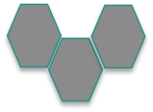
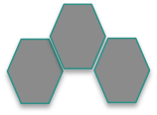
Polyglot Persistence
Freedom to pick the persistence solution.
HTTP
HTTP
Relational DB
HTTP
HTTP
Key/Value Store
AMQP
Msg
Broker
HTTP
AMQP
Graph DB

Slide 19
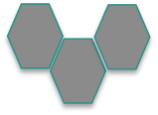
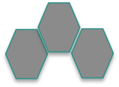
Polyglot Apps
Choice of language when developing apps.
HTTP
HTTP
Relational DB
HTTP
HTTP
Key/Value Store
AMQP
Msg
Broker
Graph DB
HTTP
AMQP

Slide 20
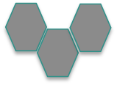
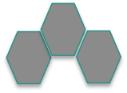
API Gateway
Device specific gateways.
HTTP
HTTP
Relational DB
HTTP
HTTP
Key/Value Store
AMQP
Msg
Broker
Graph DB
HTTP
AMQP

Slide 21
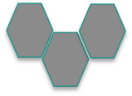
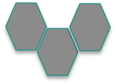
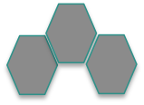
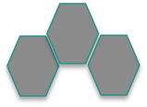
Cloud Protocols
Use cloud friendly protocols.
HTTP
HTTP
Relational DB
HTTP
HTTP
Key/Value Store
AMQP
Msg
Broker
Graph DB
HTTP
AMQP

Slide 22
Microservice Benefits

Slide 23

Microservice Advantages – 1
Change Cycle
Change cycles are decoupled
Enables more frequent deploys
Notes:
Assuming the interface to the Microservice is unchanged – true loose coupling. So message formats and protocols cannot be altered except by adding new options. Must continue to support existing protocol until all clients have also upgraded – similar to the database upgrade procedures we saw before – maintain backwards compatibility until you are certain it is no longer needed.

Slide 24
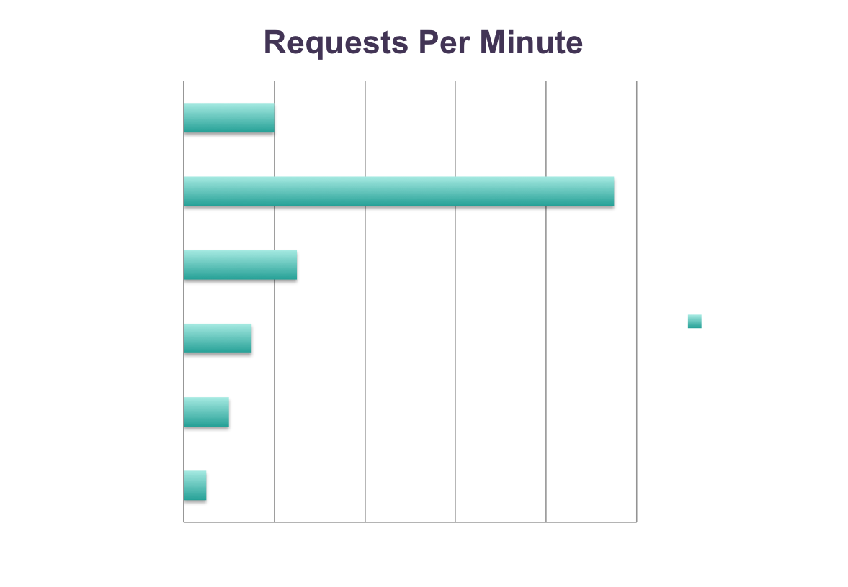
Microservice Advantages – 1
Scaling
Allow for efficient scaling.
Catalog
Search
Orders
Profile
Account
Registration

Slide 25
Microservice Advantages – 3
Developers learn a smaller codebase faster
Fewer developers in each code base
Each microservice can use its own Technology stack

Slide 26
Agenda
The Monolith
Microservices
Microservices and Pivotal Cloud Foundry

Slide 27
Microservice Challenges
Microservices have their challenges too!
  Cloud Foundry can help
http://martinfowler.com/bliki/MicroservicePrerequisites.html
http://highscalability.com/blog/2014/4/8/microservices-not-a-free-lunch.html

Slide 28

Significant Operations Overhead
Microservices have significant operations overhead
  Multiple processes, load-balancing, redundancy, HA
Agreed, but this is mitigated with PCF

Slide 29
Significant Operations Overhead
Consider:
Dynamic Routing
Scaling
Monitoring
Services
Health Mgmt
Buildpacks

Slide 30
Substantial DevOps Skills Required
Typically requires “cultural” change
  How applications are developed and deployed
Substantial DevOps skills are required to run Microservices
Agreed. This is a good thing

Slide 31
Substantial DevOps Skills Required
Consider:
Polyglot Persistence via Service Brokers
Space Parity & Immutable Infrastructure
Buildpacks
Health Mgmt

Slide 32
Development Challenges
Difficult to achieve strong consistency across services
  Eventual consistency, Compensating transactions
Distributed system
  Harder to debug/trace
  Greater need for end-to-end testing
  Expect, test for and handle failure of any process
Platform can help with some of these too
Notes:
Distributed systems are inherently harder to develop, test, debug and manage. What if you need two Microservices to commit data at the same time (or roll back both). If they are using two different databases then you should only consider XA transactions as a last resort (otherwise it ties the two Microservice together again). Finally it often requires a total overhaul of how an organization actually does development. In practice arranging “World Peace” (!) would be easier than changing corporate culture. It needs buy in at all levels of the organization.

Slide 33
Development Challenges
Consider:
Continuous Integration and Deployment
Performance Management
Cloud Services
Notes:
A good CI/CD pipeline is essential and ideally it would also run on or in conjunction with your platform
Performance monitoring to detect bottlenecks and possible race-conditions – buildpack may build support for this into you droplet (depends on the buildpack)
Cloud services are available for Java (service discovery, circuit-breaker, central configuration). Both service discovery and the Spring configuration server use REST, so they are usable from any language (in theory). The Hystrix circuit-breaker is not.

Slide 34
Summary
The Monolith
Microservices
Microservices and Pivotal Cloud Foundry

